Slide 1
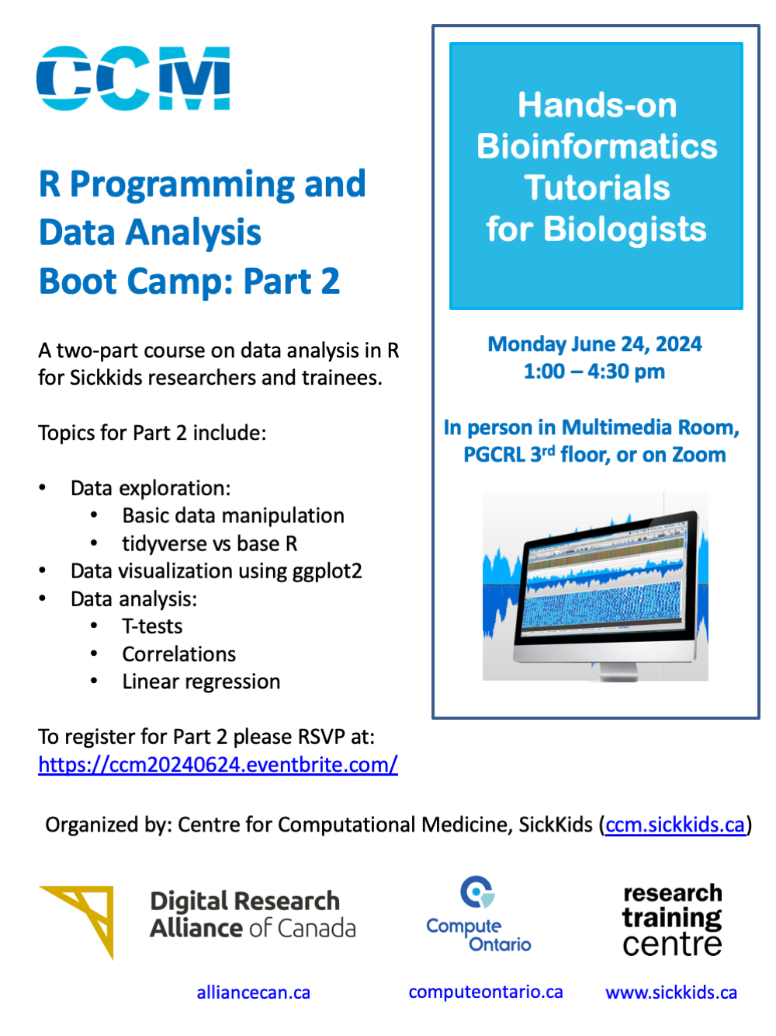
R Programming & Data Analysis
Workshop 2
June 24, 2024

Slide 2
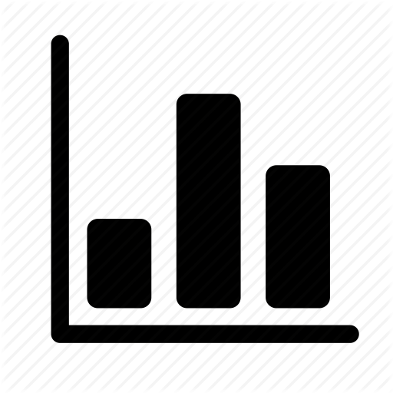


Centre for Computational Medicine (CCM)
Software
& Portals
HPC
Data analysis and grant support
Your Data
CCM
Machine Learning
Tools and pipeline development
Training
-Omics &
Imaging
Workshops and training

Slide 3
Agenda
Part 1
Scripts on GitHub
Data exploration
Basic data manipulation
tidyverse vs base R
Part 2
Data visualization using ggplot2
Data analysis
Correlations
T-tests
Linear regression

Slide 4
Framingham Heart Study
One of the longest prospective epidemiological studies of cardiovascular disease and its risk factors.
Began in 1948 in Framingham, MA
Initially enrolled 5209 men and women aged 29-62 years old.
Followed them over time, with assessments every 2 years.
Examinations included:
Detailed medical history
Physical exams
Lab tests
Lifestyle and habits
Noninvasive imaging

Slide 5
Framingham Heart Study
Data collection for the original cohort ended in 2014.
Incorporated offspring and their spouses into the study over time.
Today, they have data from three generations of participants as well as more ethnically diverse cohorts.

Slide 6
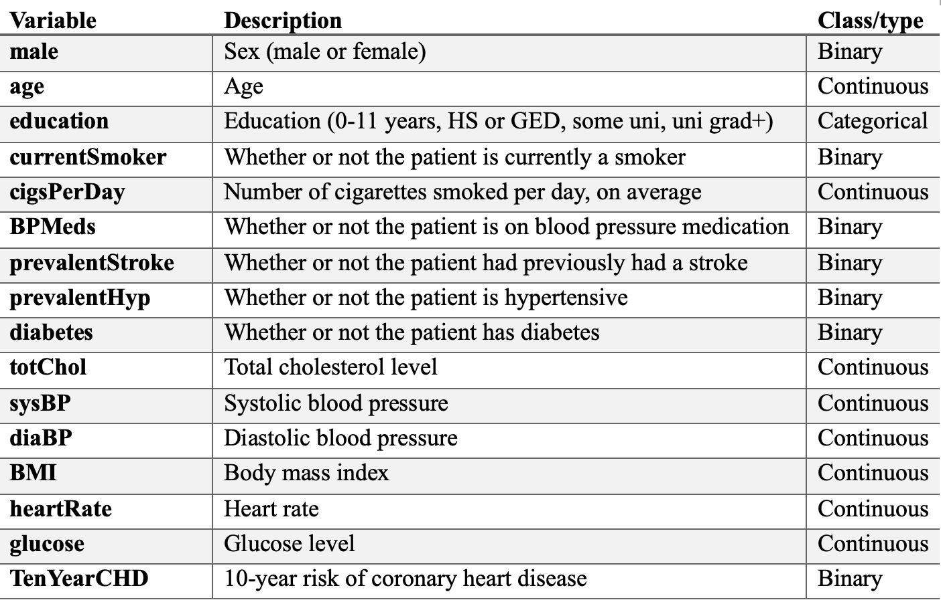
Our Dataset: Subset of the FHS Data from Kaggle
Subset of the data with 4000+ records and 16 variables.
(https://www.kaggle.com/datasets/captainozlem/framingham-chd-preprocessed-data)

Slide 7
Data exploration
Look at the data and its structure – are all the variables in the right format?
Challenge: filter the dataset to keep data from male participants who develop heart disease in 10 years

Slide 8
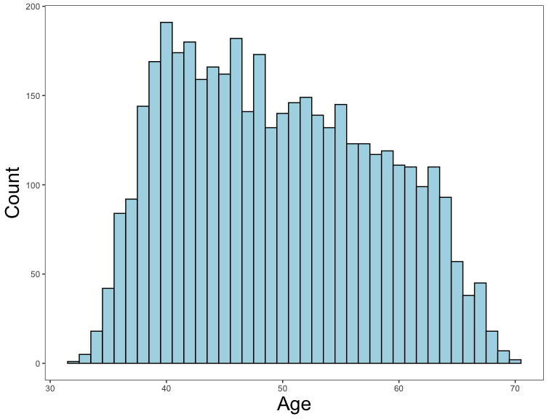
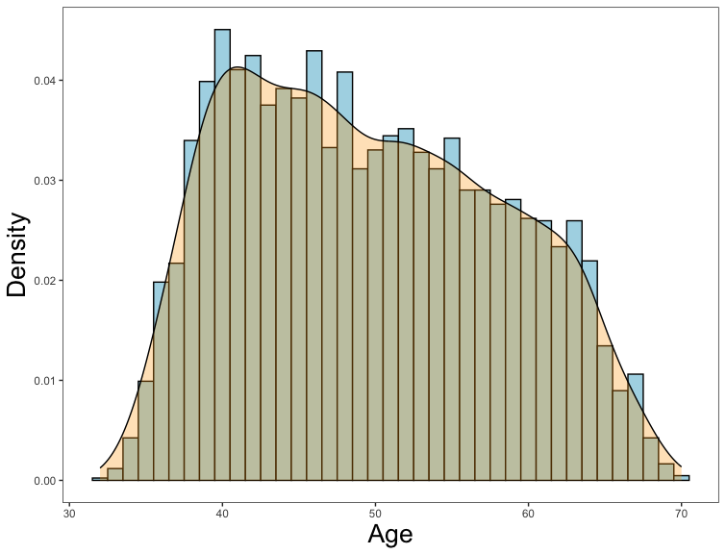
Data visualization
Histograms
Visualize the data:
What do the distributions look like?
Challenge: create a histogram and density plot showing the distribution for heart rate.

Slide 9
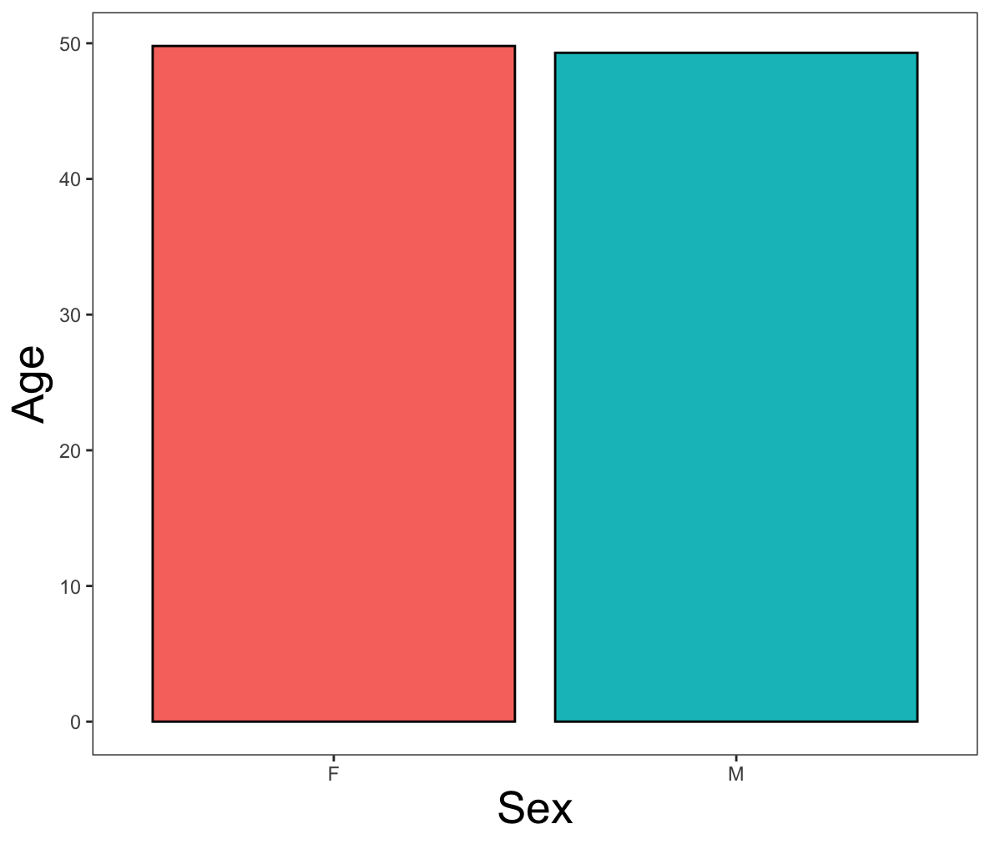
Data visualization
Bar Charts
Visualize the data:
What do the distributions look like?
Are there any patterns that jump out at you?
Challenge: create a bar chart showing sex differences in cigarette smoking.

Slide 10
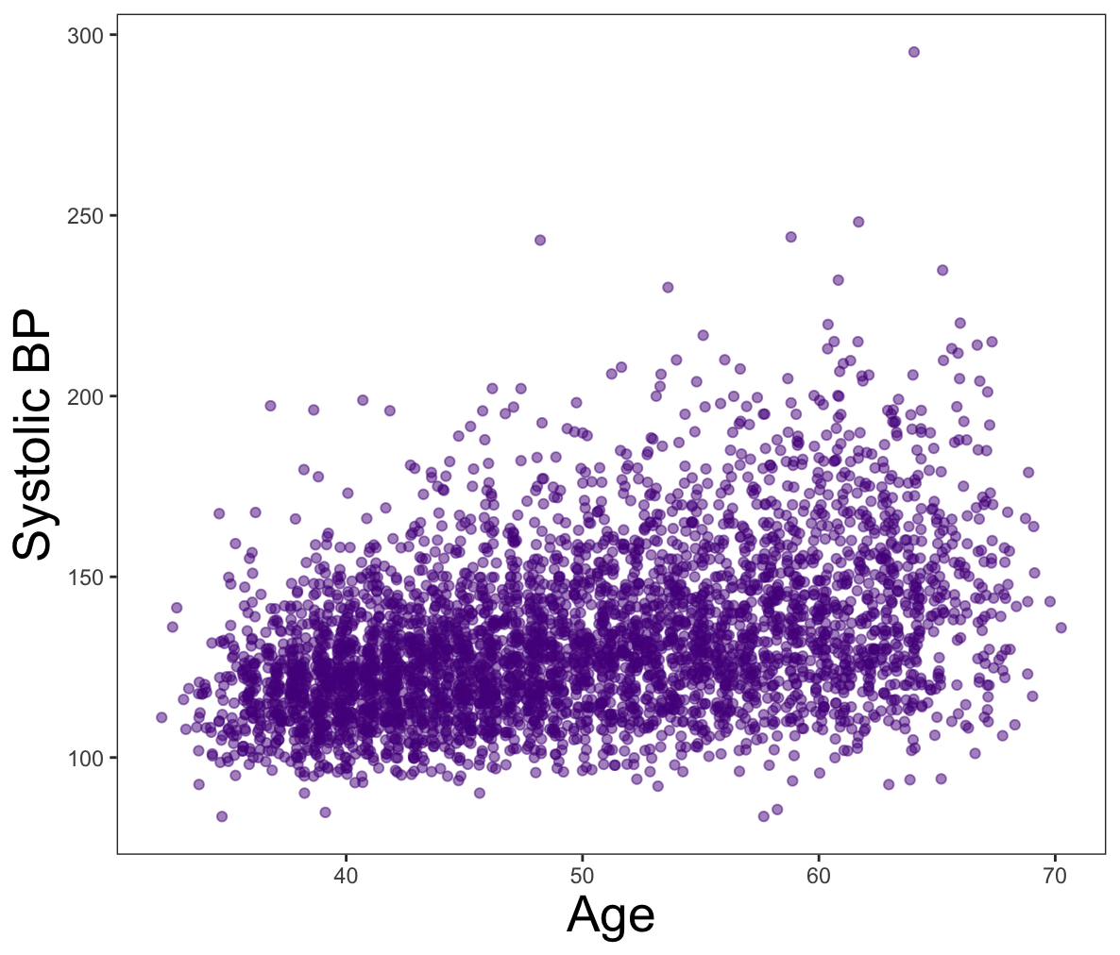
Data visualization
Scatterplots
Visualize the data:
What do the distributions look like?
Are there any patterns that jump out at you?

Slide 11
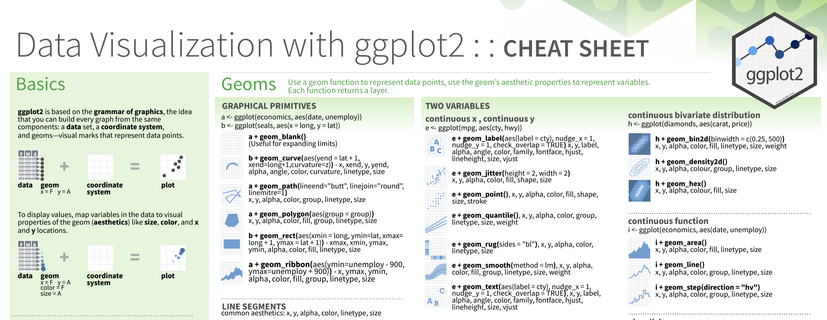
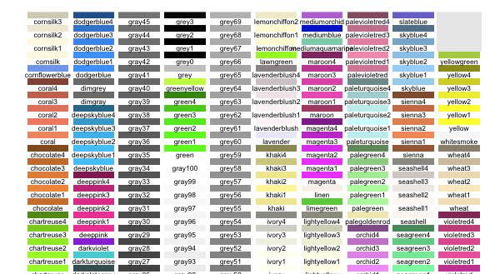
Data visualization
Helpful Links
ggplot2 cheat sheet:
https://www.maths.usyd.edu.au/u/UG/SM/STAT3022/r/current/Misc/data-visualization-2.1.pdf
color palette reference:
https://sape.inf.usi.ch/quick-reference/ggplot2/colour

Slide 12
Data analysis
Correlations
Relationships between continuous variables.
Do older people have higher blood pressure? Is this association statistically significant?
Formula syntax
cor.test(df$variable1, df$variable2)
cor.test(~ variable1 + variable2, data = df)

Slide 13
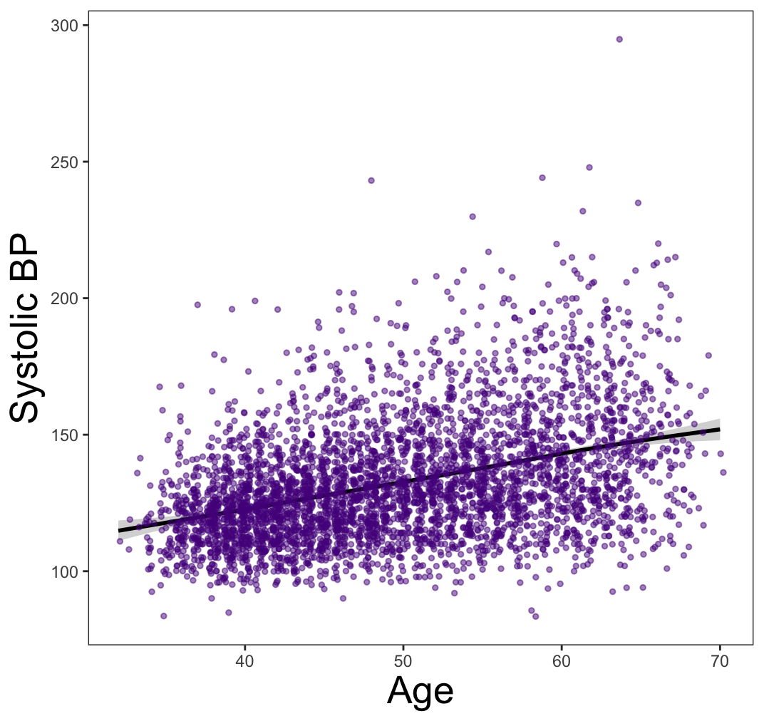
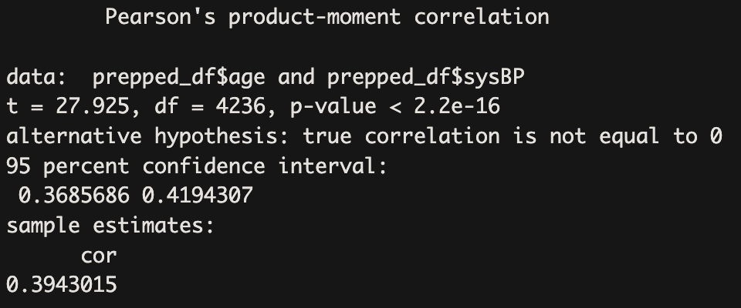
Data analysis
Correlations
Relationships between continuous variables.
Do older people have higher blood pressure? Is this association statistically significant?

Slide 14
Data analysis
Correlations
Relationships between continuous variables.
Do older people have higher blood pressure? Is this association statistically significant?
Challenge 1: perform a correlation test to see if the number of cigarettes smoked per day is related to blood glucose levels.
Challenge 2: plot the correlation and show individual data points.

Slide 15
Data analysis
T-tests
One-way t-tests
Is your sample different from the population mean on a given variable?
Are the number of cigarettes smoked by our sample significantly different from 0? Different from 10 cigarettes per day?
Formula syntax
t.test(df$outcome, mu = 0)

Slide 16
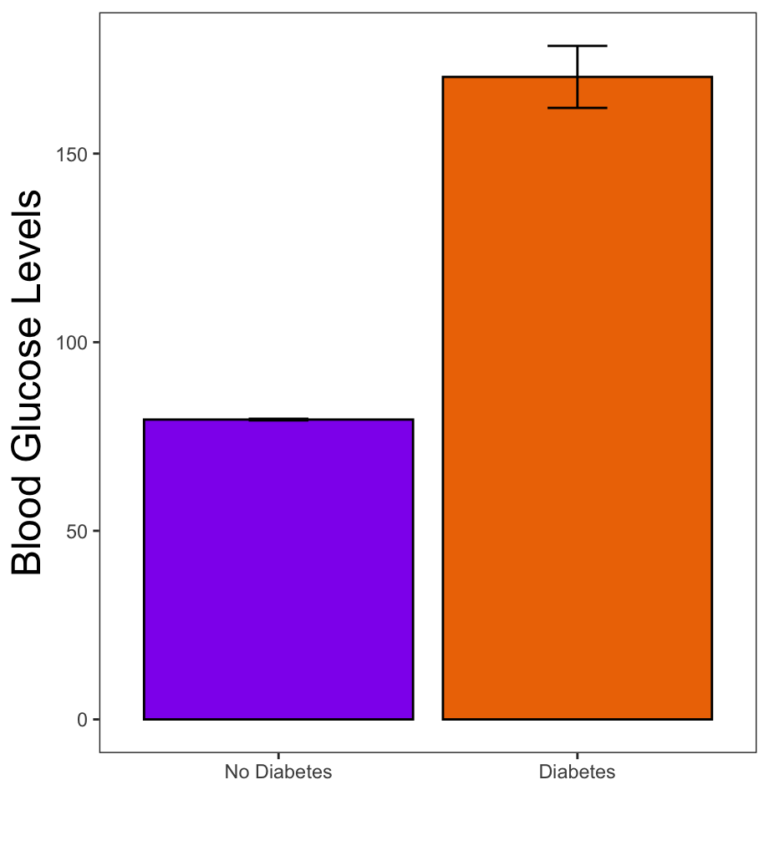
Data analysis
T-tests
Two-way t-tests:
Differences between two groups.
Do people with diabetes have higher glucose levels than those without diabetes?
Formula syntax
t.test(outcome ~ group, data = df)

Slide 17
Data analysis
Regressions
Formula syntax
Syntax | Description
outcome ~ predictor1 + predictor2 + … | Main effects of predictor 1, predictor 2, etc.
outcome ~ predictor1 + predictor2 + predictor1:predictor2 | Main effects of predictor 1 and predictor 2, and the interaction between predictor 1 and 2
outcome ~ predictor1 * predictor2 | Main effects of predictor 1 and predictor 2, and the interaction between predictor 1 and predictor 2
outcome ~ predictor1 + predictor1:predictor2 | Main effect of predictor 1 only, and the interaction between predictor 1 and predictor 2
outcome ~ predictor1:predictor2 | The interaction between predictor 1 and predictor 2 only

Slide 18
Data analysis
Regressions
Main effects
Relationships between variables of all classes.
Are age and blood pressure related to blood glucose levels?
Are smoking status and use of BP medications related to cholesterol levels?
Challenge: are sex and cholesterol levels related to blood pressure? Plot significant effects.

Slide 19
Data analysis
Regressions
Interactions
Relationships between variables of all classes.
How are sex and cholesterol levels related to blood pressure?
Challenge: how are age, hypertension, and a history of stroke related to cholesterol levels? Plot significant effects.

Slide 20
Data analysis
Helpful Links
Plotting main effects:
https://cran.r-project.org/web/packages/sjPlot/vignettes/plot_marginal_effects.html
Plotting interactions:
https://cran.r-project.org/web/packages/sjPlot/vignettes/plot_interactions.html

