Slide 1
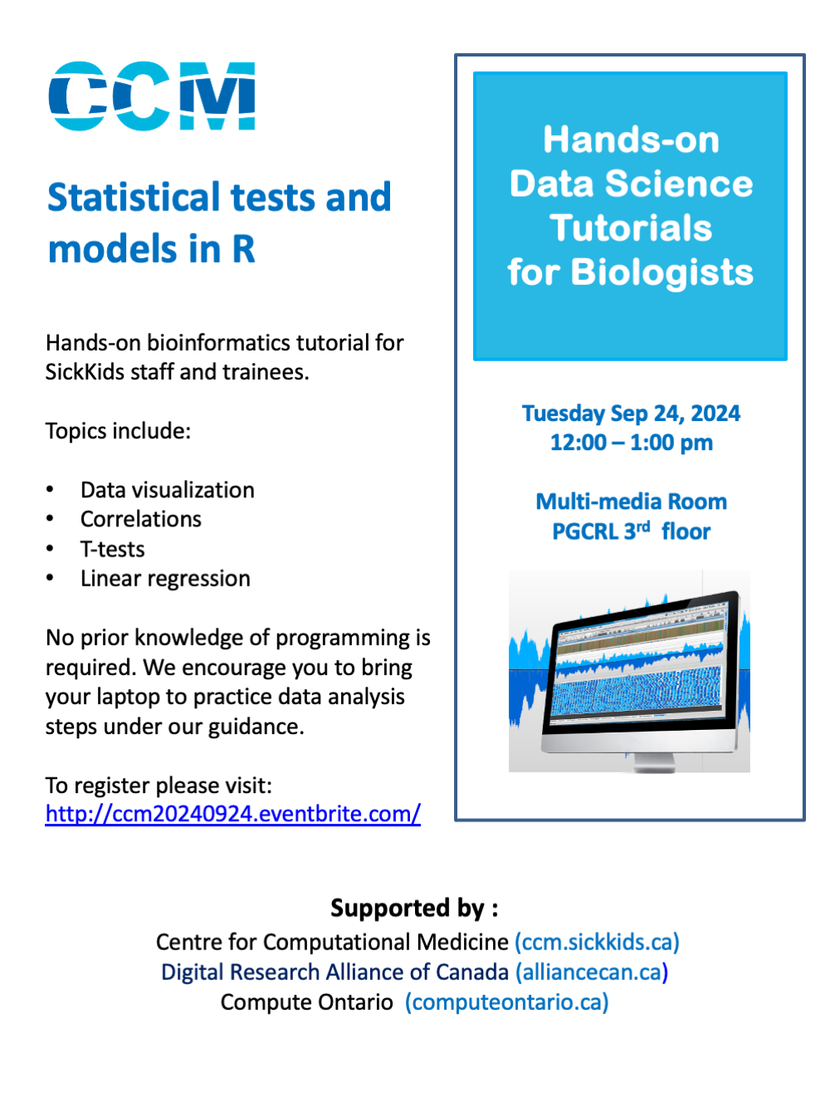
R Programming & Data Analysis
Workshop 3
September 24, 2024

Slide 2
Agenda
Scripts on GitHub
Data visualization using ggplot2
Data analysis
Correlations
T-tests
Linear regressions

Slide 3
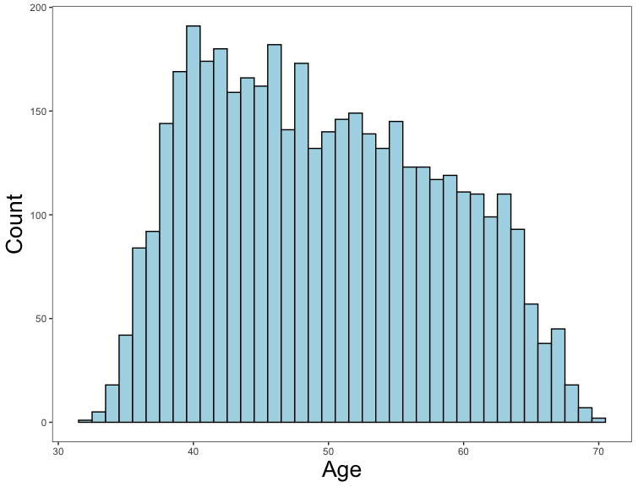
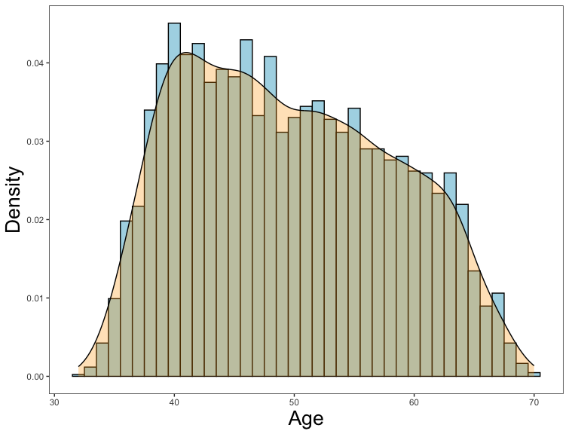
Data visualization
Histograms
Visualize the data:
What do the distributions look like?
Challenge: create a histogram and density plot showing the distribution for heart rate.

Slide 4
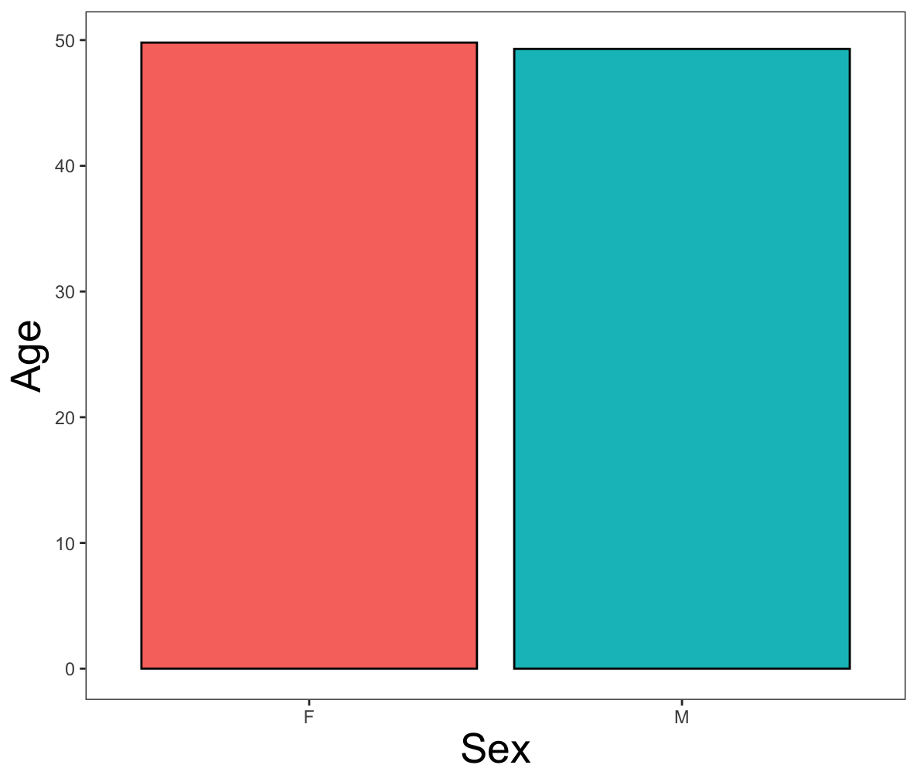
Data visualization
Bar Charts
Visualize the data:
What do the distributions look like?
Are there any patterns that jump out at you?
Challenge: create a bar chart showing sex differences in cigarette smoking.

Slide 5
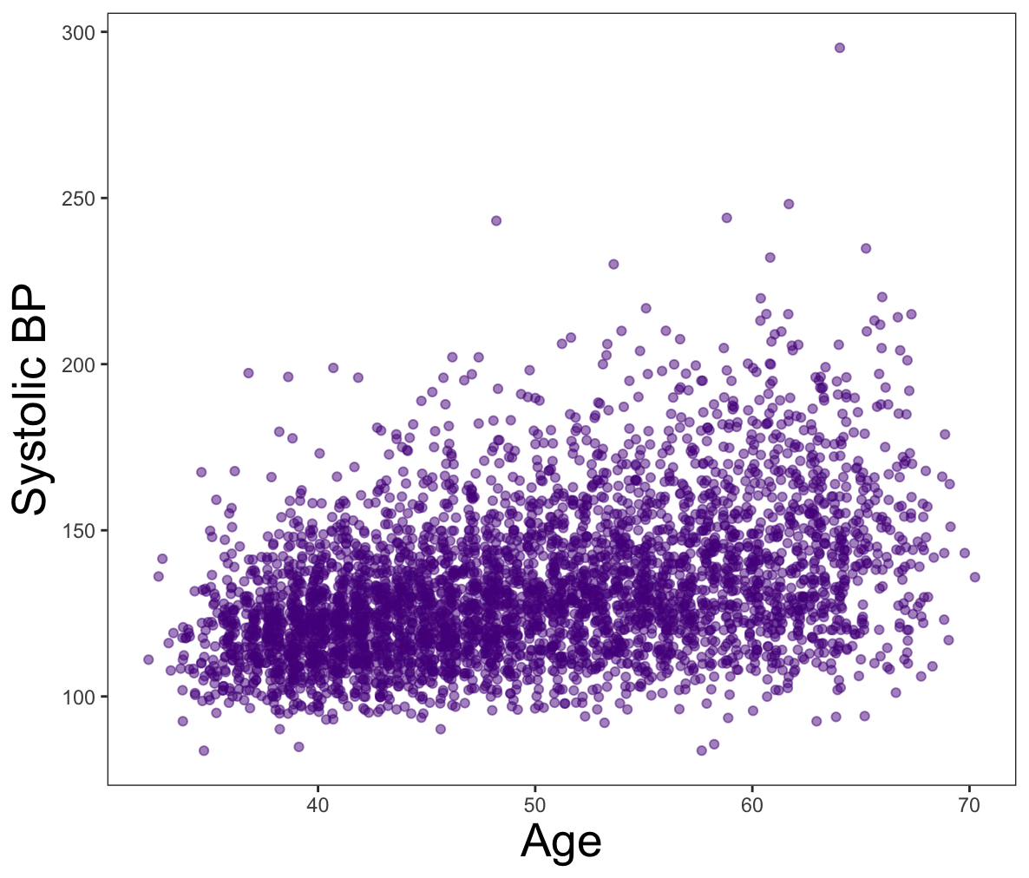
Data visualization
Scatterplots
Visualize the data:
What do the distributions look like?
Are there any patterns that jump out at you?

Slide 6
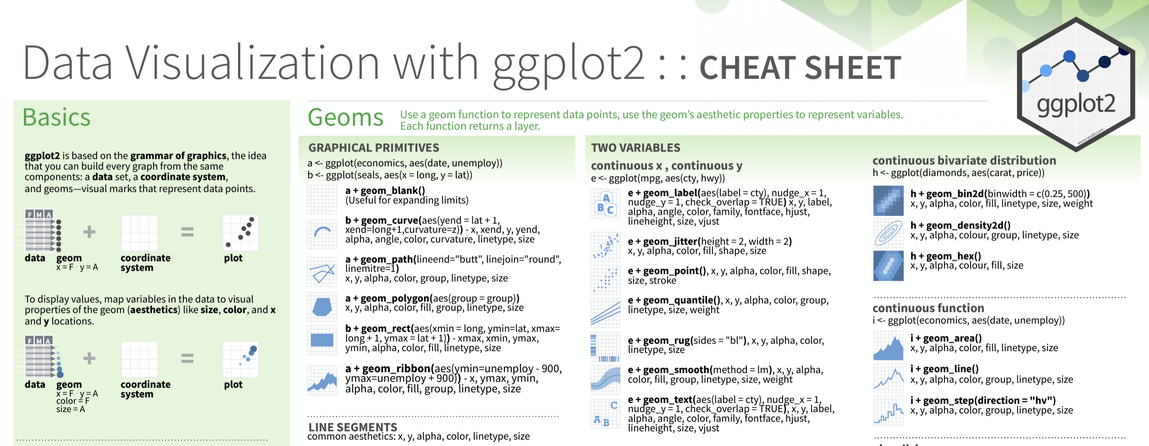
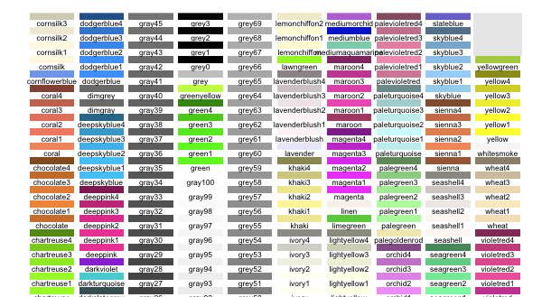
Data visualization
Helpful Links
ggplot2 cheat sheet:
https://www.maths.usyd.edu.au/u/UG/SM/STAT3022/r/current/Misc/data-visualization-2.1.pdf
color palette reference:
https://sape.inf.usi.ch/quick-reference/ggplot2/colour

Slide 7
Data analysis
Correlations
Relationships between continuous variables.
Do older people have higher blood pressure? Is this association statistically significant?
Formula syntax
cor.test(df$variable1, df$variable2)
cor.test(~ variable1 + variable2, data = df)

Slide 8
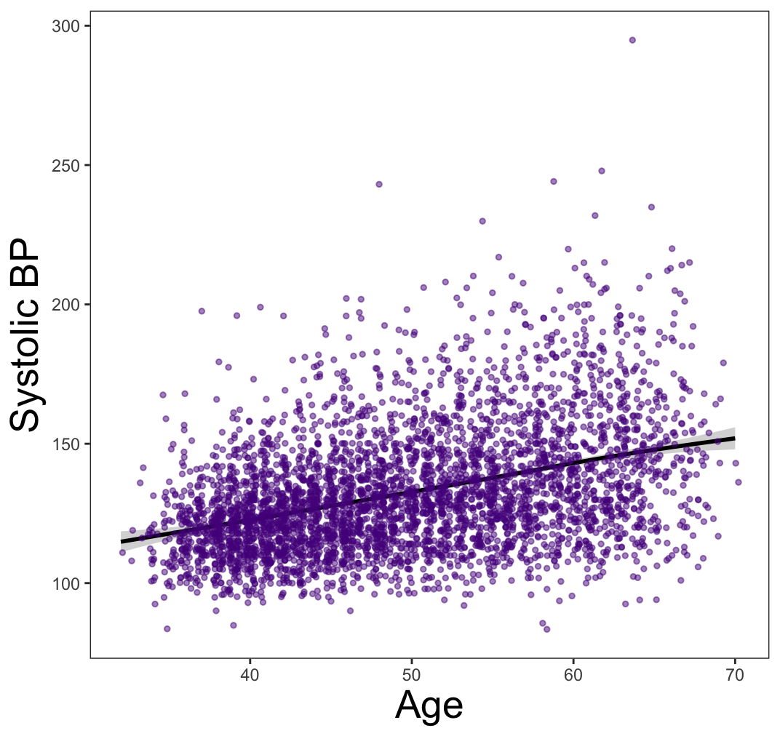
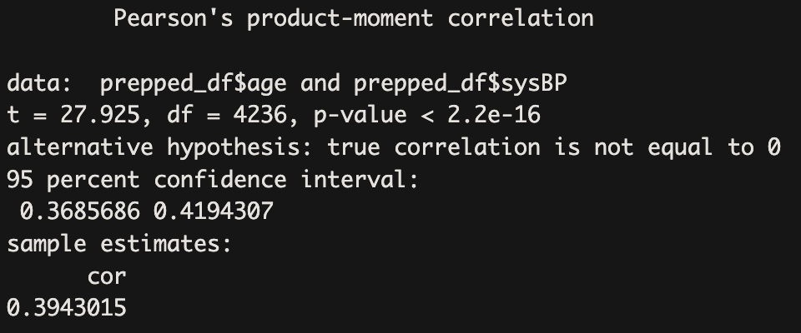
Data analysis
Correlations
Relationships between continuous variables.
Do older people have higher blood pressure? Is this association statistically significant?

Slide 9
Data analysis
Correlations
Relationships between continuous variables.
Do older people have higher blood pressure? Is this association statistically significant?
Challenge 1: perform a correlation test to see if the number of cigarettes smoked per day is related to blood glucose levels.
Challenge 2: plot the correlation and show individual data points.

Slide 10
Data analysis
T-tests
One-way t-tests
Is your sample different from the population mean on a given variable?
Are the number of cigarettes smoked by our sample significantly different from 0? Different from 10 cigarettes per day?
Formula syntax
t.test(df$outcome, mu = 0)

Slide 11
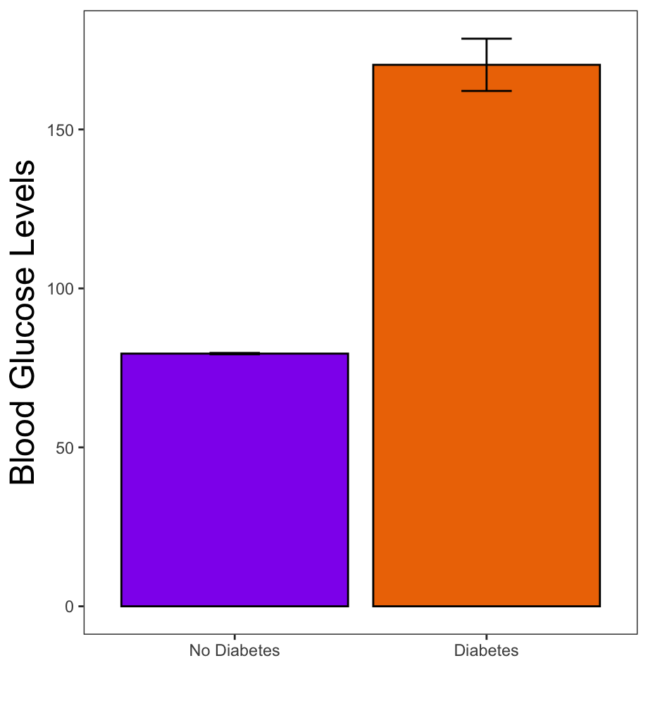
Data analysis
T-tests
Two-way t-tests:
Differences between two groups.
Do people with diabetes have higher glucose levels than those without diabetes?
Formula syntax
t.test(outcome ~ group, data = df)

Slide 12
Data analysis
Regressions
Formula syntax
Syntax | Description
outcome ~ predictor1 + predictor2 + … | Main effects of predictor 1, predictor 2, etc.
outcome ~ predictor1 + predictor2 + predictor1:predictor2 | Main effects of predictor 1 and predictor 2, and the interaction between predictor 1 and 2
outcome ~ predictor1 * predictor2 | Main effects of predictor 1 and predictor 2, and the interaction between predictor 1 and predictor 2
outcome ~ predictor1 + predictor1:predictor2 | Main effect of predictor 1 only, and the interaction between predictor 1 and predictor 2
outcome ~ predictor1:predictor2 | The interaction between predictor 1 and predictor 2 only

Slide 13
Data analysis
Regressions
Main effects
Relationships between variables of all classes.
Are age and blood pressure related to blood glucose levels?
Are smoking status and use of BP medications related to cholesterol levels?
Challenge: are sex and cholesterol levels related to blood pressure? Plot significant effects.

Slide 14
Data analysis
Regressions
Interactions
Relationships between variables of all classes.
How are sex and cholesterol levels related to blood pressure?
Challenge: how are age, hypertension, and a history of stroke related to cholesterol levels? Plot significant effects.

Slide 15
Data analysis
Helpful Links
Plotting main effects:
https://cran.r-project.org/web/packages/sjPlot/vignettes/plot_marginal_effects.html
Plotting interactions:
https://cran.r-project.org/web/packages/sjPlot/vignettes/plot_interactions.html

