Slide 1
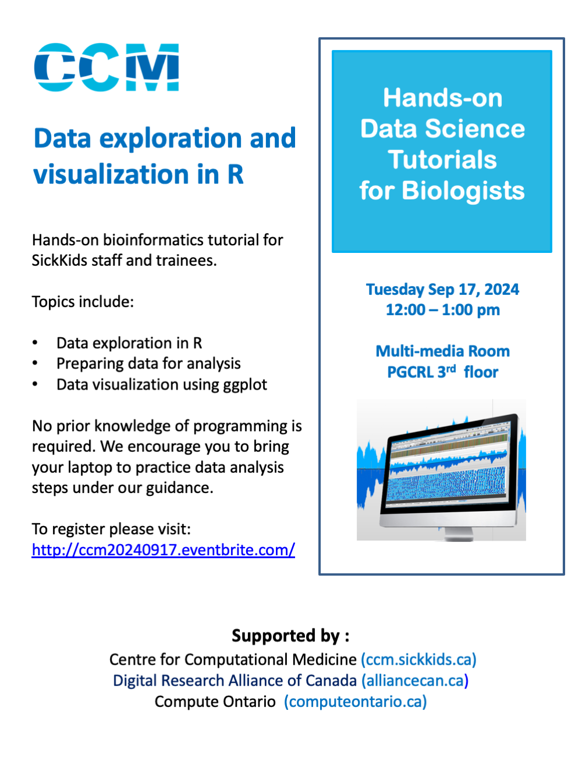
R Programming & Data Analysis
Workshop 2
September 17, 2024

Slide 2
Agenda
Scripts on GitHub
Data exploration
Basic data manipulation
tidyverse vs base R
Data visualization using ggplot2

Slide 3
Framingham Heart Study
One of the longest prospective epidemiological studies of cardiovascular disease and its risk factors.
Began in 1948 in Framingham, MA
Initially enrolled 5209 men and women aged 29-62 years old.
Followed them over time, with assessments every 2 years.
Examinations included:
Detailed medical history
Physical exams
Lab tests
Lifestyle and habits
Noninvasive imaging

Slide 4
Framingham Heart Study
Data collection for the original cohort ended in 2014.
Incorporated offspring and their spouses into the study over time.
Today, they have data from three generations of participants as well as more ethnically diverse cohorts.

Slide 5
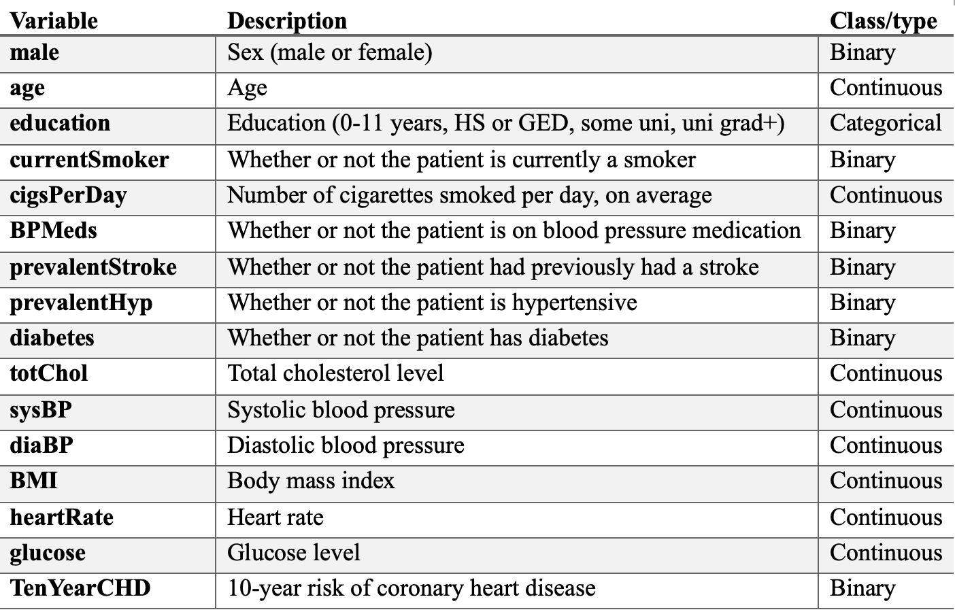
Our Dataset: Subset of the FHS Data from Kaggle
Subset of the data with 4000+ records and 16 variables.
(https://www.kaggle.com/datasets/captainozlem/framingham-chd-preprocessed-data)

Slide 6
Data exploration
Look at the data and its structure – are all the variables in the right format?
Challenge: filter the dataset to keep data from male participants who develop heart disease in 10 years

Slide 7
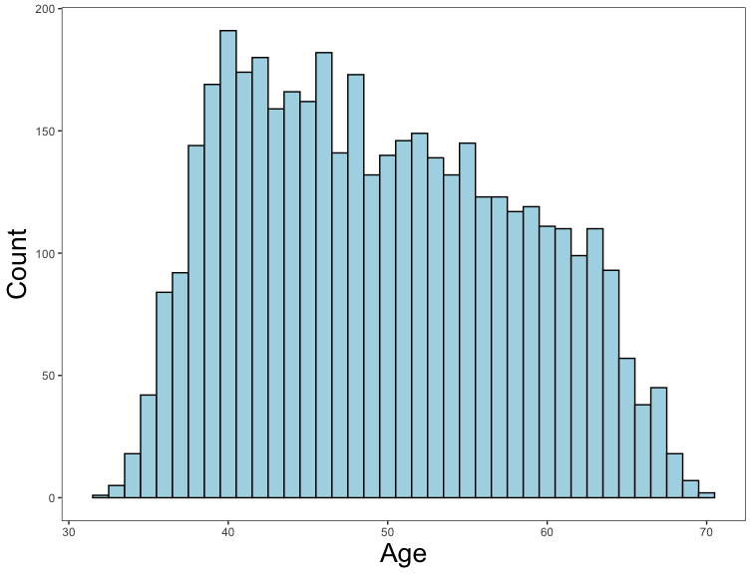
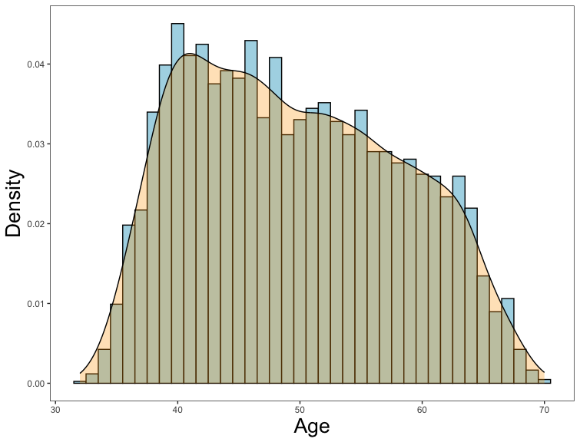
Data visualization
Histograms
Visualize the data:
What do the distributions look like?
Challenge: create a histogram and density plot showing the distribution for heart rate.

Slide 8
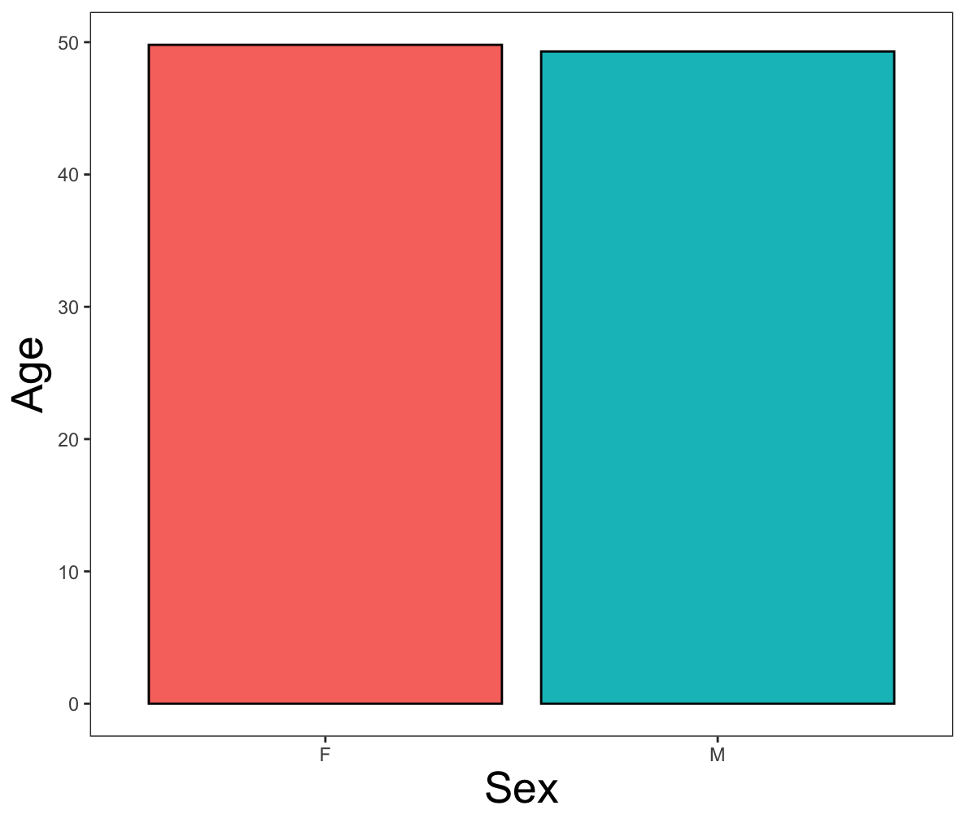
Data visualization
Bar Charts
Visualize the data:
What do the distributions look like?
Are there any patterns that jump out at you?
Challenge: create a bar chart showing sex differences in cigarette smoking.

Slide 9
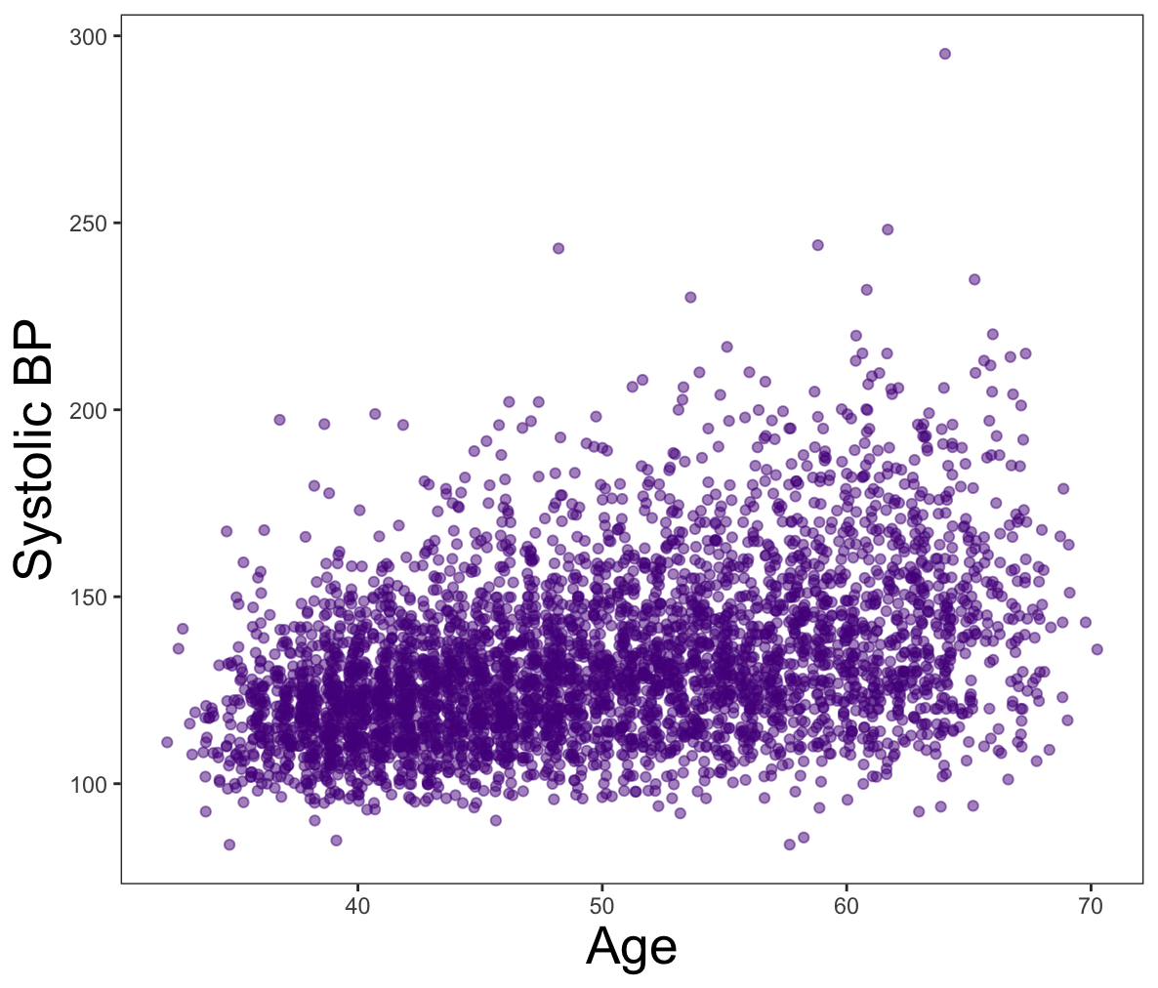
Data visualization
Scatterplots
Visualize the data:
What do the distributions look like?
Are there any patterns that jump out at you?

Slide 10
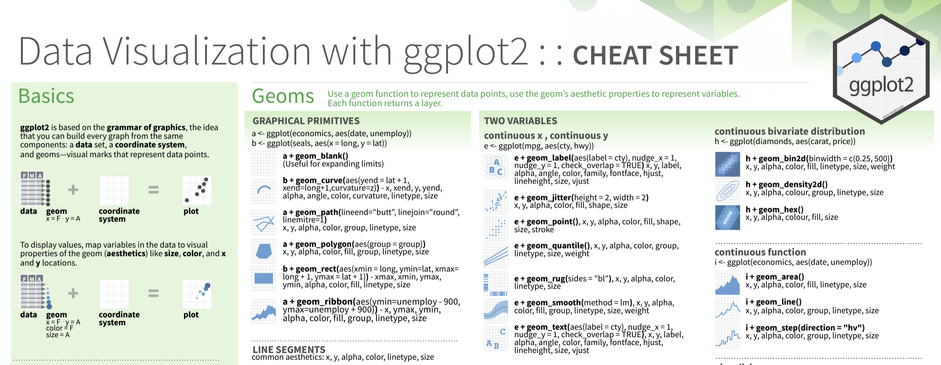
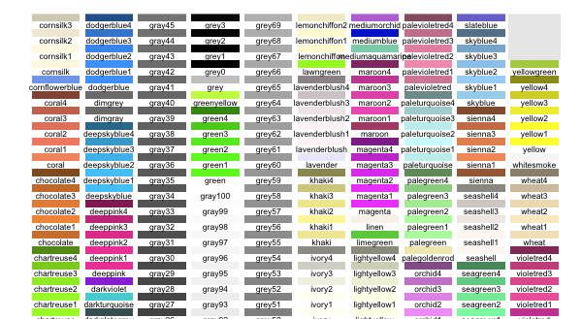
Data visualization
Helpful Links
ggplot2 cheat sheet:
https://www.maths.usyd.edu.au/u/UG/SM/STAT3022/r/current/Misc/data-visualization-2.1.pdf
color palette reference:
https://sape.inf.usi.ch/quick-reference/ggplot2/colour

