Slide 1
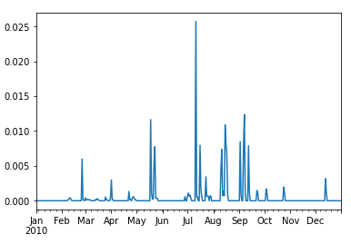
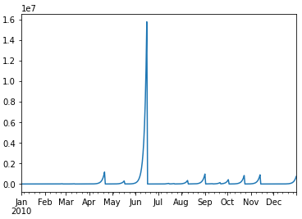
HRU ID: 025 | Hg concentration (mg/L)
Output-mercury.hru and output.hru
swatmf_out_SWAT_rechhg

Slide 2
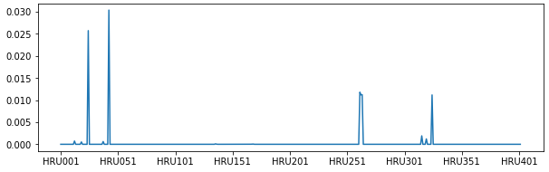
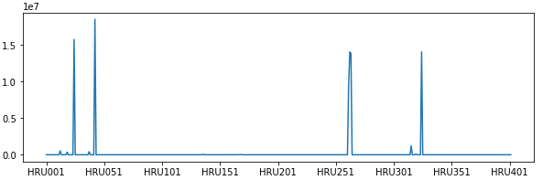
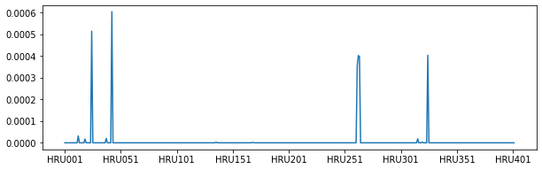
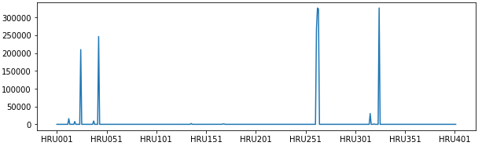
Maximum Hg concentration (mg/L) for each HRU
Output-mercury.hru and output.hru
swatmf_out_SWAT_rechhg
Average Hg concentration (mg/L) for each HRU
Output-mercury.hru and output.hru
swatmf_out_SWAT_rechhg

