Slide 1
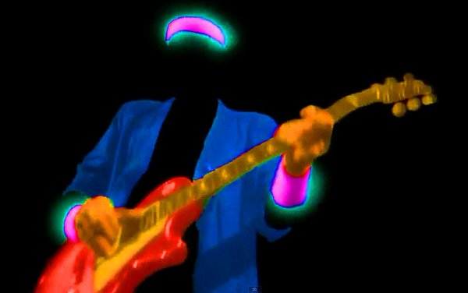
Iterative Ensemble Smoothers:
Jacobians for nothing and uncertainty for free
Jeremy T White
USGS TX

Slide 2
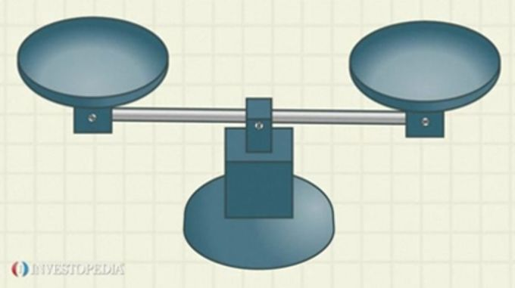
Parametric frustration©
Express model input uncertainty
computational burden

Slide 3
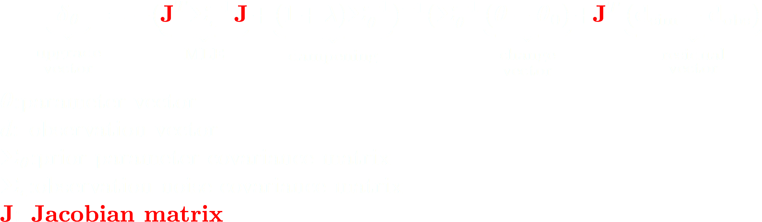
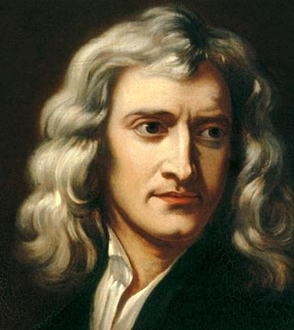
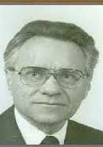
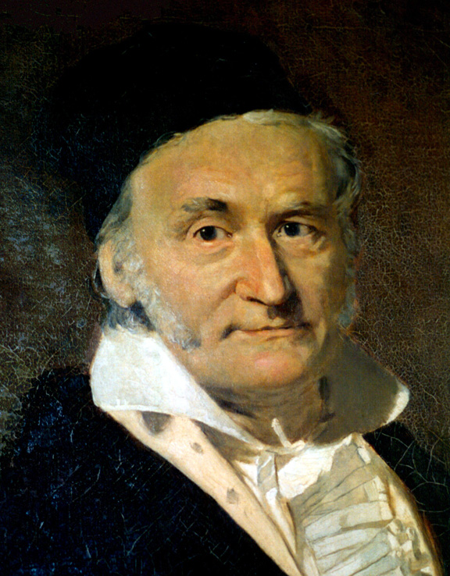
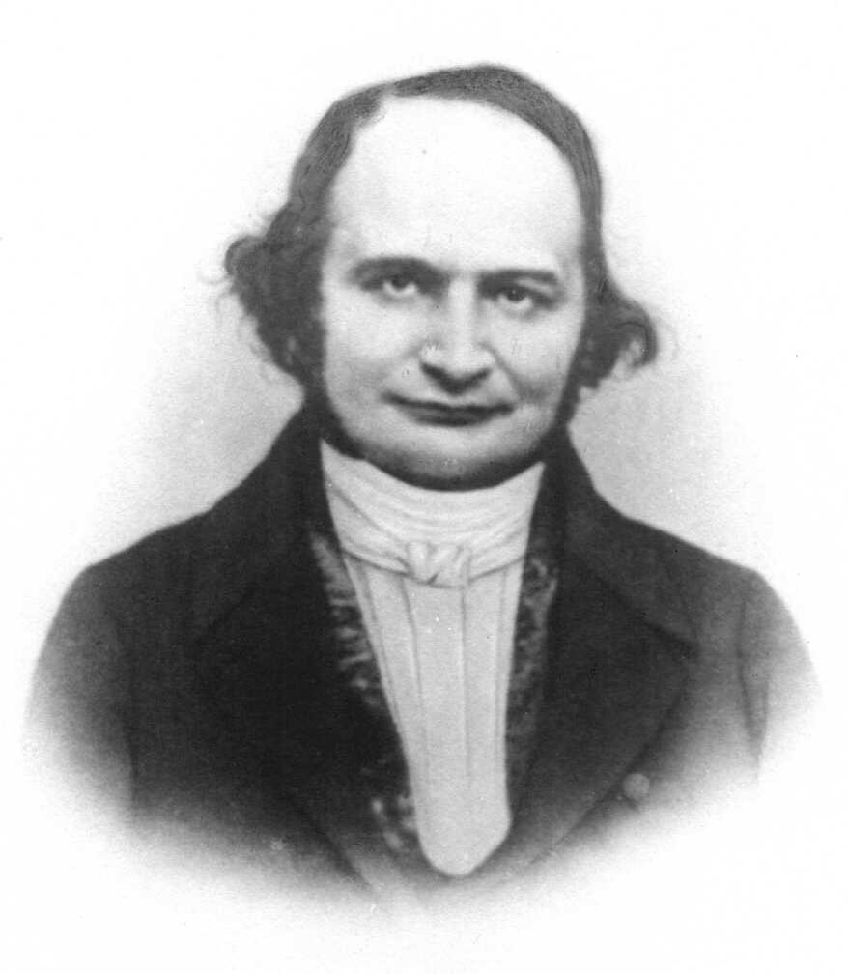
Background – GLM and the Jacobian matrix
The linear “mapping” from parameters to observations
(using the model)
Finite differences
Good: model independent
Bad: “…run the model once for each parameter…”

Slide 4

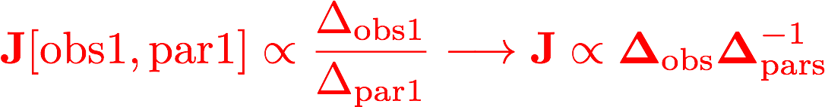
Free your mind!

Slide 5
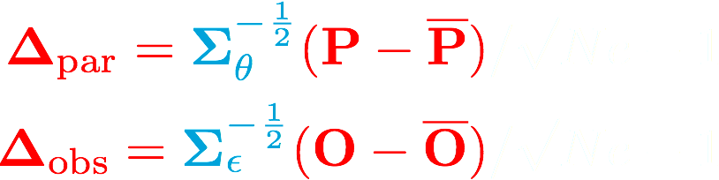
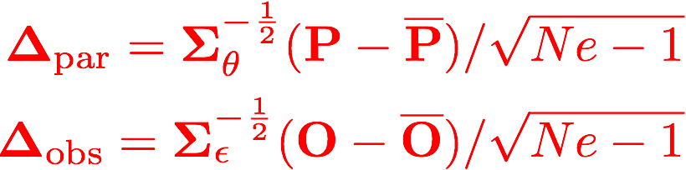
Ensemble approximation - fake it ‘til you make it!
P ( ne x npar matrix)
O ( ne x nobs matrix)
 | par1 | par2 | parN
real1 | 0.123 | 1101 | 12.3
real2 | 0.321 | 1234 | 32.1
real3 | 0.987 | 2001 | 69.0
realN | 0.789 | 1959 | 54.1
 | obs1 | obs2 | obsN
real1 | 1998 | 0.0001 | 3.21
real2 | 2001 | 0.003 | 1.23
real3 | 2004 | 0.0003 | 9.6
realN | 1980 | 0.001 | 1.45
update via GLM
model runs = ne (number reals)
 | 0.51 | 1751 | 31.4
 | 1994 | 0.002 | 4.51

Slide 6

Huh?

Slide 7
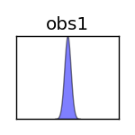
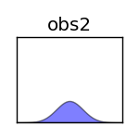

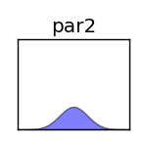
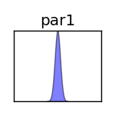
An aside: approximating derivatives with ensembles

Slide 8
iES: Chen and Oliver (2013)
Reformulated GLM with approximate Jacobian
iterative Ensemble Smoother
All vectors become matrices:
pars, obs, residuals,upgrade
Jacobians for nothing: Jacobian = running the ensemble
Uncertainty for free: iES yields a posterior parameter ensemble

Slide 9
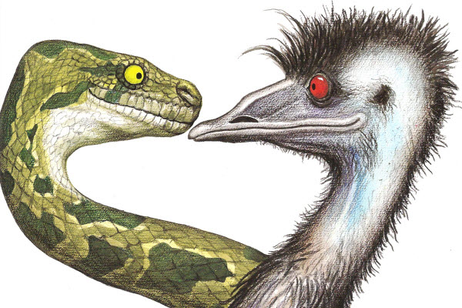
The iES implementation in pyEMU
Model independent
template, instruction, control file
any existing model in the PEST(++) framework
parallel ensemble evaluation
Locally or HTCondor
multiple lambda testing
subset ensemble evaluation
failed run handling
extensive logging
localization
es = EnsembleSmoother(“pest.pst”) es.initialize(300) for i in range(10): es.update()
https://github.com/jtwhite79/pyemu

Slide 10
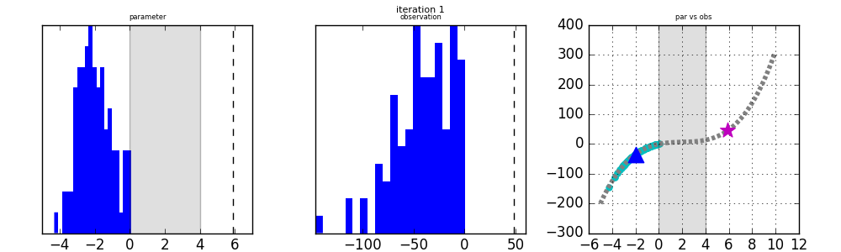

Chen and Oliver (2013): 1 par, 1 obs, 100 realizations

Slide 11
Chen and Oliver (2013): 1 par, 1 obs, 100 realizations

Slide 12
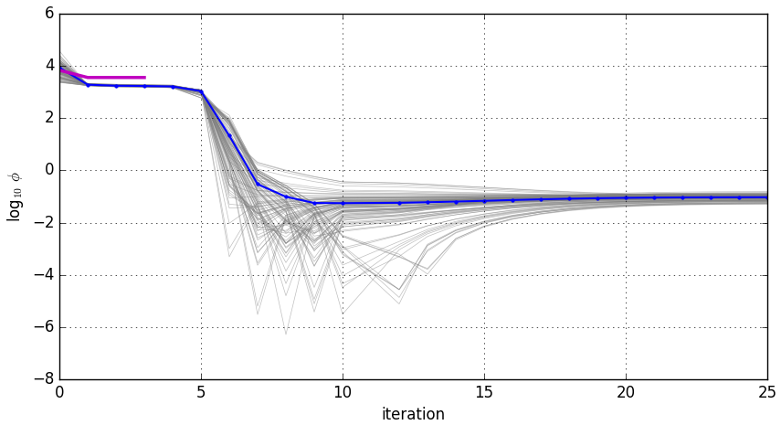
Chen and Oliver (2013): 1 par, 1 obs, 100 realizations
PEST(++)
mean
realizations

Slide 13
Chen and Oliver (2013): 1 par, 1 obs, 100 realizations
PEST(++)
mean
Behavioral characteristics:
Solves nonlinear problems
Finds global-ish solution
Prevents overfitting (to measurement noise)
realizations

Slide 14
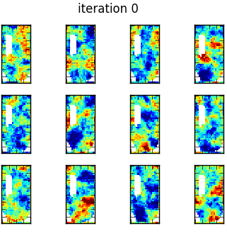
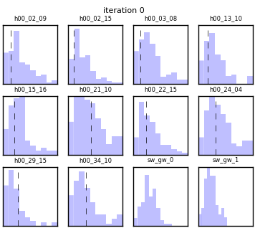
Freyberg (1988) - 761 pars, 10 obs, 100 realizations

Slide 15
Freyberg (1988) - 761 pars, 10 obs, 100 realizations

Slide 16
Freyberg (1988) - 761 pars, 10 obs, 100 realizations
Behavioral characteristics:
Upgrades respect the Prior
= happy geologist!

Slide 17
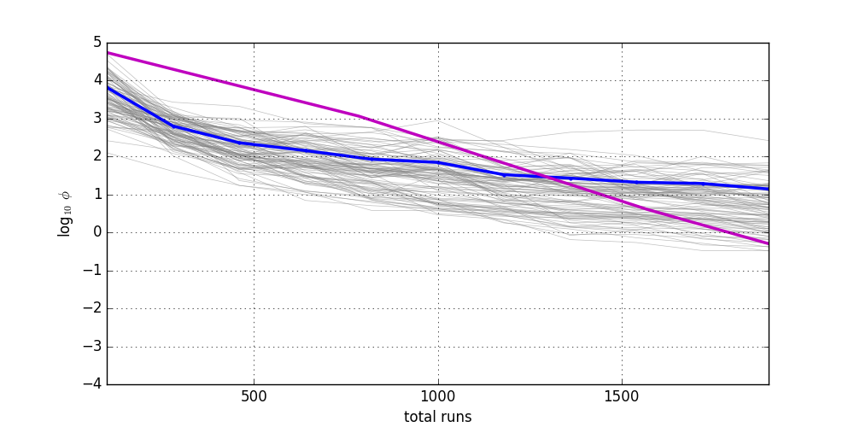
Freyberg (1988) - 761 pars, 10 obs, 100 realizations
PEST(++)
mean
realizations

Slide 18
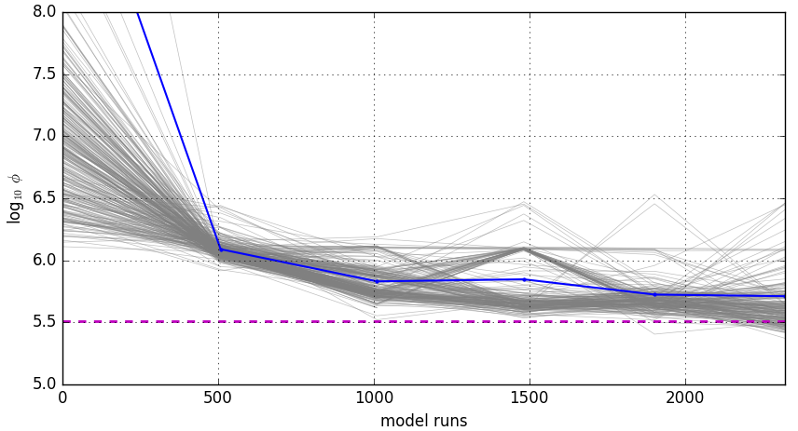
Real-world model: 16K pars, 1.8K obs, 300 reals
mean
realizations
PEST(++) best w/ 4K pars
(14K model runs)

Slide 19
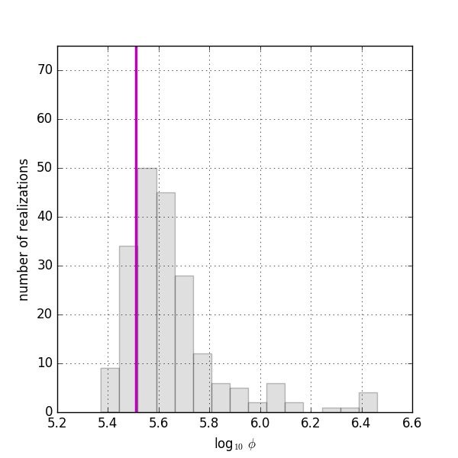

Real-world model: 16K pars, 1.8K obs, 300 reals
PEST(++) best w/ 4K pars
(14K model runs)
WTF?!
Realizations
(2.5K model runs)

Slide 20
Summary and next steps…
iES is seems promising…(more testing needed)
Next: 1M+ parameters = grid-scale parameterizations with geostatistics
template and instruction files can’t handle grid-scale parameterizations.
C++
HDF5
Next: Tools to support ensemble approaches:
Building the Prior
Integration with geostatistics
Localization

Slide 21
Jeremy White
jwhite@usgs.gov

Slide 22
Approximating derivatives with ensembles

Slide 23

GLM iES: Chen and Oliver (2013)
“Jacobians for nothing...”:only have to run the model once for each ensemble member
“...and uncertainty for free”:non-linear parameter uncertainty estimates from the ensemble

Slide 24
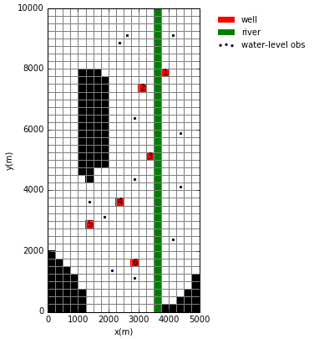
Examples - Freyberg (1988)
365 stress periods
3 layers X 40 rows X 20 cols
761 parameters :)
hk in every model cell
conductance of every river cell
well rate multipliers
SS and SY
recharge
12 water level observations
100-member ensemble

Slide 25
Examples - BONUS!
Real-world model :)
144 stress periods
5 layers X 156 rows X 174 columns
~16,000 parameters :)
Pilot points in every 3rd model cell
hk, vka, ss, sy, recharge, ghb stage, ghb conductance
Time series
global rch mults, global GHB stage mults, global MNW mults
1,700 water level observations
100 springflow discharge observations
300 member ensemble

Slide 26
An opening about complexity...always dangerous!
What’s good about complexity:
allows for more rigorous simulation of system dynamics.
Presents the opportunity to more uncertainty injection in model inputs
What’s bad about complexity:
computational burden prevents model-usage analysis (e.g., uncertainty analysis)
So we need:
Faster forward models
Better approaches for model-usage analysis

Slide 27
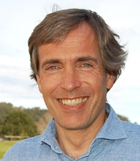
Ensemble approximation - fake it ‘til you make it!
P parameter ensemble ( ne x npar matrix)
Realized from prior parameter cov matrix
O model output ensemble (ne x nobs matrix)
Target: obs values + realized measurement noise

Slide 28
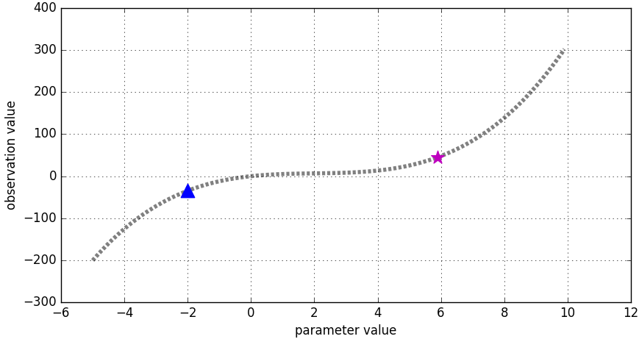
Examples - Chen and Oliver (2013)
1 parameter and 1 observation :(
Highly non-linear :)
100-member ensemble

Slide 29
Outline
Background, theory, and implementation
Gauss Levenburg Marquardt (GLM) algorithm
Jacobian matrix
Ensemble approximation
Iterative ensemble smoother GLM
Implementation
Example applications
1-parameter nonlinear model
800 parameter MODFLOW model

Slide 30
Background - The Jacobian matrix
The linear “mapping” from parameters to observations
(using the model)
Must be calculated each iteration of GLM
Analytically
Finite-differences (PEST(++))
Adjoint
PEST and finite differences
Good: model independent
Bad: “…run the model once for each parameter…”

Slide 31
Background - Gauss Levenburg Marquardt (GLM-MAP)

