Slide 1


SQL
SPARK COOKBOOK – IV
HTTPS://WWW.MEETUP.COM/APACHE-SPARK-HSINCHU/

Slide 2
Agenda
Introduction Spark SQL
Understanding the Catalyst optimizer
Creating HiveContext
Inferring schema using case classes
Programmatically specifying the schema
Loading and saving data using the Parquet format
Loading and saving data using the JSON format
Loading and saving data from relational databases
Loading and saving data from an arbitrary source

Slide 3
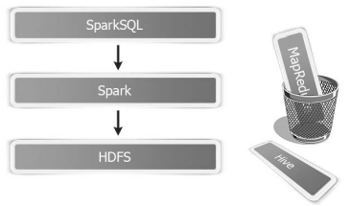
Introduction Spark SQL
Spark SQL
  Part of the core distribution since Spark 1.0 (April 2014)
  Runs SQL / HiveQL queries, optionally alongside or replacing existing Hive deployments

Slide 4
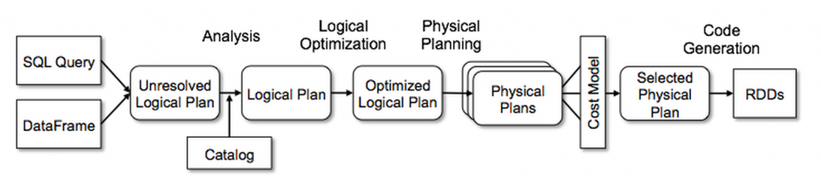
Understanding the Catalyst optimizer

Slide 5
Creating HiveContext
// Create an instance of HiveContext
val hc = new org.apache.spark.sql.hive.HiveContext(sc)
// Create a Hive table Person with first_name, last_name, and age as columns
hc.sql("create table if not exists person(first_name string, last_name string, age int) row format delimited fields terminated by ','")
// Select the person data using HiveQL
val persons = hc.sql("from person select first_name,last_name,age")

Slide 6
Inferring schema using case classes
// Create a Person case class
case class Person(first_name:String,last_name:String,age:Int)
// Convert the RDD of Array[String] into the RDD of Person case objects
val personRDD = pmap.map( p => Person(p(0),p(1),p(2).toInt))
//Convert the personRDD into the personDF DataFrame
val personDF = personRDD.toDF
//Register the personDF as a table
personDF.registerTempTable("person")
// Run a SQL query against it
val people = sql("select * from person")

Slide 7
Programmatically specifying the schema
//Convert the RDD of array[string] to the RDD of the Row objects
val personData = pmap.map( p => Row(p(0),p(1),p(2).toInt))
//Create schema using the StructType and StructField objects.
val schema = StructType(
Array(StructField("first_name",StringType,true),
StructField("last_name",StringType,true),
StructField("age",IntegerType,true)
))
//Apply schema to create the personDF DataFrame
val personDF = sqlContext.createDataFrame(personData,schema)

Slide 8
Loading and saving data using the Parquet format
//Select all the person with age over 60 years
val sixtyPlus = sql("select * from person where age > 60")
//Let's save this sixtyPlus RDD in the Parquet format
sixtyPlus.write.parquet("hdfs://localhost:9000/user/hduser/sp.parquest")
//Load contents of the Parquet files in the Spark shell
val parquetDF = sixtyPlus.read.parquet("hdfs://localhost:9000/user/hduser/sp.parquest")

Slide 9
Loading and saving data using the JSON format
//Load the jsondata directory from HDFS
val person = sqlContext.read.json("hdfs://localhost:9000/user/hduser/jsondata")
//Register the person DF as a temp table so that the SQL queries can be run against it
person.registerTempTable("person")
//Select all the persons with age over 60 years
val sixtyPlus = sql("select * from person where age > 60")
//Let's save this sixtyPlus DF in the JSON format
sixtyPlus.toJSON.saveAsTextFile("hdfs://localhost:9000/user/hduser/sp")

Slide 10
Loading and saving data from RDB
//Load DataFrame with JDBC data source (url, table name, properties)
val people = sqlContext.read.jdbc(url,"person",prop)
//Group people by gender as follows
val grouped = people.groupBy("gender")
//Find the number of males and females
val gender_count = grouped.count
//save this avg_age data to a new table
gender_count.write.jdbc(url,"gender_count",prop)

Slide 11
Loading and saving data from an arbitrary source
//Load the data from Parquet
val people = sqlContext.read.load("hdfs://localhost:9000/user/hduser/people.parquet")
//Save people as JSON in the append mode:
val people = people.write.format("json").mode("append").save("hdfs://localhost:9000/user/hduser/people.json")

Slide 12
Apache Zeppelin 資料視覺化
Demo

