Slide 1
Spark Streaming
鄭又晨

Slide 2
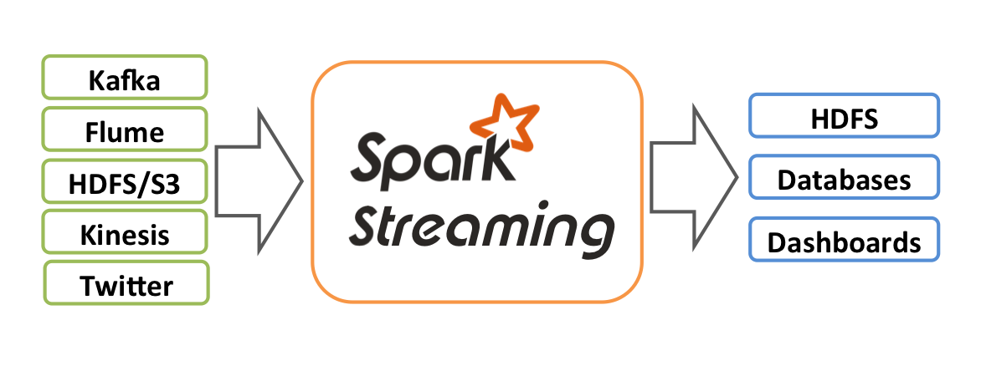
Spark Streaming
Spark's library that provides support to process live data.

Slide 3
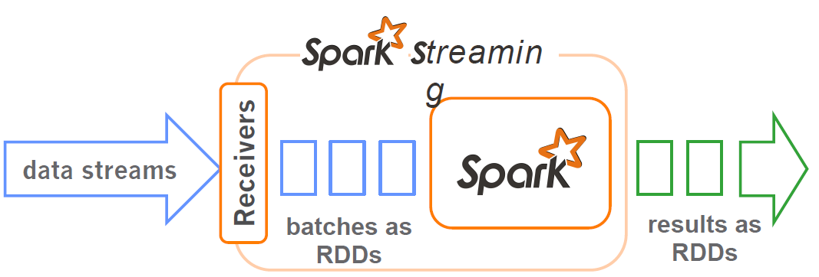
How does Spark Streaming work?
Chop up data streams into batches of few seconds
Spark treats each batch of data as RDDs and processes them using RDD operations
Processed results are pushed out in batches

Slide 4
Discretized Stream Processing
DStream 離散化串流
Represents a stream of data
The basic abstraction in Spark Streaming
Implemented as a sequence of RDDs
DStreams API very similar to RDD API
Notes:
在内部，DStream 是由一系列 RDDs 組成

Slide 5
Example – Word count using Streaming (1/3)
Create StreamingContext with a 4 second batch interval
  > val ssc = new StreamingContext(sc,Seconds(4))
Create a DStream that will connect to localhost:7777
  > val lines = ssc.socketTextStream("localhost",7777)

Slide 6
Example – Word count using Streaming (2/3)
Divide the lines into multiple words
  > val wordsFlatMap = lines.flatMap(_.split(" "))
Convert word to (word,1)
  > val wordsMap = wordsFlatMap.map( w => (w,1))
Add a number of occurrences for each word as the key
  > val wordCount = wordsMap.reduceByKey( (a,b) => (a+b))

Slide 7
Example – Word count using Streaming (3/3)
Print wordCount
  > wordCount.print
Start StreamingContext
  > ssc.start

Slide 8
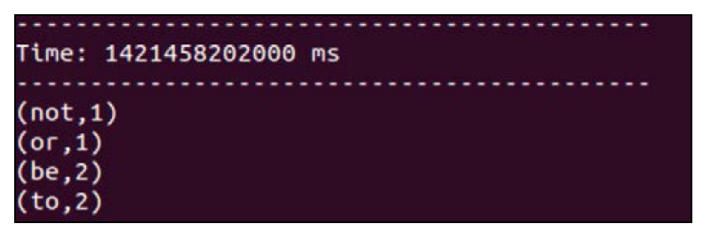
Demo – Word count using Streaming
Result

Slide 9
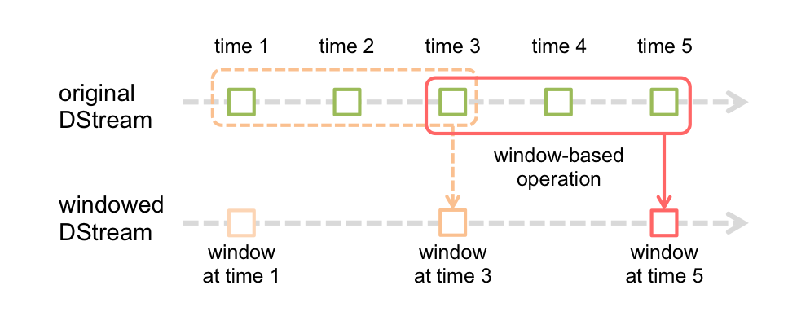
Window-based Transformations
Window Length: 3 time units (紅框)
  處理三個時間單位內的資料
Sliding Interval: 2 time units
  兩個時間單位滑一次

Slide 10
Window-based Transformations
reduceByWindow
  (window length = 4, sliding interval = 1)
t1
t2
t3
t4
t5
t6
1
4
9
3
3
1
17
1
4
9
3
3
1
-
+
17
19
1
4
9
3
3
1
-
+
17
19
16

Slide 11
Window-based Transformations
val wordCounts = pair.reduceByWindow(
{(x, y) => x + y} , //加入進入視窗的新批次
{(x, y) => x - y} , //移除離開視窗的舊批次
Seconds(4), //windows length
Seconds(1)) //sliding interval

Slide 12
Stateful Computations
Generate new state based on previous state
  > val pairs = words.map(x => (x,1))
  > val runningCounts = pairs.updateStateByKey( (values: Seq[Int], state: Option[Int]) => Some(state.sum + values.sum))

