Slide 1

FPGA-Based Smith–Waterman Score Computation with Python-Based Trace back
Shreekara H | 1RV24EC200
Yashwanth S | 1RV24EC254
Y Sanjana | 1RV24EC251
Pranati Rao | 1RV24EC257
Vartika Mrigwani | 1RV24EC256
Mentor Name: Srividya P
Designation: Assistant Professor
Department of Electronics and Communication Engineering
*
Department of ECE
1

Slide 2
Outline
Outline
About the organization (for internship students)
Introduction
Motivation
Problem Statement
Objectives of the project
Literature Survey
Methodology
Work done so far (Use this from phase 2 presentation onwards)
Work plan for next phase (Use this from phase 2 presentation onwards)
Project timeline
References
Introduction
Motivation
Problem Statement
Objectives of the project
Literature Survey
Methodology
Work done
References

Slide 3
Introduction
DNA sequence alignment is a fundamental task in computational genomics, yet it is computationally intensive at large scales.
The Smith–Waterman (SW) algorithm provides optimal sequence alignment but involves significant runtime due to its dynamic-programming structure.
FPGAs support parallel execution and allow custom hardware pipelines, making them a good fit for accelerating computation-heavy algorithms.
This project aims to develop a FPGA-based Smith–Waterman accelerator, for the forward part of the algorithm, and python-based traceback for the reverse part of the algorithm
*
Department of ECE
3

Slide 4
Problem Definition
To design and implement a low-power Smith–Waterman accelerator on an FPGA.
*
Department of ECE
4

Slide 5
Objectives
To design a Smith Waterman Hardware Accelerator : Develop a custom hardware architecture (systolic array) that implements exact Smith–Waterman local alignment for short DNA sequences.
To implement and verify on FPGA : Implement the accelerator on an FPGA, write testbenches, and verify functional correctness using synthetic and/or example DNA sequences, using Virtual I/O IP.
To obtain the maximum score of alignment and the position where that alignment is found.
To perform traceback using the scores got using python
*
Department of ECE
5

Slide 6
Literature Review
Sl No | Paper Title, Journal Name, Year | Major findings / observations
1 | An FPGA-based hardware accelerator supporting sensitive sequence homology filtering with profile hidden Markov models. BMC Bioinformatics, 2024 | 1.Uses a systolic array of 12,288 PEs to compute DP cells in parallel 2.It achieves 1739 GCUPS (up to 227× faster than CPU implementation)
2 | Proposal of Smith-Waterman algorithm on FPGA to accelerate the forward and backtracking steps. International Conference on Embedded Computer Systems: Architectures, Modeling, and Simulation, 2015 | Synthesis analyses have shown that the proposed design reaches up to 79.5 Giga Cell Updates per Second (GCUPS).
*
Department of ECE
6

Slide 7
Literature Review
Sl No | Paper Title, Journal Name, Year | Major findings / observations
3 | Architectural optimizations for high performance and energy efficient Smith-Waterman implementation on FPGAs using OpenCL. Design, Automation & Test in Europe Conference & Exhibition (DATE), 2017 | 1. They tested 4×4 matrices with binary DNA encoding. 2.This paper speeds up DNA comparison by 5× using parallel hardware processing
4 | An FPGA-Based Systolic Array to Accelerate the BWA-MEM Genomic Mapping Algorithm International Conference on Embedded Computer Systems: Architectures, Modeling, and Simulation, 2015 | Achieves ~3× kernel speedup and ~45% overall application improvement.
*
Department of ECE
7

Slide 8
Literature Review
Sl No | Paper Title, Journal Name, Year | Major findings / observations
5 | SWIFOLD: Smith-Waterman implementation on FPGA with OpenCL for long DNA sequences. BMC Systems Biology, 2019 | The best performances obtained are 132.43, 203.5 and 268.83 GCUPS for the int, short and char kernels, respectively.
6 | Pip-SW: Pipeline Architectures for Accelerating Smith-Waterman Algorithm on FPGA Platforms IEEE Transactions on Emerging Topics in Computing, 2025 | They achieved 45x the speed compared to CPU implementation of the Smith Waterman algorithm.
*
Department of ECE
8

Slide 9
Literature Review
Sl No | Paper Title, Journal Name, Year | Major findings / observations
7 | A Block-Based Systolic Array on an HBM2 FPGA for DNA Sequence Alignment. Applied Reconfigurable Computing. Architectures, Tools, and Applications 2020 | 1.Their implementation could reach 429.39 GCUPS. 2.It achieved a power efficiency of 7.68 GCUPS/W.
*
Department of ECE
9

Slide 10
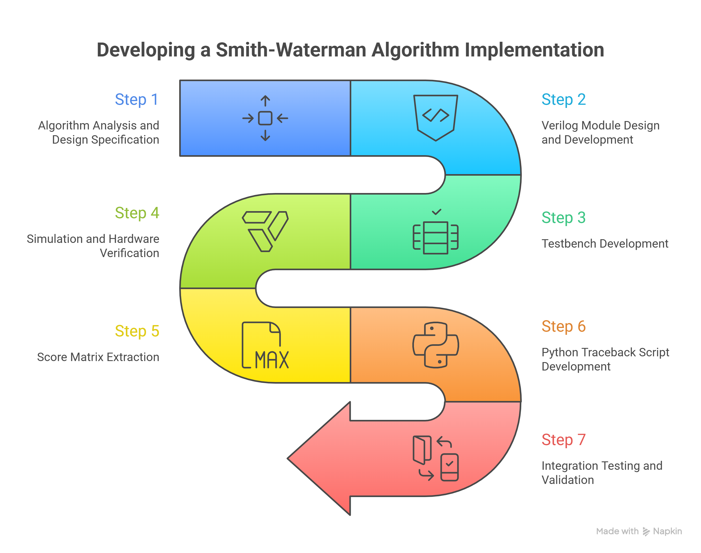
Methodology
*
Department of ECE
10

Slide 11
Tools used
Hardware- Pynq Z2 board -
Used as the FPGA hardware platform to deploy and test the design in real time, allowing interactive control and observation of signals through the VIO IP.
Software-
Vivado ML Edition:
Used to design, synthesize, and program the FPGA, and to integrate IP cores like VIO for real-time testing and debugging of signals on hardware.
Visual Studio Code + Python:
Used for writing and managing Python scripts to generate test inputs, process outputs, and quickly validate algorithm behavior during development.
*
Department of ECE
11

Slide 12
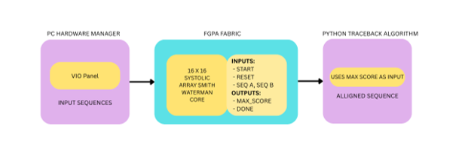
Implementation
*
Department of ECE
12

Slide 13
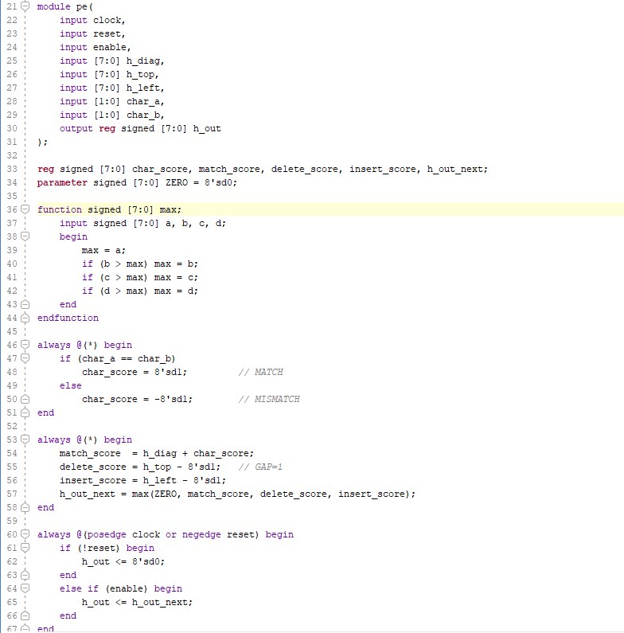
Results
Verilog Modules
PE Element
The PE element is the smallest unit in Smith Waterman Algorithm
It perform 3 main functions -
Calculates Character Score
Subtracts gap penalty from neighboring cells
Calculates the maximum value
*
Department of ECE
13

Slide 14
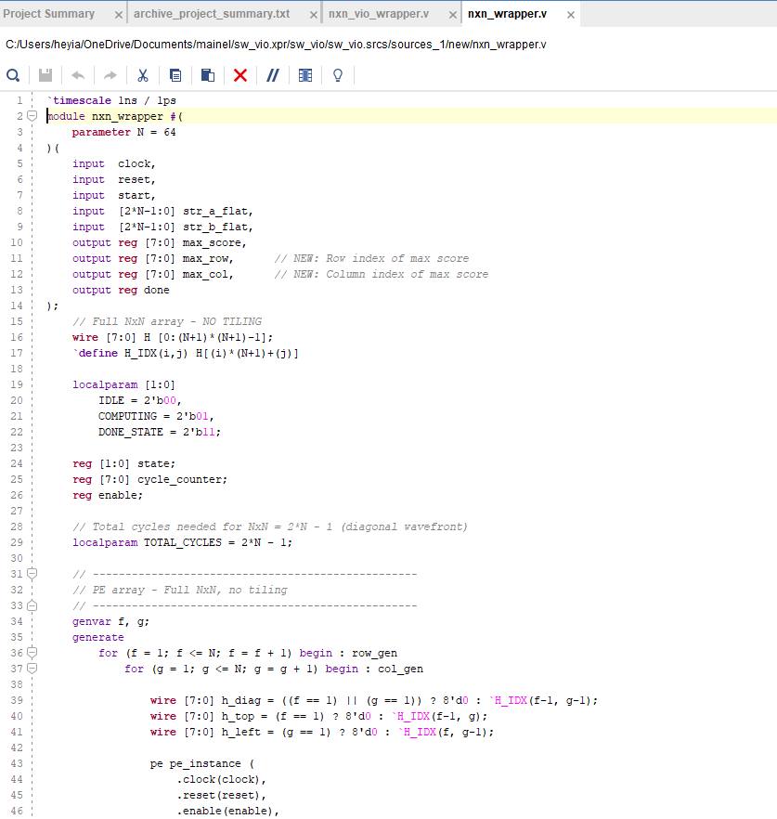
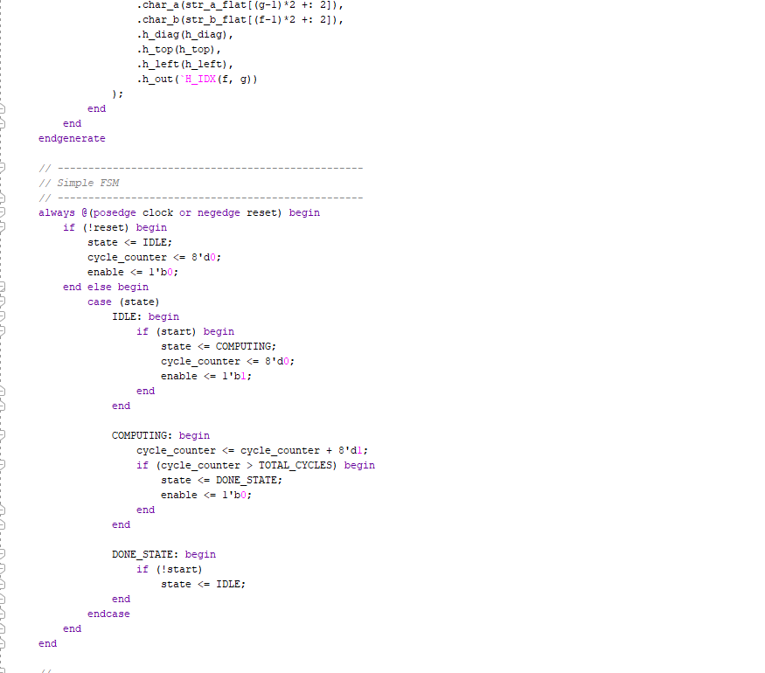
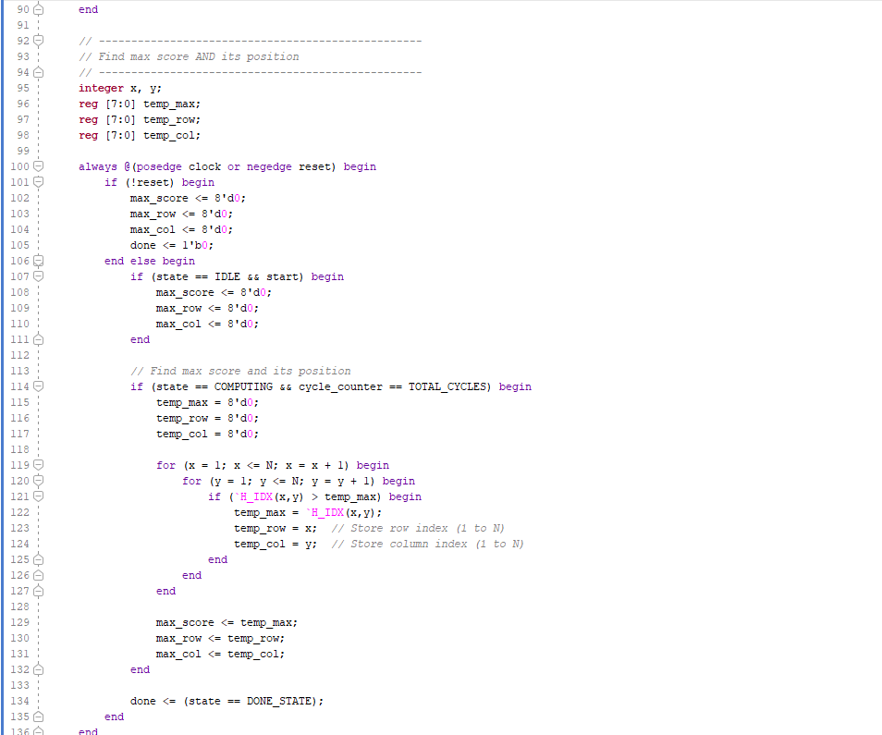
Results
Verilog Modules
NXN Wrapper
It is a FSM based Module
It instantiates the PE elements
It allows for passing of values between the PE elements
It also calculates max_score of all the PE elements as an output
*
Department of ECE
14

Slide 15
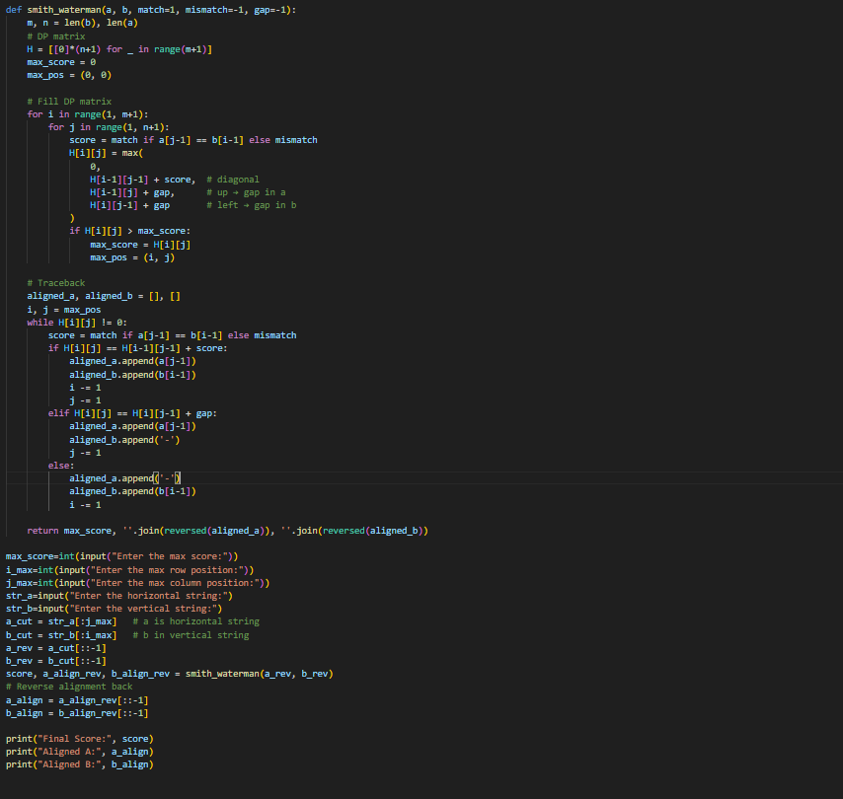
Results
2. Python Script
The Python script is the second part of the process
It takes in the max score from the Verilog code output
It uses it to perform traceback to give the locally aligned segments in the DNA strings.
*
Department of ECE
15

Slide 16
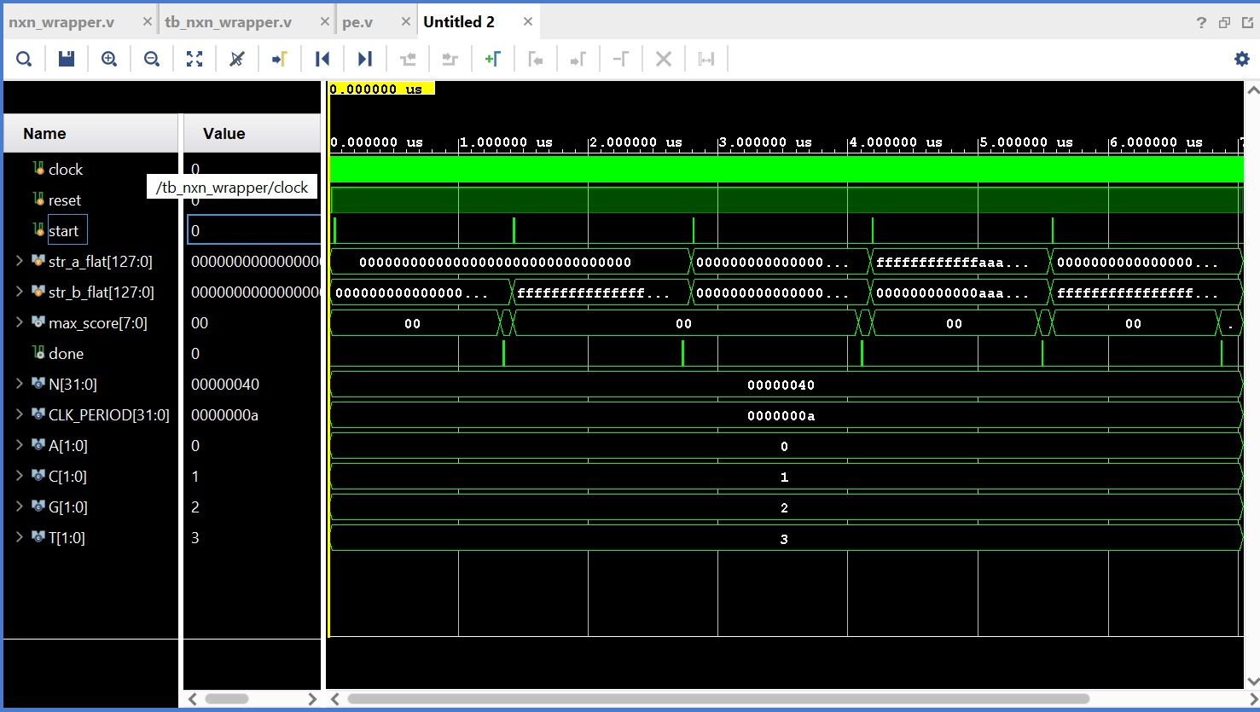
Results
Simulation in Vivado
*
Department of ECE
16

Slide 17
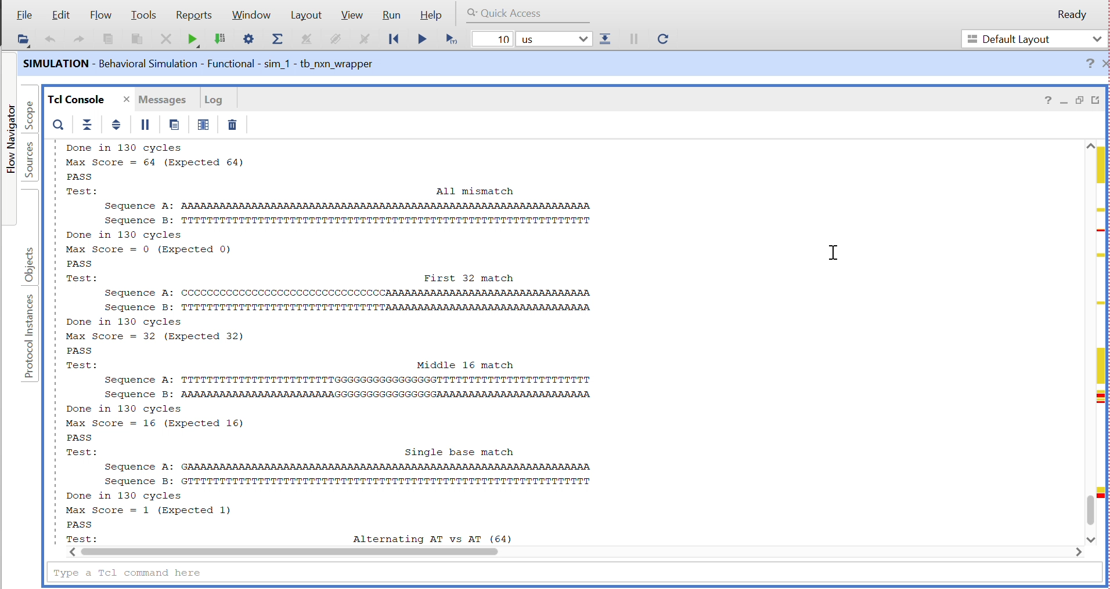
Results
Simulation in Vivado
*
Department of ECE
17

Slide 18
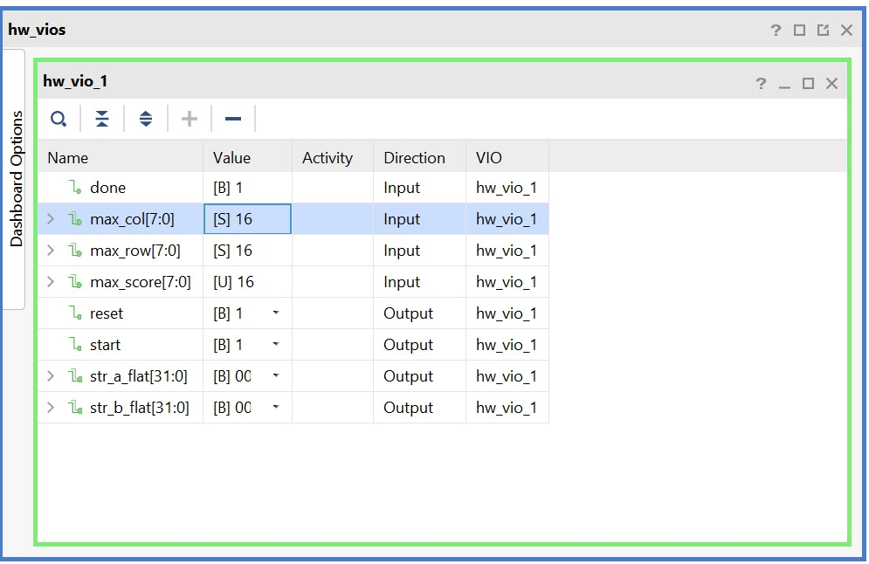
Results
CASE 1 : Input String (1) - AAAAAAAAAAAAAAAA
Input String (2) - AAAAAAAAAAAAAAAA
*
Department of ECE
18

Slide 19
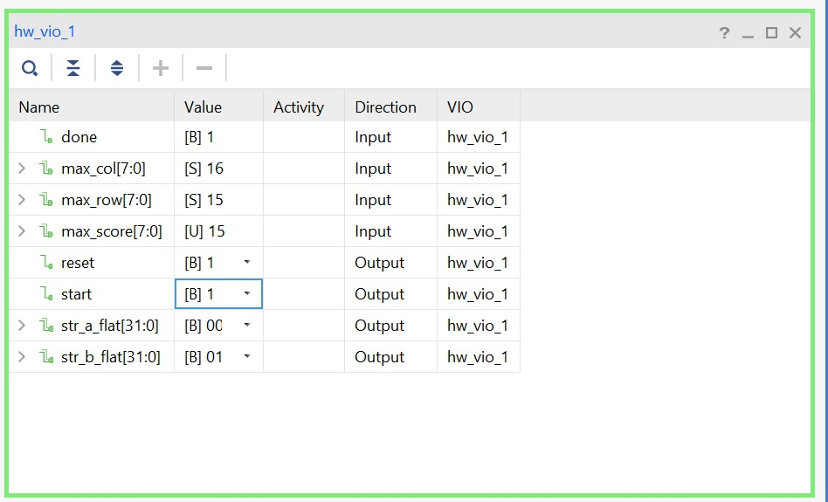
Results
CASE 2 : Input String (1) - ATATATATATATATAT
Input String (2) - TATATATATATATATA
*
Department of ECE
19

Slide 20
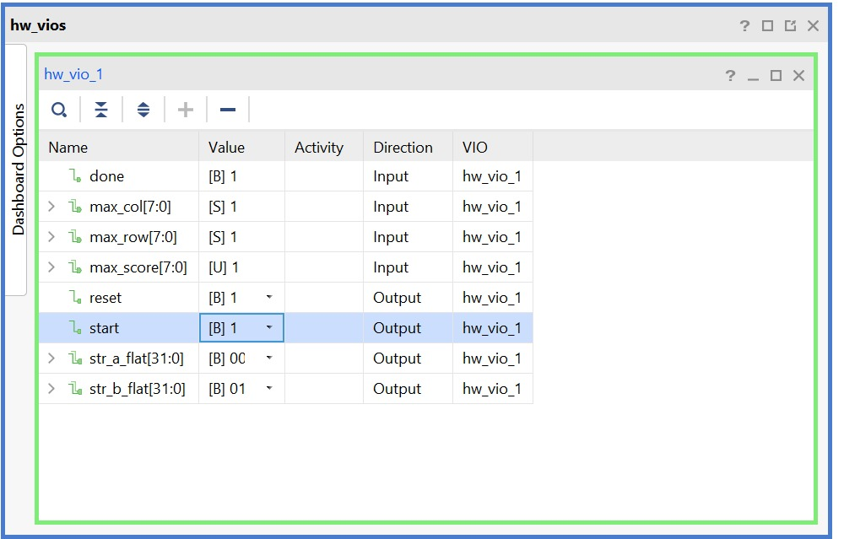
Results
CASE 3 : Input String (1) - ATGCTAGCTGACTGAC
Input String (2) - ACATGCTAGCATGCTA
*
Department of ECE
20

Slide 21

Results
*
Department of ECE
21

Slide 22
Conclusion
This project successfully implemented and tested a genome detection approach using sequence alignment on FPGA hardware
By leveraging FPGA acceleration and real-time debugging using VIO, the design achieved efficient and flexible validation of alignment behavior.
The results demonstrate the potential of hardware-accelerated solutions for handling the growing computational demands of genomic data processing.
*
Department of ECE
22

Slide 23
References
E. J. Houtgast, V. -M. Sima, K. Bertels and Z. Al-Ars, "An FPGA-based systolic array to accelerate the BWA-MEM genomic mapping algorithm," 2015 International Conference on Embedded Computer Systems: Architectures, Modeling, and Simulation (SAMOS), Samos, Greece, 2015, pp. 221-227, doi: 10.1109/SAMOS.2015.7363679.
Oliveira, F. F., Dias, L. A., & Fernandes, M. A. C. (2022). Proposal of Smith-Waterman algorithm on FPGA to accelerate the forward and backtracking steps. PloS one, 17(6), e0254736. https://doi.org/10.1371/journal.pone.0254736
M. Kalemati, A. D. Nayeri and S. Koohi, "Pip-SW: Pipeline Architectures for Accelerating Smith-Waterman Algorithm on FPGA Platforms," in IEEE Transactions on Emerging Topics in Computing, vol. 13, no. 3, pp. 628-639, July-Sept. 2025, doi: 10.1109/TETC.2024.3472649.
Ben Abdelhamid, R., Yamaguchi, Y. (2020). A Block-Based Systolic Array on an HBM2 FPGA for DNA Sequence Alignment. In: Rincón, F., Barba, J., So, H., Diniz, P., Caba, J. (eds) Applied Reconfigurable Computing. Architectures, Tools, and Applications. ARC 2020. Lecture Notes in Computer Science(), vol 12083. Springer, Cham. https://doi.org/10.1007/978-3-030-44534-8_23
Rucci, E., Garcia, C., Botella, G. et al. SWIFOLD: Smith-Waterman implementation on FPGA with OpenCL for long DNA sequences. BMC Syst Biol 12 (Suppl 5), 96 (2018). https://doi.org/10.1186/s12918-018-0614-6
Anderson, T., Wheeler, T.J. An FPGA-based hardware accelerator supporting sensitive sequence homology filtering with profile hidden Markov models. BMC Bioinformatics 25, 247 (2024). https://doi.org/10.1186/s12859-024-05879-3
L. Di Tucci, K. O'Brien, M. Blott and M. D. Santambrogio, "Architectural optimizations for high performance and energy efficient Smith-Waterman implementation on FPGAs using OpenCL," Design, Automation & Test in Europe Conference & Exhibition (DATE), 2017, Lausanne, Switzerland, 2017, pp. 716-721, doi: 10.23919/DATE.2017.7927082.
*
Department of ECE
23

Slide 24
Thank You
*
Department of ECE
24

