Slide 1
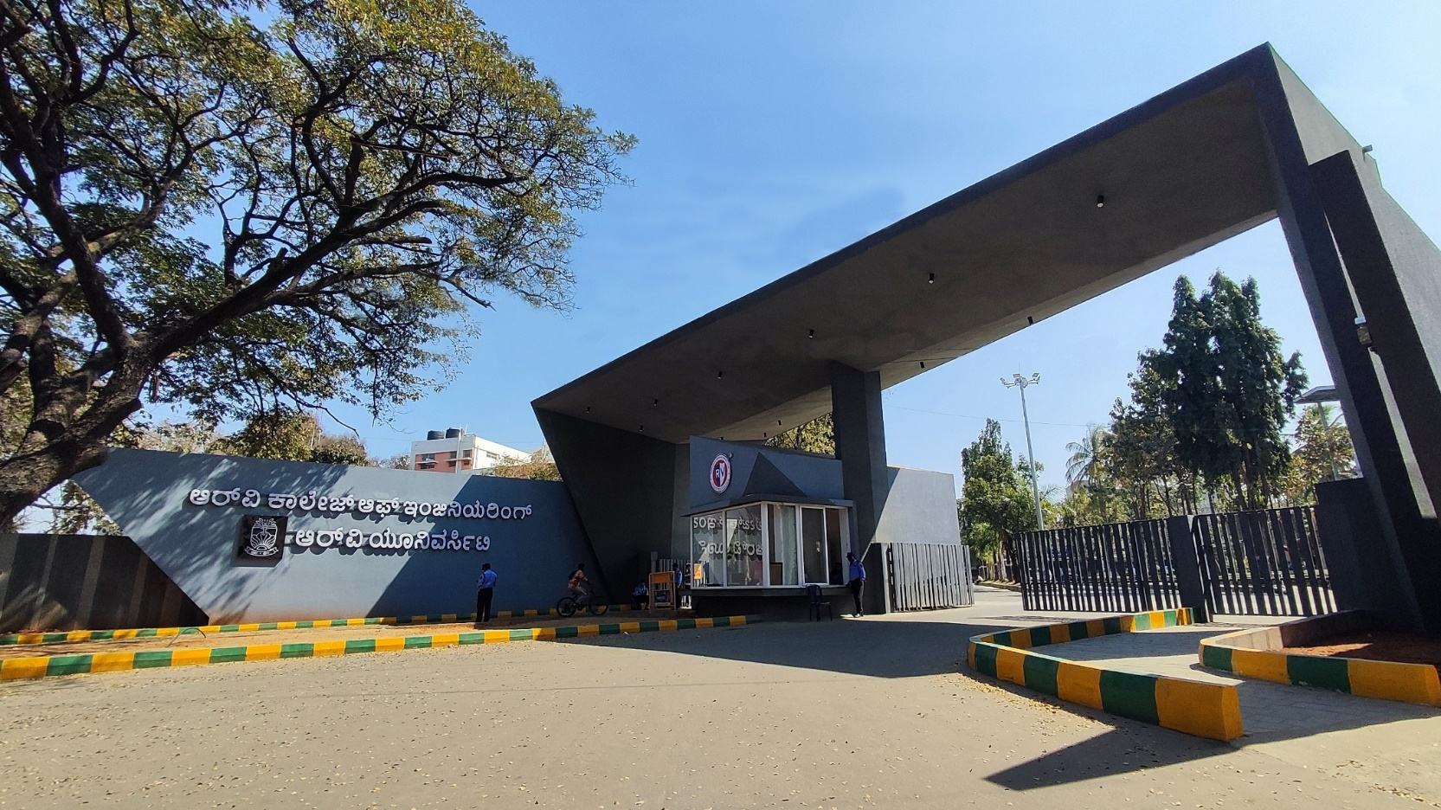
Lithium nanoparticle based Battery
Advanced Materials – Team 21

Slide 2





Asymmetric Hybrid Supercapacitor
Abhinav Mallela
Vaibhav M
Dr Sham Aan M P
Dakshraj Shetty
Manoj Gupta D B

Slide 3
EL Phase-II
Presentation Outline
Introduction
Project Overview
Comments during EL Phase-I and action taken.
Tools and Techniques Used
Project Progress
Analysis of Partial Results
Deliverables and Outcomes
Future work (Remaining tasks)
Conclusion

Slide 4
Introduction
Growing demand for efficient, sustainable, and portable energy solutions has made energy storage technologies crucial.
Batteries and supercapacitors are key technologies supporting electric vehicles, portable electronics, renewable energy systems, and grid stabilization.
Batteries offer high energy density and long-term storage capabilities.
Supercapacitors provide rapid charge/discharge cycles and high power density.
Together, they address the challenges of modern energy storage with complementary strengths.

Slide 5
Project Overview
Problem Statement:
Despite significant advancements in lithium-ion battery technology, traditional electrode materials face limitations in energy density, charging speed, cycle life, and safety. Using Lithium based nanomaterials can help enhance charge storage due to the high surface area and improved conductivity.

Slide 6
Project Overview
Primary objectives:
• To synthesize Li2ZnSiO4 using solution combustion method
• To synthesize electrodes of the prepared nanomaterial using Toray carbon sheets
• To perform electrochemical testing on the prepared electrodes
• To prepare a solid-state electrolyte by synthesizing Li2Al2Si3O10
• To manufacture coin cell
Secondary Objectives :
• Conduct research on possible applications of the coin cell.
• Publish a research paper that includes all the relevant findings from this project.

Slide 7
Project Overview
Potential Impacts:
The development of lithium based nanomaterial electrodes with solid state electrolytes could greatly advance battery technology by enabling safer, longer lasting and higher capacity energy storage, impacting day to day applications such as
EV’s
portable electronics
grid storage systems

Slide 8
Comments during EL Phase-I and action taken
Comments:
More independent research rather than overly relying on professors help
Actions Taken:
A more independent approach was taken while tackling the objectives, such as:
XRD plotting was done by ourselves
Entire calculation and the solution combustion method was done independently by applying prior experience
Conducted research on potential tests that can be done

Slide 9
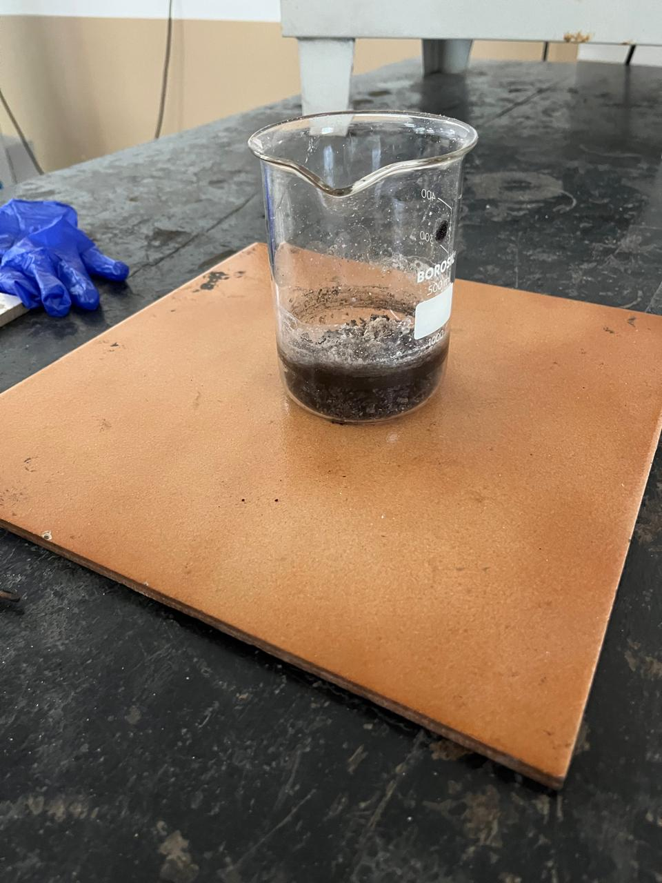
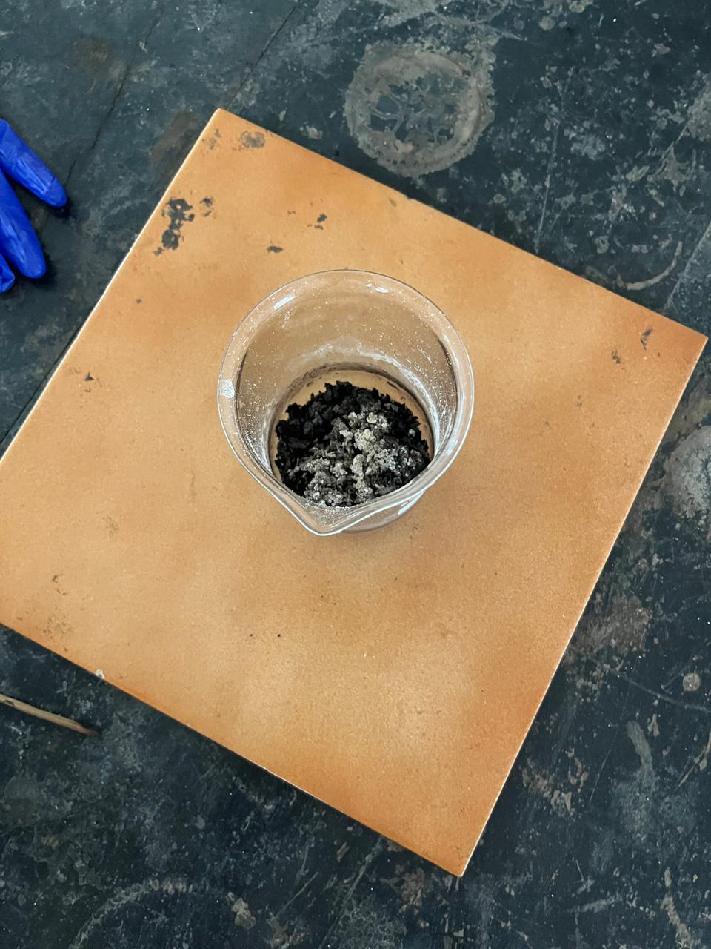
Tools and Techniques Used
For the synthesis of the solid state electrolyte (Li2Al2Si3O10):
Lithium Nitrate
Aluminium Nitrate
Silicic Acid
Ascorbic Acid
Technique used for synthesis : Solution Combustion Method.
For calcination:
Tubular furnace was used

Slide 10
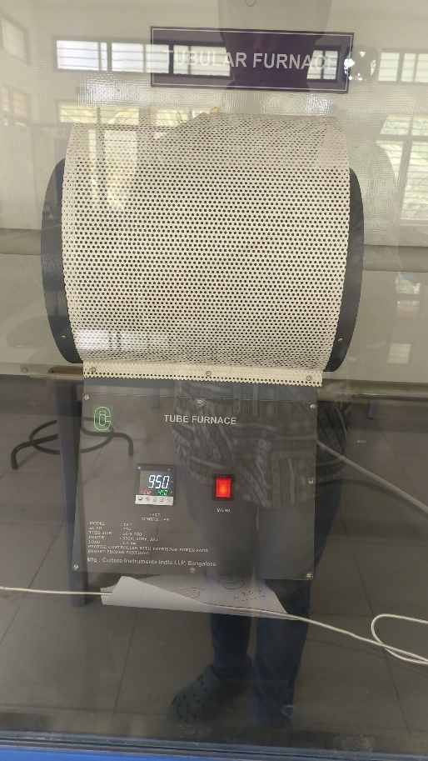
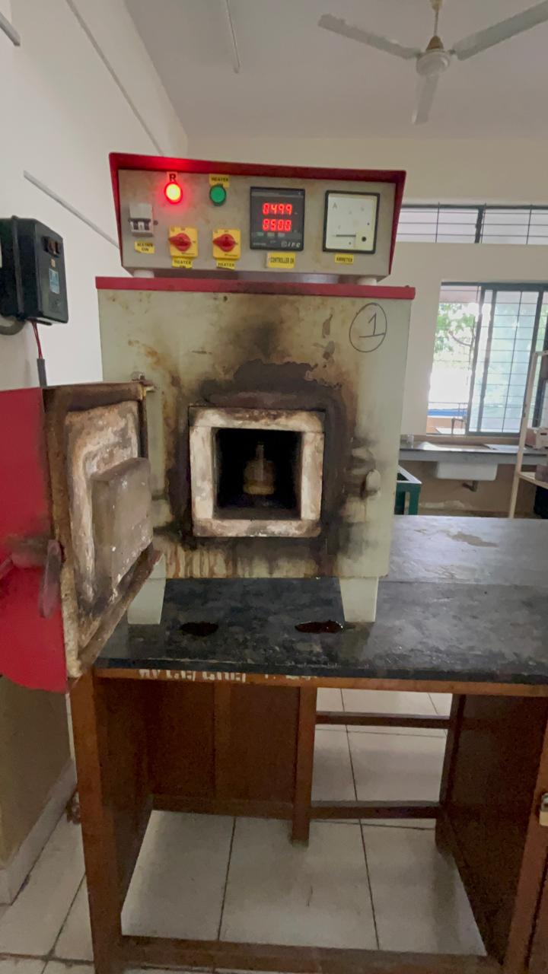
Tools and Techniques Used
Rationale:
We employed solution combustion method as:
it provides highly porous nanomaterials
Rapid reaction
minimal energy expenditure
Low cost
We employed calcination to:
Increase crystallinity of the compound
Remove impurities
Increase number of dopant sites

Slide 11
Project Progress
Current status:
The stoichiometric calculations were done
Solid State Electrolyte was synthesized
XRD was plotted
Calcination was performed
XRD of calcinated compound was plotted
Peak matching was performed
Miller indices of the peaks were obtained

Slide 12
Project Progress
Milestones:
XRD peaks were found to match 2 compounds
LiAlSiO4
LiAlSi2O6
Calcination provided increase in narrowness of peaks indicating increase in crystallinity

Slide 13
Project Progress
Challenged Faces:
The synthesized compound was found to have impurities and slight phase difference was observed in the XRD

Slide 14
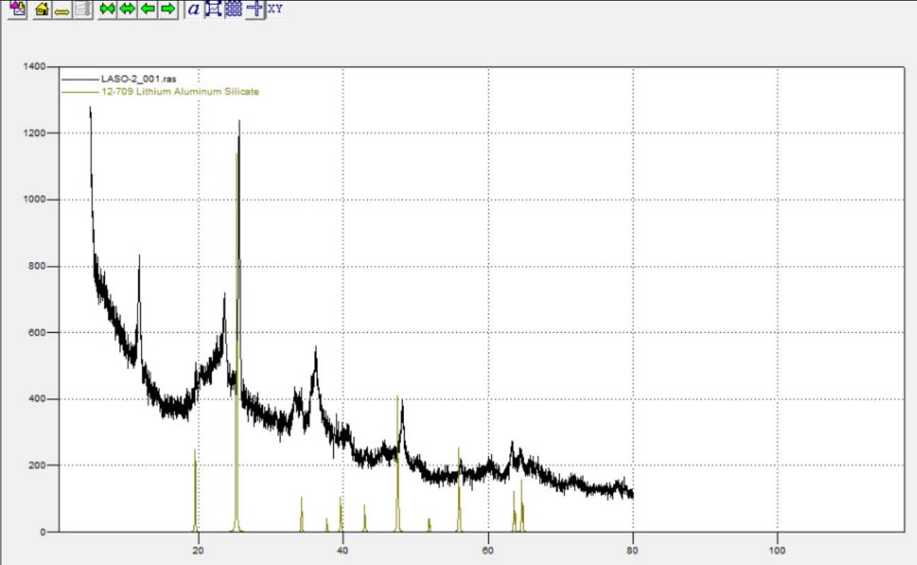
Project Progress
LiAlSiO4 LiAlSi2O6
LiAlSiO4

Slide 15
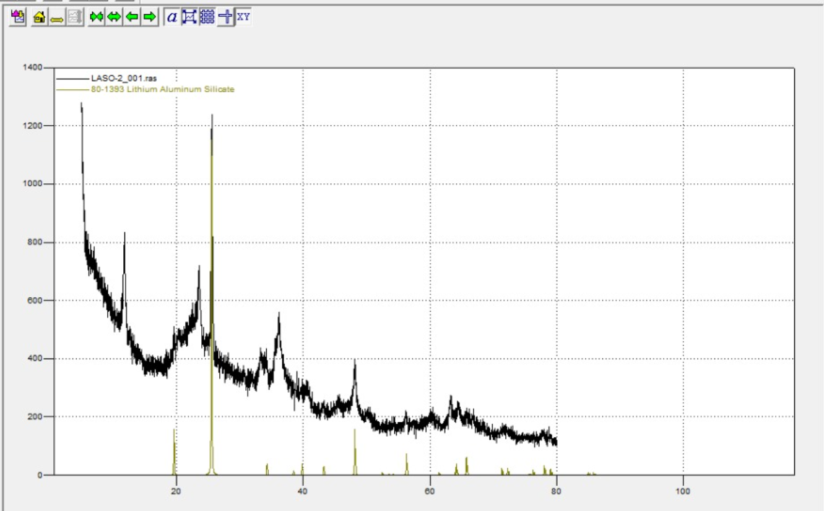
Project Progress
LiAlSiO4 LiAlSi2O6
LiAlSi2O6
LiAlSi2O6

Slide 16
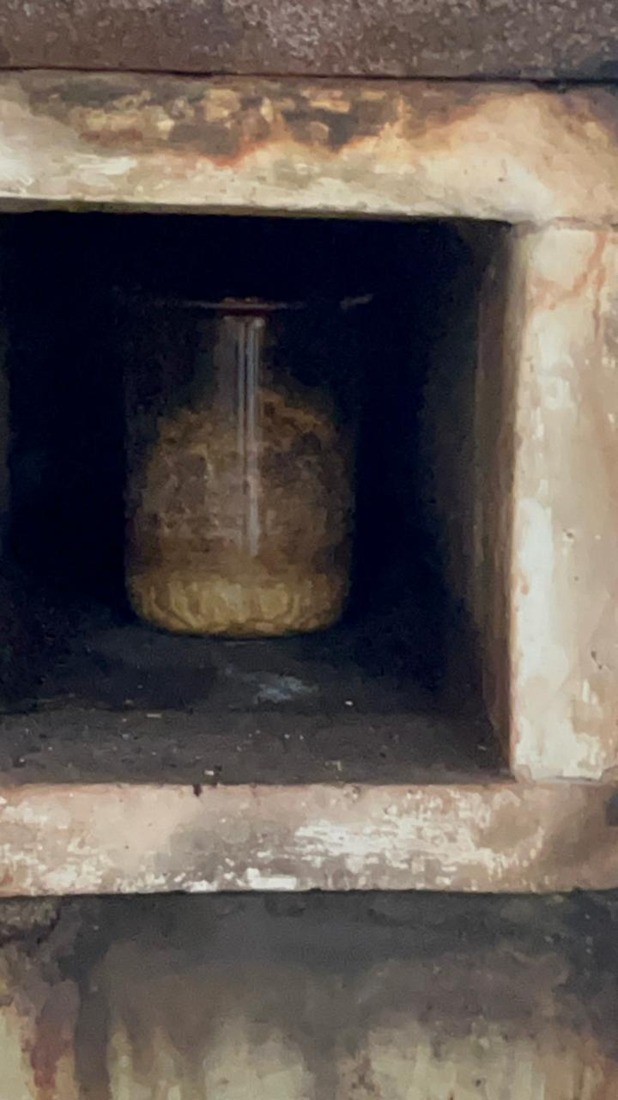
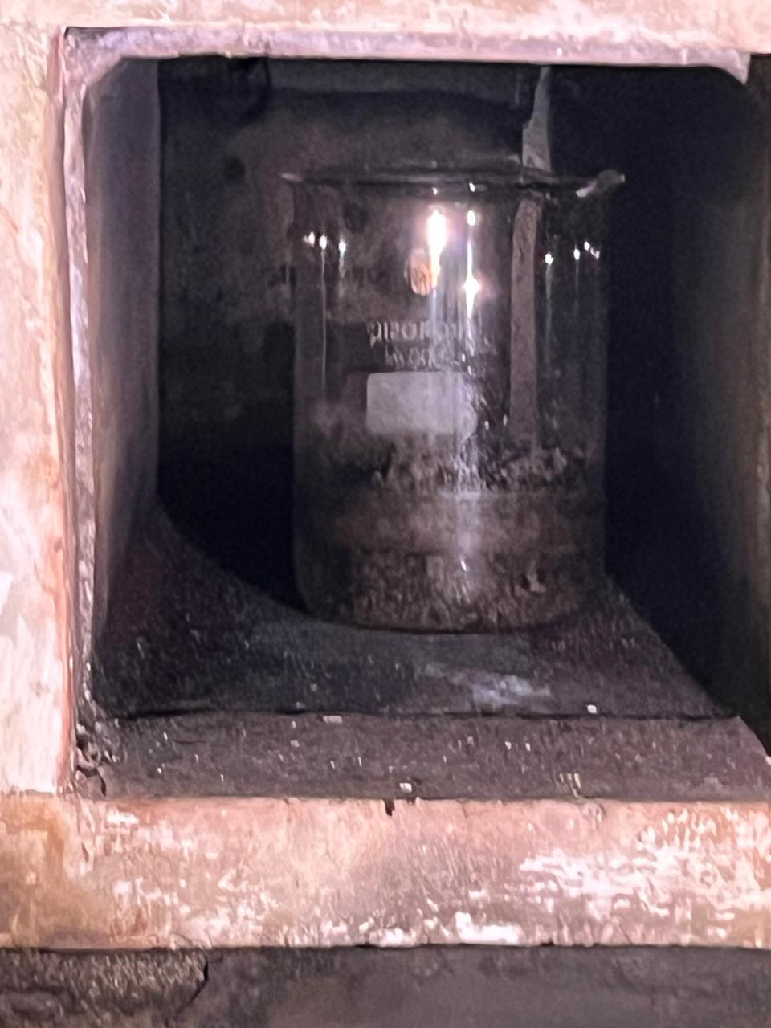
Analysis of Partial Results

Slide 17
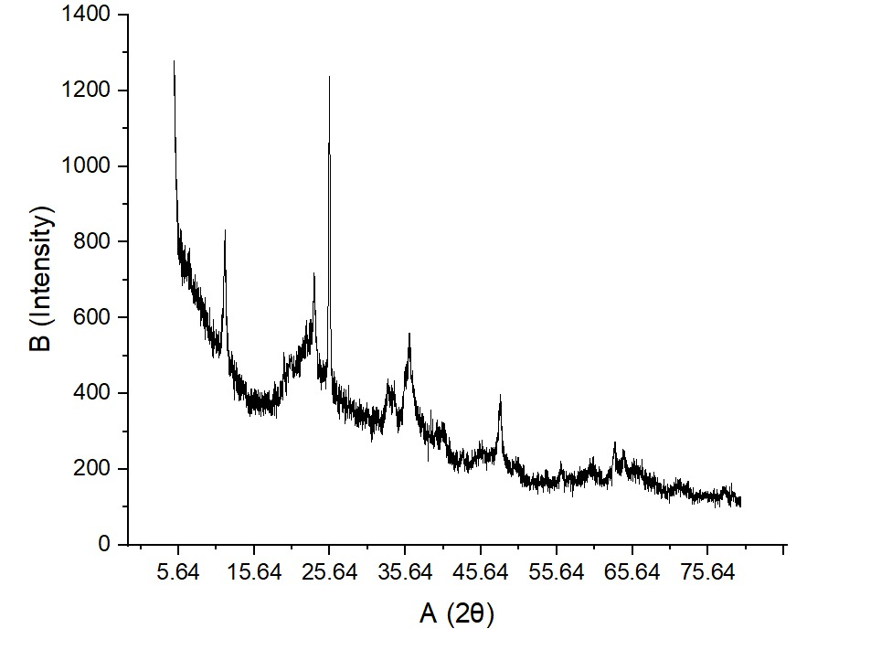
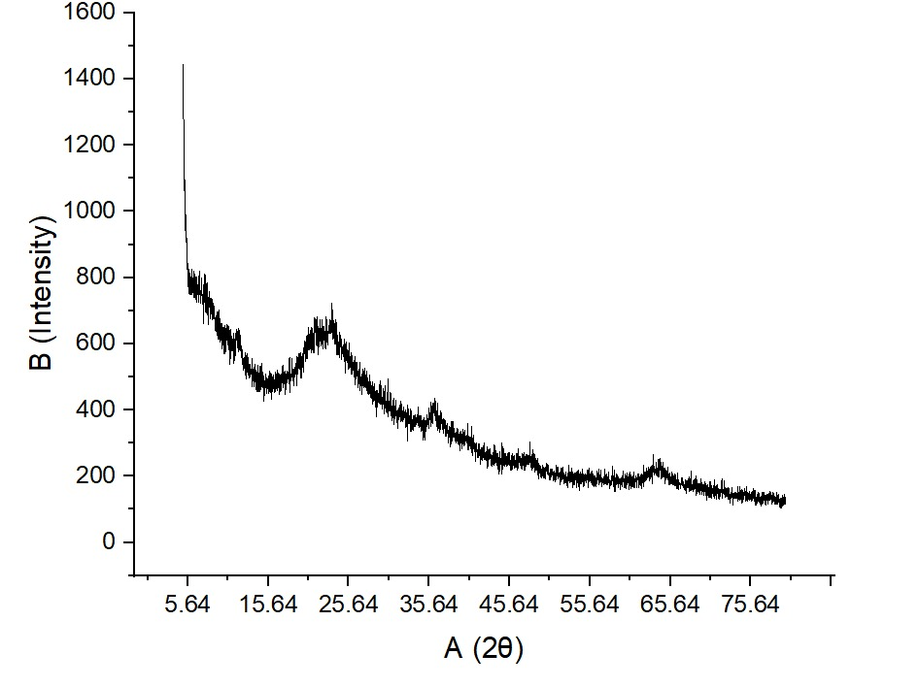
Analysis of Partial Results
Before Calcination
After Calcination

Slide 18
Deliverables and Outcomes

Slide 19
Future Work (Remaining Tasks)
To increase the purity of compound we need to heat the compound a little more
Obtain XRD of the compound
Perform Testing:
Cyclic Voltammetry
Chronopotentiometry
Electrochemical Impedance Spectroscopy
Thermogravimetric Analysis
Assembly of coin cell

Slide 20
Conclusion
Summarize the progress made in Phase-II and its alignment with the project’s overall objectives.
Reflect on the impact of the current work and how it sets the stage for Phase-III.
Acknowledge contributions, support, or any collaborative efforts involved in the project.
Mention any final takeaways or insights gained from the phase.

Slide 21


