Slide 1

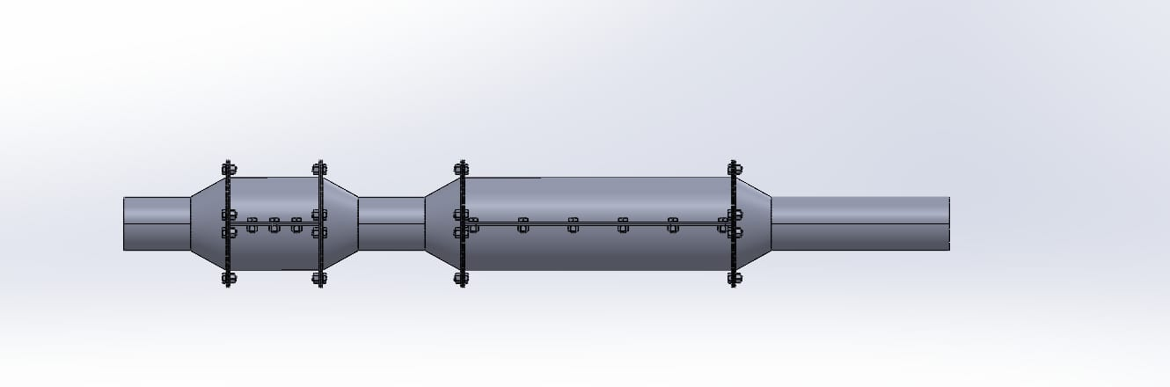
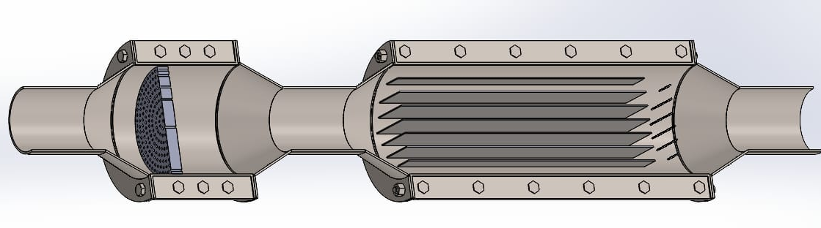
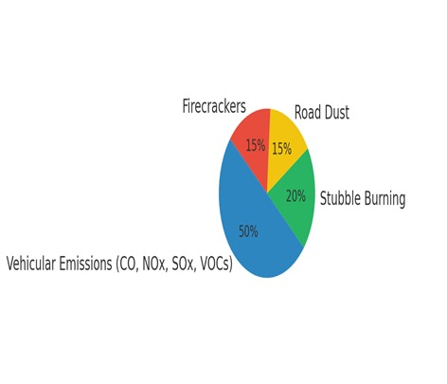
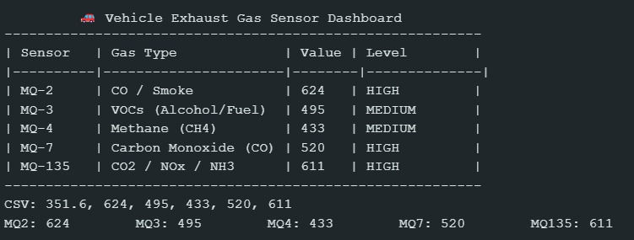
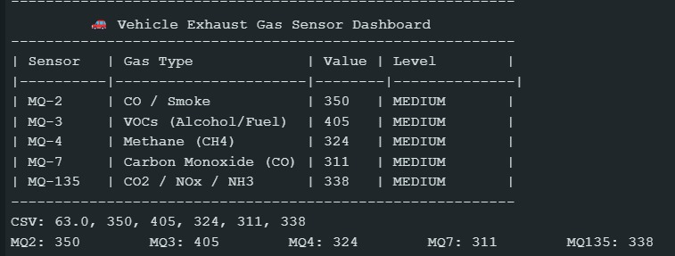
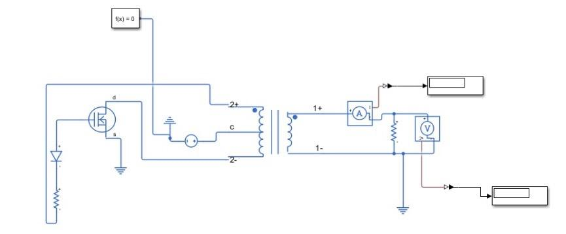
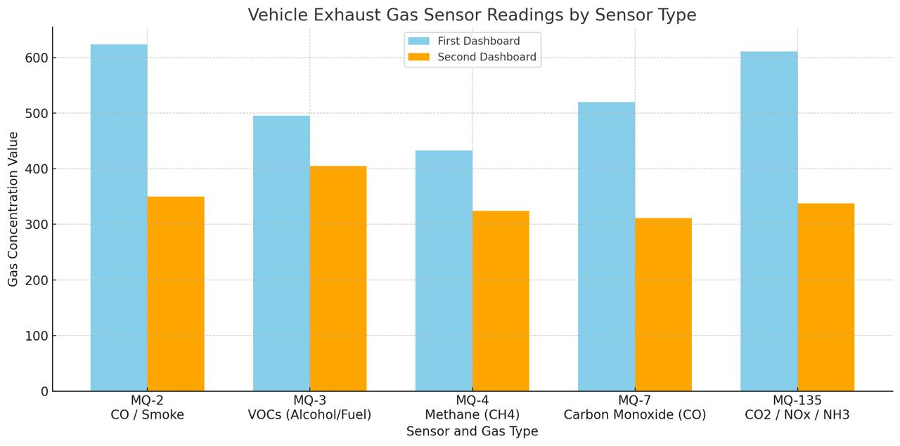
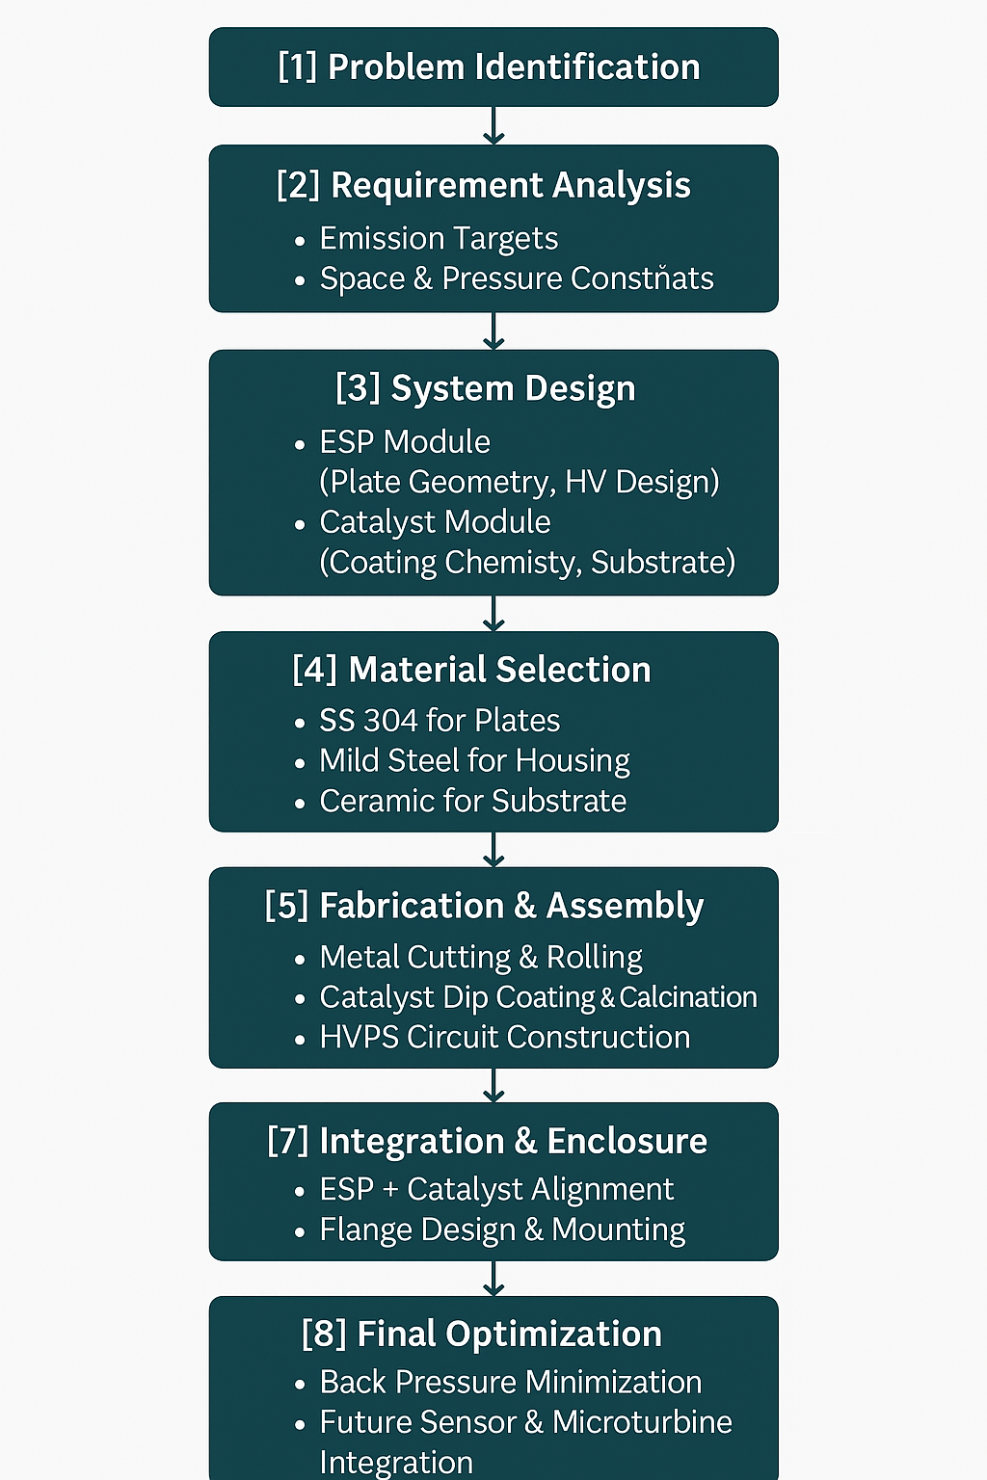
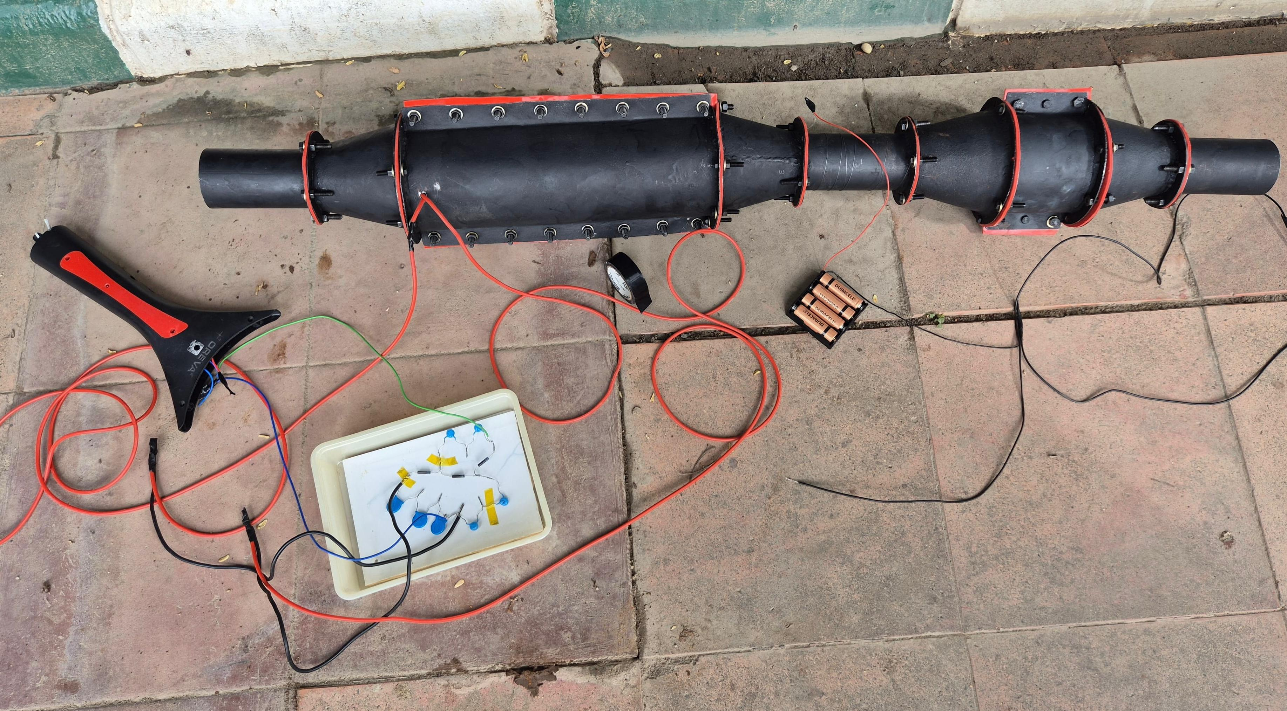


RV College of Engineering, Bengaluru – 560059.
Go, change the world
Title: Multi-Stage Exhaust Gas Purification System for Automobiles
Tharun N | Vignesh Hariharan | Devisri Harshini Baramal | Adithya M Yargal | Varsha V
1RV24CV059 | 1RV24CS317 | 1RV24IS032 | 1RV24AS005 | 1RV24CH039
Theme: Environment
gdg
Introduction
Tools used
Vehicular emissions are a major source of urban pollution. This project presents a modular exhaust purification system using ESP and a catalyst-coated honeycomb filter to reduce PM, CO, NOₓ, and other harmful gases without affecting engine performance.
Design & Simulation-CAD Software – for system layout and flow modelling
Fabrication & Assembly
Angle Grinder – cutting stainless/mild steel plates
Manual Rolling Machine & Bench Vice – forming cylindrical housings
Welding Tools – structural assembly
Laser Cutter – precision flange fabrication
Catalyst Coating & Activation
Ceramic Honeycomb Substrate – base for catalytic conversion
Dip Coating Setup – applying Cu(NO₃)₂·3H₂O + TiO₂ slurry
Oven (100 °C) – pre-heating substrate
Muffle Furnace (400 °C) – calcination to activate Cuco
High-Voltage System
Flyback Transformer, Capacitors & Diodes – voltage multiplier circuit
High-Value Resistors (50–470 MΩ) – current limiting & discharge
Problem Definition
Existing exhaust systems are inefficient under cold starts and aging. This leads to emissions of PM, CO, NOₓ, SOₓ, and VOCs—damaging air quality and public health
Results and Discussions
Objectives
Before
After
Integrate ESP + Catalyst in a compact unit Reduce >80% of CO, NOₓ, SOₓ, Foremove low back pressure Enable future microturbine integration
Methodology
Conclusions
A vehicle exhaust purification prototype was developed using an Electrostatic Precipitator (ESP), catalytic honeycomb filter. The system successfully demonstrates the removal of CO, CH₄, VOCs, and NOx from exhaust emissions.
Multiple MQ gas sensors were used to monitor pollutant levels and track purification effectiveness. Addressed cold-start pollution using a preheating approach with Nichrome wire.
References
https://www.irjet.net/archives/V6/i5/IRJET-V6I51108.pdf
https://pmc.ncbi.nlm.nih.gov/articles/PMC4243514/
https://doi.org/10.3390/molecules25246041
https://youtu.be/-hzhDPWyMcs?si=qSqPwCUL1PlTfeet
QR Code of the Demonstration Video
Demonstration Video
Project Folder

