Slide 1

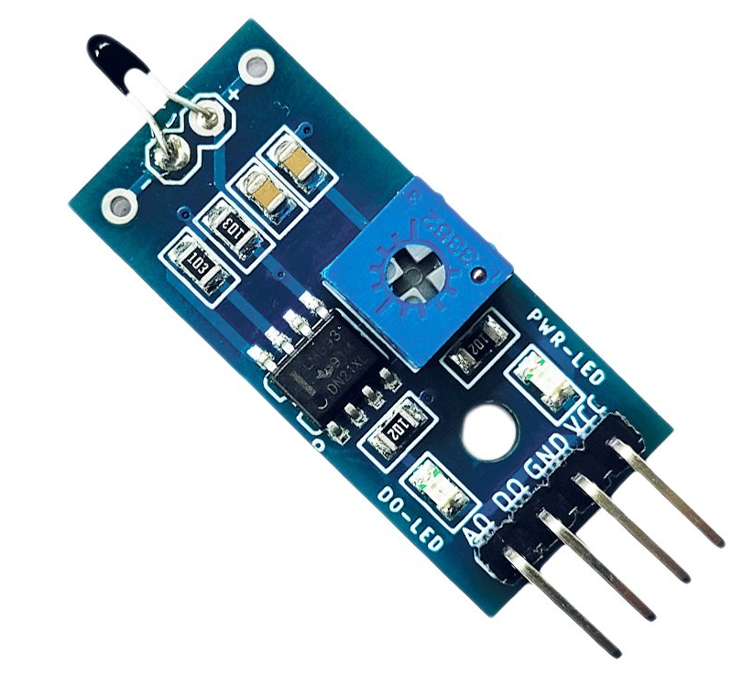
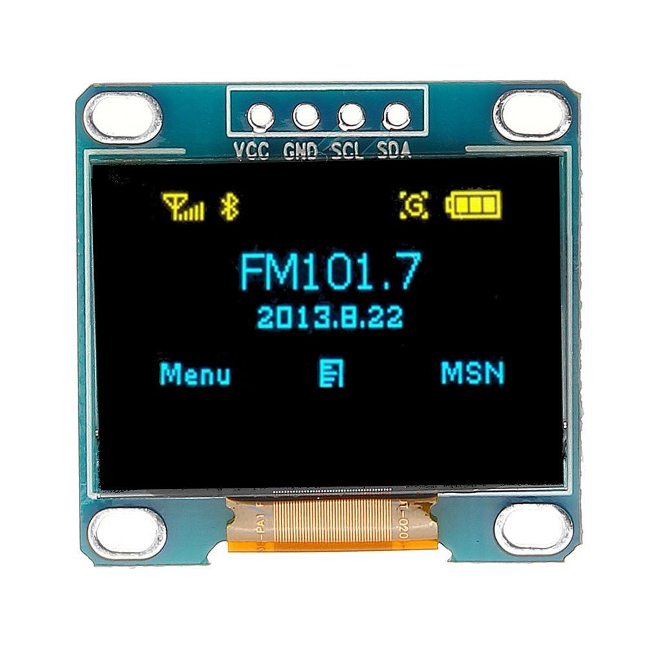
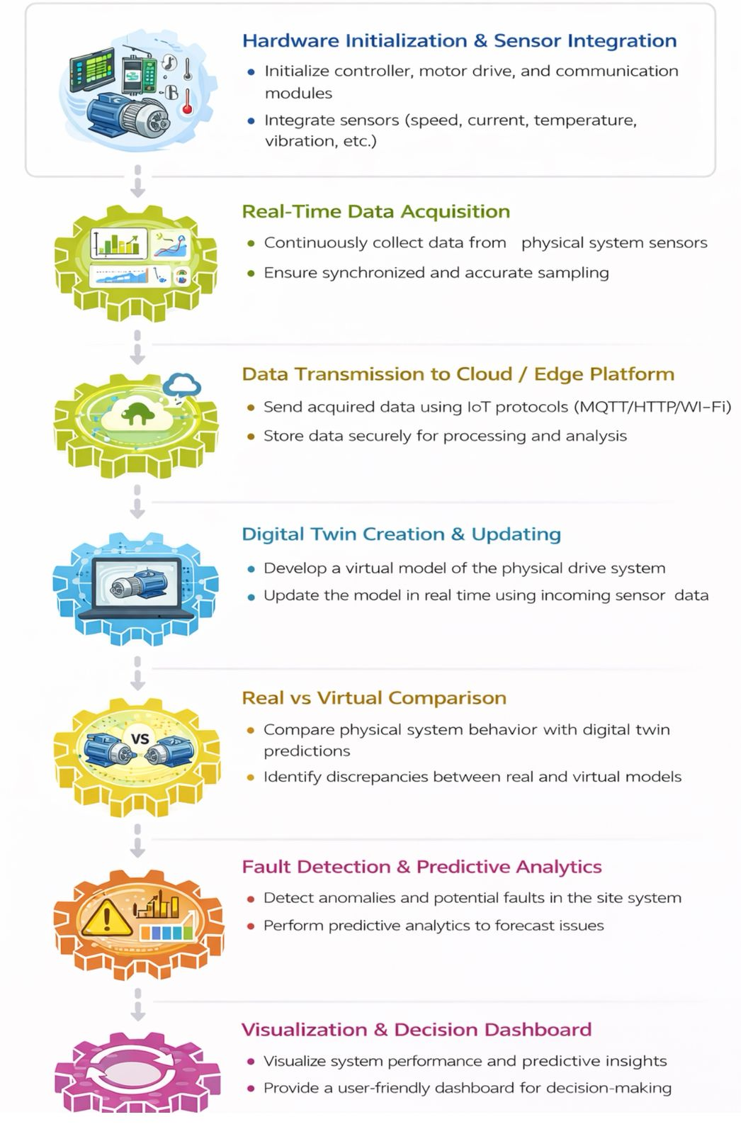

.
RV College of Engineering, Bengaluru – 560059.
Go, change the world
Title: Twindrive- A Digital Replica for Motor Insights and Analytics
M. VAIBHAV | DAKSHRAJ SHETTY| MEHUL SINGHANIA | MOHAMMAD ASIF
1RV24EC108 | 1RV24EC059 | 1RV24EC120 | 1RV24EC123
Theme: ELECTRIC VEHICLE TECHNOLOGY
V
Introduction
Tools used
TwinDrive is a digital twin for BLDC motors that uses real-time sensors to monitor temperature and vibration, enabling performance tracking and fault detection through a simple dashboard without opening the motor.
Motor failures such as overheating cause nearly 70% of industrial breakdowns, resulting in high costs and safety risks.
TwinDrive supports Industry 4.0 by using predictive maintenance to detect issues early, improving safety, reliability, and energy efficiency.
Hardware:
ESP32
BLDC Motor
Temperature sensor
Vibration sensor
Current and voltage sensors
OLed Display
Servo Master
Software
Firebase
Arduino IDE
We built a working digital dashboard of the motor that can show live parameters like speed, vibration, and temperature in a clear, understandable way.
The system is able to spot unusual patterns early (for example, rising vibration or sudden load changes) and highlight them before they become faults.
Overall, the project gives a dependable visualization and analytics layer that makes the motor’s behavior easy to interpret in real time.
The project showed that a Digital Twin can effectively monitor an electric motor using real-time sensor data, enabling accurate comparison with virtual simulations.
This improves fault detection and predictive maintenance.
Improved accuracy and speed of fault detection using live sensor data
Reduced dependency on manual inspection and reactive troubleshooting.
Problem Definition
Motors face hidden issues like torque imbalance, thermal hotspots, vibration faults, and efficiency loss.
Existing monitoring systems provide only basic diagnostics and miss early-stage faults.
There is no real-time digital model that mirrors the motor’s actual behavior for deeper analysis.
The core problem: absence of a high-fidelity digital twin that continuously predicts faults and provides motor performance insights
Results and Discussions
Objectives
[To collect and stream motor sensor data (speed, vibration, temperature, current) into a digital model.
To visualize live motor behavior through a clear analytics dashboards.
To detect anomalies and predict potential faults using trend analysis or basic ML logic.
Methodology
Conclusions
Xiaohui Gu, Wei Duan, Guoan Zhang – “Digital Twin Technology for Intelligent Vehicles and Transportation Systems” IEEE Transactions on Intelligent Transportation Systems Volume 26, Issue 4, April 2025, Pages 4240–4259.
Farzaneh Naseri, Amir Yadollahi Goharrizi, Mohammad Shirazi – “Digital twin of electric vehicle battery systems: Comprehensive review of the use cases, requirements, and platforms” Renewable and Sustainable Energy Reviews Volume 179, February 2023, Article 132801.
Sunil Sharma Verma – “A systematic review of digital twins for electric vehicles” Journal of Traffic and Transportation Engineering (English Edition) Volume 11, Issue 5, October 2024, Pages 815–834.
References
Working Demonstration

