Slide 1

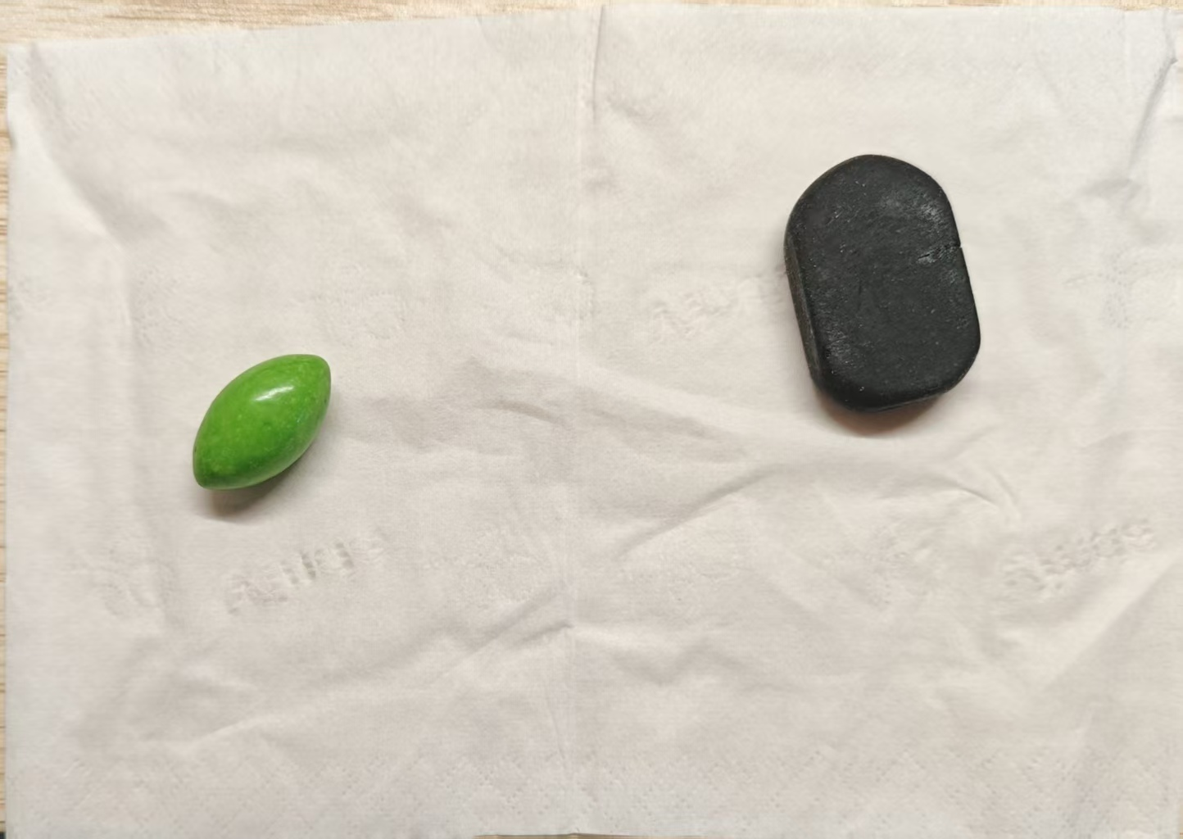
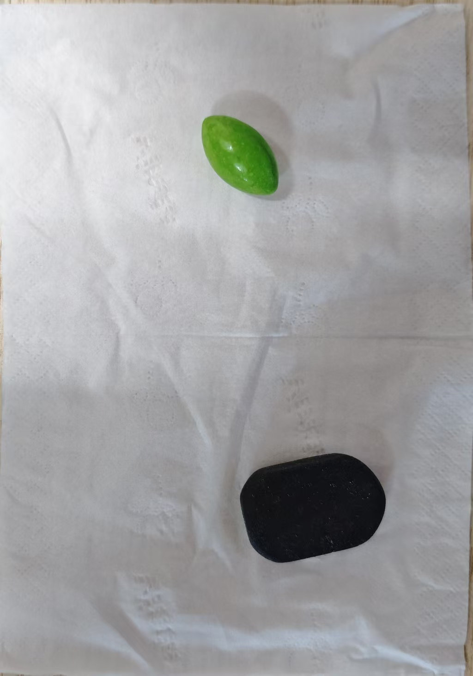
TRACK 1
From colour thresholds
to instance segmentation
A simple object-pose estimation experiment
RGB / HSV thresholding vs YOLOv8n-seg instance segmentation
Two shots of the same scene:
light.jpg (top, bright light) / dark.jpg (bottom left, dim light)
Assets: 2 raw photos · 6 result images · 3 scripts

Slide 2
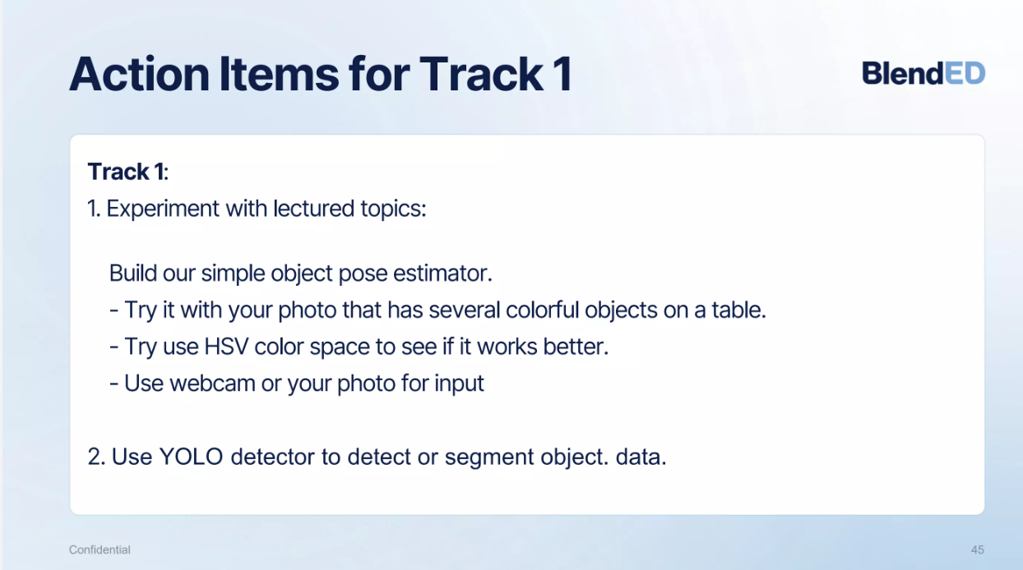
TASK 1 · BRIEF AND WHAT I DID
What the brief asked for, and what I actually did
①
Photo input
White tissue + green jelly bean + black rounded block, shot on a phone as dark.jpg / light.jpg
②
Simple pose estimator
Colour threshold → morphology → contours → min-area rectangle; outputs centre and angle
③
Retry with HSV
The same pipeline with only the colour space changed, compared image by image under both lighting conditions
④
YOLO detection / segmentation
YOLOv8n-seg pretrained weights, conf = 0.5, outputting boxes + pixel masks
Course task page (Track 1 · Action Items)
Bottom line: HSV averages 0.79 IoU against 0.36 for RGB in this scene (one threshold set covers both lighting conditions); YOLO works out of the box, but its classes do not match, so the bright photo gives zero detections at conf = 0.5.
Track 1 Report
02

Slide 3
OVERVIEW · THE EXPERIMENTS AT A GLANCE
Three methods, one shared pipeline
Input
METHOD A / B
METHOD C
Phone photos
Pose estimation by colour
YOLOv8n-seg
Two objects on a white tissue
dark.jpg 1024×1460 (dim)
light.jpg 1444×1024 (bright)
BGR or HSV channel thresholds
Open / close to denoise and fill
Outer contours → minAreaRect
Pretrained on 80 COCO classes
conf = 0.5, box + mask
Semi-transparent mask overlay
Post-processing pipeline shared by all three methods
Photo input
→
Threshold → mask
→
Open / close
→
Contours + area
→
Centre (u, v) + angle θ
"Pose" here means: planar pose = object centre (u, v) + heading θ from minAreaRect (or PCA, once a gripper is drawn — slide 12); it is not a 6D pose and carries no depth.
Assets 2 inputs → 2 RGB → 2 HSV → 2 YOLO; 3 scripts: task1_rgb.py / task1_hsv.py / task2_yolo.py
Track 1 Report
03

Slide 4
DATASET · EXPERIMENTAL SET-UP
Two objects, two lighting conditions
dark.jpg · dim indoor light
light.jpg · bright light
Target · Green jelly bean (vivid colour) and a black eraser (dark, low contrast) — exactly the easiest and the hardest case for thresholding.
Background · White tissue with creases and shadows; highlights on the paper and object shadows both leak into the threshold mask.
Capture · The same scene was shot twice (dim, bright); camera position and orientation differ, so comparisons stay within each image.
Track 1 Report
04

Slide 5
METHOD A · RGB THRESHOLDS
Thresholding directly on the three BGR channels
Processing steps
1
Define BGR bounds per colour
Two hard-coded triples per colour
task1_rgb.py
BGR_RANGES = {
"red": [(0, 0, 120), (80, 80, 255)],
"green": [(0, 120, 0), (80, 255, 80)],
"black": [(0, 0, 0), (60, 60, 60)],
}
mask = cv2.inRange(frame, np.array(lower), np.array(upper))
mask = cv2.morphologyEx(mask, cv2.MORPH_OPEN, kernel)
mask = cv2.morphologyEx(mask, cv2.MORPH_CLOSE, kernel)
cnts, _ = cv2.findContours(mask, cv2.RETR_EXTERNAL, ...)
if cv2.contourArea(cnt) < 300: continue
rect = cv2.minAreaRect(cnt) # (centre, (w, h), angle)
2
cv2.inRange builds the mask
All three channels must fall inside
3
5×5 opening + closing
Removes specks, fills small holes
4
Outer contours + area filter
Anything under 300 px is dropped
5
minAreaRect gives the pose
Centre, size, angle → draw the box
Problem
B, G and R all carry brightness: change the light and all three drift, so the bounds go stale.
Track 1 Report
05

Slide 6
METHOD B · HSV THRESHOLDS
Only the colour space changes; the rest is identical
Why it might work better
H is hue, S is saturation, V is brightness.
Lighting mostly moves V while H hardly moves — “colour” and “brightness” are decoupled.
task1_hsv.py
hsv = cv2.cvtColor(frame, cv2.COLOR_BGR2HSV) # the only extra line
COLOR_RANGES = {
"green": [(40, 40, 40), (70, 255, 255)],
"black": [(0, 0, 0), (180, 255, 70)],
"red": [(0, 120, 70), (10, 255, 255)],
}
mask = cv2.inRange(hsv, np.array(lower), np.array(upper))
rect = cv2.minAreaRect(cnt) # post-processing identical to the RGB version
Measured: mean hue of the green target
dark.jpg (dim)
47.4 / 180
light.jpg (bright)
45.7 / 180
The two shots differ by only 1.7° (≈1%) — no retuning needed.
One extra cvtColor line; morphology, contours and minAreaRect are reused as-is.
But the black target fails: V ≤ 70 alone pulls the cast shadow and dark background into the object.
Track 1 Report
06

Slide 7
METHOD C · YOLOv8n-seg
From "slice by colour" to "recognise the object"
What this pipeline does
Zero-shot, pretrained
COCO 80-class weights; no training, no colour calibration
task2_yolo.py
model = YOLO("yolov8n-seg.pt")
results = model(img, conf=0.5)[0]
masks = results.masks.data.cpu().numpy() # 640×640 letterbox
for idx, box in enumerate(results.boxes):
mask = cv2.resize(masks[idx], (img.shape[1], img.shape[0]))
color_mask[mask_bin == 1] = [0, 255, 0]
res_img = cv2.addWeighted(res_img, 1, color_mask, 0.5, 0)
cv2.putText(res_img, f"{cls_name} {conf:.2f}", ...)
One pass, two outputs
Boxes (class + confidence) and instance masks
Post-processing
Resize mask → semi-transparent overlay → box and label
Threshold
conf = 0.5; anything below simply disappears
Upside · No per-colour thresholds; a new object or new lighting needs no code change.
Cost · Classes are locked to COCO's 80, and this scene's objects are not among them.
Track 1 Report
07

Slide 8
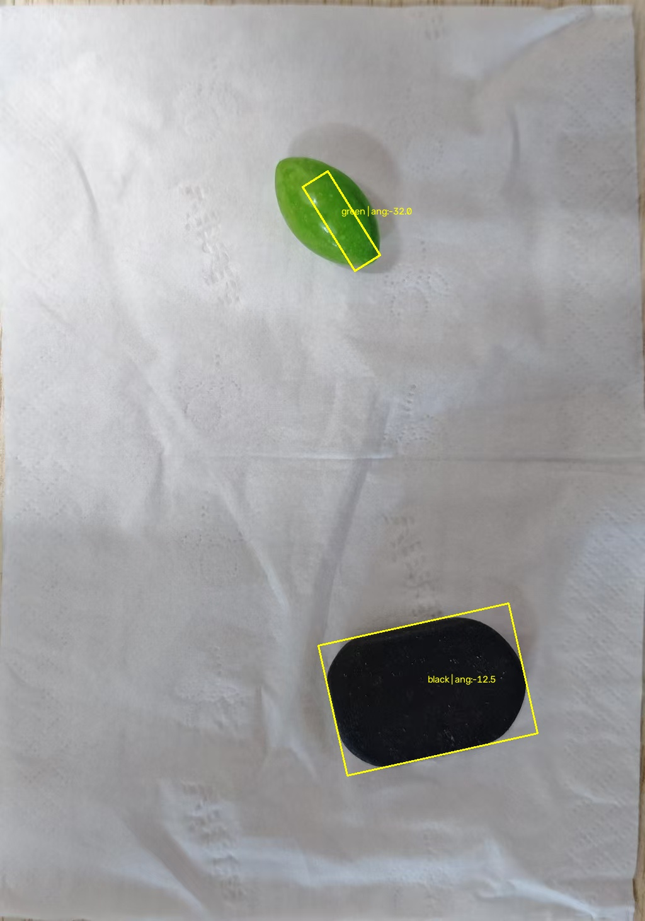
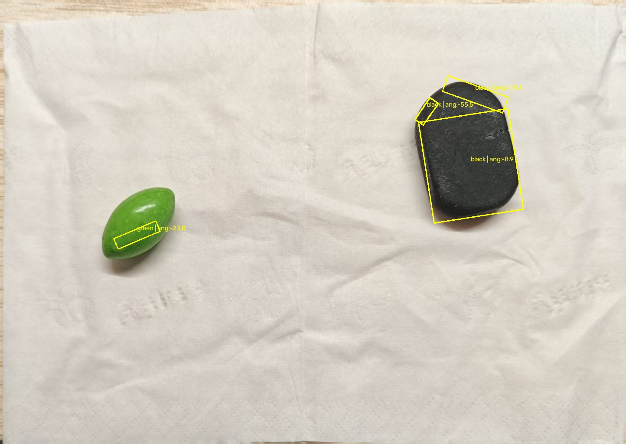
RESULT · RGB THRESHOLDS
Fine in dim light, falls apart in bright light
Reading the images
Dim light: mostly usable
One box each, but the green box only wraps the shaded left side of the bean (4,191 px); the lit side is dropped.
Bright light: the black target splits into 3 pieces
20,104 / 1,332 / 691 px, headings up to 75° apart — mutually contradictory.
Bright light: the green nearly disappears
Only a thin dark-green sliver is left: 1,831 px, about 1/11 of the HSV result (IoU 0.069).
rgb/dark · dim light
rgb/light · bright light
In that one bright image the black target yields three poses and the green one a wrong pose — exactly what happens when RGB thresholds feed a downstream task.
Track 1 Report
08

Slide 9
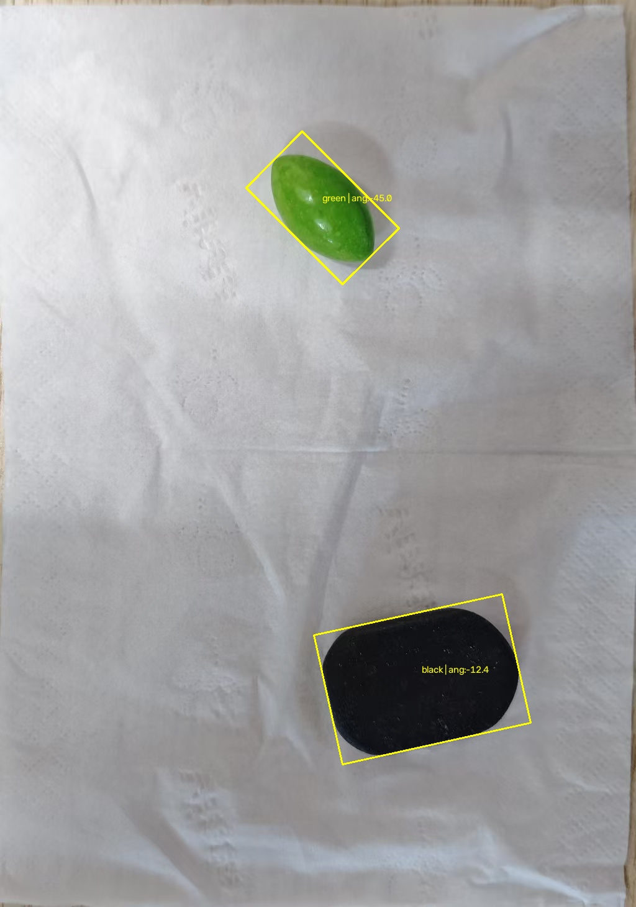
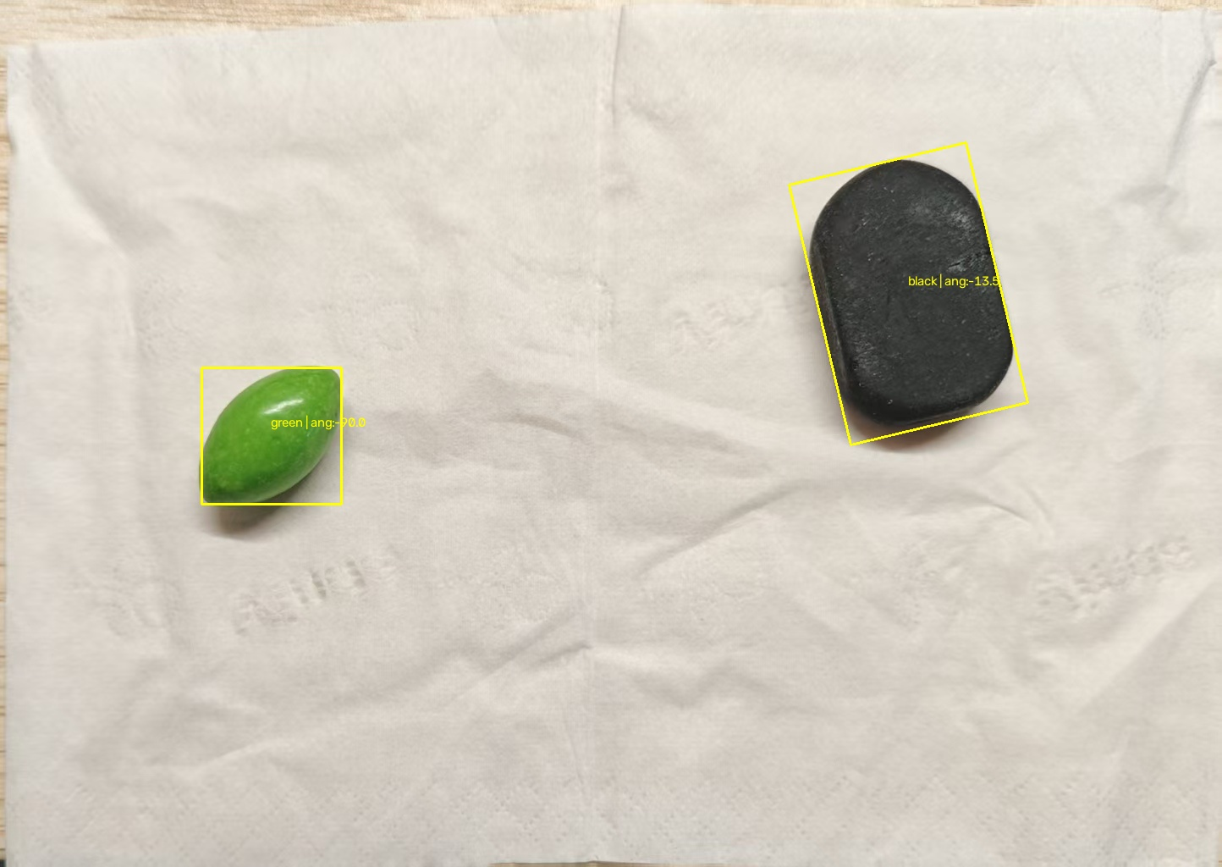
RESULT · HSV THRESHOLDS
One box per object; lighting no longer breaks it up
Reading the images
Both images: "one object, one box"
The black target keeps a single connected component; the green one is covered whole (20,987 / 19,410 px).
The green box fits far better
In dim light the box tilts with the bean (−45.0°); in bright light the aspect ratio falls to 1.17, so the heading is no longer defined.
The black target is still not clean
The box swallows the cast shadow and drags the angle to −12.4° / −13.5°, a few degrees off the true heading.
hsv/dark · dim light
hsv/light · bright light
Overall: one threshold set handles both lighting conditions — the basis for every conclusion that follows.
Track 1 Report
09

Slide 10
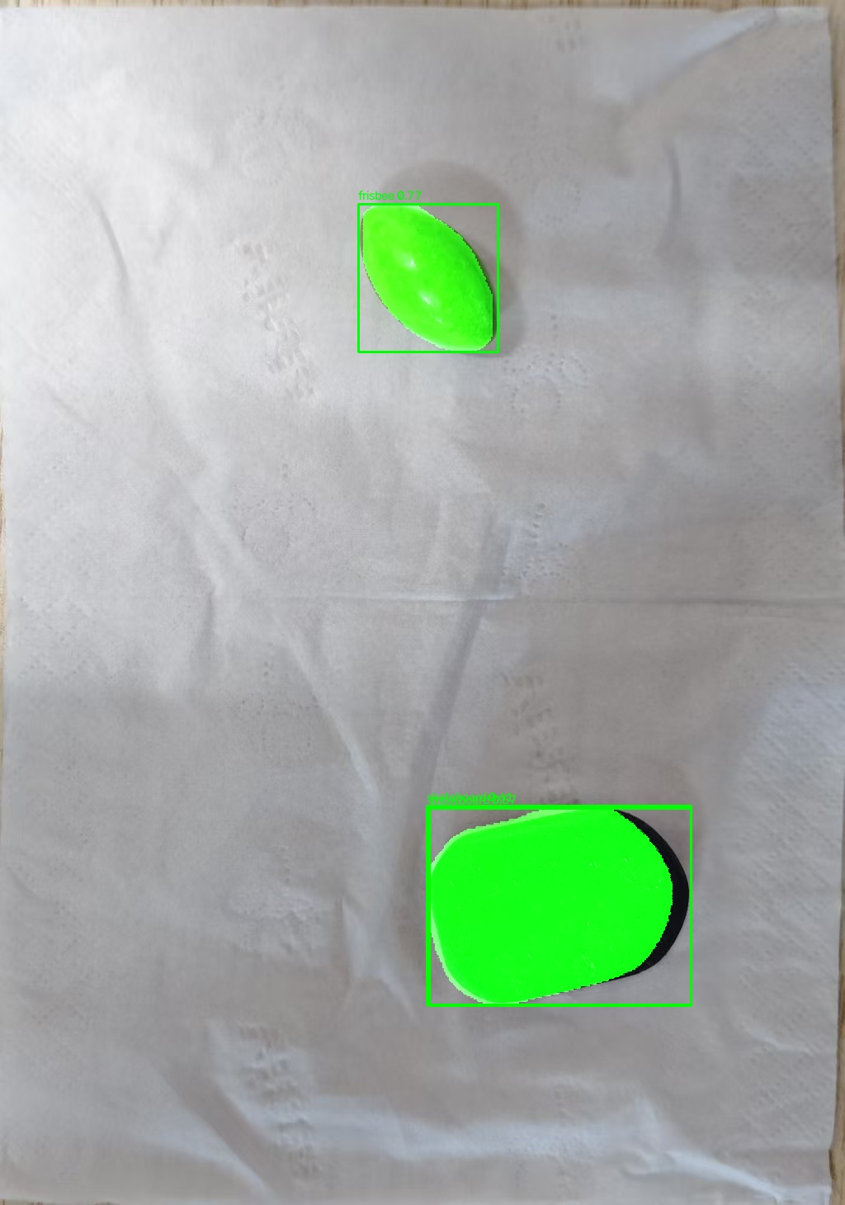
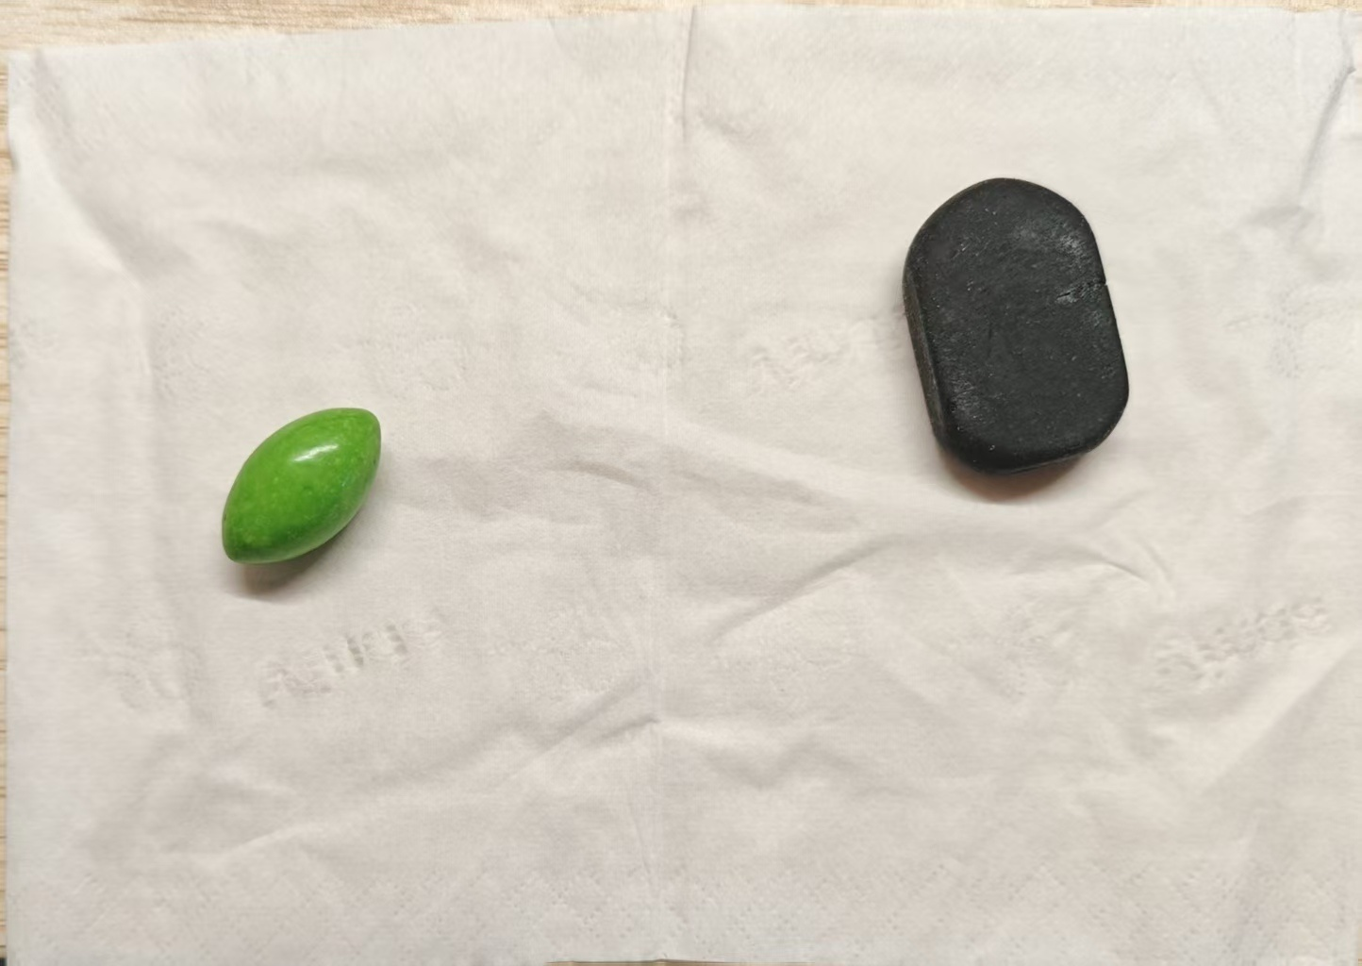
RESULT · YOLOv8n-seg
It finds “something”, but gets “what” wrong
Reading the images
Dim light: 2 detections, both wrong
The bean is called a frisbee (0.77); the black object is detected twice under another COCO class, both labels drawn in the same spot and unreadable.
Bright light: 0 detections at conf ≥ 0.5
Same scene, same objects; only stronger light and smaller targets, and the model returns nothing.
The mask is offset as a whole
The box is right, but the green mask is shifted up-left and stretched wider — the post-processing never undid the letterbox.
yolo/dark · dim light
yolo/light · bright light (no detections)
Track 1 Report
10

Slide 11
RESULT · MEASURED AGAINST GROUND TRUTH
Measured: HSV 0.79, YOLO 0.43, RGB 0.36 mean IoU
measured by Xiqian Deng
 | IoU RGB | IoU HSV | IoU YOLO | Δc RGB | Δc HSV
Dim light · green bean | 0.185 | 0.873 | 0.859 | 25.6 | 6.2
Dim light · black block | 0.830 | 0.832 | 0.853 | 9.3 | 9.2
Bright light · green bean | 0.069 | 0.728 | 0.000 | 18.2 | 15.4
Bright light · black block | 0.341 | 0.733 | 0.000 | 31.4 | 6.1
Mean | 0.356 | 0.792 | 0.428 | 21.1 | 9.2
How to read it
0.79 HSV · 0.43 YOLO · 0.36 RGB
Mean IoU across the four object × lighting cases. Only HSV stays above 0.7 under both lighting conditions.
Dim light: all three agree
0.830 / 0.832 / 0.853. When the target is dark, three very different methods converge on almost the same mask.
Bright light: two rows of zero
YOLO finds nothing at all at conf 0.5; RGB keeps the black block (0.341) but loses the bean (0.069).
Δc = centre error in px. A heading is only reported where the min-area rectangle has aspect ≥ 1.15; the bean turns near-square in bright light, so that cell has no stable angle. YOLO's dim-light black score is the union of two overlapping boxes (skateboard 0.61 / snowboard 0.57), so its shadow coverage is accidental.
Method note · one re-run of the pipeline printed on slides 05–06, on the same two photos; ground truth is semi-automatic (GrabCut from a hand-drawn box, ±5–10 % boundary), so absolute IoU reads slightly low — the bias applies equally to all three methods.
Track 1 Report
11

Slide 12
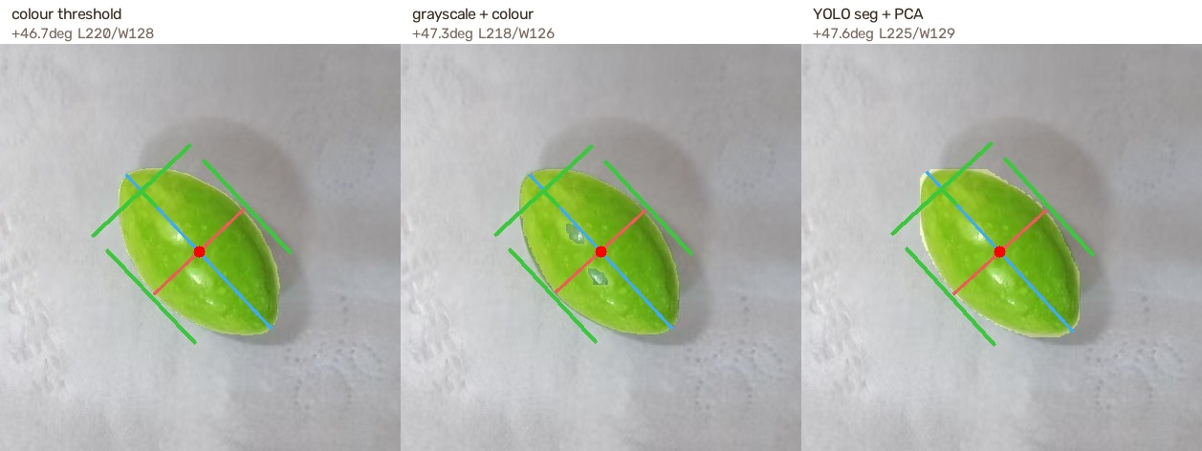
POSER · PCA + PARALLEL-JAW GRIPPER
Three masks, one pose: the heading holds to within a degree
Why PCA, not minAreaRect
It averages, so it is stable
The axes come from the covariance of all object pixels, not from the boundary. Saw-tooth edges move a min-area rectangle, not a mean.
It hands you both axes
The two eigenvectors are the long and the short axis; the eigenvalues say which is which. That is exactly what a gripper needs.
Same inputs, same outputs
Centre, heading, and the two extents — for every mask source, unchanged.
Dim light · green bean — blue = long axis, red = short axis, green = gripper
Heading from PCA | dim green | dim black | bright green | bright black
Colour threshold | +46.7 | −10.4 | −44.2 | +74.4
Grayscale + colour | +47.3 | −10.4 | −40.5 | +78.8
YOLO seg + PCA | +47.6 | −10.3 | no mask | no mask
And the gripper is the test
Fingers parallel to the long axis, opening across the short one. If the pose were wrong, the jaws would visibly miss the object — here they close around it in all six panels.
Splitting axes · numpy returns (row, column) while OpenCV draws in (x, y); every point here is flipped to (x, y) before PCA, otherwise the gripper lands on the wrong side of the object.
Track 1 Report
12

Slide 13
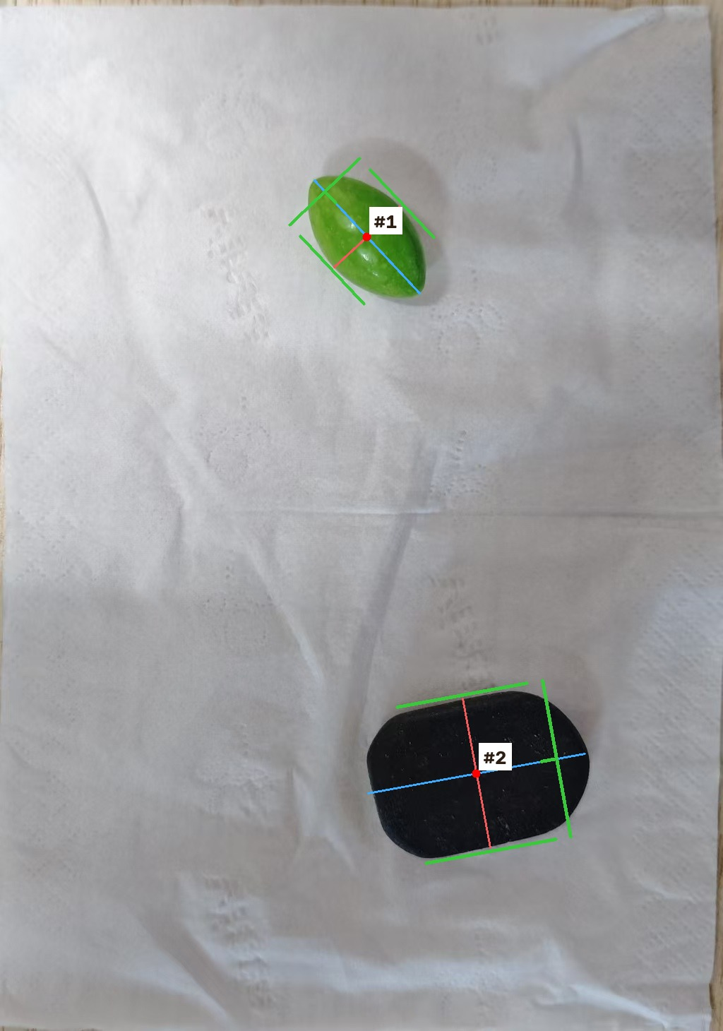
PIPELINE · ONE PASS, MANY OBJECTS
One mask, every object: the loop behind the gripper
What a single pass finds
 | blob | area px | centre | heading
#1 | green bean | 20,287 | (520, 335) | +46.9°
#2 | black block | 57,546 | (675, 1,095) | −10.4°
And the loop that produced them
for c in contours:
if cv2.contourArea(c) < MIN_AREA: # 投影、纸褶皱，一刀切
continue
single = np.zeros_like(mask) # 每个轮廓单独成一张掩码
cv2.drawContours(single, [c], -1, 255, -1)
pose = pca_pose(single) # 同一个 PCA，不区分物体
draw_gripper(vis, pose)
Three contours, one dropped by the area filter, two poses — and the same PCA that slide 12 ran on a single object.
The mask is the union of every colour we care about (green by hue, dark by brightness), so one findContours pass finds all objects; numbering is left-to-right so the order stays stable between runs.
Track 1 Report
13

Slide 14
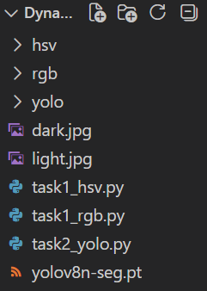
APPENDIX · ASSETS AND REPRODUCTION
All the files used in this experiment
The three scripts
Script | Purpose
task1_rgb.py | BGR threshold → contours → minAreaRect
task1_hsv.py | Same, but in HSV space
task2_yolo.py | YOLOv8n-seg detection + mask overlay
How to reproduce
python task1_rgb.py # → rgb/*.jpg
python task1_hsv.py # → hsv/*.jpg
python task2_yolo.py # → yolo/*.jpg
Track 1 Report
14
Notes:
The appendix ties the assets and scripts to page numbers, so the evidence behind each page is easy to check.

