Slide 1

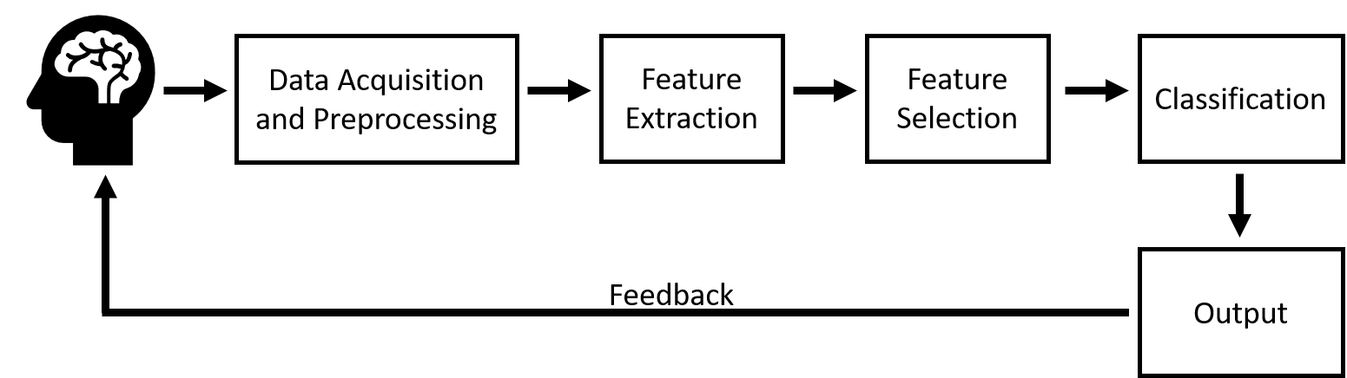
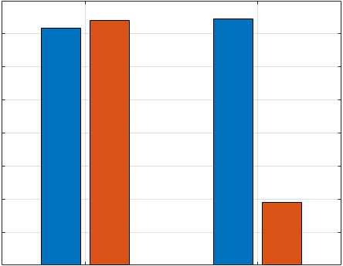
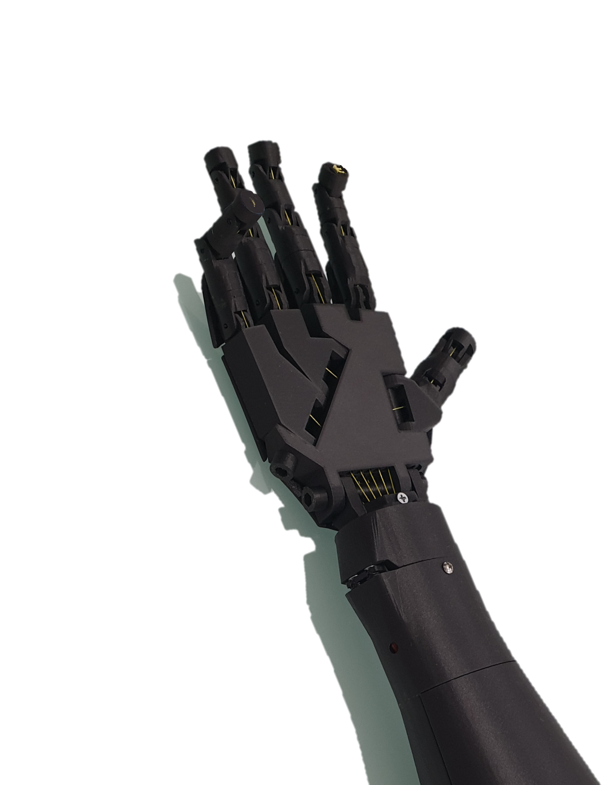
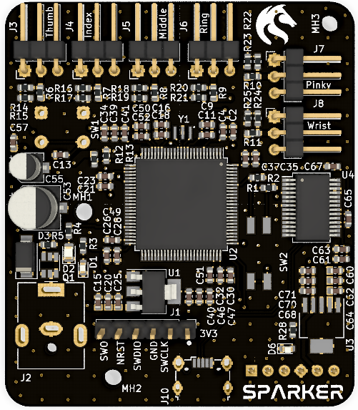
Wireless EEG Controlled Prosthetic
Samuel Parker, Kaushik Mahata
Overview
Many people across the world are living with reduced upper limb function due to a breakdown in their neural signaling pathway. Often the cortical areas responsible for movement remain functional, allowing the signals to be detected and decoded, then the motor intent can be executed using a robotic prosthetic. This is a Brain Computer Interface (BCI) Neuroprosthetic.
Wireless Data Acquisition
Recording cortical activity from the scalp is called electroencephalography (EEG). These signals are very small, and are very sensitive to noise, so specialised hardware is required. This system uses a custom board built on the ADS1299 by Texas Instruments. The signal is then sent using Bluetooth to the arm for further processing.
Utilising novel feature extraction techniques, cortical signals recorded at the scalp have been used to classify motor intent in real time, enabling the user to grasp objects using the power of thought alone.
BCI Fundamentals
Novel Feature Extraction
Classification Accuracy & Time vs FE Method
Motor intent is encoded in the firing rates of neurons. This is detected by examining the frequency content of the EEG signals. Applying the Discrete Cosine Transform (DCT), EEG observations could be classified to the same accuracy in 26% of the time taken by benchmark approach (the Short Time Fourier Transform, or STFT). This is extremely exciting for online BCI systems, where classification time is critical.
80%
0.016s
60%
0.012s
40%
0.008s
20%
0.004s
0%
STFT
DCT
0.000s
Embedded SVM Classifier
The Classification and Control Board (based on an STM32F407) receives the EEG signal over Bluetooth and computes the DCT. The extracted features are classified as “Hand Open” or “Hand Closed” using a Support Vector Machine (SVM) machine learning algorithm. The SVM model is created using a training dataset and Matlab, then uploaded to the board. When the SVM has predicted the state of the hand, 5 PWM control signals are generated to control each finger.
The 3D Printed Prosthetic Hand
The Classification &
Control Board

