Slide 1
GANDHINAGAR INSTITUTE OF TECHNOLOGY
Information Technology Department
Design Engineering-II B(3160001)
Plagiarism Analyser
Presented By
Group ID: GIT_IT_DE_IIA_22_19
Harsh Jagani (200120116060)
Viral Dedaniya (200120116076)
Naimish Pambhar (200120116112)
Himanshu Parmar (200120116091)
Guided By
Prof. Pooja J. Shah

Slide 2
Outline
Introduction
Observation and analysis
Functions, User, And Activity Of System
Functional And Non-Functional Requirement
Tools/Technology for Implementation
Analysis of system(Diagrams)
Canvases
References

Slide 3
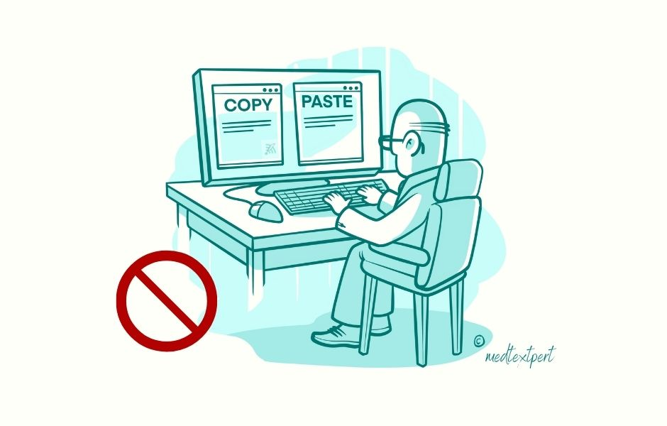
Introduction
What is Plagiarism?

Slide 4
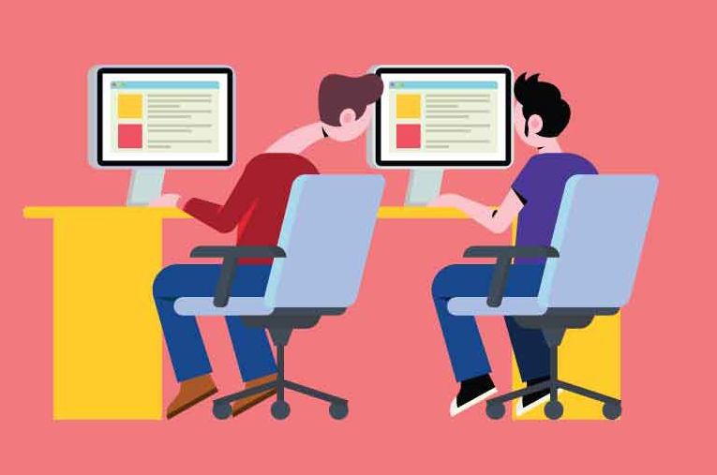
The word plagiarism originates from the Latin word ‘plagiarius’(mean ‘kidnapper’).
Definition of plagiarism is the act of stealing of work or idea or language without proper acknowledgment to the author and source.
Plagiarism is appropriation of another person’s ideas, processes, results, or words without giving appropriate credit

Slide 5
Plagiarism Detection Software
Software system that takes a submitted text as input, and compares the text against a set of publicly available and privately held documents, resulting in a similarity report.
The similarity report includes marking of similar or identical text, hyperlinks or other references to sources that match it, and an overall similarity report.
In some cases, the similarity report can be customized to include or not quoted text, and to include or not the bibliography (where the use of a style will ensure that the text of any citation matches the same text in any other document citing the same source)

Slide 6
Observation and Analysis
The anti-plagiarism software enables scanning of documents against all the documents sources, the software tool looks matches a string of eight to ten words.
for that we have to give files to software that we want to check the plagiarism from and the document which want to check.
We can install the numpy, cv2 and difflib modules using pip package manager.
This software is running on the Python script with the help of modules that we can add to our software.

Slide 7
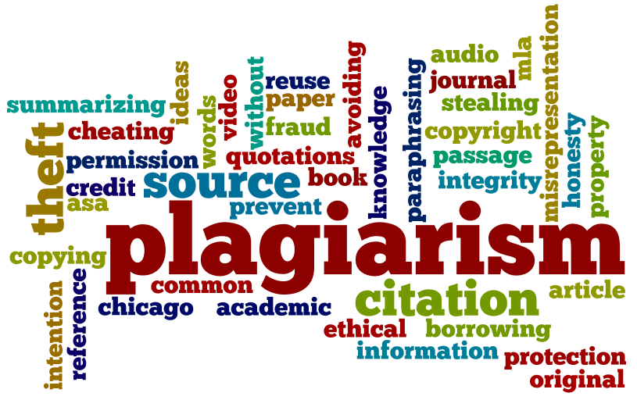
Function, Users and Activity of System
The Function of this software is check the plagiarism in text files.
And it finds the difference between two images and generates another resultant image of difference.

Slide 8

Users of this Software can be
Teachers
Students
Educational Institutes
Bloggers
News Channels
Media Companies
Content Creators etc…

Slide 9
Functional and Non-Functional Requirement
Requirements for this to be working model are
Any Computer Device with Mediocre Hardware.
An Operating System like Windows.
Python 3.8
Code Editor or IDE like IntelliJ.
Numpy, cv2 and difflib Libraries which we will include in our Python script.
And Files that you want to check plagiarism for.

Slide 10



Tools/Technology for Implementation
The Tools and Technology required are
Python Programming Language
Code Editor or IDE like IntelliJ
Numpy, cv2 and difflib Python library
And PC/Laptop for Development etc...

Slide 11
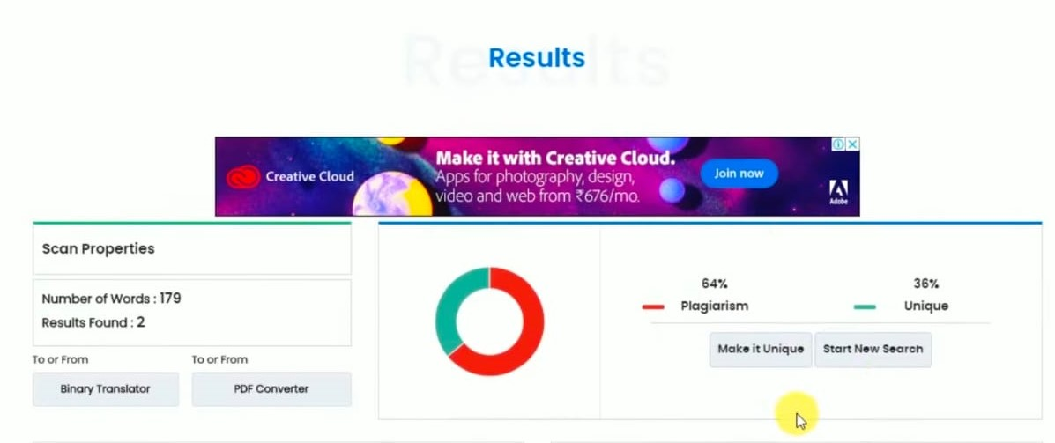
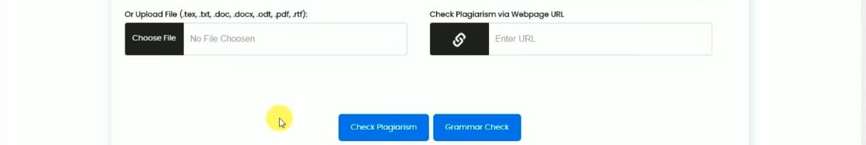
Analysis of System (Diagrams)

Slide 12
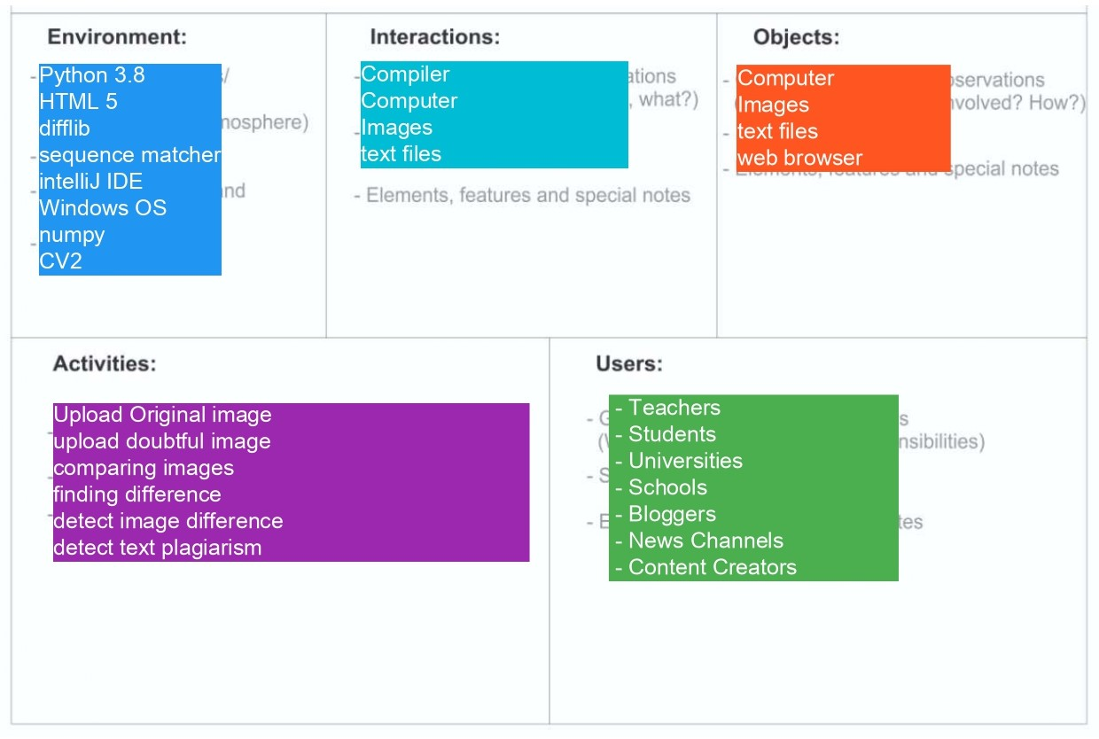
Canvases
AEIOU Canvas

Slide 13
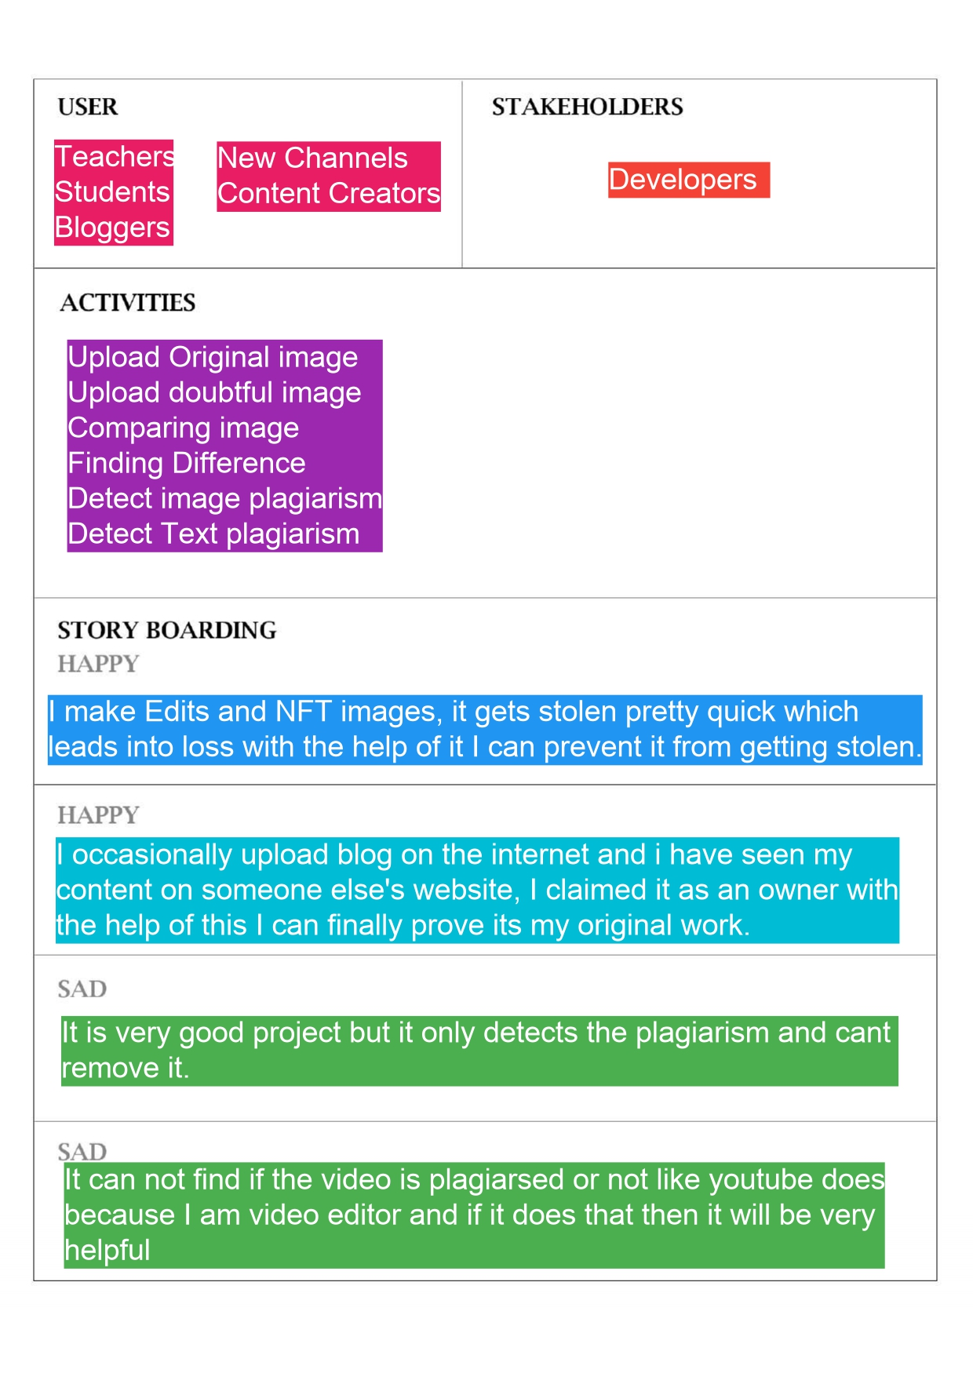
Empathy Canvas

Slide 14
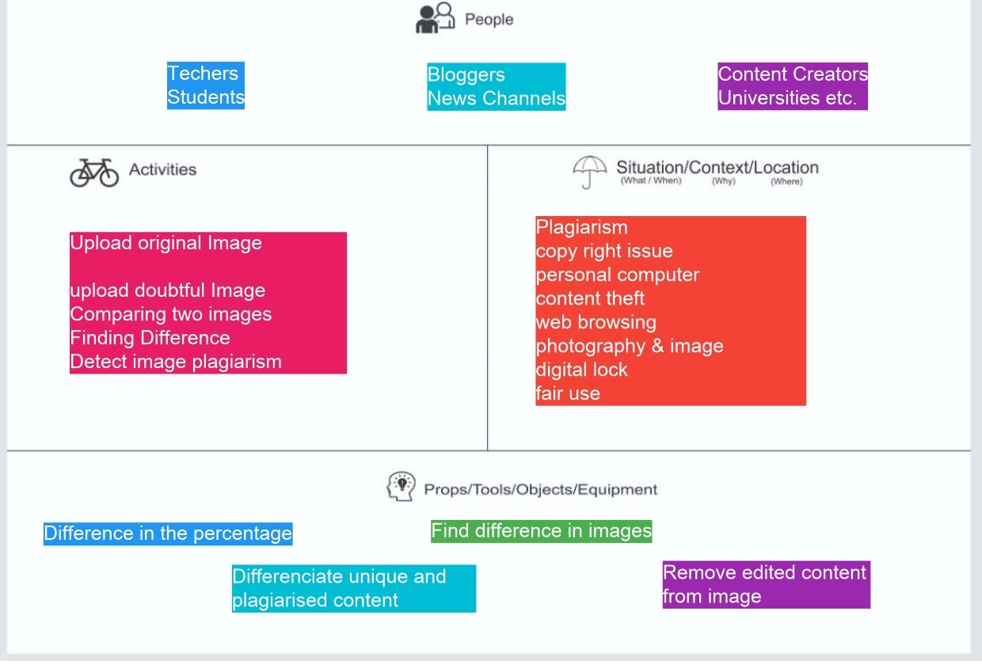
Ideation Canvas

Slide 15
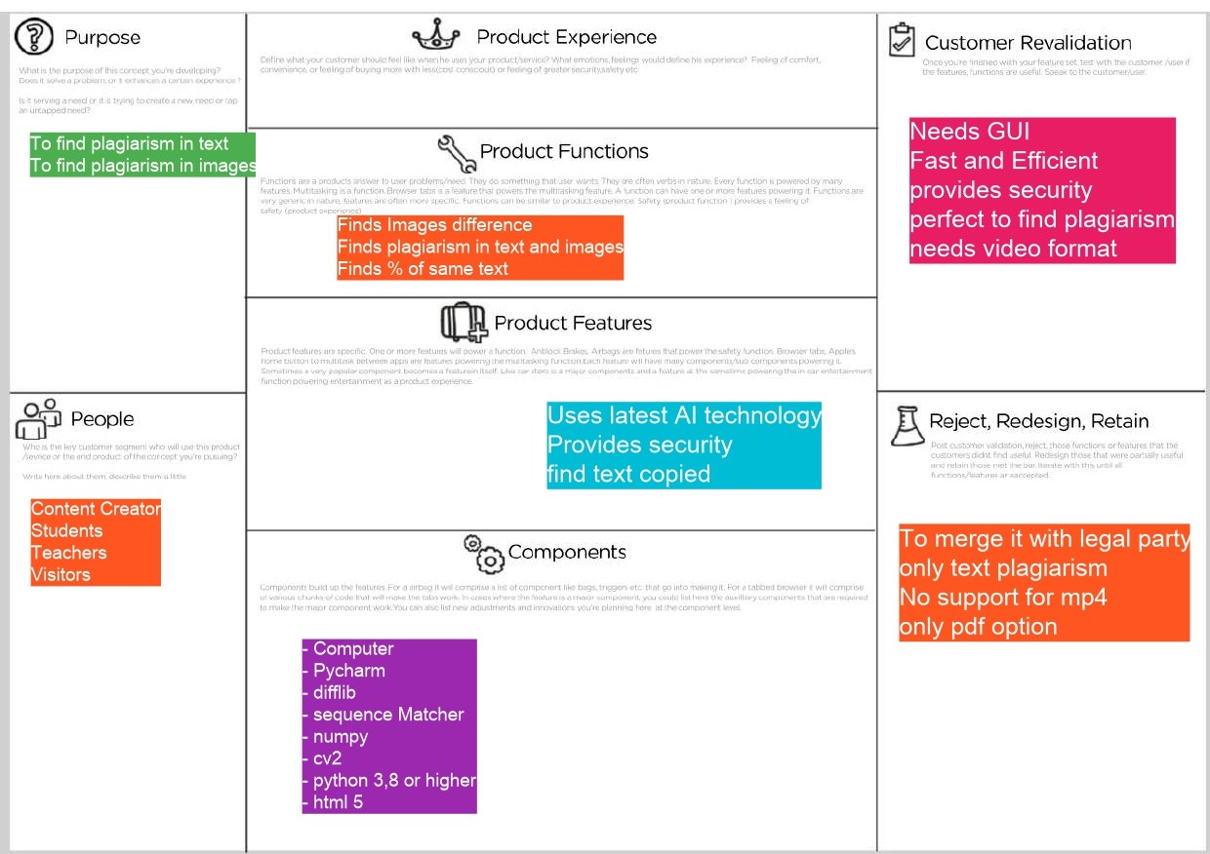
Product Development Canvas

Slide 16
References
[1] Plagiarism checkers. Author : Behic Guven. November 30, 2020 [cited 2022 November 10]; Available from URL: https://www.scribbr.com/plagiarism/how-do-plagiarism-checkers-work/
[2] Plagiarism Detection Software [cited 2022 November 11]; Available from URL: http://www.data-flair.training

