Slide 1
RedStick Review for Reds
Electrical Tests
Serial Port Ordering
Promotion through DigiKey

Slide 2
Electrical Tests
Voltage Under Load vs. Input Voltage

Slide 3
Electrical Tests

Slide 4
Electrical Tests

Slide 5
Electrical Tests

Slide 6
Electrical Tests

Slide 7
Electrical Tests
Battery protected from USB and VCC
Regulator stabilizes in ~40 ns
Reverse battery voltage OK
Runs 7x8 LED demo for 18 hr / 2 AA
I2C, SPI, UART, GPIO integrity OK
USB has nice fit

Slide 8
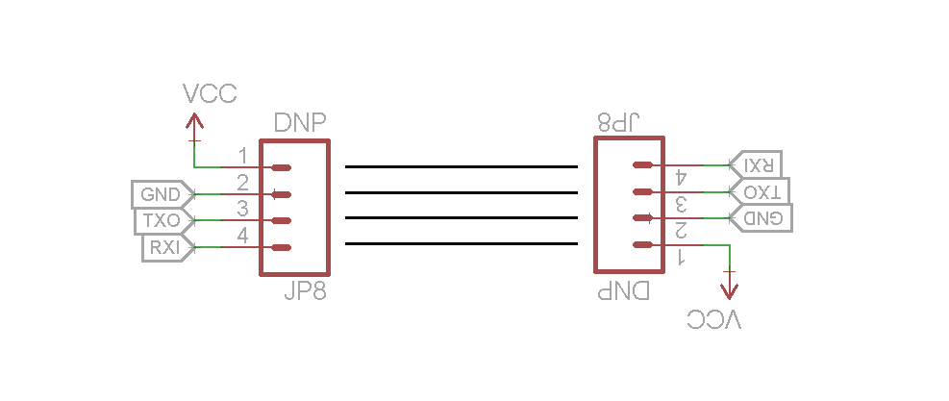
Serial Port Ordering
Best standard is FTDI, not applicable
4 pin order selected

Slide 9
Changes from Proto
Straightened Headers
Re-biased LEDs
Tweaked silkscreen

Slide 10
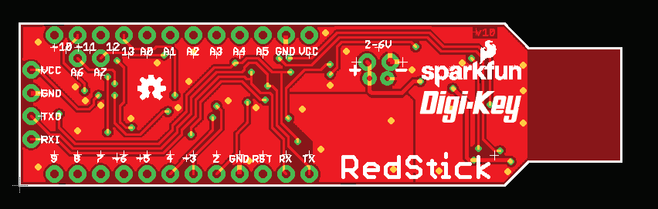
Promotion Through DigiKey
(FYI Only) DigiKey is interested!
Silk Mock-up:

