Slide 1
SWE iCON 16 Workshop
BadgerStick
https://github.com/sparkfun/SWE_iCON
Toni Klopfenstein, Michelle Shorter, Joel Bartlett, Pete Dokter

Slide 2

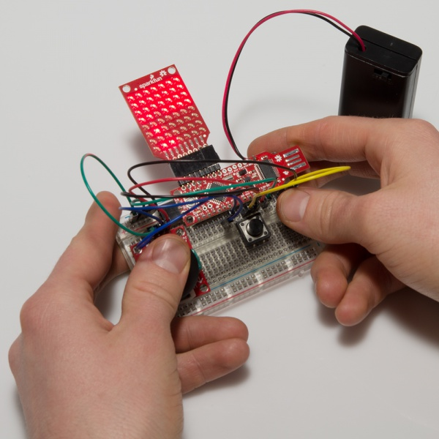
BadgerStick
  Tutorial
      https://learn.sparkfun.com/tutorials/badgerhack
  GitHub:
      https://github.com/sparkfun/BadgerStick
      https://github.com/sparkfun/BadgerArray
      https://github.com/sparkfun/BadgerHack_Demos

Slide 3
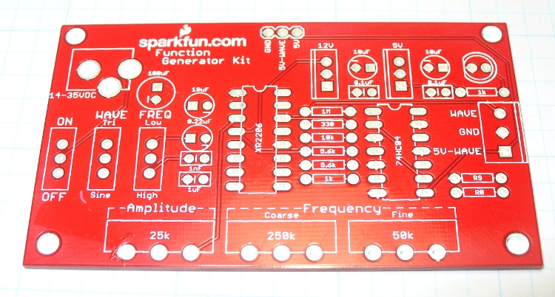
PCB
  Printed Circuit Board
  Comprised mainly of fiberglass and copper foil

Slide 4
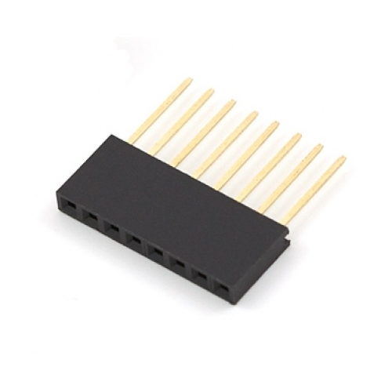
Pins and Vias
  Male and female parts that you will solder together

Slide 5
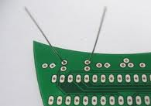
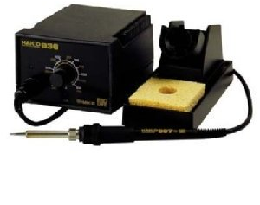
Plated Through Hole Soldering

Slide 6
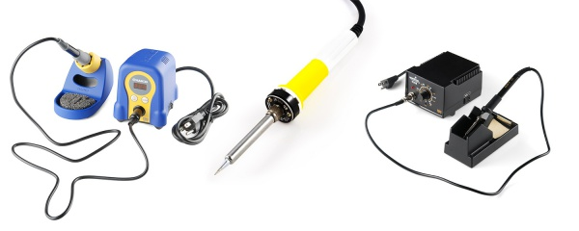
Soldering Iron
  The main soldering tool
  Used to melt solder

Slide 7
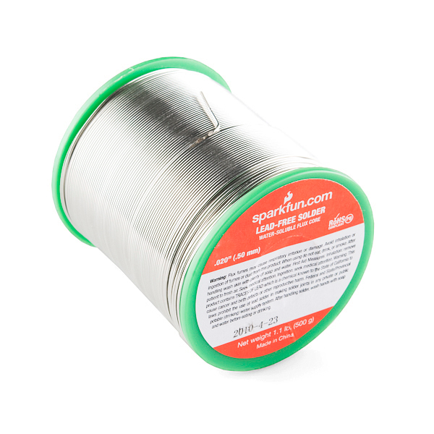
Solder
  Metal “glue” used
  to join together
  metal parts
  Contains flux
  Made of Tin and
  Copper, sometimes Lead

Slide 8
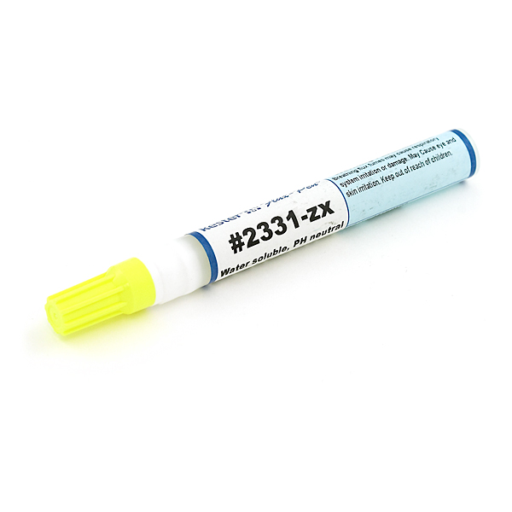
Flux
  Makes solder melt easier
  Always use extra flux for rework

Slide 9
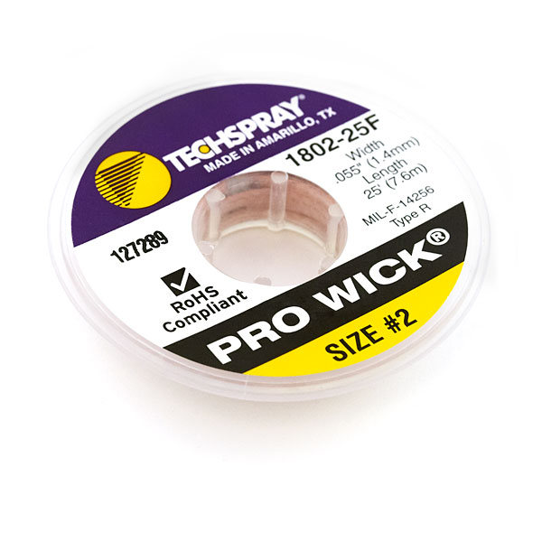
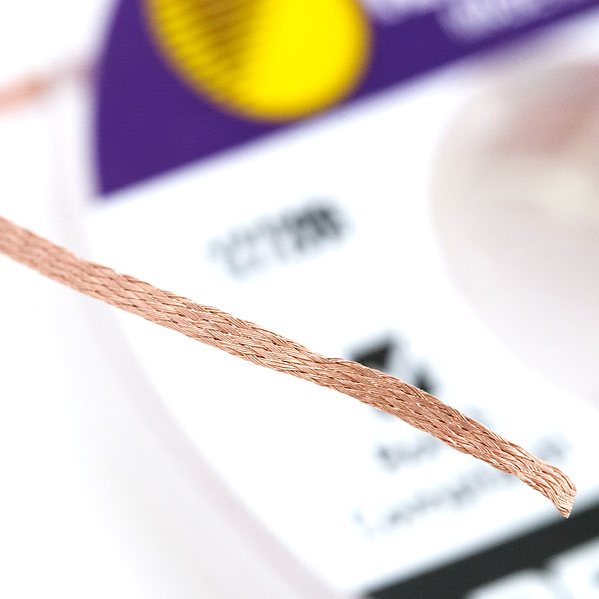
Solder Wick
  Use to remove solder
  Careful, it gets really hot!

Slide 10
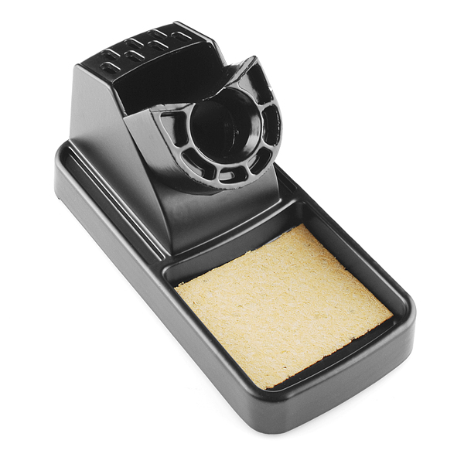
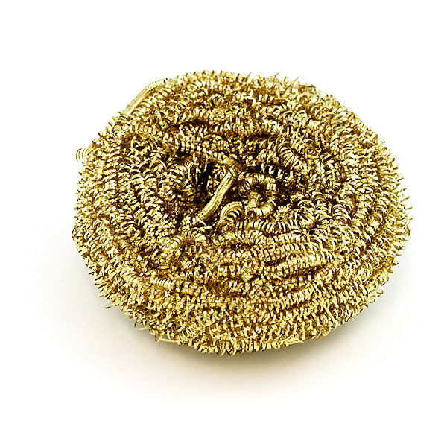
Sponge
  Used to clean off soldering iron tip
  Can be made of various materials
  Should be used every time before soldering a joint

Slide 11
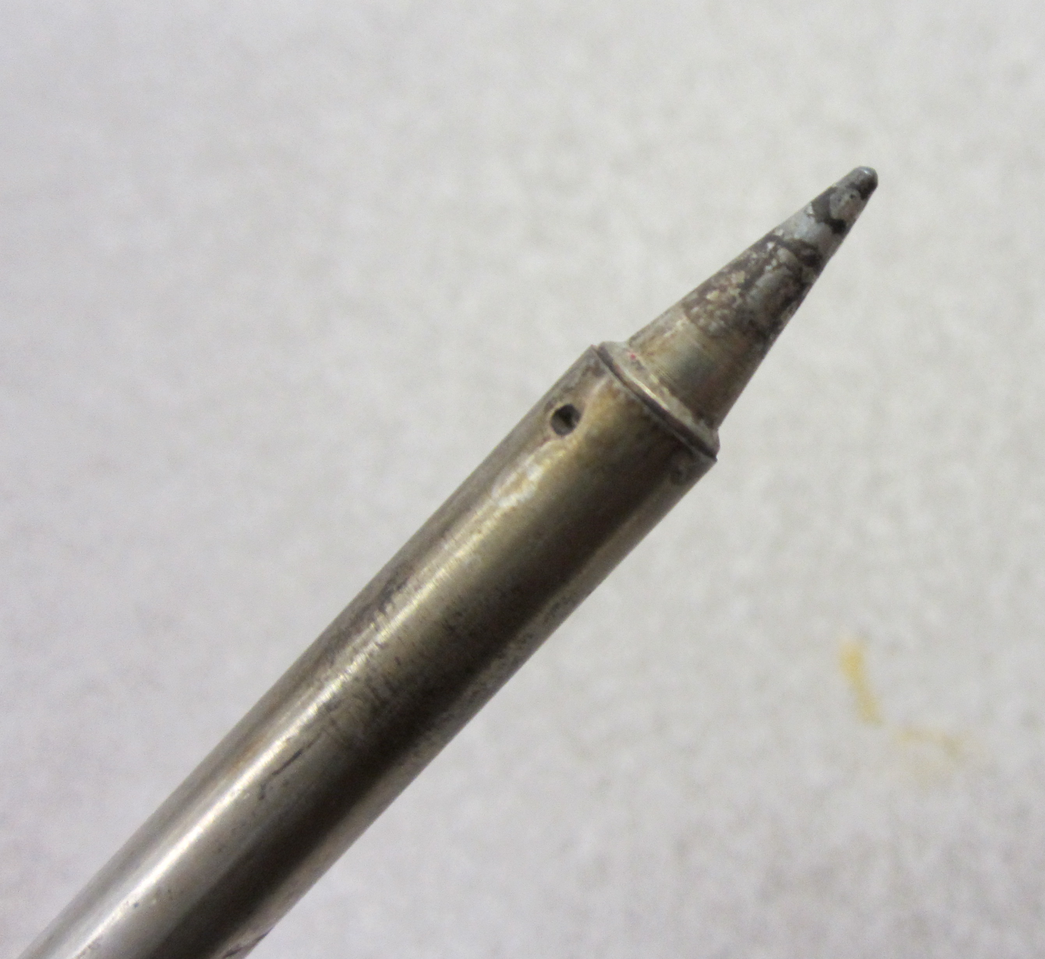
What is oxidization?
  Oxidization is what happens when oxygen breaks down matter
  It impedes heat and electricity transfer
  As a result you must clean your iron tip constantly… really!

Slide 12
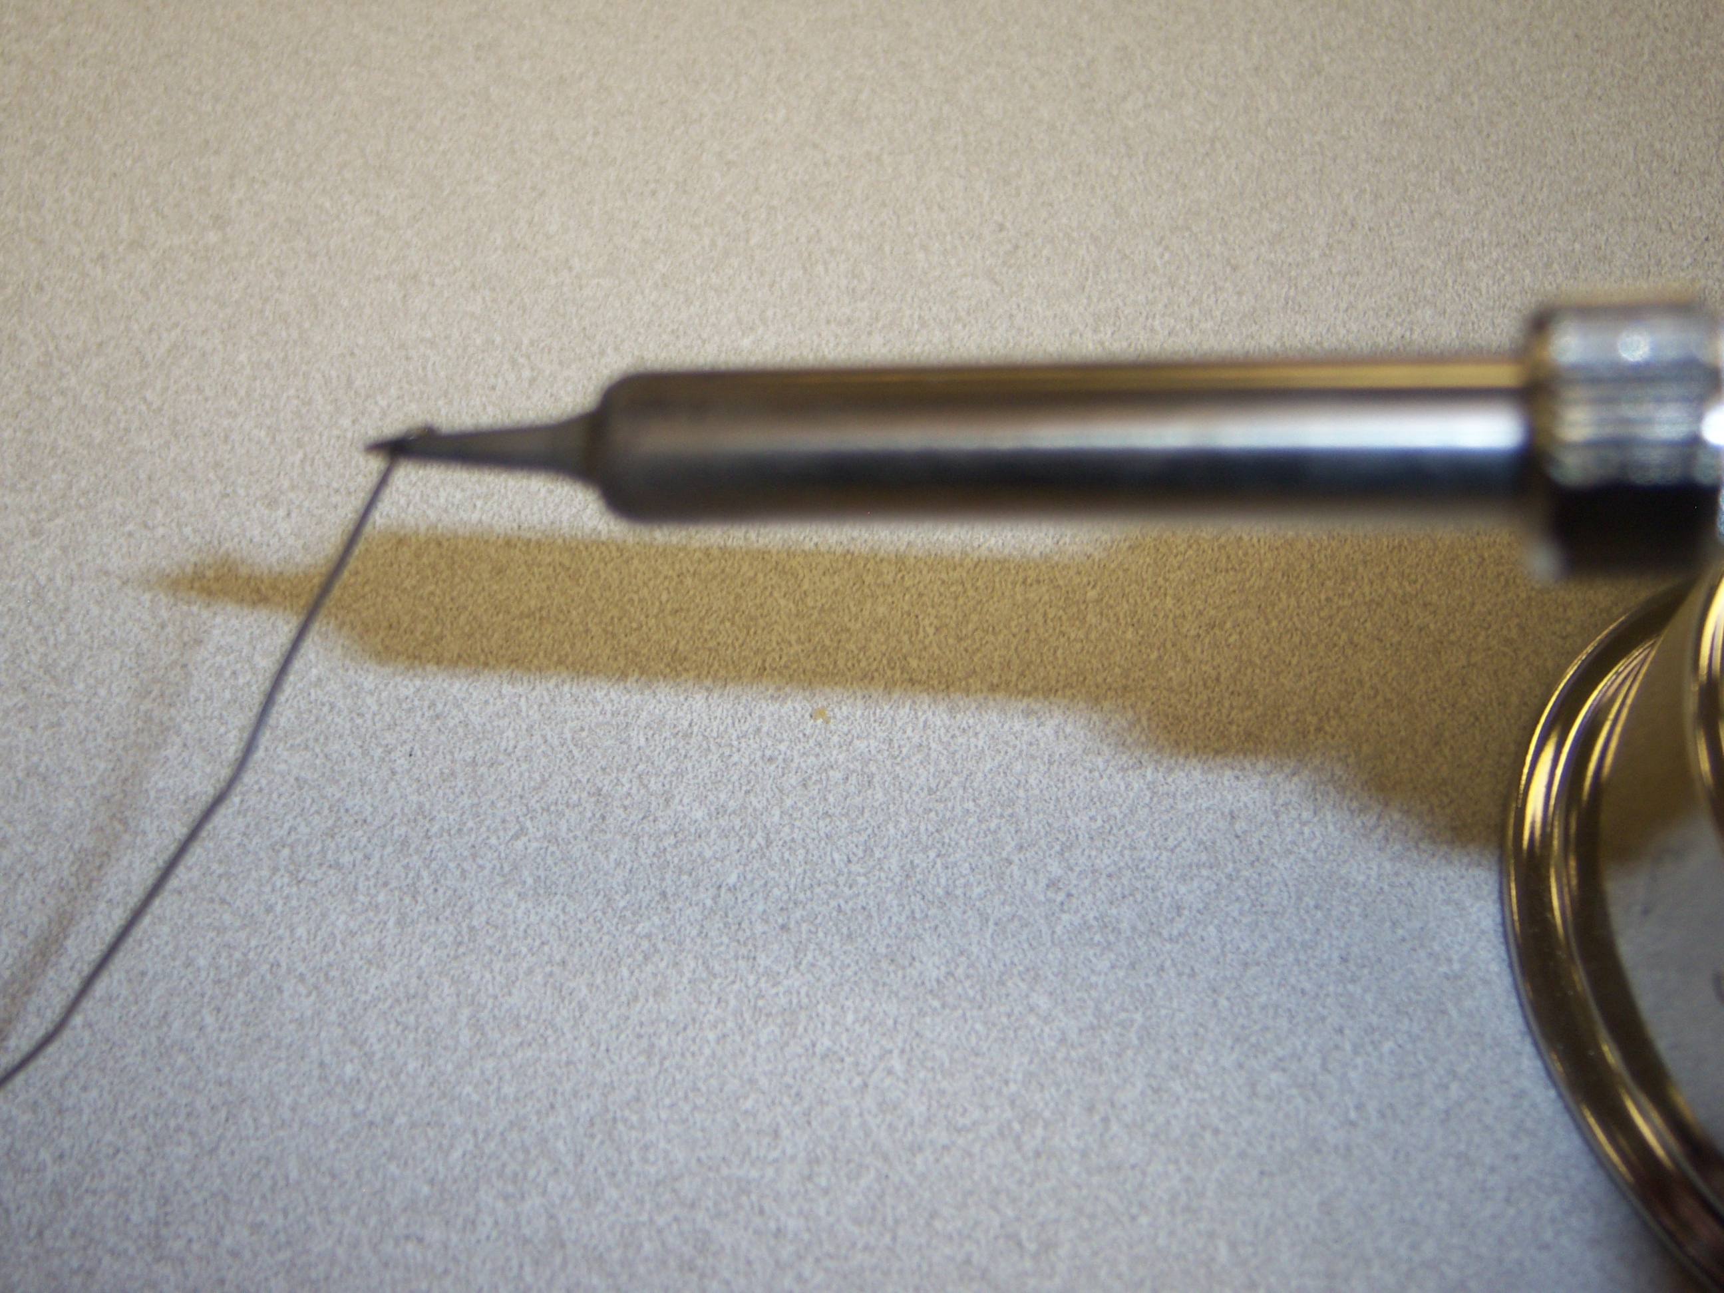
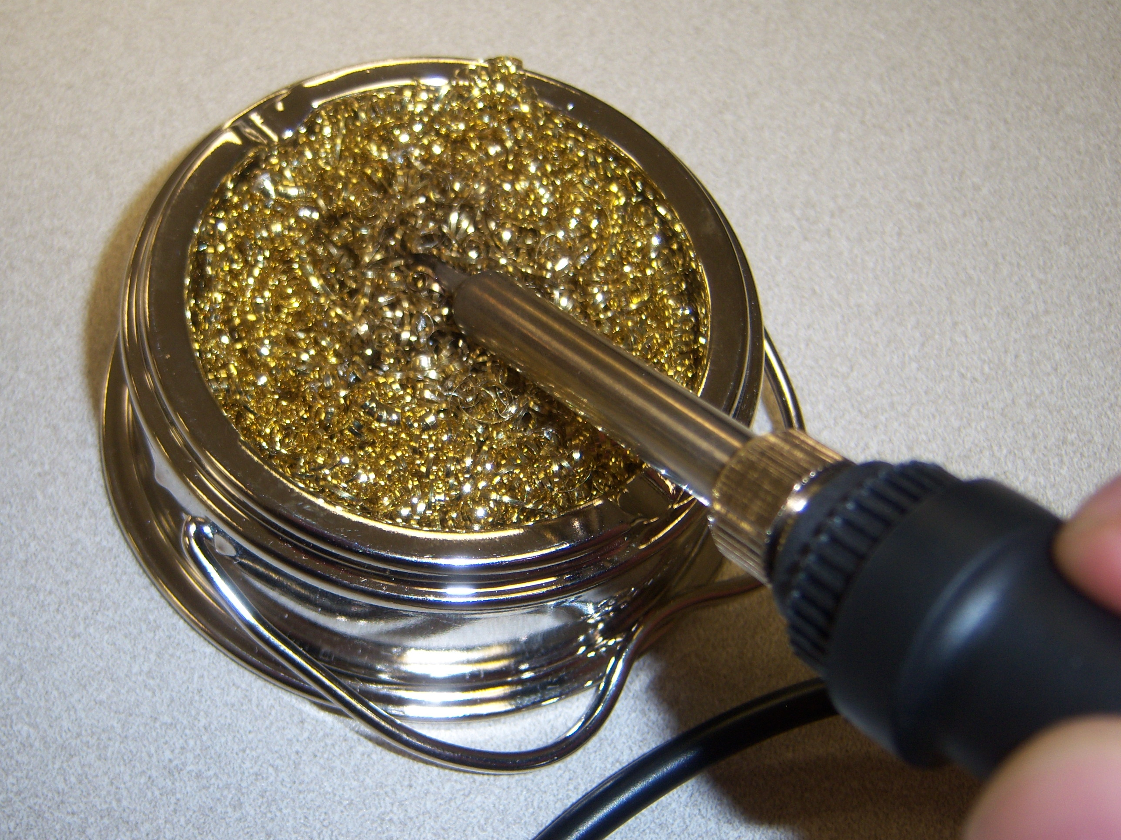
Cleaning your soldering iron
  Cleaning your soldering iron is one of the most important aspects of soldering
  If you can’t get the oxidization off using a sponge try tip tinner

Slide 13
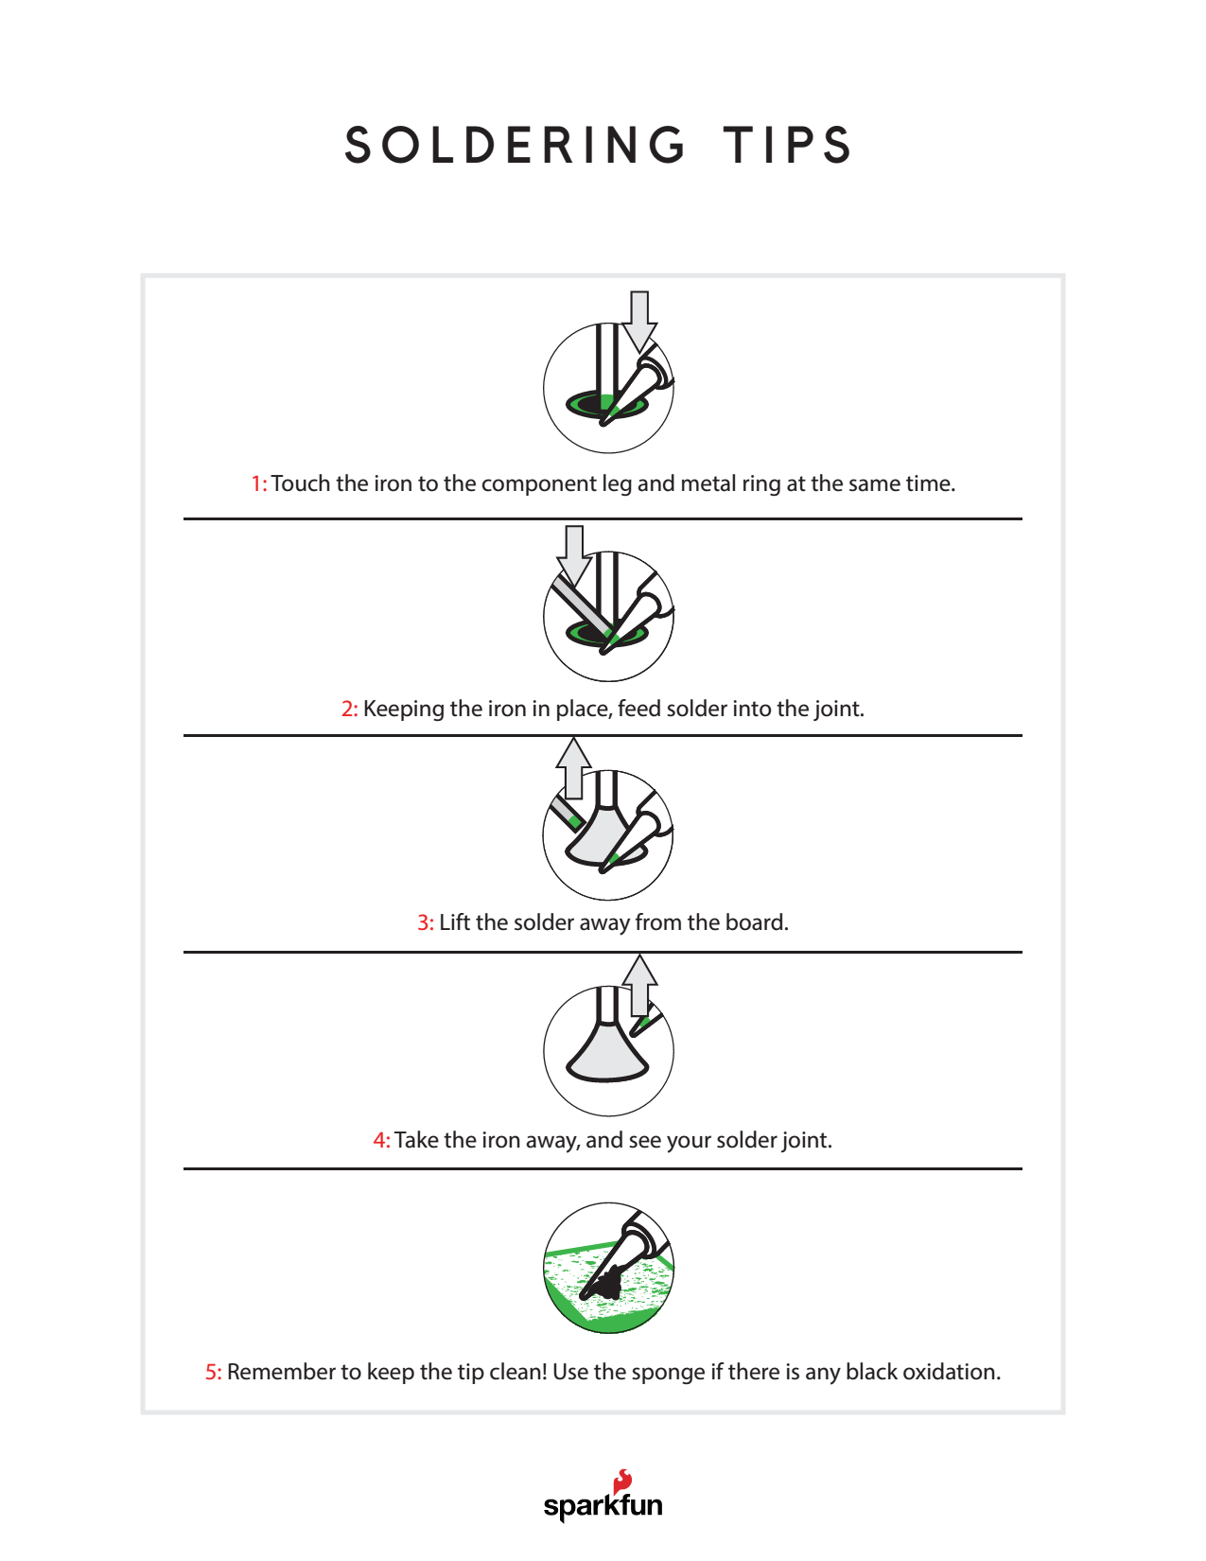

Slide 14
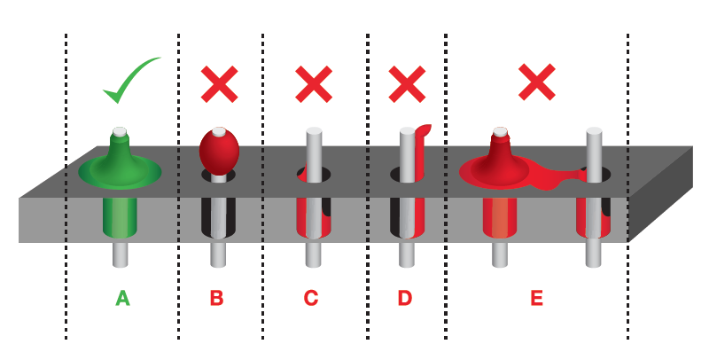
Perfect and not so perfect solder joint
  “Jumpers” will give electricity another path to travel (one that you don’t want it to travel)
  “Cold joints” may look like they are connected, but won’t conduct electricity

Slide 15
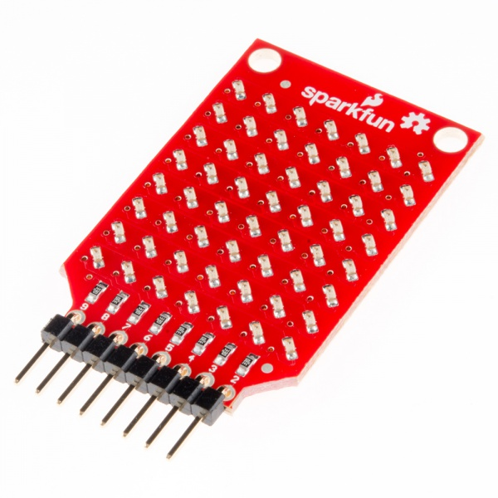
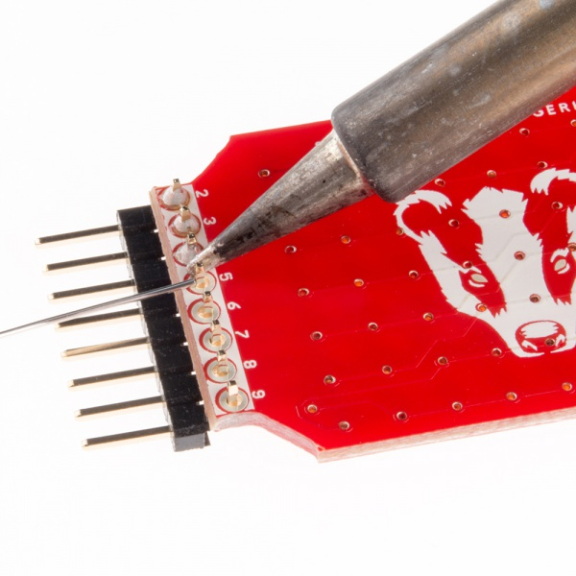
Solder 8-pin male header to LED board

Slide 16
Perfect and not so perfect solder joint
  “Jumpers” will give electricity another path to travel (one that you don’t want it to travel)
  “Cold joints” may look like they are connected, but won’t conduct electricity

Slide 17
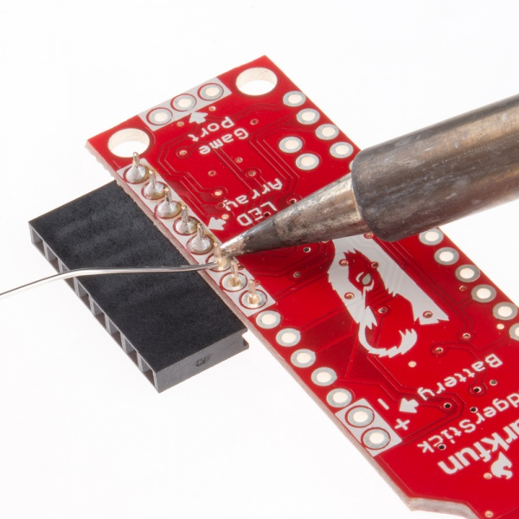
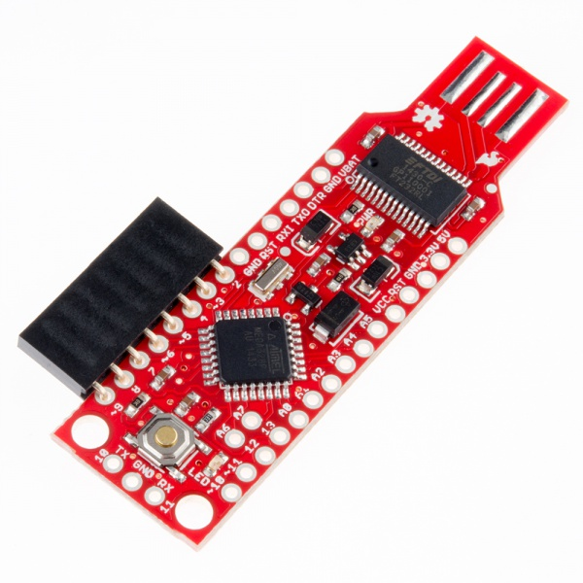
Solder 8-pin female header to BadgerStick (pins 2-9)

Slide 18
Perfect and not so perfect solder joint
  “Jumpers” will give electricity another path to travel (one that you don’t want it to travel)
  “Cold joints” may look like they are connected, but won’t conduct electricity

Slide 19
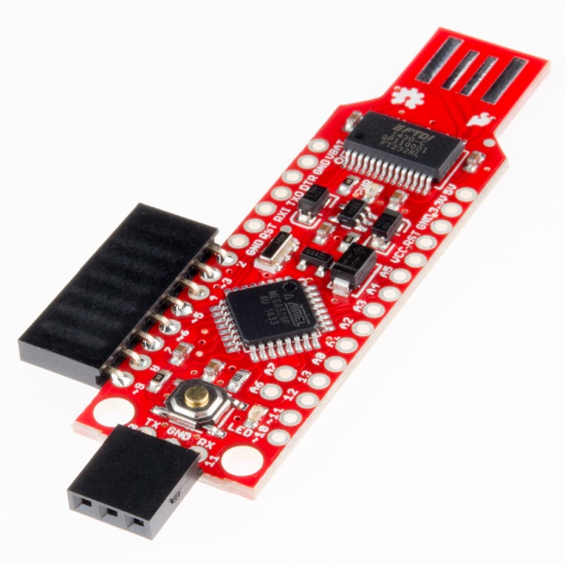
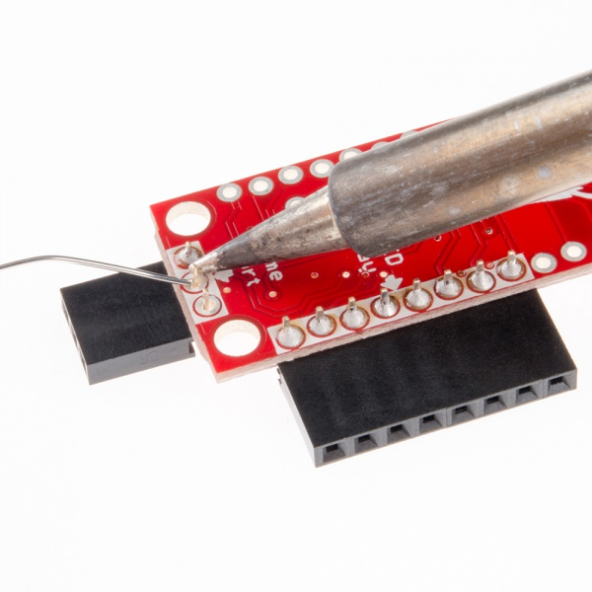
Solder 3-pin female header to BadgerStick (game port)

Slide 20
Perfect and not so perfect solder joint
  “Jumpers” will give electricity another path to travel (one that you don’t want it to travel)
  “Cold joints” may look like they are connected, but won’t conduct electricity

Slide 21
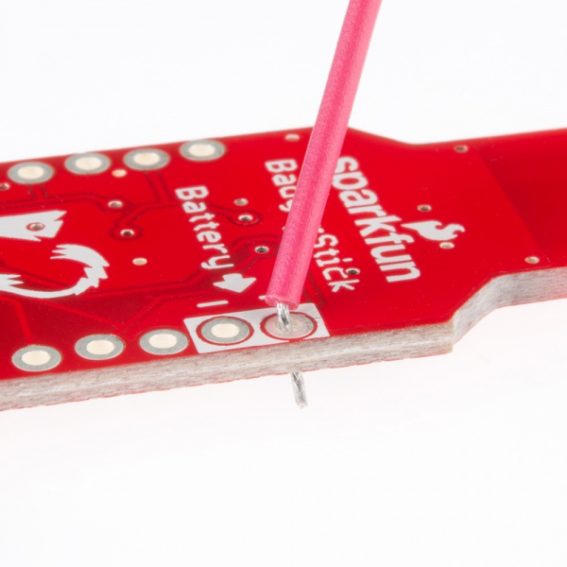
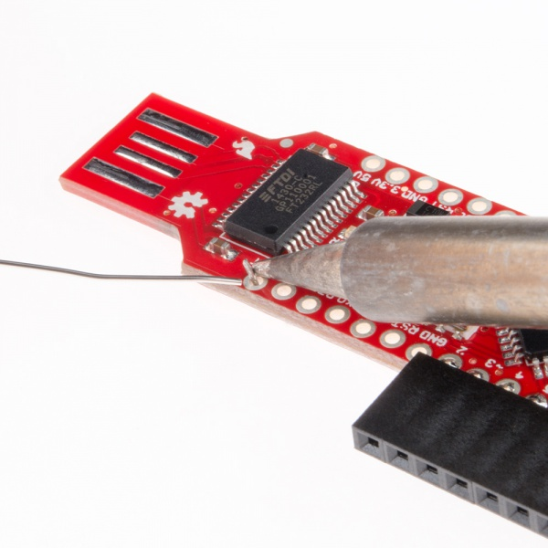
Solder red battery wire to BadgerStick (+ battery pin VBAT)

Slide 22
Perfect and not so perfect solder joint
  “Jumpers” will give electricity another path to travel (one that you don’t want it to travel)
  “Cold joints” may look like they are connected, but won’t conduct electricity

Slide 23
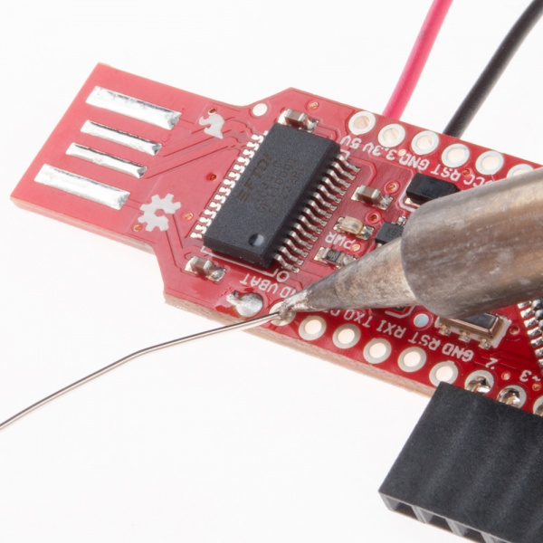
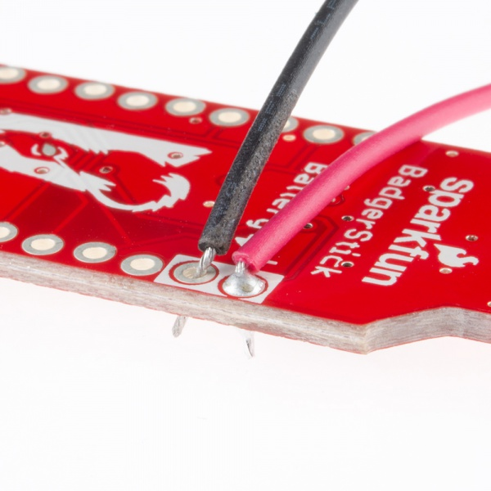
Solder black battery wire to BadgerStick (- battery pin GND)

Slide 24
Perfect and not so perfect solder joint
  “Jumpers” will give electricity another path to travel (one that you don’t want it to travel)
  “Cold joints” may look like they are connected, but won’t conduct electricity

Slide 25
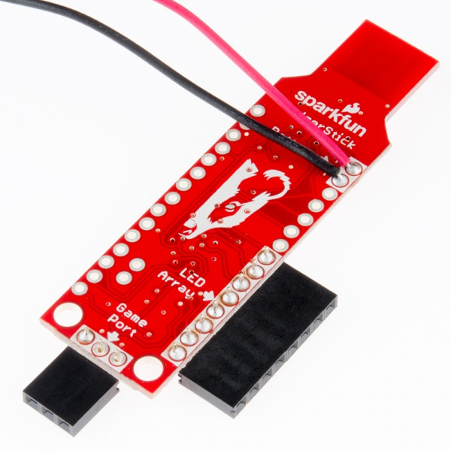
Verify!

Slide 26
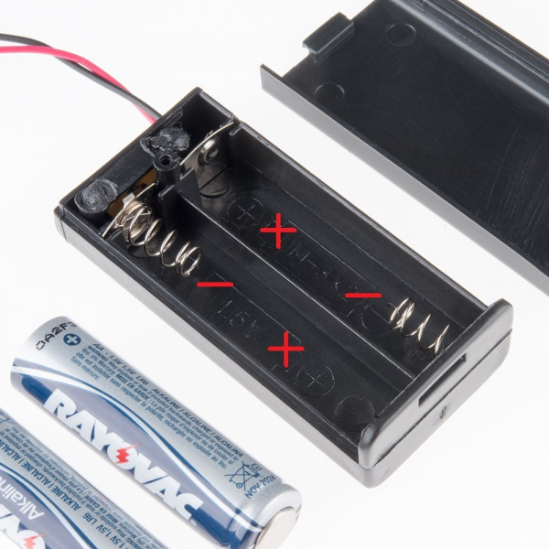
Add Batteries to Battery Pack

Slide 27
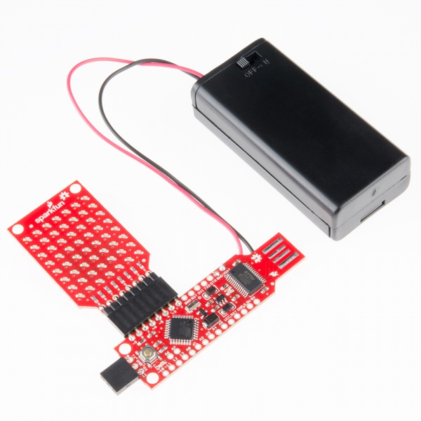
Connect LED Board to BadgerStick

Slide 28
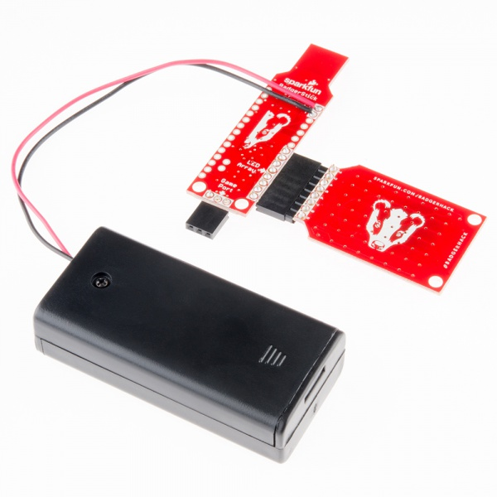
Verify Again!

Slide 29
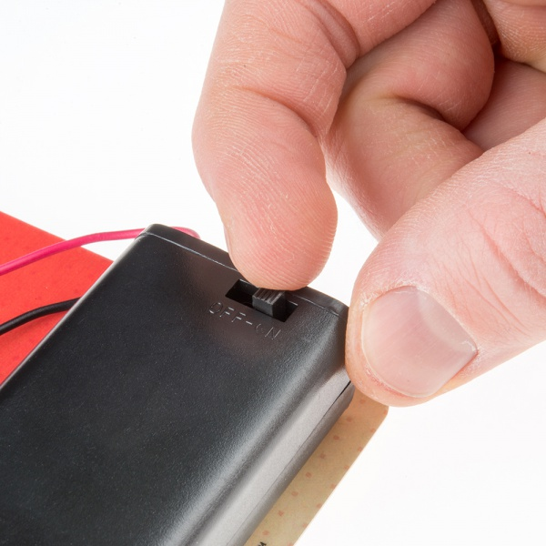
Check Functionality
Turn those batteries on and check for blinky goodness

Slide 30
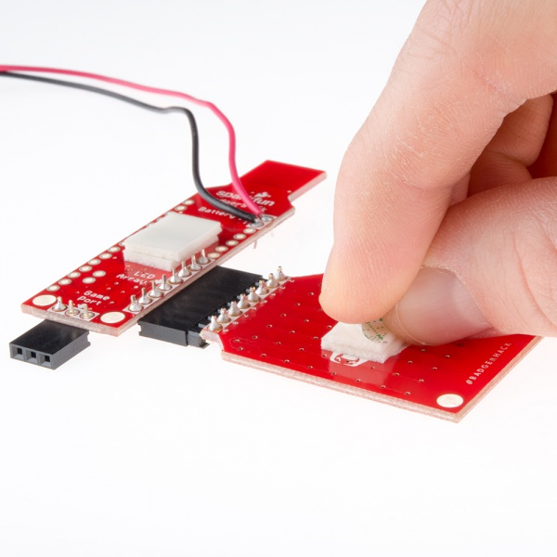
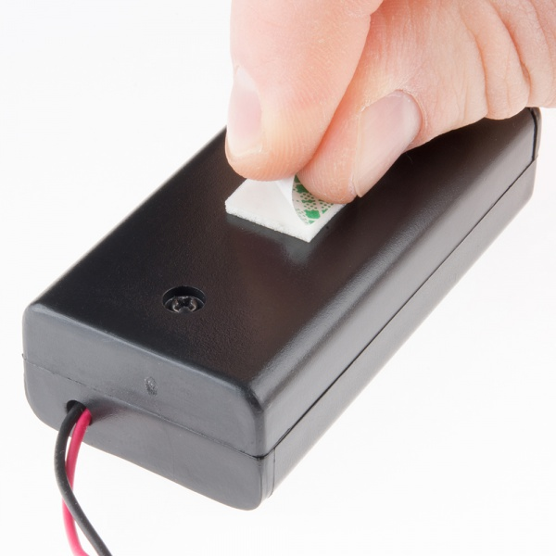
Add Foam Tape (Double stack it on PCBs)

Slide 31
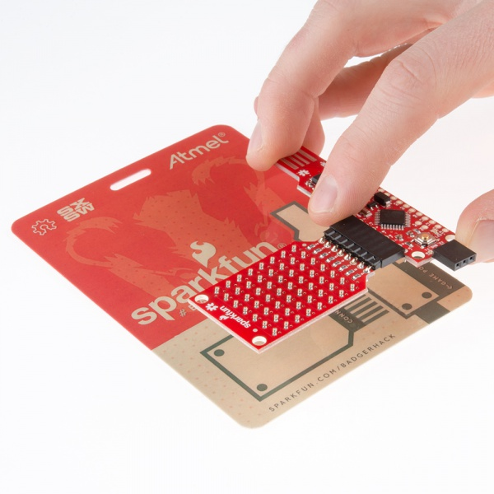
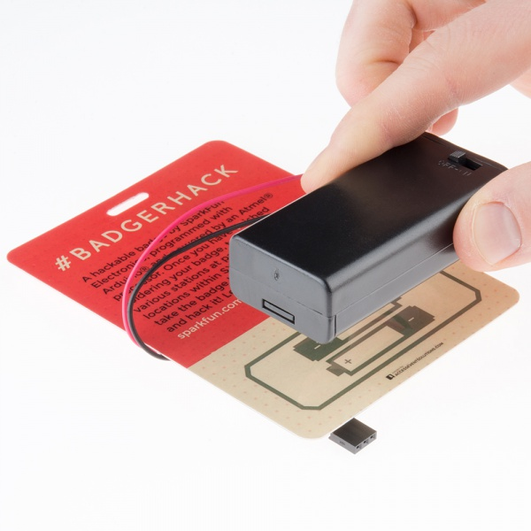
Affix Everything to the Badge

Slide 32
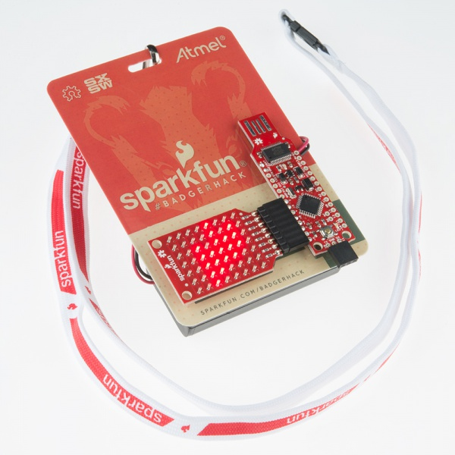
Blinky Goodness!

Slide 33

Questions?

Slide 34

www.sparkfun.com
6333 Dry Creek Parkway
Niwot, Colorado 80503

