Slide 1
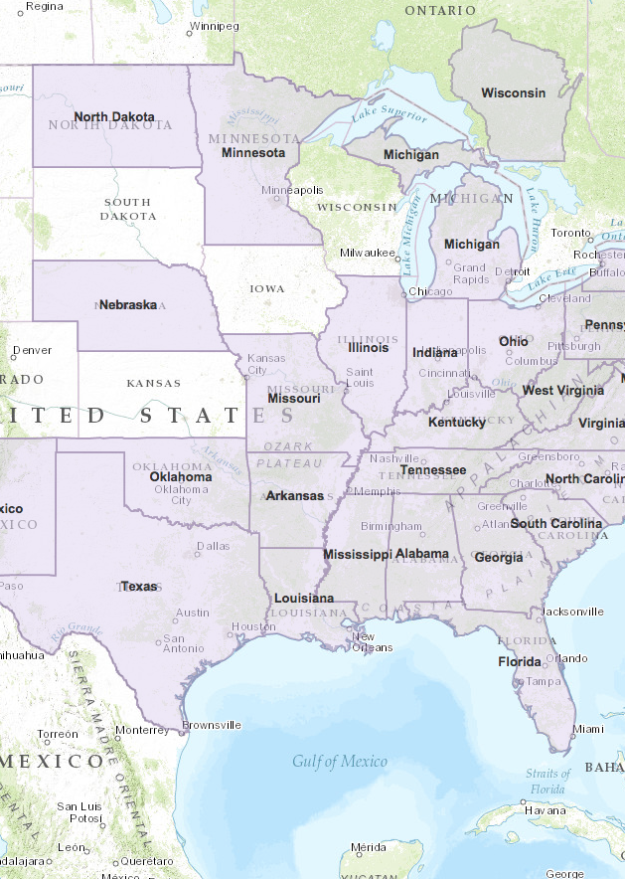
Application Boilerplate JS
Notes:
Talk about the ArcGIS Boilerplate
And making customizable templates or applications

Slide 2




What is it?
Starter Application
Template & app logic
Working with ArcGIS Online
Webmaps
Services
i18n
Authentication
Configurable
Notes:
Most mapping apps have some common functionality
Theres a common workflow for apps to get ArcGIS Online information
They consume similar services
They work with webmaps
Might be localized.
If so, sets you up to make your app work in different languages.
May need to authenticate to ArcGIS Online, Portal or Services
If so, provides helper functions for things like oAuth
May be configurable
You can enable your app to be customized from AGOL by users
A way to organize your code

Slide 3

Customizing the Boilerplate
Layers
Widgets
Panels
Legend
…Much more
Notes:
With the boilerplate, we start you out with a basic webmap.
What you do with that is limitless
We’ll walk through some examples of things in a few minutes

Slide 4
What Do I Get?
Defaults
Localization (Optional)
Web Map, Group, Group Items
Organization Settings (Optional)
Configured Application (Optional)
URL Parameters (Optional)
?webmap=<webmap>
?appid=<id>
Geocoders, print tasks, geometry services
Theme, proxy, custom settings for your app
Notes:
General app structure for large or small apps
Get common application logic
Querying AGOL data

Slide 5
Fetching Resources
Items
Authentication
Dependencies
I18n
Application
Create Portal
Org Settings
Webmap Item
Group Info
Group Items
Initialize
Proxy
Host URL
Finish Up
Geometry Service
Application Extent
Signed-in status

Slide 6
Mixing-in Layers of Data
Organization
Settings
URL Parameters
Application
Configuration
Default
Configuration
Localization
Group Info
Group Items
Webmap Item
Notes:
Default application settings via a config file
Query AGOL or portal for org settings
Query for a configured application template if applicable
Any url params that may exist like webmap= or application id. This can be extended to anything

Slide 7

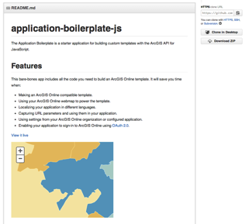

Show me the way
esriurl.com/boilerplate
Notes:
Before we jump into it, lets answer an important question
Where is this code?

Slide 8
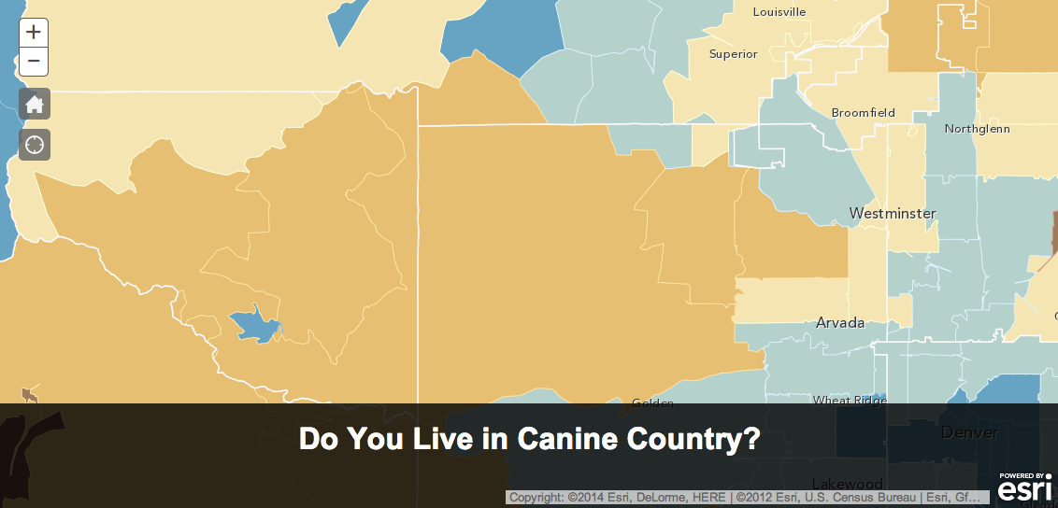
Configurable Demo App!
Home Button
Locate Button
Customizable Title
Notes:
So I’m going to demo a configurable app sample
The example will have…

Slide 9

Prep Work
Create a configurable web application item
Create custom template group
Configure map viewer in org for custom templates
Share item in templates group
Notes:
Few things we need to do before jumping right in

Slide 10
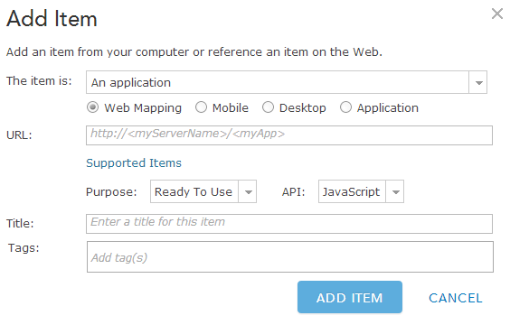
Adding the Application Item
Application
Web Mapping
Notes:
Create an item on AGOL

Slide 11
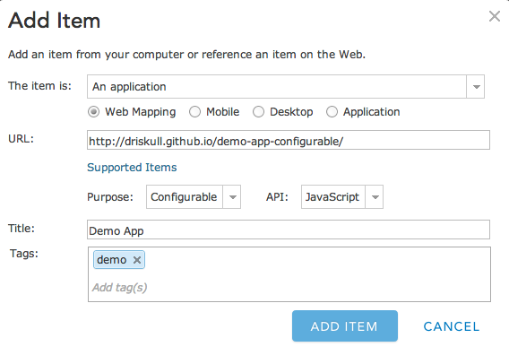
Configurable Item
Application Link
Configurable
Notes:
Make it configurable Web Mapping application
Give it a URL

Slide 12
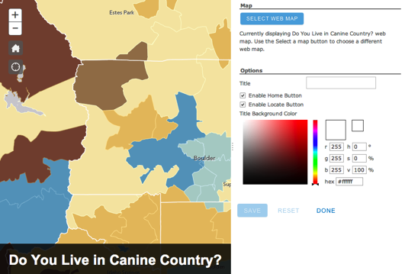
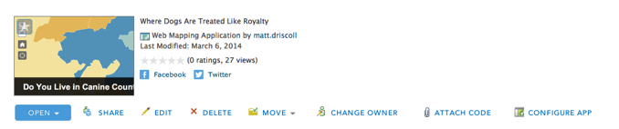
Lets make it configurable!
Configure Button
Notes:
So we want it to be configurable as shown in the second image here

Slide 13
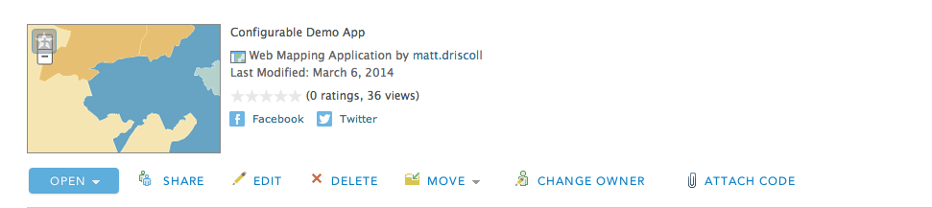
Edit Application Item
Notes:
In order to make it configurable
We need to edit the application

Slide 14
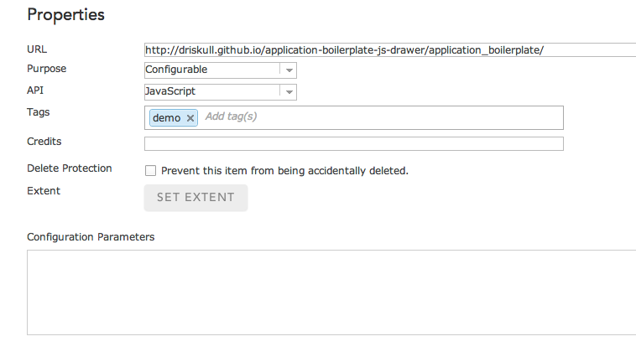

Configuration Parameters
Notes:
When we edit it,
We see this configuration params text box
What is that?
Its JSON!

Slide 15
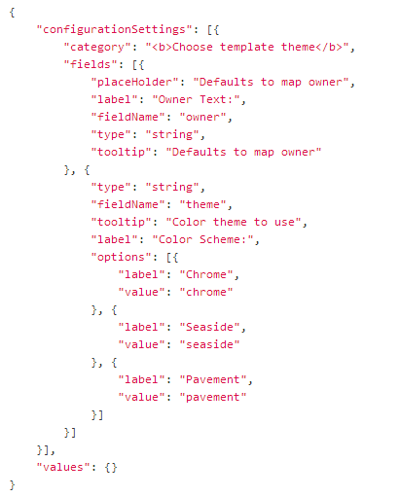
JSON!
Notes:
JSON Like this

Slide 16
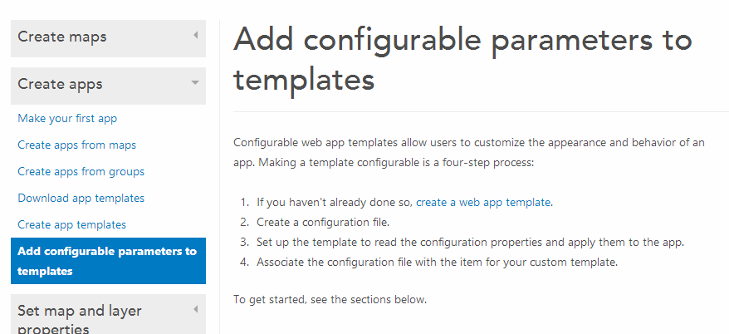
Writing the Configurable JSON
Notes:
Help docs for writing the configurable JSON

