Slide 1
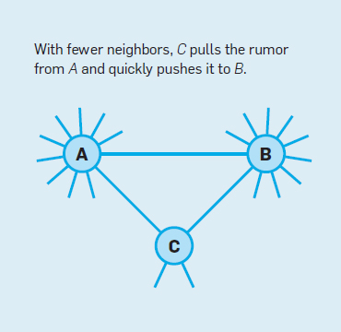
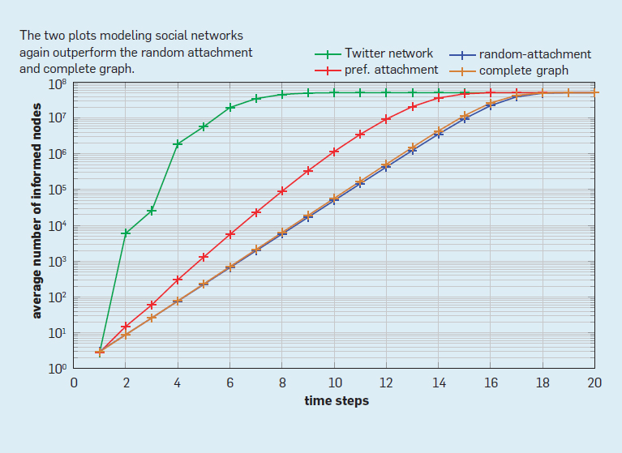
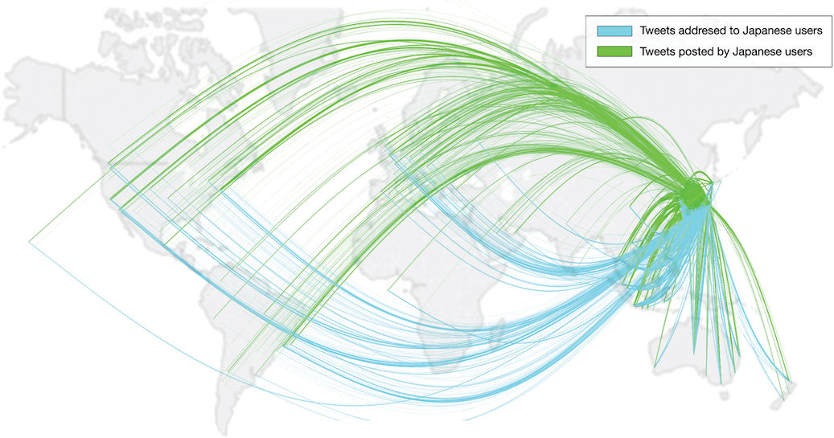
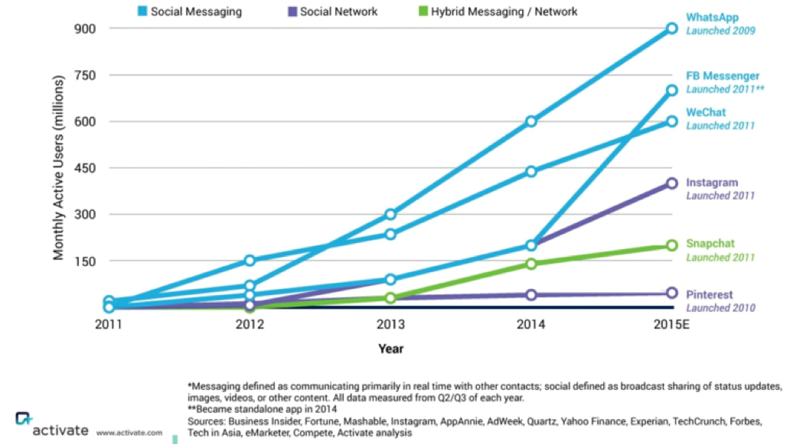
Whoseddit
What?
By Christian Holland
Expansion
The Rumour Analysis Engine
Google/Facebook
WhoSeddit allows the user to enter a hashtag resembling a rumour, and provides an in-depth breakdown of the first time it was posted. It then shows the spread of the rumour throughout other users; whether it was retweeted or simply posted by another user – and shows the link. It shows this breakdown in a graphical user-friendly manner. Due to the (rising) millions of users on Social and Messaging networks, it is important to have a dynamic system that can find links and rumours between the networks to find out the factual basis at the source.
At the moment, WhoSeddit’s progress has allowed it to permit the user to enter any keyword, and it returns the oldest Tweet obtainable by the Twitter API. The current process is beginning to find the relative spread between this Tweet and others.
Heroku/Node.js
HOW?
Google and Facebook are currently in scope for WhoSeddit’s expansion. The hashtag element of WhoSeddit will eventually be only one aspect of the rumour analysis, and the user will be able to choose how they wish to analyse their rumour; through social network choice. This will be implemented as the hashtag is not the only way a rumour can be started – even though hashtags are used on Facebook as well. Websites such as blogs also post content based on a rumour, thus WhoSeddit will eventually provide links to these websites and their references, if the user so chooses.
Twitter API
WhoSeddit is written in Node.js and is hosted on Heroku. Node.js was chosen over the usual PHP/HTML combination; it uses Node Packet Manager allowing third party code to be installed and used easily – which is useful as there are Twitter nodes for creating RESTful applications like WhoSeddit. Node.js also allows the front and backend to be written in one language – Javascript - which makes coding easier. Heroku is used as a platform due to its free usage.
WhoSeddit communicates with the Twitter API in order to retrieve the Tweets required for the analysis. The API offers control over all aspects of Tweets; the furthest of which are 9 days into the past. WhoSeddit will also store the results in its Mongo Database, thus if the rumour has already been analysed before, the results can be merged with the historic tweets in the database. The 9 days limit has been a severe technical issue, as this voids any rumours before the 9 days. Unfortunately there is no workaround for this as of yet, although alternate options are always being investigated. Another technical issue is that the API only allows for 100 Tweets to be retrieved at any one time. This has resulted in the WhoSeddit server having a high load, as it needs to loop through hundreds of requests for 100 Tweets at a time.
Statistics
Diagram 1: Rumours within friend circles
Diagram 2: Rumour spread within Twitter
Diagram 3: Rumour spread globally through Twitter
Diagram 4: Increase of users on social and messaging networks
Diagram 1 shows how quickly rumours can spread when the social circle is small. The nature of the social circle signifies that C will pass on the rumour faster than A or B as there are less people to pass it on to. By the time C has passed on the rumour to its connections, A and B will have only passed the rumour to a small fraction of its connections. By this time, C’s connections would have passed on the rumour to their connections.
Diagram 2 shows the amount of informed nodes of a rumour on Twitter. The amount of informed nodes goes up quickly, most likely due to the Discover section whereby the user is able to see rising and “hot” hashtags on the platform. As more people see the hashtag, more people are inclined to use it, resulting in the sharp rise within a small amount of time. The diagram also shows the preferred attachment; whereby the user consciously shared the rumour from the person they found it from (e.g retweets or through the Search feature). The diagram also shows the random attachment, whereby the rumour is coincidently shared between social circles.
Diagram 3 shows how news and rumours can be spread globally so easily. The diagram displays how Japan alone has a huge foothold on global communication; the diagram is only showing incoming and outgoing Tweets from a single hour period, in March 2011. With the sheer volume of Tweets, this is where WhoSeddit will thrive – getting to the bottom of how they started and the nature of their spread throughout countries, social networks and online platforms.
Diagram 4 shows the amount of users on social and messaging networks over a 4 year period. The increase is proof of the need to understand trends and spread of rumours. For example, WhatsApp has 900 million active users as of the end of 2015. With so many users, it can be almost impossible to track who said what and who begun a rumour, however WhoSeddit aims to be able to achieve this. With so many users on different networks, the link between them for a rumour would be hard to track without a formidable algorithm; that WhoSeddit will be able to provide.
References:
Heroku: https://www.heroku.com/ Node.js: https://nodejs.org/ Twitter API: https://dev.twitter.com/overview/api Diagrams 1-3: http://cacm.acm.org/magazines/2012/6/149793-why-rumors-spread-so-quickly-in-social-networks/fulltext Diagram 4: http://digitalnewsreport.org/publications/2016/predictions-2016/

