Slide 1

Advanced Scripting with Pinnacle³
10/23/2005

Slide 2
Pinnacle³ M-V-C Architecture
View
Controller
User interface, report, data file, remote process
User interface, script, data file, remote process
Query Messages
Set or Action Messages
Model
Pinnacle Process: beams, dose engines, etc.
10/23/2005
2

Slide 3
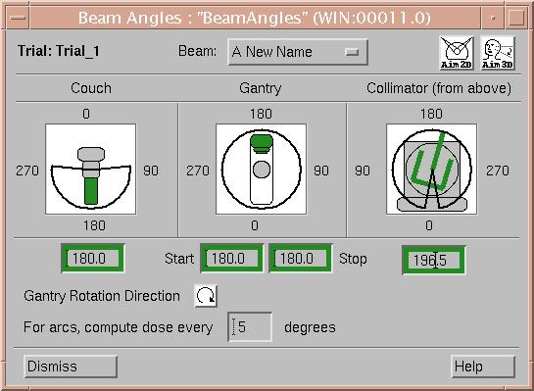
User Interface View/Controller
Each widget in the UI can be used to either “view” or “control” the Pinnacle “model” or both
The value displayed in the widget comes from the “query” message indicated in the Value line
Entering a new collimator angle in the widget launches the message to set the name with the entered value
10/23/2005
3

Slide 4
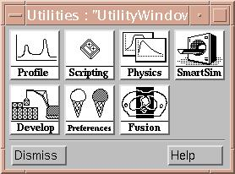
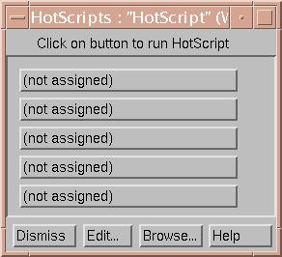
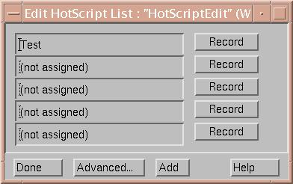
Scripting User Interface
Recording scripts simply captures the Messages sent from the UI to the Model
10/23/2005
5

Slide 5
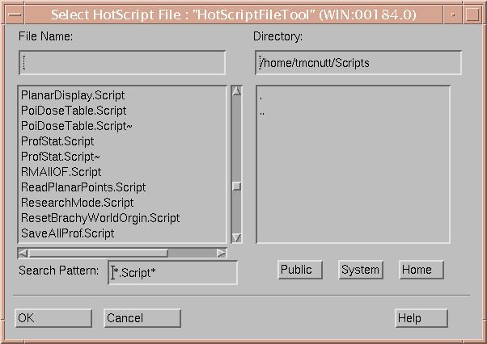
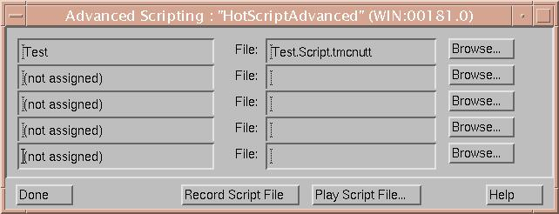
Handwritten Scripts
Run a script directly from a file
Assign a script to a hot script button
10/23/2005
6

Slide 6
Message Syntax
The basic syntax of a command message is:
<SetMessage> = <Value>;
where <Value> can be one of the following:
• A string enclosed in double quotes.
• A floating point or integer number.
• A Query message.
10/23/2005
7

Slide 7
Pinnacle³ Scripts
Sequence of commands:
  // Set the name of the current ROI to “Target”
  RoiList.Current.Name = “Target”;
  // Set the color of the current ROI to red
  RoiList.Current.Color = “red”;
  // Set gantry of last beam equal to gantry of beam “AP”
  TrialList.Current.BeamList.Last.Gantry = TrialList.Current.BeamList.AP.Gantry;
10/23/2005
8

Slide 8
Nesting Messages
Multiple levels of nesting are possible:
TrialList.Current = {
DoseGrid = {
VoxelSize.X = 0.2;
VoxelSize.Y = 0.2;
VoxelSize.Z = 0.2;
};
BeamList.Current = {
Couch = 180.0;
Gantry = 90.0;
Collimator = 0.0;
};
};
10/23/2005
9

Slide 9
Container “ObjectList”
ObjectList is a container object which is used extensively throughout Pinnacle to manage lists of objects.
The following entities are common examples:
TrialList – Root level container of trials
RoiList – Root level container of ROIs
PoiList – Root level container of POIs
DVHList – Root level container of DVH
VolumeList – Root level container of volumes
BeamList – Trial level container of beams
etc…
10/23/2005
10

Slide 10
Creating Child Objects
A “child” is an object in a list (ie beam in a beam list)
The "CreateChild'' message appends a new instance of the child class to the list
TrialList.Current.BeamList.CreateChild = "";
TrialList.Current.BeamList.CreateChildMakeCurrent = "";
Sending the class name to the ObjectList is identical.
TrialList.Current.BeamList.Beam = "";
The "Beam'' message will also route messages to the object
which was last added to the list.
TrialList.Current.BeamList.Beam = {
Couch = 180.0;
Gantry = 90.0;
Collimator = 0.0;
};
The "Beam'' message creates a new beam.
The "Couch'‘, “Gantry”, and “Collimator” messages are routed to last added object.
10/23/2005
11

Slide 11
Identifying Child Objects
Reference by Name:
TrialList.Current.BeamList.Lateral.Couch = 180.0;
TrialList.Current.BeamList.Ant Post.Couch = 180.0;
Reference the 3rd element in the list by Index:
TrialList.Current.BeamList.# "#2".Couch = 180.0;
Special Message “Current”:
TrialList.Current.BeamList.Current.Couch = 180.0;
Special Message “Last”:
TrialList.Current.BeamList.Last.Couch = 180.0;
Special Character “*”:
TrialList.Current.BeamList.# "*".Couch = 180.0;
TrialList.# "*".BeamList.# "*".Couch = 180.0;
10/23/2005
12

Slide 12
ObjectList Controls
Destroy the current child and remove from the list:
TrialList.Current.BeamList.Current.Destroy = "";
Remove the current child from the list (don’t free memory):
TrialList.Current.BeamList.Current.Remove = "";
Make the last child current:
TrialList.Current.BeamList.Last.MakeCurrent = "";
Return the number of elements in the list:
TrialList.Current.BeamList.Count;
Add 3 children (Note this won’t work for beams):
RoiList.AddChildren = 3;
For adding beams use:
CreateNewBeam = "Add New Beam";
10/23/2005
13

Slide 13
Sorting ObjectList
An ObjectList can be sorted by any child object key.
Sort the beam list by couch angle in ascending order:
TrialList.Current.BeamList.SortBy.Couch = "";
Multiple keys can be specified:
TrialList.Current.BeamList.
SortBy.Couch.Gantry = "";
To do a descending sort, precede the attribute with "D'‘.
The primary sort key is the couch angle in ascending order.
The secondary sort key is the gantry angle in descending order.
TrialList.Current.BeamList.
SortBy.Couch.D.Gantry = "";
10/23/2005
14

Slide 14
Control Commands
Exiting the System:
Quit = “”;
QuitWithSave = “”;
Saving Plan:
SavePlan = “”;
Echo String to the Console:
Echo = “Starting My Script”;
10/23/2005
15

Slide 15
UI Control Messages
Displaying Wait Messages in Status Bar:
WaitMessage = "Doing something slow...";
...
WaitMessage = “Doing something slower…”;
...
WaitMessageOff = "";
Issuing a Warning Message (Requires user interaction):
WarningMessage = "This is a test.";
Issuing an AskYesNo Window
AskYesNoPrompt = “Are you having fun?”;
AskYesNoDefault = 1; // Default yes
IF.AskYesNo.THEN.WarningMessage = “Having fun!”;
10/23/2005
16

Slide 16
Dismissing an expected Yes/No or warning message.
Dismiss the next yes/no message and reply yes:
Test.ExpectAskYesNo = 1;
Test.ExpectedAskYesNoReply = 1; // Yes
Dismiss the next yes/no message with the text “Warning text” and reply no:
Test.ExpectAskYesNo = “Warning text”;
Test.ExpectedAskYesNoReply = 0; // No
Dismiss the next warning message:
Test.ExpectWarningMessage= 1;
Dismiss the next warning message with the text “Warning text”:
Test.ExpectWarningMessage= “Warning text”;
10/23/2005
17

Slide 17
System Commands
Running a system command or external program:
SpawnCommand = “ProcessData –infile myinfile";
SpawnCommandNoWait = "xclock";
Executing another Script:
ExecuteNow = “/home/pinnbeta/MyScript.Script”;
10/23/2005
18

Slide 18
Finding Messages
The following files contain message strings you can use for examples when creating your own scripts:
Recorded Scripts
Transcript Files
Plan Files (Instituiton_x/Mount_y/Patient_z/Plan_a)
GUI Configuration files (PinnacleStatic/Config)
Additionally you can save any object to get a list of the persistent messages of the object:
TrialList.Current.BeamList.Current.Save =
"/files/rtp/Beam.out";
The file Beam.out will contain messages similar to the following:
IsocenterName = "Poi_1";
PrescriptionName = "Prescription_1";
PrescriptionPointName = "isocenter";
Name = "AP";
MachineNameAndVersion =
"PhotonQAMachine2: 96/03/29 15:59:29";
Modality = "Photons";
MachineEnergyName = "10 MV";
10/23/2005
19

Slide 19
Variables - The Store
The Store is a dictionary that associates objects with user-specified strings
The Store is a non-persistent attribute of the Root object, accessed via the “Store” message.
Store objects can be created for any object.
“MyFloatAttribute”
ptFloatObject
“MyStringAttribute”
ptStringObject
“MyBeamReference”
ptBeamReference
...
...
10/23/2005
20

Slide 20
Float Entries in the Store
Creating Float Entry
Store.FloatAt.MyFloatAttribute = 1.23;
Modifying Float Entry
Store.At.MyFloatAttribute.Value = 2.34;
Store.FloatAt.MyFloatAttribute = 2.34;
Deleting a Float Entry in the store
Store.FreeAt.MyFloatAttribute = “”;
10/23/2005
21

Slide 21
Numeric Operations
Add, Subtract, Multiply, and Divide syntax
Store.At.MyFloatAttribute.Add = 23.0; Adds 23 to MyFloat
Square, SquareRoot, Negate, and Invert(1/x) Syntax
Store.At.MyFloatAttribute.SquareRoot = “”; Replaces MyFloat with SQRT(MyFloat)
Round, Nint, and Absolute
Store.At.MyFloatAttribute.Round = “”; Rounds MyFloat
Can also be used as a Query
Store.FloatAt.MyFloatAttribute = Store.FloatAt.MyOtherFloat.Round;
10/23/2005
22

Slide 22
Numeric Operation Example
(add 10 degrees to the current beam’s gantry angle)
Store.FloatAt.MyFloatAttribute = TrialList.Current.BeamList.Current.Gantry;
Store.At.MyFloatAttribute.Add = 10.0;
TrialList.Current.BeamList.Current.Gantry = Store.FloatAt.MyFloatAttribute;
Store.FreeAt.MyFloatAttribute = “”;
10/23/2005
23

Slide 23
String Entries in the Store
Creating a String Entry
Store.StringAt.MyStringAttribute = “ABC”;
Modifying a String Entry
Store.At.MyStringAttribute.String = “DEF”;
Store.StringAt.MyStringAttribute = “DEF”;
Concatenating Strings
Store.At.MyStringAttribute.AppendString = “XYZ”;
Store.At.MyStringAttribute.AppendString =
RoiList.Current.Name;
Deleting a String Entry
Store.FreeAt.MyStringAttribute = “”;
10/23/2005
24

Slide 24
(Beam) References in the Store
Creating the Reference
Store.At.MyBeamReference =
TrialList.Current.BeamList.Current.Address;
Modifying the Reference
Store.At.MyBeamReference.Gantry = 123;
Store.At.MyBeamReference.Couch = 234;
Removing the Reference
Store.RemoveAt.MyBeamReference = “”;
*** Do not use FreeAt, it destroys the Beam object ***
Query the Address of an existing object
10/23/2005
25

Slide 25
Conditional Statements
IF.key1.OP.key2.THEN.action1.ELSE.action2 = value;
Where OP is:
Example:
IF.TrialList.Count.EQUALTO.# "#1".THEN.TrialList.
CreateChild.ELSE.TrialList.Last.MakeCurrent=1;
Numeric | String | Logical
EQUALTO | STRINGEQUALTO | AND
NOTEQUALTO | STRINGNOTEQUALTO | OR
GREATERTHAN | IS | XOR
LESSTHAN | ISNULL
GREATERTHANOREQUALTO | CONTAINS
LESSTHANOREQUALTO
10/23/2005
26

Slide 26
Conditional Statements
IF.key.THEN.action1.ELSE.action2 = value;
Where key is a boolean query.
IF.key.THEN.action = value;
10/23/2005
27

Slide 27
Example String Conditional Statements
Is: IF.Store.At.MyString.Is.xyz.
THEN.WarningMessage = “It’s xyz!”;
IsNull: IF.Store.At.MyString.IsNull.
THEN.WarningMessage = “It’s empty!”;
Contains: IF.Store.At.MyString.Contains.xyz.
THEN.WarningMessage = “Contains xyz!”;
10/23/2005
28

Slide 28
The Execute Statement
Store.StringAt.MyCommand =
“RoiList.Current.Density = 1.23”;
Store.At.MyCommand.Execute = “”;
Store.StringAt.MyCommand =
“RoiList.Current.Density = RoiList.Bone.Density”;
Store.At.MyCommand.Execute = “”;
Store.StringAt.MyCommand =
“RoiList.Current.Name = #Bone”;
Store.At.MyCommand.Execute = “”;
String literal delimiter
10/23/2005
29

Slide 29
Saving and Reloading the Store
Store.Save = “/home/pinnbeta/MyStore.Script”;
File name
Store.Load = “/home/pinnbeta/MyStore.Script”;
Note: The existing Store is not emptied before loading.
10/23/2005
30

Slide 30
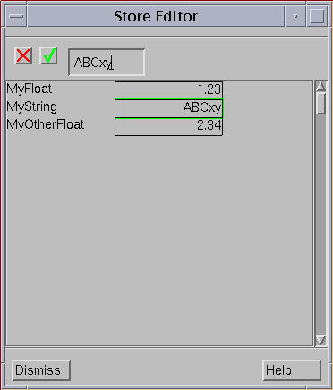
Editing the Store
WindowList.MyStoreEditor.CreateStoreEditor = “Store.Address”;
Name of the window
Command to create an editor window or launch the existing window
Address of the root Store object
Supports Strings and Floats
Relaunch using the same command (existing window will be launched)
Parameters can be edited by the user.
Script continues after window launches without waiting for user input.
10/23/2005
31

Slide 31
Forcing User Entry Using the Store
WindowList.MyStoreEditor.CreateStoreEditor = “Store.Address”;
// Dismiss the window
WindowList.MyStoreEditor.Unrealize = “”;
// Make it modal
WindowList.MyStoreEditor.IsModal = 1;
//Re-launch the window
WindowList.MyStoreEditor.Create = “”;
// Continue with script
...
10/23/2005
32

Slide 32
Custom Data Example
A Store object can be created for any object in the hierarchy (e.g. ROI, beam, wedge)
All functionality is identical to the root Store, except that:
  The data is persistent
  The data is copied with the object.
The Store is specific to each instance of the class, not the object class. (e.g. two beams might have different sets of parameters.)
TrialList.Current.BeamList.
Current.Store.FloatAt.MyFloatAttribute = 123.4;
This command:
Creates a Store specific to the current beam.
Adds a float object to the Store named MyFloatAttribute with a value of 123.4
10/23/2005
33

Slide 33
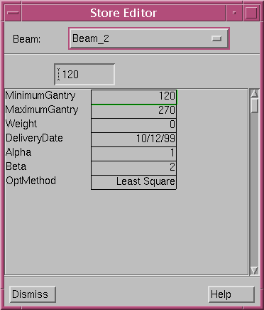
Custom Data Example
TrialList.Current.BeamList.Current.Store = {
FloatAt.MinimumGantry = 120.0;
FloatAt.MaximumGantry = 270.0;
FloatAt.Weight = 0.0;
StringAt.DeliveryDate = “1/12/06”;
FloatAt.Alpha = 1.0;
FloatAt.Beta = 1.0;
StringAt.OptMethod = “Least Square”;
};
WindowList.BeamStoreEditor.CreateStoreEditor = “TrialList.Current.BeamList.Current.Store.Address”;
10/23/2005
34

Slide 34
Adding a Dependency
KeyDependencyList.CreateChild = "";
KeyDependencyList.Last = {
Name = "IsocenterDependency";
KeyString = "TrialList.Current.BeamList.Current.Isocenter.ZCoord";
AddAction = "ViewWindowList.#0.SlicePosition = TrialList.Current.BeamList.Current.Isocenter.ZCoord";
};
Pans the first viewing window to the isocenter slice.
Pans the image when:
  The isocenter Z coordinate changes ZCoord
  The beam’s isocenter changes Isocenter
  The current beam changes BeamList.Current
  The current trial changes TrialList.Current
Remove dependency
KeyDependencyList.IsocenterDependency.Destroy = “”;
10/23/2005
35

Slide 35
Executing a Script from a Dependency
KeyDependencyList.CreateChild = "";
KeyDependencyList.Last = {
Name = ”NewRoiDependency";
KeyString = ”RoiList.Count";
AddAction = ”Script.ExecuteNow = #/home/pinnbeta/MyRoiScript.Script";
};
Executes MyRoiScript.Script whenever the number of ROIs changes.
ExecuteNow executes the specified script immediately.
10/23/2005
36

Slide 36
Iterating
Method 1
  The Root message redirects the action to the Root object.
  The script makes each ROI current, then executes the rest of the command.
RoiList.ChildrenEachCurrent.#”@”.
Root.Script.LoadNoCheckSum = “/home/pinnbeta/MyScript.Script”;
Method 2
  Recursive scripts can also be used to iterate over methods
10/23/2005
37

Slide 37
Controlling Viewing Windows
For a window named XYZ: (See the BEV selection menu for names.)
ViewWindowList.XYZ.Orientation = "Sagittal"; (or "Transverse" or "Coronal")
ViewWindowList.XYZ.InterpMode = "Nearest Neighbor Interpolation";
(or "Linear Interpolation")
ViewWindowList.XYZ.Enter2dMode = 1;
.Enter3dMode = 1;
.SetNextTrial = 1;
.NextImage = 1;
.PreviousImage = 1;
.SliceNumber = 23;
.UserSliceNumber = 24;
.SlicePosition = 13.5;
.PanToFraction = 0.5 // Pan to slice which is 50% through data set.
.ScaleZoom = 2.0; // Doubles the current zoom factor.
.Zoom = 1.0; // Sets zoom to 1.0 (life size.)
.ZoomToWindow = 1; // Fit slice to window
10/23/2005
38

Slide 38


