Slide 1
AI and the Future of Work
October 2025
Case Western Reserve University
Weatherhead School of Management
Sining Wang. PhD

Slide 2
Timeless Fear: Will Technology Take Our Jobs?
First Industrial Revolution – Machines replacing artisans (1800s)
Second Industrial Revolution – Mass production powered by electricity (1900s)
Third Industrial Revolution – Automation powered by computer (1960s)
Fourth Industrial Revolution – Connectivity powered by internet (1990s)
Now?
Notes:
Whenever a new technology arrives, one question always comes first: Will it take our jobs?
And it’s not a new question at all — it’s a timeless fear.
In the 1800s, during the Industrial Revolution, machines replaced musles In the 1980s, automation and computers started replacing office and factory work. And now, in the 2020s, artificial intelligence is coming for knowledge work — the part of the economy we once thought was safely human.
Each time, the story begins the same way: anxiety, uncertainty, headlines warning of job loss.
But if we look back, something interesting happens after every wave of disruption — work doesn’t vanish; it transforms.
The challenge today is to understand whether this time is truly different.
Is AI just the next chapter in that same story… or are we crossing a new frontier?

Slide 3

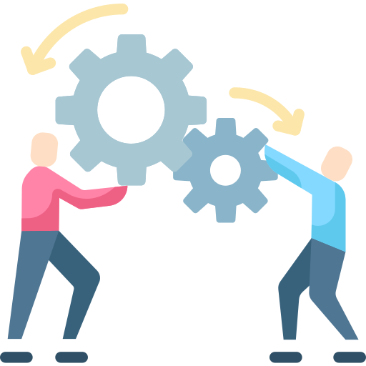

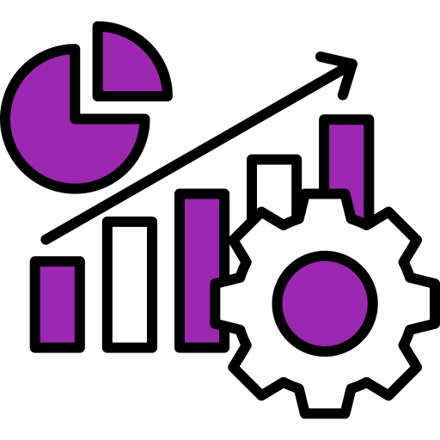
AI Feels Different— But Data Tells a More Nuanced Story
AI is everywhere
It changes what we do
It helps firms grow
It reshapes opportunities
Notes:
For the first time, technology isn’t just automating physical labor or routine office work — it’s entering the cognitive space: writing, designing, analyzing, even reasoning. It touches the very kinds of work many of us identify with — teaching, research, management, creativity.
That’s why the anxiety feels stronger this time.
But if we step back and look at the data, the story turns out to be more nuanced.
AI is indeed spreading rapidly across firms and industries — it’s everywhere. Yet when we look closely, it’s not eliminating entire occupations. It’s changing what people do inside those jobs, how firms organize work, and who captures the new opportunities.”

Slide 4
AI Reallocates Tasks More than It Eliminates Jobs
Notes:
So, let’s look at what the data actually tell us.
Across industries and firms, AI doesn’t seem to be wiping out entire occupations. Instead, it’s changing the mix of tasks inside them — what people spend time on, what gets automated, and what new work emerges.
In other words, AI reallocates tasks more than it eliminates jobs

Slide 5
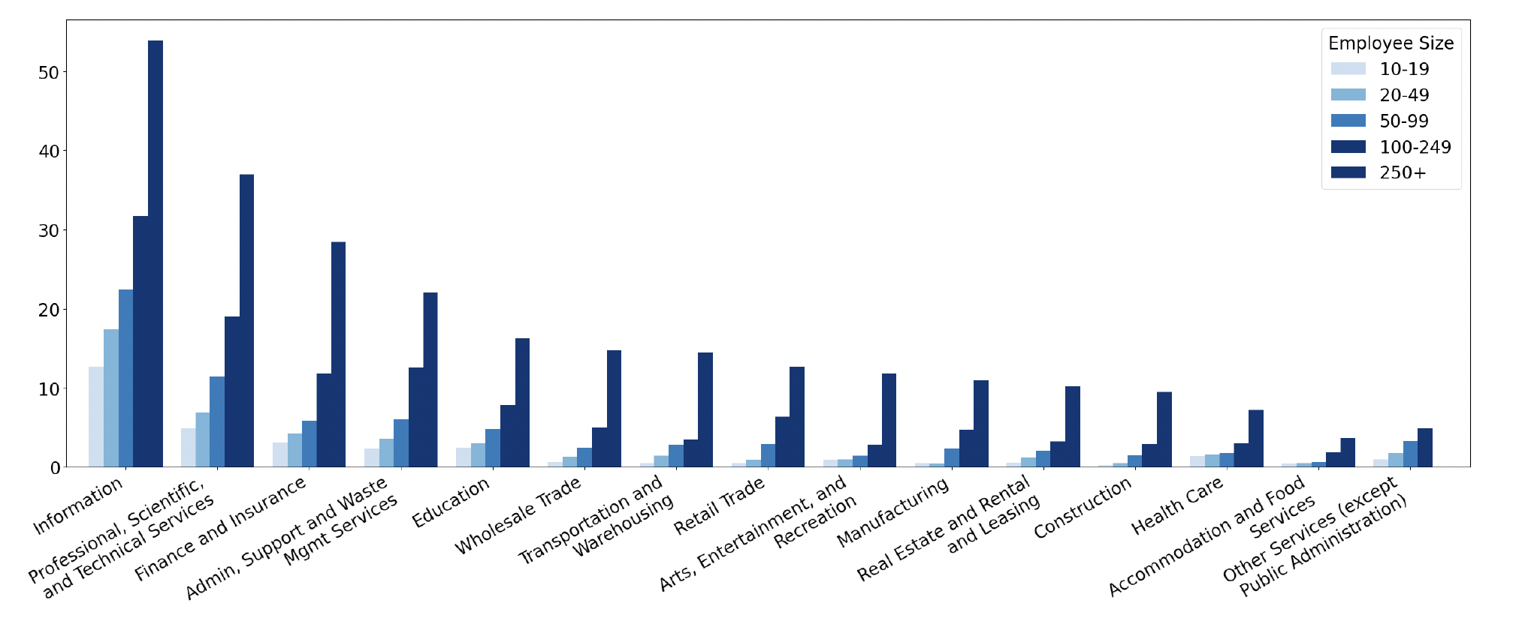
AI Has Been Widely Adopted (2014 — 2023)
Information | 50%
Professional Services | 36%
Finance and Insurance | 31%
Across Industry | 25%
Source: Hampole et al (2025). Artificial Intelligence and the Labor Market
Notes:
Let's first zoom out and see what the data say about how widely AI has been adopted.
This figure track AI adoption across U.S. industries, capture adoption patterns up to the end of 2023.
Even at that point, On average, about one in four firms—that’s roughly 25 percent—have used AI in at least one part of their operations during this period.
Adoption isn’t uniform, though. You can see that it’s highest in information and technology industries—around 50 percent of firms, followed by professional services at 36 percent and finance and insurance at about 31 percent.
Sectors like manufacturing, healthcare, and food services are much lower—typically under 15 percent—but the trend is upward across every sector.
The different shades of blue show firm size, and notice how adoption rises sharply with size. Larger firms—those with over 250 employees—are consistently the most active adopters.
So the takeaway is that AI isn’t a niche experiment anymore—it’s broadly integrated into how modern firms operate, especially in information-intensive sectors.

Slide 6
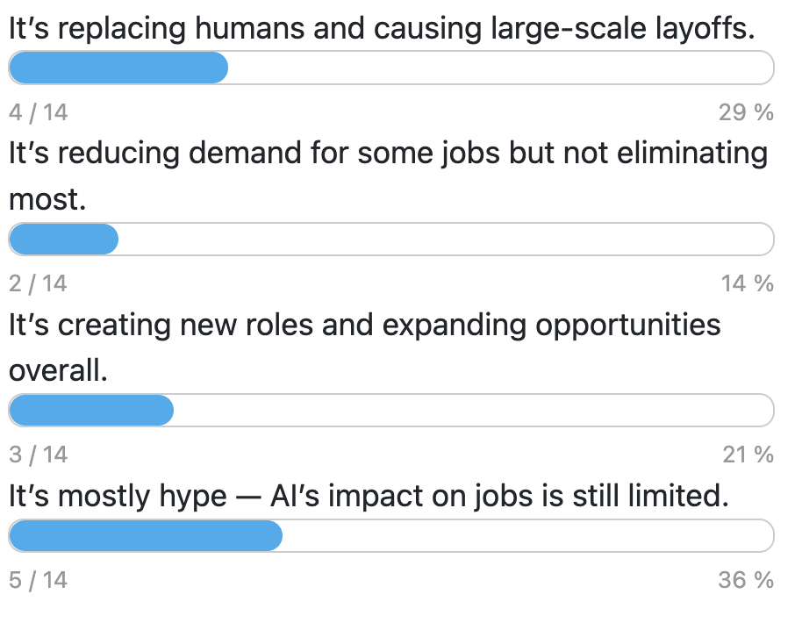
From our audience
Overall, what do you think is the main impact of AI on jobs today?

Slide 7
What a “Job” looks like?
Cyber Security Analyst (2020)
Responsibilities:
Monitor consolidated security dashboards and review automated alerts.
Investigate flagged anomalies and prepare incident summaries.
Coordinate with IT teams to apply patches and mitigations.
Maintain incident records and report recurring issues.
Participate in quarterly threat-assessment reviews.
Cyber Security Analyst (2025)
Responsibilities:
Monitor consolidated security dashboards and review automated alerts.
Investigate flagged anomalies and prepare incident summaries.
Coordinate with IT teams to apply patches and mitigations.
Participate in quarterly threat-assessment reviews.
Identify emerging threat patterns and propose detection improvements.
Notes:
What do you do for a living joke
and more formally, the best place to find a description on any job title, is on job posting.
If you actually wanted to know what a specific job looks like, go to linkedin, or Indeed, or any job board, and search that title This is an example job posting. most importantly, a job is being best described by its responsibilities.
Overtime, under the same title, or very similar titles, the descriptions about responsibilities will change

Slide 8
Is this Job Disappeared?
Cyber Security Analyst (2020)
Responsibilities:
Monitor consolidated security dashboards and review automated alerts.
Investigate flagged anomalies and prepare incident summaries.
Coordinate with IT teams to apply patches and mitigations.
Maintain incident records and report recurring issues.
Participate in quarterly threat-assessment reviews.
Cyber Security Analyst (2025)
Responsibilities:
Monitor consolidated security dashboards and review automated alerts.
Investigate flagged anomalies and prepare incident summaries.
Coordinate with IT teams to apply patches and mitigations.
Participate in quarterly threat-assessment reviews.
Identify emerging threat patterns and propose detection improvements.
Notes:
to make our like a little easier, I highlighted what changed about this job over time

Slide 9
Tasks vs. Jobs
A job (occupation) is made up of many tasks — the concrete things workers do (e.g., “analyze data,” “meet clients,” “prepare reports”, “coordinate with other”).
Job-level exposure treats the entire occupation as one unit — it says, “this job is exposed to AI or not.”
Task-level exposure looks inside the job to see which specific tasks are affected by AI
Notes:
Job-level measures miss that nuance — they assume “AI affects accountants” or “doesn’t affect teachers,” ignoring which parts of the job (e.g., grading vs. mentoring) are actually impacted.

Slide 10
Task-level AI exposure
Hampole et al (2025). Artificial Intelligence and the Labor Market
This work analyzed about 58 million résumés and 14 million job postings from U.S. companies between 2010 and 2023 and extract tasks from those data.
For each task, they measure how exposed it was to AI —how similar the task was to what AI systems were being trained to do.

Slide 11
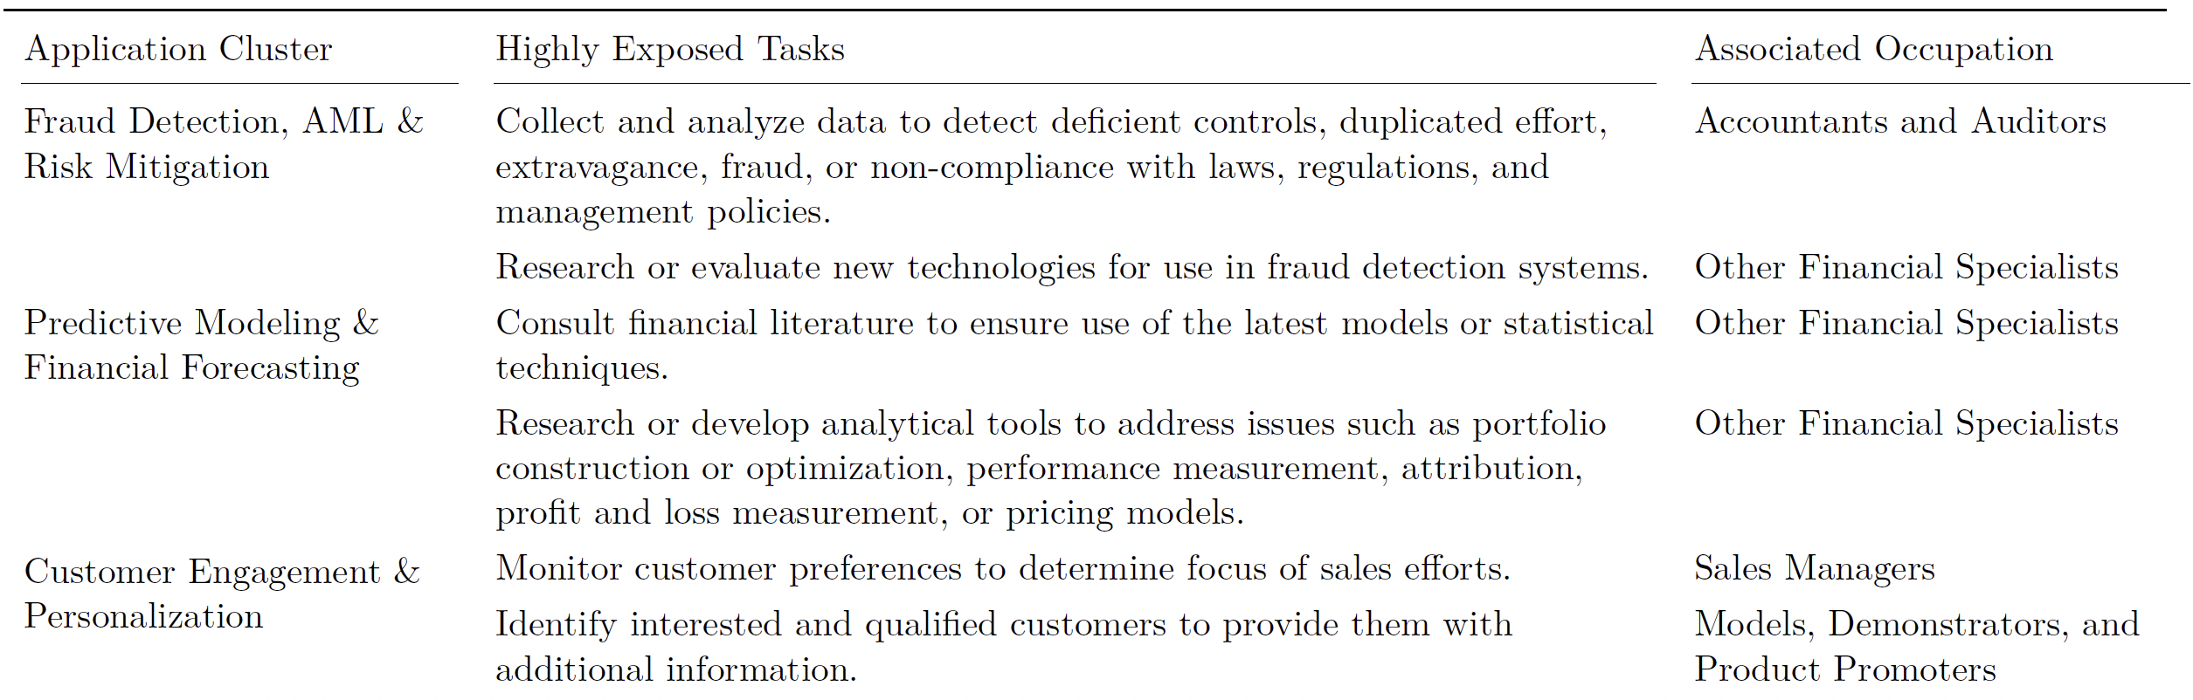
Tasks, Jobs, and AI Use Cases
Source: Hampole et al (2025). Artificial Intelligence and the Labor Market

Slide 12
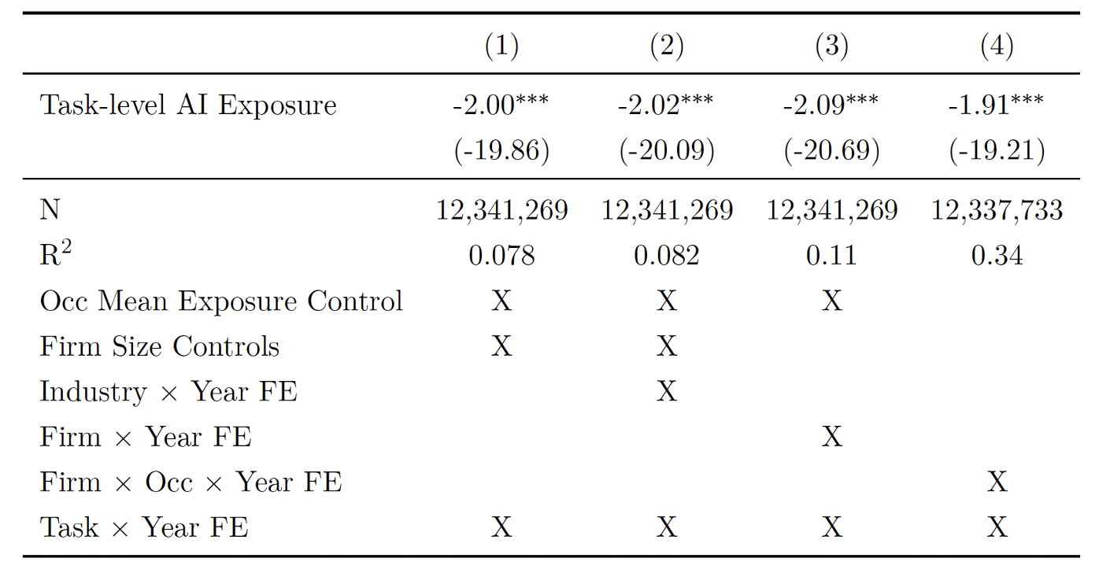
AI-exposed Tasks Quietly Vanish From Job Postings
Dependent Variable: 5-Year change in how frequently a skill appears in job postings.
Interpretation:
Tasks highly exposed to AI decreased in job posting
Each 1SD increase in AI exposure reduce task demand by ~2%
Source: Hampole et al (2025). Artificial Intelligence and the Labor Market
Notes:
Dependent variable : how often skills associated with a specific task show up in job postings over time.
Here’s what the math says: for tasks AI can handle well, mentions in job ads fall by about two percent. The job stays, but its contents shrink.”
Nowadays it is rare to see a job posting that contains the task "use Microsoft word to process document"

Slide 13
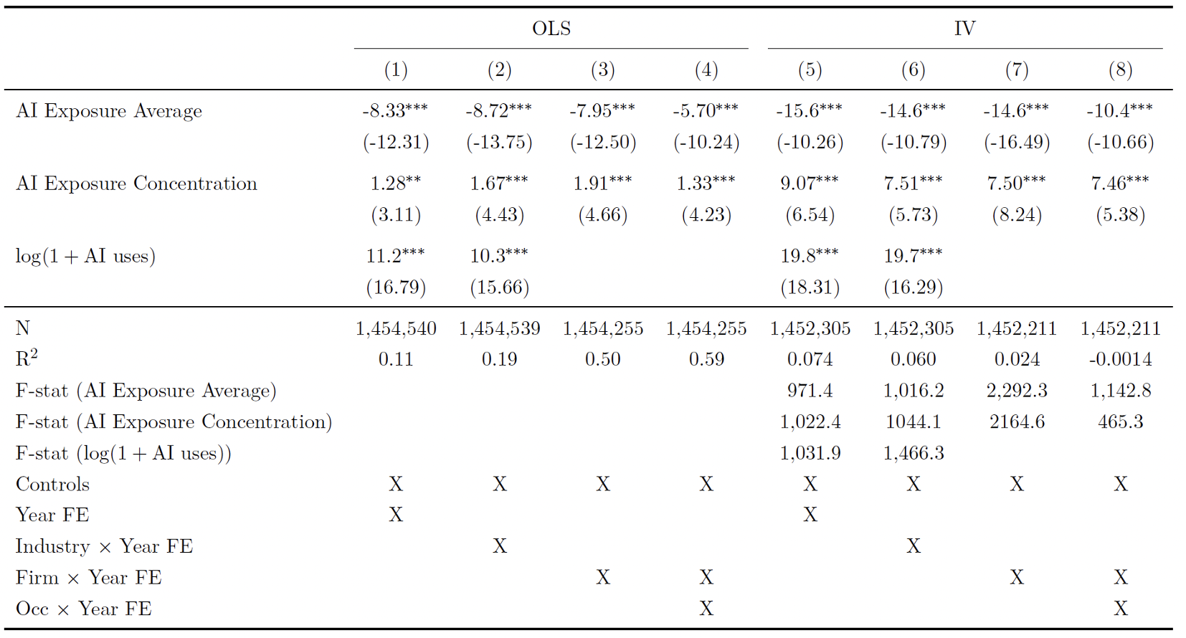
AI Adoption Promote Employment
Employment Opportunity on Firm-Occupation Level
Interpretation:
AI-exposed Jobs: Occupations that have many tasks exposed to AI
AI-Augmenting Jobs: Occupations that have some tasks being affected, and some tasks unaffected by AI
AI-exposed jobs: 8% --15% fewer opportunities
AI-Augmenting jobs: 7% -- 10% more opportunities
Source: Hampole et al (2025). Artificial Intelligence and the Labor Market
Notes:
So far, we’ve seen that AI changes the tasks inside jobs, and that adopting firms often grow. But what about who gets hired?
This table looks at employment opportunities at the firm–occupation level — in other words, how likely a firm is to post or hire for a given occupation once AI enters.
The red row shows the effect of AI exposure average — that is, when a job’s tasks are highly automatable by AI. The coefficients are all negative, around –8 to –15. That means occupations heavily exposed to AI see 8–15 percent fewer employment opportunities within firms.
But notice the green row — AI exposure concentration — that measures firms that focus AI on just a few occupations. The coefficients there are positive, roughly +1 to +9. Those firms are expanding opportunities in specific AI-augmented roles.
Finally, the last green box shows log(1 + AI uses) — a measure of firm adoption intensity — also strongly positive. So overall, firms that adopt AI hire more, but the distribution shifts: some occupations shrink, while others grow sharply.”
AI exposed occupation drop is understandable
Why AI augmenting occupations are increasing?

Slide 14
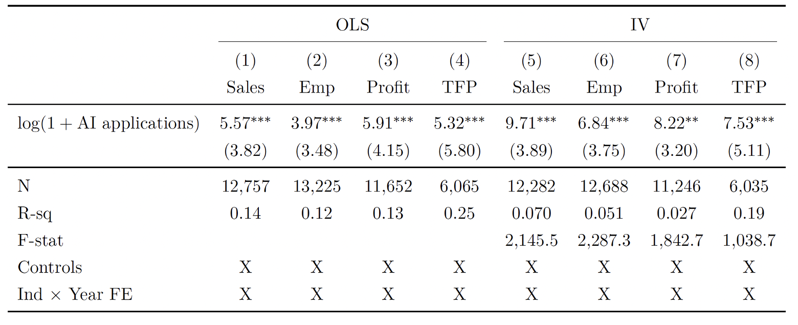
AI Adoption Promote Firm Growth
Higher Sales, Higher Profits, More Employment, More Productive
Interpretation:
Firms that adopt AI grow faster
Sales Increase about 5.6% ~ 9.7%
Employment increase 4% ~ 7%
Profit increase 6% ~ 8%
Productivity increase 5% ~ 7%
Dependent Variable: 5-Year Growth Rate on Firm Level
Source: Hampole et al (2025). Artificial Intelligence and the Labor Market

Slide 15
AI Reallocates Tasks More than It Eliminates Jobs
AI does replace certain tasks. The data show a clear drop in demand for repetitive or codifiable tasks.
Task-level substitution is strong People reallocate their time on tasks that are not affected by AI (task reallocation )
Firms adopting AI aren’t downsizing— they are growing faster and hiring more overall (productivity spillovers)
AI exposure mainly changes what people do, not whether they work.

Slide 16
While some tasks shrink, new ones grow, and firms that adopt AI actually hire more people. Work doesn’t disappear; it gets rearranged.

Slide 17
Who Gets Replaced — and Why
AI’s impact depends on experience, skill type, and the nature of knowledge.
Notes:
So far, the data show that AI isn’t wiping out jobs across the economy—it’s rearranging what people do. But averages can hide what’s happening underneath. Every technological shift starts by reshaping the edges of the labor market first—often where workers have less experience or bargaining power. To understand the early signals of change, let’s zoom in from the 30,000-foot view of the labor market to what’s happening on the ground—especially for those entering it for the first time.

Slide 18
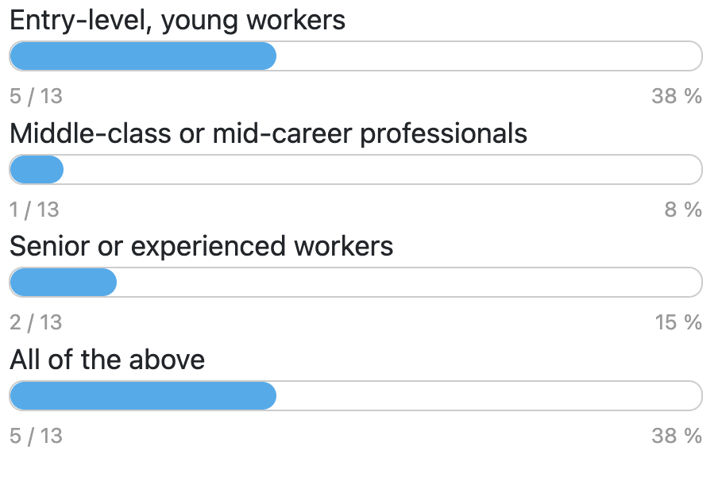
From the audience
Which group do you think is most negatively affected by the rise of AI?

Slide 19
Data Behind the Evidence (Brynjolfsson et al, 2025).
Source: ADP payroll microdata—monthly employee records to Jul 2025
Coverage: Millions of workers, tens of thousands of firms
What it measures: Realized employment changes since late-2022 (by age/experience & exposure)
Source: Brynjolfsson et al (2025). Canaries in the Coal Mine? Mine? Six Facts about the Recent Employment Effects of Artificial Intelligence
Notes:
it’s important to understand where these numbers come from.
Brynjolfsson and his co-authors use a remarkable dataset from ADP (automatic data processing), the largest payroll processor in the United States. It process roughly 1 in 6 private-sector workers in the U.S.
It’s administrative, not survey data — meaning it tracks actual employment and paychecks every month for millions of workers across tens of thousands of firms.
The researchers link those payroll records to measures of AI exposure by occupation, derived from how closely each job’s tasks align with what modern AI systems — like GPT-4 — can perform.
This linkage allows them to see, in near real time, how employment changes inside firms and occupations as AI diffuses — who’s being hired, who’s leaving, and whether those patterns differ by age and seniority.
Because the data extend through mid-2025, it gives one of the most up-to-date and credible pictures of AI’s impact on the U.S. workforce.”

Slide 20
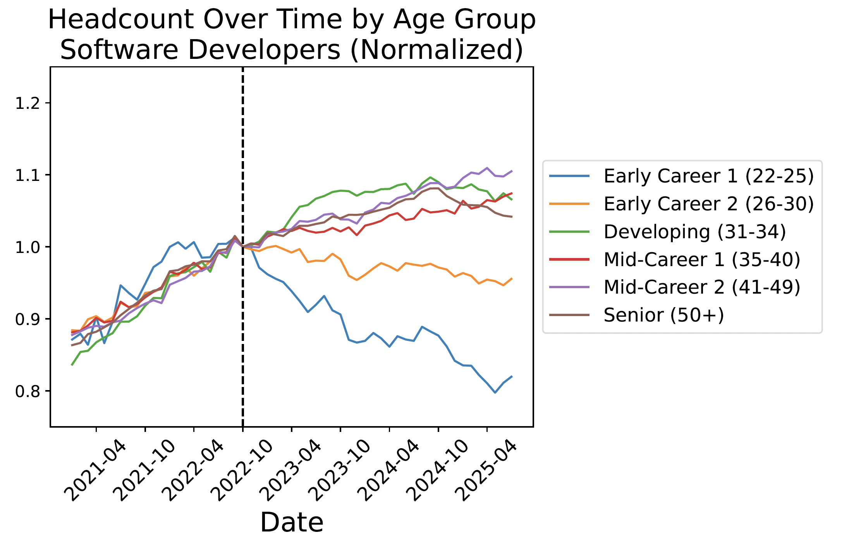
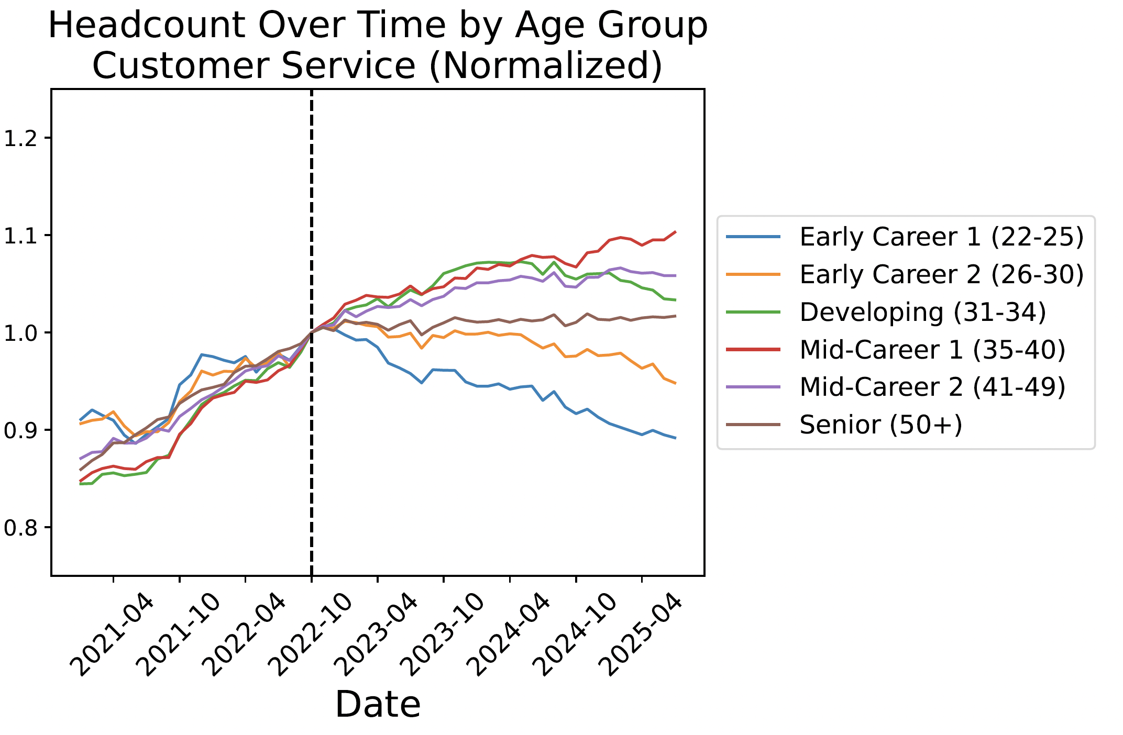
Employment for Young Workers has Declined
Source: Brynjolfsson et al (2025). Canaries in the Coal Mine? Mine? Six Facts about the Recent Employment Effects of Artificial Intelligence
Notes:
“This figure shows what’s been happening inside firms since the rise of generative AI.
On both panels, the vertical dashed line marks the release of ChatGPT — roughly late 2022 — the point when generative AI began diffusing widely.
The lines track employment by age group, normalized so that each group starts at the same level in 2021.
Focus on the blue line — that’s early-career workers, age 22–25.
You can see that right after the widespread adoption of AI tools, employment for this youngest group drops sharply, while older workers — especially those in their late 30s, 40s, and 50s — either remain stable or grow.
The same pattern appears in two very different occupations — software development, on the left, and customer service, on the right.
In both, young workers lose ground — roughly a 13% decline relative to older peers — suggesting that entry-level tasks, the ones new hires typically start with, are being automated away.
So even though overall employment in these firms might be stable or growing, the entry points for young workers are shrinking.

Slide 21
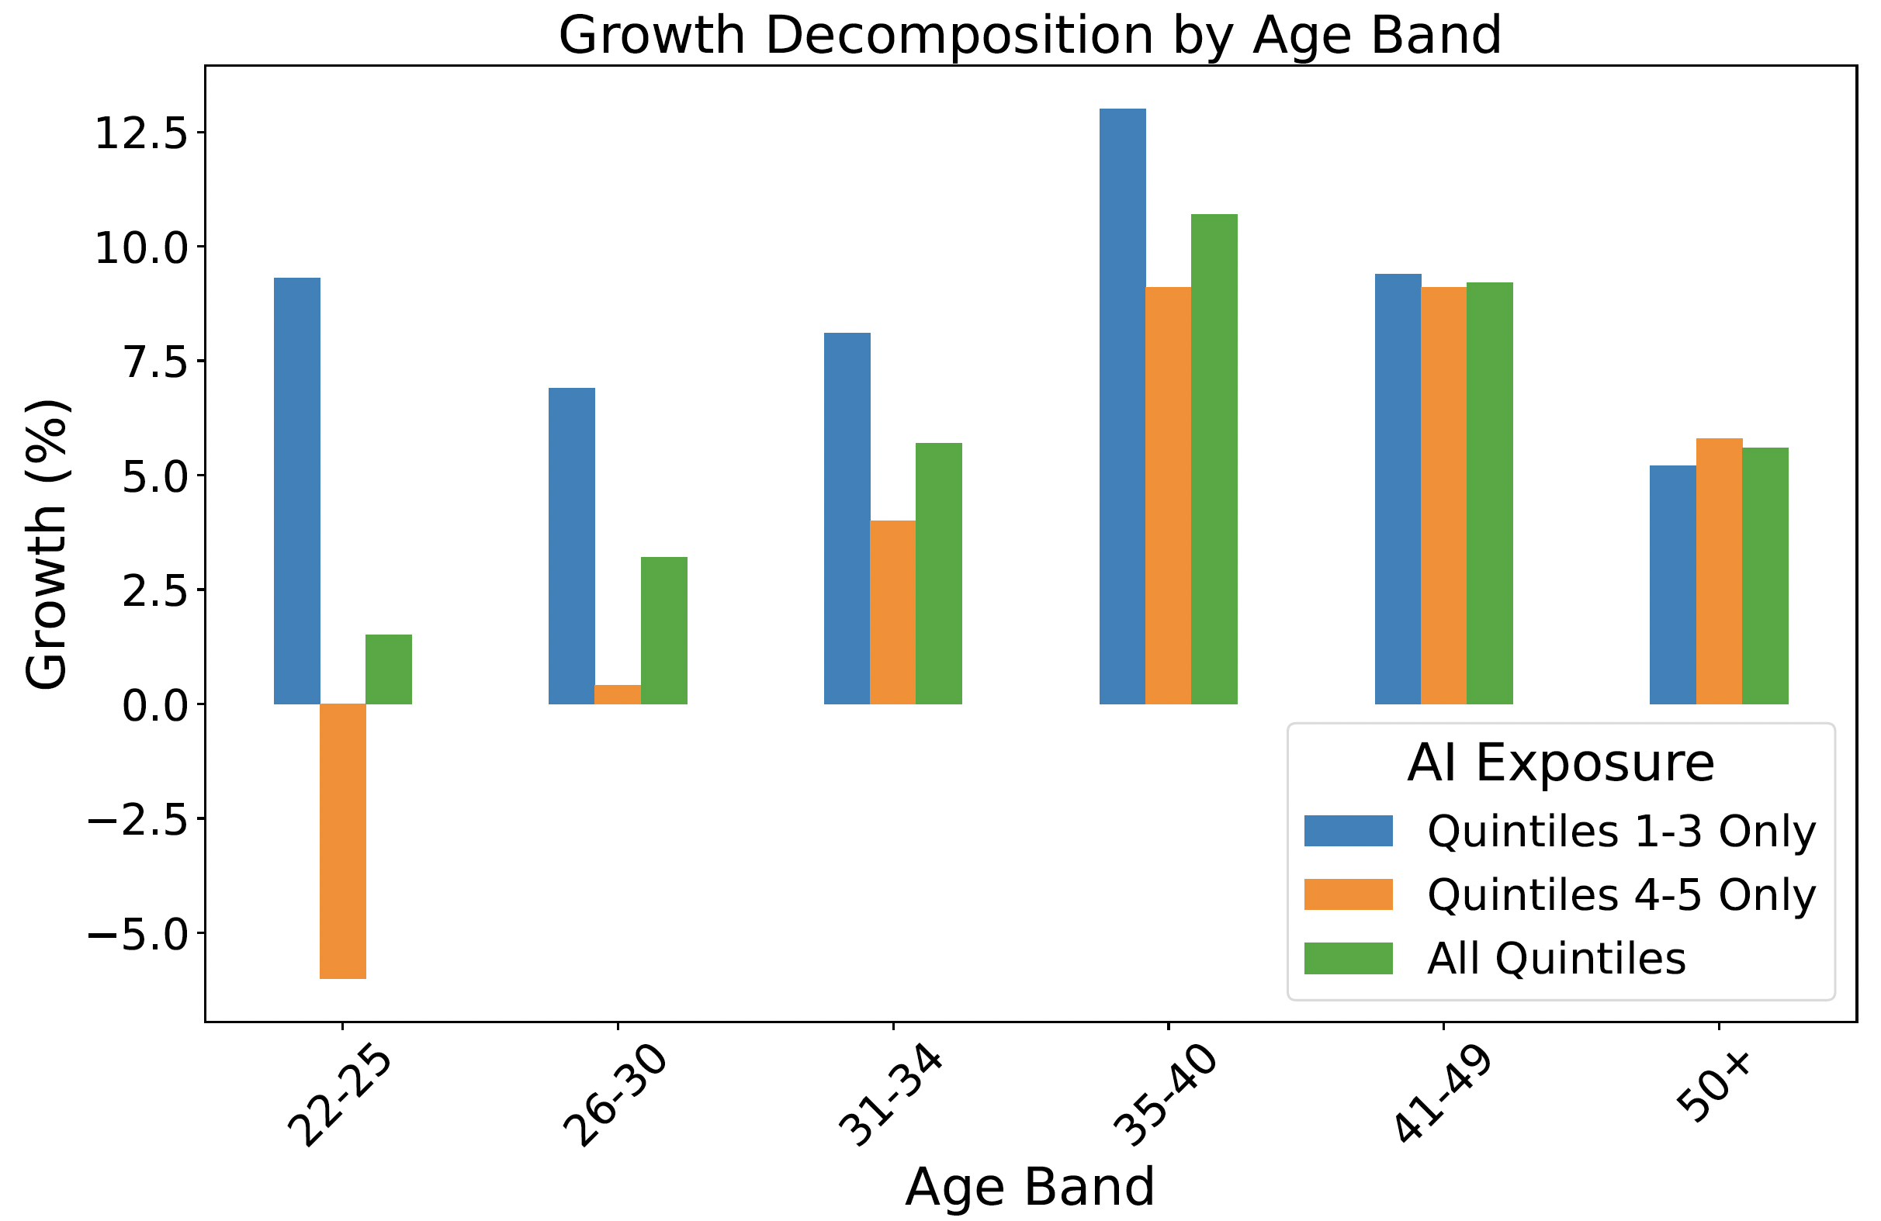
AI Exposure Magnifies the Age Divide in Job Growth
Source: Brynjolfsson et al (2025). Canaries in the Coal Mine? Mine? Six Facts about the Recent Employment Effects of Artificial Intelligence
Notes:
“This figure makes the pattern even clearer.
On the horizontal axis, we have age groups; on the vertical, their employment growth since 2022. The colors separate occupations by AI exposure:
blue bars are jobs with low exposure to AI,
orange bars are high-exposure occupations,
green shows the average across all.
Look at the left side — workers aged 22 to 25. In high-exposure occupations, shown in orange, employment actually declined by about 5 percent. But for the same age group in low-exposure jobs, shown in blue, employment still grew around 9 percent.
Now move to the right: older workers, especially those in their mid-30s to 40s, see positive growth in all cases — even in high-exposure occupations.
So AI doesn’t just change what firms do; it widens the gap between younger and older workers. Early-career workers are losing the very entry-level tasks that used to give them a foothold, while experienced workers — who combine AI with existing know-how — are expanding their roles.
This is what the authors call ‘seniority-biased technological change.’”

Slide 22
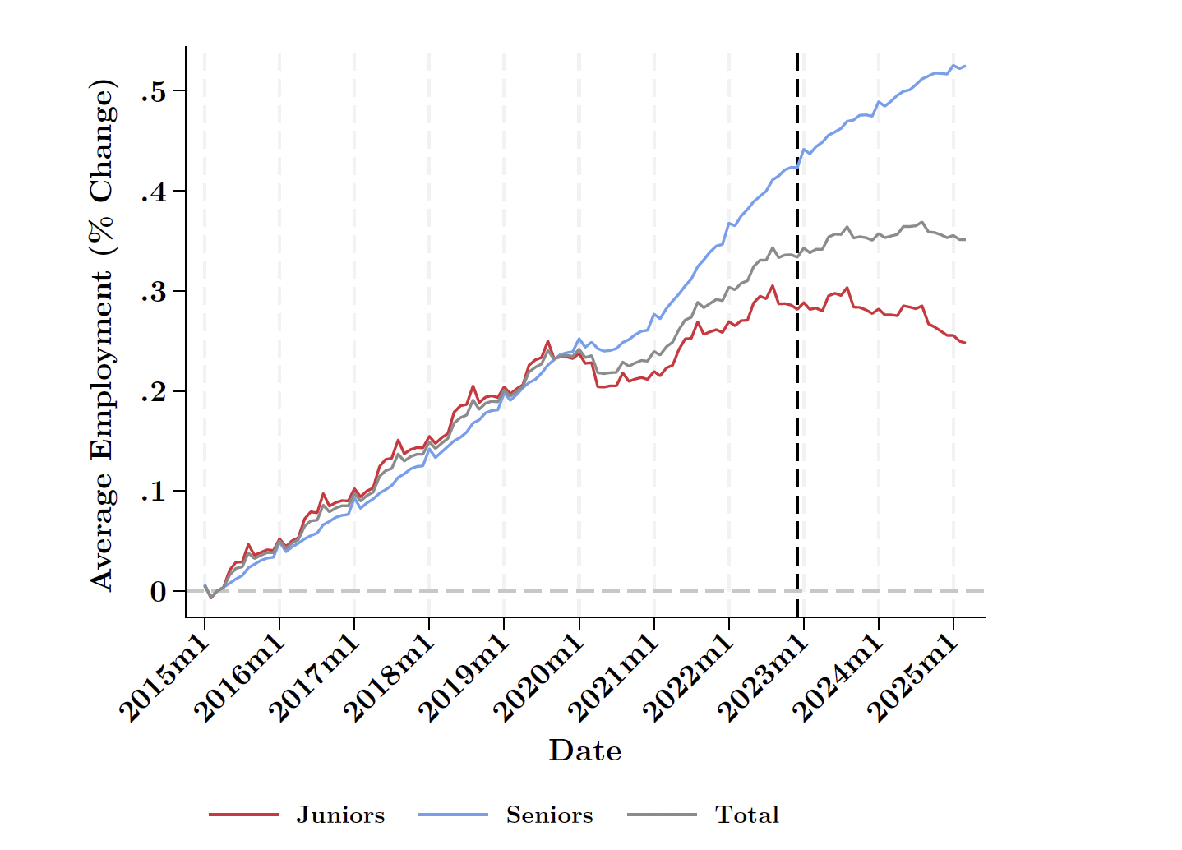
Junior positions are diminishing
Before 2022: Employment for juniors and seniors moved together — both expanding steadily.
After 2022 (AI diffusion period): Senior positions continued to grow; junior roles flattened and then declined.
The gap widens: Senior employment (blue line) now rises sharply while junior roles (red line) fall behind.
Source: Brynjolfsson et al (2025). Canaries in the Coal Mine? Mine? Six Facts about the Recent Employment Effects of Artificial Intelligence
Notes:
Interpretation: Firms are retaining or hiring experienced talent but scaling back entry-level positions.
Implication: The first effects of AI adoption appear not in layoffs, but in who gets hired next.
This shows how the gap between junior and senior roles has widened since the arrival of generative AI.
The red line represents junior positions, and the blue line represents senior positions. The dashed vertical line marks late 2022 — when AI tools began diffusing widely across firms.
Before 2022, both groups moved together — firms were adding juniors and seniors at roughly the same rate. But after 2022, the lines diverge. Senior employment keeps climbing, while junior roles flatten and then start to decline.
The total employment line in gray remains positive — firms are still growing — but they’re doing so by hiring more senior workers, not entry-level ones.
In other words, AI hasn’t reduced headcount — it’s changed who gets hired. The ladder is still there, but the bottom rungs are disappearing.”

Slide 23
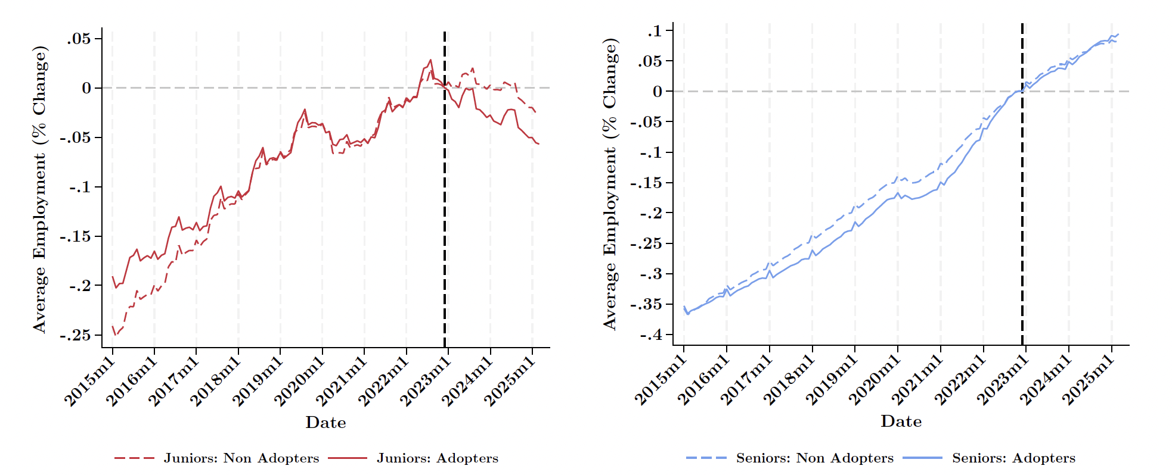
AI-Adopting Firms Hire Fewer Juniors and More Seniors
Source: Brynjolfsson et al (2025). Canaries in the Coal Mine? Mine? Six Facts about the Recent Employment Effects of Artificial Intelligence
Notes:
Together, the two panels illustrate a seniority bias in AI adoption:
Substitution effect → Juniors displaced in AI-adopting firms.
Complementarity effect → Seniors benefit, gain demand, or absorb more decision authority.
The economy-level result is a polarization within firms: AI doesn’t destroy jobs uniformly — it redistributes them toward experience.
This figure gives us the final piece of the story — it compares firms that have adopted AI tools with those that haven’t.
On the left, we see junior positions. The dashed red line shows non-adopting firms; the solid red line shows AI adopters. Before 2022, the two move together. But once AI diffuses — marked by the dashed vertical line — adopters begin hiring fewer juniors. Employment among young workers in those firms falls faster.
On the right, we see senior positions. Here the pattern flips: in AI-adopting firms, the solid blue line rises above the dashed one. That means firms using AI are adding more senior workers than firms that haven’t adopted it.
So the reallocation isn’t just across tasks — it’s across people. Within the same companies, AI appears to be substituting for entry-level work while complementing experienced talent.
In short, AI-adopting firms aren’t shrinking — they’re skewing older and more experienced.”
Reallocation is not just around tasks, it is also around people.

Slide 24
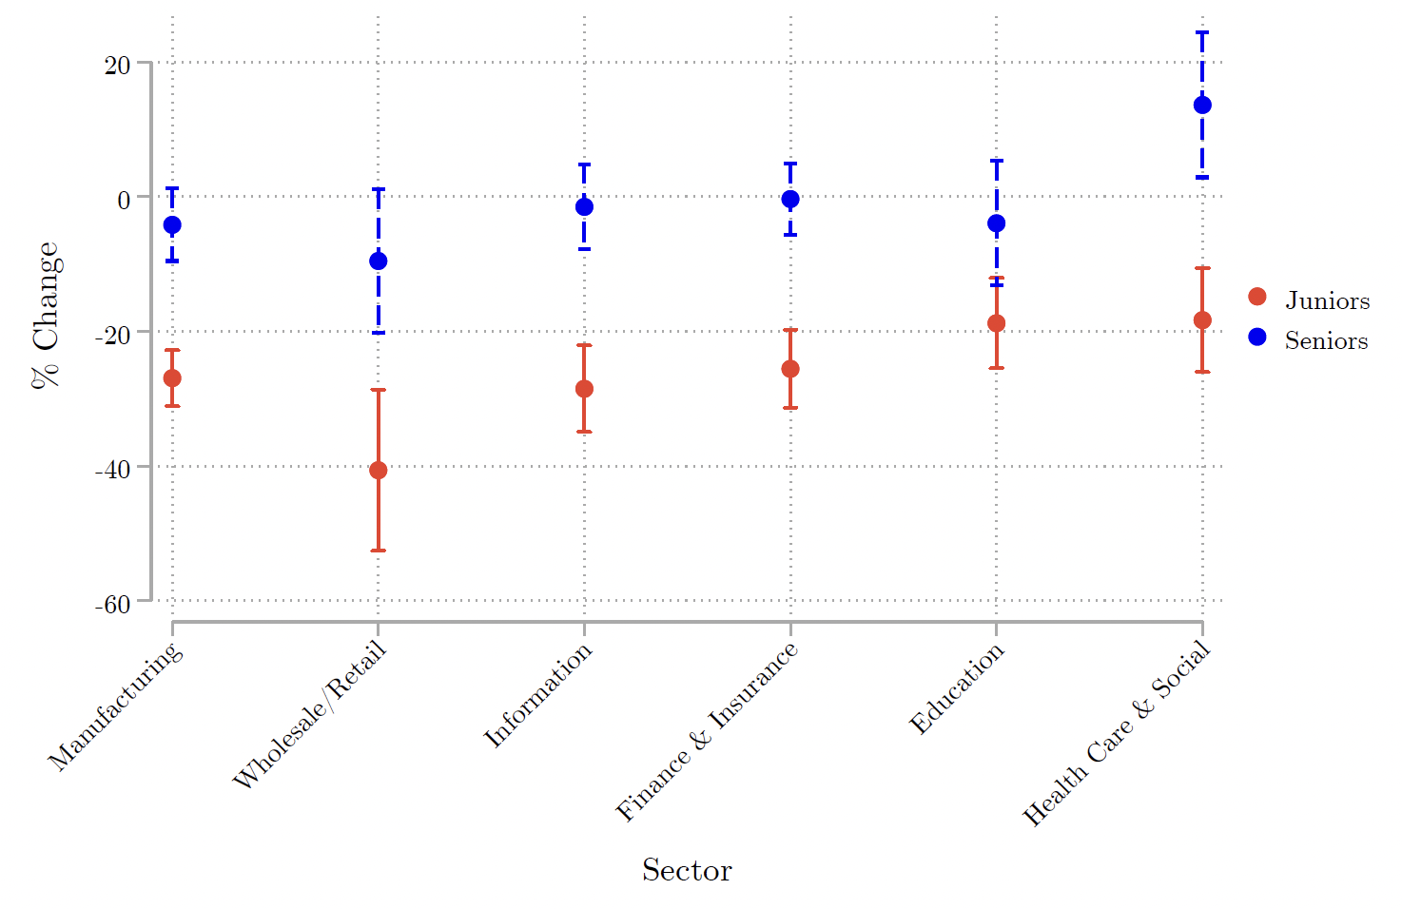
AI Adoption Widens the Experience Gap Across Industry
Source: Brynjolfsson et al (2025). Canaries in the Coal Mine? Mine? Six Facts about the Recent Employment Effects of Artificial Intelligence
Notes:
Main patterns
Across all sectors, junior employment (red) shows large declines, typically between –20% and –40%.
Senior employment (blue) is roughly stable or positive, even slightly increasing in some sectors (notably Healthcare and Education).
The gap between red and blue markers represents how AI reweights the workforce composition toward experience.
This pattern confirms that the “junior squeeze” is broad-based, not confined to tech.
Even in traditionally human-intensive sectors (like healthcare, education), entry-level positions shrink while experienced workers’ roles remain intact or expand.
Suggests a systematic, cross-sector shift in how firms allocate human capital after AI adoption:
Juniors → more substitutable tasks.
Seniors → more complementary or supervisory tasks.

Slide 25
Summary: Canaries in the Coal Mine
Early-career workers lose ground while experience gains value
Young workers (ages 22–25) in AI-exposed jobs: ~ 13 % employment decline since 2022.
Senior workers show productivity gains from GenAI tools.
Past automation hit factory workers; this wave hits interns.

Slide 26
As AI spreads, experience becomes the new entry-level — opportunity rises for veterans, but the ladder narrows for beginners.

Slide 27
Historical Lens: What We’ve Seen Before?
Past industrial and digital revolutions: mechanization, computers, internet.
The pattern: productivity up, tasks redefined, occupations restructured.
AI is a new chapter in a long story of technological change.
Notes:
To put all of this in perspective, we’ve been here before — many times.
Every major technological revolution has followed a similar arc. During the industrial era, mechanization replaced muscle; during the digital revolution, computers automated routine office work; and the internet transformed communication and information exchange.
The pattern is remarkably consistent: productivity rises, tasks are redefined, and occupations are restructured. New technologies rarely eliminate work altogether — they reorganize it.
What’s different with AI is that, for the first time, the technology is reaching into cognitive and creative domains rather than physical ones. But in historical terms, this is still a new chapter in a very long story of technological change — one where society eventually adapts, even if the transition is uneven.
Understanding that continuity helps us separate temporary disruption from lasting transformation.”

Slide 28
Takeaways
Takeaway 1. Technology doesn't simply eliminate jobs — it reshape them. It replaces some tasks, creates new ones, and transforms the rest.
Takeaway 2. AI-Adopting firms grow fast, and opportunities shift toward experienced worker.
Takeaway 3. The challenge is rebuilding entry points for the next generation.
Notes:
So to close, here are the three messages I hope you’ll take away today.
First, technology doesn’t simply eliminate jobs — it reshapes them. Each wave of innovation replaces some tasks, creates others, and transforms the rest.
Second, firms that adopt AI tend to grow faster — but the gains aren’t evenly distributed. Opportunities are shifting upward toward more experienced workers.
And third, the real challenge ahead isn’t job loss; it’s rebuilding the entry points for the next generation — making sure that young people can still learn, grow, and contribute in an AI-driven economy.
That’s the future of work we need to design for.
Talk though:
We always have to work
If you were a CEO of a company,

