Slide 1

Computational Economics
Module 1. Class Introduction
What did the Python say when he came out of his shell?

Slide 2
About me
Learning and Research Interests:
Computational Economics
Behavioral Economics

Slide 3
Computational Economics
Computational Economics is a rapidly growing
multidisciplinary field that uses advanced computing capabilities to understand and solve complex problems from all branches in economics.

Slide 4
Computational Economics
Economics
Statistics
Computer Science

Slide 5
Where is your future career?
Economic Theory
Statistics
Programming Skills

Slide 6
Where is your future career?
Economic Theory
Economist
Statistics
Programming Skills

Slide 7
Where is your future career?
Economic Theory
Data Scientist
Statistics
Programming Skill

Slide 8
Where is your future career?
Economic Theory
Full stack Developer
Statistics
Programming Skills

Slide 9
Is this the class for me?
This is the perfect class for you if you are:
Interested in the overlapping of economics and computer science.
Have some economic training background.
Have limited programming background.

Slide 10
Careers & Identity
You already are:
Economist
Data scientist
Software developer
Additional skills you’ll leave with:
Coding fluency + AI assisted workflow
Simulation & Modeling skills
Ability to apply economic thinking computationally
Portfolio of projects you can showcase

Slide 11

Learning by doing

Slide 12

How to draw a stag in three steps ?
Step 1.
head and neck

Slide 13

How to draw a stag in three steps ?
Step 1.
head and neck

Slide 14
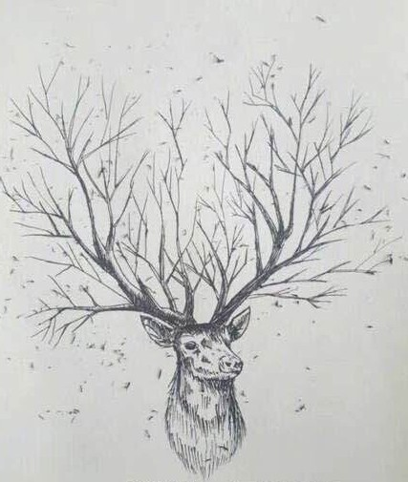

How to draw a stag in three steps ?
Step 1.
head and neck
Step 2.
add ears and some antlers
Step 3.
add a bit more details
page 16

Slide 15
How to draw a stag in three steps ?
In the era of generative AI:
I wanted to build a car

Slide 16
Learning by Doing
Just DO it.

Slide 17
Pre-course Survey
Background in economics
Background in programming

Slide 18
Making mistakes is a great way to learng
Accept this fact: bugs will be part of your life (if you ever wanted to do any coding).
Some general advices:
Don't hate bugs, fix them;
Don't only fix bugs, understand them;
Don't only understand bugs, learn from them.

Slide 19
Making mistakes is a great way to learng
When you had a bug, sometimes you will see some error messages:
In[1]
my_list = [1,3,5,7,9] print(my_list[5])
Out[1]
IndexError: list index out of range

Slide 20

Making mistakes is a great way to learn
In a bad coder's eyes: What to do:
In[1]
my_list = [1,3,5,7,9] print(my_list[5])
Out[1]
YouStupidHuman: bug
again? lol~ lol~ hahaha

Slide 21
Making mistakes is a great way to learng
In a good coder's eyes: What to do:
In[1]
my_list = [1,3,5,7,9] print(my_list[5])
Read the error message; Identify the problem;
Fix the bug;
make sure you understand it; Learn from it.
Out[1]
IndexError: list index out of range I'm confused, please help!
In[2]
my_list = [1,3,5,7,9] print(my_list[4])
Out[2]
9

Slide 22
Textbook: no required textbook
Programming software: Python
Hands-on learning (bring your laptop)

Slide 23
Mindset
Computational method requires iteration, patience, and creativity;
Plan before you code
Learning by doing—it’s ok if code doesn’t run the first time.

Slide 24
Please bring your laptop

Slide 25
Vibe Coding
“The hottest new programming language is English”
— Andrej Karpathy
Notes:
Show a demo

Slide 26
Vibe Coding
General Suggestion
Avoid “vibe coding” until you’re skilled enough to code confidently on your own.
Do vibe code only when:
You know exactly what you’re doing.
You have a comprehensive plan in place.
You can clearly translate technical or statistical jargon into plain English, so the model won’t misinterpret you.
There’s a shared common ground between you and the AI.

Slide 27
Human-AI Partnership
Known to Human
Unknown to Human
Known to AI
Working From Common Gound
Powered by AI Capability
Unknown to AI
Guided by Human Judgement
Exploring the Unknown Together
Notes:
Here’s a useful way to think about the human–AI partnership: Johari’s Window. Originally designed to map self-awareness, it also works as a framework for collaboration.
In the top-left, we have what’s known to both human and AI — this is our common ground, where we work smoothly with minimal explanation.
On the top-right is what’s unknown to the human but known to the AI — areas where the model brings in capabilities like pattern recognition, summarization, or search across large corpora.
Bottom-left is what’s known to the human but not to the AI — the judgment, context, and values that only people bring.
And in the bottom-right, we have the space that’s unknown to both. That’s where real exploration happens, when human and AI iterate together to surface insights neither could reach alone.
This window isn’t static — with each project, the balance of these quadrants can shift. The key is to recognize where we are working, and lean into the right kind of collaboration

Slide 28
Johari’s Window
Known to Human, Known to AI:
Human and AI work smoothly with minimal explanation because they already understand the task and context in common terms.
Known to Human, Unknown to AI:
The human leads with judgment, context, and values, while AI supports execution within those boundaries, accelerates and scales work by handling heavy-lifting
Known to AI, Unknown to Human:
The human, as an inquisitor, elicits insights through iterative questioning
Unknown to Human, Unknown to AI:
Human and AI explore unknowns together, using dialogue and iteration to uncover insights neither could reach alone.
Notes:
Let’s walk through each quadrant more concretely.
When something is known to both human and AI, collaboration is seamless. We share the same context and terms, so the AI can accelerate routine tasks without much explanation.
When it’s known to the human but not to the AI, the human takes the lead, bringing judgment, ethics, and situational awareness. The AI becomes an assistant, handling the heavy lifting inside those boundaries.
When it’s known to the AI but not to the human, the model acts almost like an investigator, surfacing patterns or connections we might miss, and the human probes with questions to extract insight.
Finally, in the unknown-to-both space, human and AI explore together. This is where dialogue, iteration, and creative back-and-forth can spark genuinely new ideas — insights that emerge from the partnership rather than either side alone.
Each of these quadrants highlights a different role for the human and the AI. The power lies in moving fluidly between them, depending on the task at hand

Slide 29
For Coding…
Do you think :
AI fully understand your vision?
AI fully understand your intention?
When Coding is a skill that known to AI but not to you, Do you want to:
Blindly delegate the job to AI?
Learn from AI and establish the “common ground”?
Notes:
Let’s walk through each quadrant more concretely.
When something is known to both human and AI, collaboration is seamless. We share the same context and terms, so the AI can accelerate routine tasks without much explanation.
When it’s known to the human but not to the AI, the human takes the lead, bringing judgment, ethics, and situational awareness. The AI becomes an assistant, handling the heavy lifting inside those boundaries.
When it’s known to the AI but not to the human, the model acts almost like an investigator, surfacing patterns or connections we might miss, and the human probes with questions to extract insight.
Finally, in the unknown-to-both space, human and AI explore together. This is where dialogue, iteration, and creative back-and-forth can spark genuinely new ideas — insights that emerge from the partnership rather than either side alone.
Each of these quadrants highlights a different role for the human and the AI. The power lies in moving fluidly between them, depending on the task at hand

Slide 30
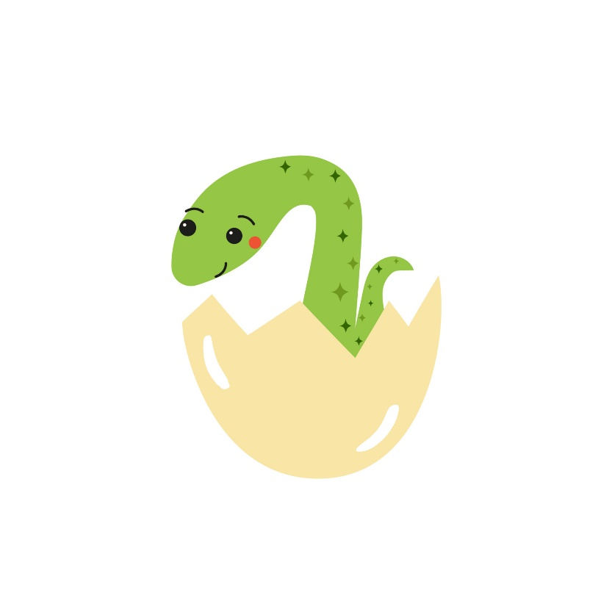
What did the Python say when he came out of his shell?
Answer:
Print(“Hello World!”)

