Slide 1

Computational Economics
Module 2: Stable Matching Problem and
the Gale-Shapley Algorithm

Slide 2


Slide 3
Matching Problems
“Matching” is the part of economics that focuses on
the question of who gets what, particularly when the scarce goods to be allocated are heterogeneous and indivisible.
–– Alvin E. Roth

Slide 4
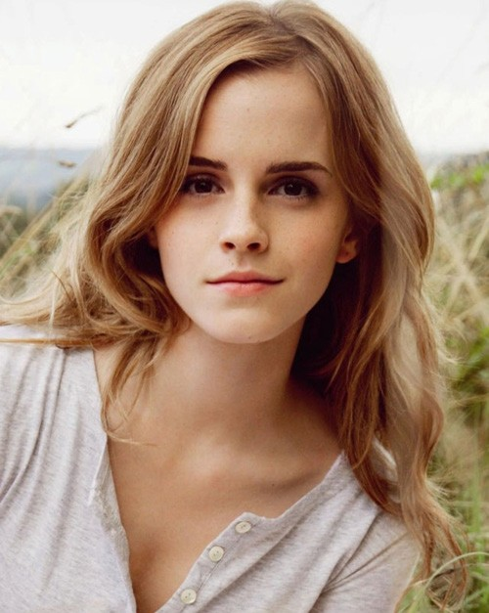

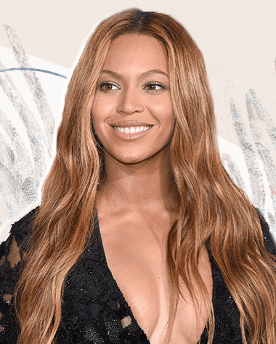
People have preferences
Suppose tinder gives me three options…
Different men may have different preferences.

Slide 5



People have preferences
Similarly, suppose a woman sees these men. Different women may have different preferences.

Slide 6
Problem Setting
n men and n women
Each men has a preference list of all women Each women has a preference list of all men
We wanted to match them as couples based on their preferences

Slide 7
Example
Start with two men and two women, see if we can help them out.
Romeo: Juliet > Rosaline
Juliet: Romeo > Mercutio
Mercutio: Rosaline > Juliet
Rosaline: Mercutio >Romeo

Slide 8
Example
Solution 1.
Romeo & Juliet ; Mercutio &Rosaline
Solution 2.
Romeo & Rosaline; Mercutio &Juliet
Which solution makes more sense?

Slide 9
Example
What if their preferences look like this:
Romeo: Juliet > Rosaline
Juliet: Romeo > Mercutio
Mercutio: Juliet > Rosaline
Rosaline: Romeo > Mercutio

Slide 10
Example
Solution 1.
Romeo & Juliet ; Mercutio &Rosaline
Solution 2.
Romeo & Rosaline; Mercutio &Juliet
Which solution makes more sense?

Slide 11
Unstable Pair
A man m and a woman w form an unstable pair (or blocking pair) if both:
m prefer w to his current spouse w prefer m to her current spouse
Matching with unstable pair results in inefficiency.
An unstable pair m — w could each improve by joint action.

Slide 12
Stability of Matching Outcome
Stable matching:
matching outcome with no unstable pairs. In the above example:
Individual self-interest prevent any affairs.

Slide 13
More Examples
What if their preferences look like this:
w₁: m₁ > m₂ > m₃
w₂ w₂: m₁ > m₃ > m₂ w₃ w₃: m₂ > m₃ > m₁
m₁: w₁ > w₂ > w₃
m₂: w₁ > w₃ > w₂
m₃: w₂ > w₁ > w₃

Slide 14
Example
m₁: w₁ > w₂ > w₃
m₂: w₁ > w₃ > w₂ m₃: w₂ > w₁ > w₃
m₁
w₁
w₁: m₁ > m₂ > m₃
w₂ w₂: m₁ > m₃ > m₂ w₃ w₃: m₂ > m₃ > m₁
m₂
m₃
Current match:
{m₁ : w₂}, {m₂, w₁}, {m₃, w₃}
Is this a stable matching outcome ?

Slide 15
Example
Let's take a look at the first two pairs
m₁: w₁ > w₂ > w₃ m₁ w₁
m₂: w₁ > w₃ > w_{2 m w}
2 2
w₁: m₁ > m₂ > m₃
w₂: m₁ > m₃ > m₂
m₁ currently married with w₂, but he prefers w₁ to w₂
If w₁ prefers her husband to m1, then m₁ has no chance
If w₁ prefers m1 to her current partner, then both m₁ and w₁
prefer each other to their current partners.

Slide 16
Example
Let's take a look at the first two pairs:
m₁: w₁ > w₂ > w₃ m₁ w₁
m₂: w₁ > w₃ > w_{2 m w}
2 2
w₁: m₁ > m₂ > m₃
w₂: m₁ > m₃ > m₂
m₁ currently married with w₂, but he prefers w₁ to w₂
If w₁ prefers her husband to m1, then m₁ has no chance
If w₁ prefers m1 to her current partner, then both m₁ and w₁
prefer each other to their current partners.
This forms an unstable pair. Both {m₁ : w₂} and {m₂ : w₁} fall apart.

Slide 17
A slightly more complex example: 10 x 10
James: Elizabeth, Emily, Jennifer, Rachel, Laura, Sarah, Jessica, Ashley, Amanda, Emma
Michael: Amanda, Laura, Emily, Jessica, Rachel, Elizabeth, Jennifer, Ashley, Sarah, Emma
William: Sarah, Emily, Elizabeth, Amanda, Ashley, Jessica, Laura, Rachel, Jennifer, Emma
David: Emma, Rachel, Jennifer, Jessica, Laura, Emily, Ashley, Amanda, Sarah, Elizabeth
Robert: Jessica, Laura, Emily, Jennifer, Sarah, Ashley, Rachel, Amanda, Emma, Elizabeth
Joseph: Laura, Jennifer, Ashley, Sarah, Jessica, Emily, Amanda, Rachel, Elizabeth, Emma
Charles: Sarah, Laura, Rachel, Jennifer, Ashley, Jessica, Emily, Emma, Elizabeth, Amanda
Thomas: Emily, Jessica, Rachel, Amanda, Laura, Ashley, Sarah, Emma, Jennifer, Elizabeth
Daniel: Amanda, Jessica, Emily, Jennifer, Ashley, Sarah, Laura, Rachel, Elizabeth, Emma
Matthew: Sarah, Laura, Emily, Amanda, Jessica, Rachel, Ashley, Elizabeth, Emma, Jennifer
Emily: Daniel, Matthew, David, James, Robert, William, Joseph, Michael, Charles, Thomas
Jessica: Robert, Michael, David, Joseph, William, Thomas, Daniel, James, Charles, Matthew
Sarah: James, Daniel, David, Robert, William, Charles, Joseph, Michael, Matthew, Thomas
Ashley: Michael, William, James, David, Thomas, Daniel, Charles, Robert, Joseph, Matthew
Jennifer: Michael, William, Charles, Robert, Daniel, Joseph, Thomas, James, David, Matthew
Rachel: William, James, Charles, Joseph, Daniel, Thomas, Robert, David, Michael, Matthew
Amanda: Robert, Joseph, Charles, David, Michael, Daniel, Matthew, William, James, Thomas
Emma: Daniel, Robert, James, David, William, Joseph, Charles, Michael, Thomas, Matthew
Elizabeth: Joseph, Charles, Daniel, Robert, David, William, Michael, James, Thomas, Matthew
Laura: James, Michael, Robert, David, Charles, Joseph, William, Daniel, Thomas, Matthew

Slide 18
Applications
住院医师规范化培训招录
器官捐赠移植排序
研究生与导师的双向选择
新高考改革下的部分大类专业分流
企事业单位内部人岗匹配
校企合作“订单班”与实习分配

Slide 19
Questions need to be addressed
Question 1: How to find a stable match?
First come, first serve?
Lottery game ?
Check all pairs?

Slide 20
Questions need to be addressed
Question 1: How to find a stable match?
Answer:
Brute force approach: generating all possible matchings and checking each one for stability.
Notes:
Step 1
In an instance with n men and n women, the total number of possible ways to match them is n!(factorial)
For example, with n=3n = 3n=3, the possible matchings would be:
(m1,w1),(m2,w2),(m3,w3)(m_1, w_1), (m_2, w_2), (m_3, w_3)(m1​,w1​),(m2​,w2​),(m3​,w3​)
(m1,w2),(m2,w3),(m3,w1)(m_1, w_2), (m_2, w_3), (m_3, w_1)(m1​,w2​),(m2​,w3​),(m3​,w1​)
(m1,w3),(m2,w1),(m3,w2)(m_1, w_3), (m_2, w_1), (m_3, w_2)(m1​,w3​),(m2​,w1​),(m3​,w2​)
And so on... up to 3!=63! = 63!=6 combinations.
For larger values of , the number of possibilities grows exponentially (e.g., for n=10, there are 10! = 3,628,800 possible matchings).
Step 2: Check Stability for Each Matching
For each generated matching, we need to check if there exists an unstable pair, which occurs when:
A man prefers a woman over his current partner and
That woman also prefers him over her current partner.
To do this, the algorithm would:
Iterate through each pairing in the current matching.
Compare preferences and check if any blocking pairs exist.
If a blocking pair is found, discard the matching as unstable.
If no blocking pairs are found, consider it a stable matching.
Step 3: Choose a Stable Matching
Once all possible matchings have been evaluated, the algorithm selects the first stable match it finds or returns that no stable match exists if none are found.
Time Complexity Analysis
Generating all matchings: O(n!)
Checking stability for each matching: O(n2), since each person’s preferences need to be compared against nnn potential partners.
Total time complexity: O

Slide 21
Questions need to be addressed
Question 1: How to find a stable match?
Answer:
Gale-Shapley's deferred acceptance algorithm

Slide 22
Deferred acceptance
What is "engagement"?
Is it necessary?
Can I break up my engagement?
The essence of engagement is deferred acceptance

Slide 23
Gale-Shapley Algorithm
Initially, all men and women are free
while there is a man m who is free and hasn't proposed to every women:
''' let w be the highest ranked women on his list to whom m hasn't proposed yet. '''
m propose to w
if w is free:
then {m, w} engaged
elif:
{w, m'} is engaged, and w
prefer m' to m, w rejected m,
m is still free and will propose to the next one on his list
else:
w is engaged with m', and w
prefer m to m'
{w, m} is engaged m is no longer free m' is free now
return all the engaged pairs, they now can get married.

Slide 24
Gale-Shapley Algorithm
m₁: w₁ > w₂ > w₃
m₂: w₁ > w₂ > w₃ m₃: w₂ > w₁ > w₃
m₁ w₁
w₁: m₁ > m₂ > m₃
w₂: m₁ > m₃ > m₂ w₃: m₂ > m₃ > m₁
m₂
m₃
w₂
w₃

Slide 25
Gale-Shapley Algorithm
m₁: w₁ > w₂ > w₃
m₂: w₁ > w₂ > w₃ m₃: w₂ > w₁ > w₃
m₁ w₁
w₁: m₁ > m₂ > m₃
w₂: m₁ > m₃ > m₂ w₃: m₂ > m₃ > m₁
m₂
m₃
w₂
w₃
m₁ propose to w₁,
{m₁ , w₁} are engaged (i.e., w₁ says maybe)
m₂ propose to w₁
w₁ is engaged with m₁ , and w₁ prefer m₁ to m₂, w₁ reject m₂,
m₂ propose to w₂
{m₂, w₂} are engaged
m₃ propose to w₂
w₂ is engaged with m₂, and w₂prefer m₃ to m₂, w₂ dumped m₂
{w₂,m₃} are engaged
m₂ is free
m₂propose to w₃
{m₂ w₃} are engaged
all pairs are engaged.
they can now get married (yes!).

Slide 26
Questions need to be addressed
Question 2: Dose a “stable matching” always exist?

Slide 27
Questions need to be addressed
Question 2: Dose a “stable matching” always exist?
Answer: Yes. Given n men and n women and their preference lists, there always exists at least one stable matching solution.
This is a theorem has been proven by David Gale and Lloyd S. Shapley.

Slide 28
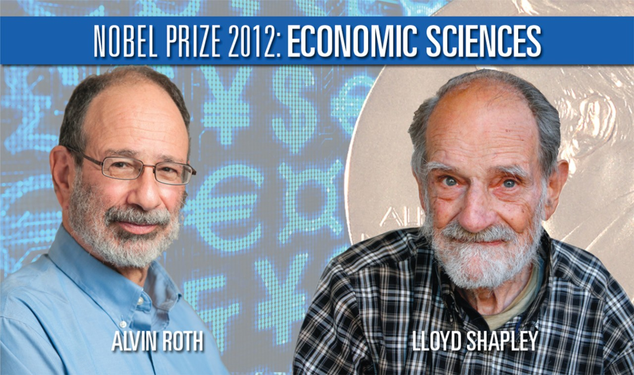
The Stable Matching Theorem

Slide 29
Proof of correctness
Proof of correctness: Perfect matching claim 1: all men get matched
claim 2: all women get matched claim 3: there are no unstable pairs
Proof of termination:
Claim 1: the algorithm terminates after at most n²
iteration of WHILE loop.
Notes:
Gale-ShapleyO(n2)O(n^2)O(n2)Efficient for real-world applications

Slide 30
Questions need to be addressed
Question 3:
Who should propose? Does it matter?

Slide 31
Questions need to be addressed
Question 3:
Who should propose? Does it matter?
Answer:
No matter who propose, it always end up with a stable matching.
However, only the proposer get the optimized result.

Slide 32
Questions need to be addressed
If men propose, then:
In each man’s eyes:
His engaged women get worse and worse.
But finally he gets the best possible. (The best
that avoids a later divorce.)
In each woman’s eyes:
Her engaged men get better and better.
But finally she gets the worst possible. (The worst
that avoids a later divorce.)

Slide 33
Summary
Stable matching problem: Given the same number of X and Y, and their preference lists, find a stable matching if one exists.
Theorem. The Gale–Shapley algorithm guarantees to
find a stable matching for any problem instance.
Whichever side proposes finally get their best possible.

Slide 34
Extensions
Extension 1. Some agents declare others as unacceptable.
Extension 2. Some agents have more than one position (this is common under job-market matching context).
Extension 3. Unequal number of agents.

