Slide 1
Computational Economics
Module 1. Class Introduction
What did the Python say when he came out of his shell?

Slide 2
About me
Learning and Research Interests:
Behavioral Economics
Computational Economics

Slide 3
Course Objectives
Establish basic understanding in the field of computational economics
Getting familiar with python as a coding language
Learn several classic applications:
- Algorithms
- Agent-based simulation (Micro)
- Dynamic system simulation (Macro)
- Machine Learning and Predictive Modeling

Slide 4
Course Objectives
Build your confidence in coding (but this is not a pure coding class)
Experience the evolving workflow in coding:
Manual
AI as a standalone tool
AI assisted coding
Agentic coding

Slide 5
Course Content
Module 1. Introduction
Module 2. Gale-Shapely Algorithm
Module 3. Agent-Based Simulation
Module 4. Dynamic System Simulation
Module 5. Data Analysis and Machine Learning
Course Structure
Lecture + Workshop + Project
Course Website
https://sparks5969.github.io/course-computational-economics/index.html

Slide 6
Computational Economics
Computational Economics is a rapidly growing
multidisciplinary field that uses advanced computing capabilities to understand and solve complex problems from all branches in economics.

Slide 7
Computational Economics
Economics
Statistics
Computer Science

Slide 8
Where is your future career?
Economic Theory
Statistics
Programming Skills

Slide 9
Where is your future career?
Economic Theory
Economist
Statistics
Programming Skills

Slide 10
Where is your future career?
Economic Theory
Data Scientist
Statistics
Programming Skill

Slide 11
Where is your future career?
Economic Theory
Full stack Developer
Statistics
Programming Skills

Slide 12
How do you want to build your skill profile?
Economic Theory
Statistics
Programming Skills

Slide 13
Careers & Identity
You already are:
Economist
Additional skills you’ll leave with:
Coding fluency + AI assisted workflow
Simulation & Modeling skills
Ability to apply economic thinking computationally
Skill portfolio that you can showcase

Slide 14

Learning by doing

Slide 15

How to draw a stag in three steps ?
Step 1.
head and neck

Slide 16

How to draw a stag in three steps ?
Step 1.
head and neck
Step 2.
add ears and some antlers

Slide 17
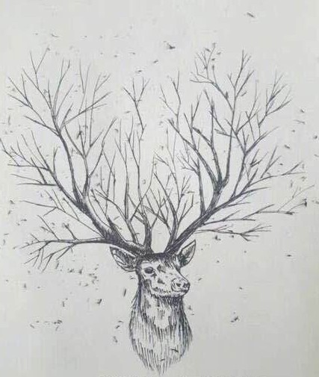

How to draw a stag in three steps ?
Step 1.
head and neck
Step 2.
add ears and some antlers
Step 3.
add a bit more details
page 16

Slide 18

How to build a car in the era of AI
I wanted to build a car…

Slide 19

How to build a car in the era of AI
And let’s make it better…

Slide 20
Learning by Doing
Just DO it.

Slide 21
Pre-course Survey
Background in economics
Background in programming
Background in ‘vibe’ coding

Slide 22
Making mistakes is a great way to learn
Accept this fact: bugs will be part of your life (if you ever wanted to do any coding).
Some general advices:
Don't hate bugs, fix them;
Don't only fix bugs, understand them;
Don't only understand bugs, learn from them.

Slide 23
Making mistakes is a great way to learn
When you had a bug, sometimes you will see some error messages:
In[1]
my_list = [1,3,5,7,9] print(my_list[5])
Out[1]
IndexError: list index out of range

Slide 24

Making mistakes is a great way to learn
In a bad coder's eyes: What to do:
In[1]
my_list = [1,3,5,7,9] print(my_list[5])
Out[1]
YouStupidHuman: bug
again? lol~ lol~ hahaha

Slide 25
Making mistakes is a great way to learn
In a good coder's eyes: What to do:
In[1]
my_list = [1,3,5,7,9] print(my_list[5])
Read the error message; Identify the problem;
Fix the bug;
make sure you understand it; Learn from it.
Out[1]
IndexError: list index out of range I'm confused, please help!
In[2]
my_list = [1,3,5,7,9] print(my_list[4])
Out[2]
9

Slide 26
Syntax error: The code breaks the language’s grammar rules, so it cannot run.
Runtime error: The code starts running but crashes during execution.
Semantic error: The code runs, but the logic is wrong, so it gives the wrong result (and you don’t even know it was wrong!).

Slide 27
Textbook: no required textbook
Programming software: Python
IDE:
Spyder
Google colab
vscode or cursor
Hands-on learning (bring your laptop)

Slide 28
Mindset
Computational method requires iteration, patience, and creativity;
Plan before you code
Learning by doing—it’s ok if code doesn’t run the first time.

Slide 29
Please bring your laptop

Slide 30
Vibe Coding
“The hottest new programming language is English”
— Andrej Karpathy
Notes:
Show a demo

Slide 31
Human-AI Partnership
Known to Human
Unknown to Human
Known to AI
Working From Common Gound
Powered by AI Capability
Unknown to AI
Guided by Human Judgement
Exploring the Unknown Together
Notes:
Here’s a useful way to think about the human–AI partnership: Johari’s Window. Originally designed to map self-awareness, it also works as a framework for collaboration.
In the top-left, we have what’s known to both human and AI — this is our common ground, where we work smoothly with minimal explanation.
On the top-right is what’s unknown to the human but known to the AI — areas where the model brings in capabilities like pattern recognition, summarization, or search across large corpora.
Bottom-left is what’s known to the human but not to the AI — the judgment, context, and values that only people bring.
And in the bottom-right, we have the space that’s unknown to both. That’s where real exploration happens, when human and AI iterate together to surface insights neither could reach alone.
This window isn’t static — with each project, the balance of these quadrants can shift. The key is to recognize where we are working, and lean into the right kind of collaboration

Slide 32
Johari’s Window
Known to Human, Known to AI:
Human and AI work smoothly with minimal explanation because they already understand the task and context in common terms.
Known to Human, Unknown to AI:
The human leads with judgment, context, and values, while AI supports execution within those boundaries, accelerates and scales work by handling heavy-lifting
Known to AI, Unknown to Human:
The human, as an inquisitor, elicits insights through iterative questioning
Unknown to Human, Unknown to AI:
Human and AI explore unknowns together, using dialogue and iteration to uncover insights neither could reach alone.
Notes:
Let’s walk through each quadrant more concretely.
When something is known to both human and AI, collaboration is seamless. We share the same context and terms, so the AI can accelerate routine tasks without much explanation.
When it’s known to the human but not to the AI, the human takes the lead, bringing judgment, ethics, and situational awareness. The AI becomes an assistant, handling the heavy lifting inside those boundaries.
When it’s known to the AI but not to the human, the model acts almost like an investigator, surfacing patterns or connections we might miss, and the human probes with questions to extract insight.
Finally, in the unknown-to-both space, human and AI explore together. This is where dialogue, iteration, and creative back-and-forth can spark genuinely new ideas — insights that emerge from the partnership rather than either side alone.
Each of these quadrants highlights a different role for the human and the AI. The power lies in moving fluidly between them, depending on the task at hand

Slide 33
For Coding…
Do you think :
AI fully understand your vision?
AI fully understand your intention?
When Coding is a skill that known to AI but not to you, Do you want to:
Blindly delegate the job to AI?
Learn from AI and establish the “common ground”?
Notes:
Let’s walk through each quadrant more concretely.
When something is known to both human and AI, collaboration is seamless. We share the same context and terms, so the AI can accelerate routine tasks without much explanation.
When it’s known to the human but not to the AI, the human takes the lead, bringing judgment, ethics, and situational awareness. The AI becomes an assistant, handling the heavy lifting inside those boundaries.
When it’s known to the AI but not to the human, the model acts almost like an investigator, surfacing patterns or connections we might miss, and the human probes with questions to extract insight.
Finally, in the unknown-to-both space, human and AI explore together. This is where dialogue, iteration, and creative back-and-forth can spark genuinely new ideas — insights that emerge from the partnership rather than either side alone.
Each of these quadrants highlights a different role for the human and the AI. The power lies in moving fluidly between them, depending on the task at hand

Slide 34
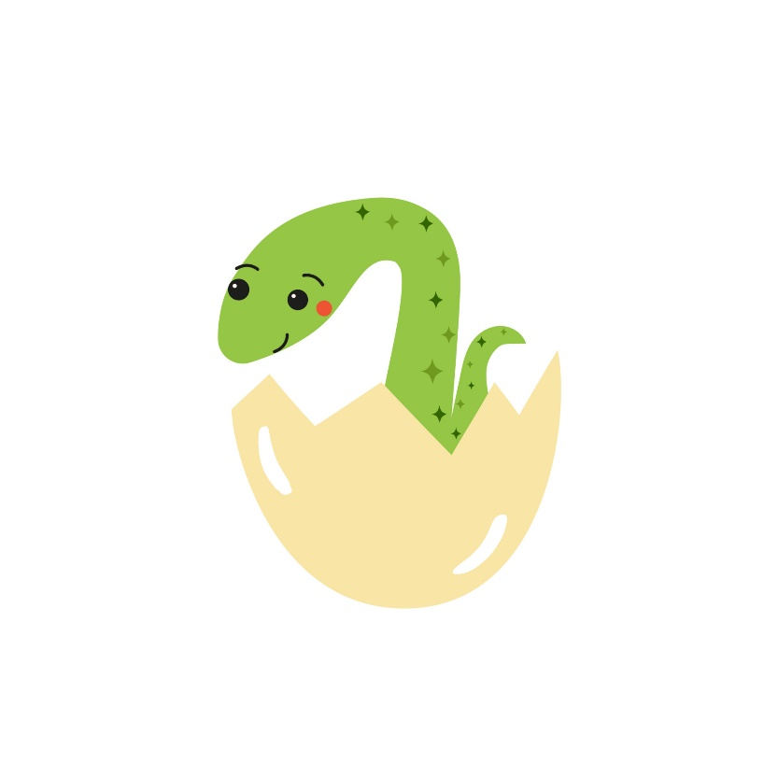
What did the Python say when he came out of his shell?
Answer:
Print(“Hello World!”)

