Slide 1
Seattle Park
Seattle, WA

Slide 2
The Budget
Fountain | $ 1,000.00
Playground Equipment | $18,000
Climbing Circle | $ 2,500.00
4 Benches | $ 800.00
4 Outdoor Tables w/ chairs | $ 1,200.00
Sprinkler System | $ 3,500.00
3 Cornus alternifolia | $ 243.00
10 Aster divaricatus | $ 100.00
1 single red rose | $ 10.00
Total | $ 27,353.00

Slide 3
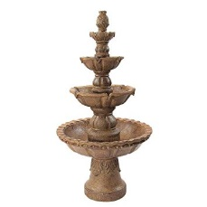
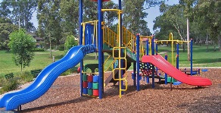
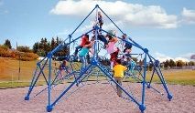

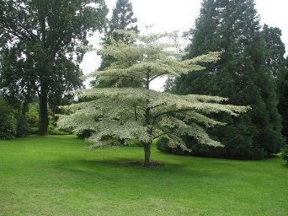
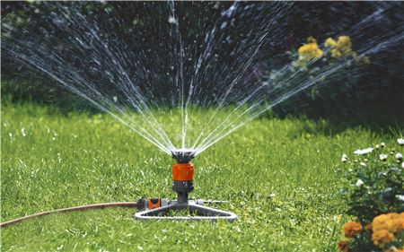
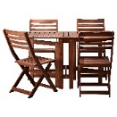
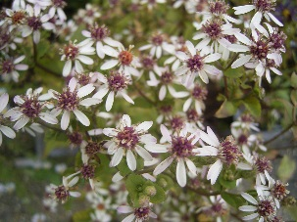
The plans

Slide 4
Credits
Budgeting/planning team: Sparksammy – Sparksammy.com or .tk
Uploading/misc research: Austin
Planting/construction team: John Doe & Jane Doe

