Slide 1

Unveiling Secrets: Harnessing Frida, Ghidra, and Decompilers for Enhanced Analysis of Android and Apple Applications

Slide 2

Who am I?
Senior Security Consultant
Worked in IT Security for 6+ years
Started on the blue team as a Network Security Analyst
Started on the red team with Network and Wireless penetration testing then transisitoned to Web Application and Mobile

Slide 3
Tools Being Used in Talk
Frida (Both)
Text Editor (Using VSCode but doesn’t matter)
Jadx-gui (Android)
Ghidra (Both)
Hopper (Apple only)

Slide 4
Frida
What is frida?
Dynamic instrumentation toolkit / Tool that attacks memory
Really exciting tool with wild abilities just waiting to be tapped into
Injection scripts written in Javascript
Can be used in a LOT of things
  Android, Apple, MacOS, Linux, Windows, etc...

Slide 5
Text Editor
I like sublime and Visual Studio Code
GitHub CoPilot is also helpful for writing Frida scripts
A little bit difficult to edit and save code without a means to edit and save the code

Slide 6
Jadx-gui
Why use Jadx-gui?
  Pros
    Easy to use/navigate
    Friendlier interface
    Can create frida code easily
    Open Source
  Cons
    Only can be used on Dex and Apk files (Android)
    Doesn’t decompile all the code

Slide 7
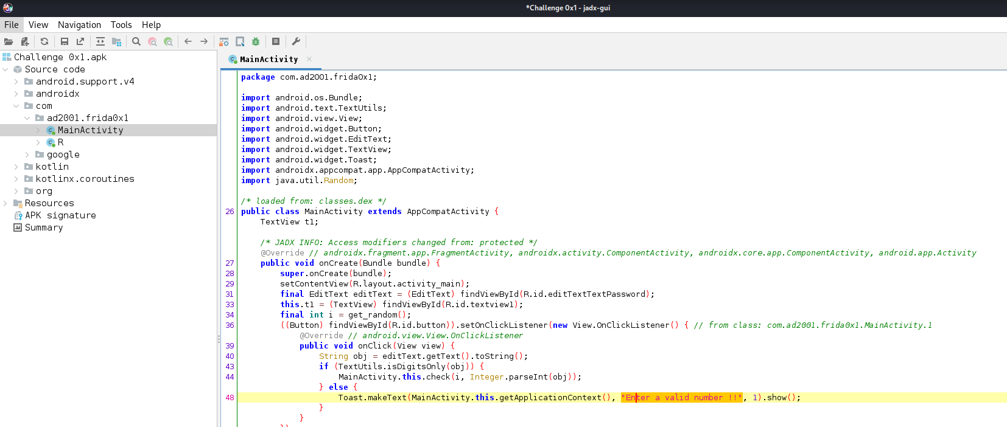
Jadx-gui Interface
Nice and clean! Not that scary at all!

Slide 8
Ghidra
Why use Ghidra?
  Pros
    Works with both IPAs and APKs
    Has a lot of nice features such as code flow and function graph
    Worth learning and spending time becoming proficient
  Cons
    Intimidating interface
    Everything on the initial page is overwhelming at first

Slide 9
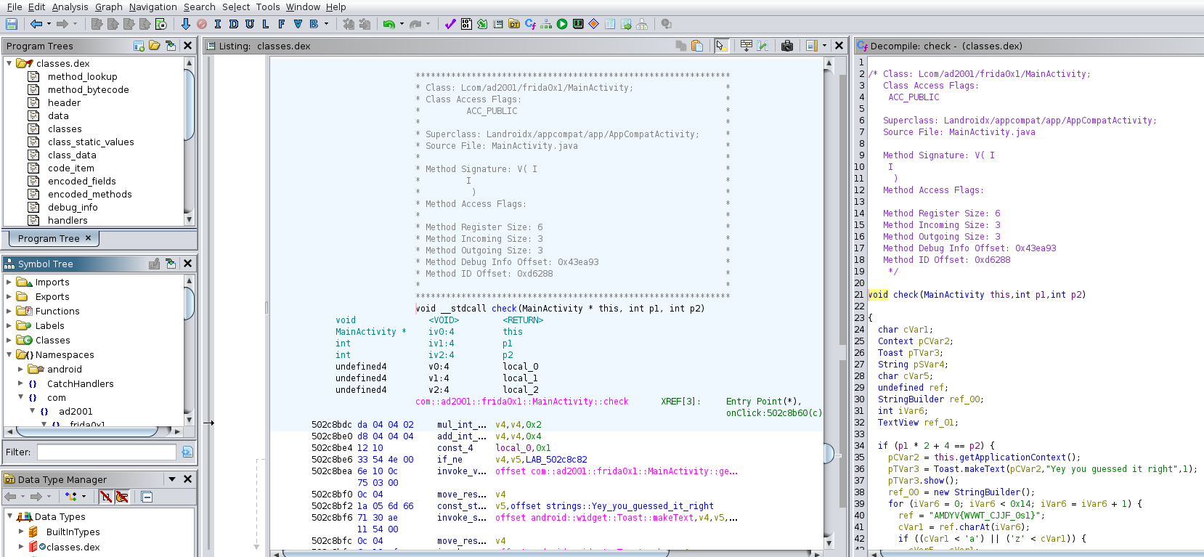
Showing what Ghidra looks like
Scary at first, but the decompile page is great!

Slide 10
Hopper
Why use Hopper?
  Pros
    Disassembler purpose built for Apple programs
    Demo version is free
    Less overwhleming that Ghidra
  Cons
    Only tool mentioned that is not open source
    More than 30 minutes at a time and full functionality costs $99
    Can’t be used on Windows. Only Mac, Ubuntu 20.04 (64 bits), Fedora 31 (64 bits), and ArchLinux (64 bits)

Slide 11
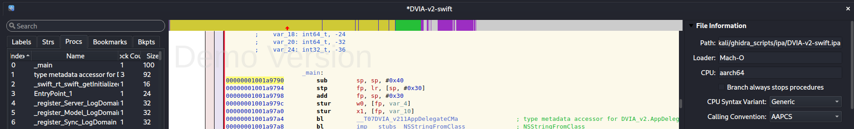
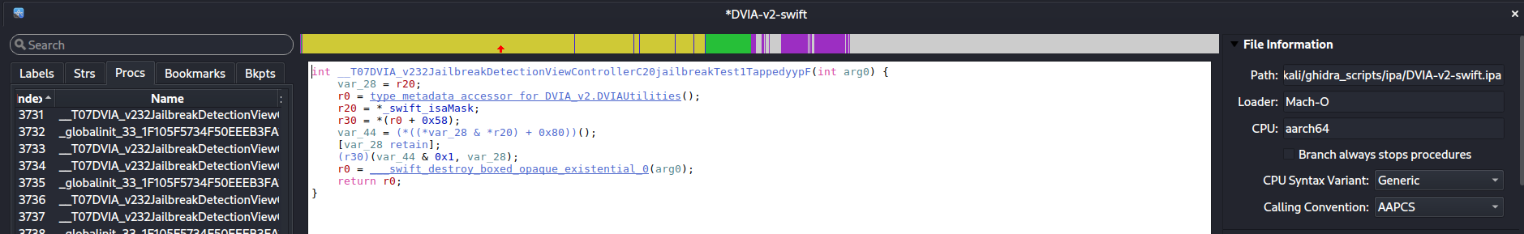
How does Hopper look???
Scary version (Assembly)
Less scary version (Pseudo Code of Procedure)

Slide 12
Last important concept
2 ways we are going to interact with the apps
  Directly calling them
  Hooking
Android:
  Doesn’t require
  Calling directly creates a new class object
  Overloading or hooking their implementation
Apple
  + [ClassName FunctionName]
  - [ClassName FunctionName]

Slide 13

Easy option first!
Android!

Slide 14
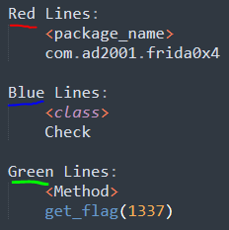
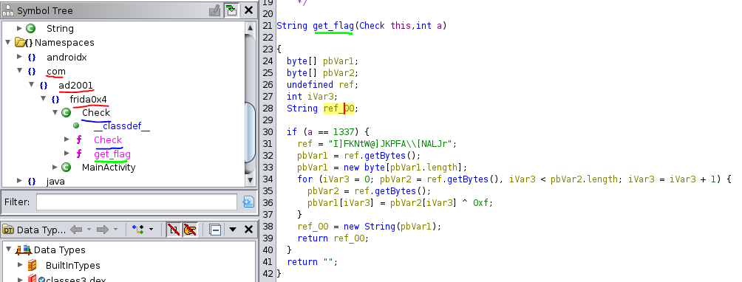
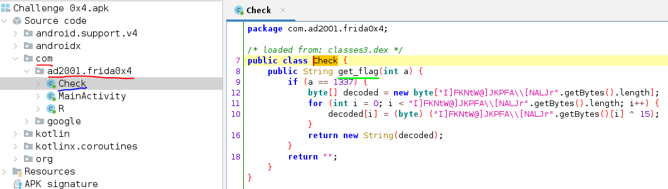
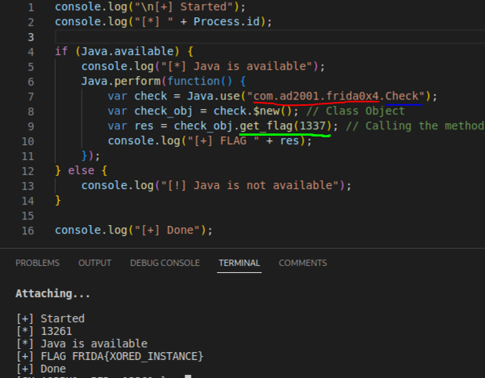
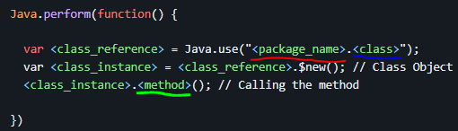
Calling a function and get the return
Legend ->
What to look for in Ghidra
What to look for in Jadx-gui
Code to get the returned string
Breakdown of code

Slide 15
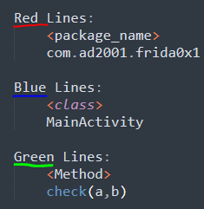
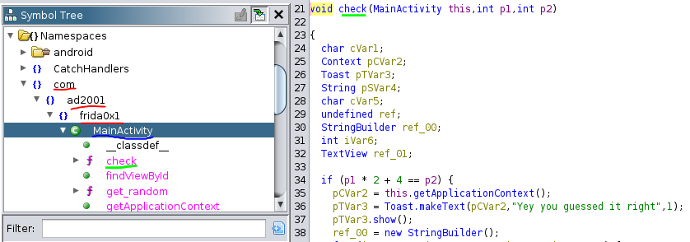
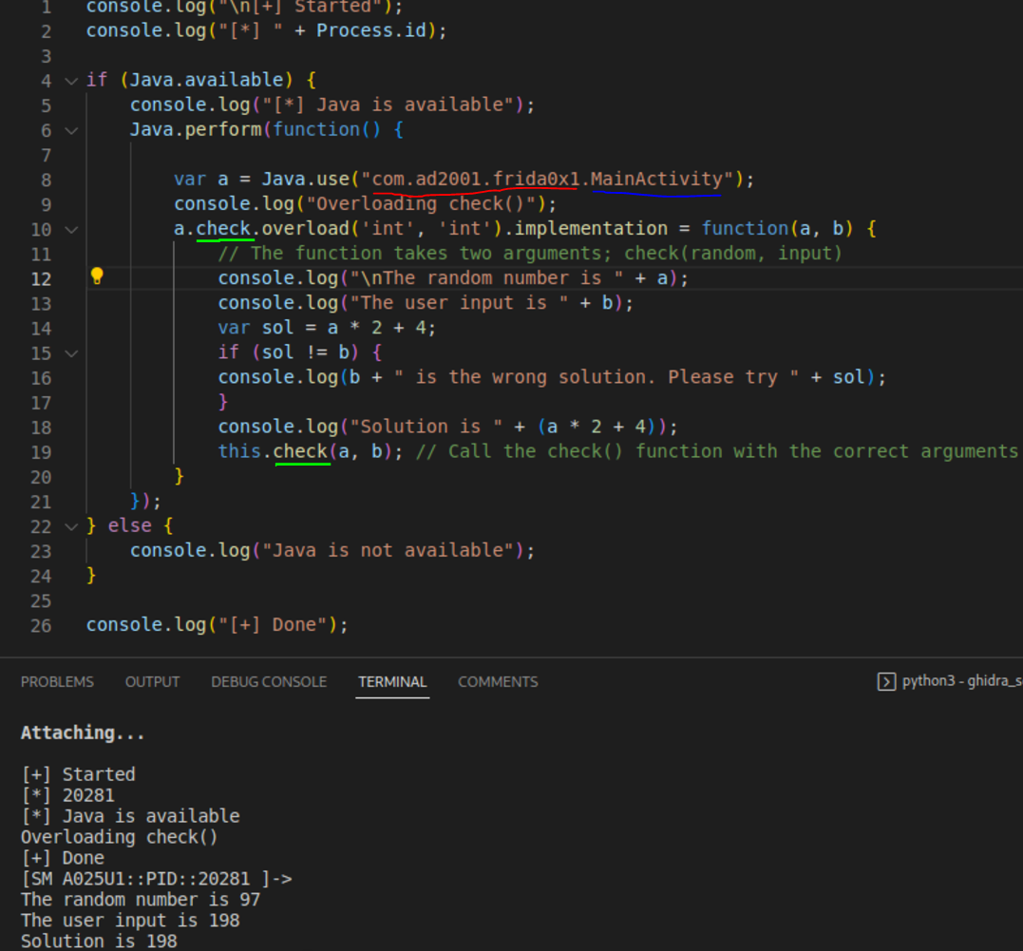
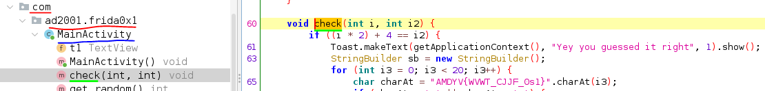
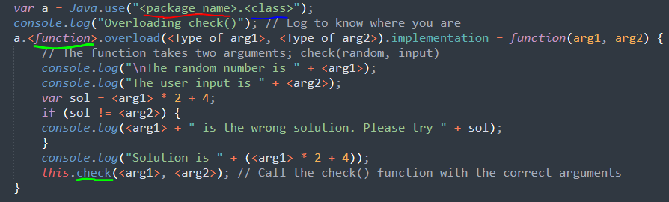
App calls function and get the return value
Legend ->
What to look
for in Ghidra
Code to get the returned string
What to look
for in Jadx-gui
Breakdown of code

Slide 16
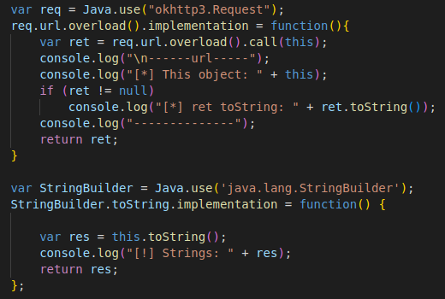
Taking the the next level
Other methods like StringBuilder and Request
Crypto libraries and other custom libraries that are app specific

Slide 17
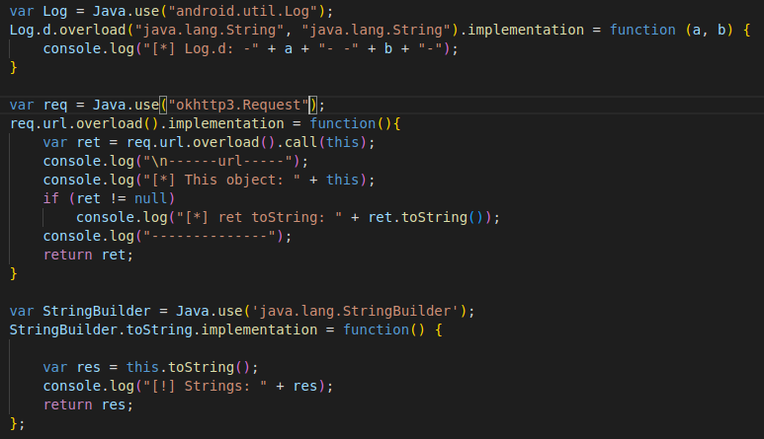
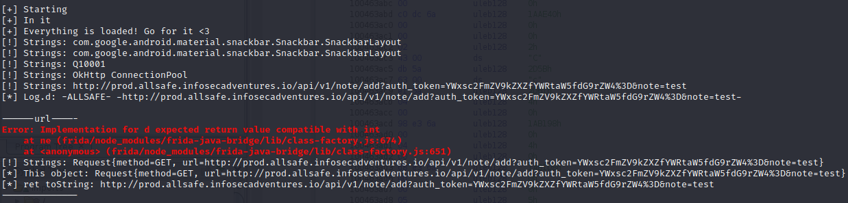
Real world example
Code Example ->
Output of example code

Slide 18

Now for the harder one!
Apple!

Slide 19
Differences between Android and Apple
Harder to Reverse Engineer
Order for attack is going to be different
We can use frida to get methods and then we can look them up with ghidra/hopper
Flow:
    <GitHub Repo URL>/iOS/find-app-classes.js
    Use frida-trace and see if it is called as you expect
    <GitHub Repo URL>/iOS/find-specific-method.js
    Use interceptor.attach

Slide 20


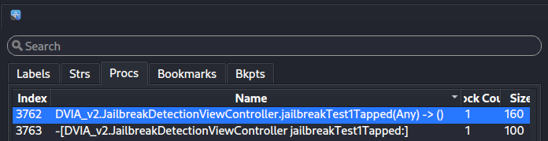
Apple Reverse Engineering
Flow Demonstration:
find-app-classes.js output
Frida-trace command
Frida-trace output
find-specific-method.js output
Method: - vs +
Called on vs Create instance
Looking up package / method type / method information on Hopper

Slide 21
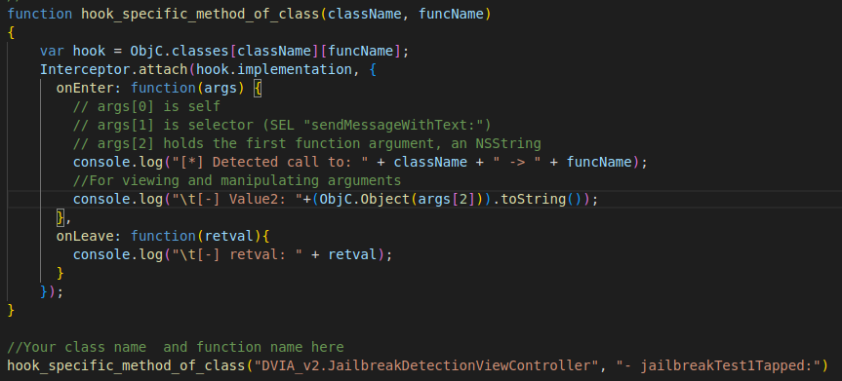
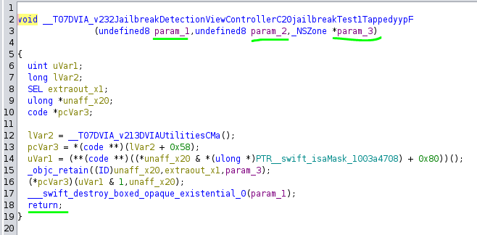
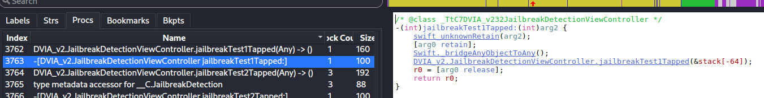
Putting it together
Frida Script ->
Frida Output
Ghidra
Hopper

Slide 22
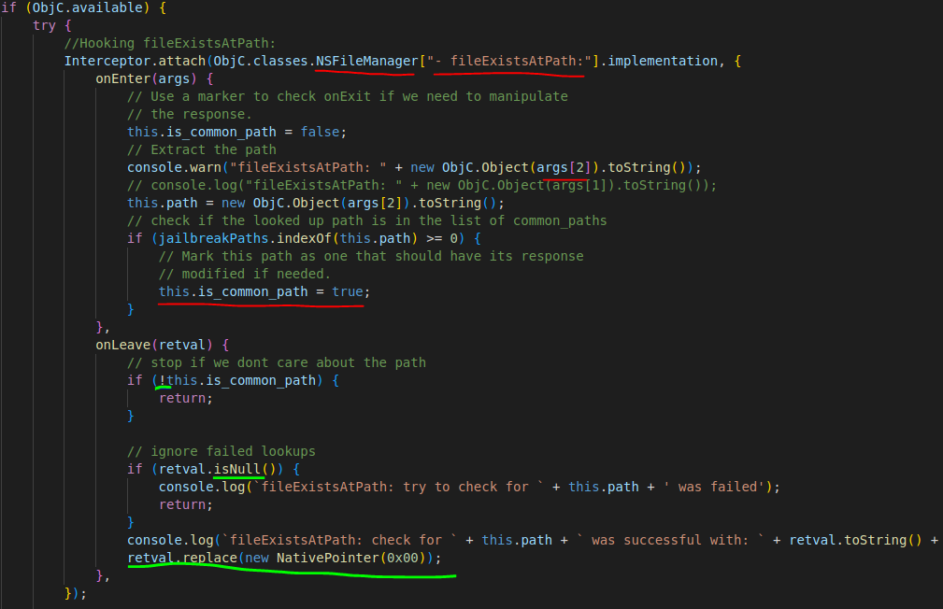
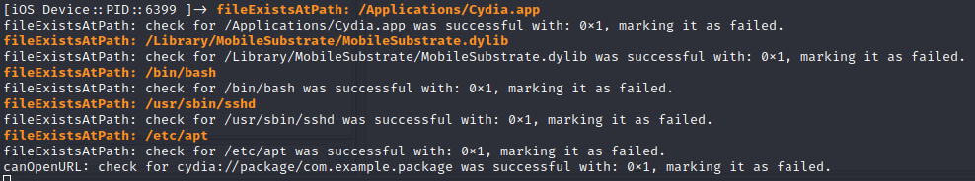
Real World Example
ClassName and Function ->
Output of script

Slide 23
Why does this matter?
Taking steps to understand an application deeper
Information being returned from a function
Being able to control information going into a function

Slide 24
Tutorials used in presentation
Android
https://github.com/DERE-ad2001/Frida-Labs/tree/main/Frida%200x4
https://github.com/DERE-ad2001/Frida-Labs/tree/main/Frida%200x1
https://github.com/t0thkr1s/allsafe
Apple
https://github.com/prateek147/DVIA-v2/tree/master

Slide 25
Resources to Learn More!
Frida on Android
  https://github.com/DERE-ad2001/Frida-Labs/tree/main
  https://github.com/t0thkr1s/allsafe
Frida on Apple
  https://github.com/prateek147/DVIA-v2/tree/master
  https://github.com/interference-security/frida-scripts/tree/master/iOS

Slide 26
References
Android
  https://udemy.com/course/hacking-and-pentesting-android-applications
Apple
  https://www.youtube.com/watch?v=mLDsIMXafP4
  https://udemy.com/course/hacking-and-pentesting-ios-applications
  https://udemy.com/course/the-complete-ios-pentesting-bug-bounty-course

Slide 27
Questions?

