Slide 1
CMOS yield prediction using ML algorithm
- Rahul Srikonda(112147600)

Slide 2

Contents
1. Introduction:
Brief description of wafer processing
What is parametric testing
What is CMOS yield
2. CMOS yield prediction
Algorithm used – Random forest
3. Building the decision tree model
4. Building the random forest model
Advantages of random forest
5. Test comparisons
5. Conclusion

Slide 3
1. Introduction:
Wafer Processing:
Typical wafer processing in a fab takes abound 30-45 days for 1 single lot with multiple wafers in it
Takes approximately 25 days to process CMOS layers
CMOS layers are layers which help build up the sense amp circuits, buffers and drivers for a basic storage element
Test structures are setup on wafer, which can be tested after CMOS processing and do not hinder the performance of the actual cell
Parametric testing:
These test structures are basic structures such as resistors and capacitors of different sizes
They help give us a rough idea of the speed performance of the overall single chip
There are typically 1000+ registers where are shown as output post parametric testing
Dies that do not reach speed criteria are not considered to be good and are not shipped for further backend processing
This test is expensive and hence we only have limited number of structures
CMOS yield:
Post parametric testing, the wafers go to next higher levels of processing which includes the cell structures
Once overall wafer processing is completed, we test the wafer for CMOS yield and array yield
CMOS yield is defined as # of dies that failed CMOS tests/# of dies
Parametric testing gives us a early prediction of CMOS yield

Slide 4
2. CMOS yield prediction
As overall CMOS yield can be predicted based on param performance, we have used random forest machine learning algorithm to predict CMOS yield
Test 1:
Initial x-y plots have shown 17 features to correlate well with CMOS yield
This has given us an accuracy of 42%
Test 2:
This test has used all 1100 features for correlation in random forest model
The test ended up into an infinite loop as there are many repetitive registers which are outputting the same value and hence a clear split wasn’t able to be formed
Test 3:
This has used a combination of top 25 best features that correlate to CMOS yield
Above 25 features are then combined with a list of another 15 features which are critical registers
Combination of above features has resulted in an accuracy of 53%

Slide 5
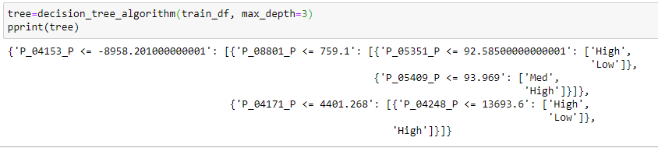
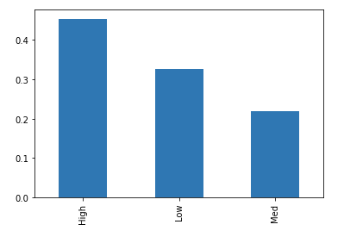
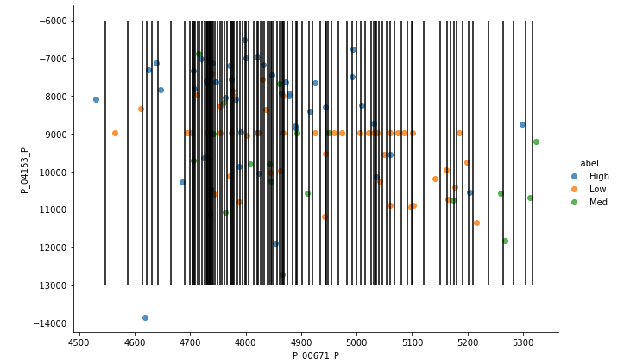
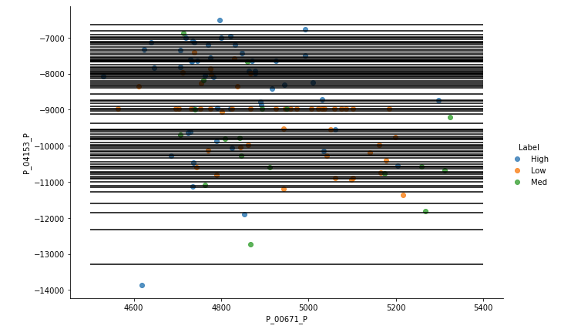
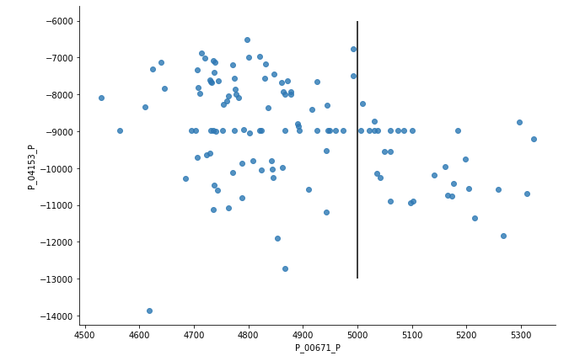

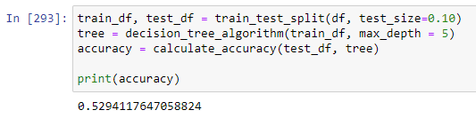
3. Building the decision tree model
Step 4
Step 4
Step 1: Load data set by imputing empty rows with median values of features
Step 2: Generate train set and test set with a test size of 30%
Step 3: Validating for purity of data
Step 4: Generating potential splits
Step 5: Splitting data
Step 6: Generating decision tree algorithm
Step 7: Calculating accuracy
Step 5
Step 7

Slide 6
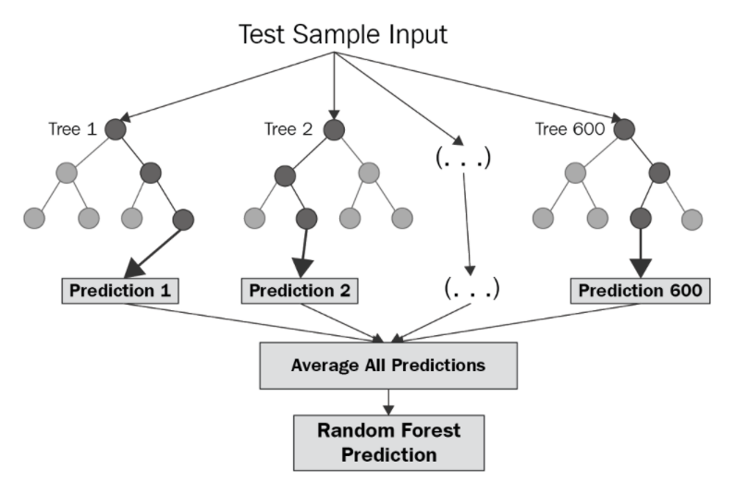
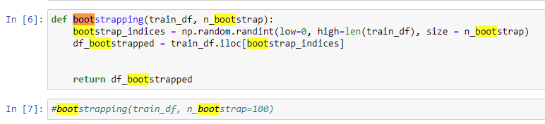
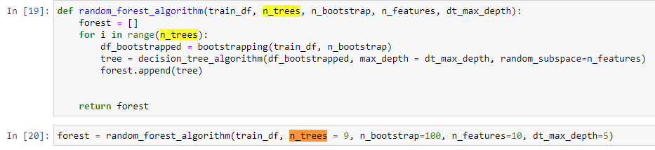
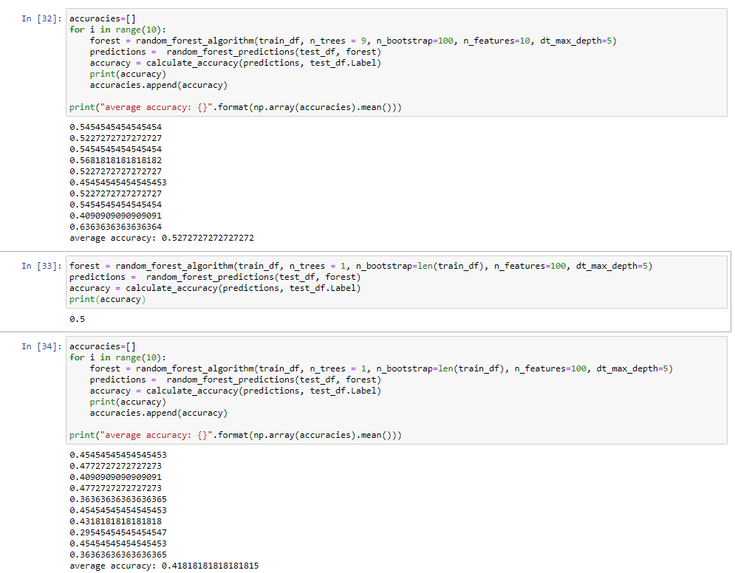

4. Building the random forest model
Advantages:
Collects various decision trees
Ensemble algorithm
Large dataset
Better accuracy
Low risk of overfit
Step 2
Step 3
Step 1: Begin with decision tree model and have the helper functions updated to be able to fit into random forest model
Step 2: Generate boot strapping function to loop for selected number of rows multiple number of times
Step 3: Generate random forest algorithm to loop on selected number of features multiple number of times to create multiple trees
Step 4: Generate accuracy
Step 5: Compare random forest model against decision tree model
Step 4
Step 5

Slide 7
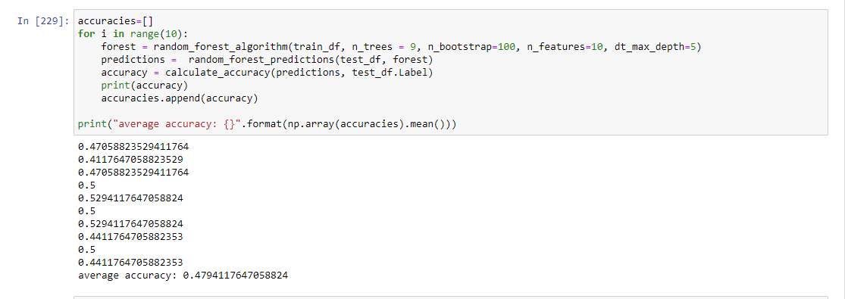
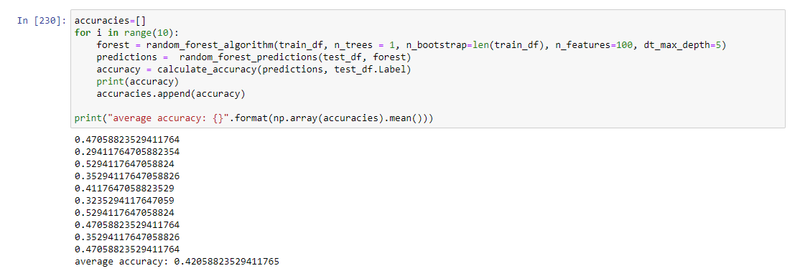
5 – Test comparison for 17 features dataset – Test - 1
Random forest – 17 features and 160 rows
Decision tree - 17 features and 160 rows

Slide 8
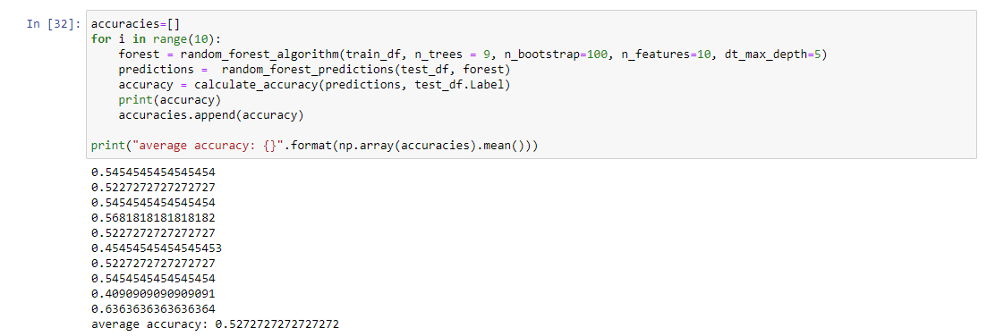
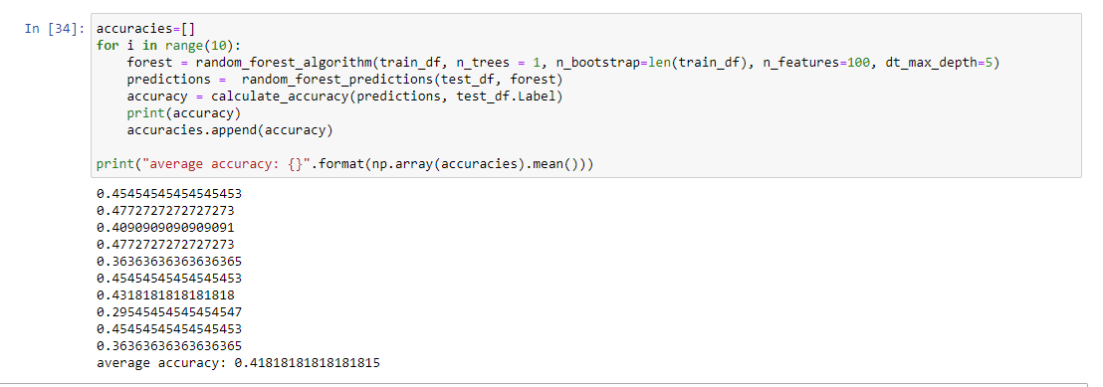
5 –Ensemble of models - Test - 3
Random forest – 42 features and 220 col
Decision tree - 42 features and 220 col

Slide 9
Conclusion
Algorithm | Accuracy(TP+TN)/(TP+TN+FP+FN) | Comments
Random forest – 17 features – 160 data points | 0.47 | Random forest performs better than decision tree, as decision tree follows the greedy algorithm path to find the best match
Decision tree – 17 features – 160 data points | 0.42
Random forest – 42 features – 220 data points | 0.53 | Random forest performs better than decision tree, as the sample size increases and takes into account the increased variability of data set by using bootstrap function and ensemble model
Decision tree – 42 features – 220 data points | 0.41
Random forest model helps predict if the overall CMOS yield would be High(>50%), Med(40%-50%) or Low(<40%) with an accuracy of 52%
Being able to predict CMOS yield based on param data helps save 15 days of cycle time
Only using the top 17 features the best accuracy obtained was 50%, while using a combination of top 17 features and critical registers(domain knowledge) has given best accuracy case of 67%
Above helps confirm the fact that mere ML model or mere domain knowledge with no idea of the other respectively doesn’t give full success in accuracy.
Both domain knowledge and ML knowledge when combined will help give the best accuracy

