Slide 1
ELI-DL : ELI extension to describe draft legislation
Version : « final1 »
Last updated : 17/03/2020
Creator : thomas.francart@sparna.fr

Slide 2
Events / Activities
Works / « Documents »
property / link
Concepts / Controlled values
Out of scope
of ELI Draft Legislation extension
Subclass of

Slide 3
EXAMPLE 1 : A BILL IN IRELAND

Slide 4
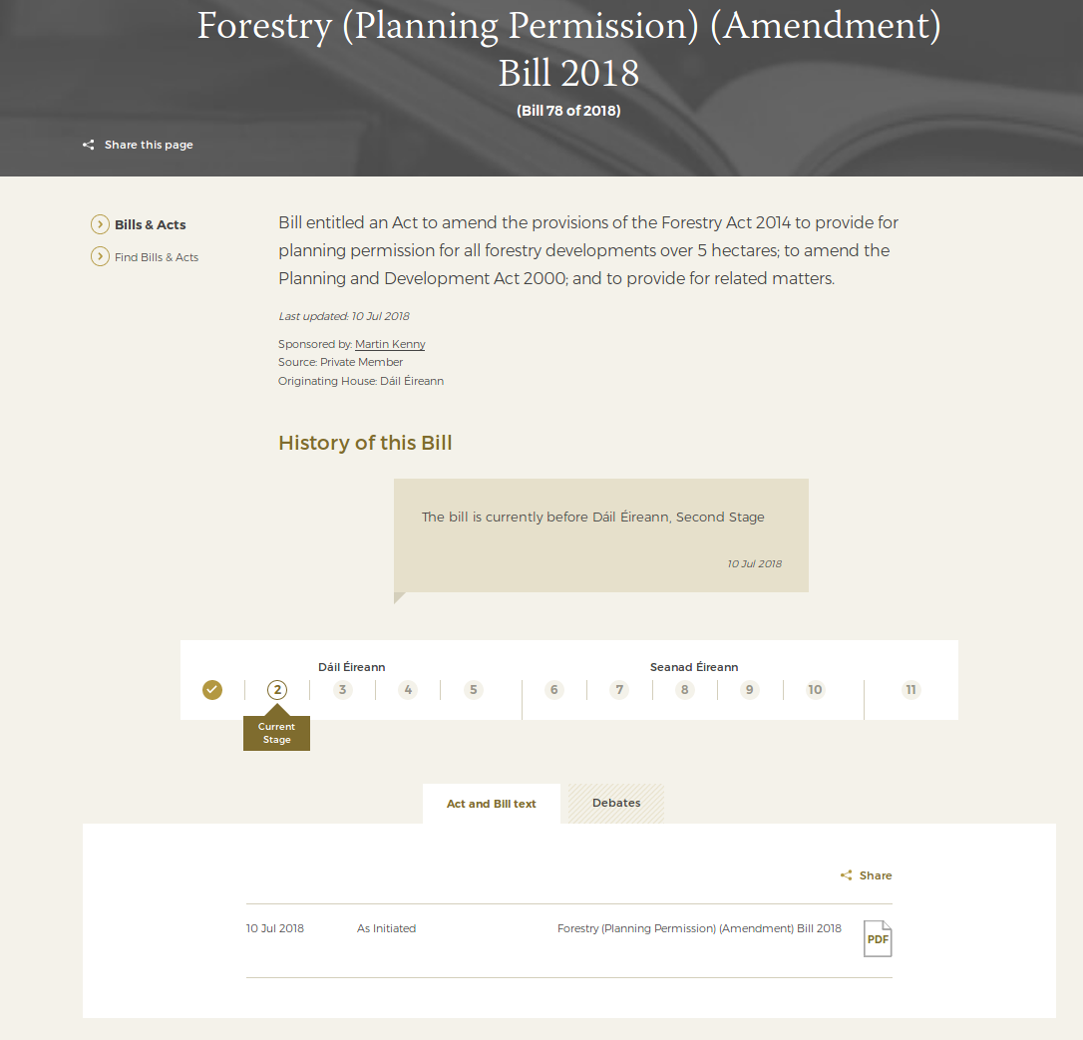
https://www.oireachtas.ie/en/bills/bill/2018/78/?tab=debates

Slide 5
LegislativeProcess
legislative_project_title : Forestry (Planning Permission) (Amendment) Bill 2018
legislative_process_number : « 78 »
legislative_process_description: « Bill entitled an Act to amend… »
date_last_updated : 2018-07-10
Person : Martin Kenny
had_responsible_person

Slide 6
LegislativeProcessType : Bill
legislative_process_type
LegislativeProcess
legislative_process_title : Forestry (Planning Permission) (Amendment) Bill 2018
legislative_process_number : « 78 »
legislative_process_description: « Bill entitled an Act to amend… »
date_last_updated : 2018-07-10
Person : Martin Kenny
LegislativeProcessStatus : Ongoing
had_responsible_person
legislative_process_status

Slide 7
LegislativeProcessType : Bill
legislative_process_type
LegislativeProcess
legislative_process_title : Forestry (Planning Permission) (Amendment) Bill 2018
legislative_process_number : « 78 »
legislative_process_description: « Bill entitled an Act to amend… »
date_last_updated : 2018-07-10
Person : Martin Kenny
LegislativeProcessStatus : Ongoing
had_responsible_person
legislative_process_status
consists_of
latest_activity
consists_of
LegislativeActivity
activity_label : « Dàil first stage »
activity_start_date : 2018-07-10
activity_end_date : 2018-07-10
LegislativeActivity
activity_label : « Dàil second stage »
activity_start_date : 2018-07-10
occured_at_stage

Slide 8
LegislativeProcessType : Bill
legislative_process_type
LegislativeProcess
legislative_process_title : Forestry (Planning Permission) (Amendment) Bill 2018
legislative_process_number : « 78 »
legislative_process_description: « Bill entitled an Act to amend… »
date_last_updated : 2018-07-10
Person : Martin Kenny
LegislativeProcessStatus : Ongoing
had_responsible_person
legislative_process_status
consists_of
latest_activity
current_stage
LegislativeProcessStage : « Dàil first stage »
consists_of
LegislativeProcessStage : « Dàil second stage »
LegislativeActivity
activity_label : « Dàil first stage »
activity_start_date : 2018-07-10
activity_end_date : 2018-07-10
LegislativeActivity
activity_label : « Dàil second stage »
activity_start_date : 2018-07-10
occured_at_stage
occured_at_stage

Slide 9
LegislativeProcessType : Bill
legislative_process_type
LegislativeProcess
legislative_process_title : Forestry (Planning Permission) (Amendment) Bill 2018
legislative_process_number : « 78 »
legislative_process_description: « Bill entitled an Act to amend… »
date_last_updated : 2018-07-10
Person : Martin Kenny
LegislativeProcessStatus : Ongoing
had_responsible_person
legislative_process_status
consists_of
latest_activity
current_stage
LegislativeProcessStage : « Dàil first stage »
consists_of
LegislativeProcessStage : « Dàil second stage »
LegislativeActivity
activity_label : « Dàil first stage »
activity_start_date : 2018-07-10
activity_end_date : 2018-07-10
LegislativeActivity
activity_label : « Dàil second stage »
activity_start_date : 2018-07-10
occured_at_stage
occured_at_stage
created_a_realization_of
LegislativeProcessWork
legislative_process_work_date : 2018-07-10
legislative_process_work_version
LegislativeProcess
WorkVersion : « as initiated »
is_realized_by
Expression
title : « Forestry (Planning Permission) (Amendment) Bill 2018 »
language : en
is_embodied_by
ManifestationProductType
media_type : PDF

Slide 10
LegislativeProcessType : Bill
legislative_process_type
LegislativeProcess
legislative_process_title : Forestry (Planning Permission) (Amendment) Bill 2018
legislative_process_number : « 78 »
legislative_process_description: « Bill entitled an Act to amend… »
date_last_updated : 2018-07-10
Person : Martin Kenny
LegislativeProcessStatus : Ongoing
had_responsible_person
legislative_process_status
consists_of
latest_activity
current_stage
LegislativeProcessStage : « Dàil first stage »
consists_of
LegislativeProcessStage : « Dàil second stage »
LegislativeActivity
activity_label : « Dàil first stage »
activity_start_date : 2018-07-10
activity_end_date : 2018-07-10
LegislativeActivity
activity_label : « Dàil second stage »
activity_start_date : 2018-07-10
occured_at_stage
occured_at_stage
recorded_in_realization_of
created_a_realization_of
LegislativeProcessWork
legislative_process_work_date : 2018-07-10
LegislativeProcessWork
legislative_process_work_date : 2018-07-10
legislative_process_work_version
LegislativeProcess
WorkVersion : « as initiated »
is_realized_by
Expression
title : « Forestry (Planning Permission) (Amendment) Bill 2018 »
language : en
Expression
title : « Dàil Eireann - Forestry (Planning Permission) (Amendment) Bill 2018 »
language : en
is_embodied_by
ManifestationProductType
media_type : PDF
ManifestationProductType
media_type : MP4

Slide 11
EXAMPLE 2 : A EUROPEAN PROCEDURE

Slide 12
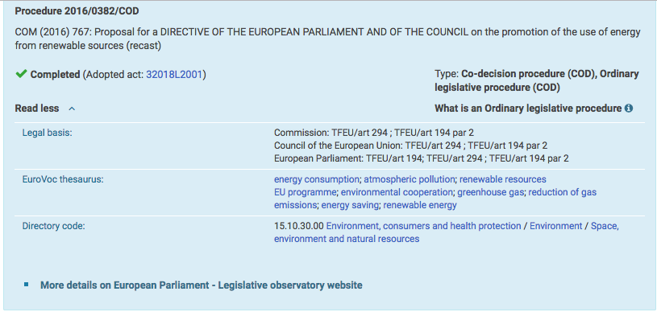
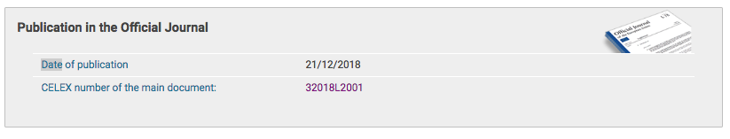
https://eur-lex.europa.eu/legal-content/EN/HIS/?sortOrder=asc&uri=CELEX%3A32018L2001

Slide 13
« COD » is not part of the id (a project can change type during its life)
LegislativeProcess
legislative_process_id: 2016/0382
legislative_process_name : COM (2016) 767: Proposal for a DIRECTIVE OF THE EUROPEAN PARLIAMENT AND OF THE COUNCIL on the promotion of the use of energy from renewable sources (recast)
legislative_process_type : Co-decision procedure (COD)
legislative_process_type : Ordinary legislative procedure (COD)
legislative_process_status: Completed
had_legal_basis: Commission: TFEU/art 294 ; TFEU/art 194 par 2
had_legal_basis: Council of the European Union: TFEU/art 294
had_legal_basis: European Parliament: TFEU/art 194; TFEU/art 294 ; TFEU/art 194 par 2
is_subject_of : http://www.europarl.europa.eu/oeil/FindByProcnum.do?lang=en&procnum=OLP/2016/0382
This is how the title is dispayed in Eur-Lex even though this is the title of the COM document.
created_a_realization_of_legal_resource
based_on_a_realization_of
legislative_process_keyword
DraftLegislationWork
legislative_process_work_version: « as initiated »
legislative_process_work_date: 2018-07-10
legislative_process_work_id : (2016) 767
skos:Concept
skos:prefLabel : energy consumption
LegalResource
http://data.europa.eu/eli/dir/2018/2001/oj
eli:date_document: 2018-12-21
eli:id_local: 32018L2001
is_about
skos:Concept
skos:prefLabel : energy consumption
skos:Concept
Note : in this example we have repeated the legal basis and the keywords on the LegislativeProject; a detailed analysis should determine if this should be the case or not.

Slide 14
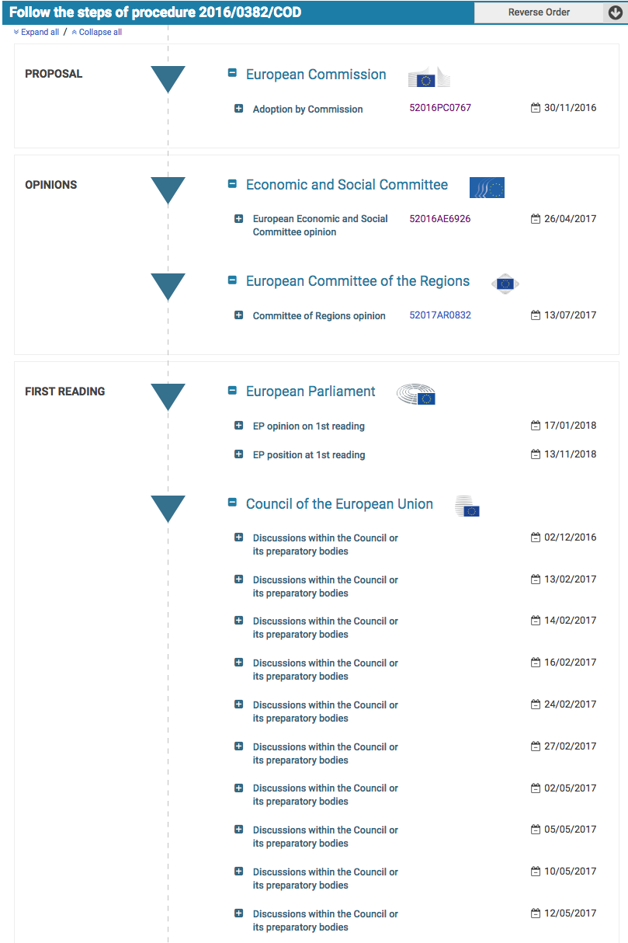
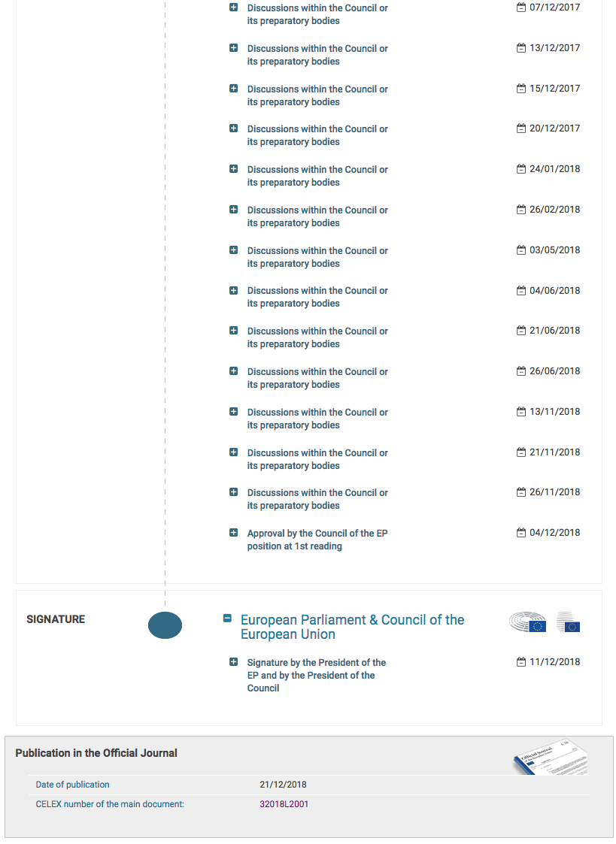
https://eur-lex.europa.eu/legal-content/EN/HIS/?sortOrder=asc&uri=CELEX%3A32018L2001

Slide 15
LegislativeProcess
legislative_process_id: 2016/0382
...
created_a_realization_of_legal_resource
There might be more steps involved in the adoption by the commission, but not visible on Eur-Lex
consists_of
LegislativeActivity
occured_at_stage: Adoption by Commission
had_responsible_organization: Directorate-General for energy, European Commission
activity_date: 2016-11-30
LegislativeActivity
occured_at_stage: European Economic and Social Committee Opinion
had_responsible_organization: Economic and Social Committee
activity_date: 2017-04-26
LegislativeActivity
occured_at_stage: Committee of Regions opinion
had_responsible_organization: European Committee of the Regions
activity_date: 2017-07-13
LegislativeActivity
occured_at_stage: EP opinion on 1st reading
had_responsible_organization: European Parliament
activity_date: 2018-01-17
LegislativeActivity
occured_at_stage: EP position at 1st reading
had_responsible_organization: European Parliament
activity_date: 2018-11-13
LegalActivity
activity_stage: Discussion within the Council or its preparatory bodies
activity_responsible: European Parmliament & Council of the European Union
LegislativeActivity
occured_at_stage: Signature by the President of the EP and by the President of the Council
had_responsible_organization: European Parmliament & Council of the European Union
activity_date: 2018-11-12
LegislativeActivity
occured_at_stage: Publication in the Official Journal
activity_date: 2018-12-21
created_a_realization_of_legal_resource
LegalActivity
activity_stage: Discussion within the Council or its preparatory bodies
activity_responsible: European Parmliament & Council of the European Union
LegalActivity
activity_stage: Discussion within the Council or its preparatory bodiesLegalActivity
activity_stage: Discussion within the Council or its preparatory bodies
activity_responsible: European Parmliament & Council of the European Union
activity_responsible: European Parmliament & Council of the European Union
LegislativeActivity
occured_at_stage: Discussion within the Council or its preparatory bodies
had_responsible_organization: Council of the European Union
activity_date: 2016-02-12
LegalResource
http://data.europa.eu/eli/dir/2018/2001/oj

Slide 16
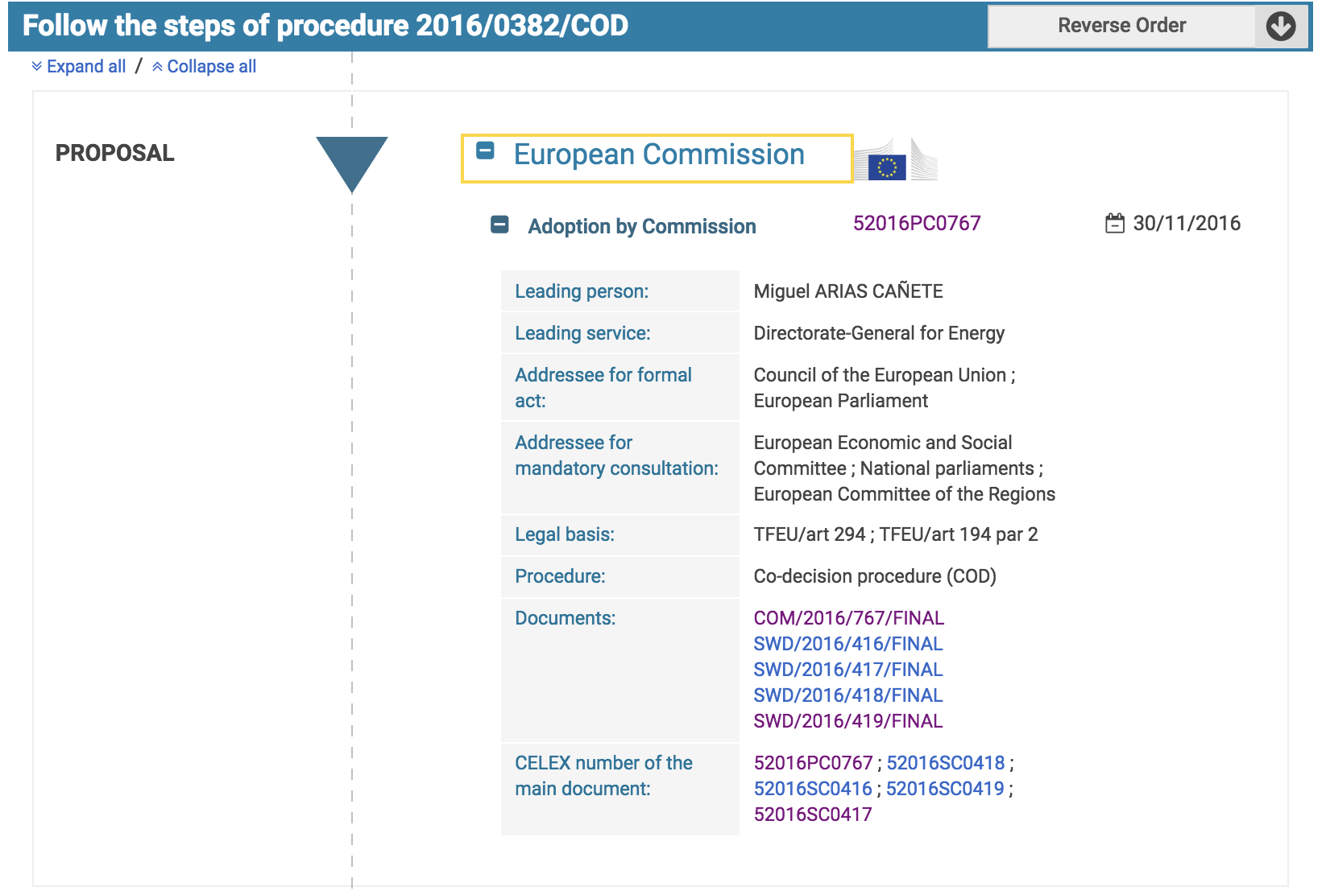
COM Document
Staff Working Documents
https://eur-lex.europa.eu/legal-content/EN/HIS/?sortOrder=asc&uri=CELEX%3A32018L2001

Slide 17
LegislativeProcess
consists_of
LegislativeActivity
activity_stage: Adoption by Commission
had_responsible_organization: European Commission
had_responsible_organization: Directorate-General for Energy
had_responsible_person: Miguel ARIAS CAÑETE
activity_date: 2016-11-30
had_legal_basis: TFEU/art 294
had_legal_basis: TFEU/art 194 par 2
Legal basis is already expressed at the LegislativeProject level.
Should it be repeated ?
created_a_realization_of
involved_work
LegislativeProcessWork
legislative_project_work_id: 52016SC0418
LegislativeProcessWork
legislative_project_work_id: 52016SC0416
LegislativeProcessWork
legislative_project_work_id: 52016SC0419
LegislativeProcessWork
legislative_project_work_id: 52016SC0417
COM document
DraftLegislationWork
legislative_project_work_id: 52016PC0767
Note : in this example « adressee for formal act » and « adressee for mandatory consultation » are not mapped. A detailled analysis should determine if/how they can be mapped to ELI-DL.

Slide 18
PART 1 : ACTIVITY DESCRIPTION

Slide 19
The notion of LegislativeActivity plays a central role in the description of a draft legislation process.
A LegislativeActivity has a label and date information, either as range (start / end date) or single date.

Slide 20
LegislativeActivity
activity_label
activity_date
activity_start_date
activity_end_date

Slide 21
A LegislativeActivity can have participants and/or responsible persons or organizations.
They can be indicated either as entities or simply with a label.

Slide 22
had_participant_person
LegislativeActivity
activity_label
activity_date
activity_start_date
activity_end_date
participant_person_label
participant_organization_label
responsible_person_label
responsible_organization_label
Person
had_responsible_person
< had_participant_person
had_participant_organization
Organization
had_responsible_organization
< had_participant_organization

Slide 23
A LegislativeActivity can correspond to a stage in a legislative workflow.
Stage can be « 1ère lecture à l’assemblée », « Dàil second stage », « Opinion from Economic and Social Council », etc.
It is possible to indicate the legal basis of the activity, by referring to the act or article that made this activity possible.

Slide 24
LegalResource
< Work
had_legal_basis
had_participant_person
LegislativeActivity
activity_label
activity_date
activity_start_date
activity_end_date
participant_person_label
participant_organization_label
responsible_person_label
responsible_organization_label
Person
occured_at_stage
had_responsible_person
< had_participant_person
LegislativeProcessStage
< skos:Concept
had_participant_organization
Organization
had_responsible_organization
< had_participant_organization

Slide 25
A LegislativeActivity can consist of other activities.
(« first lecture in parliament is composed of commision reading then discussion in plenary session, then vote »)
A LegislativeActivity can be motivated by another activity.
(« economic commitee produced an opinion because the legislation service sent a request for an opinion »)

Slide 26
LegalResource
< Work
consists_of /
forms_part_of
was_motivated_by
/ motivated
had_legal_basis
had_participant_person
LegislativeActivity
activity_label
activity_date
activity_start_date
activity_end_date
participant_person_label
participant_organization_label
responsible_person_label
responsible_organization_label
Person
occured_at_stage
had_responsible_person
< had_participant_person
LegislativeProcessStage
< skos:Concept
had_participant_organization
Organization
had_responsible_organization
< had_participant_organization

Slide 27
A LegislativeActivity can use input works/documents , or create output works/documents.
These documents are called LegislativeProcessWork, « any work created during a legislative process ».

Slide 28
LegislativeActivity
based_on_a_realization_of
< involved_work
created_a_realization_of
< involved_work
LegislativeProcessWork
< Work

Slide 29
Sometimes it is not clear if the documents are input or output of the activity.
In this case, a more generic link can be used to state that the activity simply « involved » some work.

Slide 30
Work
involved_work
LegislativeActivity
based_on_a_realization_of
< involved_work
created_a_realization_of
< involved_work
LegislativeProcessWork
< Work

Slide 31
A LegislativeActivity can be recorded in related documents.
(debates recording)

Slide 32
Work
LegislativeProcessWork
involved_work
recorded_in_realization_of
LegislativeActivity
based_on_a_realization_of
< involved_work
created_a_realization_of
< involved_work
LegislativeProcessWork
< Work

Slide 33
PART 2 : LEGISLATIVE PROCESS DESCRIPTION

Slide 34
A special kind of LegislativeActivity is the LegislativeProcess itself.
The LegislativeProcess corresponds to the entire « Bill » / « Dossier parlementaire », from initiation to signature.
It inherits all the properties of a LegislativeActivity (including start / end date, and can consists of sub-activities.)

Slide 35
LegislativeActivity
consists_of
LegislativeProcess
< LegislativeActivity

Slide 36
The LegislativeProcess can have a type (« Proposition de loi », etc. List of values need to be defined in each country.)
It can be associated to a global status to indicate if the project is Ongoing, was Successful or abandonned.
It can be associated with some keywords.

Slide 37
LegislativeActivity
legislative_process_type
LegislativeProcessType
< skos:Concept
consists_of
legislative_process_status
LegislativeProcessStatus
< skos:Concept
Open
Successful
Abandonned
LegislativeProcess
< LegislativeActivity
skos:Concept
legislative_process_keyword
< P129_is_about

Slide 38
The LegislativeProcess can be described with
A title and description
A number (its public number)
One or more identifiers of the process for different institutions
Its date of latest update
Who submitted the project

Slide 39
LegislativeActivity
legislative_process_type
LegislativeProcessType
< skos:Concept
consists_of
legislative_process_status
LegislativeProcessStatus
< skos:Concept
Open
Successful
Abandonned
LegislativeProcess
< LegislativeActivity
legislative_process_title
legislative_process_id
legislative_process_external_id (< legislative_process_id)
legislative_process_number (only one)
date_last_update
legislative_process_description
skos:Concept
legislative_process_keyword
< P129_is_about
was_submitted_by
Agent

Slide 40
The LegislativeProcess can point to the latest activity that took place within it. It can also state what is its current stage in the workflow.
This allows to express directly the current status of the legislative project.

Slide 41
LegislativeActivity
legislative_process_type
LegislativeProcessType
< skos:Concept
consists_of
legislative_process_status
LegislativeProcessStatus
< skos:Concept
Open
Successful
Abandonned
LegislativeProcess
< LegislativeActivity
legislative_process_title
legislative_process_id
legislative_process_external_id (< legislative_process_id)
legislative_process_number (only one)
date_last_update
legislative_process_description
skos:Concept
latest_activity
< consists_of
legislative_process_keyword
< P129_is_about
current_stage
was_submitted_by
Agent
LegislativeProcessStage
< skos:Concept

Slide 42
The LegislativeProcess is the subject of multiple webpages (OJ, parliament, commitees, etc.)
(ability to crosslink websites)

Slide 43
LegislativeActivity
legislative_process_type
LegislativeProcessType
< skos:Concept
consists_of
legislative_process_status
LegislativeProcessStatus
< skos:Concept
Open
Successful
Abandonned
LegislativeProcess
< LegislativeActivity
legislative_process_title
legislative_process_id
legislative_process_external_id (< legislative_process_id)
legislative_process_number (only one)
date_last_update
legislative_process_description
skos:Concept
latest_activity
< consists_of
legislative_process_keyword
< P129_is_about
current_stage
is_subject_of
owl:Thing
was_submitted_by
Agent
LegislativeProcessStage
< skos:Concept

Slide 44
The LegislativeProcess can be further described with some « foreseen information » :
Its foreseen date of adoption
The foreseen type of legal resource to be published

Slide 45
LegislativeProcess
< LegislativeActivity
foreseen_date_of_adoption
foreseen_type_document
eli:ResourceType

Slide 46
The LegislativeProcess groups all the documents/work created in the course of the drafting.
(opinions, debates recording, draft of the legislation, etc.)
The event is said to have « created a realization of » these works.

Slide 47
LegislativeProcess
< LegislativeActivity
foreseen_date_of_adoption
foreseen_type_document
eli:ResourceType
created_a_realization_of
< involved_work
LegislativeProcessWork
< Work

Slide 48
Similarly, once finished, the LegislativeProcess will yield the official LegalResource (+ corresponding Expressions and Formats).
The event is said to « create a realization of the legal resource ».
Actually, any LegislativeActivity in the course of the process can yield the creation of a LegalResource, for « intermediate » publications in an official journal.

Slide 49
LegislativeActivity
created_a_realization_of_legal_resource
< involved_work
LegislativeProcess
< LegislativeActivity
foreseen_date_of_adoption
LegalResource
< Work
foreseen_type_document
eli:ResourceType
created_a_realization_of
< involved_work
LegislativeProcessWork
< Work

Slide 50
PART 3 : LEGISLATIVE PROCESS WORK DESCRIPTION

Slide 51
LegislativeProcessWork created during draft legislation process inherit the generic Work class, like LegalResource in ELI.

Slide 52
Work
Generic FRBR level
LegislativeProcessWork
< Work
LegalResource
< Work

Slide 53
Some properties from ELI are moved « up » on generic FRBR classes (Work/Expression/Manifestation) : titles and media_type + links between W/E/M, including has_part / is_part_of.
It means these properties can be used both in ELI and ELI-DL.

Slide 54
is_realized_by / realizes
has_part / is_part_of
Expression
title
title_short
title_alternative
language
Work
is_embodied_by / embodies
has_member / is_member_of
ManifestationProductType
media_type
Generic FRBR level
LegislativeProcessWork
< Work
LegalResource
< Work

Slide 55
A LegislativeProcessWork can be given a more specific type in 2 cases :
It is a new version of the draft legislation, called DraftLegislationWork
It is an amendment or list of amendments, called AmendmentToDraftLegislationWork.

Slide 56
is_realized_by / realizes
has_part / is_part_of
Expression
title
title_short
title_alternative
language
Work
is_embodied_by / embodies
has_member / is_member_of
ManifestationProductType
media_type
Generic FRBR level
LegislativeProcessWork
< Work
LegalResource
< Work
DraftLegislationWork
< LegislativeProcessWork
< Work
AmendmentToDraftLegislationWork
< LegislativeProcessWork
< Work

Slide 57
A LegislativeProcessWork can have an identifier, a creator, a date, a description, a type.
It can refer to any other Work. (a generic link, e.g. an opinion is about a version of the draft, etc.).
Its version can be indicated, in particular to indicate if it is preparatory or final. (e.g. preparatory version of an amendment versus tabled amendment)

Slide 58
LegislativeProcessWorkVersion
< skos:Concept
Work
refers_to
legislative_process_work_version
Preparatory
Final
LegislativeProcessWork
< Work
legislative_process_work_id
legislative_process_work_date
legislative_process_work_description
legislative_process_work_creator
Agent
legislative_process_work_type
< P2_has_type
LegislativeProcessWorkType
< skos:Concept

Slide 59
An Amendment amends a version of the draft legislation.
Successive versions of the draft legislation includes amendments (the ones that have been voted).

Slide 60
LegislativeProcessWorkVersion
< skos:Concept
Work
refers_to
legislative_process_work_version
Preparatory
Final
LegislativeProcessWork
< Work
legislative_process_work_id
legislative_process_work_date
legislative_process_work_description
legislative_process_work_creator
Agent
legislative_process_work_type
< P2_has_type
LegislativeProcessWorkType
< skos:Concept
amends_draft / draft amended_by
< refers_to / referred_to_by
DraftLegislationWork
< LegislativeProcessWork
< Work
AmendmentToDraftLegislationWork
< LegislativeProcessWork
< Work
includes_amendment / amendment_included_in
< refers_to / referred_to_by

Slide 61
A LegislativeProcessWork can foresee modifications on existing LegalResources.
This is true in particular for a version of the draft legislation, but can also be described for an amendment or an opinion.

Slide 62
LegislativeProcessWorkVersion
< skos:Concept
Work
refers_to
legislative_process_work_version
LegalResource
< Work
Preparatory
Final
LegislativeProcessWork
< Work
legislative_process_work_id
legislative_process_work_date
legislative_process_work_description
legislative_process_work_creator
foresees_change_of
foresees_repeal_of
foresees_amendment_of
foresees_commencement_of
foresees_transposition_of
foresees_application_of
foresees_citation_of
foresees_based_on
foresees_consolidation_of
< refers_to
Agent
legislative_process_work_type
< P2_has_type
LegislativeProcessWorkType
< skos:Concept
amends_draft / draft amended_by
< refers_to / referred_to_by
DraftLegislationWork
< LegislativeProcessWork
< Work
AmendmentToDraftLegislationWork
< LegislativeProcessWork
< Work
includes_amendment / amendment_included_in
< refers_to / referred_to_by

Slide 63
COMPLETE SET OF ELI-DL DIAGRAMS

Slide 64
LegalResource
< Work
consists_of /
forms_part_of
was_motivated_by
/ motivated
had_legal_basis
had_participant_person
LegislativeActivity
activity_label
activity_date
activity_start_date
activity_end_date
participant_person_label
participant_organization_label
responsible_person_label
responsible_organization_label
Person
occured_at_stage
had_responsible_person
< had_participant_person
LegislativeProcessStage
< skos:Concept
had_participant_organization
Organization
had_responsible_organization
< had_participant_organization

Slide 65
Work
LegislativeProcessWork
involved_work
recorded_in_realization_of
LegislativeActivity
based_on_a_realization_of
< involved_work
created_a_realization_of
< involved_work
LegislativeProcessWork
< Work

Slide 66
LegislativeActivity
legislative_process_type
LegislativeProcessType
< skos:Concept
consists_of
legislative_process_status
LegislativeProcessStatus
< skos:Concept
Open
Successful
Abandonned
LegislativeProcess
< LegislativeActivity
legislative_process_title
legislative_process_id
legislative_process_external_id (< legislative_process_id)
legislative_process_number (only one)
foreseen_date_of_adoption
date_last_update
legislative_process_description
skos:Concept
latest_activity
< consists_of
legislative_process_keyword
< P129_is_about
current_stage
is_subject_of
owl:Thing
was_submitted_by
Agent
LegislativeProcessStage
< skos:Concept

Slide 67
LegislativeActivity
created_a_realization_of_legal_resource
< involved_work
LegislativeProcess
< LegislativeActivity
foreseen_date_of_adoption
LegalResource
< Work
foreseen_type_document
eli:ResourceType
created_a_realization_of
< involved_work
LegislativeProcessWork
< Work

Slide 68
is_realized_by / realizes
has_part / is_part_of
Expression
title
title_short
title_alternative
language
Work
is_embodied_by / embodies
has_member / is_member_of
ManifestationProductType
media_type
Generic FRBR level
LegislativeProcessWork
< Work
LegalResource
< Work
DraftLegislationWork
< LegislativeProcessWork
< Work
AmendmentToDraftLegislationWork
< LegislativeProcessWork
< Work

Slide 69
LegislativeProcessWorkVersion
< skos:Concept
Work
refers_to
legislative_process_work_version
LegalResource
< Work
Preparatory
Final
LegislativeProcessWork
< Work
legislative_process_work_id
legislative_process_work_date
legislative_process_work_description
legislative_process_work_creator
foresees_change_of
foresees_repeal_of
foresees_amendment_of
foresees_commencement_of
foresees_transposition_of
foresees_application_of
foresees_citation_of
foresees_based_on
foresees_consolidation_of
< refers_to
Agent
legislative_process_work_type
< P2_has_type
LegislativeProcessWorkType
< skos:Concept
amends_draft / draft amended_by
< refers_to / referred_to_by
DraftLegislationWork
< LegislativeProcessWork
< Work
AmendmentToDraftLegislationWork
< LegislativeProcessWork
< Work
includes_amendment / amendment_included_in
< refers_to / referred_to_by

Slide 70
COMPLETE SET OF ELI-DL DIAGRAMS WITH FRBR-OO REFERENCES

Slide 71
LegalResource
< Work
consists_of
< P9_consists_of /
forms_part_of < P9i_forms_part_of
was_motivated_by
< P17_was_motivated_by /
motivated < P17i_motivates
had_legal_basis
< P33_used_specific_technique
had_participant_person
< P11_had_participant
LegislativeActivity
< E7_Activity
activity_label
activity_date
activity_start_date
activity_end_date
participant_person_label
participant_organization_label
responsible_person_label
responsible_organization_label
Person
occured_at_stage
< P2_has_type
had_responsible_person
< had_participant_person
+ P14_carried_out_by
LegislativeProcessStage
< skos:Concept
had_participant_organization
< P11_had_participant
Organization
had_responsible_organization
< had_participant_organization
+ P14_carried_out_by

Slide 72
Work
LegislativeProcessWork
involved_work
< P16_used_specific_object
recorded_in_realization_of
LegislativeActivity
< E7_Activity
based_on_a_realization_of
< involved_work
< P16_used_specific_object
created_a_realization_of
< R19_created_a_realization_of
+
< involved_work
< P16_used_specific_object
LegislativeProcessWork
< Work

Slide 73
LegislativeActivity
< E7_Activity
legislative_process_type
< P2_has_type
LegislativeProcessType
< skos:Concept
consists_of
< P9_consists_of
legislative_process_status
< P2_has_type
LegislativeProcessStatus
< skos:Concept
Open
Successful
Abandonned
LegislativeProcess
< LegislativeActivity
legislative_process_title
legislative_process_description
legislative_process_number (only one)
legislative_process_id
legislative_process_external_id (< legislative_process_id)
date_last_update
skos:Concept
latest_activity
< consists_of
< P9_consists_of
legislative_process_keyword
< P129_is_about
current_stage
< P2_has_type
is_subject_of
< P129i_is_subject_of
owl:Thing
was_submitted_by
< P17_was_motivated_by
+ < P11_had_participant
Agent
LegislativeProcessStage
< skos:Concept

Slide 74
LegislativeActivity
created_a_realization_of_legal_resource
< R19_created_a_realization_of
+
< involved_work
< P16_used_specific_object
LegislativeProcess
< LegislativeActivity
foreseen_date_of_adoption
LegalResource
< Work
< F1_Work
foreseen_type_document
eli:ResourceType
created_a_realization_of
< R19_created_a_realization_of
+
< involved_work
< P16_used_specific_object
LegislativeProcessWork
< Work

Slide 75
is_realized_by / realizes
< R3_is_realized_in / R3i_realizes
has_part / is_part_of
Expression
title
title_short
title_alternative
language
Work
is_embodied_by / embodies
< R4_carriers_provided_by / R4i_comprises_carriers_of
has_member / is_member_of
< R10_has_member / < R10i_is_member_of
ManifestationProductType
media_type
Generic FRBR level
LegislativeProcessWork
< Work
LegalResource
< Work
DraftLegislationWork
< LegislativeProcessWork
< Work
< F1_Work
AmendmentToDraftLegislationWork
< LegislativeProcessWork
< Work
< F1_Work

Slide 76
LegislativeProcessWorkVersion
< skos:Concept
Work
refers_to
< P67_refers_to
legislative_process_work_version
< P2_has_type
LegalResource
< Work
< F1_Work
Preparatory
Final
LegislativeProcessWork
< Work
legislative_process_work_id
legislative_process_work_date
legislative_process_work_description
legislative_process_work_creator
foresees_change_of
foresees_repeal_of
foresees_amendment_of
foresees_commencement_of
foresees_transposition_of
foresees_application_of
foresees_citation_of
foresees_based_on
foresees_consolidation_of
< refers_to
< P67_refers_to
Agent
legislative_process_work_type
< P2_has_type
LegislativeProcessWorkType
< skos:Concept
amends_draft / draft amended_by
< refers_to / referred_to_by
< P67_refers_to / P67i_referred_to_by
DraftLegislationWork
< LegislativeProcessWork
< Work < F1_Work
AmendmentToDraftLegislationWork
< LegislativeProcessWork
< Work < F1_Work
includes_amendment / amendment_included_in
< refers_to / referred_to_by
< P67_refers_to / P67i_referred_to_by

