Slide 1
Garance architecture
Generic tool to publish RDF data in static websites
Lightweight solution to make RDF data browsable
Initially deployed for the SAPA foundation vocabularies
  https://vocab.performing-arts.ch/
  Small SKOS controlled lists, each in one page
  With URI resolution

Slide 2
Why static websites ?
Eassy deployment : only a web server is needed, no need to install a database + an application
Speed : static files load quicker
  Google crawler likes that
Security : no server-side application, less possibilities of intrusion
Simplicity : HTML + JS + CSS
Cost : no application maintenance needed
Reliability : no possible downtimes, since there is no database or application that runs
Customisation :
  Generic layout for any RDF data
  Dedicated layout for SKOS vocabularies
  Ability to customize some part of the layout
    E.g. Display a certain predicate in a certain way
Good for data that does not change often
  of course less suited for data that is updated frequently

Slide 3
Relies on 2 main components
JSON-LD framing
  https://www.w3.org/TR/json-ld11-framing/
  Serialize RDF graphs into a classical JSON tree-like structure
  « From RDF to clean JSON »
Static website generator that reads the JSON and do the actual website generation
  11ty : https://www.11ty.dev/
  Based on Javascript

Slide 4
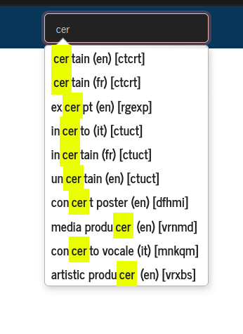
What about search in static website ?
There are solutions !
Client-side custom quick-access
Pagefind integration for browser-side full-text search + facets
  https://pagefind.app/
  Impressively fast and scalable
The static website can be coupled with a dynmic part to query e.g. A SPARQL endpoint

Slide 5







70000 RDF/XML files
Read / merge
A single JSON-LD file
« Flat » serialization (flat list of entities)
Framing
“From graph to tree”
3 clean JSON(-LD) files : Agents, Places, Vocabularies
Controlled, tree-shaped JSON serialisation
JSON Framing spec :
Agents / Places / Vocabulaires
Site generation
Static website generator
70000 HTML pages
RiC-O relations entities included in each page
Labelled of referenced entities included in each page

Slide 6



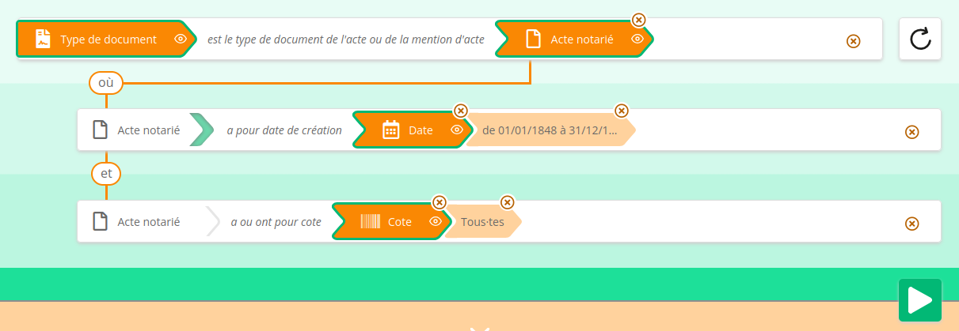
Original RDF dataset
Website generation
Loading
Static website with content negociation
SPARQL query service
RDF files
HTML pages
full-text Index
QLever
Sparnatural interface

Slide 7
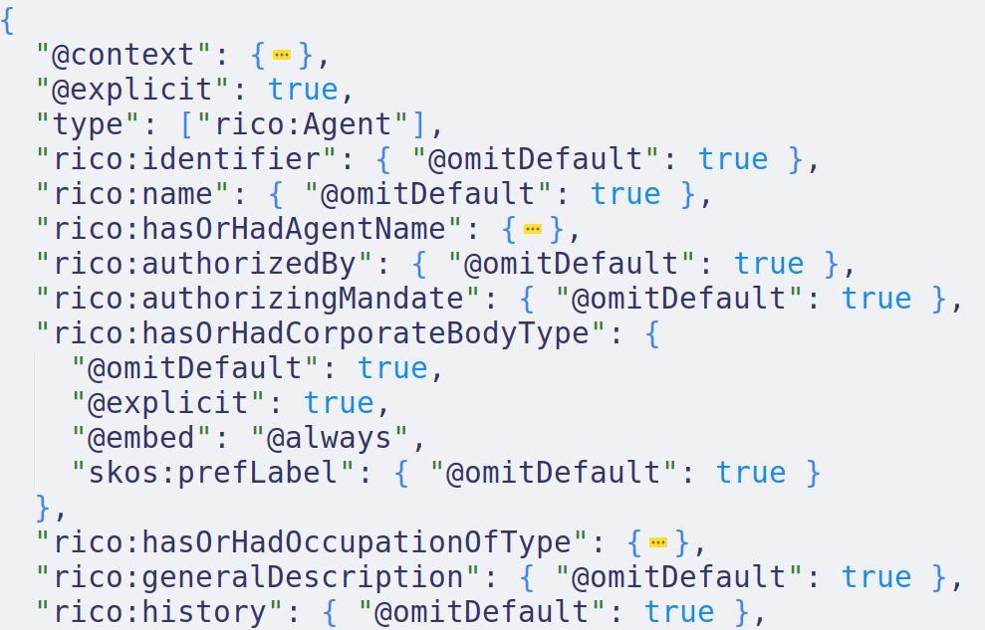
Indicate that we want the skos:prefLabel to be included inside the rico :hasOrHadCorporateBody type
(so that the human-readable label can be shown in the screen)

Slide 8
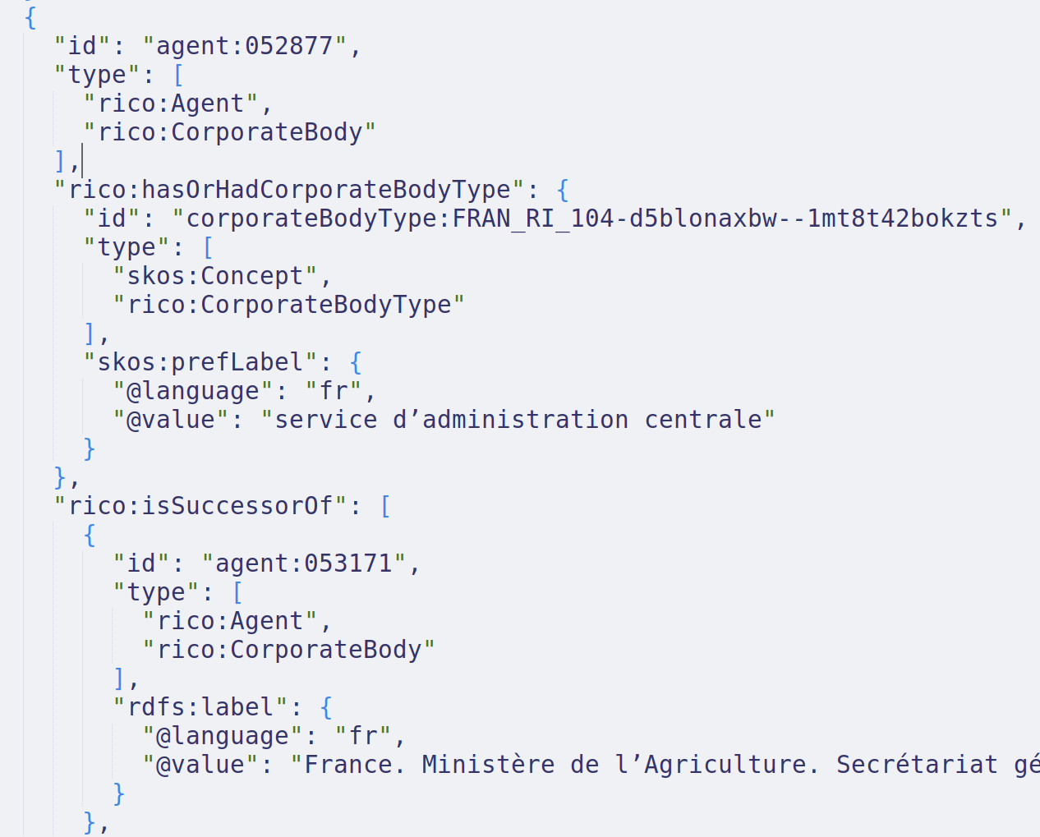
Final hierarchical JSON structure showing how labels of referred entities are included in the data structure.
Each entity is described in a self-sufficient JSON object (no need to navigate the graph)
The JSON structure is clean and easy to process.

Slide 9
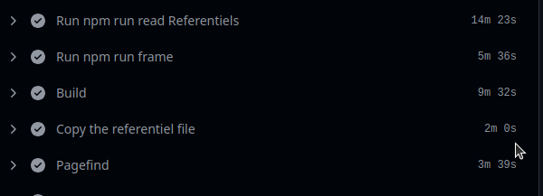
Scalability ?
Current deployment for the ANF generates with 70k pages in ~ 40 minutes
  14 minutes only to read/merge the RDF files !
  6 minutes of framing
  9 minutes to generate the pages
  2 minutes to copy RDF file for content negociation
  3 minutes to create the PageFind index
  + 3 minutes to copy files to the final server
It would be more efficient with a dataset in a single (JSON-LD) file
Right now we think the approach would scale up to 100k entities / pages

Slide 10
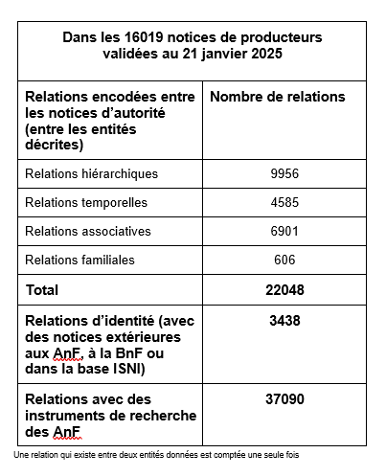
Tableau diapo 7

Slide 11
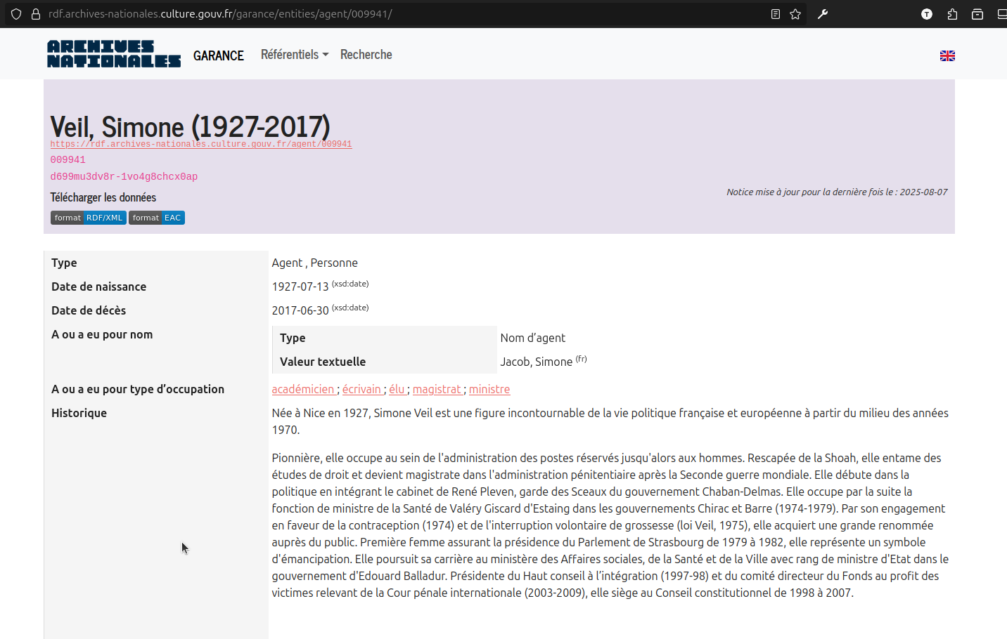
Copie d’écran Agent

Slide 12
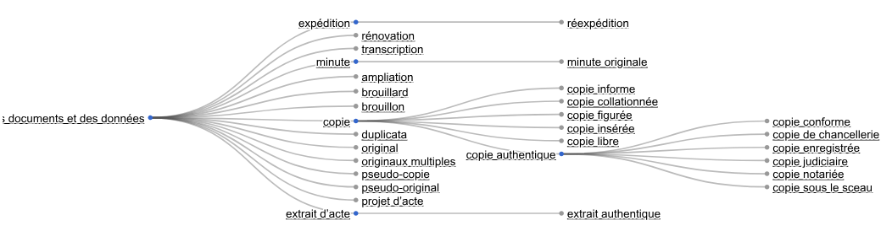
Arborescence d’un vocabulaire

Slide 13
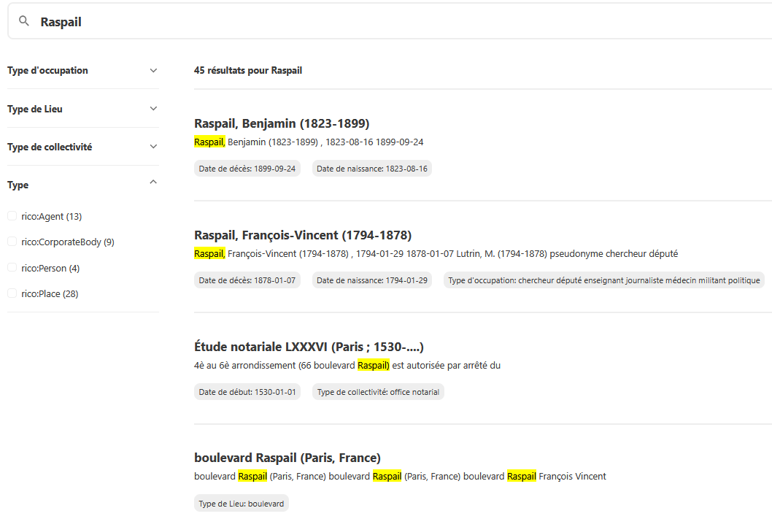
recherche rapide

