Slide 1
ISSN Linked Data Application Profile diagrams

Slide 2
Legend
URI pattern : class URI
A node in the data graph, with its class (possibly multiple classes, separated by commas)
http://issn.org/resource/ISSN/{ISSN} : bf:Work, bf:Instance, schema:Periodical
The ISSN resource has a red color for quick reference.
Variable sections in URI patterns are indicated between curly braces {…} and replaced with the corresponding value
http://issn.org/resource/ISSN/{ISSN}
#RecordCreation : prov:Activity
Relative URIs are always relative to the ISSN resource URI http://issn.org/resource/ISSN/{ISSN}
bf:identifiedBy
Object property (linking 2 resources in the graph)
schema:startDate
"…"
Data property (with a literal value)

Slide 3
"…"
rdf:value
bf:identifiedBy
#ISSN-L : bf:IssnL
http://issn.org/resource/ISSN-L/{ISSN-L} : schema:CreativeWork
prov:generated
idStatus:Valid
bf:status
bf:identifiedBy
"the ISSN"
rdf:value
schema:isPartOf
schema:hasPart
#ISSN : bf:Issn
prov:generated
bf:identifiedBy
idStatus:Valid
bf:status
http://issn.org/resource/ISSN/{ISSN} : bf:Work, bf:Instance, schema:Periodical
"…"
rdf:value
#KeyTitle : bf:Identifier, bf:KeyTitle
prov:generated
bf:identifiedBy
(+ bf:title)
bibo:issn
"…"
rdf:value
schema:issn
dc:identifier
#AbbreviatedKeyTitle : bf:Identifier, bf:AbbreviatedTitle
prov:generated
"the ISSN"
"the ISSN"
"the ISSN"
bf:identifiedBy
(+ bf:title)
schema:mainEntity
#RecordCreation : prov:Activity
prov:generated
#Record : schema:CreativeWork
Same or different
http://issn.org/organization/ISSNCenter#{CCID} : schema:Organization
http://issn.org/organization/ISSNCenter#{CCID} : schema:Organization
prov:wasAssociatedWith
prov:wasAttributedTo
Relative URIs (beginning with #) are relative to the ISSN resource URI : http://issn.org/resource/ISSN/{ISSN}

Slide 4
"incorrect ISSN"
"cancelled ISSN-L"
issnprop:hasIncorrectISSN
issnprop:hasCancelledISSN-L
"…"
rdf:value
http://issn.org/resource/ISSN/{ISSN} : bf:Work, bf:Instance, schema:Periodical
bf:identifiedBy
#ISSN : bf:Issn
idStatus:Valid
bf:status
schema:mainEntity
issnprop:hasCancelledISSN
issnprop:cancelledInFavorOf
#Record : schema:CreativeWork
recordStatus:Register
or recordStatus:Legacy
or recordStatus:Provisional
bf:status
"…"
rdf:value
bf:identifiedBy
#ISSN : bf:Issn
http://issn.org/resource/ISSN/{CancelledISSN} :
no class
idStatus:Cancelled
bf:status
schema:mainEntity
#Record : schema:CreativeWork
recordStatus:Cancelled
bf:status
Relative URIs (beginning with #) are relative to the ISSN resource URI : http://issn.org/resource/ISSN/{ISSN}

Slide 5
schema:parentOrganization
schema:contributor
schema:contributor
#IssuingBody –{name} : schema:Organization
#IssuingBody –{name} : schema:Organization
bfrel:isb
bfrel:isb
dct:spatial
schema:startDate
schema:location
MARC Country URI
http://issn.org/resource/ISSN/{ISSN} : bf:Work, bf:Instance, schema:Periodical
"…"
schema:location
ISO Country URI
"…"
dct:spatial
schema:endDate
#ReferencePublicationEvent : schema:PublicationEvent
schema:publication
schema:publication
schema:publication
schema:publisher
dct:temporal
Same modelling pattern for each event
#EarliestPublicationEvent : schema:PublicationEvent
Other publication events :
#InterveningPublicationEvent{n}
#LatestPublicationEvent : schema:PublicationEvent
"…"
"…"
schema:location
schema:publishedBy
#PublicationPlace-{placename} :
schema:Place
#Publisher-{publisherName} : schema:Organization
#Publisher-{publisherName} : schema:Organization
#PublicationPlace-{placename} : schema:Place
schema:geo
schema:latitude
#PublicationPlace-{placename}-GeoCoordinates : schema:GeoCoordinates
#PublicationPlace-{placename}-GeoCoordinates : schema:GeoCoordinates
"…"
"…"
schema:longitude
Relative URIs (beginning with #) are relative to the ISSN resource URI : http://issn.org/resource/ISSN/{ISSN}

Slide 6
"Key title** "
bf:mainTitle
(+ rdf:value)
rdf:value
"…"
#KeyTitle : bf:Identifier, bf:KeyTitle
bf:title
(+ bf:identifiedBy)
bf:note
_:blank node : bf:Note
bf:translationOf
"…"
bf:mainTitle
(+ rdf:value)
bf:noteType
"Abbreviated Key Title**"
"…"
#AbbreviatedKeyTitle : bf:Identifier, bf:AbbreviatedTitle
bf:title
(+ bf:identifiedBy)
rdf:value
_:blank node : bf:ClassificationUdc
bf:classification
"Other title**"
bf:mainTitle
_:blank node : bf:ClassificationDdc
bf:translationOf
_:blank node : bf:ParallelTitle
bf:title
bf:classification
"Other title**"
rdf:value
bf:mainTitle
http://issn.org/resource/ISSN/{ISSN} : bf:Work, bf:Instance, schema:Periodical
"…"
bf:translationOf
_:blank node : bf:VariantTitle
bf:title
bf:variantType
schema:keywords
"…"
schema:about
schema:alternateName
bf:translationOf
_:blank node : bf:Title
bf:title
UDC Summary URI
bf:mainTitle
"UDC summary label"
_:blank node : bf:Title
"Title proper * "
schema:name
+ bf:mainTitle
"Title proper *"
"Abbreviated Key Title or Parallel Title or Variant Title*** "
"Key title** "
schema:name
bf:mainTitle
* : the title proper is both in schema:name and in a bf:Title entity
**: the key title is both in schema:name and in the #KeyTitle entity
*** : abbreviated key title, parallel and variant titles are both in schema:alternateNames and in bf:AbbreviatedTitle, bf:ParallelTitle and bf:VariantTitle entities.
"Title in original script"
Relative URIs (beginning with #) are relative to the ISSN resource URI : http://issn.org/resource/ISSN/{ISSN}

Slide 7
http://issn.org/resource/ISSN/{ISSN} : bf:Work, bf:Instance, schema:Periodical
http://issn.org/resource/ISSN/{another_ISSN} : bf:Work, bf:Instance, schema:Periodical
dc:relation
schema:citation
bf:hasSubseries
bf:subseriesOf
schema:translationOfWork
schema:workTranslation
bf:translationOf
bf:translation
bf:supplementTo
bf:supplement
dct:isVersionOf
bf:otherEdition
dct:isFormatOf
bf:otherPhysicalFormat
bf:issuedWith
bf:precededBy
bf:continues
bf:continuedBy
bf:continuesInPart
bf:continuedInPartBy
bf:replacementOf
bf:mergerOf
bf:absorbed
bf:absorbedBy
bf:separatedFrom
bf:replacedBy
bf:splitInto
bf:mergedToForm
dct:hasPart
dct:isPartOf
bflc:indexedIn
#IndexingService-{name} : bf:Work
schema:name
"…"
bf :electronicLocator
URL
Relative URIs (beginning with #) are relative to the ISSN resource URI : http://issn.org/resource/ISSN/{ISSN}

Slide 8
issnprop:cancelledInFavorOf
"incorrect ISSN"
"cancelled ISSN-L"
issnprop:hasCancelledISSN
issnprop:hasIncorrectISSN
issnprop:hasCancelledISSN-L
"the ISSN"
rdf:value
http://issn.org/resource/ISSN-L/{ISSN-L} : schema:CreativeWork
#ISSN : bf:Issn
bf:identifiedBy
bf:status
schema:isPartOf
schema:hasPart
schema:location
dct:spatial
"…"
MARC Country URI
http://issn.org/resource/ISSN/{ISSN} : bf:Work, bf:Instance, schema:Periodical
schema:url
schema:location
ISO Country URI
dct:spatial
dc:format
#ReferencePublicationEvent : schema:PublicationEvent
schema:publication
bibo:issn
schema:issn
dc:identifier
_:blank node : schema:ArchiveComponent
schema:subjectOf
"the ISSN"
"the ISSN"
"the ISSN"
"Title proper"
schema:name
schema:name
"Key title"
schema:mainEntity
http://issn.org/organization/ISSNCenter#{CCID} : schema:Organization
prov:wasAttributedTo
#Record : schema:CreativeWork
dc:modified
"…"
bf:status
Relative URIs (beginning with #) are relative to the ISSN resource URI : http://issn.org/resource/ISSN/{ISSN}

Slide 9
schema:name
"Name of the ISSN Centre"
schema:logo
<http://logo.png>
schema:identifier
"ISSN Centre code"
http://issn.org/organization/ISSNCenter#{CCID} : schema:Organization
schema:url
"website"
schema:email
"e-mail"
schema:telephone
"telephone"
schema:streetAddress
schema:faxNumber
"street address"
"fax"
schema:address
_:blank node : schema:PostalAddress
schema:addressLocality
"city name"
schema:contactPoint
dct:spatial
schema:addressCountry
ISO Country URI
"country code"
schema:name
"Mr John Doe, Librarian"
schema:contactType
"Main contact point" (only for the first contact point)
_:blank node : schema:ContactPoint
schema:email
"e-mail"
schema:telephone
"telephone"
schema:faxNumber
"fax"

Slide 10
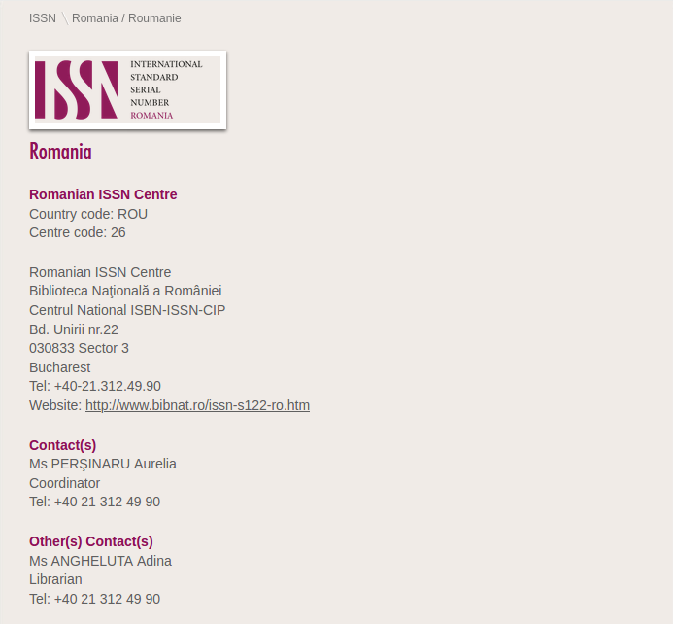
https://www.issn.org/centre/romania-roumanie/

Slide 11
"Organization’s name
(e.g. « Internet Archive »)"
dc:format
http://issn.org/resource/ISSN/{ISSN} : bf:Work, bf:Instance, schema:Periodical
schema:name
"Keeper’s code"
http://issn.org/organization
/keepers#{keeperCode} : schema:ArchiveOrganization
schema:identifier
http://issn.org/vocabularies/Medium#Online (most of the time)
schema:subjectOf
schema:holdingArchive
schema:holdingArchive
Repeated for each archive of the same serial
"http://..."
_:blank node : schema:ArchiveComponent
http://issn.org/archive
#{archiveName} : schema:ArchiveComponent
schema:url
schema:isPartOf
schema:temporalCoverage
schema:name
schema:creative
WorkStatus
"begin year/end year"
"Archived" or "In Progress" or "Triggered"
"Name of web archive
(e.g. «wayback machine »)"
schema:dateModified
schema:description
"last update date"
schema:mainEntity
"Extent of archive (full)"
schema:abstract
"Extent of archive (short)"
_:blank node : no class
schema:name
Original title, publisher and ISSN as they are provided by the Keeper Agency.
"Title, as provided by keeper agency"
schema:issn
schema:publisher
"ISSN, as provided by keeper agency"
"Publisher name, as provided by keeper agency"

