Slide 1
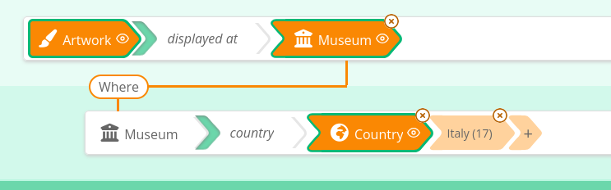


provides graph structure, labels, tootips, icons, etc.
JSON query structure (including entity labels : « Italy »)
refers to identifiers from the SHACL spec
2
1
Specification of the graph structure in SHACL
SHACL
Sparnatural services API
« query2text »
3
provides labels of classes (« Museum ») and properties (« displayed at »)
4
« Artworks displayed at museums in Italy »

Slide 2
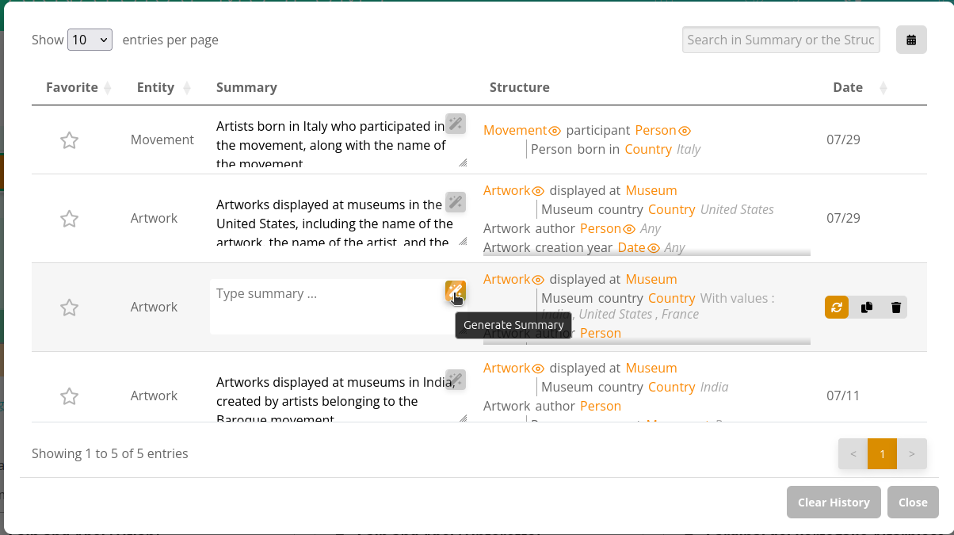

Slide 3
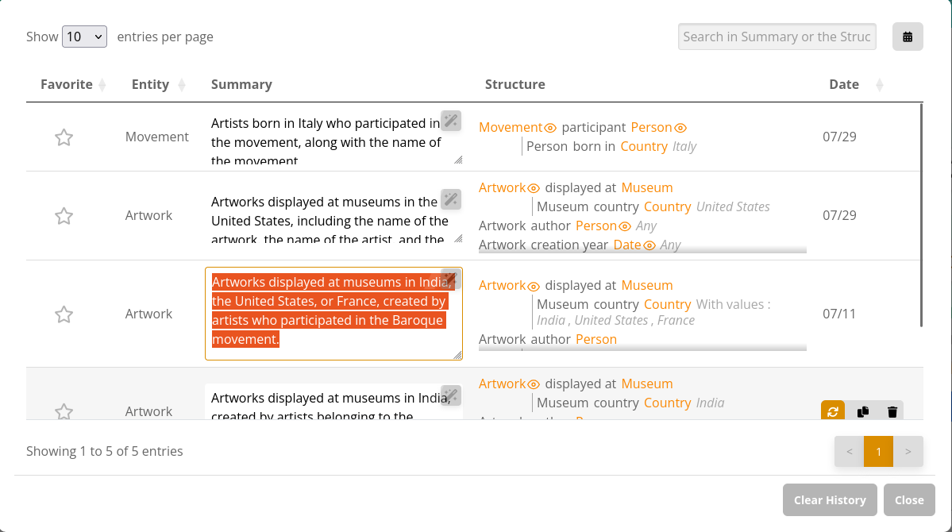

Slide 4
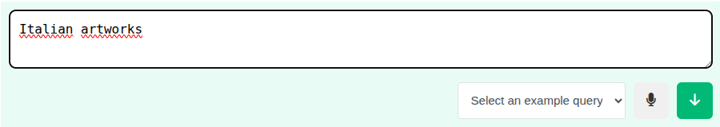
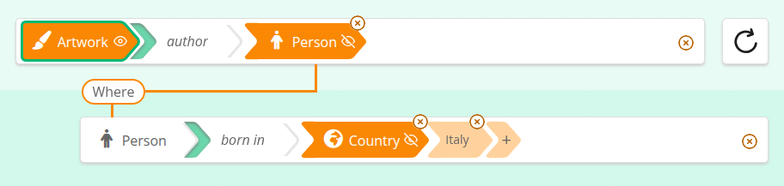
2
Remote endpoint
« Italian artworks »
Lookup SPARQL query
« Italy ? »
Sparnatural services API
« text2query »
Sparnatural services API
« reconcile »
<http://dbpedia.org/resource/Italy>
3
5
Query including entity URIs
1
provides graph structure, labels, constraints
Query with entity labels (« Italy »), but no URIs
Specification of the graph structure in SHACL
SHACL
4
provides graph structure, labels, tootips, icons, etc.
6

