Slide 1
Xls2rdf : editing RDF, SKOS, OWL, SHACL in Excel
Thomas Francart, Sparna

Slide 2
xls2rdf

Slide 3
What is xls2rdf ?
« An open-source Java library that can produce RDF data from Excel files that follow a certain structure »
Official project repository : https://github.com/sparna-git/xls2rdf
xls2rdf comes in 4 « packages » :
As a Java library that can integrated in applications
As a command-line tool
As a web tool part of the SKOS-Play suite : https://skos-play.sparna.fr/play/convert
As an online open API at https://xls2rdf.sparna.fr/rest/
Historically, it was made to produce only SKOS, but has been generalized to produce any RDF data
It contains some SKOS-specific « processings »

Slide 4
Use-cases
Manually edit RDF datasets
Controlled lists, vocabularies, etc.
Convert tabular datasets
After a manual intervention to set the proper headers in the file

Slide 5
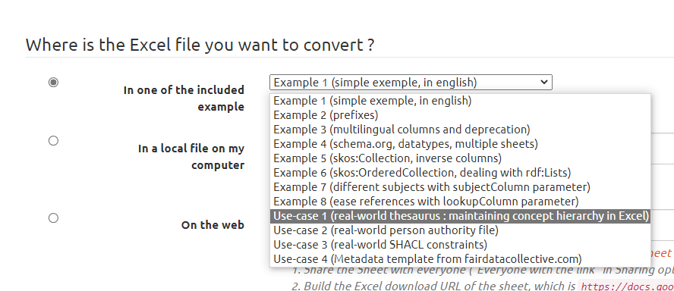
Xls2rdf Documentation
All the documentation on how to structure the Excel file is online : https://xls2rdf.sparna.fr/rest/doc.html
Also look at included example files at https://skos-play.sparna.fr/play/convert

Slide 6
Some general rules
All tabs are converted (if they follow the structure – if they don’t they are ignored)
Formatting is ignored except striketrough, you can apply any color/fonts in the file
All formulas can be used to compute the cell values
Only visible cells are converted (so that you can filter only row you want to convert)

Slide 7
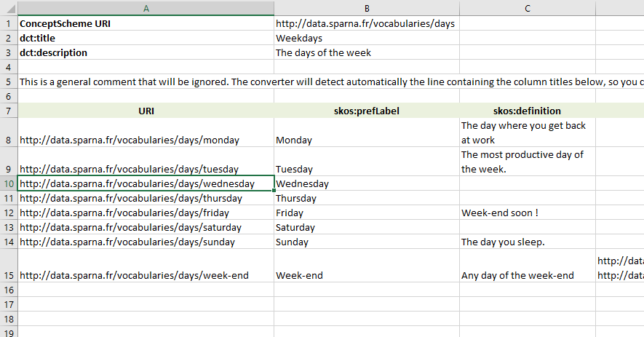
Header & Body
Header
« Magic line » / « title row »
Body

Slide 8
To be converted, a tab MUST…
Contain a URI in cell B1
Declare a « Magic row » at any row with either :
At least 2 columns in the first 10 columns starting from column B that declare a property URI
Or if not found, the string « URI » or « IRI » in column A

Slide 9
Triple generation principle
Subject : URI in column A
Predicate : the predicate declared in the magic row
Object : the cell at the intersection of that row and that column

Slide 10
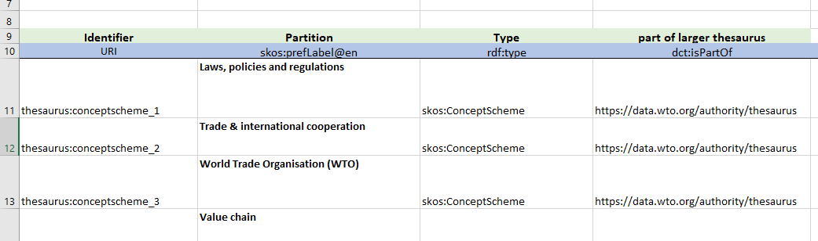
Triple generation principle
Object = URI if the value of the cell starts with « http » or with a known prefix
Otherwise, object is a literal
URI value
URI value
Literal value

Slide 11
Column header syntax
[^]<predicate URI>[@<languageCode> or ^^<datatype>][(parameter="value" parameter="value")]
skos:definition
skos:prefLabel@en
ex:validUntil^^xsd:date
skos:definition(separator=",")
skos:altLabel@en(separator=",")
skos:notation^^ex:idType(separator=",")
^skos:member

Slide 12
Colums can be ignored
Once the title row has been found, columns will be ignored if they don’t declare a known property URI
Typically, use a « # » sign or any other string value not a URI so that the column will be ignored
Columns will be ignored
Columns will be converted

Slide 13
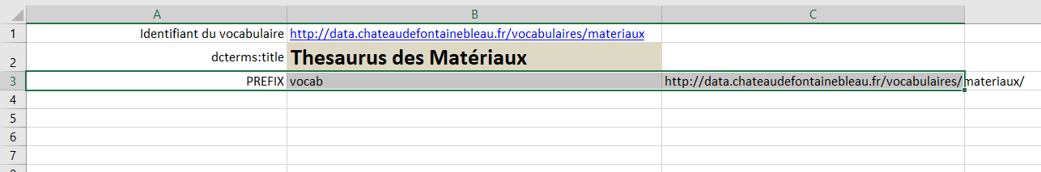
Declaring prefixes in the header
Column A = « PREFIX » or « prefix » or « @prefix »
Column B = prefix
Column C = corresponding URI
All prefixes used in predicates and URI and values must be declared
It is possible to group prefixes in a separate, dedicated sheet if the list is long
Some prefixes are already known by default, no need to declare them (see documentation)

Slide 14
API

Slide 15
Online API documentation
https://xls2rdf.sparna.fr/rest
Can allow you to convert online Google Spreadsheets
Can give you a direct URL to your RDF file
With speadsheet URL as a parameter
Don’t use in production !

Slide 16
Advanced usage

Slide 17
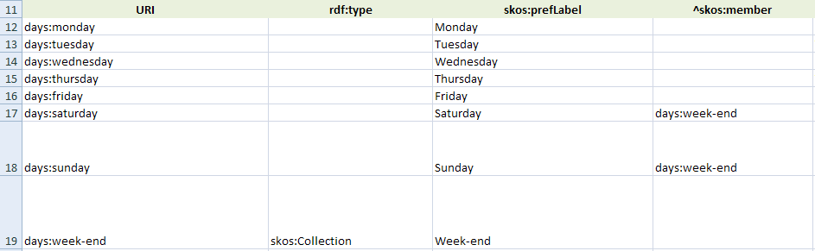
Create predicates « the inverse way » with ^
Normally the triples are created from the URI in column A to URI in property column
Use ^ before the predicate URI so that the link is made from the URI in property column to URI in column A
Useful to indicate collection membership with :
^skos:member
^sh:property

Slide 18
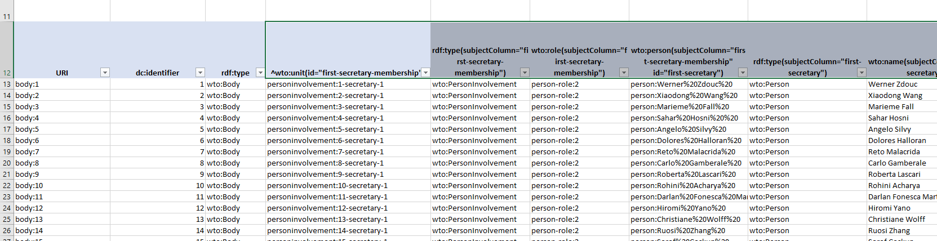
Describe « nested objects » with id="…" + subjectColumn="…"
Normally the triples are created with URI of column A as subject
You can indicate that some column should use the URI in another column as subject with parameter : subjectColumn="…"
The value of subjectColumn is an id of another header indicated with id="…"

Slide 19
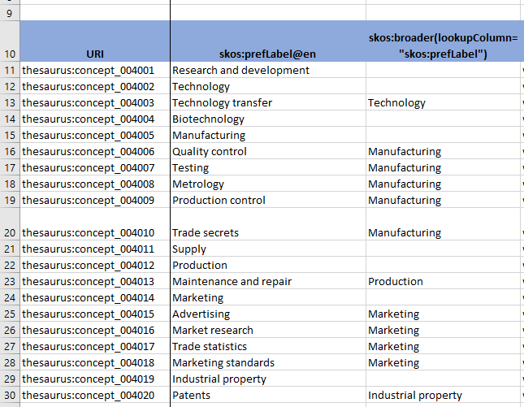
Refer to URI of entities through their labels using lookupColumn="…"
URI value thesaurus:concept_004002
Normally the object of triples are URIs if the cell starts with « http » or with a known prefix
But if you want to make a reference to a URI that is in the same sheet with its label, you can refer to this URI by indicating its label in the cell and set lookupColumn="…" parameter in the header
The value of lookupColumn is an id of another header indicated with id="…"
Can be the predicate too
The converter will look for this label in the corresponding column, and use the URI in column A as the value

Slide 20
Pattern to describe hierarchies
Use columns structured as hierarchies with labels, that will not be converted (simply indicate « # » in the header row, or any other non-URI string)
Compute 2 columns with Excel formulas, to retrieve the label of the row and the label of the level above
=IF(F11<>"";F11;IF(E11<>""; E11;IF(D11<>""; D11;IF(C11<>""; C11; B11))))
Use « lookupColumn » parameter on the parent column

Slide 21
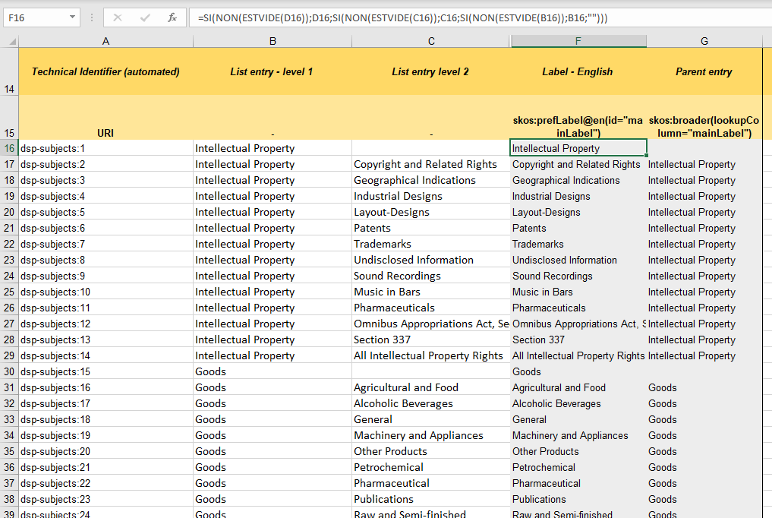

Slide 22
SHACL-specific features

Slide 23
SHACL xls2rdf Template
Available from SHACL Play : https://shacl-play.sparna.fr/play/shaclexcel
Contains a predefined Excel template to maintain SHACL specifications

Slide 24
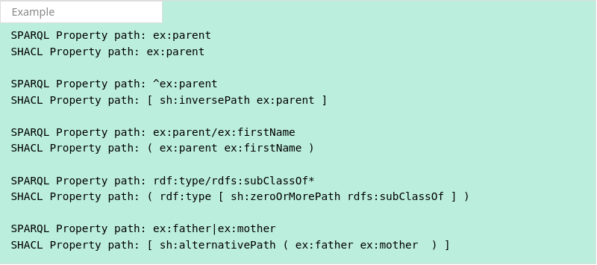
You can use SPARQL property paths in sh:path
SHACL property paths have their own syntax (not SPARQL) and are cumbersome to write
xls2rdf automatically understands SPARQL property path syntax in sh:path column and will translate it into SHACL.
You can write « ^ex:parent » and it will be translated to [ sh :inversePath ex :parent ]

Slide 25
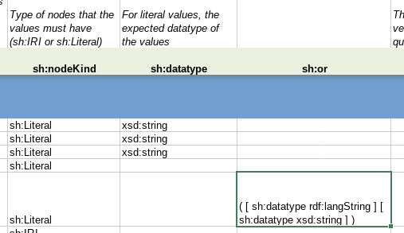
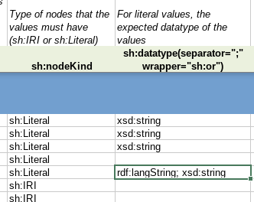
Multiple values in certain columns can be automatically translated into sh:or
Using sh:or in SHACL introduces complexity as :
It has to be in a different column than the original constraints to be combined
It has to use an inner blank node syntax
Most of the time, sh:or is used to combine constraints of the same type
Multiple sh:datatype
Multiple sh:class
Multiple sh:node
For those cases, xls2rdf has a specific annotation to use the same column (e.g. sh:datatype) and « wrap » it inside an sh:or if it has multiple values
To be combined with « separator=";" »
sh:datatype(separator=";" wrapper="sh:or")
See documentation
No need for a dedicated sh :or column for simple cases (but still needed for other kinds of constraints combination)

Slide 26


