Slide 1
Web Development Assignment
ARCHANA CHAUDHARY
Roll no. : 2260
1st Sem. B.Tech. (CST)
HTML, CSS

Slide 2
INDEX
Introduction
Objective
Feasibility Study
Application of Software tools
Conclusion
References

Slide 3
INTRODUCTION
There are one HTML files, where we are selling the variety of fresh flowers and flower pots. Content of the repository -
Flower.html
style.css
images

Slide 4
Objective
To design a website that people can order fresh and beautifull flower and flower pots and have a good day.
User will choose there favourite flower and order it from online .
User can pay it online
We have 10 day replacement
We have free delivery
We have offer and gits

Slide 5
Feasibility Study
Technical Feasibility
The Project only involves Front End development with all the backend work happening on the Brave server.

Slide 6
Application of Software tools
Tools used :-
VS CODE : Visual Studio Code, also commonly referred to as VS Code, is a source-code editor made by Microsoft with the Electron Framework, for Windows, Linux and macOS.
SUBLIME : it , is a source-code editor made by Microsoft with the Electron Framework, for Windows, Linux and macOS.
OS : Window 11

Slide 7
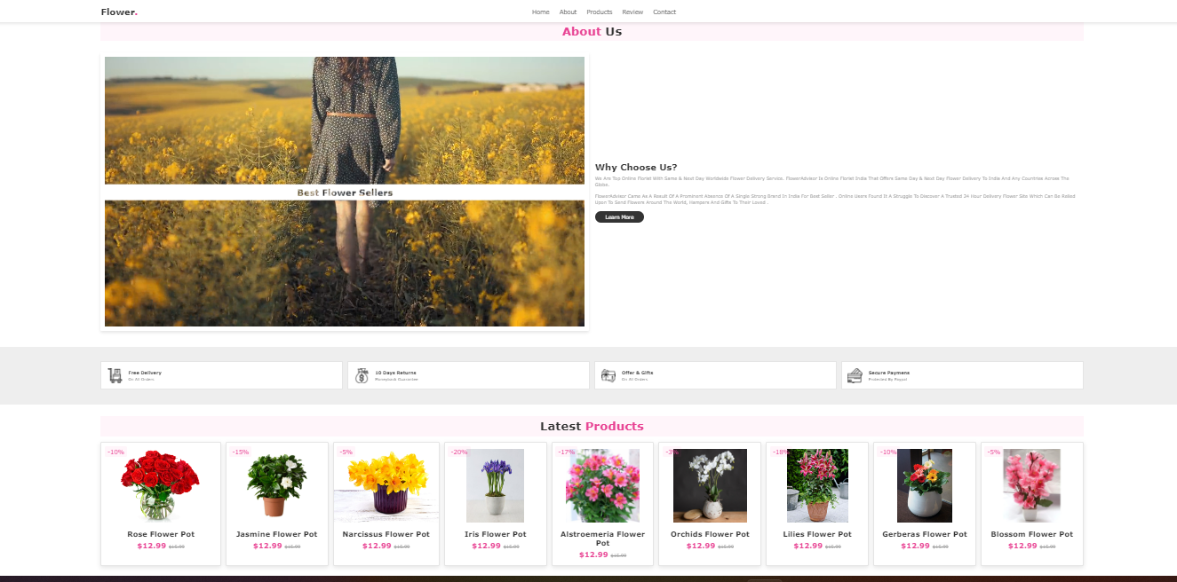
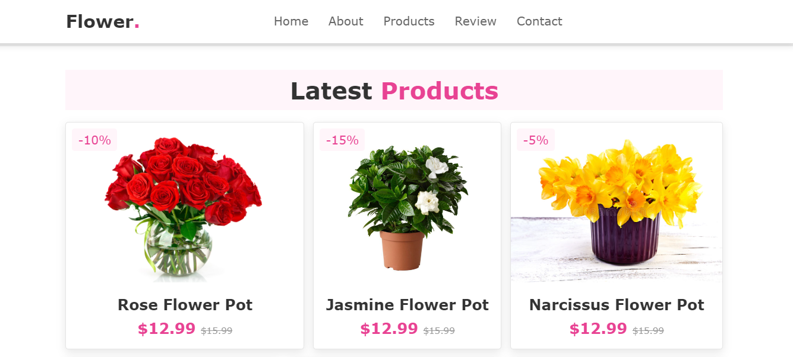
Conclusion
Simple images to show how the website works

Slide 8
References
Thank You
ARCHANA CHAUDHARY
Roll no. :- 226038
St. Andrews Institute of Technology and Management
1st Semester B.Tech. CST

