Slide 1

Case: The Advent of Smartphone Applications
Sparsh Singhal
Team - Strikers

Slide 2
Brief Overview of Case Study and Dataset
This case study aims at generating insights and extracting useful information from the given dataset of 10,000 mobile applications.
It provides various parameters like Name of application, Total number of downloads, Average rating, Number of reviews, Free or Paid, File size, etc.
By using various data cleaning and data processing measures, our aim is to generate a list of best 100 and worst 100 mobile applications by taking as many factors as possible into consideration.
Also, using various data visualization techniques, to get insights from the dataset and representing it in graphical or chart forms.

Slide 3
Tools and Technologies
Programming Language:
Python
Libraries:
Pandas: For data manipulation and analysis.
NumPy: For numerical computations.
Scikit-learn: For machine learning algorithms and model evaluation.
Matplotlib and Seaborn: For data visualization.
IDE: Jupyter Notebook or any other Python IDE

Slide 4
Process of Implementation
Data Cleaning
Applying Logic
Data Visualization
Data Transformation
Data Processing
Getting Insights

Slide 5
Data Cleaning Process
The first step towards data visualization and generating insights from it is to clean the data efficiently.
Due to large dataset, it contains many null values and duplicates which require adjustment and then can be used further.
The major problem comes when a single column contains integer, null as well as string values. In order to clean that data we need to assign values to string based on some criteria and 0 value to NULL., as it in columns Downloads, Purchase Price and Reviews of the given dataset.
Example:
Converting 10,000+ OR “Everyone” to integer without disturbing their original reference.

Slide 6
Assigning Weighs / Calculations
Assigning weighs to different columns according to their importance in calculating the overall value of application.
Multiplying the original value of the column to the weighs assign to them to get their actual value and then adding all those values to get a score,
Based on this score, the performance of application will be determined and then they are ranked accordingly.
Formula Used for Score: Sum of(Weigh(i) * Value(i)) for every i.

Slide 7
Feature Selection
In this project, we used Label Encoding, Standard Scaling, and Principal Component Analysis (PCA) for feature selection and preprocessing.
Label Encoding converted categorical variables like job, marital status, and education into numerical labels, allowing them to be used in machine learning models.
Standard Scaling normalized the data by adjusting features to have a mean of 0 and a standard deviation of 1, ensuring that features on different scales contributed equally to the model.
PCA was then applied to reduce the dataset's dimensionality, focusing on retaining the most significant variance. This step transformed the original features into a smaller set of principal components, capturing key patterns in the data.
Together, these techniques helped optimize the model's performance by reducing complexity and improving accuracy, making the dataset more manageable and enhancing the model's ability to generalize from the data.

Slide 8
Top 100 Applications:
Index of Top 100 Applications are:
Index ([ 2544, 3943, 381, 336, 3904, 2604, 2545, 2611, 3909, 382, 4104, 335, 1917, 1872, 1750, 1700, 1654, 3896, 3665, 3928, 10472, 2884, 2808, 2853, 5395, 411, 338, 3996, 3223, 3117, 4098, 3234, 4150, 4234, 468, 391, 5856, 865, 451, 340, 4096, 2554, 4144, 3523, 3565, 3454, 4170, 3232, 3127, 464, 4153, 386, 341, 152, 9844, 3816, 3736, 3765, 3687, 4005, 7536, 1869, 1966, 1842, 1751, 1705, 1655, 3994, 420, 3971, 378, 1908, 1722, 3888, 2610, 2550, 2603, 3870, 3739, 3796, 4115, 4676, 467, 431, 385, 342, 1885, 1702, 1662, 3879, 3255, 4566, 403, 474, 4122, 2546, 4105, 3711, 3703, 4365]

Slide 9
Bottom 100 Applications:
Index of Bottom 100 Applications are:
Index([10535, 10536, 10537, 10538, 10539, 10541, 10542, 10543, 10544, 10545, 10546, 10547, 10548, 10550, 10551, 10553, 10555, 10557, 10558, 10559, 10560, 10561, 10563, 10565, 10567, 10605, 10606, 10608, 10612, 10618, 10622, 10625, 10626, 10627, 10631, 10650, 10651, 10653, 10654, 10657, 10658, 10660, 10661, 10662, 10664, 10668, 10669, 10670, 10672, 10674, 10676, 10692, 10693, 10694, 10695, 10696, 10698, 10699, 10700, 10701, 10702, 10704, 10705, 10708, 10709, 10734, 10735, 10736, 10744, 10745, 10746, 10748, 10751, 10759, 10761, 10762, 10764, 10769, 10772, 10773, 10774, 10775, 10788, 10794, 10798, 10806, 10807, 10808, 10811, 10813, 10816, 10818, 10821, 10822, 10823, 10824, 10825, 10831, 10835, 10838]

Slide 10
Names of Top 100 & Bottom 100:
2544 Facebook
3943 Facebook
381 WhatsApp Messenger
336 WhatsApp Messenger
3904 WhatsApp Messenger
4105 Facebook Lite
3711 MX Player
3703 MX Player
4365 MX Player
10535 FK Vojvodina
10536 FK Liepaja
10537 FK Teplice
10538 FK Sarajevo
10825 Naruto & Boruto FR
10831 payermonstationnement.fr
10835 FR Forms
10838 Parkinson Exercices FR

Slide 11
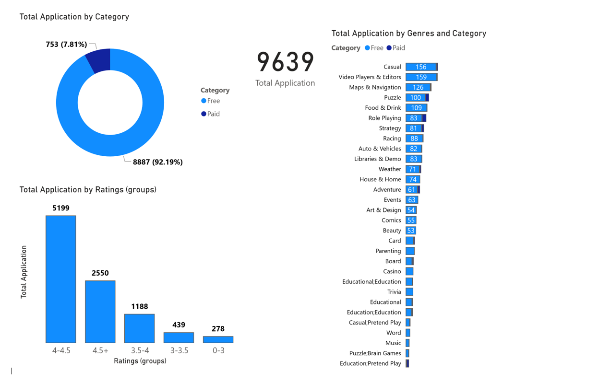
PowerBI Dash Board for Data Visualization and Insights

Slide 12
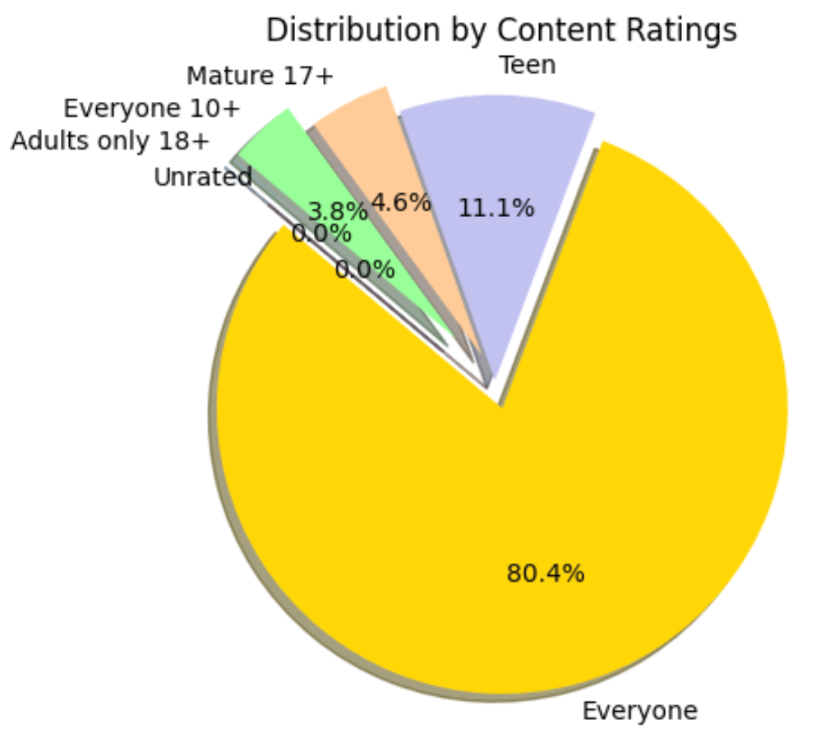
Pie Chart showing % distribution of different type of content given in the dataset
A pie chart is a graphical representation technique that displays data in a circular-shaped graph.
It is a composite static chart that works best with few variables.
The code can be seen in the jupyter notebook attached.

Slide 13
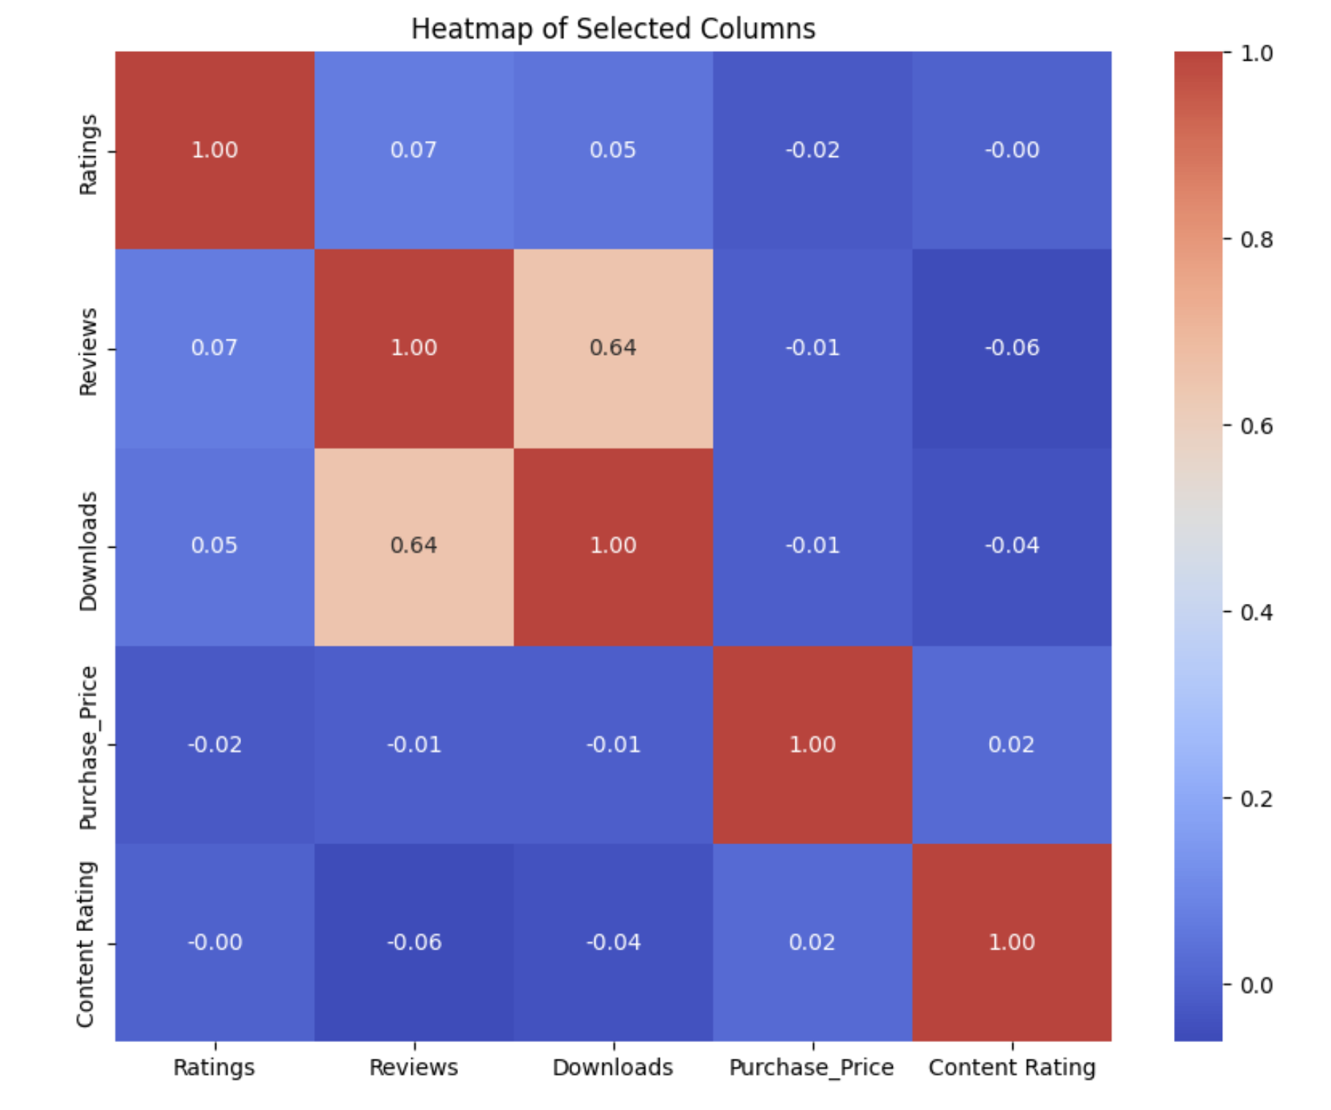
Heatmap
Heatmap showing correlation between different dataset variables and how much they depend on each other.
The cell having higher value shows higher dependencies of values on each other.

Slide 14
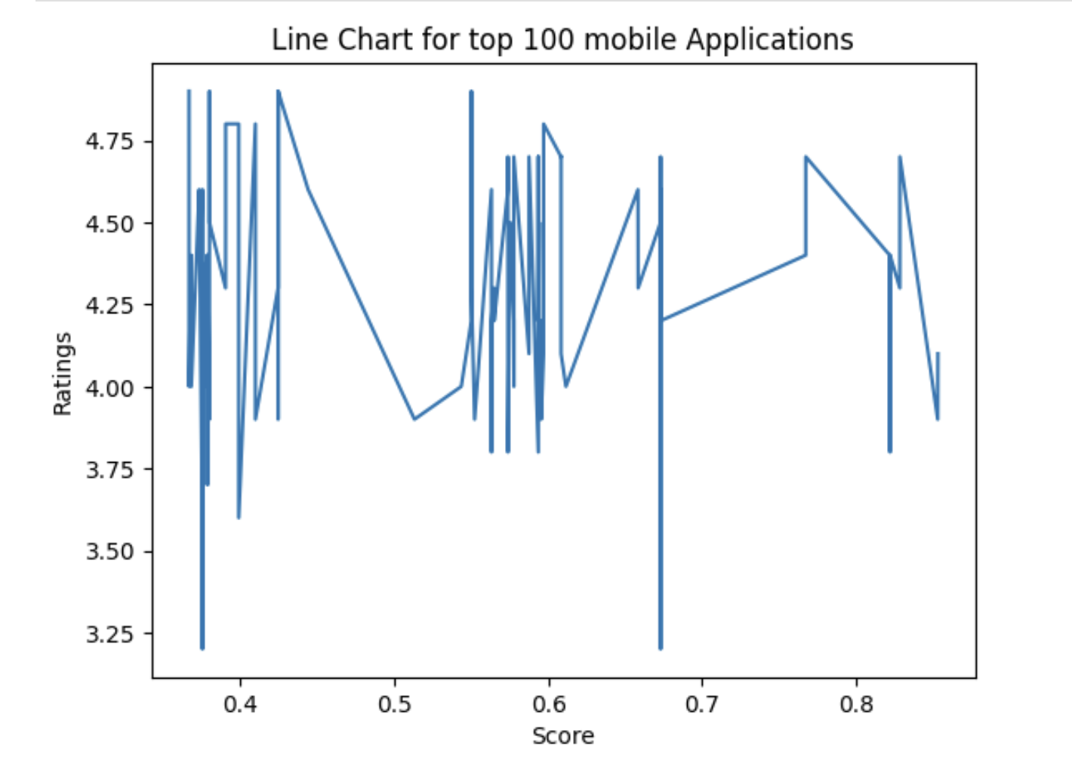
Line Chart
Line Chart showing how the rating and score of top 100 applications relate to each other.
Line charts are graphical representations that succinctly illustrate trends and patterns in numerical data.

Slide 15
Conclusion
So after carefully evaluating the dataset and performing multiple operations on it, we have got something interesting.
We get the best 100 and worst 100 mobile applications after considering multiple factors like downloads, ratings, type, genre, etc.
We got multiple useful insights of which type of apps are successful and why and what makes the other lose.
We get multiple relationship between different types of values which shows the dependency of columns on each other.

Slide 16

Q&A
Feel Free To Ask Any Questions

Slide 17
References
https://numpy.org/doc
https://pandas.pydata.org/docs
https://matplotlib.org/stable
https://openai.com/chatgpt

Slide 18
Thank You
Name - Sparsh Singhal
Team - Strikers

