Slide 1
MyOffer
Discounts at Doorstep!

Slide 2
Introduction

Slide 3
We are developing…
Android App; iOS; Apk; WebPage

Slide 4
Scope of Work
Vision: To become the intelligence layer for local commerce, guiding customers to the right store and the right offer instantly.
Mission: To systematically drive 2X revenue growth for local businesses through AI-native, hyperlocal discount intelligence.

Slide 5
What we are solving for?
We are building an AI-native hyperlocal commerce platform that connects customers to the right nearby store in real time.
We are predominantly solving for…
Wasted customer time caused by visiting multiple shops or scrolling irrelevant platforms to find the right local offer.
Low footfall for local businesses despite having genuine discounts and competitive pricing.
Lack of hyperlocal discovery, where existing platforms fail to show offers specific to a customer’s pin code and timing.
Inefficient advertising spend by shopkeepers on mass or non-targeted marketing channels.
No real-time offer visibility, resulting in discounts that fail to reach customers when they are most likely to buy.
Campaigning platform for small stores who cannot spend heavy on reaching out customer
Unknown shops but known presences; giving visibility to these Eg. Laundry Service the corner
Shop in Shop for Hyperlocal stores
Working Capital Loans from the platform

Slide 6
Impact
Create Employment
The model encompasses creating employment basis “Company Employees” & “Self Serving Agents” hence in long run will impact millions of lives by giving employment.
AI Driven Advance Tech Platform
The model has a deep integration with AI sources making it future ready
Uniqueness
The idea is absolutely fresh; not platform currently has been developed like this
Support to Small Self Employed Businesses
The model with its unique strength of going hyperlocal will make the smallest of business keepers relevant and not just killed by online business giants
Inclusion
The model can be taken to every nook and corner of the country; making it relevant without geographical boundaries

Slide 7
Profiles

Slide 8
Customer
Shopkeeper
Sales Agent – Employee
Self Service Agent
Admin
Sub Admin

Slide 9
Customer Profile
Discover nearby offers and engage with local shops.
Category | Capabilities | Detailed Description | System Permissions
Onboarding | Mobile OTP Login | Mobile number verification | Create profile
Profile Creation | Name, DOB, Gender | Used for targeting | Edit own profile
Address Details | Address, Pin code, City, State | Geo-based filtering | View / Edit own
Preference Mapping | Product likeliness | Category personalization | Stored in customer DB
Offer Discovery | View offers | Based on location + preferences | Read-only
Like Feature | Like / Save offers | Creates behavioral signals | Write to DB
Banner Interaction | Click → View shop address | Deep link to shop profile | Read-only
Notifications | Receive push notifications | Campaign based | Passive
Offer History | View liked offers | Personal record | Read-only

Slide 10
Shopkeeper Profile
Digitize local store & run campaigns to nearby customers.
Category | Capabilities | Detailed Description | System Permissions
Onboarding | App download + Subscription Payment | Mandate-based signup | Create shop account
Coupon Application | Enter discount code | Validate against admin rules | Limited
Shop Profile Creation | Upload shop photo + 3-5 interior photos | Mini digital storefront | Edit own page
QR Generation | Unique QR for shop page | Share offline | Auto-generated
Banner Creation | Upload promotional banner | Requires sub-admin approval | Submit
Campaign Creation | Choose target filters | Pin code, Gender, Age, Category | Configure
Audience Visibility | View base count | See how many customers targeted | Read-only
Pricing Preview | View dynamic campaign cost | Real-time calculation | View-only
Campaign Scheduling | Schedule WhatsApp / App Notification | Set date & time | Submit
Campaign History | View past campaigns | Reach + cost | Read-only
Payment | Pay for campaign | Online payment gateway | Transactional

Slide 11
Sales Profile
Sales Agent - Employee
Field onboarding of shopkeepers.
Category | Capabilities | Detailed Description | System Permissions
Login | Employee ID | Company verified | Role restricted
Shop Onboarding | Create shop account | Assisted signup | Limited write
Coupon Issue | Apply employee discount (EMPID20) | Pre-approved discount % | Controlled
Performance Tracking | View shops onboarded | Sales performance | Read-only
Revenue View | See commission summary | Based on onboardings | Read-only
Sales Agent – Self Onboarding
Earn incentives by onboarding shops independently..
Category | Capabilities | Detailed Description | System Permissions
Unique Code | Personal referral code | Acts as coupon | System validated
Shop Referral | Share code | Shop applies during signup | Passive
Incentive Earning | Earn per activation | Based on subscription payment | Read-only dashboard
Tracking | View shops activated via code | Incentive ledger | Read-only

Slide 12
Sub Admin
Category | Capabilities | Detailed Description | System Permissions
Shop Approval | Approve / Reject shop profile | Quality control | Moderate
Banner Approval | Approve promotional banners | Content moderation | Moderate
Campaign Approval | Review campaign filters | Prevent misuse | Approve / Reject
Coupon Monitoring | Track discount usage | Abuse control | Read-only
Regional Dashboard | View region-wise stats | Shop count, revenue | Read-only
Payment Monitoring | View campaign payments | Financial tracking | Read-only

Slide 13
Admin
Category | Capabilities | Detailed Description | System Permissions
Pricing Engine | Define base price per 1,000 users Eg. 999 | Core monetization logic | Full control
Filter Premium Setup | Set surcharge for product category Eg. Jewellery higher, laundry lower | Revenue optimization | Full
Channel Multiplier | WhatsApp vs App Notification pricing for campaigns by shop keeper | Configurable | Full
Subscription Fee | Define monthly/yearly plan cost | Business control | Full
Coupon Creation | Create % or flat discount codes | Sales strategy | Full
Agent Management | Create Sales / Self Agents | Role assignment | Full
Revenue Dashboard | Full revenue analytics | Campaign + Subscription | Full
Customer Analytics | User base insights | Behavior data | Full
Fraud Detection | Monitor unusual activity | Compliance | Full
Notification System | Push global announcements | System-wide | Full

Slide 14
Cross Functional Comparative
Capability | Customer | Shopkeeper | Sales Agent | Self Agent | Sub Admin | Admin
Profile Creation | Own | Own | Assist | Referral only | Moderate | Full
Campaign Creation | ❌ | ✅ | ❌ | ❌ | Approve | Override
Pricing Logic | ❌ | View | ❌ | ❌ | ❌ | Full
Coupon Creation | ❌ | Apply | Issue | Issue | Monitor | Create
Revenue View | ❌ | Own | Own | Own | Regional | Global
System Governance | ❌ | ❌ | ❌ | ❌ | Partial | Full

Slide 15
Customer Flow

Slide 16
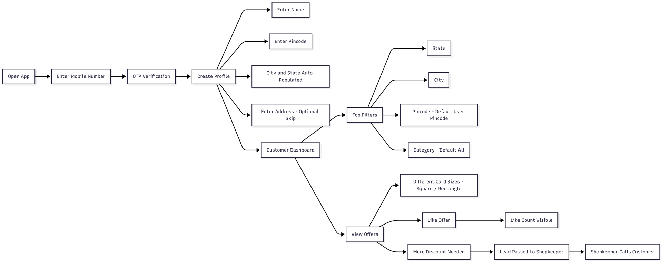
Customer Flow

Slide 17
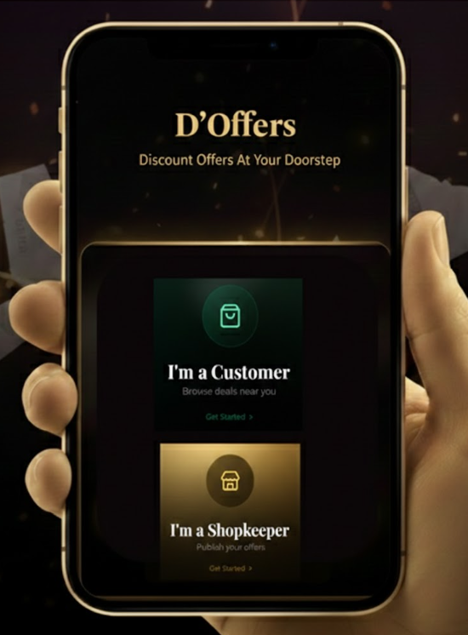
Opening Screen
MyOffer

Slide 18
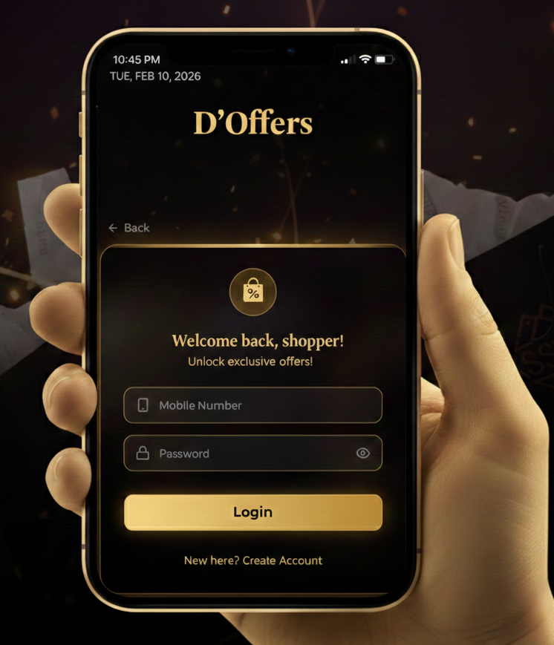

Customers Opening Screen
MyOffer
Enter Mobile Number
OTP
Enter OTP

Slide 19
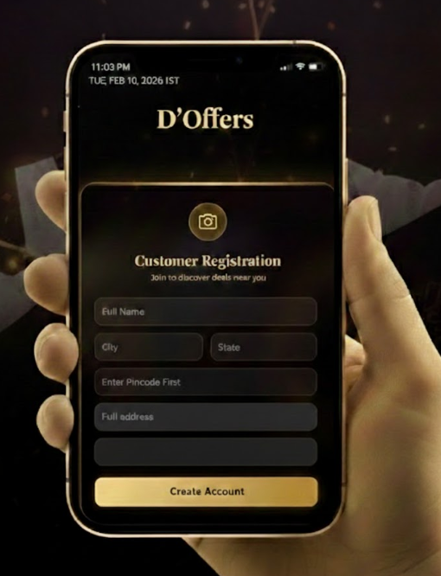
Customer Registration
MyOffer
Pin code
City
Address
Pin code
Your Age
Student/Service/Business

Slide 20
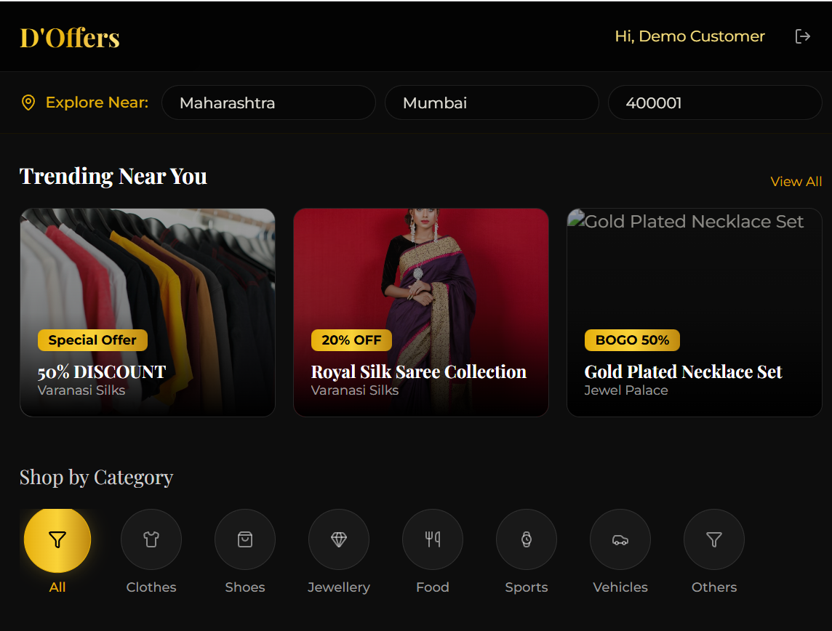
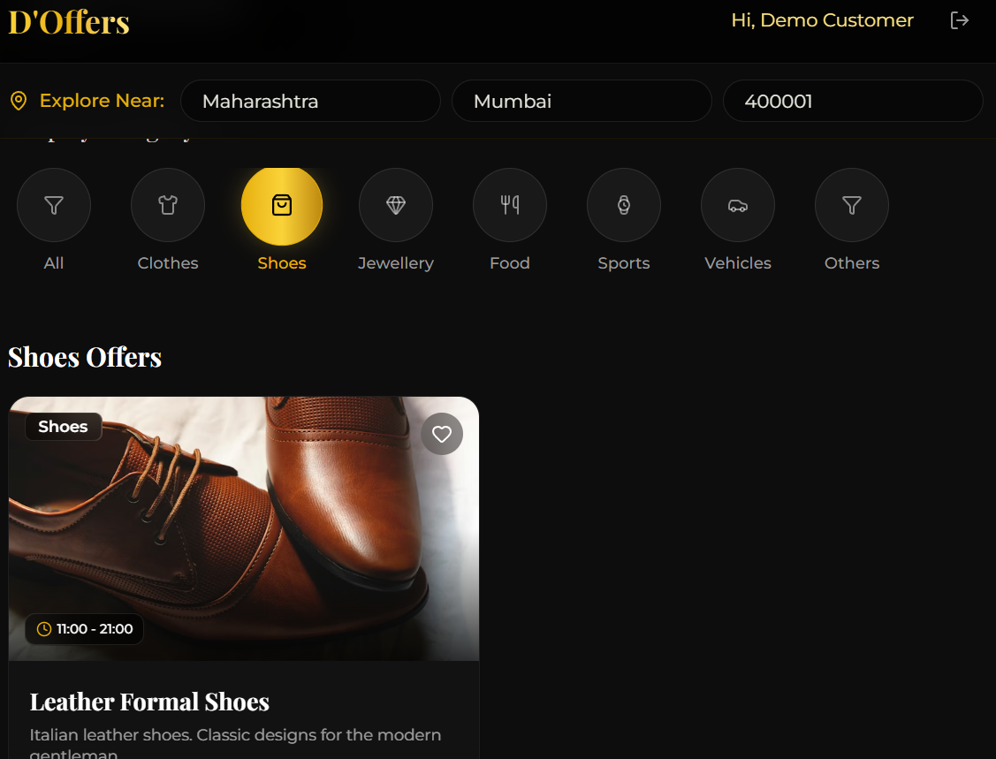


Customer Offer Dashboard
MyOffer
MyOffer
Customer can like a product
Customer can negotiate offer
Customer can request call back

Slide 21
Shopkeeper Flow

Slide 22
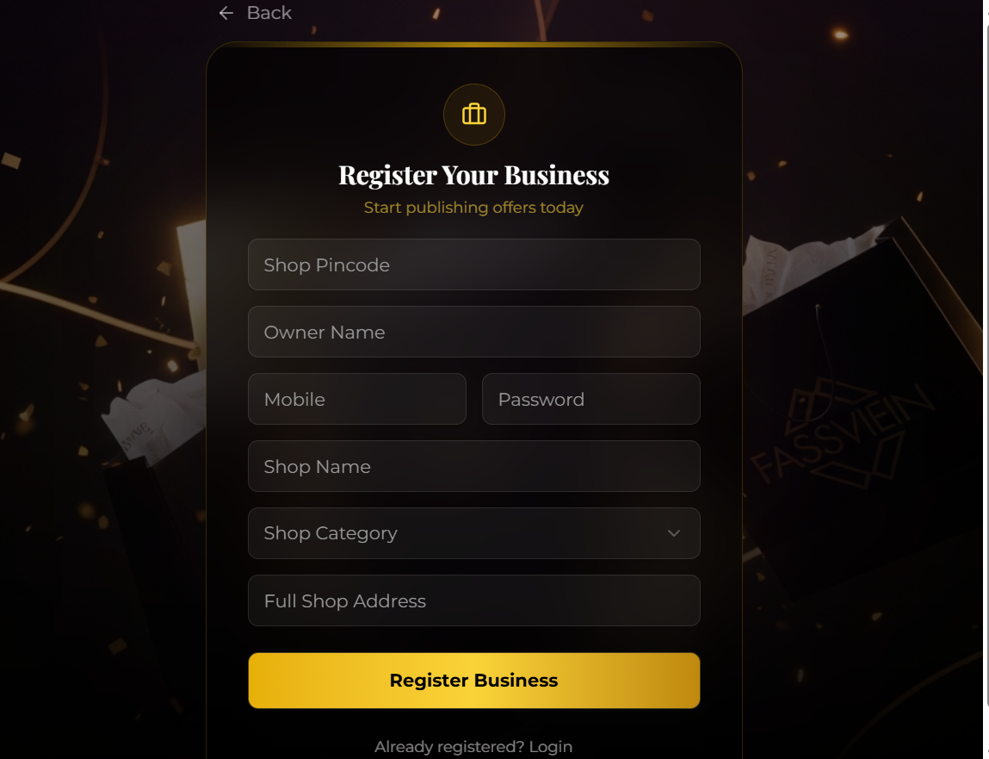

Slide 23
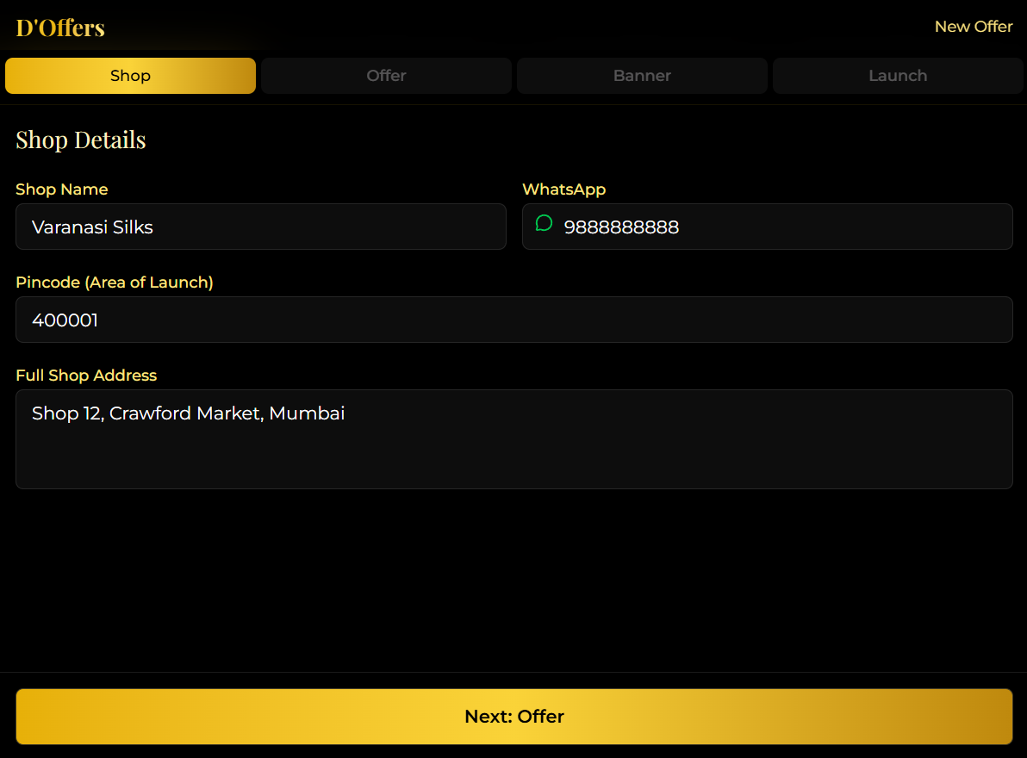
MyOffer

Slide 24
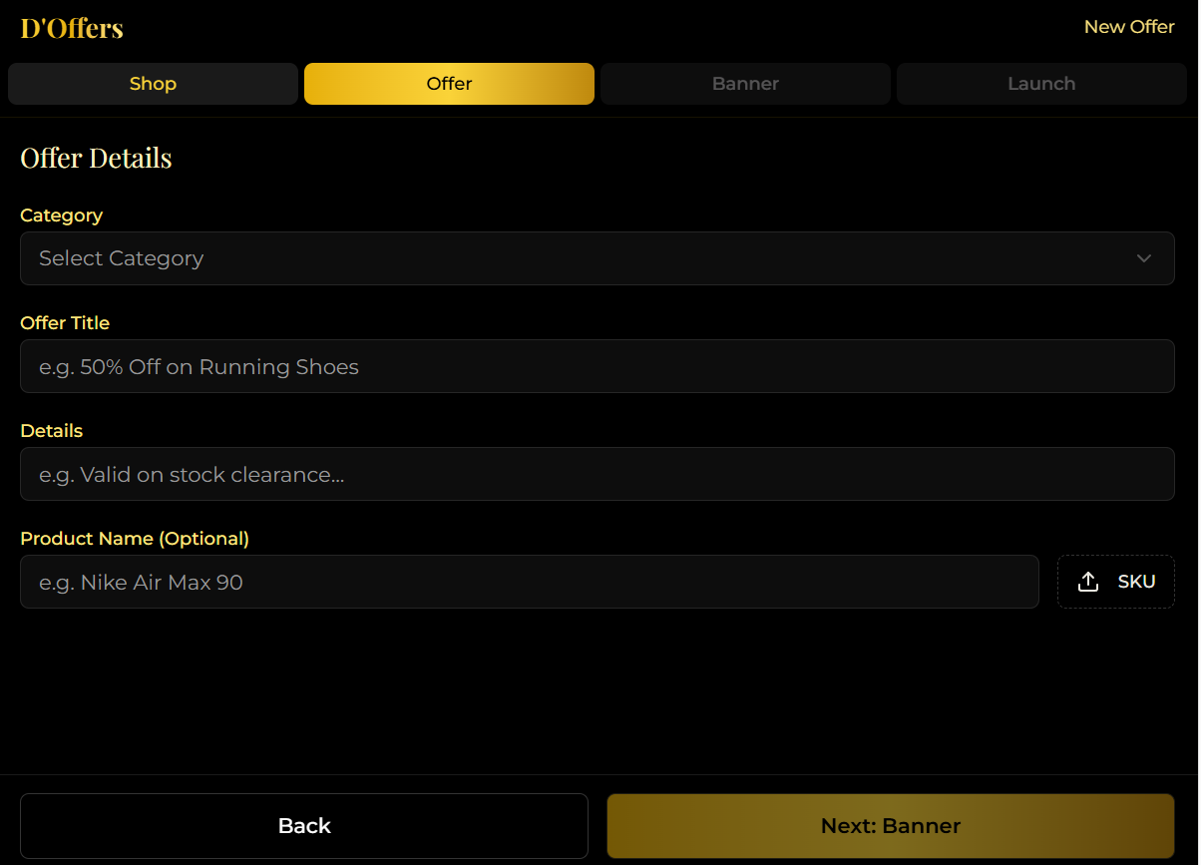
MyOffer

Slide 25
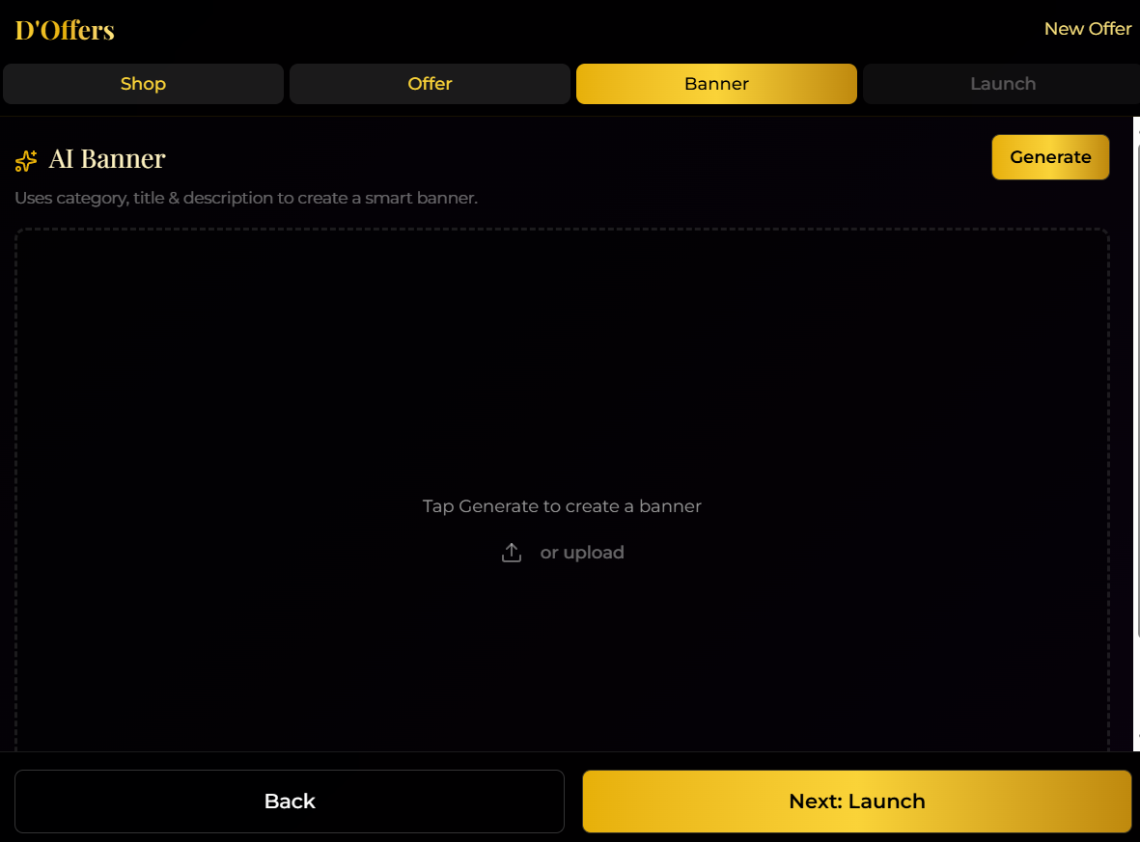
MyOffer

Slide 26
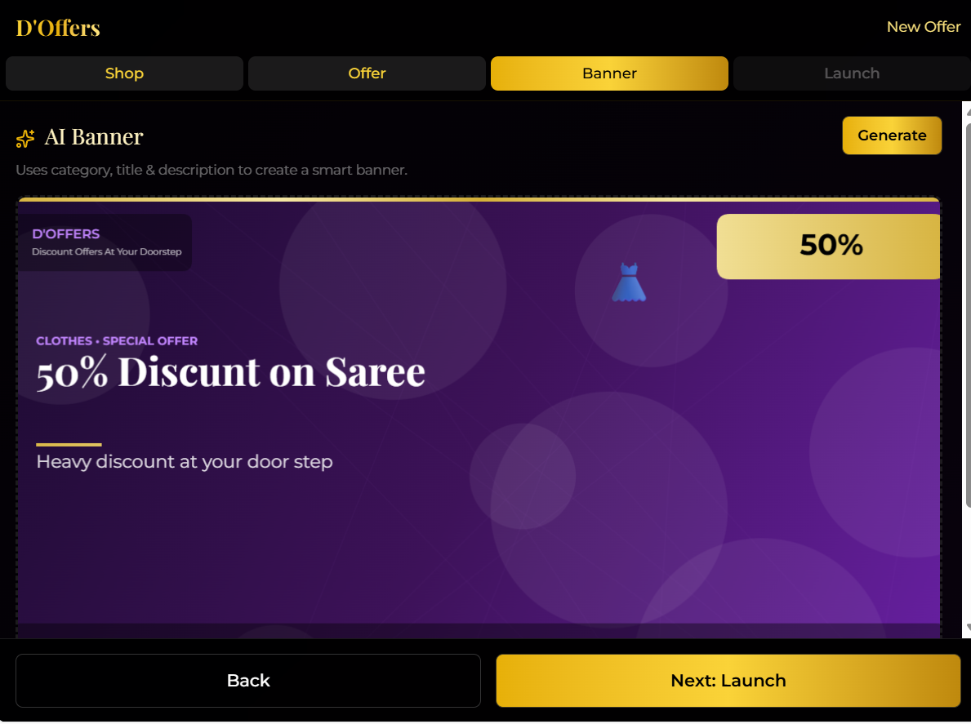
MyOffer

Slide 27
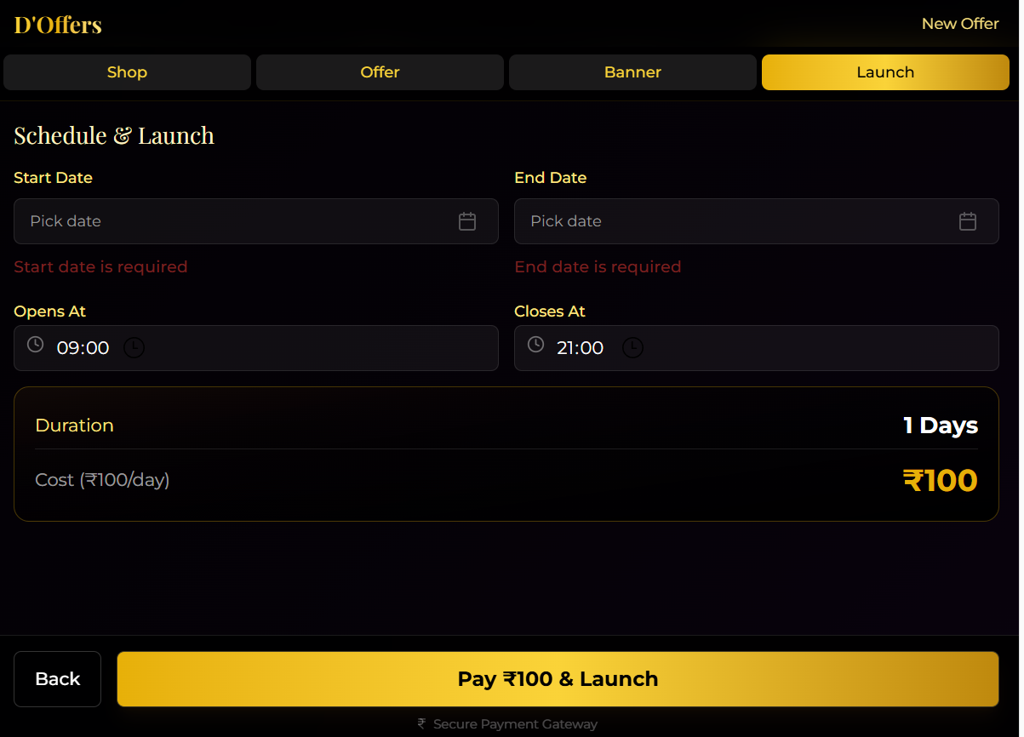
MyOffer

Slide 28
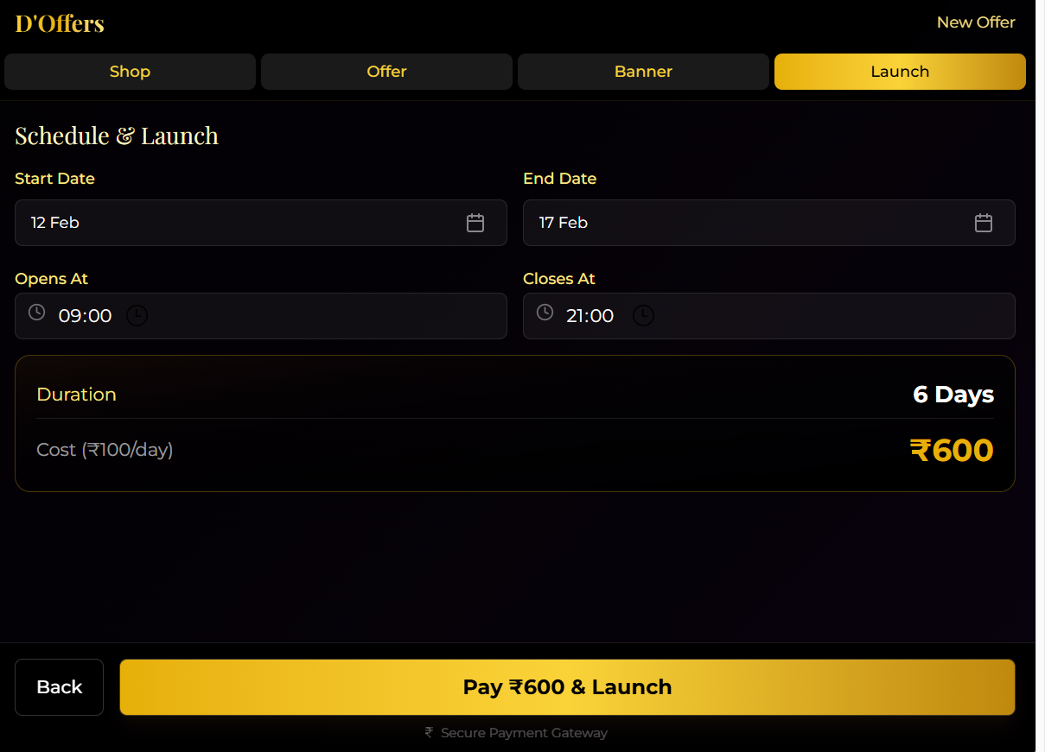
MyOffer

Slide 29
Sales Strategy

Slide 30
Sales Strategy
High-density micro-markets (1–2 km clusters) to create visible traction.
For shopkeeper onboarding, deploy a field sales + referral model targeting high-footfall categories (grocery, pharmacy, salons, restaurants), offering a free trial period and assisted onboarding to reduce entry barriers.
Equip sales teams show competitors already listed to create FOMO and offers they have already put in
For customer acquisition, run geo-targeted digital ads, WhatsApp campaigns, and in-store QR displays encouraging shoppers to check live nearby offers.
“Deal of the Day” push notifications to drive repeat usage.
Build a referral loop where customers bring other customers and shopkeepers invite nearby businesses to increase visibility.
Finally, track cluster-wise GMV, active merchants, and offer redemption rate to decide expansion to adjacent localities.

Slide 31
Sales Strategy
Collect phone number of all the shop keepers in pin code – sales team job
1 Staff per Pincode – 1 staff per mall model
This has to be a proper field activity
Shop Name | Owner Name| Geo Location | Address Pin Code
Reach out on phone to book an appointment
Once appointment scheduled; go and pitch the product; and get it downloaded for free
Make them understand – that people near by you have already downloaded… and you will be able to see comparative discount the other store is giving on the app itself
You will get reviews from customers as well on the app; a positive review helps you get more customer
Before customer leaves you can request to give review over the app
A QR to be deployed a the store for the customers who have not downloaded

Slide 32
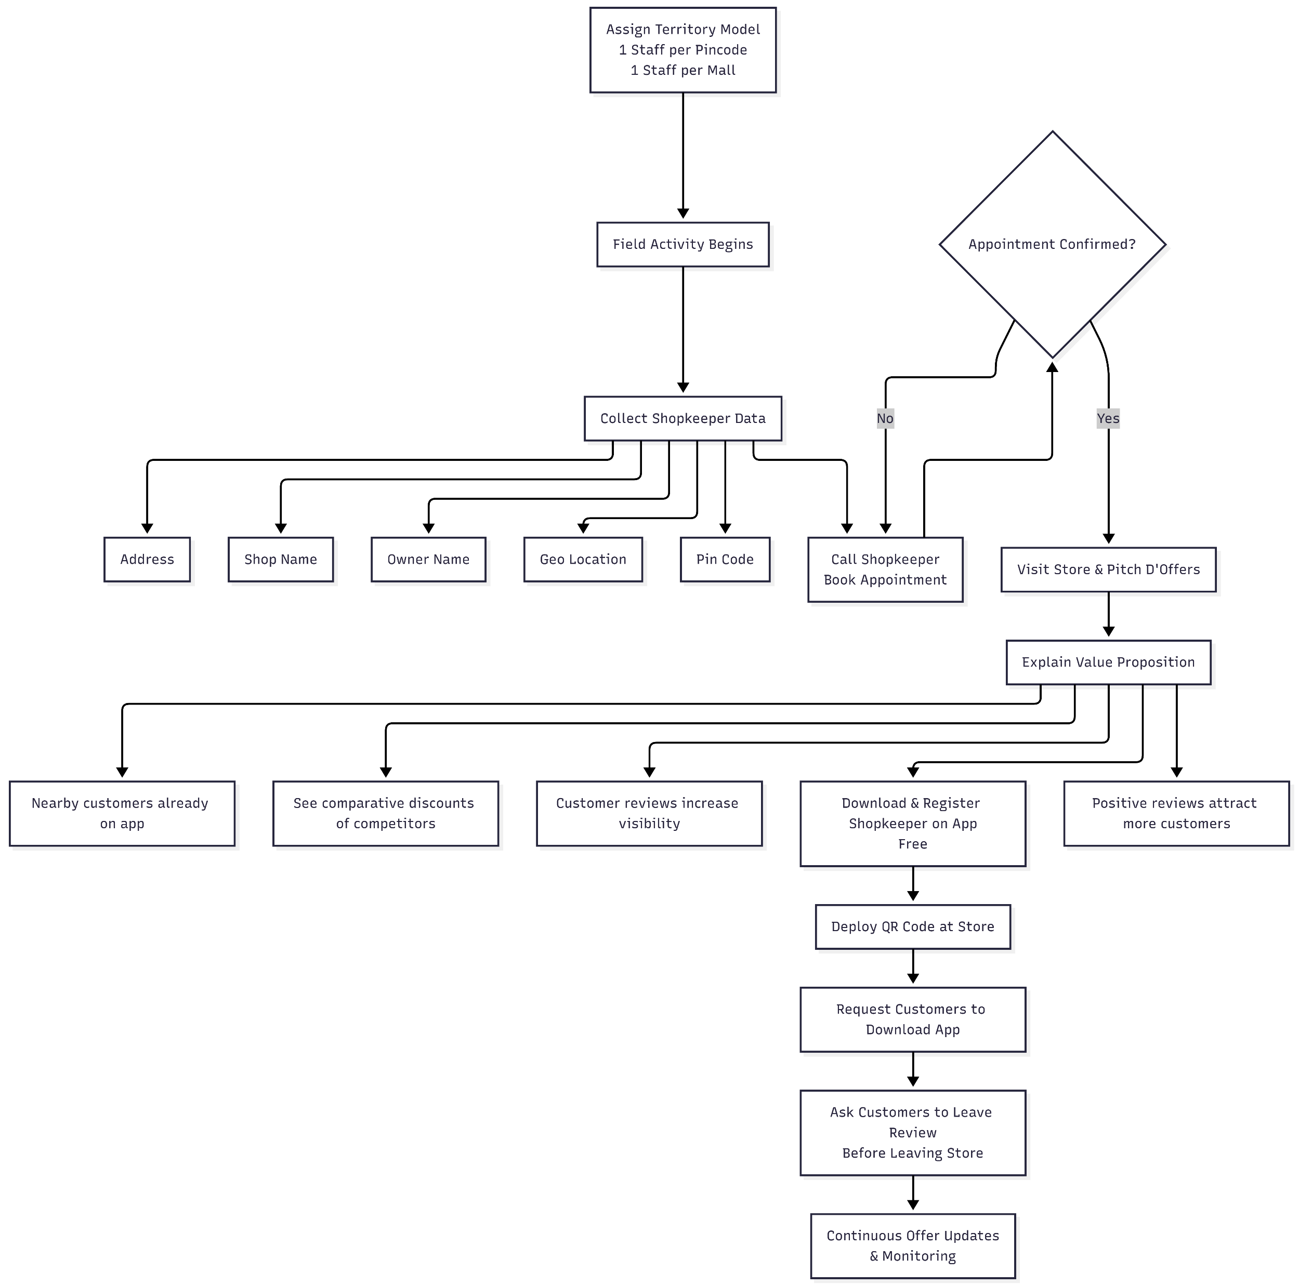
Sales Strategy Mermaid

Slide 33
Convince Shopkeepers
🔹 Position It as Risk-Free
“Sir, this is completely free to download — no upfront cost.”
“You only benefit if customers walk in — no risk for you.”
🔹 Show Competitive Pressure (FOMO Strategy)
“Nearby stores are already visible on the app.”
“Customers can compare discounts — if you're not listed, you lose visibility.”
🔹 Hyperlocal Visibility
“People within 1–2 km can instantly see your shop.”
“Instead of waiting for walk-ins, you reach customers searching nearby.”
🔹 Reviews = Trust = More Sales
“Customers leave reviews — good ratings bring repeat business.”
“It builds your digital reputation without extra marketing cost.”
🔹 Future Proofing
“Today customers check offers on phone before buying.”
“This keeps you competitive with online platforms.”

Slide 34
To Convince Them to Put Offers on the App
🔹 Offers = Footfall Driver
“Even a small 5% discount increases footfall.”
“You control what offer you want to run — no pressure.”
🔹 Smart Discount Strategy
“You can see competitor discounts on the app.”
“You decide whether to match or beat them.”
🔹 Slow-Moving Stock Clearance
“Run offers on slow-moving items.”
“Convert dead inventory into cash.”
🔹 Time-Based Offers
“Lunch time offers, weekend offers, festival offers.”
“You decide duration — 1 day, 3 days, 1 week.”
🔹 Data & Feedback
“You will know how many people viewed your offer.”
“Customer reviews help you improve and grow.”

Slide 35
Revenue Streams
Shopkeeper Onboarding
Brands Onboarding
Shopkeeper Banners
Brands Banners
Shopkeeper Campaigns
Brands Campaigns
Cross Sell Product - NBFC Ties up for WC Loan(Phase2)
Customer Ask If a product is available (Phase3)
Sell my product (As a customer) – Customer to Customer Connection

Slide 36
How a shopkeeper boarding will be done?
1️⃣ Shopkeeper Banner Packages (Visibility Model)
Shops
Duration | Price | Effective Cost Per Day
1 Day | ₹100 | ₹100
7 Days | ₹500 | ₹70
30 Days | ₹900 | ₹30
Brands (Pan India)
Duration | Price | Effective Cost Per Day
1 Day | ₹10,000 | ₹10,000
7 Days | ₹50,000 | ₹7000
30 Days | ₹1,00,000 | ₹3000
Key Selling Points to Shopkeeper:
Unlimited banner edits during package duration
Add/remove offers anytime
No limit on number of banners during active period
Cheapest hyperlocal advertising in the area
Less than cost of printing physical flex
Dashboard onto how many customers viewed
Top 2 Positions – 1000 Each
Top 2 Positions – 10,000 Each
2️⃣ Shopkeeper Targeted Campaigns (Performance Model)
Audience Size | Cost Per Person
0 – 100 | ₹1
100 – 500 | ₹0.75
500 – 1000 | ₹0.50
> 1000 | ₹0.25
Flat Rate for Brand Marketing: ₹0.25 per person nationwide targeting.

Slide 37
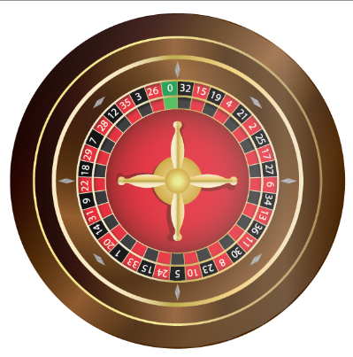
How a shopkeeper boarding will be done?
Gamified acquisition + incentive economics model.
Sales teams stay motivated
Company protects minimum revenue
Pricing doesn’t look chaotic
Incentive logic is clean & scalable
BASE PRICING STRUCTURE (Uniform Across All Models)
Displayed Price: ₹99/month
Mandatory 7-Day Free Banner Included
Wheel-based engagement mechanism
Mandate collection required for activation
Discount by Luck!
Because everyone wants to feel lucky
Because ever one wants discounts and offers in their lives

Slide 38
Shopkeeper Onoarding

Slide 39
Subscription Pricing
Sr. No | Shop Category | Base Subscription (₹) | Company Share (50%) (₹) | Discount Play Allowed (₹) | Max Discount Allowed
1 | Jewellery Shop | 1,000 | 500 | 500 | Up to ₹500
2 | Shoe Shop | 500 | 250 | 250 | Up to ₹250
3 | Apparel Shop | 500 | 250 | 250 | Up to ₹250
4 | Pan Shop | 100 | 50 | 50 | Up to ₹50
5 | Laundry Shop | 100 | 50 | 50 | Up to ₹50
6 | Stationery Shop | 250 | 125 | 125 | Up to ₹125
7 | Real Estate Agency | 25,000 | 12,500 | 12,500 | Up to ₹12,500
8 | Other Categories | Variable | 50% of Base | 50% of Base | Up to 50%

Slide 40
Onboarding Channel Model
Onboarding Type | Who Initiates | Discount Code Used | Incentive Eligibility | Revenue Share Logic
Shopkeeper Self Onboard | Shop Owner | No Sales Code (Standard Price) | No | Full Base Price → 50% Company Reserve
Sales Officer Onboards | Sales Officer | Sales Officer Unique Code | Yes | 50% Fixed to Company + 50% Discount Play
Self Assistant Agent Onboards | Field Agent | Agent Unique Code | Yes | 50% Fixed to Company + 50% Discount Play

Slide 41
Discount Structure
Component | Rule
Base Price | Category dependent
Company Locked Share | 50% (Non-negotiable)
Discount Budget | 50% (Flexible by Onboarding Person)
Unique Code | Mandatory for Incentive Tracking
Incentive Calculation | Based on net collected amount after discount
Tracking | Code-based attribution
Settlement | Automated payout based on onboarding code

Slide 42
Brand Model
Coverage Level | Subscription Price (₹) | Company Share (₹) | Discount Allowed
Single City | 25,000 | 12,500 | Up to ₹12,500
One State | 50,000 | 25,000 | Up to ₹25,000
Pan India | 1,00,000 | 50,000 | Up to ₹50,000

Slide 43
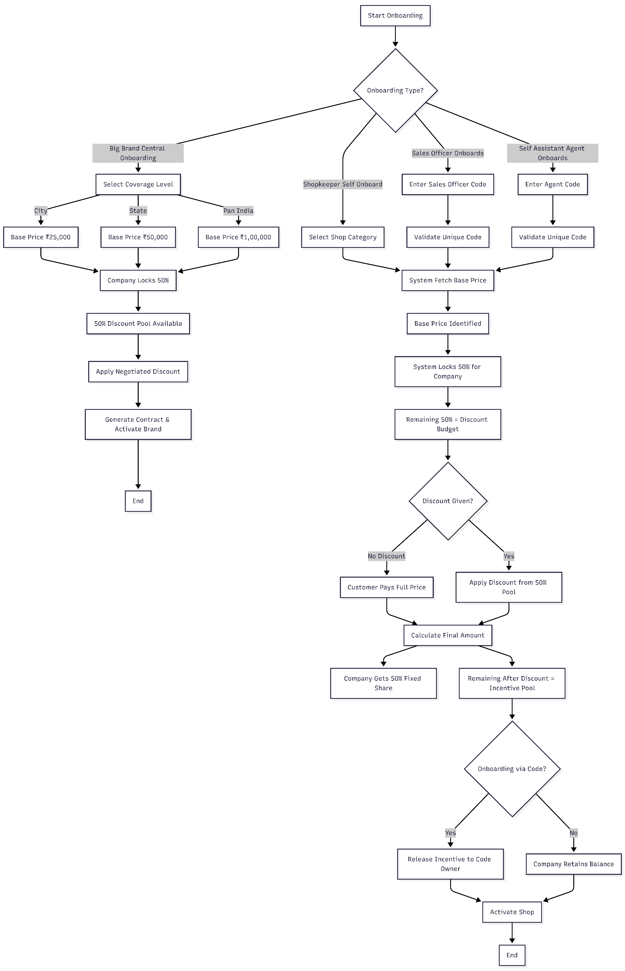
How a shopkeeper boarding will be done?

Slide 44
Financials

Slide 45
24MPLAN

Slide 46
Thank You!

