Slide 1
Name: Sparsh Gupta
Roll No: 2010992457
Group No: 17
Instructor: Mr. Lavish Arora

Slide 2
The objective of this project is to learn and apply the concepts of HTML and CSS by creating an e-commerce website.
This website consists of the following pages:
Home Page
Feedback Page
Sign In Page
Sign Out Page
About Us Page

Slide 3
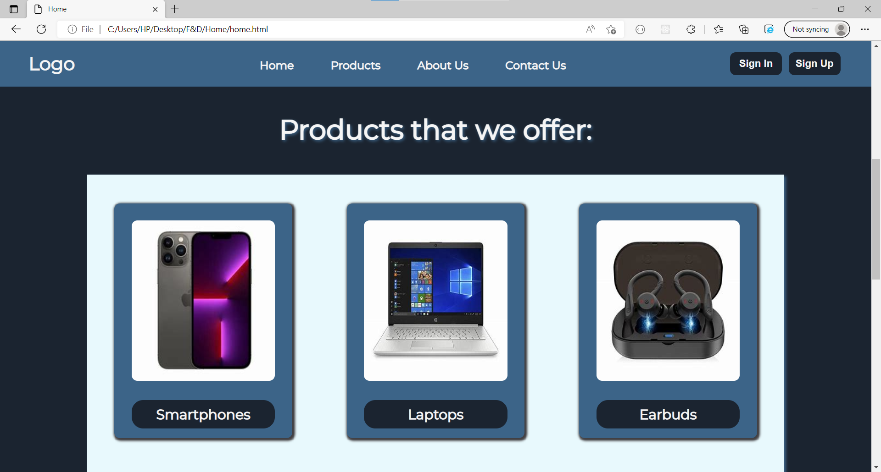
Home Page
The home page consists of the main categories like smartphones, laptops .etc available for sale on the website.
It consists of a fixed navbar for easy navigation and a footer at the bottom.
It also holds the button which directs to the feedback form.

Slide 4
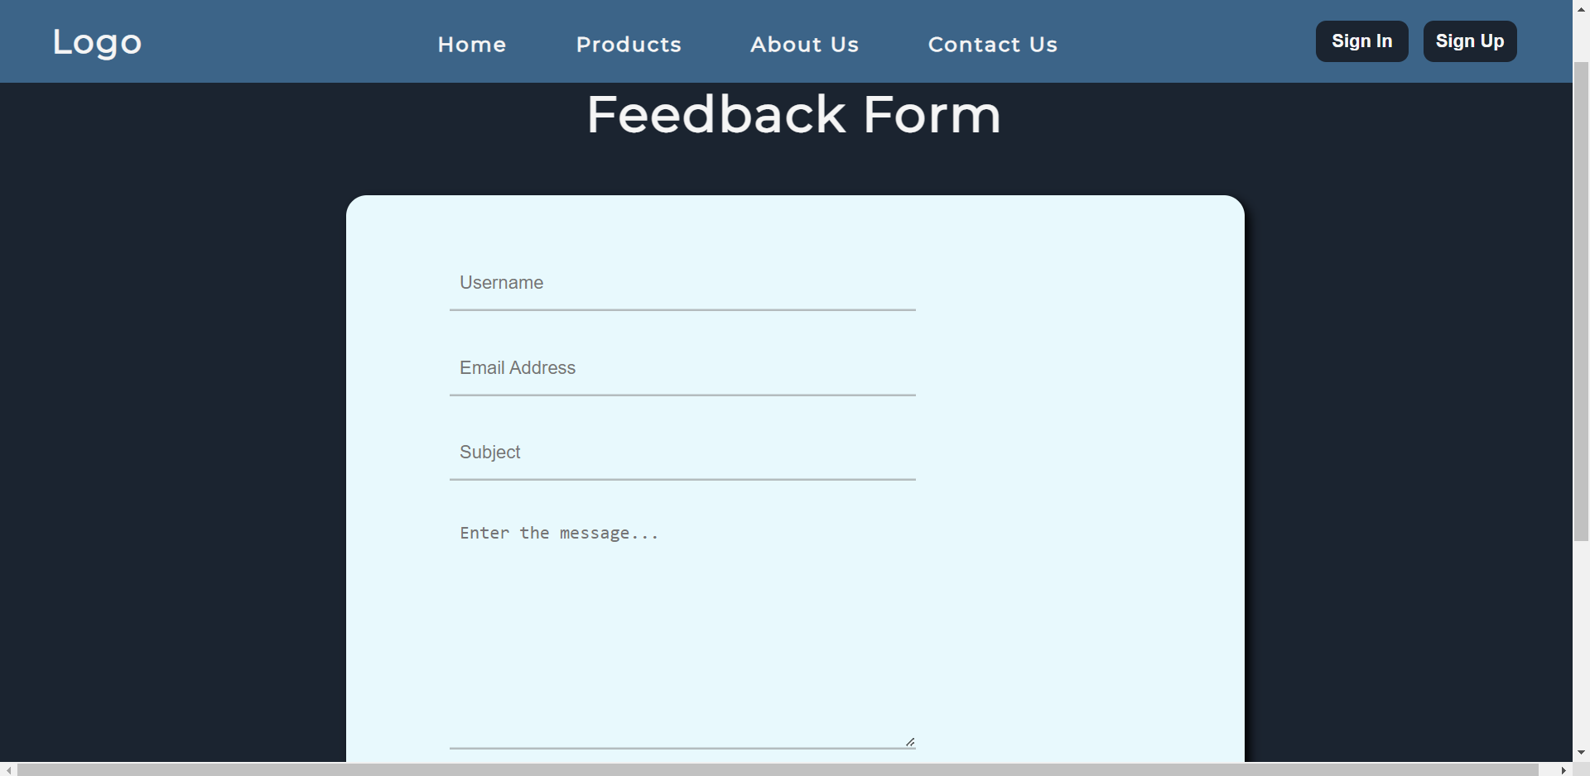
Feedback Page
The feedback page consists of a navbar from the home page, a feedback form and a footer.
The feedback form consists of various input fields such as username, email, subject and also a textarea to type in the message or the feedback.

Slide 5
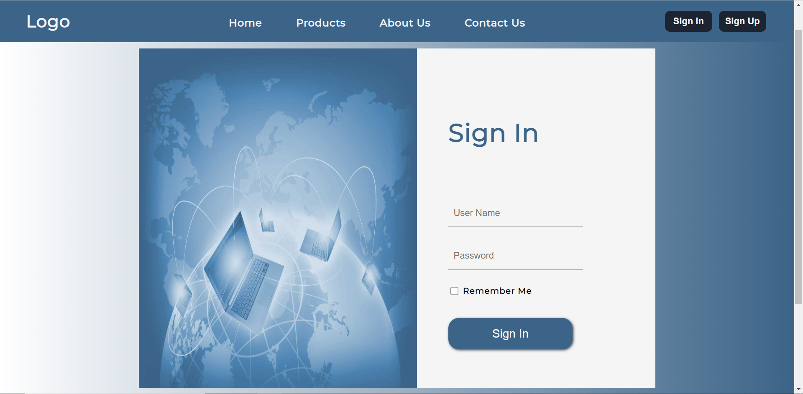
Sign In Page
The sign in page is for the users who have already registered themselves and wish to login into the website.
It consists of input fields such as username and password.
It also provides the ability to remember the user so that next time the user can login without typing in the credentials again.

Slide 6
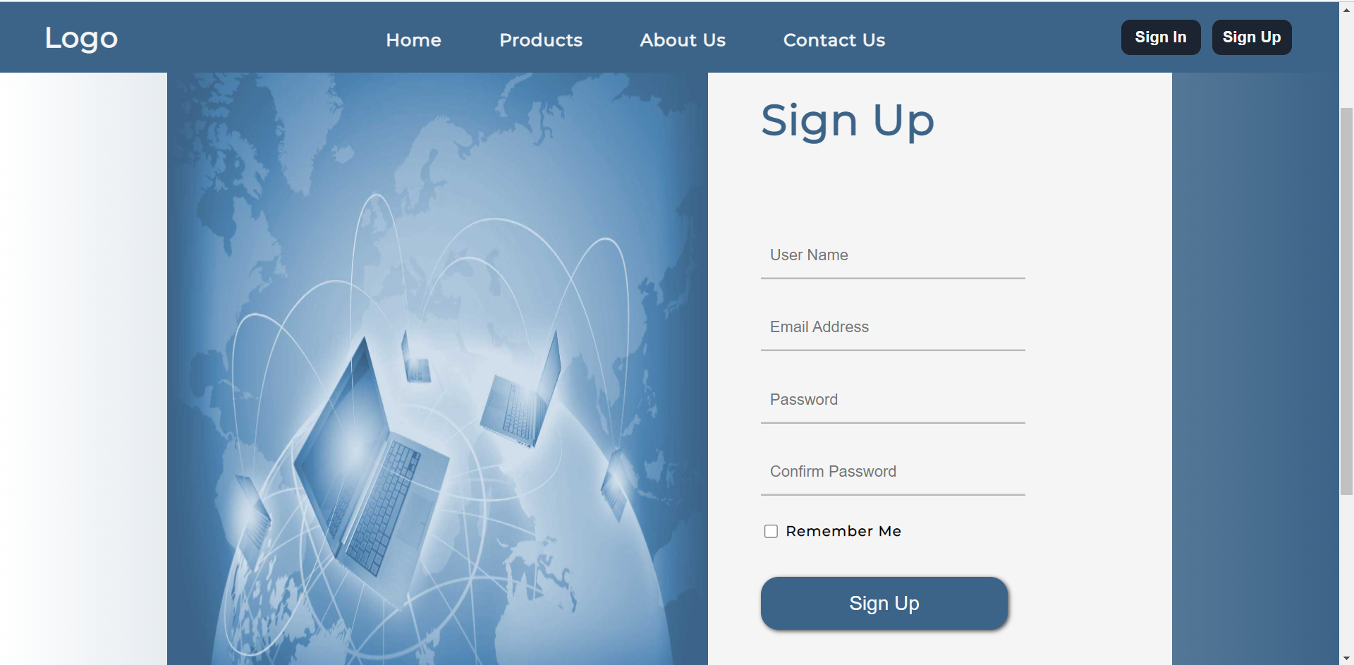
Sign Up Page
The sign up page is used to register new users into the database.
It consists of various fields that are essential to register a new user.
It also consists of a confirm password field which enables the user to recheck the password by typing it again.

Slide 7
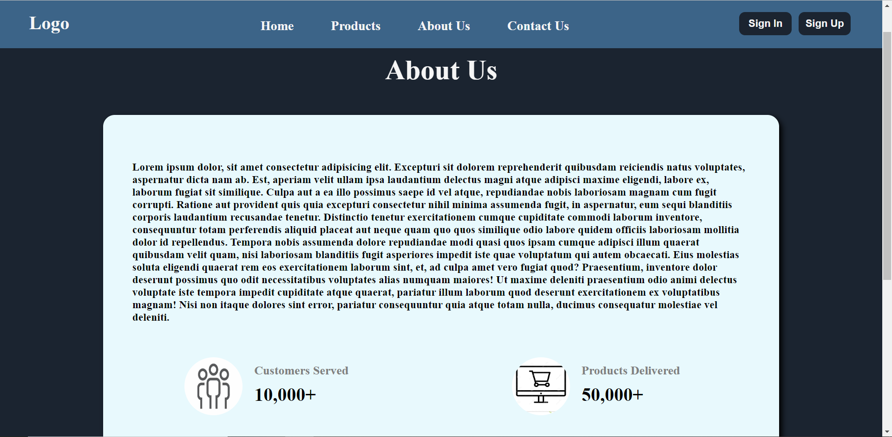
About Us Page
The about us page gives information about the company.
This page also consists of some statistics such as customers served, products delivered etc.

Slide 8
Thank You

