Slide 1
REVIEW 1 & REVIEW 2
Confidence-Gated AI Clinical Documentation
Hard-blocking unverified AI-drafted facts from the medical record using acoustic, entailment and clinical-plausibility signals, with adaptive per-clinician thresholds and an append-only audit trail
Verified
Needs review
Blocked
Team: [Name, Reg. No.] · [Name, Reg. No.] · [Name, Reg. No.]
Guide: [Faculty name] Course / School: [Course code, School]
Notes:
Title slide. Red text = placeholders to fill in before presenting.

Slide 2
REVIEW 1 · TITLE, KEYWORDS AND ABSTRACT
Keywords and abstract
Keywords
Abstract
Ambient clinical documentation
AI medical scribe
Speech recognition confidence
Natural language inference (NLI)
Hallucination detection
Evidence-grounded generation
Clinical decision support
Human-in-the-loop review
Adaptive thresholds
Audit trail / provenance
AI scribes transcribe a consultation and let a language model draft the note, but misheard words, invented details and unsafe instructions reach the draft, and current products only show the clinician where each sentence came from. We propose a gate that enforces evidence: every drafted fact must cite transcript segments and quote them verbatim, and is auto-inserted only if (0) the quote really occurs in the cited segment, (1) the speech recogniser was confident about exactly those words, (2) an NLI model finds the evidence entails, and does not contradict, the fact, and (3) it does not conflict clinically with the rest of the encounter. Failing facts are hard-blocked to a review queue with one-click audio replay; clinician decisions adapt per-field thresholds; every decision is logged append-only. On real PriMock57 consultation audio the prototype auto-verified 23 of 26 drafted facts, held a fact corrupted by a real ASR error for review, and measured 17.5 % WER for the local recogniser.
2
Notes:
Keywords map to the search terms in the patent disclosure. Numbers in the abstract are from our own runs on PriMock57 day1_consultation01.

Slide 3
REVIEW 1 · INTRODUCTION
Introduction: AI scribes are arriving fast
Ambient AI scribes record the doctor-patient conversation, transcribe it (ASR) and have a large language model draft the clinical note (chief complaint, history, medications, assessment, plan).
Deployed products: Nuance/Microsoft DAX Copilot, Abridge, Suki, AWS HealthScribe, Augnito.
Trust mechanism today = evidence linking. AWS HealthScribe attaches transcript segment ids to every summary sentence [9]; Abridge lets the clinician highlight note text and replay the source audio [10].
But the clinician must still verify every line. Linking helps a human check; it does not stop an unsupported sentence from entering the record.
Market (analyst estimates)
USD 1.2-1.4 bn
AI scribe / clinical documentation market, 2025 [15][16]
20-29 % CAGR
projected to 2035; estimates vary by source [15][16]
Figures are third-party projections, not our measurements.
Sources: [9] AWS HealthScribe docs; [10] Abridge Linked Evidence; [15] Astute Analytica; [16] Towards Healthcare
3
Notes:
Market figures: Astute Analytica USD 1.2bn (2025) to 15.1bn (2035), 28.8% CAGR; Towards Healthcare USD 1.39bn to 8.93bn, 20.48% CAGR.

Slide 4
REVIEW 1 · PROBLEM STATEMENT
Three kinds of error reach the AI-drafted note
1
Misheard
2
Invented
3
Unsafe
Speech recognition error
LLM hallucination / mis-citation
Faithful but clinically wrong
Doctor said "take some time off work"; the recogniser wrote "take some type of work". "Stool" became "stall" / "stalk".
A duration, dose or symptom that was never said, e.g. "diarrhoea for three weeks" when the patient said three days.
"Start amoxicillin" for a patient who just said they are allergic to penicillin: perfectly transcribed, still unsafe.
Problem statement: existing AI scribes insert every drafted statement into the note and rely on a busy clinician to find these errors. There is no automatic, per-fact mechanism that verifies each statement against its own evidence and blocks it from the record when the evidence is weak, contradicts it, or it is clinically unsafe.
Sources: Examples 1 and 2 from our own run on PriMock57 day1_consultation01 audio [1]; example 3 from the synthetic gate-demo transcript
4
Notes:
Emphasise example 1 is a real ASR error from our own pipeline, not a hypothetical.

Slide 5
REVIEW 1 · OBJECTIVES AND SCOPE
Objectives and scope of the work
Objectives
In scope
1
Draft structured clinical facts from consultation audio, each with cited, verbatim evidence.
Outpatient consultations in English
Local, on-premise ASR and verification
Prototype web app for clinicians
7 note fields: complaint, history, meds, allergies, vitals, assessment, plan
2
Verify every fact with independent signals: citation integrity, ASR confidence, NLI entailment, clinical plausibility.
3
Hard-block failing facts from the note and route them to a clinician review queue with audio replay.
4
Adapt the auto-insert threshold per clinician and per field from approve / reject decisions.
Out of scope
5
Record every automatic and human decision in an append-only audit log.
Training or improving the speech recogniser
A full clinical knowledge base (RxNorm / DrugBank)
EHR integration, clinical deployment, user study
6
Validate on real, external consultation data (PriMock57).
5

Slide 6
REVIEW 1 · LITERATURE REVIEW / RELATED WORK
Related work: products, patents and research
Work | What it does | Limitation for our problem
AWS HealthScribe [9] | Transcript + summary; every sentence carries EvidenceLinks to transcript segments | Links are for human validation; nothing is blocked
Abridge Linked Evidence [10] | Highlight note text to see source transcript and replay audio | Optional convenience; relies on clinician checking
US 11,222,716 B2 - Nuance/Microsoft [11] | Links audio, transcript, report; confidence model shows a section only if editing beats rewriting | Gates whole sections on editing effort, not each fact on its evidence
US 10,719,222 / 11,227,688 B2 - Google [12][13] | Transcript beside generated note; extracted phrases linked to audio | Verification by physician inspection
US 6,006,183 A - IBM [14] | Colour-codes low-confidence ASR words above a threshold | Word level only; not tied to note statements
SummaC [6], FactCC [7] | NLI / classifier scoring of summary factual consistency | Offline evaluation metric, not an enforcing gate
ACI-BENCH [8] | Benchmark for visit-note generation from conversations | Measures quality; no verification mechanism
Sources: [6] SummaC; [7] FactCC; [8] ACI-BENCH; [9] AWS HealthScribe; [10] Abridge; [11] US11222716B2; [12] US10719222B2; [13] US11227688B2; [14] US6006183A
6

Slide 7
REVIEW 1 · GAP ANALYSIS
Gap analysis: nobody enforces the evidence
Capability | HealthScribe / Abridge | US 11,222,716 | Google patents | SummaC / FactCC | Ours
Note statement linked to transcript | Yes | Yes | Yes | No | Yes
ASR confidence used | No | No | Partial | No | Yes
Checks the citation is correct (quote in segment) | No | No | No | No | Yes
Semantic entailment / contradiction check | No | No | No | Yes | Yes
Blocks content from the record | No | Partial | No | No | Yes
Decision per individual fact | No | No | No | Yes | Yes
Clinical-plausibility check on drafted text | No | No | No | No | Yes
Thresholds adapt per clinician | No | No | No | No | Yes
Per-line provenance audit log | Partial | No | No | No | Yes
Partial: US 11,222,716 hides whole sections when predicted editing effort is high; Google patents show confidence indicators on transcript words; AWS returns links, not a decision log.
Sources: [9]-[14] as on previous slide; capability marks from each source's documentation / claims
7

Slide 8
REVIEW 1 · PROPOSED SOLUTION
Proposed solution: an evidence gate in front of the record
Draft
Gate 0
Gate 1
Gate 2
Gate 3
Each fact + cited segments + verbatim quotes
Quote really occurs in cited segment?
ASR confident about the quoted words?
Evidence entails, not contradicts?
Clinically plausible with rest of visit?
Verified
Needs review
Blocked
auto-inserted into the note
blocked, queued with reason + audio replay
rejected with logged reason
Plus: clinician decisions tune per-field thresholds for that clinician; every decision (machine or human) is appended to an audit log, so every line in the chart is traceable.
8

Slide 9
REVIEW 1 · NOVELTY
What is new
1
Enforce, don't annotate
2
Per-fact dual signal on the same evidence
Evidence decides whether each fact may enter the record, instead of being displayed for optional checking [9][10].
ASR confidence over exactly the quoted words + NLI entailment on the cited segments; contradiction is an absolute block.
3
Citation integrity first
4
Third gate for faithful-but-unsafe
The model must quote verbatim; a quote not found in its segment is rejected before any scoring.
Allergy class, indication, contraindication, interaction and stewardship checks across the encounter's own facts.
5
Learns per clinician
6
No imputed signals
Per-field thresholds adapt to each clinician's approve / reject decisions; safety floors never move.
Text input has no audio, so the acoustic signal is logged as unavailable rather than faked.
vs. US 11,222,716: that patent gates whole report sections on predicted editing effort; ours gates each fact on its own evidence.
Sources: Closest prior art: US 11,222,716 B2 [11]; evidence linking: AWS HealthScribe [9], Abridge [10]; NLI consistency: SummaC [6]
9

Slide 10
REVIEW 1 · REFERENCES
References
[1] Papadopoulos Korfiatis A., Moramarco F., Sarac R., Savkov A. PriMock57: A Dataset of Primary Care Mock Consultations. ACL 2022. github.com/babylonhealth/primock57 (CC BY 4.0)
[2] Radford A. et al. Robust Speech Recognition via Large-Scale Weak Supervision (Whisper). ICML 2023.
[3] SYSTRAN. faster-whisper (CTranslate2 Whisper implementation). github.com/SYSTRAN/faster-whisper
[4] He P., Gao J., Chen W. DeBERTaV3: Improving DeBERTa using ELECTRA-Style Pre-Training with Gradient-Disentangled Embedding Sharing. ICLR 2023.
[5] Laurer M. DeBERTa-v3-base-mnli-fever-anli (model card). huggingface.co/MoritzLaurer/DeBERTa-v3-base-mnli-fever-anli
[6] Laban P., Schnabel T., Bennett P. N., Hearst M. A. SummaC: Re-Visiting NLI-based Models for Inconsistency Detection in Summarization. TACL 2022.
[7] Kryscinski W., McCann B., Xiong C., Socher R. Evaluating the Factual Consistency of Abstractive Text Summarization. EMNLP 2020.
[8] Yim W. et al. ACI-BENCH: a Novel Ambient Clinical Intelligence Dataset for Benchmarking Automatic Visit Note Generation. Scientific Data 2023.
[9] AWS HealthScribe - Clinical documentation insights. docs.aws.amazon.com/transcribe/latest/dg/health-scribe-insights.html
[10] Abridge - Verify a Note With Linked Evidence. support.abridge.com/hc/en-us/articles/30235128433811
[11] US 11,222,716 B2. System and method for review of automated clinical documentation from recorded audio. Nuance / Microsoft, 2022.
[12] US 10,719,222 B2. Method and system for generating transcripts of patient-healthcare provider conversations. Google, 2020.
[13] US 11,227,688 B2. Interface for patient-provider conversation and auto-generation of note or summary. Google, 2022.
[14] US 6,006,183 A. Speech recognition confidence level display. IBM, 1999.
[15] Astute Analytica. AI Clinical Documentation (Ambient Scribe) Market report. astuteanalytica.com
[16] Towards Healthcare. AI in Medical Scribing Market sizing. towardshealthcare.com
[17] Google. Gemini API documentation (structured JSON output). ai.google.dev
[18] RapidFuzz - fuzzy string matching library. github.com/rapidfuzz/RapidFuzz
[19] British National Formulary (drug indications, contraindications, interactions). bnf.nice.org.uk
10

Slide 11
REVIEW 2
Methodology and system development
Architecture · data · models · the pipeline step by step · algorithm · validation · preliminary results

Slide 12
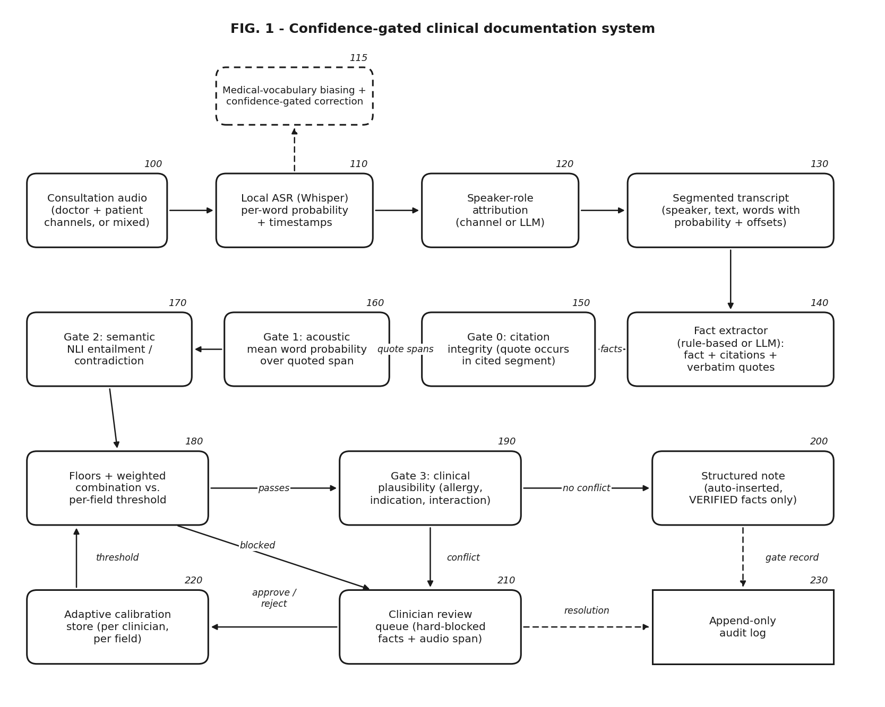
REVIEW 2 · PROPOSED ARCHITECTURE
Proposed architecture
Capture + ASR (100-130): local Whisper, per-word probability, speaker roles
Extractor (140): rule-based or LLM; facts with citations + quotes
Gates 0-2 (150-180): quote check, acoustic, entailment, per-field threshold
Gate 3 (190): clinical plausibility
Outputs (200-230): note, review queue, calibration store, audit log
Sources: Figure generated from the prototype's module structure (prototype/src); ASR [2][3]; NLI [4][5]; LLM [17]
12

Slide 13
REVIEW 2 · ENVIRONMENT SETUP
Environment setup
Layer | Technology | Why
Language / backend | Python 3.13, FastAPI, Uvicorn | async API, background pipeline jobs
Speech recognition | faster-whisper (Whisper base.en, int8, CPU) [2][3] | local: audio never leaves the machine; word-level probabilities
Entailment | PyTorch 2.8 + Transformers; DeBERTa-v3 NLI [4][5] | local P(entail / neutral / contradict)
Quote alignment | RapidFuzz partial-ratio alignment [18] | fuzzy match quote inside segment
Fact extraction | Rule-based, or Gemini 3.6 Flash with JSON schema [17]; Claude optional | structured, cited output
Storage | SQLite (users, patients, cases); JSON case files; JSONL audit log | simple, inspectable
Front end | HTML / CSS / JavaScript | upload, live progress, review, audio replay
Test machine
8-core CPU
no GPU
7.8 GB RAM
Windows 11; models cached locally
Everything runs on a student laptop.
Sources: [2][3] Whisper / faster-whisper; [4][5] DeBERTa NLI; [17] Gemini API; [18] RapidFuzz
13

Slide 14
REVIEW 2 · DATASET COLLECTION
Dataset: PriMock57 (real audio, real transcripts)
57 mock primary-care consultations recorded by Babylon Health: real clinicians, actors as patients, separate doctor and patient audio channels, human transcripts and reference clinical notes. We use it because it is real speech with ground truth, and freely licensed [1].
57
8.6 h
6,727
85,914
9.1 min
consultations
total conversation time
human-transcribed utterances
words
mean length (3.8 - 14.3)
Per consultation we use | Format | Used for
Doctor + patient audio | 16 kHz mono WAV, one speaker per channel | ASR input, acoustic signal, speaker roles
Human transcript | TextGrid (converted to JSON segments) | text-input pipeline; WER reference
Reference clinical note | text | future: fact-level accuracy of drafts
Sources: [1] Papadopoulos Korfiatis et al., ACL 2022 - Babylon Health, CC BY 4.0; statistics computed by us from the released transcripts
14

Slide 15
REVIEW 2 · PREPROCESSING
Preprocessing
1
Transcripts
PriMock57 TextGrid files converted to JSON segments {id, start, end, speaker, text}; 57 cases indexed by presenting complaint.
2
Audio decoding
16 kHz mono PCM; voice-activity detection skips silence while the other party speaks.
3
Utterance segmentation
Whisper segments re-split at pauses >= 0.8 s using word timestamps, so doctor/patient turns interleave correctly.
4
Word features
each word keeps probability, start/end time and character offsets in the segment text (needed to score quoted spans).
5
Medical vocabulary
decoding biased with a drug/symptom prompt; only words with ASR probability < 0.70 are fuzzy-corrected, original word kept.
6
WER normalisation
lower-case, strip punctuation, drop fillers (um, uh, erm), unify UK/US spelling before comparing.
Sources: [1] PriMock57 format; [2][3] Whisper / faster-whisper VAD and word timestamps; medical-term list: prototype/src/medical_terms.py
15

Slide 16
REVIEW 2 · DATA DIVISION AND AUGMENTATION
Data division and augmentation
No model is trained
PLANNED, not yet done
Whisper, the DeBERTa NLI model and Gemini are used exactly as released [2][4][5][17]. The contribution is the verification method, so there is no training set and no train / test split for model weights.
Division for tuning the gate
Split the 57 consultations by consultation (not by utterance) into a development set for tuning thresholds / weights and a held-out test set.
Label each drafted fact correct / incorrect against the transcript and reference note to measure the gate.
What the data is used for today
1 consultation end to end from audio (both channels)
57 human transcripts for text-input runs
Synthetic transcripts only for unsafe-prescription tests
Augmentation (stress tests)
Add background noise / change speed to the audio to test that the acoustic gate reacts to degraded speech.
Sources: [1] PriMock57; [2][4][5] pretrained models used as released
16

Slide 17
REVIEW 2 · MACHINE LEARNING / DEEP LEARNING MODELS
Models used (all pretrained, none fine-tuned)
Whisper base.en
DeBERTa-v3-base NLI
Gemini 3.6 Flash
Speech recognition
Entailment
Fact extraction; speaker roles for mixed audio
Transformer encoder-decoder, ~74 M parameters, trained on 680k h of weakly supervised audio [2]; run int8 on CPU via faster-whisper [3].
DeBERTaV3 encoder [4] fine-tuned by its authors on MNLI, FEVER-NLI, ANLI [5]; ~184 M parameters. Cross-encodes (evidence, statement).
Hosted LLM, prompted to return facts with citations and verbatim quotes under a JSON schema [17]. Optional; a rule-based extractor also works.
Output: per-word probability = acoustic signal
Output: P(entailment), P(contradiction) = semantic signal
Output: drafts; never trusted without the gate
Sources: [2] Whisper; [3] faster-whisper; [4] DeBERTaV3; [5] NLI model card; [17] Gemini API; parameter counts from the model papers / cards
17

Slide 18
1
Audio capture and speech recognition
Upload doctor + patient recordings (or one mixed recording).
Local faster-whisper transcribes each channel with voice-activity detection and word timestamps [3].
Decoding is biased with a medical vocabulary prompt.
Words scored < 0.70 that are near a known drug / symptom are corrected; original kept for audit.
Output: utterances with per-word probability and character offsets.
Real run: day1_consultation01
186
17.5 %
utterances (2 x 7:38)
word error rate vs human transcript
0.853
9.5 %
mean word probability
words below 0.5 probability
WER: 231 errors / 1,319 words (doctor 17.5 %, patient 17.6 %), fillers removed.
Audio + ASR
Speakers
Extract
Gate 0
Gate 1
Gate 2
Combine
Gate 3
Review
Calibrate
Audit
Sources: [2][3] Whisper / faster-whisper; WER computed by us against the PriMock57 human transcript [1]
18

Slide 19
2
Speaker roles
Separate channels (default)
Single mixed recording
Each recording holds one speaker, so every utterance from the doctor channel is DOCTOR and from the patient channel is PATIENT. Channels are merged in time order. This is exact, as in PriMock57 [1].
No channel information, so an LLM labels each utterance DOCTOR / PATIENT / OTHER from what is said (questions vs. symptoms) [17]. Roles are marked "inferred" in the note's provenance.
Tested up to attribution; extraction step not completed (API quota). Limitation: an utterance spanning a turn change gets one role.
Real run: 106 doctor + 82 patient utterances.
Audio + ASR
Speakers
Extract
Gate 0
Gate 1
Gate 2
Combine
Gate 3
Review
Calibrate
Audit
Sources: [1] PriMock57 separate channels; [17] Gemini API for mixed recordings
19

Slide 20
3
Fact extraction with citations and verbatim quotes
Extractor drafts facts in 7 fields: complaint, history, medications, allergies, vitals, assessment, plan.
Each fact must cite the segment(s) it relies on and quote them character-for-character.
Questions are cited with their answers ("Do you smoke?" + "No").
Output is forced into a JSON schema [17], so it always parses.
The extractor is untrusted: its citations and quotes are exactly what the gates check next.
{
"field": "plan",
"value": "Take two to three days off
work to rest.",
"citations": [
{"segment_id": 154,
"quote": "some type of work."},
{"segment_id": 157,
"quote": "take some time off and rest."}
]
}
Audio + ASR
Speakers
Extract
Gate 0
Gate 1
Gate 2
Combine
Gate 3
Review
Calibrate
Audit
Sources: [17] Gemini structured output; fact from our real run on PriMock57 audio [1], citations abridged (4 in the original)
20

Slide 21
4
Gate 0: citation integrity
Before any scoring, every quote must actually occur in the segment it cites.
Fuzzy-align the quote inside the segment text (RapidFuzz partial ratio [18]).
Score >= 90 / 100 required for every quote.
Otherwise: REJECTED as invented or mis-attributed evidence.
The aligned character span is kept: it tells Gate 1 which words to score.
Segment #6 (patient, real ASR)
"I've just had some diarrhea for the last three days, and it's been affecting me..."
Quote: "I've just had some diarrhea for the last three days"
alignment 100 / 100 -> continue
Quote: "I take metformin 500 mg twice a day"
alignment 46 / 100 -> REJECTED
Audio + ASR
Speakers
Extract
Gate 0
Gate 1
Gate 2
Combine
Gate 3
Review
Calibrate
Audit
Sources: [18] RapidFuzz partial-ratio alignment; example from our gate regression suite on real ASR output [1]
21

Slide 22
5
Gate 1: acoustic confidence of the quoted words
A = (1 / |Q|) Σ_{w ∈ Q} p(w)
Real Whisper word probabilities, segments #153-154
Said: "take some time off work" Heard: "take some type of work"
Q = ASR words whose character span overlaps the aligned quotes; p(w) = Whisper's word probability.
A < 0.50 -> REJECTED, weakest words listed.
Only the words the fact relies on count, not the whole transcript.
Text input (no audio): A is recorded as unavailable, never invented.
The misheard word is the least confident one. The fact's quoted span averaged A = 0.85, and its entailment fell to 0.43 (Gate 2), so it was held for review.
Audio + ASR
Speakers
Extract
Gate 0
Gate 1
Gate 2
Combine
Gate 3
Review
Calibrate
Audit
Sources: Word probabilities from faster-whisper [3]; example from our real run on PriMock57 day1_consultation01 [1]
22

Slide 23
6
Gate 2: semantic entailment (NLI)
Premise = cited segments ("Doctor: ... Patient: ..."); hypothesis = drafted fact. The NLI model [4][5] returns three probabilities.
Premise (cited evidence) | Drafted fact | P(entail) | P(contra) | Decision
Patient: I've just had some diarrhea for the last three days. | Patient reports diarrhea for 3 days. | 0.997 | 0.000 | pass
Doctor: Do you smoke? Patient: No, I don't. | Denies smoking. | 0.994 | 0.001 | pass
Patient: I have really bad chest pain. | Denies chest pain. | 0.006 | 0.990 | REJECT
Doctor: I'll start you on metformin 500 mg twice a day. | Metformin 1000 mg three times a day. | 0.000 | 0.997 | REJECT
Patient: I've been coughing for a week. | Patient has a history of asthma. | 0.000 | 0.001 | REJECT
Rules: P(contradiction) >= 0.50 -> REJECTED; P(entailment) < 0.30 -> REJECTED. Replaced a word-overlap proxy that blocked correct paraphrases (0 of 21 passed).
Audio + ASR
Speakers
Extract
Gate 0
Gate 1
Gate 2
Combine
Gate 3
Review
Calibrate
Audit
Sources: [4] DeBERTaV3; [5] NLI model card; [6] SummaC (NLI for consistency); probabilities measured by us with the model
23

Slide 24
7
Combining the signals against a per-field threshold
S = 0.6 · E + 0.4 · A
S = E (text input, no audio)
Real fact (audio run, wording abridged) | E | A | S | Result
Diarrhea for the last three days. | 0.996 | 0.896 | 0.96 | VERIFIED
Fever at onset, none now. | 0.631 | 0.967 | 0.77 | VERIFIED
Take 2-3 days off work to rest. | 0.426 | 0.853 | 0.60 | REVIEW
History of asthma, well controlled. | 0.384 | 0.784 | 0.54 | REVIEW
E = P(entailment), A = acoustic score.
S >= t(clinician, field) -> VERIFIED (auto-insert).
S < t -> NEEDS_REVIEW (blocked, queued).
t starts at 0.75 per field; floors (0.30, 0.50) and contradiction limit never adapt.
Audio + ASR
Speakers
Extract
Gate 0
Gate 1
Gate 2
Combine
Gate 3
Review
Calibrate
Audit
Sources: Parameters set by design (not yet tuned on data); values from prototype/src/grounding.py and calibration.py
24

Slide 25
8
Gate 3: clinical plausibility
Catches statements that are faithful to the audio but clinically unsafe. Runs on every non-rejected medication / plan fact, against the encounter's other facts.
Allergy conflict
Antibiotic for viral
Indication mismatch
Contraindication
Drug interaction
amoxicillin + documented penicillin allergy
antibiotic while assessment says viral
"aspirin for your diarrhoea"
naproxen + history of peptic ulcer
warfarin + NSAID
Negation-aware: "No known drug allergies", "no history of stomach ulcers" and "you don't need amoxicillin" raise nothing.
Effect: a conflict demotes VERIFIED -> NEEDS_REVIEW and attaches the reason for the clinician.
Knowledge: curated drug classes / indications / interactions [19]; production would use RxNorm / openFDA.
Audio + ASR
Speakers
Extract
Gate 0
Gate 1
Gate 2
Combine
Gate 3
Review
Calibrate
Audit
Sources: [19] BNF for indications / contraindications / interactions (curated subset, not exhaustive); examples from our plausibility tests
25

Slide 26
9
Clinician review queue with audio replay
Only blocked facts need attention; verified facts are already in the note.
Each card shows: badge (needs review / blocked), entailment, acoustic, combined score, the quoted evidence, and any plausibility conflict.
Clicking a fact highlights the exact quoted words in the transcript.
▶ on a segment plays only that audio span from the original recording.
Approve or Reject: recorded under the clinician's name.
NEEDS REVIEW
Take two to three days off work to rest.
entailment 0.43 · acoustic 0.85 · combined 0.60
#154 "some type of work." #157 "take some time off and rest."
Approve
Reject
Schematic of the review card with real values. Add a screenshot of the running app here.
Audio + ASR
Speakers
Extract
Gate 0
Gate 1
Gate 2
Combine
Gate 3
Review
Calibrate
Audit
Sources: Prototype web app (prototype/web/case.js); speaker-level provenance idea related to evidence linking in [9][10], here attached to blocked facts only
26

Slide 27
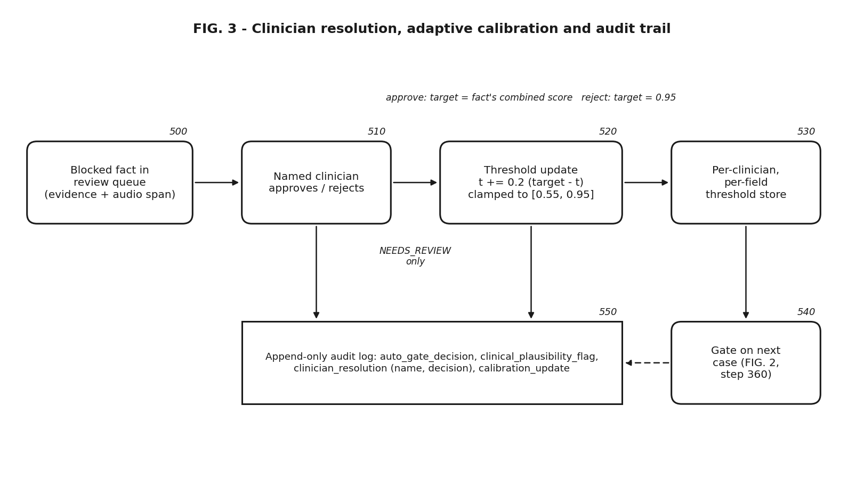
10
Adaptive calibration per clinician
t ← clip( t + 0.2 · (τ − t), 0.55, 0.95 )
τ = S of the fact (approve) · τ = 0.95 (reject)
Stored per clinician and per field, reused on all of that clinician's future cases.
Only NEEDS_REVIEW decisions move t; REJECTED facts failed a fixed floor.
Approvals relax the bar toward the level the clinician trusts; rejections tighten it.
Real test: rejecting the borderline "days off work" fact moved this clinician's plan threshold 0.75 -> 0.79; a medications rejection in the web app showed 0.79 on a different case too.
Audio + ASR
Speakers
Extract
Gate 0
Gate 1
Gate 2
Combine
Gate 3
Review
Calibrate
Audit
Sources: Update rule from prototype/src/calibration.py; result from our web-app test
27

Slide 28
11
Append-only audit trail
Every event is appended, never edited: input_received, auto_gate_decision, clinical_plausibility_flag, clinician_resolution, calibration_update.
Each gate record stores the fact, citations, extractor, entailment / contradiction, acoustic, combined score, status and reason.
So every line in the chart is traceable to machine verification (with its scores) or a named clinician's decision.
{"event": "auto_gate_decision",
"fact_id": "F012", "field": "plan",
"value": "as an infection clears from your
system, take some time off and rest.",
"cited_segment_ids": [157],
"extractor": "rule_based",
"nli": {"entailment": 0.9893,
"contradiction": 0.001},
"acoustic_score": 0.801,
"combined_confidence": 0.914,
"status": "VERIFIED"}
Audio + ASR
Speakers
Extract
Gate 0
Gate 1
Gate 2
Combine
Gate 3
Review
Calibrate
Audit
Sources: prototype/src/audit.py; entry copied from a real audit log produced by our web-app run
28

Slide 29
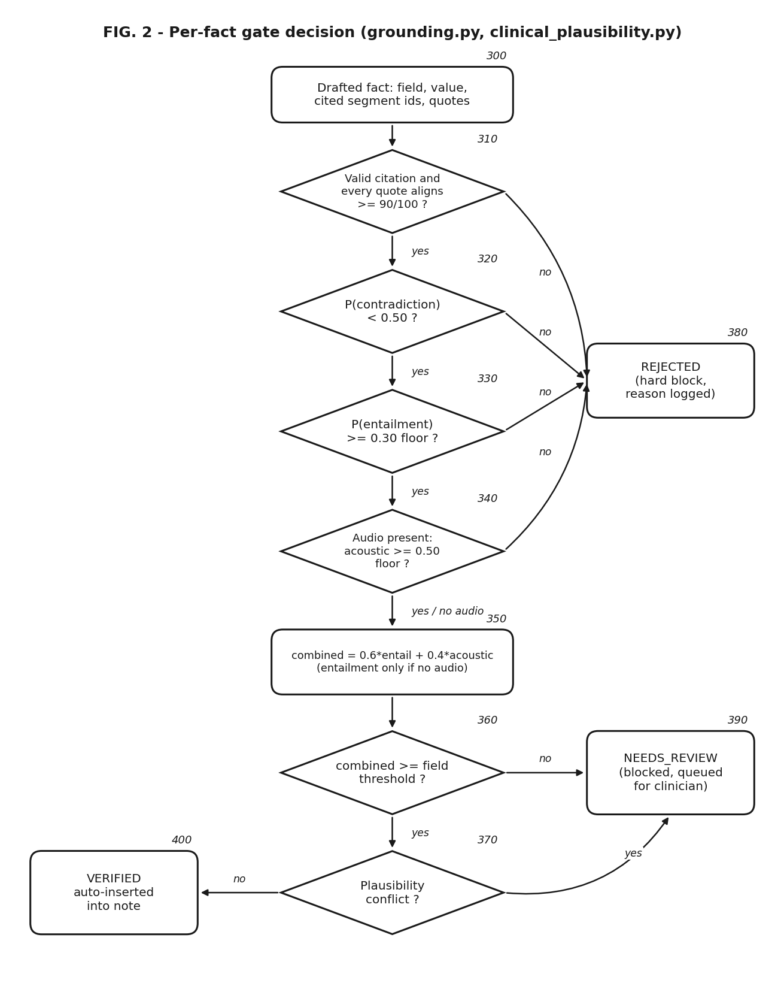
REVIEW 2 · ALGORITHM AND MATHEMATICAL FORMULATION
Algorithm: gating one drafted fact
Input: fact f = (field, statement h, citations {(s_i, q_i)}), segments, threshold t
1 if no valid citation or any align(q_i, s_i) < 90: return REJECTED
2 premise P = concat(speaker_i : text(s_i))
3 (E, N, C) = NLI(P, h)
4 if C >= 0.50 or E < 0.30: return REJECTED
5 Q = ASR words overlapping aligned quotes
6 A = mean_{w in Q} p(w) (None if no audio)
7 if A is not None and A < 0.50: return REJECTED
8 S = 0.6 E + 0.4 A (S = E if A is None)
9 status = VERIFIED if S >= t[clinician, field] else NEEDS_REVIEW
10 if status == VERIFIED and plausibility_conflict(f, other facts):
status = NEEDS_REVIEW
11 append(audit, f, E, C, A, S, status, reason); return status
Sources: prototype/src/grounding.py, clinical_plausibility.py; FIG. 2 of the patent disclosure
29

Slide 30
REVIEW 2 · VALIDATION PROCESS AND PERFORMANCE METRICS
Validation process and metrics
What is validated | Metric | Status
Speech recognition quality | Word error rate vs. human transcript; mean word probability | Measured: 1 consultation
Gate behaviour on known cases | Expected decision for 7 scripted scenarios (true fact, wrong duration, unsupported, invented quote, ASR error, calibration, unsafe Rx) | Measured: 7 / 7
NLI discrimination | P(entail) / P(contradict) on paraphrase, negation, wrong dose, unsupported pairs | Measured: 6 pairs
End-to-end throughput | facts verified / held / blocked per consultation; runtime on CPU | Measured: 3 runs
Gate accuracy | precision / recall of blocking against facts labelled correct / incorrect | Planned
Across the dataset | all 57 consultations from audio; WER distribution | Planned
Clinician usefulness | review time, acceptance rate (user study) | Planned
Sources: [1] PriMock57; WER = (S + D + I) / N over words after normalisation
30

Slide 31
REVIEW 2 · PRELIMINARY RESULTS
Preliminary results
0 → 17
of the same consultation's Gemini facts auto-verified after replacing word overlap with NLI
23 / 26
facts auto-verified from real audio; 3 held (one caused by a real ASR error)
17.5 %
WER of local Whisper base.en
Sources: Our runs on PriMock57 day1_consultation01 [1], 22-23 Sep 2026; LLM output varies between runs
31
Notes:
Word-overlap run: 21 facts, 11 needs review, 10 rejected (0 verified). NLI text run: 19 facts. Audio CLI: 26 facts. Audio web: 20 facts.

Slide 32
REVIEW 2 · ANALYSIS AND DISCUSSION
Analysis and discussion
What the results show
Limitations and next steps
A real entailment model is essential: word overlap blocked every correct paraphrase.
The gate catches a real ASR error ("type of work") that a transcript-faithful check would have let through.
Contradiction is decisive (0.99-1.0) for wrong durations, doses and negations.
Faithful-but-unsafe prescriptions are held by Gate 3, which fidelity checks cannot do.
Runs fully on a CPU laptop; audio never leaves the machine.
Only 1 of 57 consultations run from audio so far: run all 57.
Mean acoustic score can hide one badly heard word ("blood in the stalk" passed at 0.84): add a weakest-word floor.
Thresholds / weights set by design: tune on a development split, report on a held-out split.
Plausibility tables are a small curated set: move to RxNorm / openFDA.
No clinician study yet.
32

Slide 33
REVIEW 2 · REFERENCES
References
[1] Papadopoulos Korfiatis A., Moramarco F., Sarac R., Savkov A. PriMock57: A Dataset of Primary Care Mock Consultations. ACL 2022. github.com/babylonhealth/primock57 (CC BY 4.0)
[2] Radford A. et al. Robust Speech Recognition via Large-Scale Weak Supervision (Whisper). ICML 2023.
[3] SYSTRAN. faster-whisper (CTranslate2 Whisper implementation). github.com/SYSTRAN/faster-whisper
[4] He P., Gao J., Chen W. DeBERTaV3: Improving DeBERTa using ELECTRA-Style Pre-Training with Gradient-Disentangled Embedding Sharing. ICLR 2023.
[5] Laurer M. DeBERTa-v3-base-mnli-fever-anli (model card). huggingface.co/MoritzLaurer/DeBERTa-v3-base-mnli-fever-anli
[6] Laban P., Schnabel T., Bennett P. N., Hearst M. A. SummaC: Re-Visiting NLI-based Models for Inconsistency Detection in Summarization. TACL 2022.
[7] Kryscinski W., McCann B., Xiong C., Socher R. Evaluating the Factual Consistency of Abstractive Text Summarization. EMNLP 2020.
[8] Yim W. et al. ACI-BENCH: a Novel Ambient Clinical Intelligence Dataset for Benchmarking Automatic Visit Note Generation. Scientific Data 2023.
[9] AWS HealthScribe - Clinical documentation insights. docs.aws.amazon.com/transcribe/latest/dg/health-scribe-insights.html
[10] Abridge - Verify a Note With Linked Evidence. support.abridge.com/hc/en-us/articles/30235128433811
[11] US 11,222,716 B2. System and method for review of automated clinical documentation from recorded audio. Nuance / Microsoft, 2022.
[12] US 10,719,222 B2. Method and system for generating transcripts of patient-healthcare provider conversations. Google, 2020.
[13] US 11,227,688 B2. Interface for patient-provider conversation and auto-generation of note or summary. Google, 2022.
[14] US 6,006,183 A. Speech recognition confidence level display. IBM, 1999.
[15] Astute Analytica. AI Clinical Documentation (Ambient Scribe) Market report. astuteanalytica.com
[16] Towards Healthcare. AI in Medical Scribing Market sizing. towardshealthcare.com
[17] Google. Gemini API documentation (structured JSON output). ai.google.dev
[18] RapidFuzz - fuzzy string matching library. github.com/rapidfuzz/RapidFuzz
[19] British National Formulary (drug indications, contraindications, interactions). bnf.nice.org.uk
33

Slide 34
THANK YOU
Evidence first, then the record.
Questions?
Code: prototype/ (FastAPI + local Whisper + DeBERTa NLI). Note: the GitHub repository is public; see patent disclosure section 18.

