Slide 1
DAMG 6210 Summer 2022 Lab Management System
Contributors: Professor: Sparsh Sinha (001000390) Simon W. Wang
Nagashree Seshadri (001050979) &
Rajiv Ranjan Sahu (002101619) TA Team
Krishna Pal Singh (002954173)
Mohit Malani (001568891)

Slide 2

Purpose:
The recent pandemic has made us realize the importance of Healthcare infrastructure.
We have developed a Laboratory Management System(LMS) that supports the existing healthcare system by centralizing data and providing quick & efficient reports.
It also supports a multitude of tests including Covid while providing functionalities to manage the labs and their day-to-day tasks including staff and suppliers

Slide 3
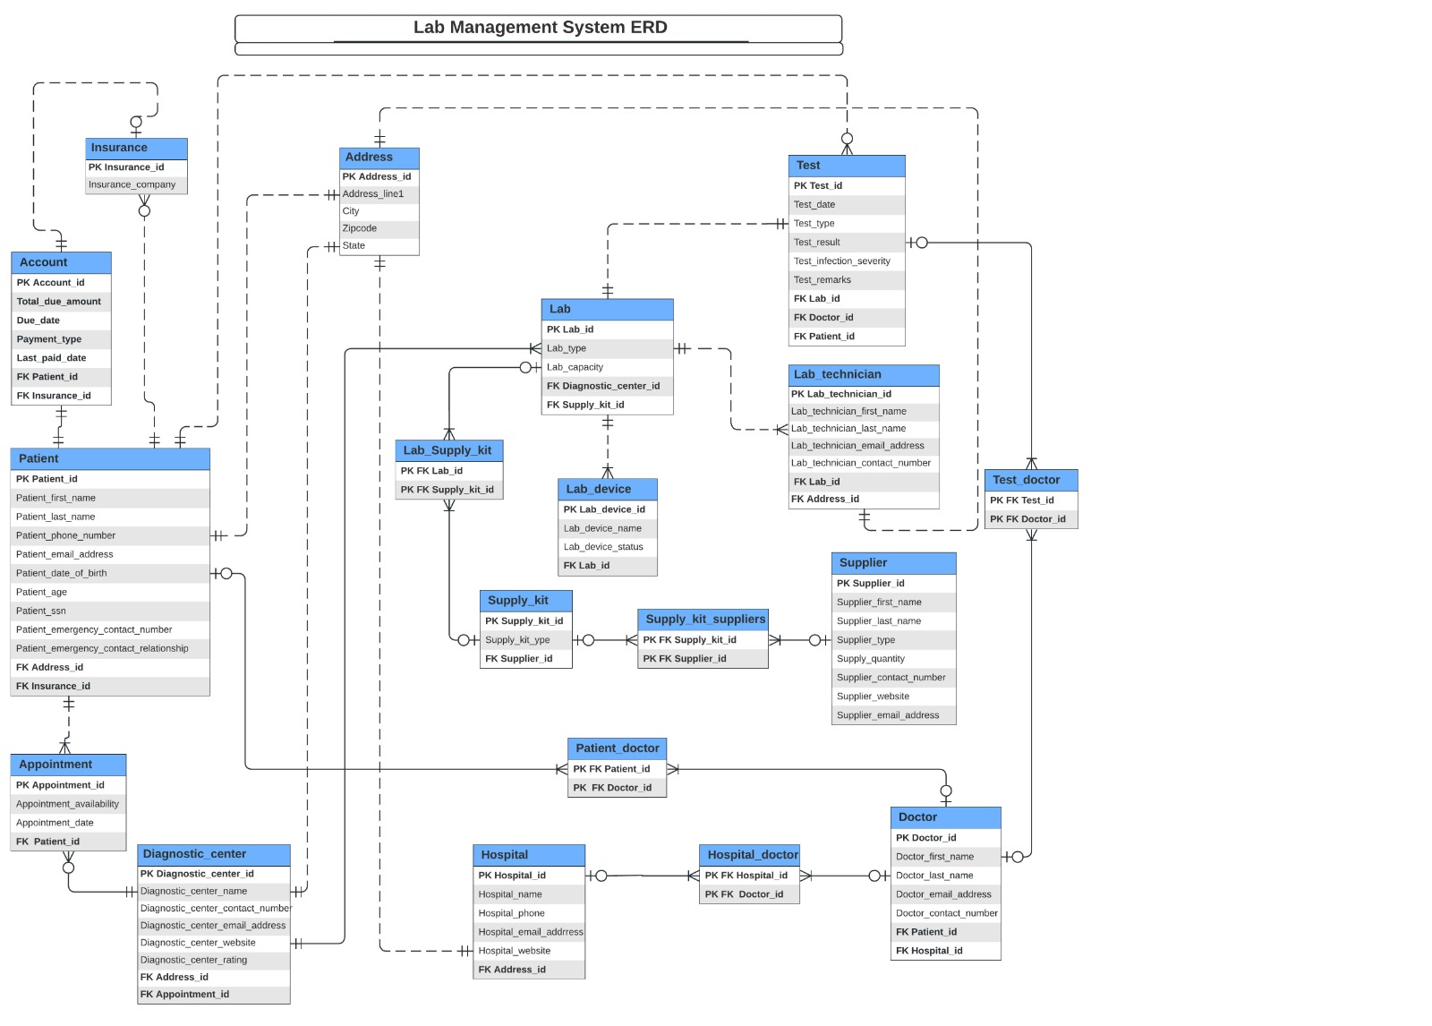
Entity Relationship Diagram:

Slide 4
DDL Excerpt & Data Insertion:
Each table has been crafted with care and we have enabled an intelligent design such that no data is lost during storage and are stored in variables that are utilized for deriving computed columns.
Data has been inserted through two means for our tables - through a Stored Procedure and Insert scripts based on the structure and encryption of tables.
We have 15 parent entities and 4 associative entities in our project. All the entities are normalized up to 3NF to take care of repetitions and data redundancies.

Slide 5
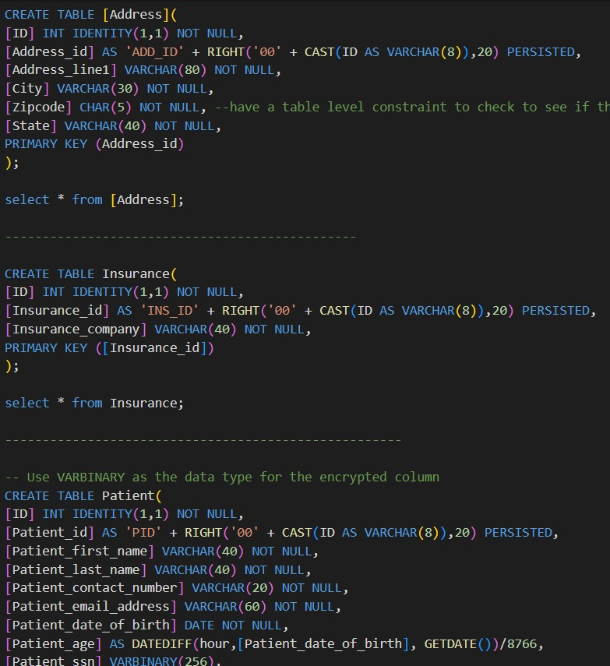
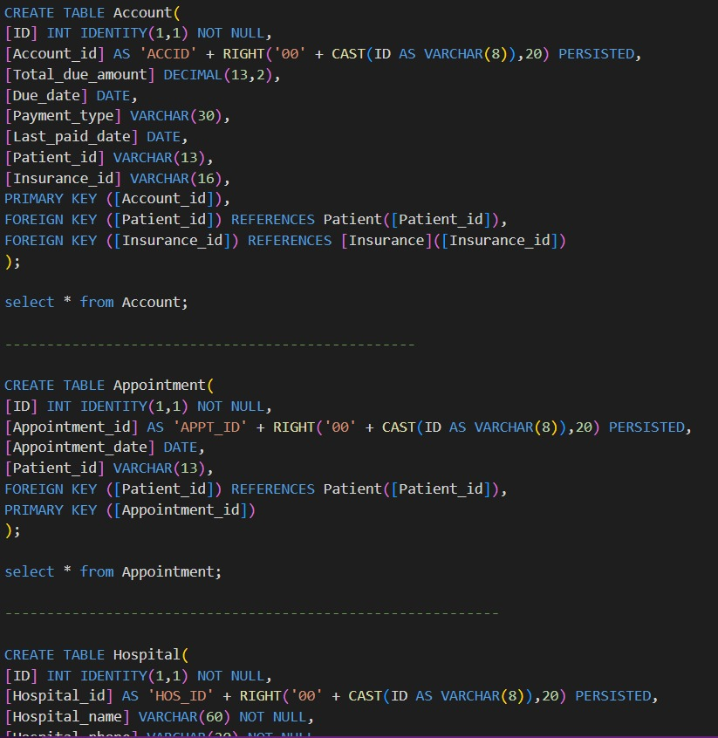
DDL Excerpt & Data Insertion:

Slide 6
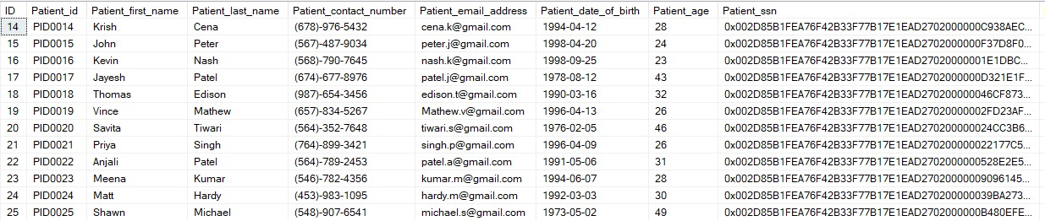
Encryption:
We have implemented encryption in our project for sensitive columns i.e., SSN of Patient by using symmetric key with AES_128 algorithm.
The same column can be decrypted by using the symmetric key.

Slide 7
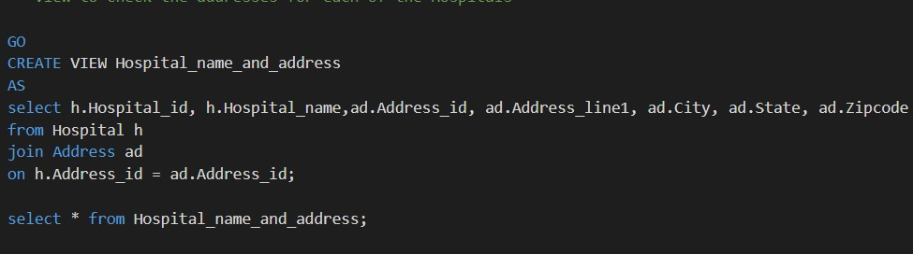
Views:
We have created 6 views that span across multiple tables to ease the lookup handling volumes of data. Address is 1 out of 4 most important associative entities.

Slide 8
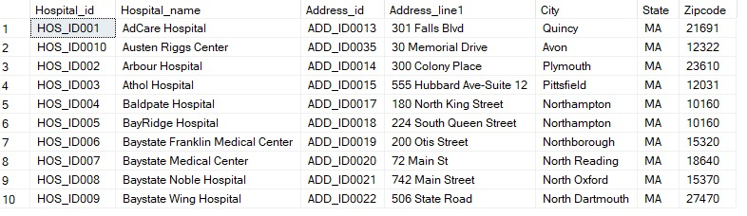
Views:
4 Views are storing the result set of Address & entities related to it.

Slide 9
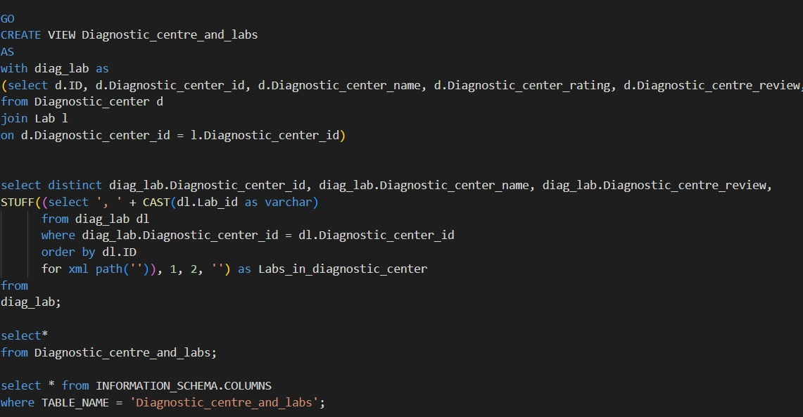
Views:

Slide 10
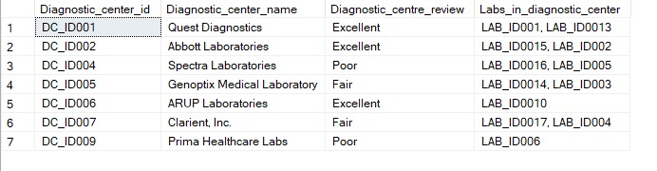
Views:
The other 2 Views are storing the result set for Diagnostic_centre, Lab and Lab_technicians

Slide 11
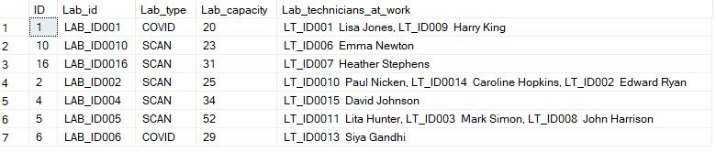
Views:

Slide 12
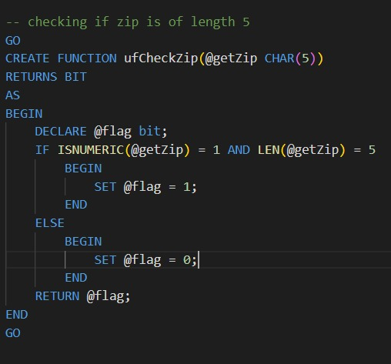
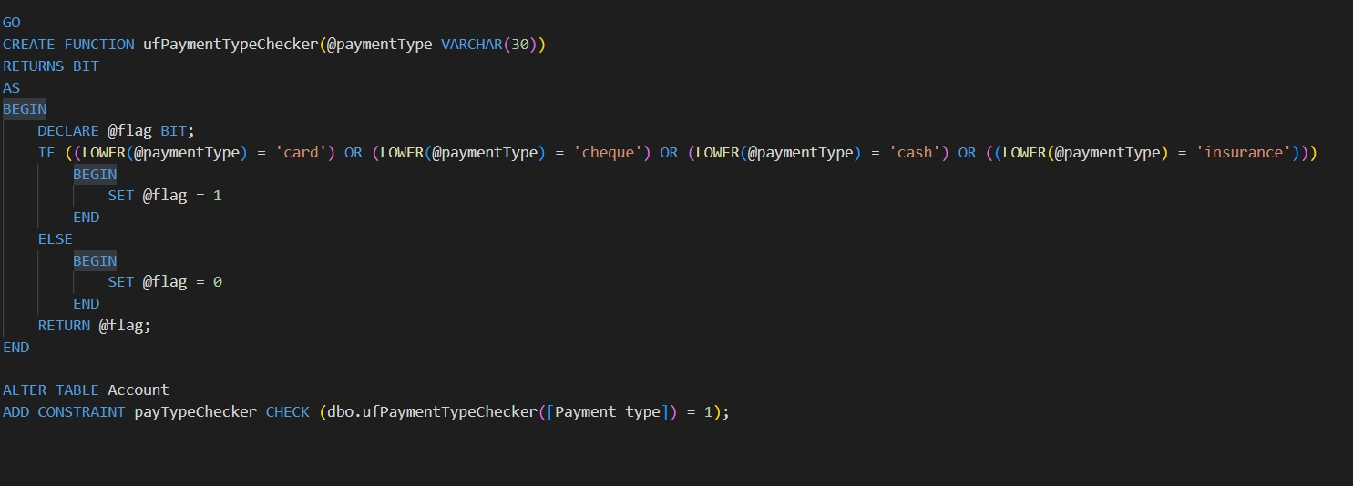
Constraints:
We have implemented 2 table level check constraints:
- Zip Code - Payment Type Checker

Slide 13
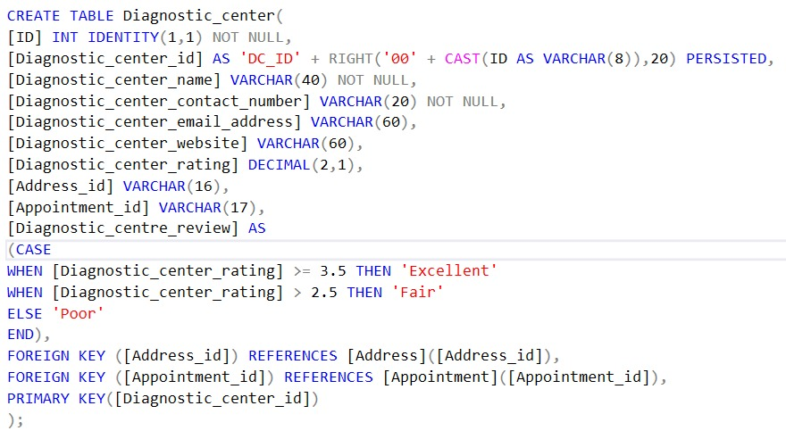
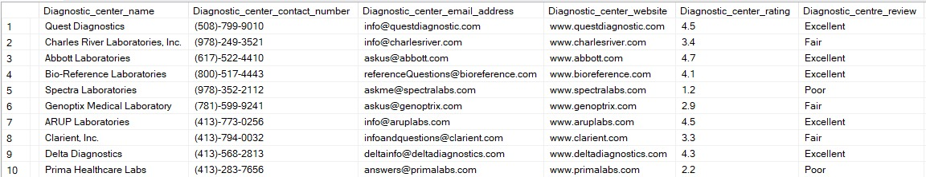
Computed Columns:
Multiple computed columns have been implemented:
Age
Diagnostic center review
Test infection severity

Slide 14
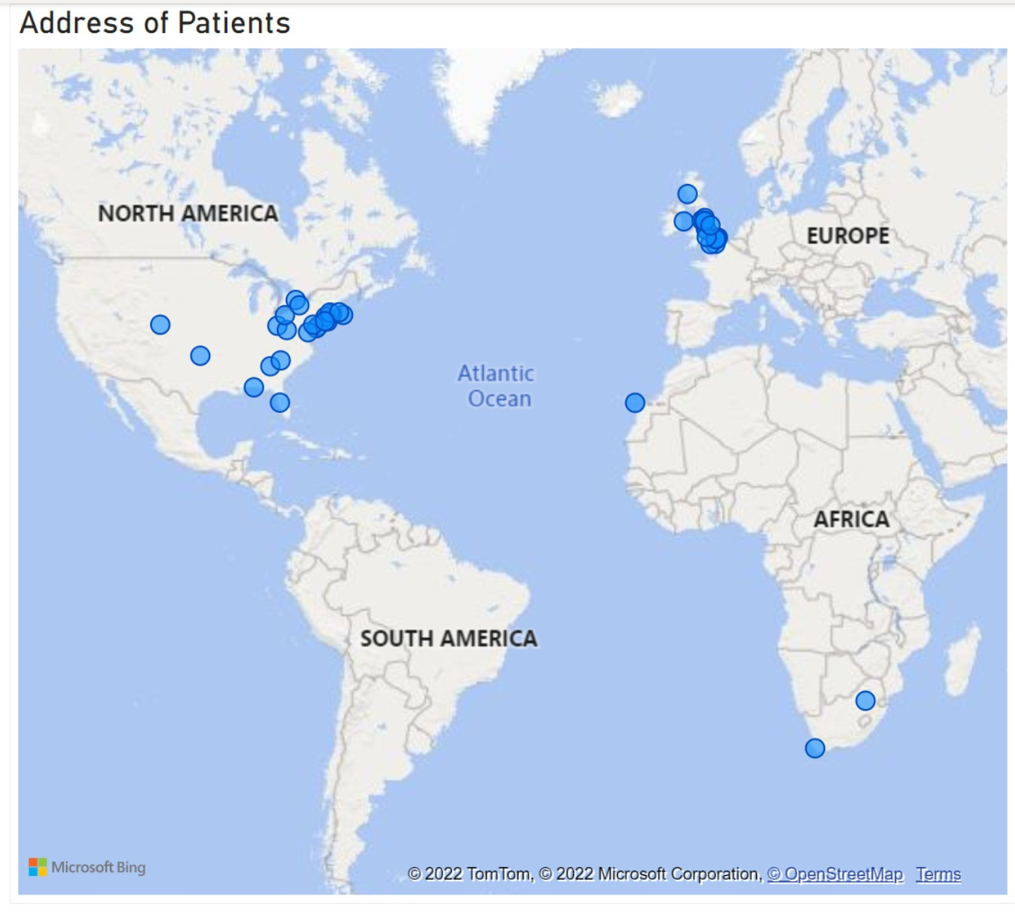
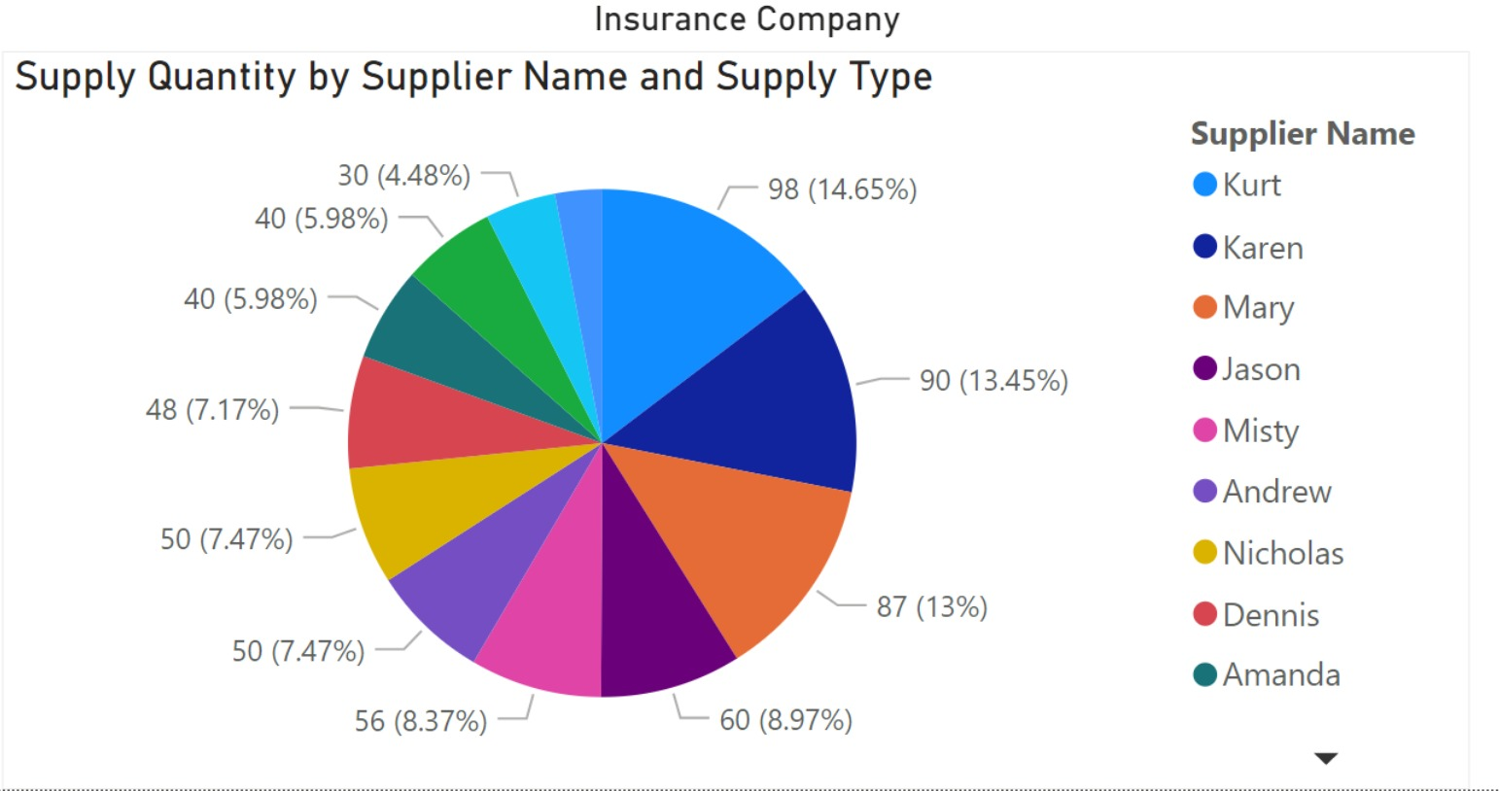
Power BI Data Visualizations:

Slide 15
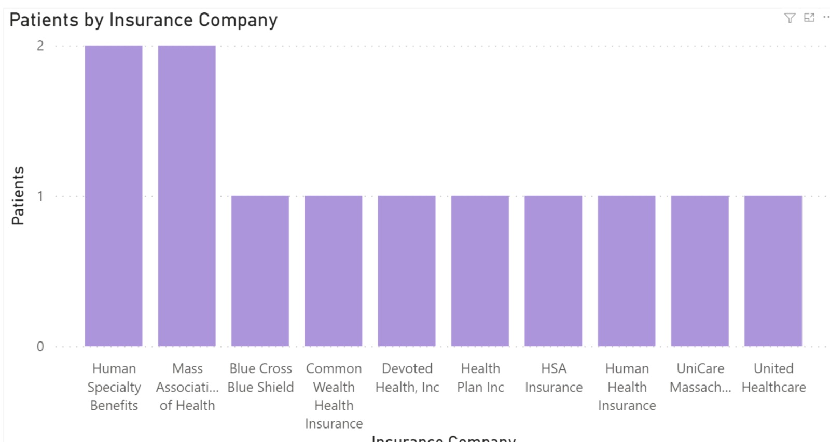
Power BI Data Visualizations:

Slide 16
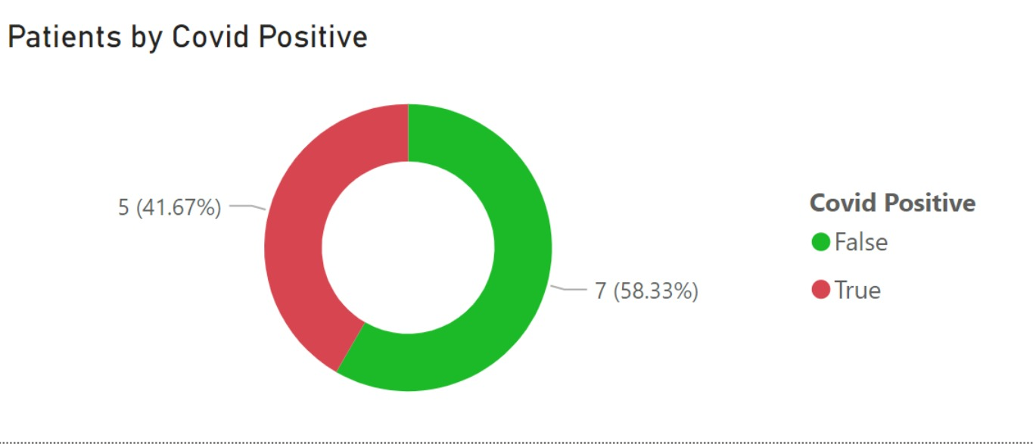
Power BI Data Visualizations:

Slide 17

Questions

Slide 18

- Team 14

