Slide 1
NFA

Slide 2
Intro to NFA
In NDFA, for a particular input symbol, the machine can move to any combination of the states in the machine. In other words, the exact state to which the machine moves cannot be determined. Hence, it is called Non-deterministic Automaton. As it has finite number of states, the machine is called Non-deterministic Finite Machine or Non-deterministic Finite Automaton.
Formal Definition of an NDFA
An NDFA can be represented by a 5-tuple (Q, ∑, δ, q₀, F) where −
Q is a finite set of states.
∑ is a finite set of symbols called the alphabets.
δ is the transition function where δ: Q × ∑ → 2^{Q}
(Here the power set of Q (2^{Q}) has been taken because in case of NDFA, from a state, transition can occur to any combination of Q states)
q₀ is the initial state from where any input is processed (q₀ ∈ Q).
F is a set of final state/states of Q (F ⊆ Q).

Slide 3
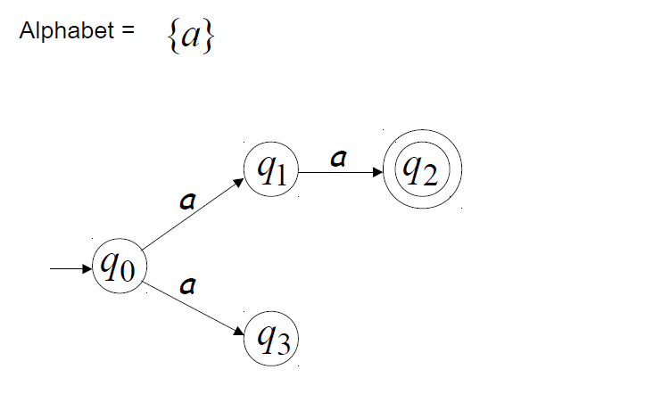
Example of NFA

Slide 4
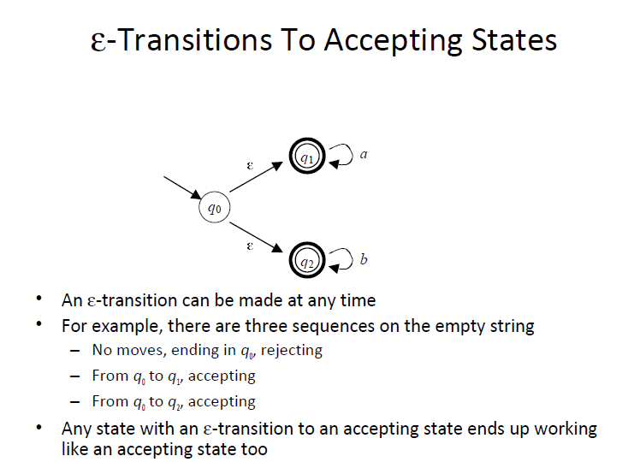

Slide 5
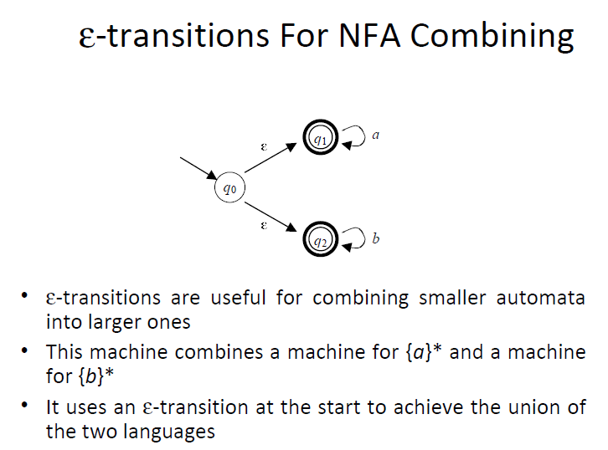

Slide 6
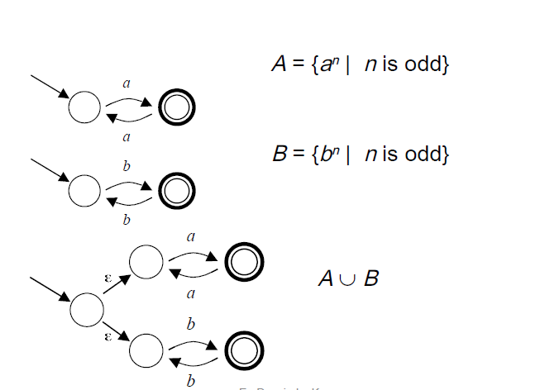
Example of Union

Slide 7
DFA | NFA
Deterministic Finite Automata | Nondeterministic Finite Automata
In DFA the next possible state is distinctly set. | In NFA each pair of state and input symbol can have many possible next states.
For every symbol of the alphabet, there is only one state transition in DFA | For every symbol of the alphabet, there may be more state transition in NFA. Or We do not need to specify how does the NFA react according to some symbol
DFA cannot use empty string transition. | NFA can use empty string transition,
It is more difficult to construct DFA. | NFA is easier to construct,
DFA requires more space | NFA requires less space.
DFA will reject the string if it ends at other than accepting state. | If all of the branches of NFA dies or rejects the string, we can say that NFA reject the string.
The transition function for DFA it is single valued. | The transition function for NFA i.e. delta is multi valued
δ is the input transition function where δ: Q × ∑ → Q | δ is the input transition function where δ: Q × ∑ → 2^{|Q|}

Slide 8
Question1-
Construct a NFA, that accepts the set of all strings over {a,b} where each string starts with ‘a’
Question2-
Construct a NFA, that accepts the set of all strings over {a,b} where each string contains ‘a’
Question3-
Construct a NFA, that accepts the set of all strings over {a,b} where each string ends with ‘a’

Slide 9
Question4-
Construct a NFA, that accepts the set of all strings over {a,b} where each string starts with ‘ab’
Question5-
Construct a NFA, that accepts the set of all strings over {a,b} where each string contains ‘ab’.
Question6-
Construct a NFA, that accepts the set of all strings over {a,b} where each string ends with ‘ab’

