Slide 1

Finance and Risk Analytics
Presented By
Sparsh Chaurasia
Sudeshna Mazumder
Anki Singha
(DS C-56: DA Track)

Slide 2
AGENDA
1. Objective
2. Methodology
3. Insights and Visualization
4. Portfolio Analysis

Slide 3
Objective
Our task is to evaluate a stock portfolio and provide investment management advice that aligns with the distinct objectives of two clients, Mr. Patrick Jyenger and Mr. Peter Jyenger.
Mr. Patrick Jyenger plans to invest $500,000 in equities. With a preference for conservative investment approaches, he aims to double his investment over the next five years, focusing on low-risk options to achieve steady capital appreciation.
Mr. Peter Jyenger intends to invest $1,000,000 in equities. Known for his aggressive investment style, he is targeting high-yield opportunities to double his capital within a five-year timeframe, despite the higher risk involved.

Slide 4
METHODOLOGY
EXPLORATORY DATA ANALYSIS:
Checked for Missing Data: The dataset was carefully examined for missing values, and it was confirmed that all columns contained complete data.
Outlier Detection: An analysis was conducted to identify any outliers or extreme values that could skew the results.
Data Imputation for Facebook (FB): Updated the dataset to assign a value of “0” for Facebook (FB) data before its NYSE listing on May 18, 2012, as there was no trading data available before this date.
DATA ANALYSIS:
Financial Calculations: Various financial metrics were calculated, including daily returns, cumulative daily returns, Sharpe ratios, portfolio risk, and return on investment (ROI), to perform a thorough analysis of the stock data.
Optimal Stock Identification: The best-performing stocks for all portfolios were identified based on the analysis.
Data Visualization: Utilized Power BI to create effective and insightful visualizations of the data.
Sector-Wise Analysis: Conducted an in-depth sector-wise analysis to gain a comprehensive understanding of the performance and characteristics of each sector.

Slide 5
METHODOLOGY
INFERENCES AFTER ANALYSING THE DATA:
High-Performing Stocks: Identified seven stocks that have achieved more than 80% returns over the past five years.
Top Stocks for Returns: The stocks that yielded the highest returns include AMZN, MSFT, AAPL, FB, UNH, GOOG, and MS.
Risk and Reward Assessment: Each stock was analyzed based on its annualized risk, Sharpe ratio, and cumulative returns to evaluate risk and reward profiles.
Amazon's Performance: Found that AMZN offers the highest returns among all stocks but comes with a higher risk compared to others.
Stable Returns with Lower Risk: Stocks like JNJ, RHHBY, MRK, and MSFT were identified as providing good returns with relatively lower risk.
Sector Performance: Technology was identified as the best-performing sector, followed by Finance. In contrast, the least performing sectors were Aviation and Health and Pharma.
Portfolio Finalization: Based on the analysis, the final portfolios were designed for both clients.

Slide 6
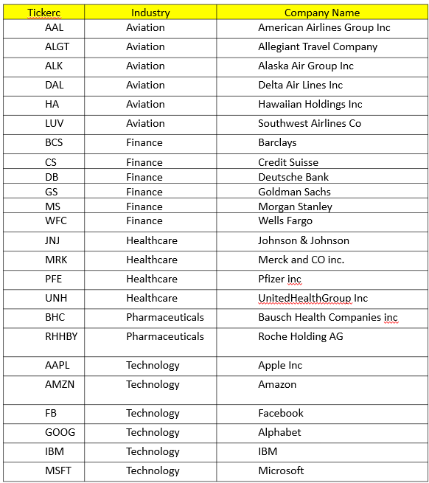
INSIGHTS AND VISUALIZATION
There are 24 stocks available from four sectors containing 6 stocks from each sector.
There is an index available to compare the stocks’ outcome with. S&P500 is a combination of the top 500 stocks in the US stock market.
Here is the list of stocks with their abbreviation and Industry and company name.

Slide 7
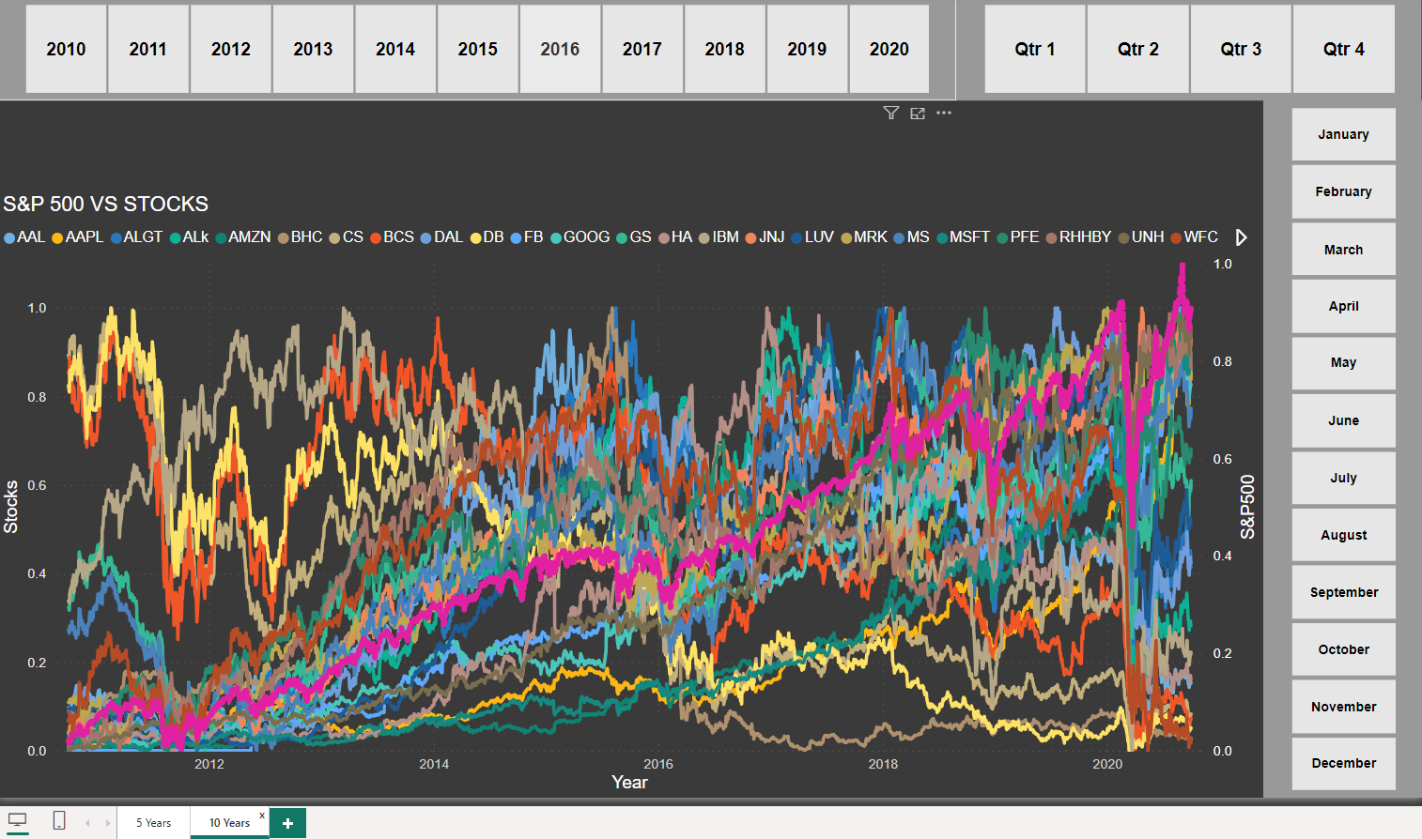
Visualization of Stocks after normalizing the values
The graph illustrates the performance of individual stocks in comparison to the S&P 500 index.
In this analysis, we've examined the ten-year trends in stock values for each listed company.
After reviewing the stocks, we noticed that Facebook went public on May 18, 2012.- Additionally, we've incorporated buttons into our dashboard to make sector-specific analysis easier.

Slide 8
Sector Wise Analysis
Aviation Sector
The S&P 500 does not show a strong correlation with the aviation sector.
The market experienced a significant downturn in 2020 due to the COVID-19 pandemic, resulting in a bear market.
Although the market eventually recovered, the aviation sector performed poorly.
In the aviation sector, Allegiant Travel Company, Delta Airlines, and Southwest Airlines stood out as noteworthy exceptions
Analysis using a pair plot indicates a positive correlation between Allegiant Travel Company and Delta Airlines.

Slide 9
Sector Wise Analysis
Finance SectorThe S&P 500 shows a strong positive correlation with the finance sector.
Despite the significant impact of the 2020 coronavirus pandemic on the market, both Morgan Stanley and Goldman Sachs were able to recover and outperform the sector; however, the majority of stocks were still negatively affected.
Additionally, it is evident that Goldman Sachs and Morgan Stanley are highly correlated when compared to other stocks.

Slide 10
Sector Wise Analysis
Pharma and Healthcare Sector
The S&P 500 has a positive correlation with the health and pharmaceutical sector, including companies like Johnson & Johnson, Merck & Co., and UnitedHealth Group.
During the pandemic, the health, pharmaceutical, and technology sectors experienced rapid expansion after the market crash, outperforming other industries.
Bausch Health Companies Inc. has shown stagnant growth over the past five years.
In summary, the health and pharmaceutical sector has exhibited robustness compared to the S&P 500.

Slide 11
Sector Wise Analysis
Technology Sector
The S&P 500 shows a strong correlation with the technology sector, which includes companies such as Amazon, Facebook, Microsoft, Google, and Apple.
During the pandemic, the tech sector notably rebounded compared to other sectors.
All stocks, with the exception of IBM, have surpassed market performance.
Additionally, all stocks, excluding IBM, demonstrate significant correlations with each other.

Slide 12
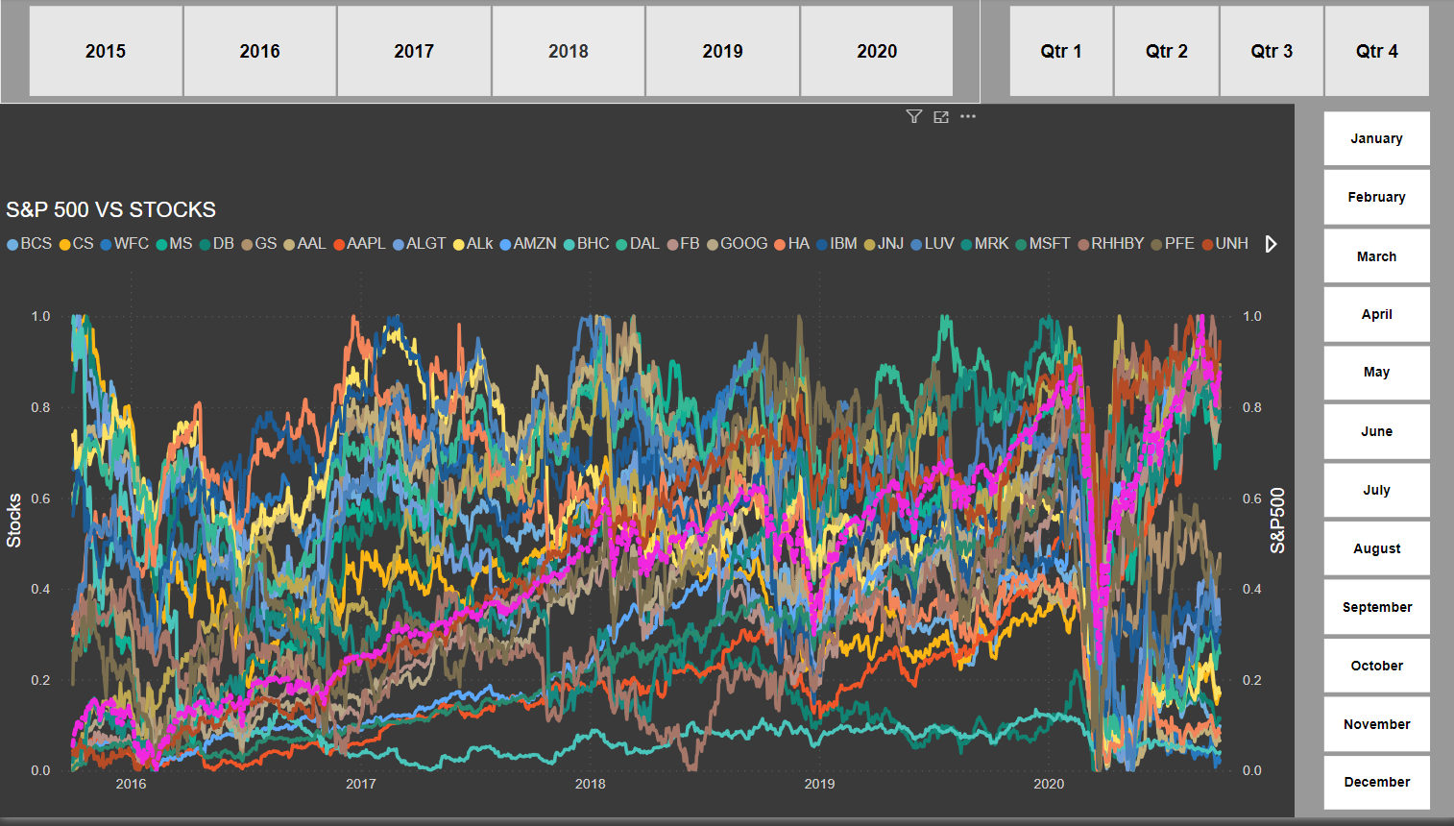
Visualization of stocks (Past 5 Years)
As we had to perform analysis on past 5 years stocks data we have also created a dashboard with the stock of past 5 years.

Slide 13
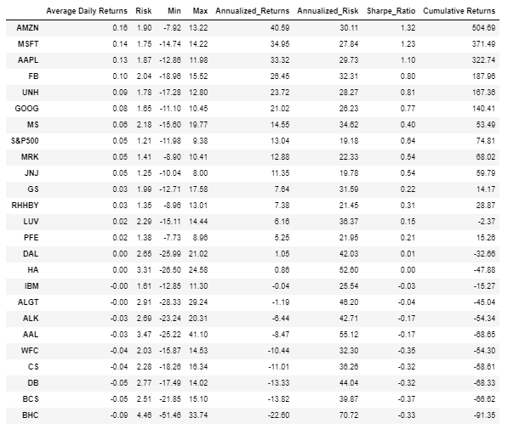
Insights: Top 8 Performers Over 5 Years Based on Annual Returns
Amazon provides 40.59% annual returns.
Microsoft delivers 34.95% annual returns.
Apple offers 33.32% annual returns.
FaceBook generates 26.45% annual returns.
United Health Group yields 23.72% annual returns
Google produces 21.02% annual returns.
Morgan Stanley achieves 14.55% annual returns.
Merck and CO returns 12.88% annually.

Slide 14
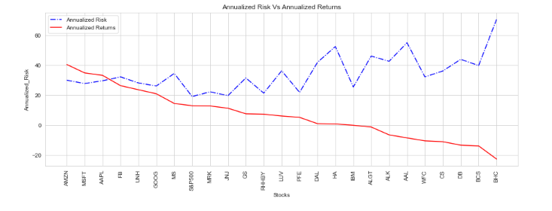
Annualized Return & Annualized Risk
The top five stocks by annualized return are AMZN, MSFT, AAPL, FB, and UNH, each boasting annualized returns exceeding 20%.
Despite their strong performance, their risk levels remain moderate compared to other equities.
There's a correlation between decreasing return and an increased likelihood of losing money, underscoring the importance of balancing risk with potential gains.
Some stocks, such as BHC, BCS, DB, CS, and WFC, pose higher risks due to their inability to provide a return on investment at the time of investing.
Generally, riskier companies tend to offer lower returns, though there are exceptions where certain stocks provide relatively risk-free investment opportunities despite offering modest returns.
Stocks like JNJ, RHHBY, and MRK stand out for offering favorable returns with minimal associated risk, presenting attractive investment opportunities for risk-averse investors.

Slide 15
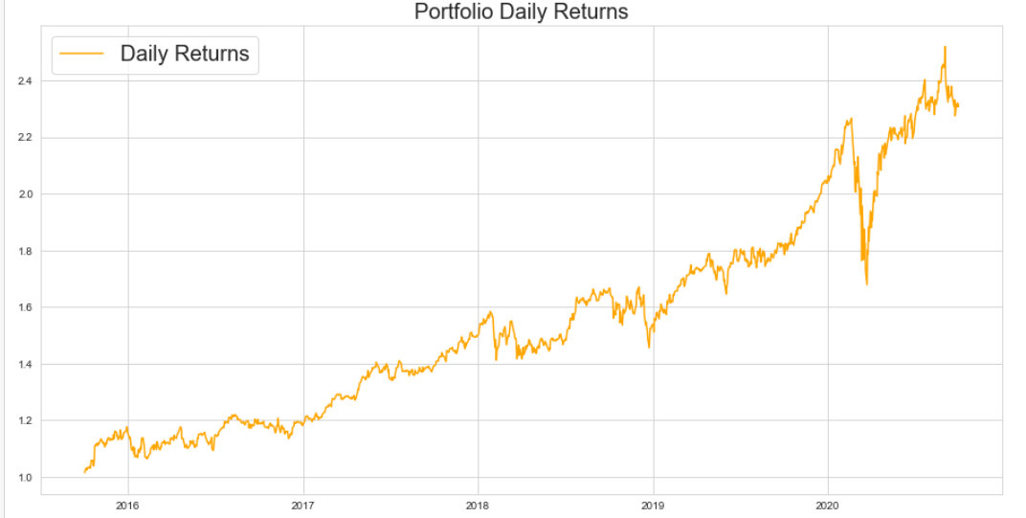
PORTFOLIO ANALYSIS
Patrick Jyengar Portfolio
Mr. Patrick Jyengar aims to double his investment within five years.
He is looking for low-risk stocks with favorable returns to achieve his financial goal.
Based on his risk profile, he finds stocks like Johnson & Johnson, Roche Holding, and Google suitable for investment.
As the combined returns from these stocks may not be enough to meet his target, Mr. Patrick Jyengar could diversify his portfolio by investing in Microsoft to help achieve the desired returns.

Slide 16
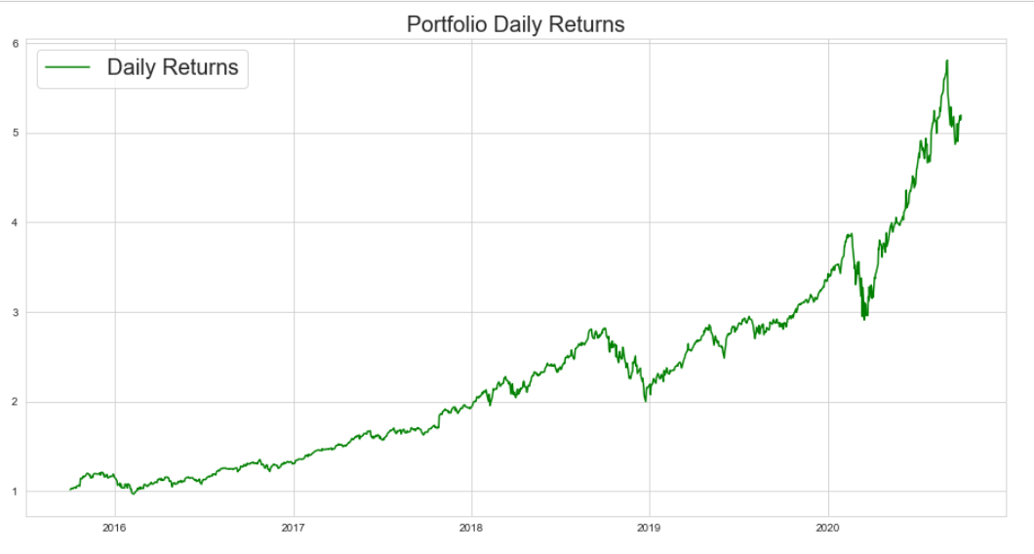
PORTFOLIO ANALYSIS
Peter Jyengar Portfolio
Mr. Peter Jyengar prefers high-return investments and has a high-risk appetite, believing he can recover from occasional losses, demonstrating a resilient investment approach.
He plans to invest $1 million from the company's cash reserves in high-margin stocks, with the expectation of significant returns within five years to fuel his company's expansion.
Given his high-risk tolerance and desire for high returns, Mr. Peter Jyengar considers stocks like Amazon, Microsoft, and Apple as suitable investment options.
Investing in stocks such as Amazon, Microsoft, and Apple could potentially provide Mr. Peter Jyengar with maximum returns while effectively managing associated risks.

Slide 17


