Slide 1
VerifyMe
By : Team Stimulus

Slide 2
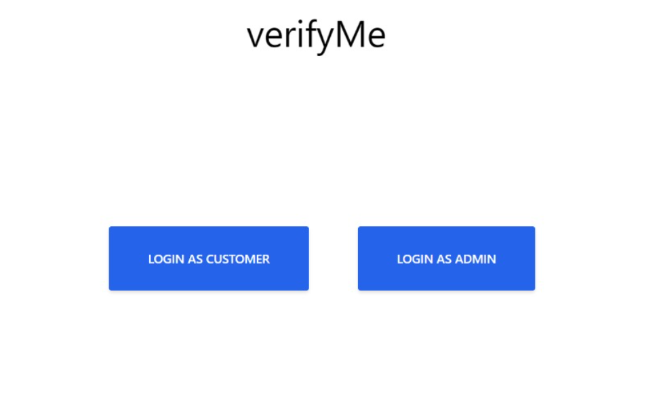

Slide 3
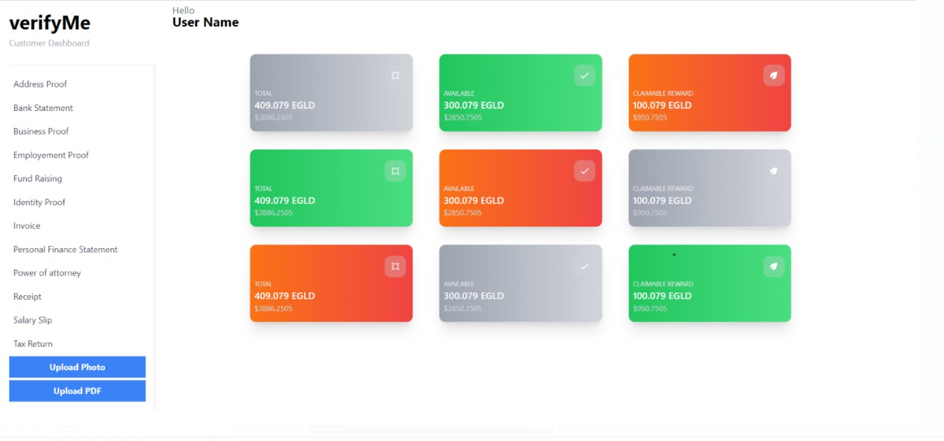

Slide 4
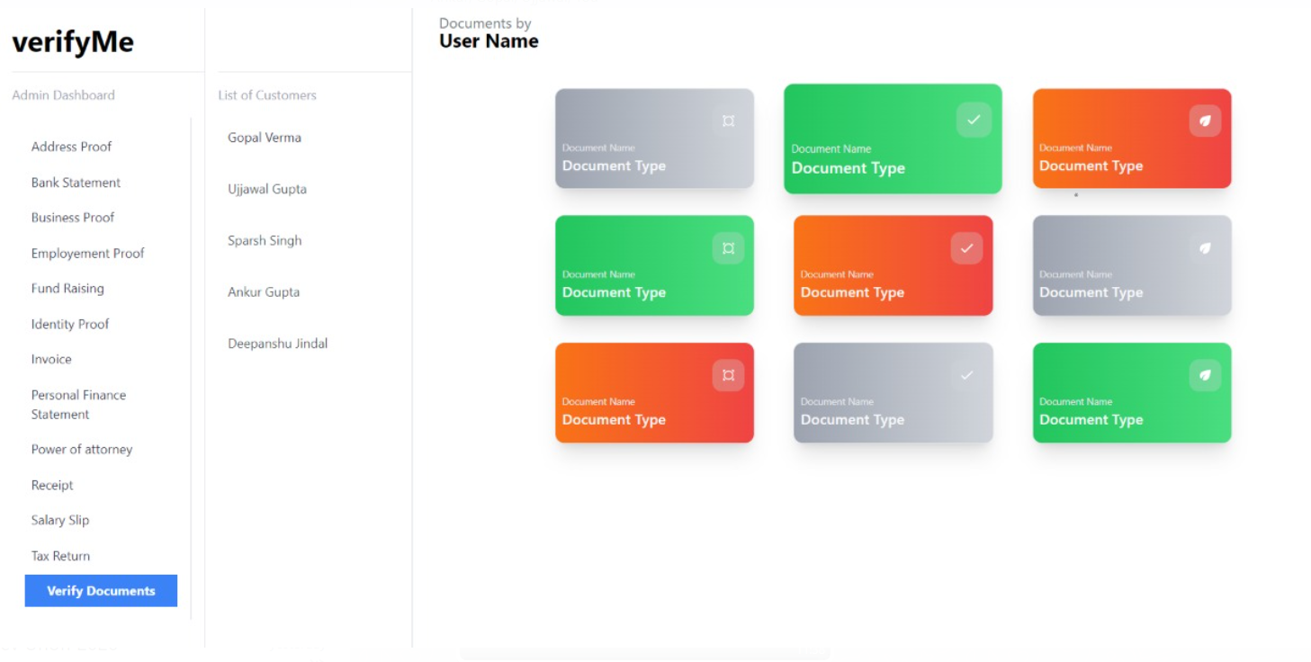

Slide 5
Machine Learning Model
Our model has the capability to straight away give the class label to which the image belong.
We were able to achieve 75 % accurate results.
Pytesseract and Pillow For reading the image.
Pytorch and Transformer for tokenization and encoding the images and there classes.
https://colab.research.google.com/drive/1zUYWm-c6iOKpYjKRZnIDXdtPC02dbIty#scrollTo=oPraN6ybP5t6

Slide 6
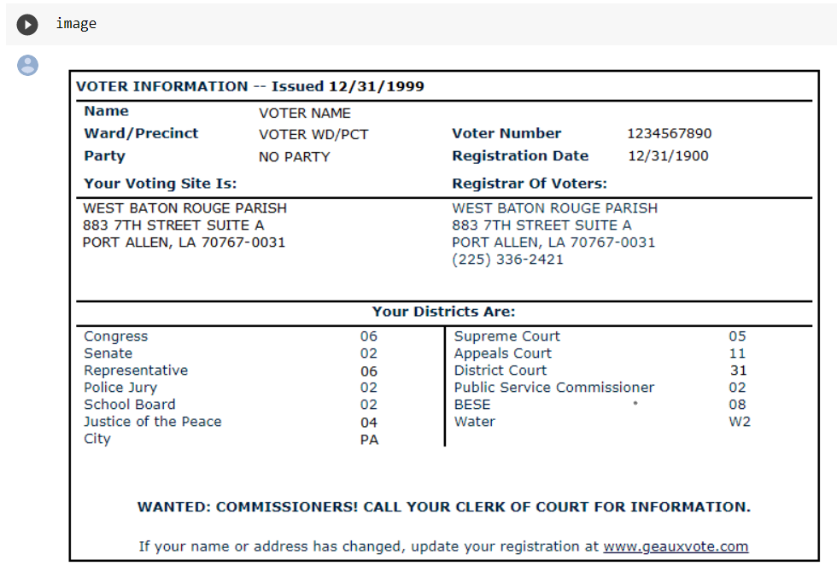
Demo Of Machine Learning Model:
Loading the image to be classified

Slide 7
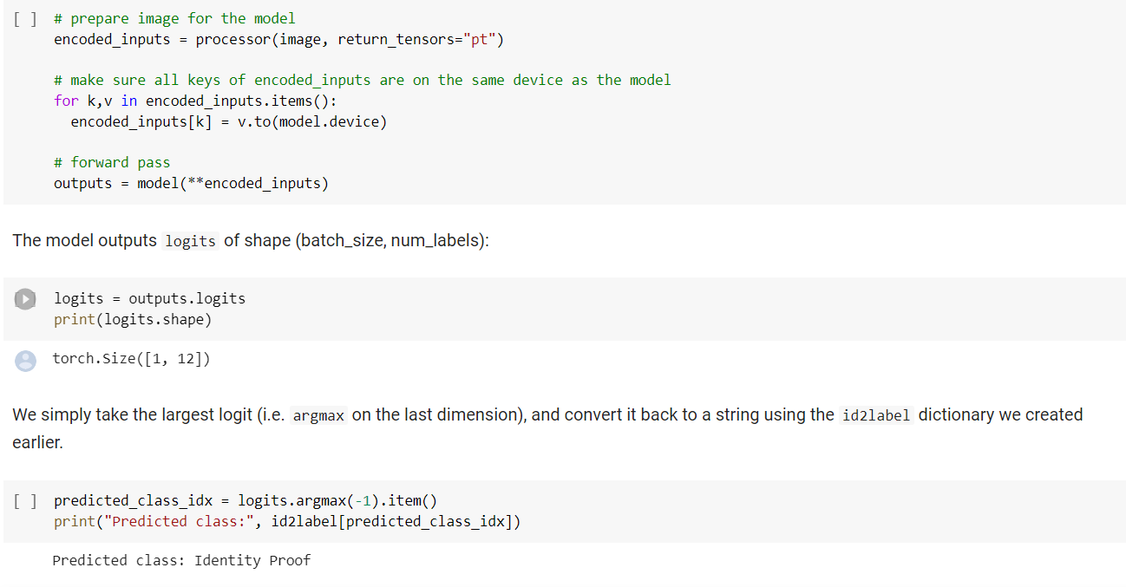

Slide 8
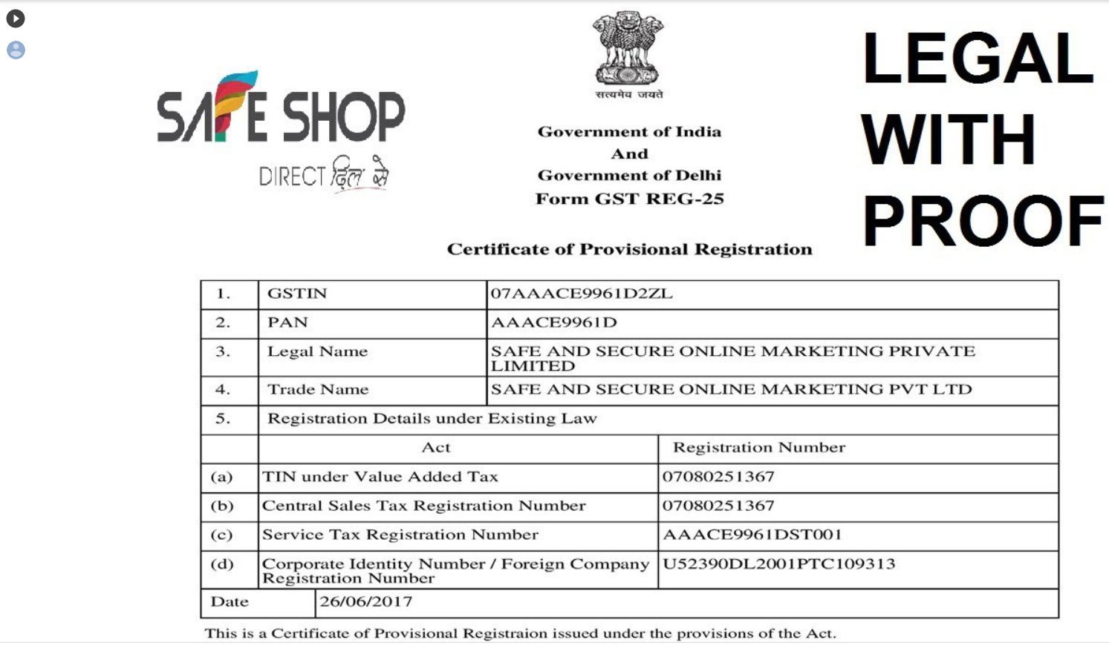
This is a Bussiness related Document..

Slide 9
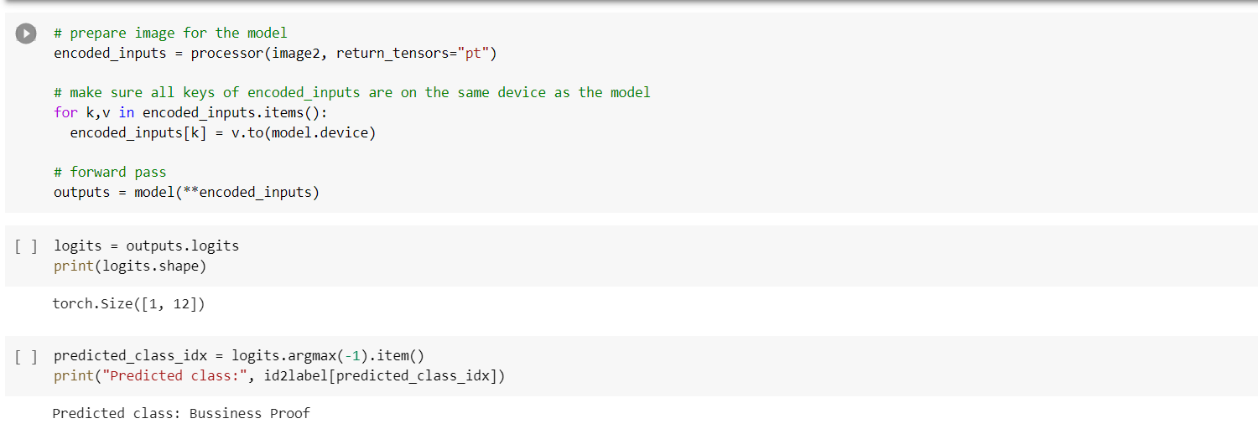
Predicted Class: Bussiness Proof…

Slide 10
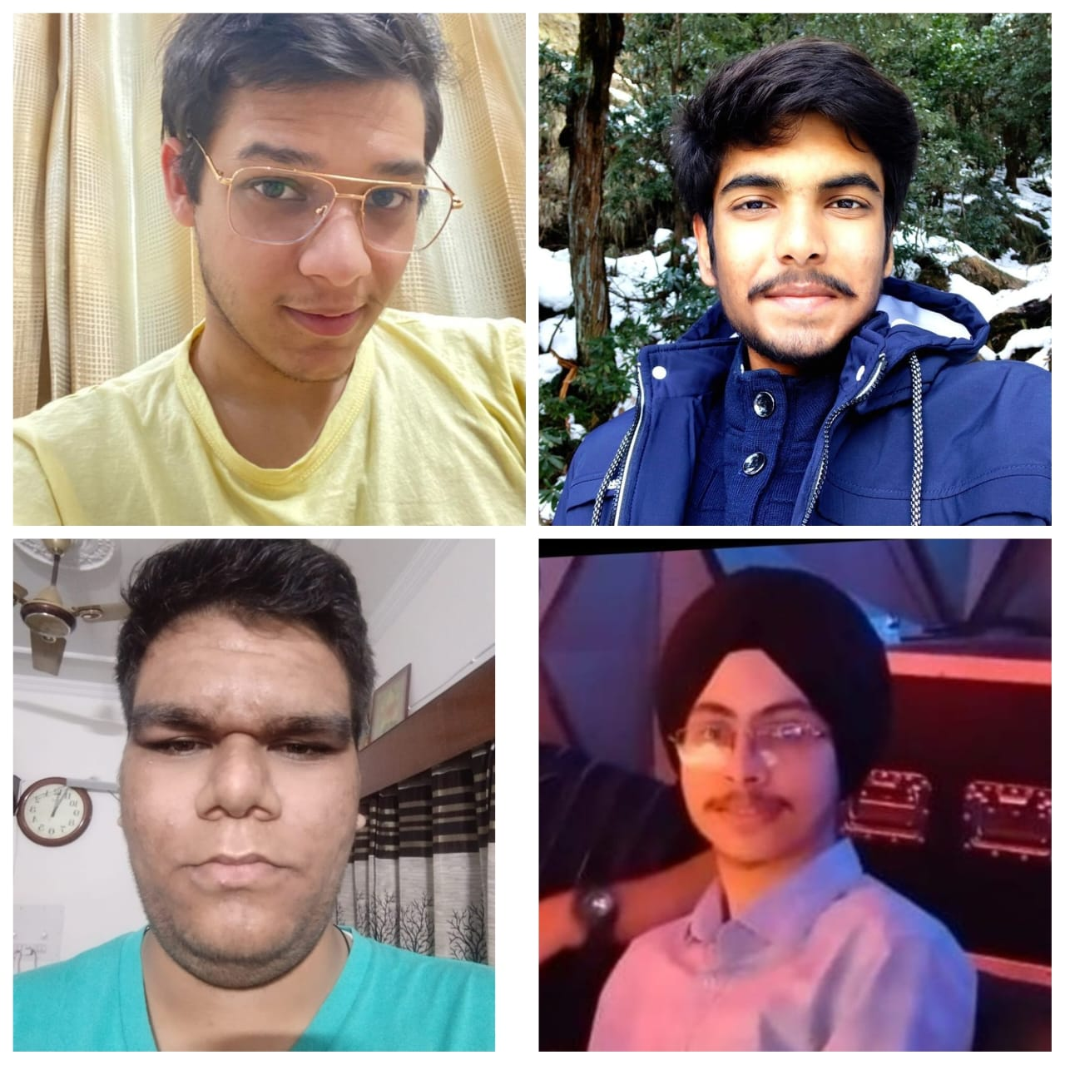
Thank You
Team Members:
Ujjawal Gupta(Pec)
Ankur Gupta(Pec)
Gopal Verma(Pec)
Sparsh Singh(Pec)

