Slide 1
Hack DAY
Therabot

Slide 2
THERABOT
As the name suggests, we went on making a bot which could help people deal with mental instability and stress in their lives by acting as a sort of “virtual therapist”.
The main implementation of bot was done in Python and the training data was fetched from various forums where strangers tried to help other strangers in their mental troubles.

Slide 3
Why Therabot?
A study in the US revealed that nearly 7% of the population went through some sort of depressing episode in the past year.
Given the way our Modern Society exists, they are plenty of reasons to suggest that the number wont be much lower for rest of the world.
There is a big scarcity of professional psychiatrists specially in India.
Sometimes people are not comfortable communicating their problems and tribulations with friends or family. This is where we hope Therabot can help.

Slide 4
THEME
The theme under which this project was thought of was the theme of “MODERN SOCIETY”. In a society where competition is ever increasing along with stress and workload, and where it is hard to have someone you can trust with your heart, it can become difficult to feel at the best of your mental health.
While most tech is dedicated towards physical health, our bot tries to cater to the mental health of individuals and help them feel better about there feelings.

Slide 5
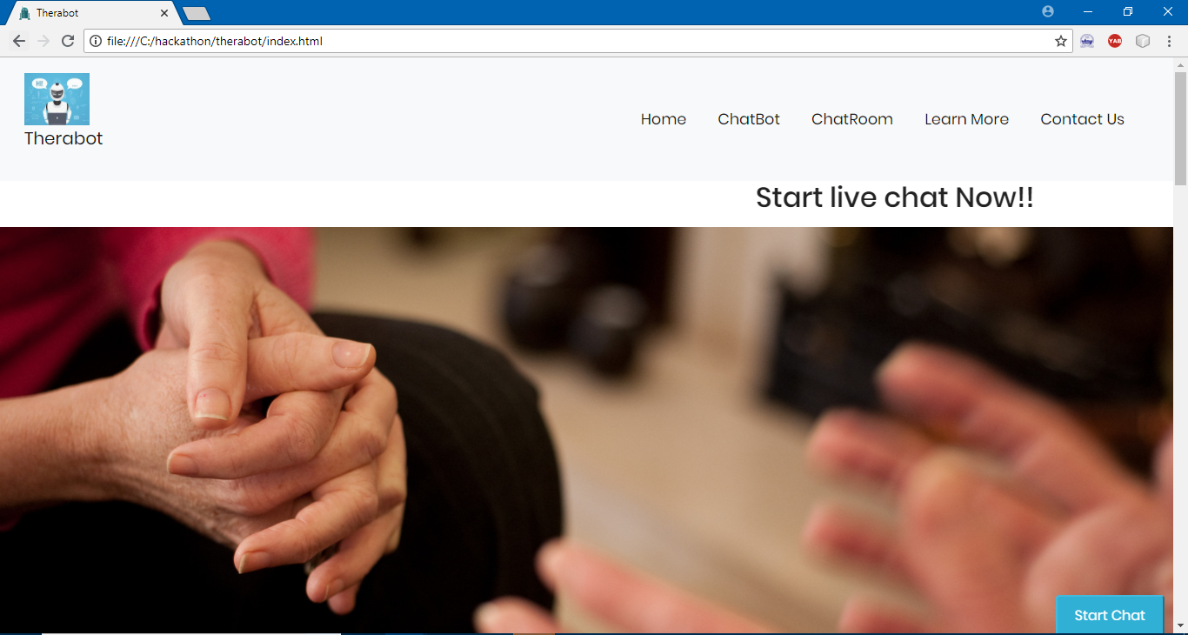

Slide 6
Features of Therabot
Chatbot
Online bot
Our online bot terabot is a chatbot which is made for immediate couselling of patients,they can put up any question and our bot will give reply to them in no time
Chatroom
Our Professional Psychiatrists will be available 24*7 to provide online therapy to our patients. We provide this chatroom as a platform, where our customers can take online therapy sessions from our expert therapists .

Slide 7
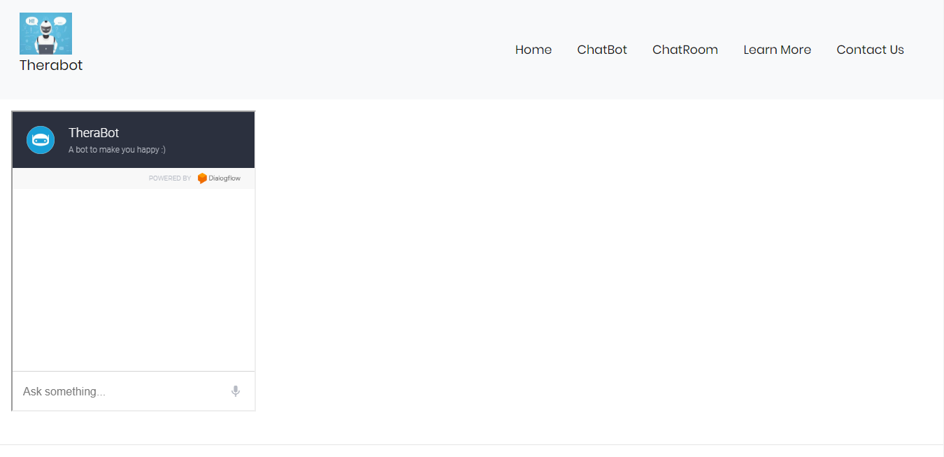
Chatbot

Slide 8
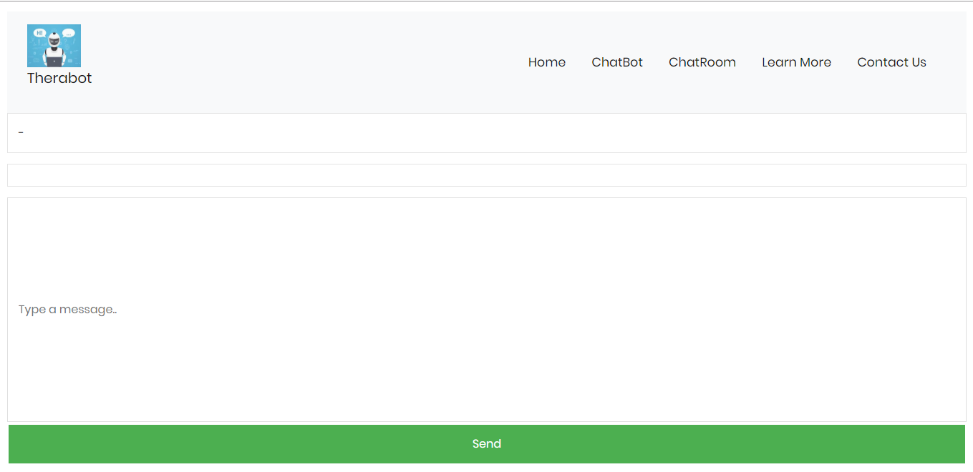
Chatroom

Slide 9
Thank You
Mandeep Verma-16bce1188
Sparsh Agarwal-16bce1116
Prateek Goyal-16bce1038

