Slide 1



Visual Cryptography
Sparsh Gupta, Mark Belanger, Sidney Taylor
Notes:
Sid

Slide 2


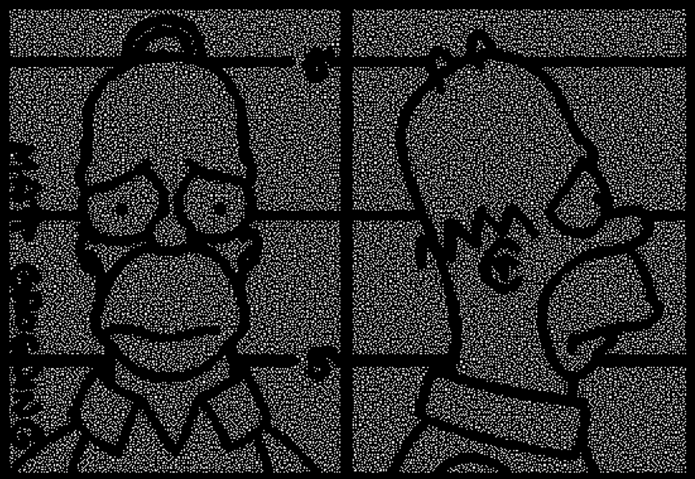
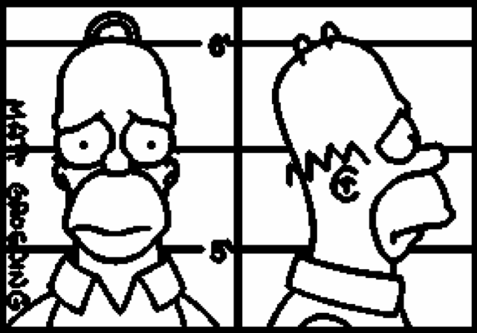



$$⋮$$
Less than k shares
overlayed
k shares overlayed
(decrypted image)
Original image
[5]
n encrypted shares
Notes:
Sid
Idea of visual cryptography is to encrypt an image by breaking it down into shares
We have our original image. It can broken up into n number of shares. If k-1 (or anything less than k) shares are overlayed, we still do not get the encrypted picture. However, if k shares are overlayed, we get the decrypted image.

Slide 3
Shamir’s Visual Cryptography Scheme
Notes:
Sid

Slide 4



How White Pixels are Handled
Shares are made of the same subpixel arrangement
$$\left[\begin{matrix}1 & 0 \\ 1 & 0\end{matrix}\right]$$
Share 1
$$\left[\begin{matrix}1 & 0 \\ 1 & 0\end{matrix}\right]$$
White Pixel
$$\left[\begin{matrix}1 & 0 \\ 1 & 0\end{matrix}\right]$$
Shares 1 & 2 Overlayed
Share 2
Notes:
Sid:
One pixel can be converted into 4 sub-pixels, and these sub-pixels can be represented with a matric. When you overlay these 2 sets of sub-pixels, it is conducting an OR type operation, meaning if at least one of the entries is black, it becomes the dominant face.
For white pixels, the shares overlayed in such a way that 2 sub-pixels remain white and 2 sub-pixels are black. (explain that this is what cause the loss of contrast in decrypted image.)

Slide 5



How Black Pixels are Handled
Shares are made of reciprocal subpixel arrangements
$$\left[\begin{matrix}1 & 0 \\ 1 & 0\end{matrix}\right]$$
Share 1
$$\left[\begin{matrix}1 & 1 \\ 1 & 1\end{matrix}\right]$$
Black Pixel
Shares 1 & 2 Overlayed
$$\left[\begin{matrix}0 & 1 \\ 0 & 1\end{matrix}\right]$$
Share 2
Notes:
Sid
For black pixels, the shares overlayed in such a way that all subpixels in the overlay are black, and this can be done by taking shares that are complementary.

Slide 6
Pixel Expansion (Black Pixel Shares)
Each pixel is broken into sub-pixels, and that get encoded
Diagonal
Shares
Horizontal
Shares
Vertical
Shares
Notes:
Sparsh
Explain how the previous encoding into sub-pixels is basically the pixel expansion scheme.
Also, explain that these are different combinations (different types of shares: diagonal, horizontal, vertical) that can be represented by matrices.

Slide 7



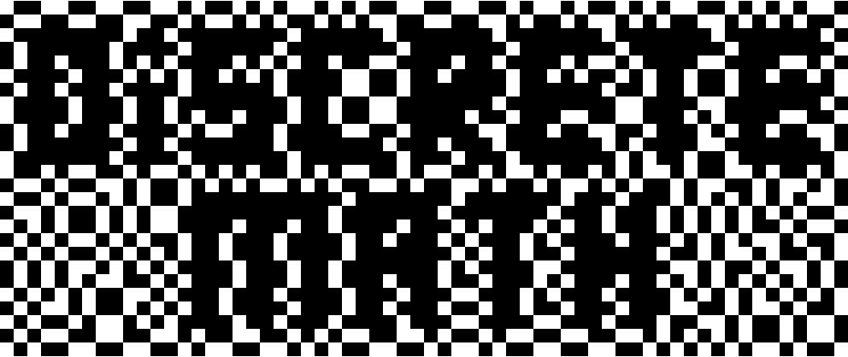
Shamir’s scheme Example (PIXEL Expansion)
Share 2
Share 1
Notes:
Sparsh
Explain the example by using the concepts built in last 4 slides and then highlight how the example is working by focusing on one white and one black pixel.

Slide 8









General Pixel encoding MATRIX (for 2 shares)
Share 1
$$\left[\begin{matrix}1 & 1 \\ 0 & 0\end{matrix}\right]$$
$$\left[\begin{matrix}1 & 1 & 0 & 0\end{matrix}\right]$$
$$\left[\begin{matrix}1 & 1 & 0 & 0 \\ 1 & 1 & 0 & 0\end{matrix}\right]$$
C₀ = all the matrices obtained by permuting the columns of this matrix
$$\left[\begin{matrix}1 & 1 \\ 0 & 0\end{matrix}\right]$$
White Pixel
$$\left[\begin{matrix}1 & 1 & 0 & 0\end{matrix}\right]$$
Share 2
Share 1
$$\left[\begin{matrix}1 & 1 \\ 0 & 0\end{matrix}\right]$$
$$\left[\begin{matrix}1 & 1 & 0 & 0\end{matrix}\right]$$
$$\left[\begin{matrix}1 & 1 & 0 & 0 \\ 0 & 0 & 1 & 1\end{matrix}\right]$$
C₁ = all the matrices obtained by permuting the columns of this matrix
Black Pixel
$$\left[\begin{matrix}0 & 0 \\ 1 & 1\end{matrix}\right]$$
$$\left[\begin{matrix}0 & 0 & 1 & 1\end{matrix}\right]$$
Share 2
Notes:
Sparsh

Slide 9



k out of n scheme – Decoding Shares
S₀ / S₁ = s_{i, j} (m x n)
$$\left[\begin{matrix}0 & 1 & 1 & 0 & 1 & 0 & 1 & 1 & 0 & 1 & 0 & . & . & .\end{matrix}\right]$$
$$\left[\begin{matrix}1 & 0 & 1 & 0 & 1 & 1 & 1 & 0 & 0 & 1 & 0 & . & . & .\end{matrix}\right]$$
$$\left[\begin{matrix}0 & 1 & 1 & 0 & 1 & 1 & . & . & . \\ 1 & 0 & 1 & 0 & 1 & 1 & . & . & . \\ 0 & 1 & 0 & 1 & 1 & 0 & . & . & . \\ 1 & 1 & 0 & 0 & 1 & 0 & . & . & . \\ 0 & 1 & 1 & 0 & 0 & 1 & . & . & . \\ . & . & . & . & . & . & . & & \\ . & . & . & . & . & . & & . & \\ . & . & . & . & . & . & & & .\end{matrix}\right]$$
$$\left[\begin{matrix}0 & 1 & 0 & 1 & 1 & 0 & 0 & 1 & 1 & 1 & 0 & . & . & .\end{matrix}\right]$$
n
shares
$$⋮$$
$$⋮$$
$$\left[\begin{matrix}1 & 1 & 0 & 0 & 1 & 0 & 1 & 1 & 0 & 1 & 1 & . & . & .\end{matrix}\right]$$
m pixels
$$\left[\begin{matrix}0 & 1 & 1 & 0 & 0 & 1 & 0 & 1 & 0 & 1 & 0 & . & . & .\end{matrix}\right]$$
S₀ => white pixel shares
S₁ => black pixel shares
n shares
Each share has m pixels
Notes:
Sparsh

Slide 10






k out of N scheme - Decrypting Image
If H(V) <= d
Column vector V
If H(V) < d - $αm$
$$\left[\begin{matrix}0 & 1 & 1 & 0 & 1 & 0 & . & . & . \\ 1 & 0 & 1 & 0 & 1 & 1 & . & . & . \\ 0 & 1 & 0 & 1 & 1 & 0 & . & . & . \\ 1 & 1 & 0 & 0 & 1 & 0 & . & . & . \\ 0 & 1 & 1 & 0 & 0 & 1 & . & . & . \\ . & . & . & . & . & . & . & & \\ . & . & . & . & . & . & & . & \\ . & . & . & . & . & . & & & .\end{matrix}\right]$$
(where H(V) is the hamming weight of V,
0 <= d <= m and $α$ > 0)
S₀ =
$$α=\frac{1}{2^{k−1}}$$
$$\left[\begin{matrix}0 & 1 & 1 & 0 & 1 & 0 & . & . & . \\ 1 & 1 & 1 & 0 & 1 & 1 & . & . & . \\ 0 & 1 & 1 & 1 & 1 & 0 & . & . & . \\ 1 & 1 & 1 & 0 & 1 & 1 & . & . & . \\ 1 & 1 & 1 & 0 & 0 & 1 & . & . & . \\ . & . & . & . & . & . & . & & \\ . & . & . & . & . & . & & . & \\ . & . & . & . & . & . & & & .\end{matrix}\right]$$
$$\left[\begin{matrix}0 & 0 & 1 & 1 & 1 & 0 & . & . & . \\ 1 & 1 & 0 & 0 & 0 & 1 & . & . & . \\ 0 & 0 & 1 & 0 & 1 & 0 & . & . & . \\ 0 & 1 & 1 & 0 & 0 & 1 & . & . & . \\ 1 & 0 & 1 & 0 & 0 & 1 & . & . & . \\ . & . & . & . & . & . & . & & \\ . & . & . & . & . & . & & . & \\ . & . & . & . & . & . & & & .\end{matrix}\right]$$
$$\left[\begin{matrix}10 & 21 & 5 & 23 & 35 & 8 & 27 & 19 & . & . & .\end{matrix}\right]$$
S₁ =
Boolean OR result
(between each row of S₀ and S₁)
Notes:
Sparsh

Slide 11
What if we expand this algorithm for color images?

Slide 12
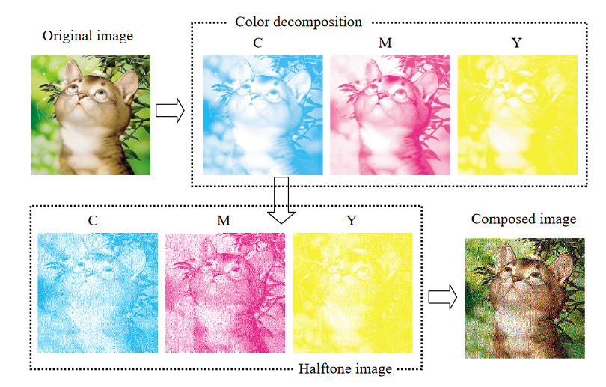
Decomposing Color Images
Color images can be represented using combinations of cyan, magenta, and yellow
=
+
+
Red
(0, 1, 1)
Cyan
0
Magenta
1
Yellow
1
[4]
Notes:
Many color images can be represented using combinations of cyan, magenta, and yellow. This is how most color printers print color. For example, the color red can be represented by combining magenta and yellow but no cyan.
We can take advantage of this fact by encrypting according what parts of CMY should be visible and what parts should be not visible

Slide 13




How It Works
Decompose image into CMY (i.e each pixel looks something like (1, 0, 1))→ pixel-by-pixel encryption into the 4 shares with pixel expansion
Cyan Share
Magenta Share
Yellow Share
Black Share
[4]
Notes:
Like Shamir’s method, color encrypting breaks a message into multiple shares that can be overlayed to get the original message. This method also still uses pixel expansion. By contrast, this scheme only allows 4 shares to be made and all 4 are needed to reveal the original message
The algorithm starts by having a message image decomposed into its cyan, magenta, and yellow weights. So each pixel would be represented by 3 weights with 1 representing if the color is present and 0 if it is not
This scheme also encrypts pixel by pixel with some randomness and starts with the black share

Slide 14
Creating the black Share
Step 1: Select one of these for each pixel:
Notes:
For each pixel, one of the black subpixel groups is selected at random. Each subpixel group has 2 black subpixel and 2 white/transparent subpixels. The other 3 shares are selected based upon what black subpixel group is selected and take advantage of the fact that overlayed subpixels under the black subpixels in the black share will be covered while those under the white/transparent will be shown

Slide 15
Arrangement of Color Shares
Depends on the black share
CMY fills white space depending on if it needs to be shown
Notes:
If a color in the pixel needs to be shown, then the subpixel group of the CMY shares will be chosen to have the color portions correspond the white/transparent subpixels of the black share’s subpixel group. If the color should not be shown, then the colored subpixels will be under the black share's black subpixels.
These on the screen would result in a white pixel, which is 2 white subpixels and 2 black subpixels, since all the colored pixels correspond to the black subpixels of the black share. The white pixel is still half black

Slide 16
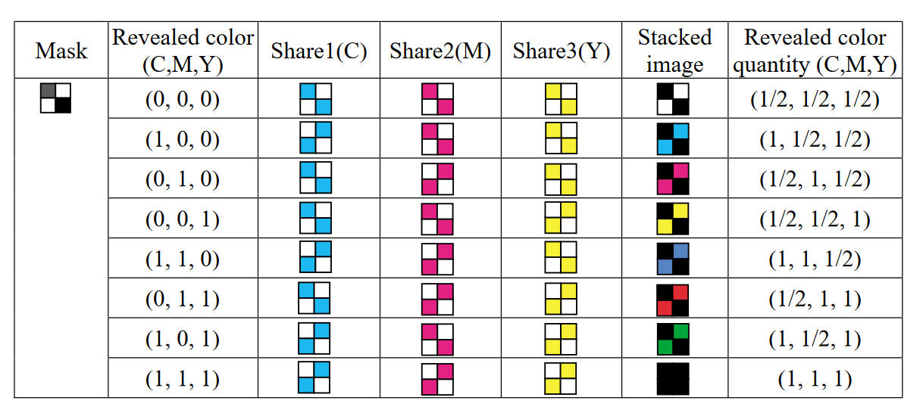
Colors that can be Created
[4]
Notes:
A total of 8 colors can be made
Other than white, black, cyan, magenta, and yellow → blue, red, and green can be made
Black is the only color that is full since all the remaining colors are half black. This results in a decrease in contrast that you will see later

Slide 17
Red Pixel Example
If black share subpixel group is
+
+
+
=
Red
(0, 1, 1)
Cyan
0
Magenta
1
Yellow
1
Cyan must be covered by black since Cyan weight = 0
Notes:
Sid
For example, red requires magenta and yellow to be mixed and overlayed to output red. If cyan is present the resulting color would not be red so the cyan must be colored. In this example, the black subpixel group selected for a pixel has the 2 left subpixels black and 2 right subpixels white/transparent. Since it’s formed of magenta and yellow, the colored portions of their respective subpixel groups will be selected so that they correspond with the white/transparent. Cyan however cannot be present so the colored part of the cyan subpixel group must correspond to the black part of the black share’s subpixel group. This means that magenta and yellow will be shown but cyan will not

Slide 18

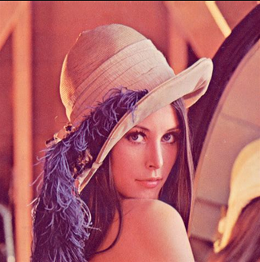
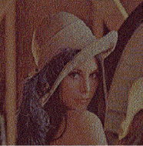
Color Image Visual Cryptography Example
Cyan Share
Magenta Share
Original image
Decrypted image
Yellow Share
Black Share
[4]
Notes:
Sid
This is an example. The quality of the image is decreased and part of it is due to the pixel expansion and the fact that every pixel has 2 black subpixels, naturally decreasing the overall resolution. As you can see by the image of the zoomed in cyan share, each different coloured share has its respective colour and white, to ensure that when they are overlayed the original representation is accurately represented. By overlaying each of the shares, we can decrypt the image to arrive

Slide 19
Thank you! Questions?

Slide 20
References
[1] https://www.cs.jhu.edu/~fabian/courses/CS600.624/NaorShamir-VisualCryptography.pdf
[2] https://www.researchgate.net/publication/353374619_An_overview_of_visual_cryptography_techniques
[3] https://www.ciphermachinesandcryptology.com/en/visualcrypto.htm
[4] https://www.sciencedirect.com/science/article/pii/S0031320302002583#SEC3
[5] https://homes.esat.kuleuven.be/~fvercaut/talks/visual.pdf
[6] https://fardapaper.ir/mohavaha/uploads/2018/12/Fardapaper-A-Comprehensive-Study-of-Visual-Cryptography.pdf
[7] https://www.101computing.net/visual-cryptography/

