Slide 1

Quiz Time

Slide 2
Hello!
Quiz Time
Submitted To:- Submitted By:-
Mr.Pankaj Kapoor Sparsh Gupta

Slide 3
About Quiz Time:-
The purpose of On-Line Examination System is to take online examination in an efficient & effective way & no time wasting for checking the paper. The main objective of Online Examination System is to efficiently evaluate the candidates’ examination thoroughly through a fully administrative system that not only saves lot of time but also provides fast results in case of any consideration. It is cost effective and time effective . Students are provided the flexibility to choose among different types of aptitude and programming language tests.

Slide 4


Hardware And Software Used
RAM:- 4.00GB
Processor:- Intel(R)Core(TM) i3-4005U CPU @ 1.70GHz
Chrome and Edge for Testing
VS Code text editor
Google firebase for authentication ,hosting and storage purpose
Github,Git bash
Technologies Used:-HTML,CSS,JAVASCRIPT

Slide 5

HTML
HTML is not a programming language; it is a markup language that defines the structure of your content. HTML consists of a series of elements , which you use to enclose, or wrap, different parts of the content to make it appear a certain way, or act a certain way. The enclosing tags can make a word or image hyperlink to somewhere else, can italicize words, can make the font bigger or smaller, and so on.

Slide 6
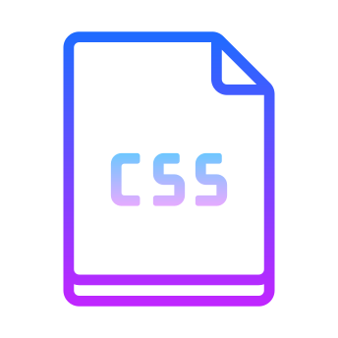
CSS
CSS is short for Cascading Style Sheets, and is the preferred way for setting the look and feel of a website. Cascading Style Sheets (CSS) is a markup language responsible for how your web pages will look like. It controls the colors, fonts, and layouts of your website elements. This style sheet language also allows you to add effects or animations to your website. You can use it to display some CSS animations like click button effects, spinners or loaders, and animated backgrounds. Without CSS, your website will appear as a plain HTML page. The cascading means that a style applied to a parent element will also apply to all children elements within the parent. For example, setting the colour of body text will mean all headings and paragraphs within the body will also be the same colour.

Slide 7

Javascript
JavaScript is a client-side scripting language of web developed by Netscape in 1995 with the name LiveScript. JavaScript is used to build interactive websites with dynamic features and to validate form data. JavaScript is high-level, dynamic and browser interpreted programming language, supported by all modern web browsers. Apart from web browser, JavaScript is also used to build scalable web applications using Node JS. JavaScript is also being used widely in game development and Mobile application development.
JavaScript is also known as the Programming Language of web as it is the only programming language for Web browsers. JavaScript is an object-based scripting language which is lightweight and cross-platform. The programs in this language are called scripts. They can be written right in a web page’s HTML and run automatically as the page loads. Scripts are provided and executed as plain text. They don’t need special preparation or compilation to run. The browser has an embedded engine sometimes called a “JavaScript virtual machine”.

Slide 8
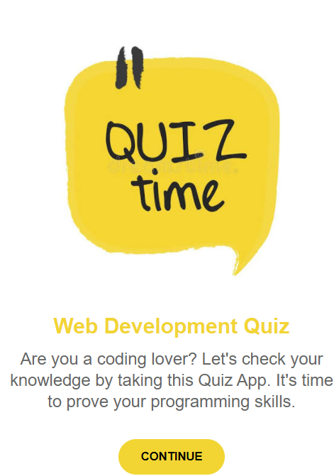
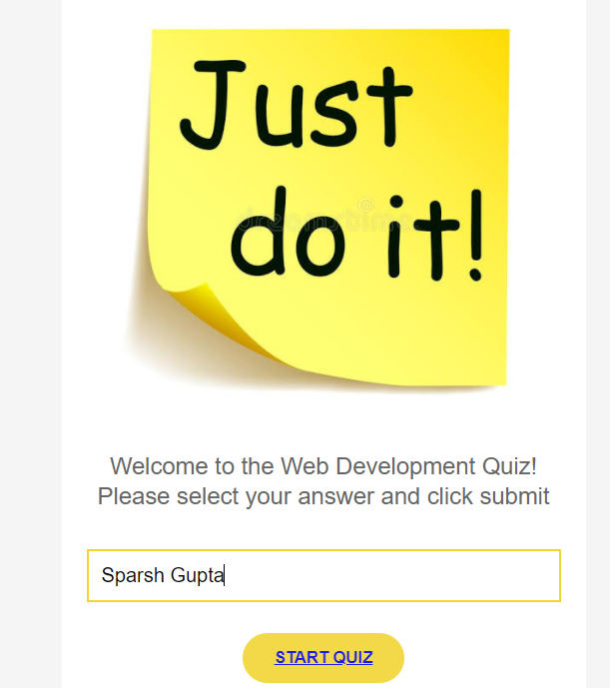
snas
Snapshots

Slide 9
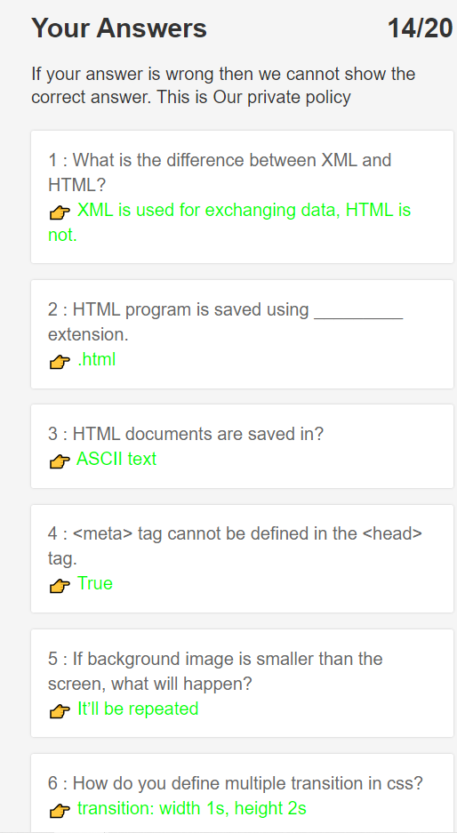
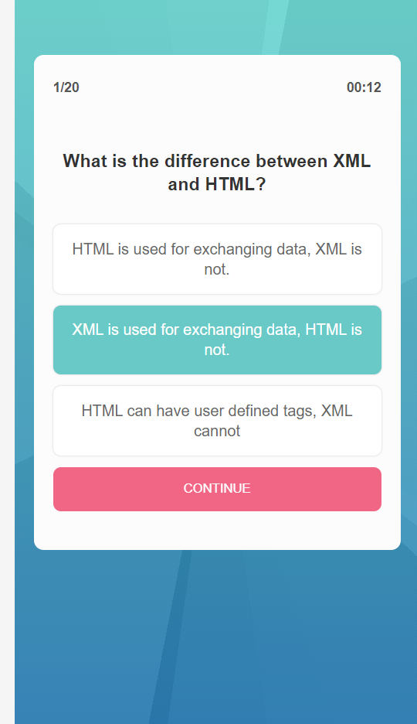
Snapshots

Slide 10
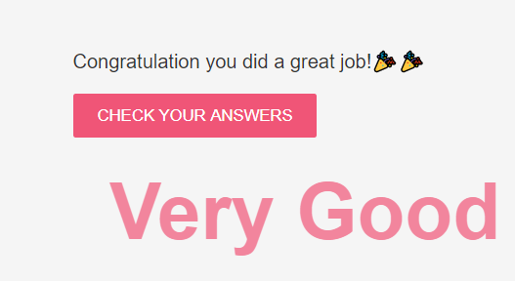

Slide 11
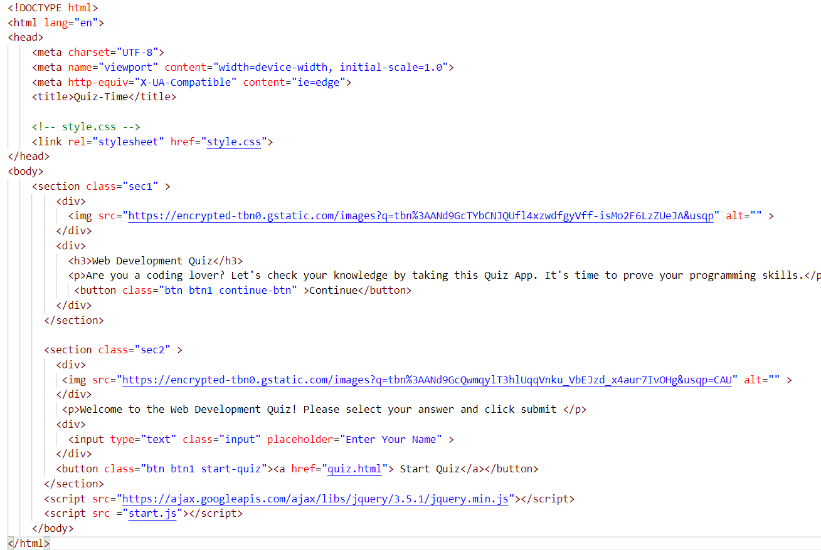
Screenshots of code

Slide 12
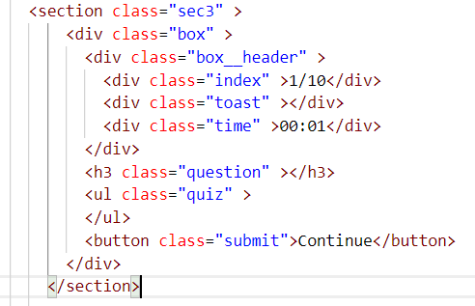
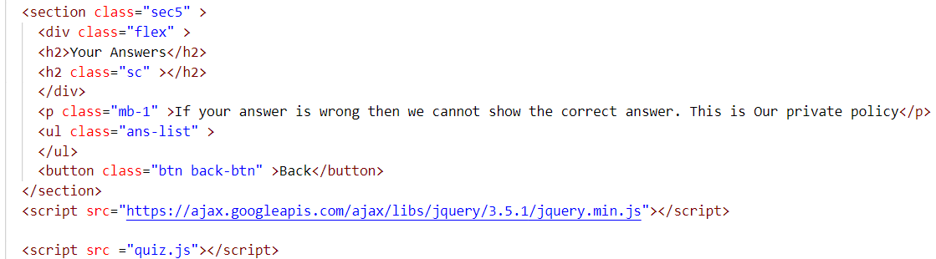

Slide 13

Benefits:-
No instructor needed
Better overview
Assists in Memorizing
You can quiz large numbers of employees all at once
Improved overview of the workforce

Slide 14
Thanks!
Any questions?
You can find us at:
sparsh.gupta_cs18@gla.ac.in
Github id:-sparshgupta2212

