Slide 1
PRABHAV
GRIEVANCE REDRESSAL SYSTEM
Team members-
Vishal Yadav-2000290120194
Shruti Gautam-2000290120155
Yuvraj Narayan Mishra-2000290120200
Project guide-
Prof. Pallavi Sharma

Slide 2
PROBLEM STATEMENT
As India inches towards becoming a clean and digital country under schemes like Swachh Bharat Abhiyaan and Digital India, it becomes imperative that people have convenient means of communicating their grievances related to cleanliness in their neighbourhood, overflowing drainage and garbage bins, unauthorized construction, etc. People prefer to neglect these issues as nobody wants to spend their time standing in long queues and waiting for the authorities to address their issues.

Slide 3
SOLUTION DESCRIPTION
This in turn encourages the authorities to turn a blind eye to their problems. Consider a scenario where a society is facing overflowing drains and garbage bins or if there are uncovered potholes and other related issues that need immediate response. Then these problems can be directly addressed through this website or app with the help of geo-tagging facility so that authorities can efficiently locate and solve these issues with just a click. Our initiative can act as a bridge between the public and the concerned bodies. This will be very helpful for authorities also as they can have direct access to problems of society. So no queues and no negligence.

Slide 4
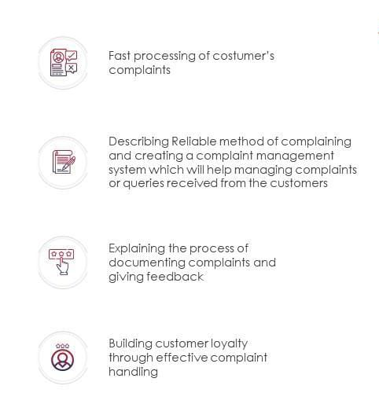

OBJECTIVE

Slide 5
METHODOLOGY
CLOUD COMPUTING PLATFORM LIKE – AWS
FOR STORAGE
HOSTING WEBSITES ON AWS
WEB DEVELOPMENT USING -
HTML
CSS
JAVASCRIPT
BOOTSTRAPPING

Slide 6
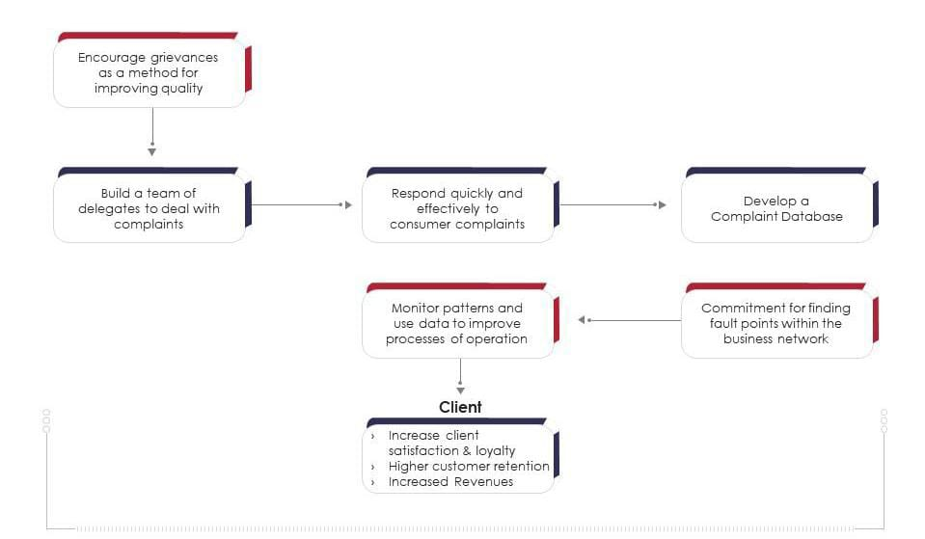
FLOWCHART

Slide 7
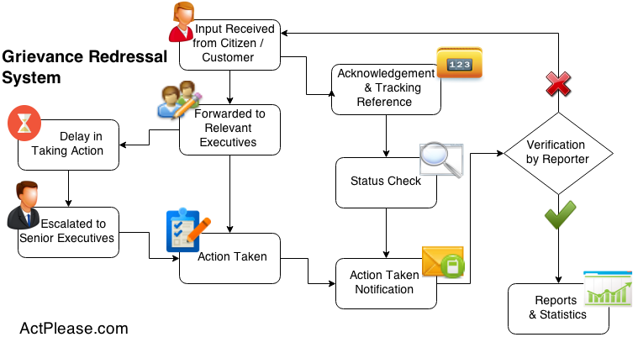
WORKING MODEL

Slide 8
SERVICES
Services for users :
User creates an account.
Verifies his/her Aadhaar number by OTP verification.
User files complaints under various categories.
Geo-tagging is used to pin-point the location.
Complaint is auto-escllated on expiry of due date.
Services for administrator :
Admin is provided with a dashboard where assigned , pending and completed complaints are shown .
A graphical representation of the statistics of the complaints within his/her jurisdiction.
Admin can assign the subordinates depending on the type of problem.
Service level architecture (SLA), can be specified for certain categories.
Auto assignment of concerned officer in case user fills in all the details properly.
SMS notifications to assigned person, with details on where to report.

Slide 9
CONCLUSION
We have introduced an online platform which is based on cloud computing.
Cloud for hosting website increased reliability of website i.e. Minimize Downtime.
Cloud computing services ensure better speed and consistent performance which helps user to get rid of the problem fastly.

Slide 10
THANK YOU!!

