Slide 1

DEPARTMENT OF COMPUTER SCIENCE Project Presentation (KCS 851) CLICK - AI Virtual Mouse PCS24 - 67
Guide Name: Asst. Prof. Vivek Kumar Sharma
Project Members :
1. Sparsh Dagar, 2000290120163, 8C
2. Suryansh Shukla, 2000290120171, 8C
3. Sumit Agrawal, 2000290120167, 8C

Slide 2
Problem Statement
Traditional computer mouse and touchpad interfaces can be limiting in terms of precision and accessibility for various users.
The objective of this project is to develop an AI-powered virtual mouse system that can offer a more intuitive, precise, and adaptable pointing and clicking experience for users across different devices and scenarios.
This AI virtual mouse should address issues related to input accuracy, user comfort, and accessibility, ultimately enhancing user interaction with digital interfaces.

Slide 3
Objectives
Enhanced Precision: Develop an AI virtual mouse system that offers superior pointing and clicking accuracy compared to traditional input methods.
Accessibility: Ensure the AI virtual mouse is accessible to users with physical disabilities by offering customizable input methods and support for alternative input devices.
Gesture Recognition: Enable gesture recognition capabilities, allowing users to perform common mouse functions through intuitive eye and lip movements.

Slide 4
Objectives
Adaptive Sensitivity: Implement dynamic sensitivity adjustments to accommodate user preferences and different tasks, such as graphic design, gaming, or text editing.
Natural Interaction: Create a virtual mouse that mimics natural eye and lip movements to reduce user fatigue and discomfort during prolonged use.

Slide 5
Technology Used
Programming Language:
Python: Often used for machine learning and AI development.
Computer Vision Libraries:
OpenCV: Useful for tasks involving image and video processing, such as tracking hand movements or detecting gesture.
IDE:
Pycharm
Automation and Input Simulation:
Autopy: Utilize the Autopy library for automating tasks related to mouse input simulation, such as moving the virtual mouse cursor and simulating clicks and keystrokes.
Data Processing and Manipulation:
NumPy: Integrate NumPy for efficient data processing and manipulation, especially when working with arrays or matrices of input data, such as image or sensor data for AI model training.

Slide 6
Literature Survey-1
Title: Deep Learning-Based Real-Time AI Virtual Mouse System Using Computer Vision to Avoid COVID-19 Spread.
Author: S. Shriram
Journal Name: AI and healthcare
Year of Publishing: 2021
Summary: This research paper talks about the main objective of the AI virtual mouse system. It is used to control the mouse cursor functions by using the hand gestures instead of using a physical mouse. The proposed system can be achieved by using a webcam or a built-in camera which detects the hand gestures and hand tip and processes these frames to perform the particular mouse functions. From the results of the model, we can come to a conclusion that the proposed AI virtual mouse system has performed very well and has a greater accuracy compared to the existing models and also the model overcomes most of the limitations of the existing systems. Since the proposed model has greater accuracy, the AI virtual mouse can be used for real-world applications, and also, it can be used to reduce the spread of COVID-19, since the proposed mouse system can be used virtually using hand gestures without using the traditional physical mouse

Slide 7
Literature Survey-2
Title: Cursor Control System Using Hand Gesture Recognition
Author: Nilesh J Uke
Journal Name: Artificial intelligence
Year of Publishing: 2013
Summary: This research papers talks about the technique which has been proposed to increase the adaptability of the system. We have developed a system to control the mouse cursor and implement its function using a real time camera. The goal of this project is to create a system that will recognize the hand gestures and control the computer/laptop according to those gestures. The project will also benefit the mobile systems where using pointing devices like mouse is difficult. Before actual implementing gesture comparison algorithms, skin pixel detection and hand segmentation from stored frames need to be done. The project is also developed in such a way that the user, new to the system will just have to install the set up and not run the whole project.

Slide 8
Literature Survey-3
Title: Cursor Control System Using Hand Gesture Recognition
Author: L. Somas
Journal Name: Artificial intelligence
Year of Publishing: 2018
Summary: This research papers is based on technology which has wide applications in the fields of augmented reality, computer graphics, computer gaming, prosthetics, and biomedical instrumentation. Digital Canvas is an extension of our system which is gaining popularity among artists, by which the artist could create 2D or 3D images using the Virtual Mouse technology using the hand as brush and a Virtual Reality kit or a monitor as display set. This technology can be used to help patients who don’t have control of their limbs. In case of computer graphics and gaming this technology has been applied in modern gaming consoles to create interactive games where a person’s motions are tracked and interpreted as commands.

Slide 9
Literature Survey-4
Title: A review of human–computer interaction and virtual reality research fields in cognitive InfoCommunications
Author: J. Katona
Journal Name: Applications of Cognitive Infocommunications
Year of Publishing: 2021
Summary: This research papers talks about the human–computer interaction (HCI) and virtual reality (VR) research fields in CogInfoCom during the eight-year period from 2012 to 2020 based on the International Conference on Cognitive Infocommunications and its special issues. These works were classified in terms of application areas into two categories:
Human-computer interaction and
Virtual reality
The study provided a brief overview of the results published and most cited in the two most important research areas of the CogInfoCom discipline based on the International Conference on Cognitive Infocommunications and its special issues.

Slide 10
Literature Survey-5
Title: Realtime computer vision with OpenCV.
Author: K. Pulli, A. Baksheev, K. Kornyakov, and V. Eruhimov
Journal Name: Applications of OpenCV
Year of Publishing: 2012
Summary: This research paper talks about the use and application of OpenCV in Real time computer vision. Computer vision is a rapidly growing field devoted to analyzing, modifying, and high-level understanding of images. Its objective is to determine what is happening in front of a camera and use that understanding to control a computer or robotic system, or to provide people with new images that are more informative or esthetically pleasing than the original camera images. Application areas for computer-vision technology include video surveillance, biometrics, automotive, photography, movie production, Web search, medicine, augmented reality gaming, new user interfaces, and many more.

Slide 11
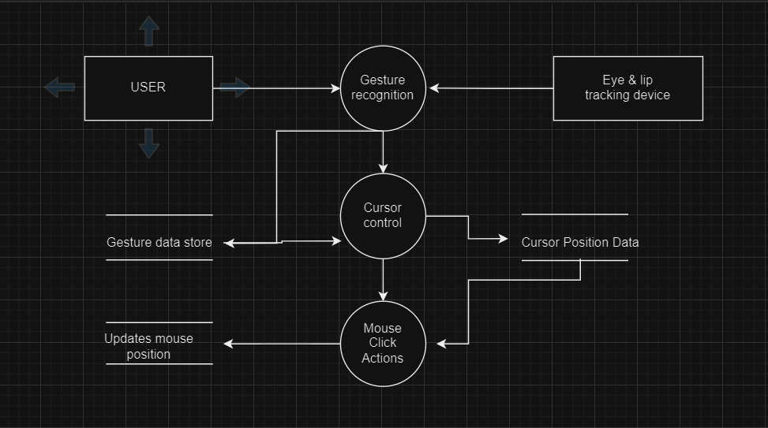
Diagrams
Data Flow Diagram

Slide 12
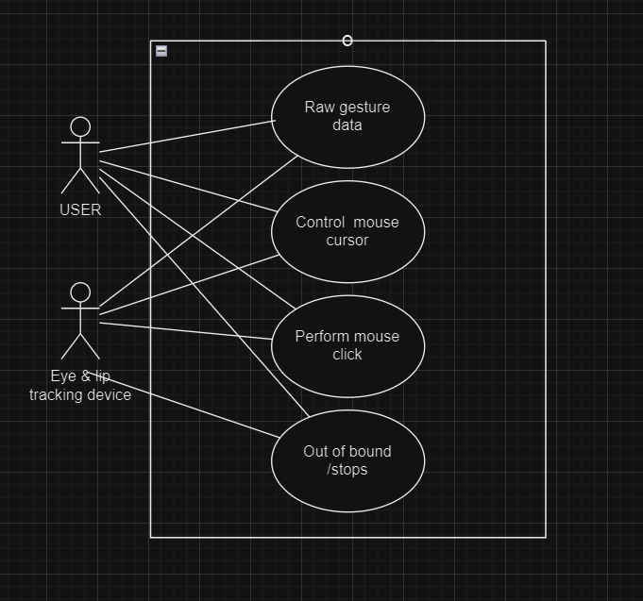
Diagrams
Use Case Diagram

Slide 13
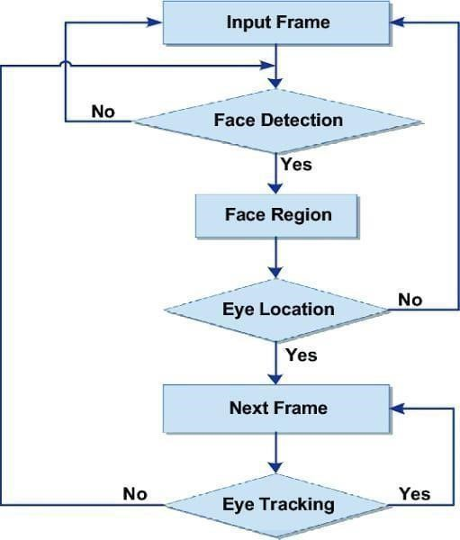
Diagram
Flowchart

Slide 14
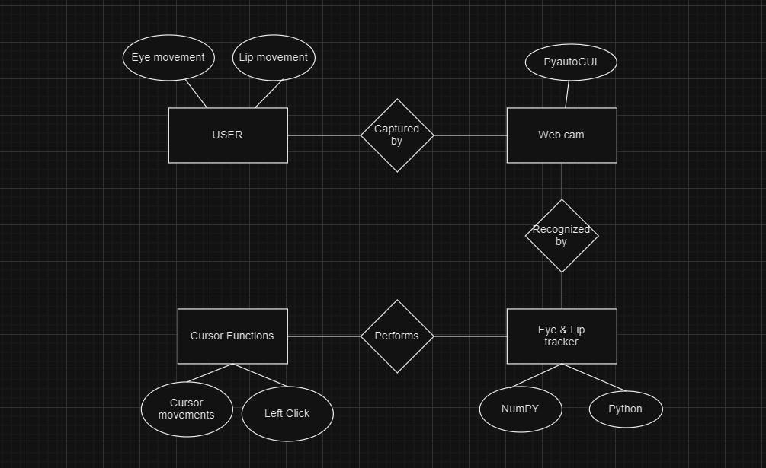
Diagram
Entity-relationship diagram

Slide 15
Patent Status
The patent is filed by project guide for the publication.

Slide 16
Research Paper Status
Submitted for review.

Slide 17
Project Status
The project is complete and in working state.

Slide 18
All documents Proofs (Github and Drive)
Testing report : https://docs.google.com/document/d/1JE7ycLe9YpBjQ30JZUdRS6M1eYT4C5_5/edit?usp=drive_link&ouid=115357137803999699891&rtpof=true&sd=true
Report : https://drive.google.com/file/d/1Cbe38jFXbWs4xqBVrmiQxC2GXlhLe-1m/view?usp=drive_link
SRS: https://drive.google.com/file/d/1iviqSuI9e_6S_KYtYm8zm2DTpER8KGAO/view?usp=sharing

Slide 19
References
[1] S. Shriram, “Deep Learning-Based Real-Time AI Virtual Mouse System Using Computer Vision to Avoid COVID-19 Spread”, 25 Oct 2021, doi:
https://doi.org/10.1155/2021/8133076
[2] S. U. Dudhane, “Cursor control system using hand gesture recognition,” IJARCCE, vol. 2, no. 5, 2013.
[3] L. Somas, “Virtual mouse using hand gesture,” International Research Journal of Engineering and Technology (IRJET), vol. 5, no. 4, 2018.
[4] J. Katona, “A review of human–computer interaction and virtual reality research fields in cognitive InfoCommunications,” Applied Sciences, vol. 11, no. 6, p. 2646, 2021.
[5] K. Pulli, A. Baksheev, K. Kornyakov, and V. Eruhimov, “Realtime computer vision with openCV,” Queue, vol. 10, no.4, pp. 40–56, 2012.]
[6] J. Jaya and K. Thanushkodi, “Implementation of classification system for medical images,” European Journal of Scientific Research, vol. 53, no. 4, pp. 561–569, 2011.
[7] L. Thomas, “Virtual mouse using hand gesture,” International Research Journal of Engineering and Technology (IRJET), vol. 5, no. 4, 2018.

Slide 20
[8] V. Bazarevsky and G. R. Fan Zhang. On-Device, MediaPipe for Real-Time Hand Tracking.
[9] J. T. Camillo Lugaresi, “MediaPipe: A Framework for Building Perception Pipelines”, 2019, https://arxiv.org/abs/1906.08172.
[10] K. Pulli, A. Baksheev, K. Kornyakov, and V. Eruhimov, “Realtime computer vision with openCV,” Queue, vol. 10, no. 4, pp. 40–56, 2012.
[11] K. P. Vinay, “Cursor control using hand gestures”, International Journal of Critical Accounting, vol. 0975–8887, 2016.
[12] V. Bazarevsky and G. R. Fan Zhang. On-Device, MediaPipe for Real-Time Hand Tracking.
[13] K. Pulli, A. Baksheev, K. Kornyakov, and V. Eruhimov, “Realtime computer vision with openCV,” Queue, vol. 10, no. 4, pp. 40–56, 2012.
[14] A. Haria, A. Subramanian, N. Asokkumar, S. Poddar, and J. S. Nayak, “Hand gesture recognition for human computer interaction,” Procedia Computer Science, vol. 115, pp. 367–374, 2017.
[15] K. H. Shibly, S. Kumar Dey, M. A. Islam, and S. Iftekhar Showrav, “Design and development of hand gesture based virtual mouse,” in Proceedings of the 2019 1st International Conference on Advances in Science, Engineering and Robotics Technology (ICASERT), pp. 1–5, Dhaka, Bangladesh, May 2019.

