Slide 1

Seminar
on
“Steganography”
Presented By:
Sparsh Jain
17EJCCS167
CS/VII Sem/C (C-2)
Submitted To:
Manju Vyas
Seminar Coordinator, CSE
Dr. Sanjay Gaur
HOD, CSE

Slide 2
Contents
What is Steganography?
Steganography v/s Cryptology
Evolution
Types
Dissecting Steganography
Steps for Hiding an Image Steganography
Advantages
Disadvantages

Slide 3
What is Steganography?
The word steganography literally means covered writing as derived from Greek. Steganography is the art of concealing the existence of information within seemingly innocuous carriers. In broad sense, term Steganography is used for hiding message within an image.
Steganography is the art and science of communicating in a way which hides the existence of the communication. In contrast to cryptography, where the "enemy" is allowed to detect, intercept and modify messages without being able to violate certain security premises guaranteed by a cryptosystem, the goal of steganography is to hide messages inside other "harmless" messages in a way that does not allow any "enemy" to even detect that there is a second secret message present. Steganography is in the (especially military) literature also referred to as transmission security or short TRANSEC.

Slide 4
Steganography v/s Cryptography
Steganography can be viewed as akin to cryptography. Both have been used throughout recorded history as means to protect information. At times these two technologies seem to converge while the objectives of the two differ.
Cryptographic techniques "scramble" messages so if intercepted, the messages cannot be understood. Steganography, an essence, "camouflages" a message to hide its existence and make it seem "invisible" thus concealing the fact that a message is being sent altogether. An encrypted message may draw suspicion while an invisible message will not.
Steganography cannot be detected. Therefore, it is used when encryption is not permitted. Or, more commonly, steganography is used to supplement encryption. An encrypted file may still hide information using steganography, so even if the encrypted file is deciphered, the hidden message is not seen.

Slide 5
Evolution
CODE BREAKERS : David Kahn's The Code breakers and Bruce Norman’s Secret Warfare: The Battle of Codes and Ciphers recounts numerous tales of steganography .
INVISIBLE INK : An innocent letter may contain a very different message written between the lines with invisible ink. Common sources for invisible inks are milk, vinegar, fruit juices and urine. All of these darken when heated. Later on, more sophisticated inks were developed which react to various chemicals.
MICRODOTS: The Germans developed microdot technology. Microdots are photographs the size of a printed period having the clarity of standard-sized typewritten pages. The first microdots were discovered masquerading as a period on a typed envelope carried by a German agent in 1941. The message was not hidden, nor encrypted. It was just so small as to not draw attention to itself (for a while). Besides being so small, microdots permitted the transmission of large amounts of data including drawings and photographs

Slide 6
Types
MESSAGES IN TEXT program is called SPAM MIMIC.
MESSAGES IN STILL IMAGES most popular tool is outguess.
MESSAGES IN AUDIO data is hidden in layer III of encoding process of MP3 file. Messages in audio are always sent along with ambient noise.
MESSAGES IN VIDEO embedding information into multimedia data has gained increasing attention lately.

Slide 7
An Example
Fishing freshwater bends and saltwater coasts rewards anyone feeling stressed. Resourceful anglers usually find masterful leapers fun and admit swordfish rank overwhelming anyday.
“Send lawyers guns and money”
Most communication channels like telephone lines and radio broadcasts transmit signals which are always accompanied by some kind of noise. This noise can be replaced by a secret signal that has been transformed into a form that is indistinguishable from noise without knowledge of a secret key and this way, the secret signal can be transmitted undetectable.

Slide 8
Dissecting Steganography
Steganography is a term used for hiding messages within an image. Any color pixel is made of a combination of red –green-blue mode(RGB) wherein each RGB component consist of 8 bits. If letters in ASCII are to be represented within the color pixels, the rightmost digit, called the least significant bit (LSB), can be altered.
Any variation in the value of this bit leads to very minimal variation in color. If we have to hide the word ‘digit’ in the image, we take the LSB of every color and hide each bit of the word in its RGB combination.
To insert the letter ‘D’ we modify three color pixels with three bits in each color pixel, we utilize 14 color pixels to hide the entire word with only 1 bit in the 14th pixel.
CONTD…………..

Slide 9
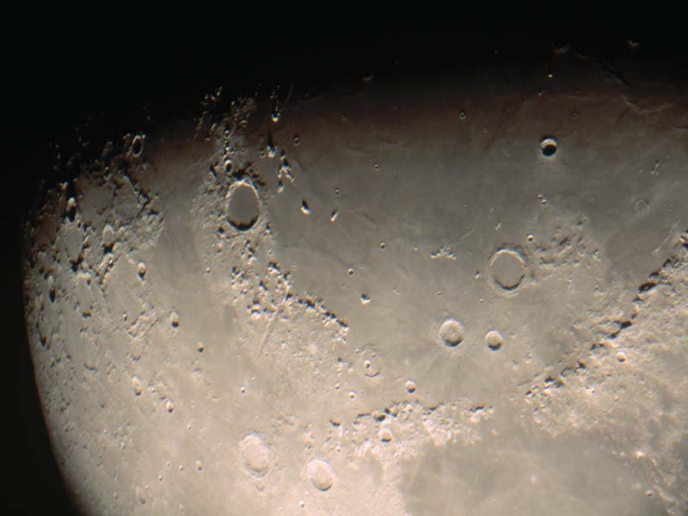
Dissecting Steganography
00000000 11111111 10101010 ASCII CHARACTER CODE
01010100 01010100 10101010
D-01000100
01010100 01010100 I-01101001
G-01100111
I-01101001
T-01110100
MSB
AMOUNT OF DATA STORED INSIDE A PICTURE

Slide 10
Dissecting Steganography
Suppose we have a 24-bit image 1024 x 768 (this is a common resolution for satellite images, electronic astral photographs and other high resolution graphics). This may produce a file over 2 megabytes in size (1024x768x24/8 = 2,359,296 bits). All color variations are derived from three primary colors, Red, Green and Blue. Each primary color is represented by 1 byte (8 bits). 24-bit images use 3 bytes per pixel. If information is stored in the least significant bit (LSB) of each byte, 3 bits can be a stored in each pixel. The "container" image will look identical to the human eye, even if viewing the picture side by side with the original.

Slide 11
Steps For Hiding An Image Using Steganography
Start s-tool and window explorer using the later as drag and drop interface the software.
Drag and drop the image to be used as the carrier file from the explorer onto the actions window in s-tool.
Drag and drop the data file on the carrier file.
Give pass phrase and encryption algorithm when prompted. Pass these to receiver too.
The hidden file is ready. Receiver has to click on the “reveal” button to extract the data.

Slide 12
Advantages
It can be used for safeguarding data, such as in the field of media where copywriting ensures authenticity.
It can be used by intelligence agencies for sending their secret data.

Slide 13
Disadvantages
Many a terrorist and anti humanist activities have been carried out cloaked under this technique.

Slide 14

Thanks

