Slide 1

Expense Tracker Automation
Using n8n + Google Forms + Google Sheets
Subject
Focus
Finance Automation
Workflow Design & Implementation
Outcome
Group 1
Faster, Smarter Expense Management
Aarchie - 2520982502
Sanjeet- 2520982709
Shreya- 2520982726
Sparsh- 2520982740

Slide 2



The Problem with Manual Expense Management
Most organizations still rely on emails, spreadsheets, and paper trails to handle expense claims — a process riddled with inefficiencies.
Delays in Approval
Claims sit in inboxes for days, slowing down reimbursements and frustrating employees.
Missing Records
Receipts get lost, emails go unanswered, and critical data disappears from spreadsheets.
Human Errors
Manual data entry leads to miscalculations, duplicate entries, and audit failures.
No Real-Time Visibility
Finance teams have no live view of spending — decisions are made on stale data.
Bottom line: A manual system is slow, error-prone, and unscalable. There's a better way.

Slide 3



Our Objective
This project builds a fully automated expense tracking system that eliminates manual steps — from submission to notification — using free, accessible tools.
Automate Submission
Store Data Automatically
Replace email-based submissions with a structured Google Form that captures data consistently every time.
All responses flow instantly into Google Sheets — no manual copy-paste, no missed entries.
Apply Finance Rules
Send Instant Alerts
n8n evaluates each claim against predefined thresholds and routes it accordingly.
Automated email notifications keep employees and approvers informed in real time.

Slide 4


Workflow Design
The automation pipeline connects four key tools into a seamless, trigger-based flow — from form submission to email alert.
Submit Form
Save to Sheets
n8n Trigger
Finance Review
Once an employee submits a form, the entire process — storage, evaluation, and notification — completes automatically in under 3 minutes, with zero manual intervention.

Slide 5

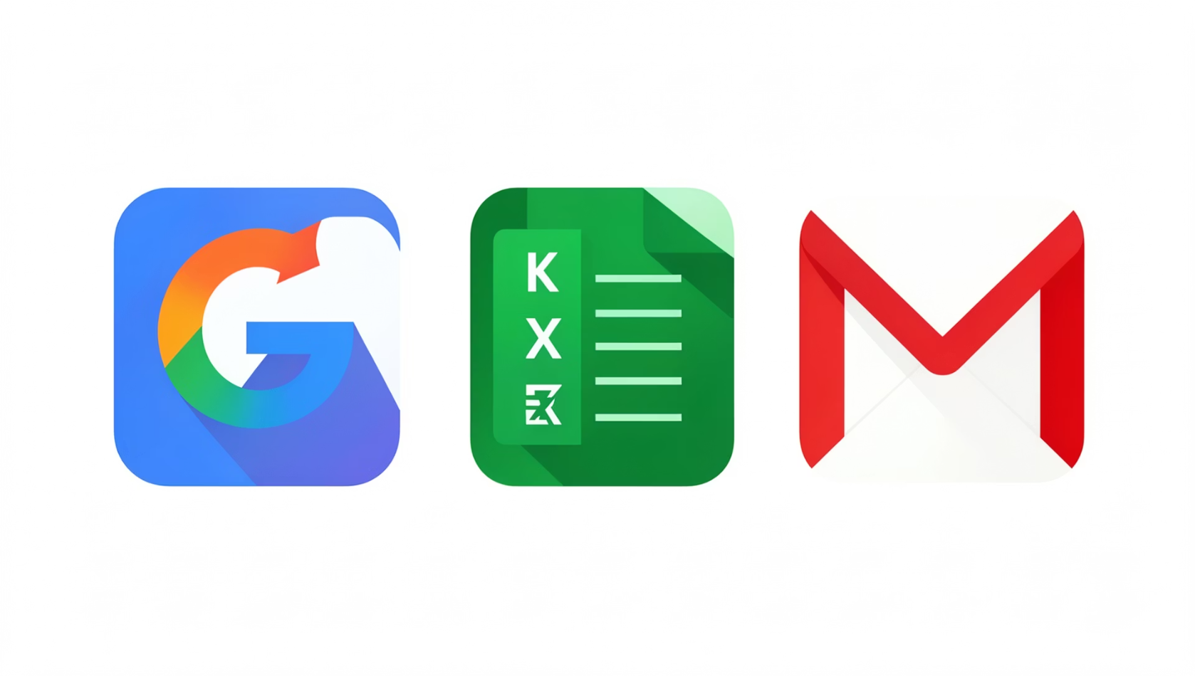




Tools Used
Google Forms
Collects structured expense submissions from employees.
Google Sheets
Stores all submitted data in an organized, queryable format.
n8n
The automation engine — triggers, processes, and routes data.
Gmail
Send alerts, format data, and apply conditional logic within n8n.

Slide 6
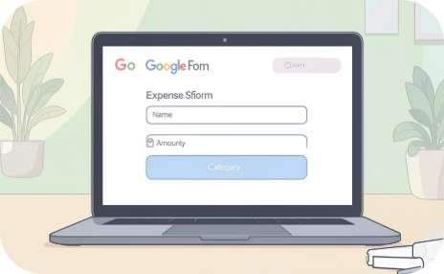
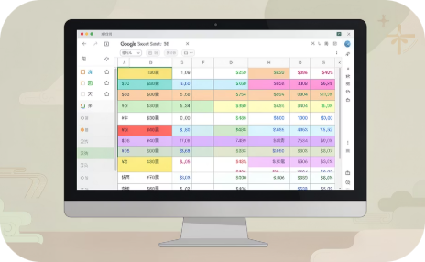
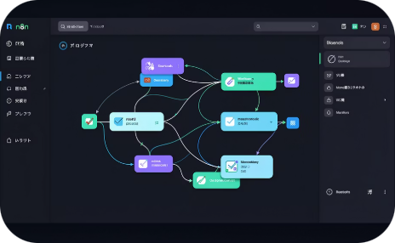

System in Action
Here's how the full pipeline looks end-to-end — from the employee's perspective to the finance team's inbox.
Step 1: Google Form
Step 2: Google Sheets Log
Step 3: n8n Workflow
Step 4: Email Notification
Employee submits expense details — name, amount, category, and description — through a clean, mobile-friendly form.
n8n detects the new row, applies the finance rule, and triggers the appropriate email — all within seconds.
Each submission is instantly appended as a new row in the shared sheet, creating a complete, timestamped audit trail.
The employee and approver each receive a tailored email — either a confirmation or a high-expense flag alert.

Slide 7



Time & Cost Savings
The ROI of this automation is immediate and measurable — even at low transaction volumes.
12–15 min
10+ hrs
Saved Per Claim
Monthly Time Saved
Manual: 15–20 min → Automated: 2–3 min
Based on 50 expense claims per month
₹45K
~₹0
Annual Cost Saved
Tool Cost
At ₹300/hr — ₹3,000–₹3,750/month saved
Google Forms, Sheets, and n8n are free or very low cost
Very low investment. Very high return. This is automation at its most accessible.

Slide 8

Industry Impact & Real-World Relevance
Expense automation isn't just a class project — it's a standard practice at leading organizations worldwide.
Reduced Workload
Finance teams spend less time on manual data entry and more time on strategic analysis.
Faster Reimbursements
Employees receive reimbursements in days, not weeks — improving satisfaction and trust.
Real-Time Monitoring
Finance managers gain a live dashboard view of all expense activity across the organization.
Enterprise Scalable
Companies like Infosys and TCS use similar automation frameworks across thousands of employees.

Slide 9


Before vs. After Automation
The impact of automation is measurable from day one. Here's how the experience changes for both employees and finance teams.
🔴 Before Automation
🟢 After Automation
Manual emails and spreadsheet entries
15–20 minutes per expense submission
High risk of data entry errors
No real-time tracking or visibility
Slow, multi-day approval cycles
Fully automated from form to inbox
2–3 minutes per expense — end to end
Accurate, structured, duplicate-free data
Live tracking across Google Sheets
Instant email alerts upon submission
"Automation drastically improves speed, accuracy, and visibility — transforming expense management from a burden into a background process."

Slide 10


Key Takeaways
What This Project Demonstrates
"Automation using n8n makes financial processes faster, smarter, and cost-efficient — and this project proves it."
Faster processing — claims resolved in minutes, not days
Real-time tracking — live visibility for finance teams
Better accuracy — no more manual errors or missing data
High ROI — built entirely on free tools with measurable savings

Slide 11
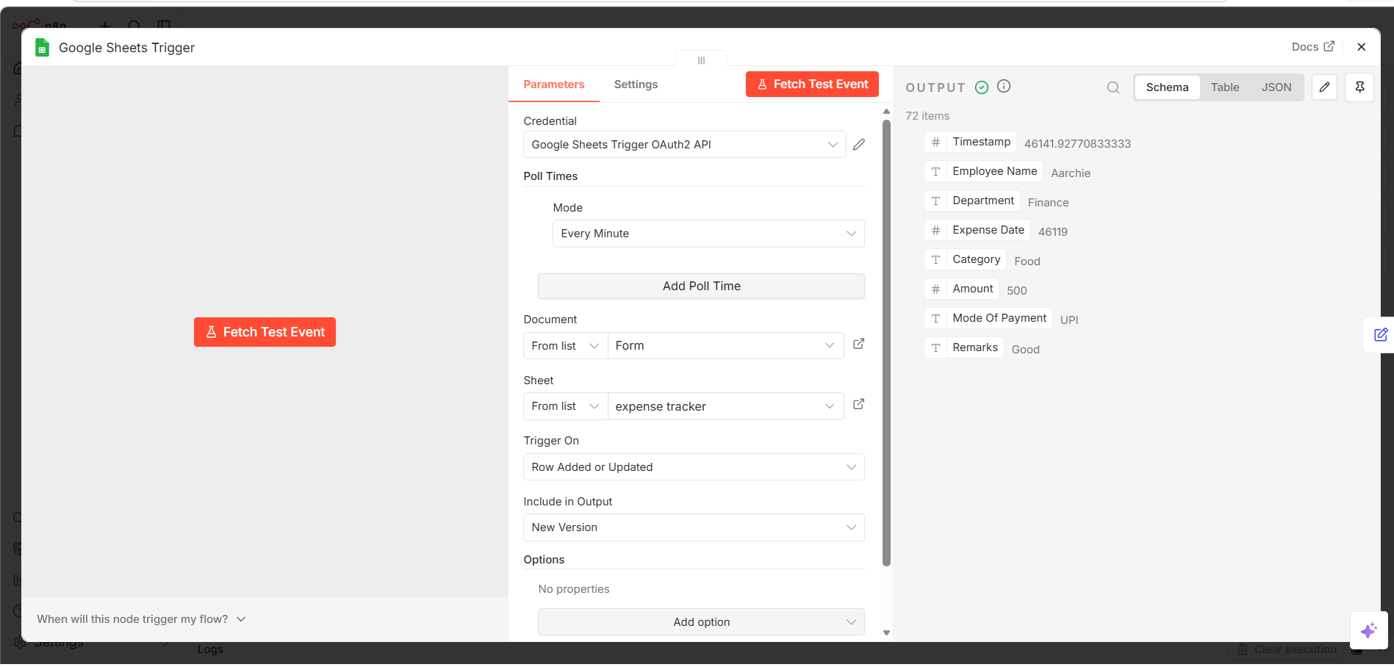
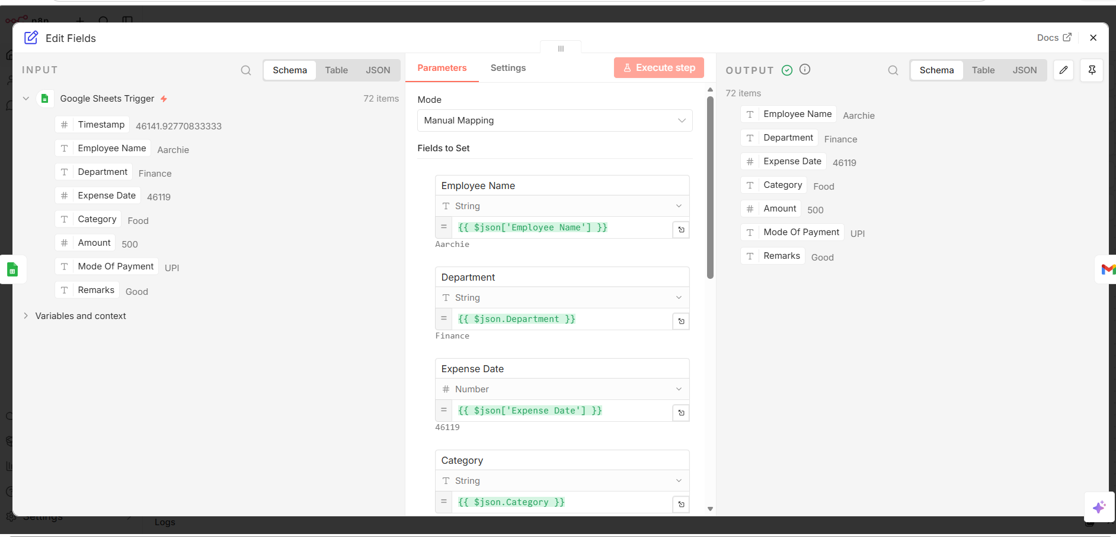
Screenshots of our work

Slide 12
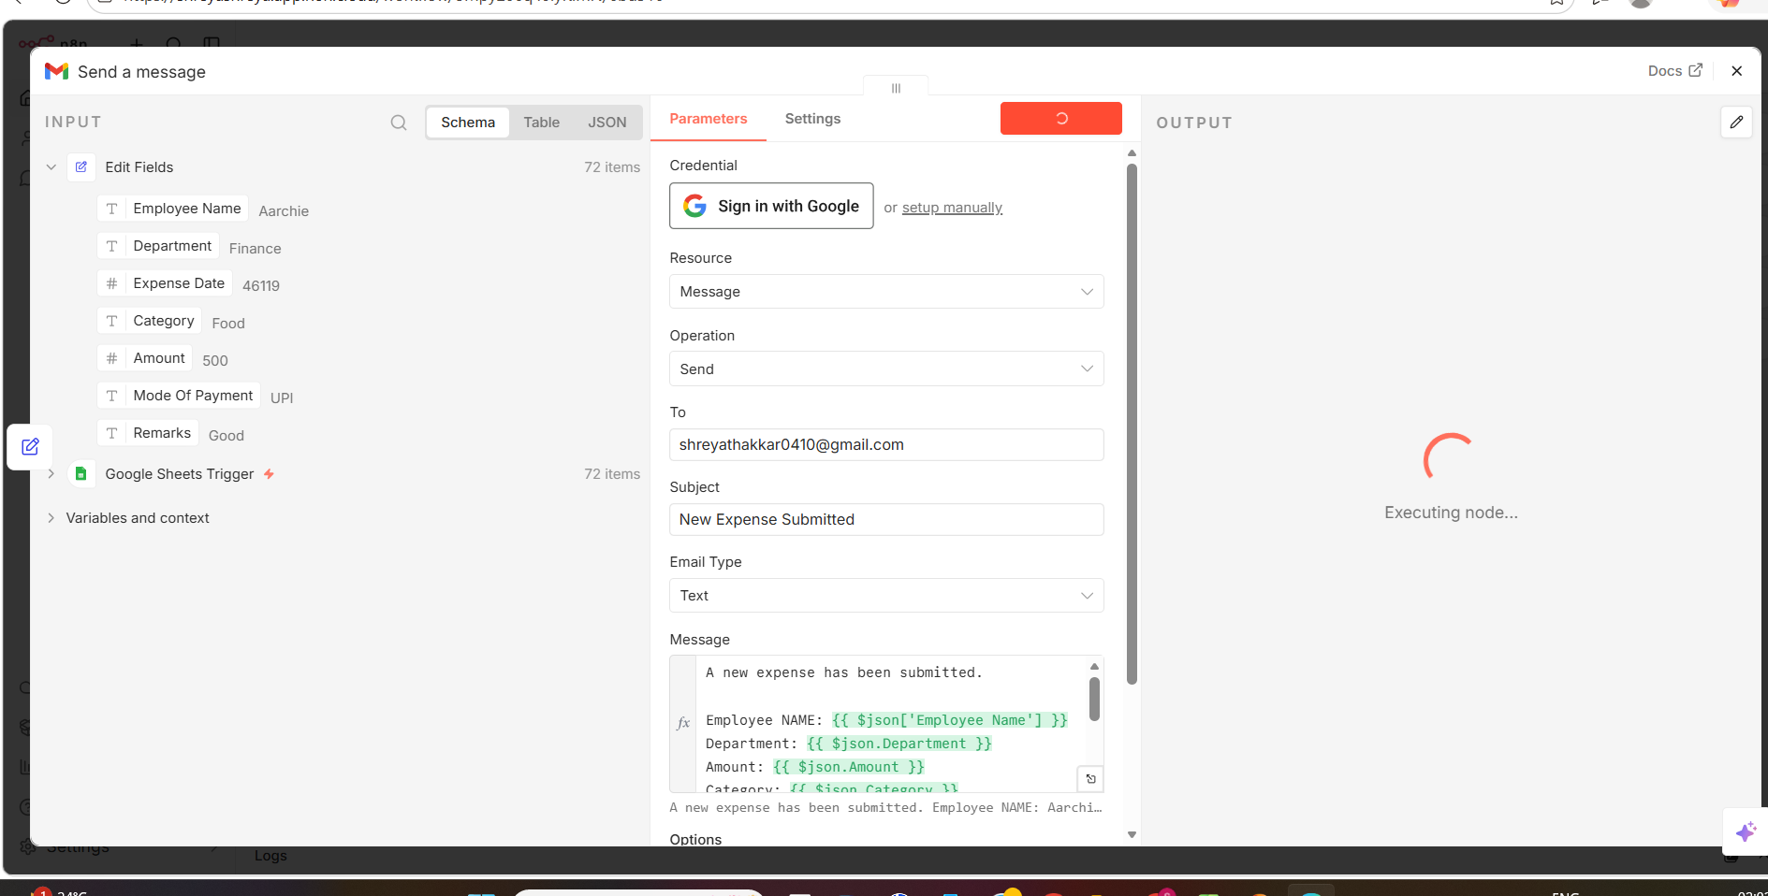
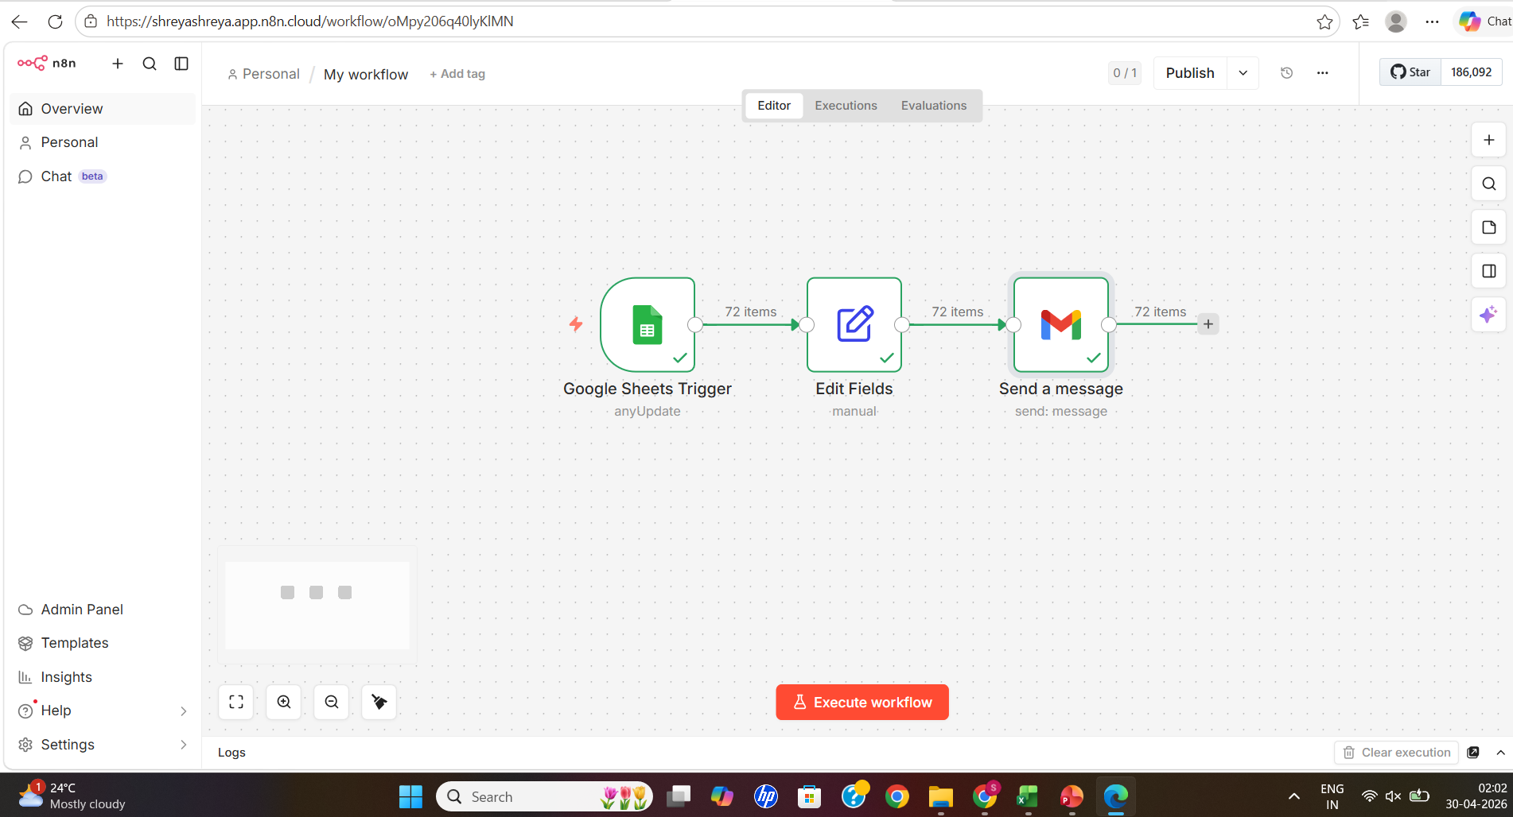
Screenshots of our work

Slide 13
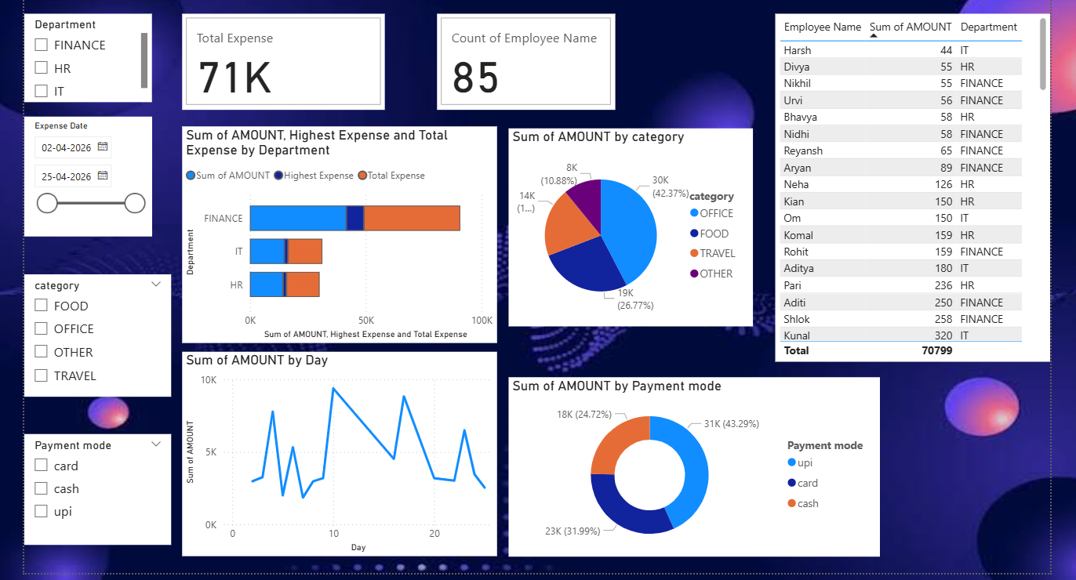
Screenshots of our work

Slide 14
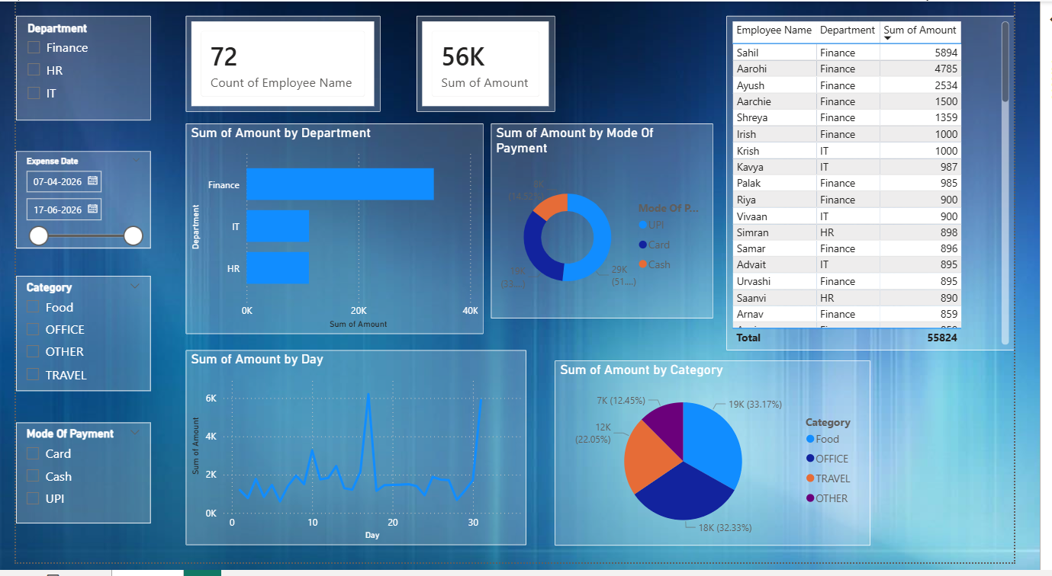
Screenshots of our work

