Slide 1
● WAR ROOM
AN EVENT-DRIVEN NLP RISK ENGINE FOR WHOLESALE PORTFOLIO STRESS TESTING
Sparsh Pawar · IIT Guwahati
S&P Global & Crisil Campus Hackathon 2026
MKT -0.95 ▼ IMP 10.0 AAPL -0.79 ▼ IMP 6.3 JPM +0.41 ▲ IMP 4.9 MKT -0.86 ▼ IMP 3.2
WAR ROOM · S&P Global & Crisil Hackathon 2026
01

Slide 2
PROBLEM & APPROACH
"Regional bank defaults on commercial paper… contagion fears grip the sector"
unstructured wire — 08:14
SENTIMENT −1 … +1
FinBERT, dual-benchmark calibrated
▼ manual reading · judgment · spreadsheets · hours
EVENT TYPE — 6 classes
keyword rules → zero-shot NLI fallback
PORTFOLIO EXPOSURE: ???
the number risk systems need — buried in text
IMPACT 1–10
fully explainable formula, no black box
The bridge between text and risk numbers is manual, slow,
and inconsistent. WAR ROOM closes it end to end.
▼ fires automatically when systemic & impact ≥ 7
AUTOMATIC STRESS TEST
portfolio P&L waterfall within seconds
WAR ROOM · S&P Global & Crisil Hackathon 2026
02

Slide 3
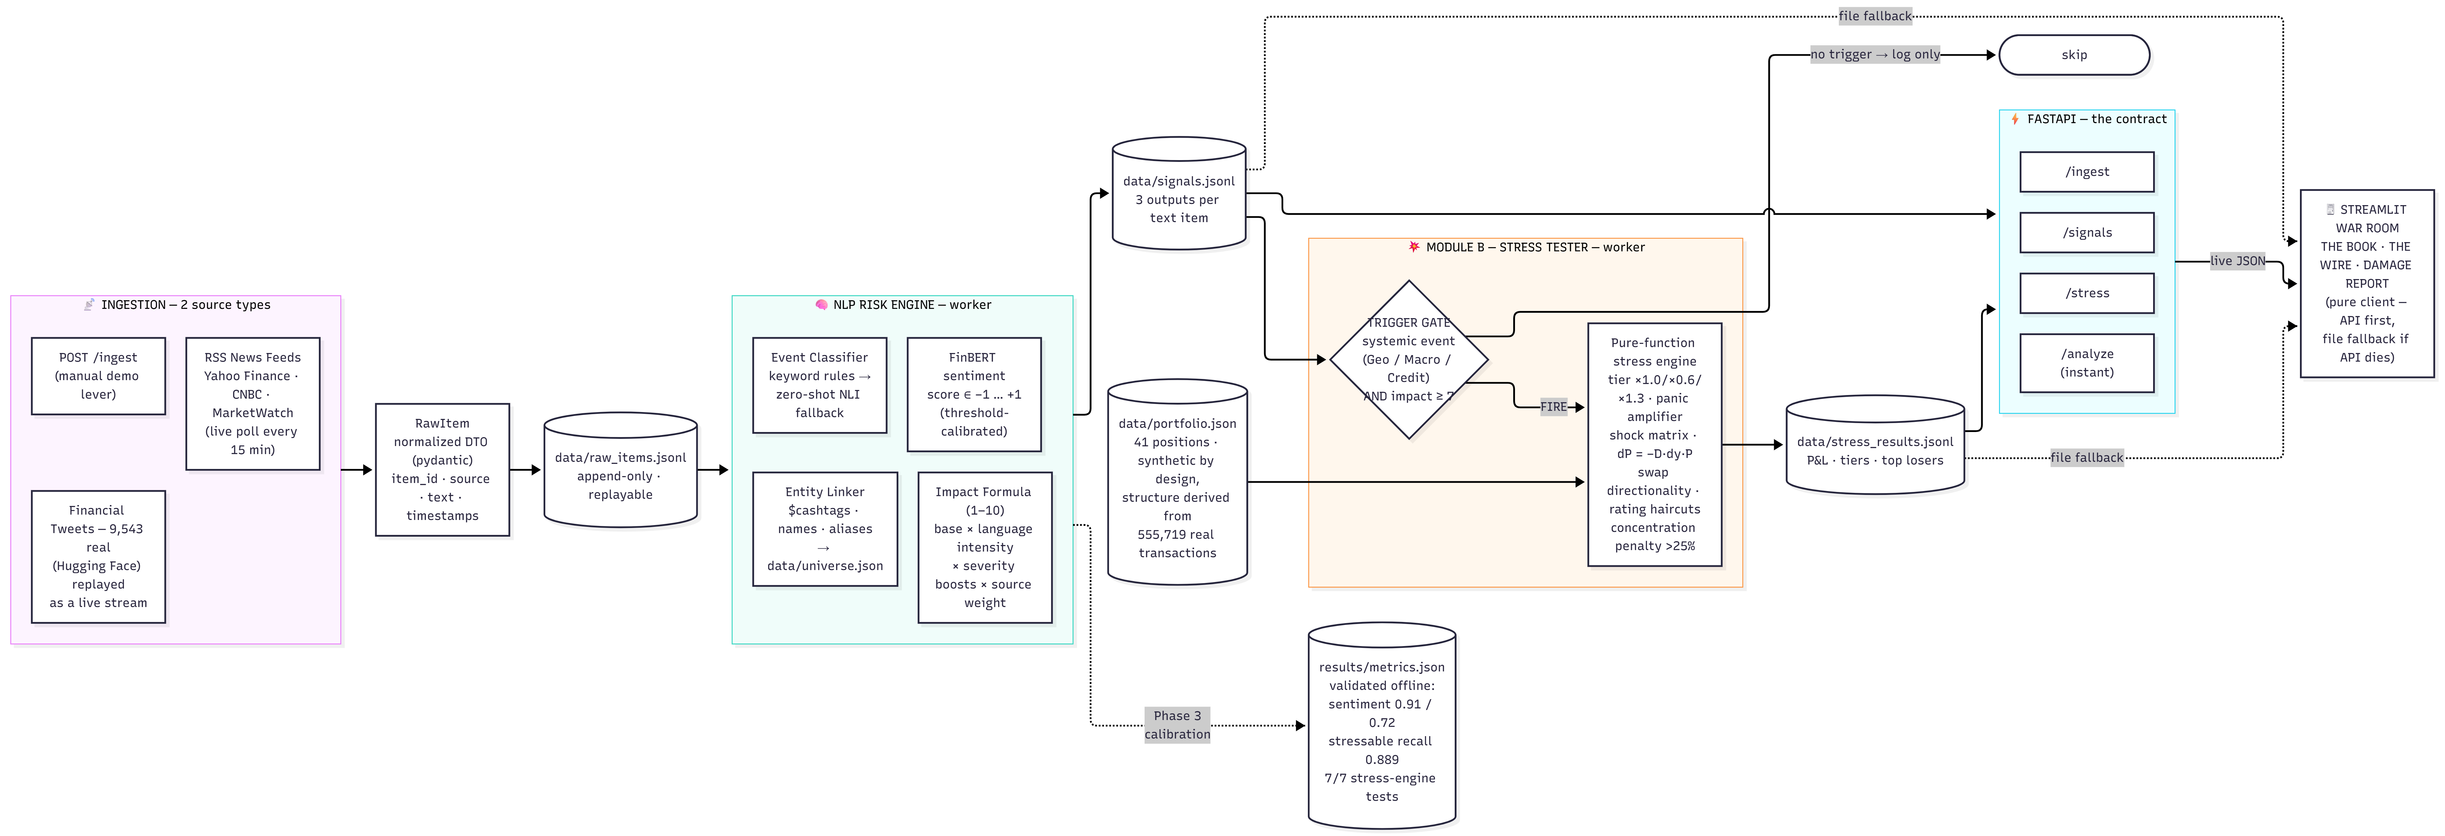
SYSTEM DESIGN
① 2 sources → 1 normalized DTO
append-only JSONL transport — replayable, crash-safe
② impact ≥ 7 trigger gate
3.1% of signals fire — selective by design
③ file-fallback client
dashboard degrades gracefully if the API dies
WAR ROOM · S&P Global & Crisil Hackathon 2026
03

Slide 4
IMPLEMENTATION HIGHLIGHTS
FinBERT
finance-tuned transformer
sentiment calibrated on 2 labeled benchmarks
HYBRID CLASSIFIER
deterministic rules first
zero-shot NLI fallback · degrades gracefully
EXPLAINABLE IMPACT
every point of 1–10 traces
to visible, tunable constants
DATA-DERIVED BOOK
sector weights from 555,719
real transactions (CC0) — not hand-picked
PURE-FN STRESS ENGINE
7/7 unit tests incl. exact
verification of dP = −D·Δy·P
TERMINAL UI
ticker · severity bands · waterfall
built the way a risk desk thinks
WAR ROOM · S&P Global & Crisil Hackathon 2026
04

Slide 5
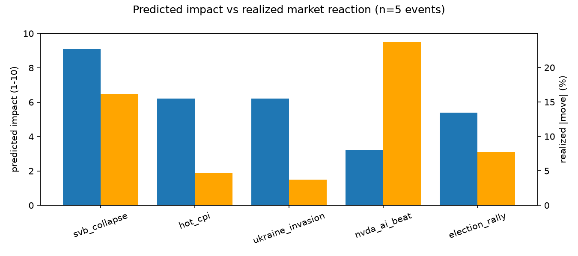
KEY RESULTS — VALIDATED, NOT ASSUMED
SENTIMENT · IN-DIST
0.910
PhraseBank · vs VADER 0.614
SENTIMENT · OUT-OF-DIST
0.720
HF tweets · vs VADER 0.578
STRESSABLE RECALL
0.889
9 of 10 systemic events caught
TRIGGER RATE
3.1%
of live signals — selective
SVB: engine 9.1 → market −16%
NVDA: engine 3.2 → stock +24%
the score prices systemic risk,
not single-stock headlines
7/7 stress-engine unit tests · confusion matrices in results/
WAR ROOM · S&P Global & Crisil Hackathon 2026
05

Slide 6
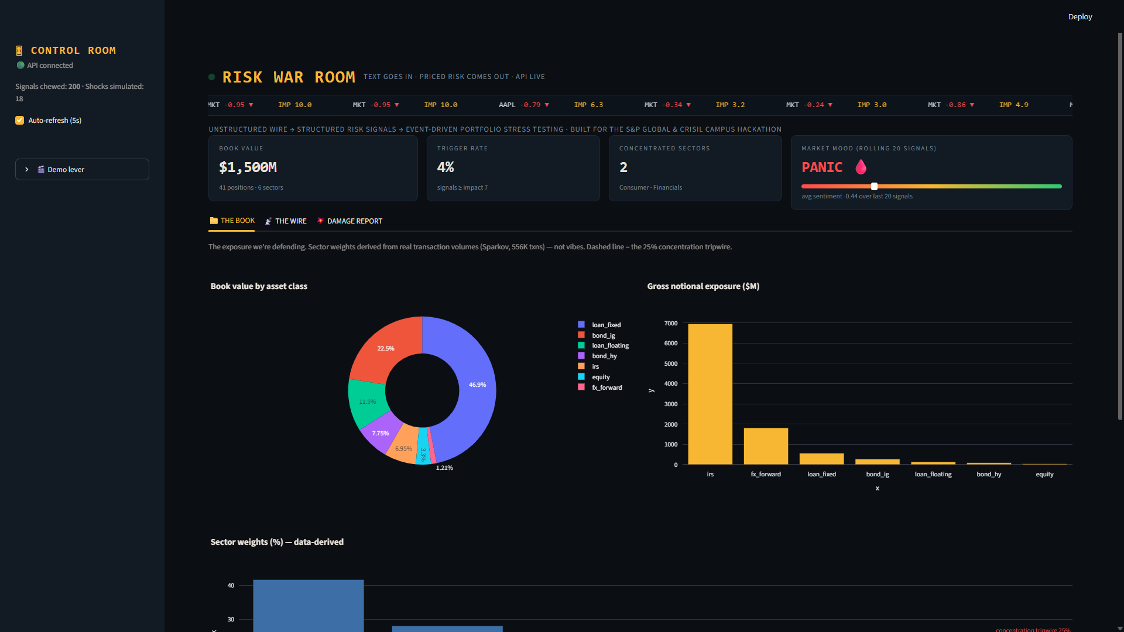
DOMAIN IMPACT — HOURS TO SECONDS
TODAY (manual)
headline 08:14 → analyst reads → meeting 11:00 → exposure 13:30
WITH WAR ROOM (automated)
headline 08:14 → signals 08:14:12 → stress report 08:14:30
▪ idiosyncratic ≠ systemic NVDA +24% stock → impact 3.2
▪ concentration from data Consumer + Financials flagged, not assumed
▪ hedges show gains FX forwards +8.5 under geopolitical shock
live console — the book tab (screenshot)
WAR ROOM · S&P Global & Crisil Hackathon 2026
06

Slide 7
LIMITATIONS & NEXT STEPS
KNOWN LIMITATIONS
• Headline-level NLP — feeds give summaries, not full articles
• Backtest n=5 — directional validation, not statistics
• Golden set n=37 — adequate, not large
• Static models — real-time labels don't exist
NEXT STEPS
• Full-article context & longer inputs
• Scale the historical event library
• Grow golden set to 100+ (labeling tool exists)
• Feedback loop: signals vs realized moves → recalibration
The hooks for learning are already in the schema.
● WAR ROOM
WAR ROOM · S&P Global & Crisil Hackathon 2026
07

