Slide 1

WOW — Business Management Tool
An integrated project by Team Aura++ — a Jira-inspired collaborative workspace and task management platform built for modern development workflows.
INTEGRATED PROJECT
AURA++
Sparsh Sharma · 2310992218

Slide 2
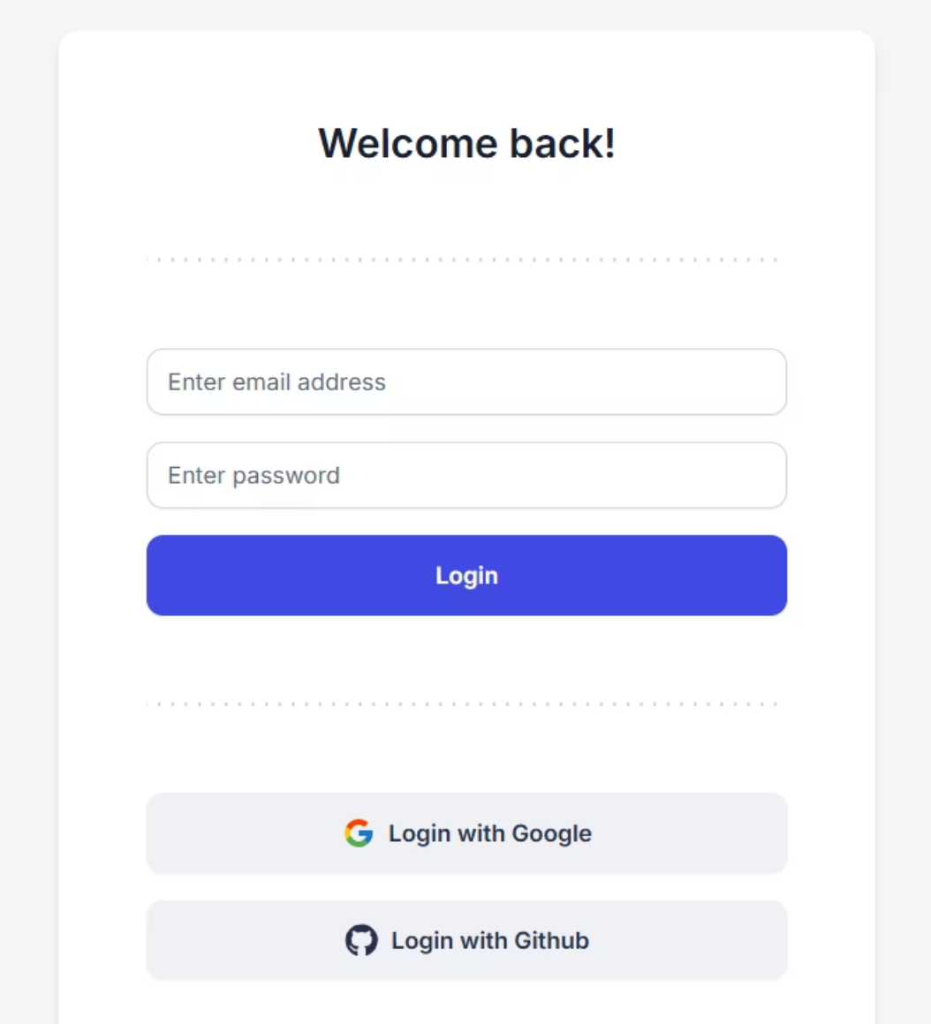
Login & Signup
WOW provides a secure, frictionless authentication experience. Users can sign in with email and password or leverage OAuth via Google and GitHub — keeping onboarding fast and enterprise-ready.
Authentication Features
Email & Password
OAuth — Google
OAuth — GitHub
Secure credential-based login with session management via Appwrite.
One-click sign-in using Google accounts for fast, trusted access.
Seamless login for developers using their existing GitHub identity.

Slide 3
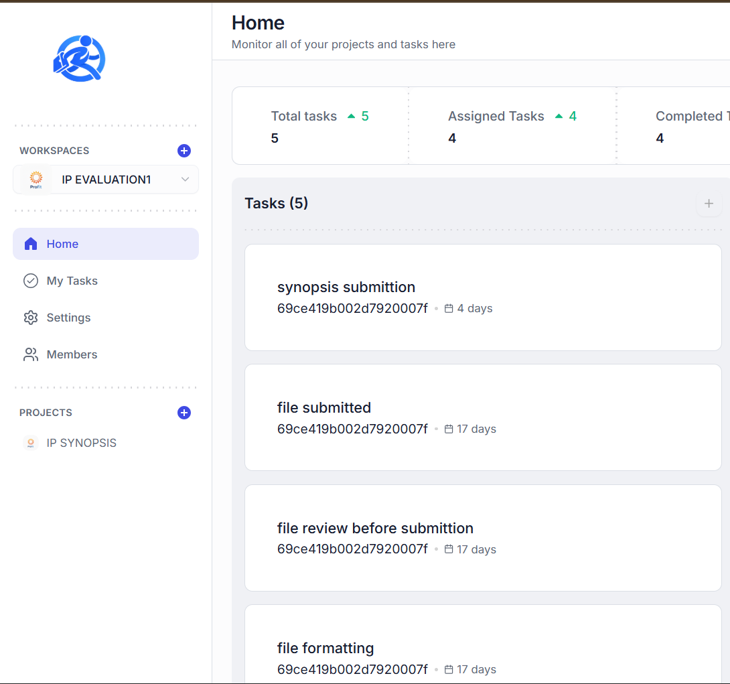
Home Dashboard
The WOW home page gives every team member a real-time command center — surfacing total, assigned, completed, overdue, and incomplete tasks alongside active projects at a glance.
Task Overview
Project Panel
Aggregated task counters across all workspaces — always current.
Quick access to every project within the active workspace.
Workspaces
Switch between workspaces instantly from the left-side navigation.

Slide 4
Tech Stack
WOW is built on a modern, type-safe, full-stack architecture — combining best-in-class tools for routing, API handling, data management, and UI consistency.
Next.js App Router
React + TypeScript
Hono API
Powers all routes, layouts, and pages with server-first rendering.
Strict typing across components via package.json and tsconfig.json.
Lightweight API framework mounted inside Next.js catch-all API routes.
Appwrite SDK
TanStack Query
Zod + React Hook Form
Backend-as-a-service for accounts, users, DB, and storage operations.
Client-side data fetching, caching, and background sync.
Schema validation and typed form handling — zero runtime surprises.
Tailwind + shadcn UI
Utility-first styling with consistent, composable UI component wrappers.

Slide 5
Runtime Flow
Every user interaction in WOW follows a precise, end-to-end request lifecycle — from browser render through session validation to Appwrite data operations and back to a responsive UI.
01
02
03
User opens page in App Router
Page/layout renders feature components
Feature hooks call typed RPC client
04
05
06
RPC hits Hono through Next API catch-all
Middleware validates session from auth cookie
Feature server routes do member/role checks
07
08
09
Appwrite is called for read/write
Response returns JSON to hooks
React Query updates cache and UI re-renders
This layered pipeline ensures every request is authenticated, authorized, and efficiently cached — delivering a fast, secure experience at every step.

Slide 6
Project Documents
WOW ships with a comprehensive set of configuration and documentation files that ensure a consistent, maintainable, and scalable codebase from day one.
README.md
package.json
postcss.config.mjs
eslint.config.mjs
Main project documentation and architecture summary for onboarding.
All dependencies, build scripts, and project metadata in one place.
PostCSS pipeline configured to process Tailwind utilities.
Lint rules based on Next.js core-web-vitals and TypeScript presets.
tsconfig.json
next.config.ts
next-env.d.ts
components.json
TypeScript strict mode configuration with path alias mapping.
Next.js runtime and build configuration for production deployments.
Next.js ambient type declarations for the TypeScript compiler.
shadcn generator configuration for component scaffolding and theming.
tailwind.config.ts
Design tokens, theme extensions, and content path scanning.

Slide 7
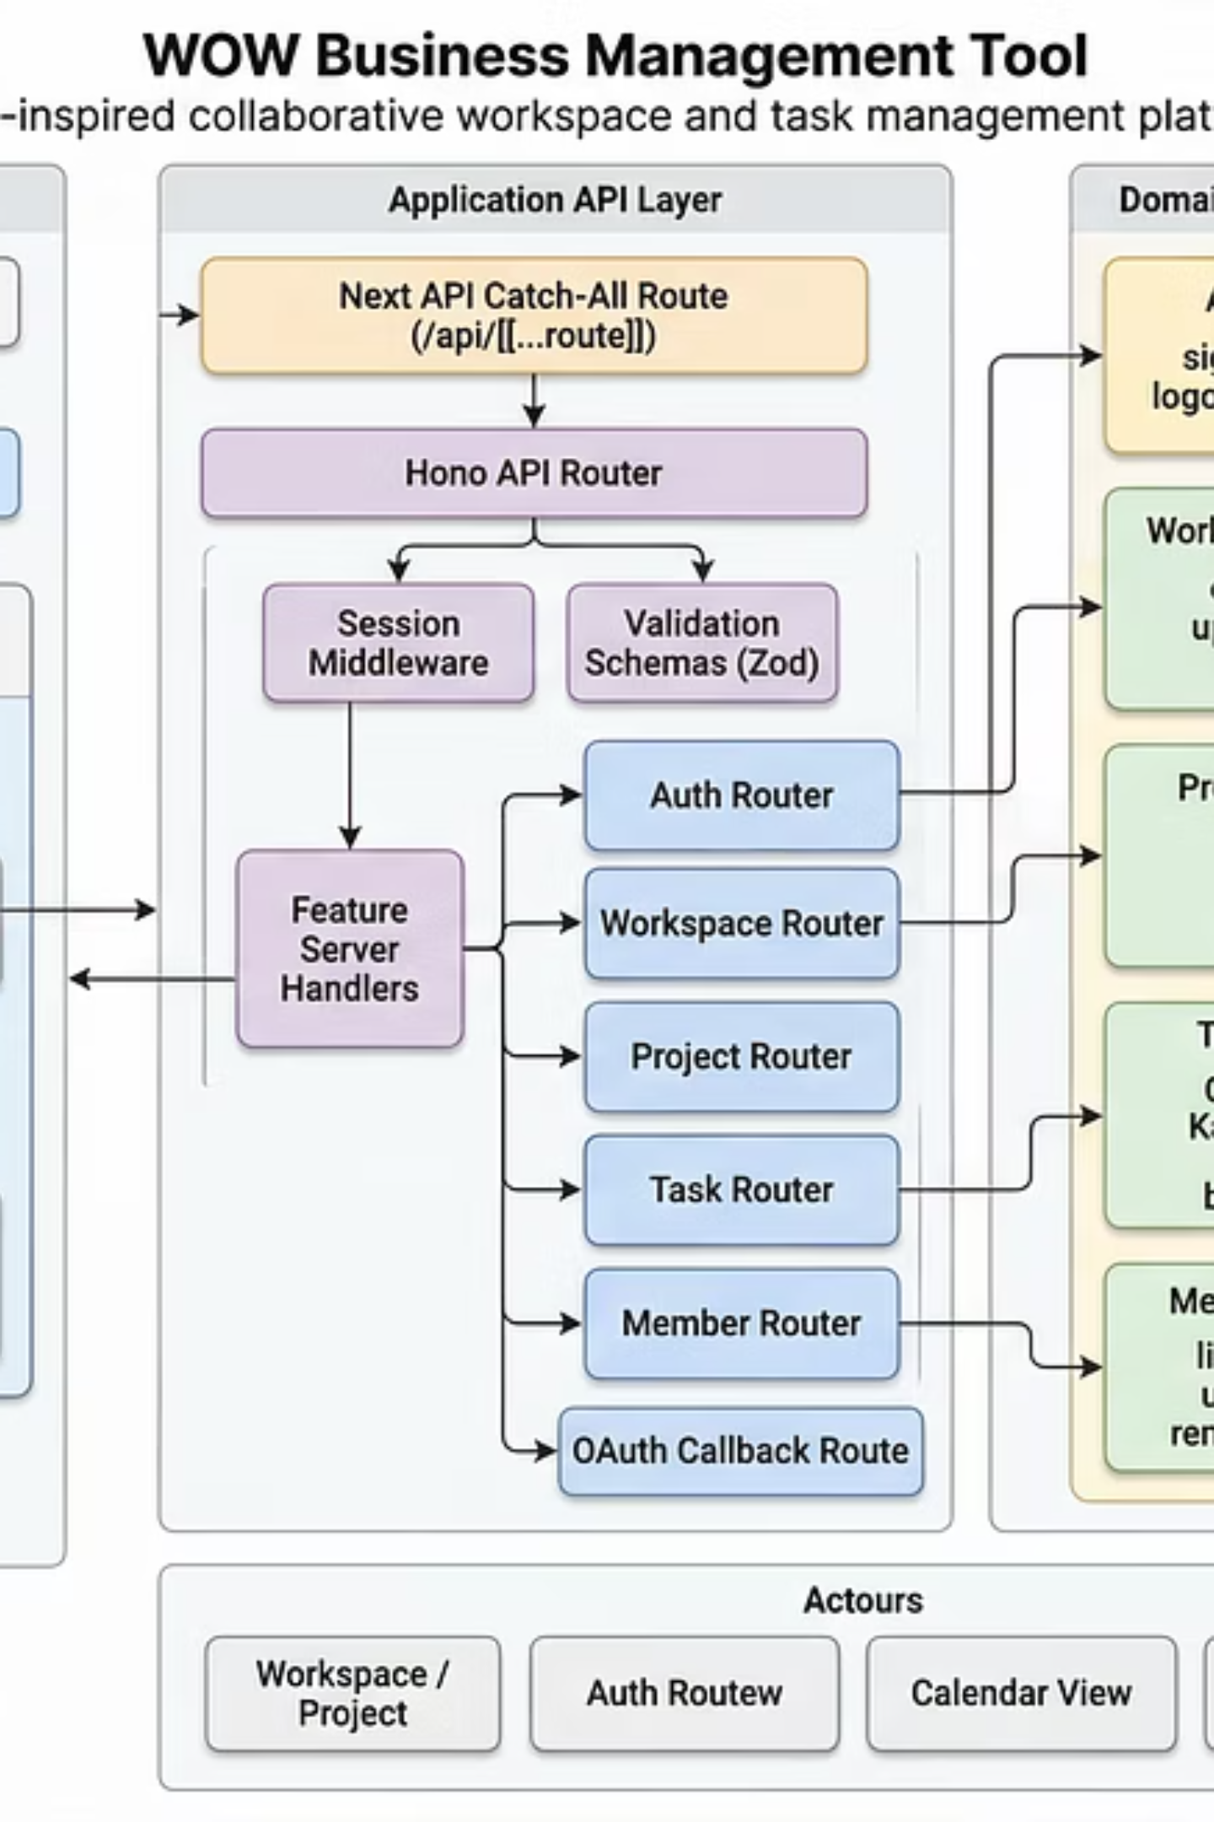
High-Level Architecture Diagram
The WOW platform is structured across four clearly separated layers — Presentation, API, Domain Features, and Backend Services — enabling scalable, maintainable, and role-aware collaboration at every level.
Client Layer
Next.js App Router with React Query and typed RPC components.
API Layer
Hono-based catch-all routes with session middleware and Zod validation.
Domain Modules
Auth, Workspaces, Projects, Tasks, and Members feature routers.
Backend Services
Appwrite for accounts, databases, storage, and session management.

