Slide 1

Cyber.Ai : Ai powered cyber security tool
Sparsh Verma (220996233)
Project Supervisor: Syed rafee
Msc Artificial intelligence, qmul

Slide 2
What is Cyber.ai
CyberAi identifies the status of all opened ports on the target server and executes the exploit at pinpoint using Machine Learning. It's key features are following.
Efficiently execute exploit. CyberAi can execute exploits at pinpoint (minimum 1 attempt) using Machine Learning.
Deep penetration. If CyberAi succeeds the exploit to the target server, it further executes the exploit to other internal servers.
Self-learning. CyberAi can learn how to exploitation by itself (uses Reinforcement Learning). It is not necessary for humans to prepare learning data.
Learning time is very fast. Generally, reinforcement learning takes a lot of time. So, CyberAi uses distributed learning by multi agents. We adopted an advanced machine learning model called A3C.
Powerful intelligence gathering To gather the information of software operated on the target server is very important for successful the exploitation. CyberAi can identify product name and version using following methods.
Port scanning
Machine Learning (Analyze HTTP responses gathered by Web crawling)
Contents exploration

Slide 3
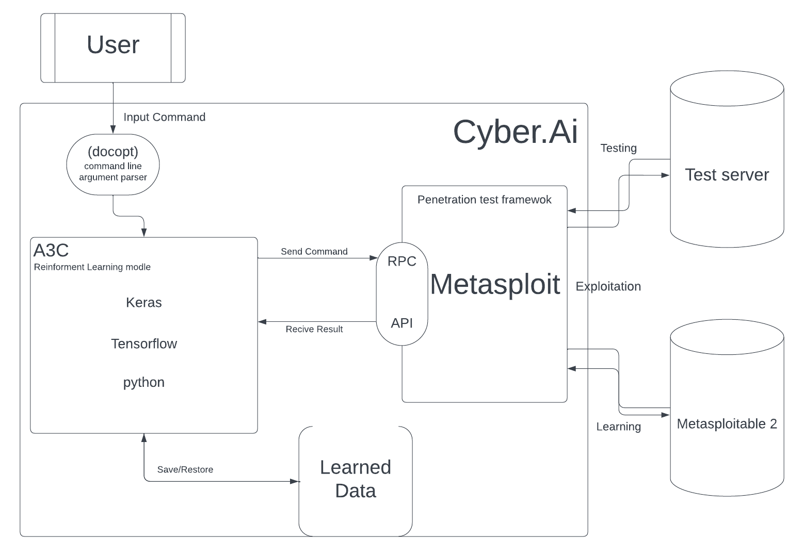
Architecture

Slide 4
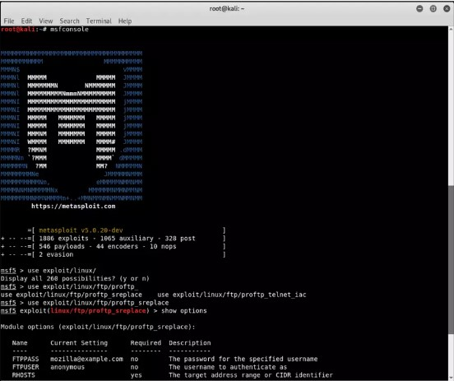
What is Metasploit?
Metasploit is an open-source framework developed to aid penetration testers and security researchers in discovering, exploiting, and validating vulnerabilities within computer systems. Over the years, it has evolved into a comprehensive tool with a vast database of exploits, payloads, and auxiliary modules that cater to various aspects of cybersecurity.
Core Features:
Exploit Database: Metasploit houses an extensive collection of ready-to-use exploits for various software and systems. An exploit is essentially a piece of software, a set of commands, or a methodology that leverages a software bug or vulnerability to induce a particular behaviour on the system, often to gain control or access.
Payloads: Once an exploit is successfully executed on a target system, payloads determine the subsequent action. Payloads can range from creating a simple backdoor shell to more sophisticated actions.
Auxiliary Modules: These are supportive modules that provide functionalities like port scanning, service identification, and other reconnaissance methods.
Post-Exploitation Modules: After a successful compromise, these modules can help in actions such as gathering further information, pivoting to other systems, or escalating privileges.
Encoders and NOP Generators: These assist in bypassing certain defensive mechanisms, ensuring the exploit and payload can be delivered without interference.

Slide 5
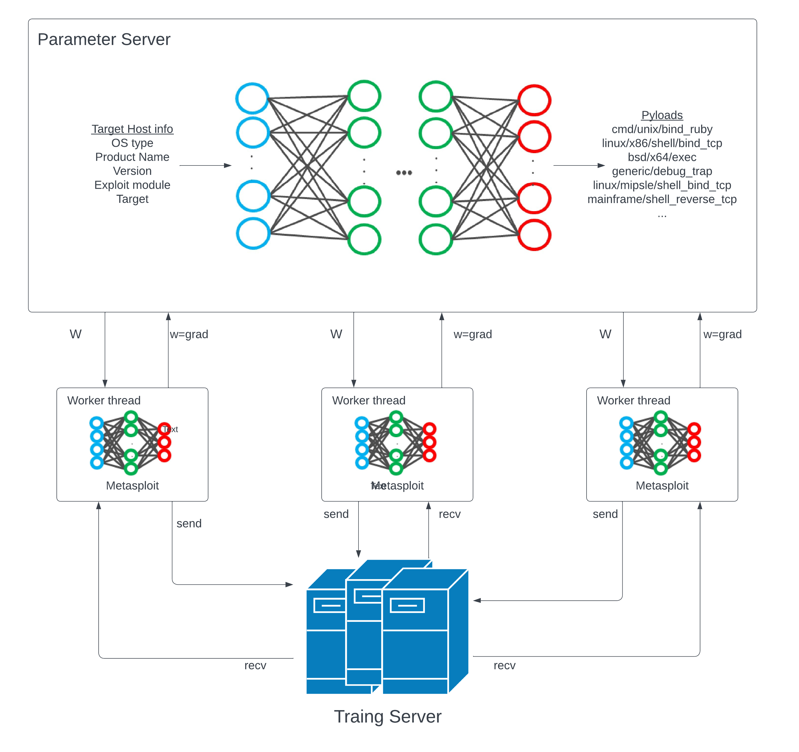
Overview of Cyber.ai

Slide 6
What is A3c and how it is used in Cyber.ai
A3C - Asynchronous Advantage Actor-Critic: A3C, which stands for Asynchronous Advantage ActorCritic, is an advanced reinforcement learning algorithm. It's a combination of two key ideas: the Actor-Critic architecture and asynchronous updates.
Actor-Critic Architecture:
Actor: Determines which action to take given a certain state. It essentially defines the current policy of the agent.
Critic: Estimates the value of taking a certain action in a given state. In other words, it evaluates the actor's policy.
The Actor-Critic method combines the benefits of value-based approaches (where we estimate a value function) and policy-based approaches (where we directly optimise the policy). The critic assesses the action taken by the actor and gives feedback to improve the policy.
Asynchronous Updates: The asynchronous aspect of A3C means that multiple agent-environment instances run in parallel on separate threads. Each of these agents explores its environment independently. The benefit of this asynchrony is that it helps in decorrelating the experiences of the agents, leading to a more stable and faster learning process.
Implementation of A3C in CyberAi: CyberAi incorporates the A3C algorithm to enhance its decision-making capabilities during penetration testing.
Parallel Learning: CyberAi can run multiple penetration testing routines in parallel (asynchronous agentenvironment instances). Each of these routines explores different strategies and vulnerabilities independently.
Action Selection: The "Actor" part of A3C helps CyberAi decide on which exploit or vulnerability to target based on its current knowledge and policy. Given a state (e.g., a detected open port or service on the target system), the actor chooses an action (an exploit attempt).
Policy Evaluation and Improvement: After the action is taken, the "Critic" evaluates the result (whether the exploit was successful or not). Based on this feedback, the critic guides the actor to adjust and improve its policy for future decisions. This feedback loop ensures that CyberAi gets better over time, refining its exploit strategies based on past experiences.
Exploration and Exploitation: The A3C framework inherently balances between exploration (probing new exploits or vulnerabilities) and exploitation (utilising known successful exploits). This ensures that CyberAi is both innovative in discovering new vulnerabilities and efficient in exploiting known ones.
Continuous Learning: Due to the asynchronous nature of A3C, CyberAi is constantly updating its knowledge base and policy from multiple sources of feedback. This allows for a faster and more comprehensive learning process. In essence, the integration of the A3C algorithm provides CyberAi with a robust, adaptive, and efficient learning mechanism. It empowers the tool to continually refine its penetration testing strategies, ensuring it remains effective against an ever-evolving cybersecurity landscape.

Slide 7
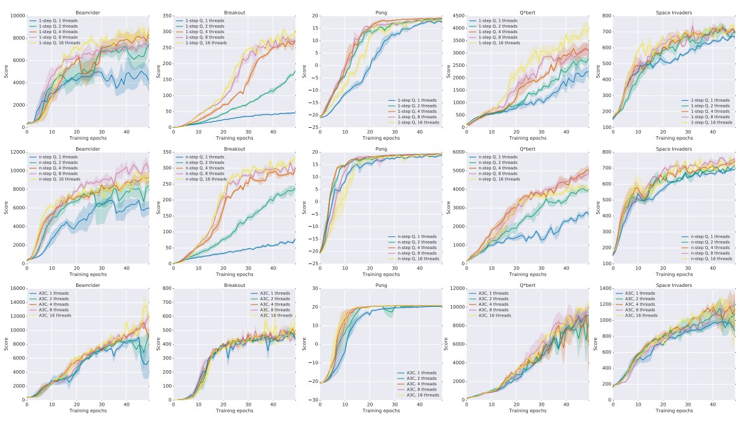
What is A3c and how it is used in Cyber.ai

Slide 8
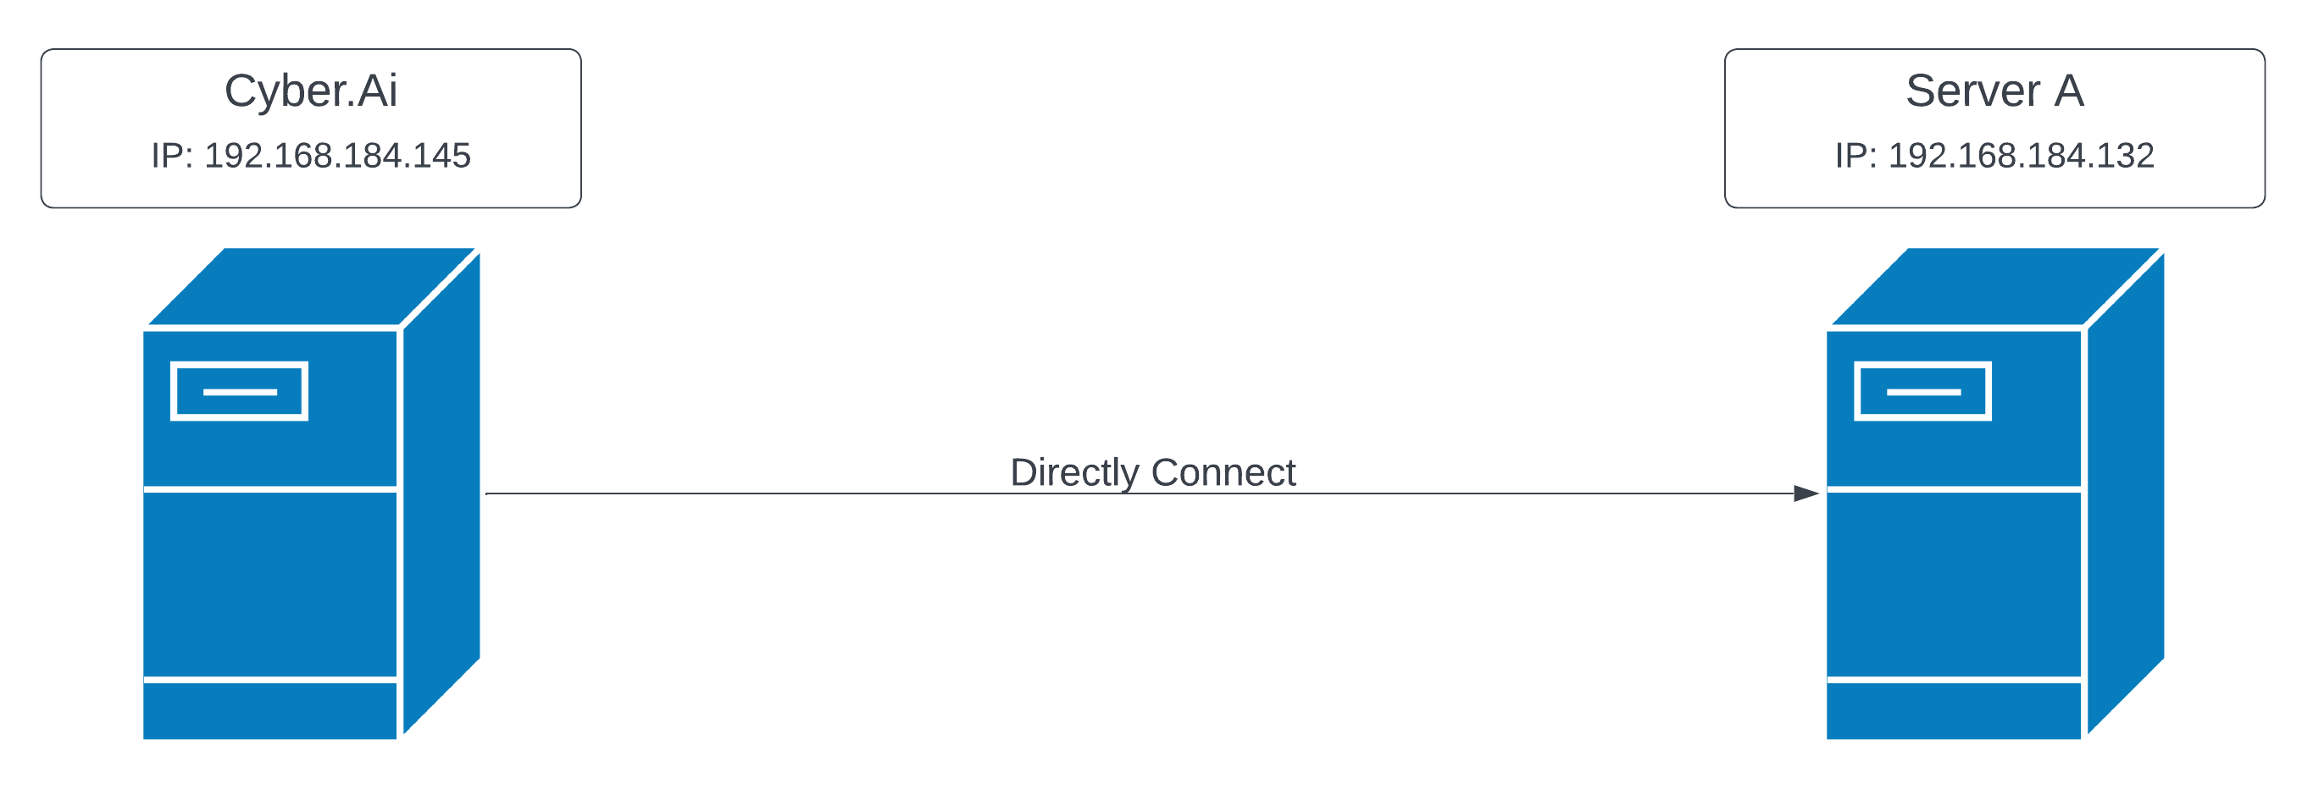
Experiment A: Single target server
This case is very simple. In this case the CyberAi execute the exploit to directly reachable server

Slide 9
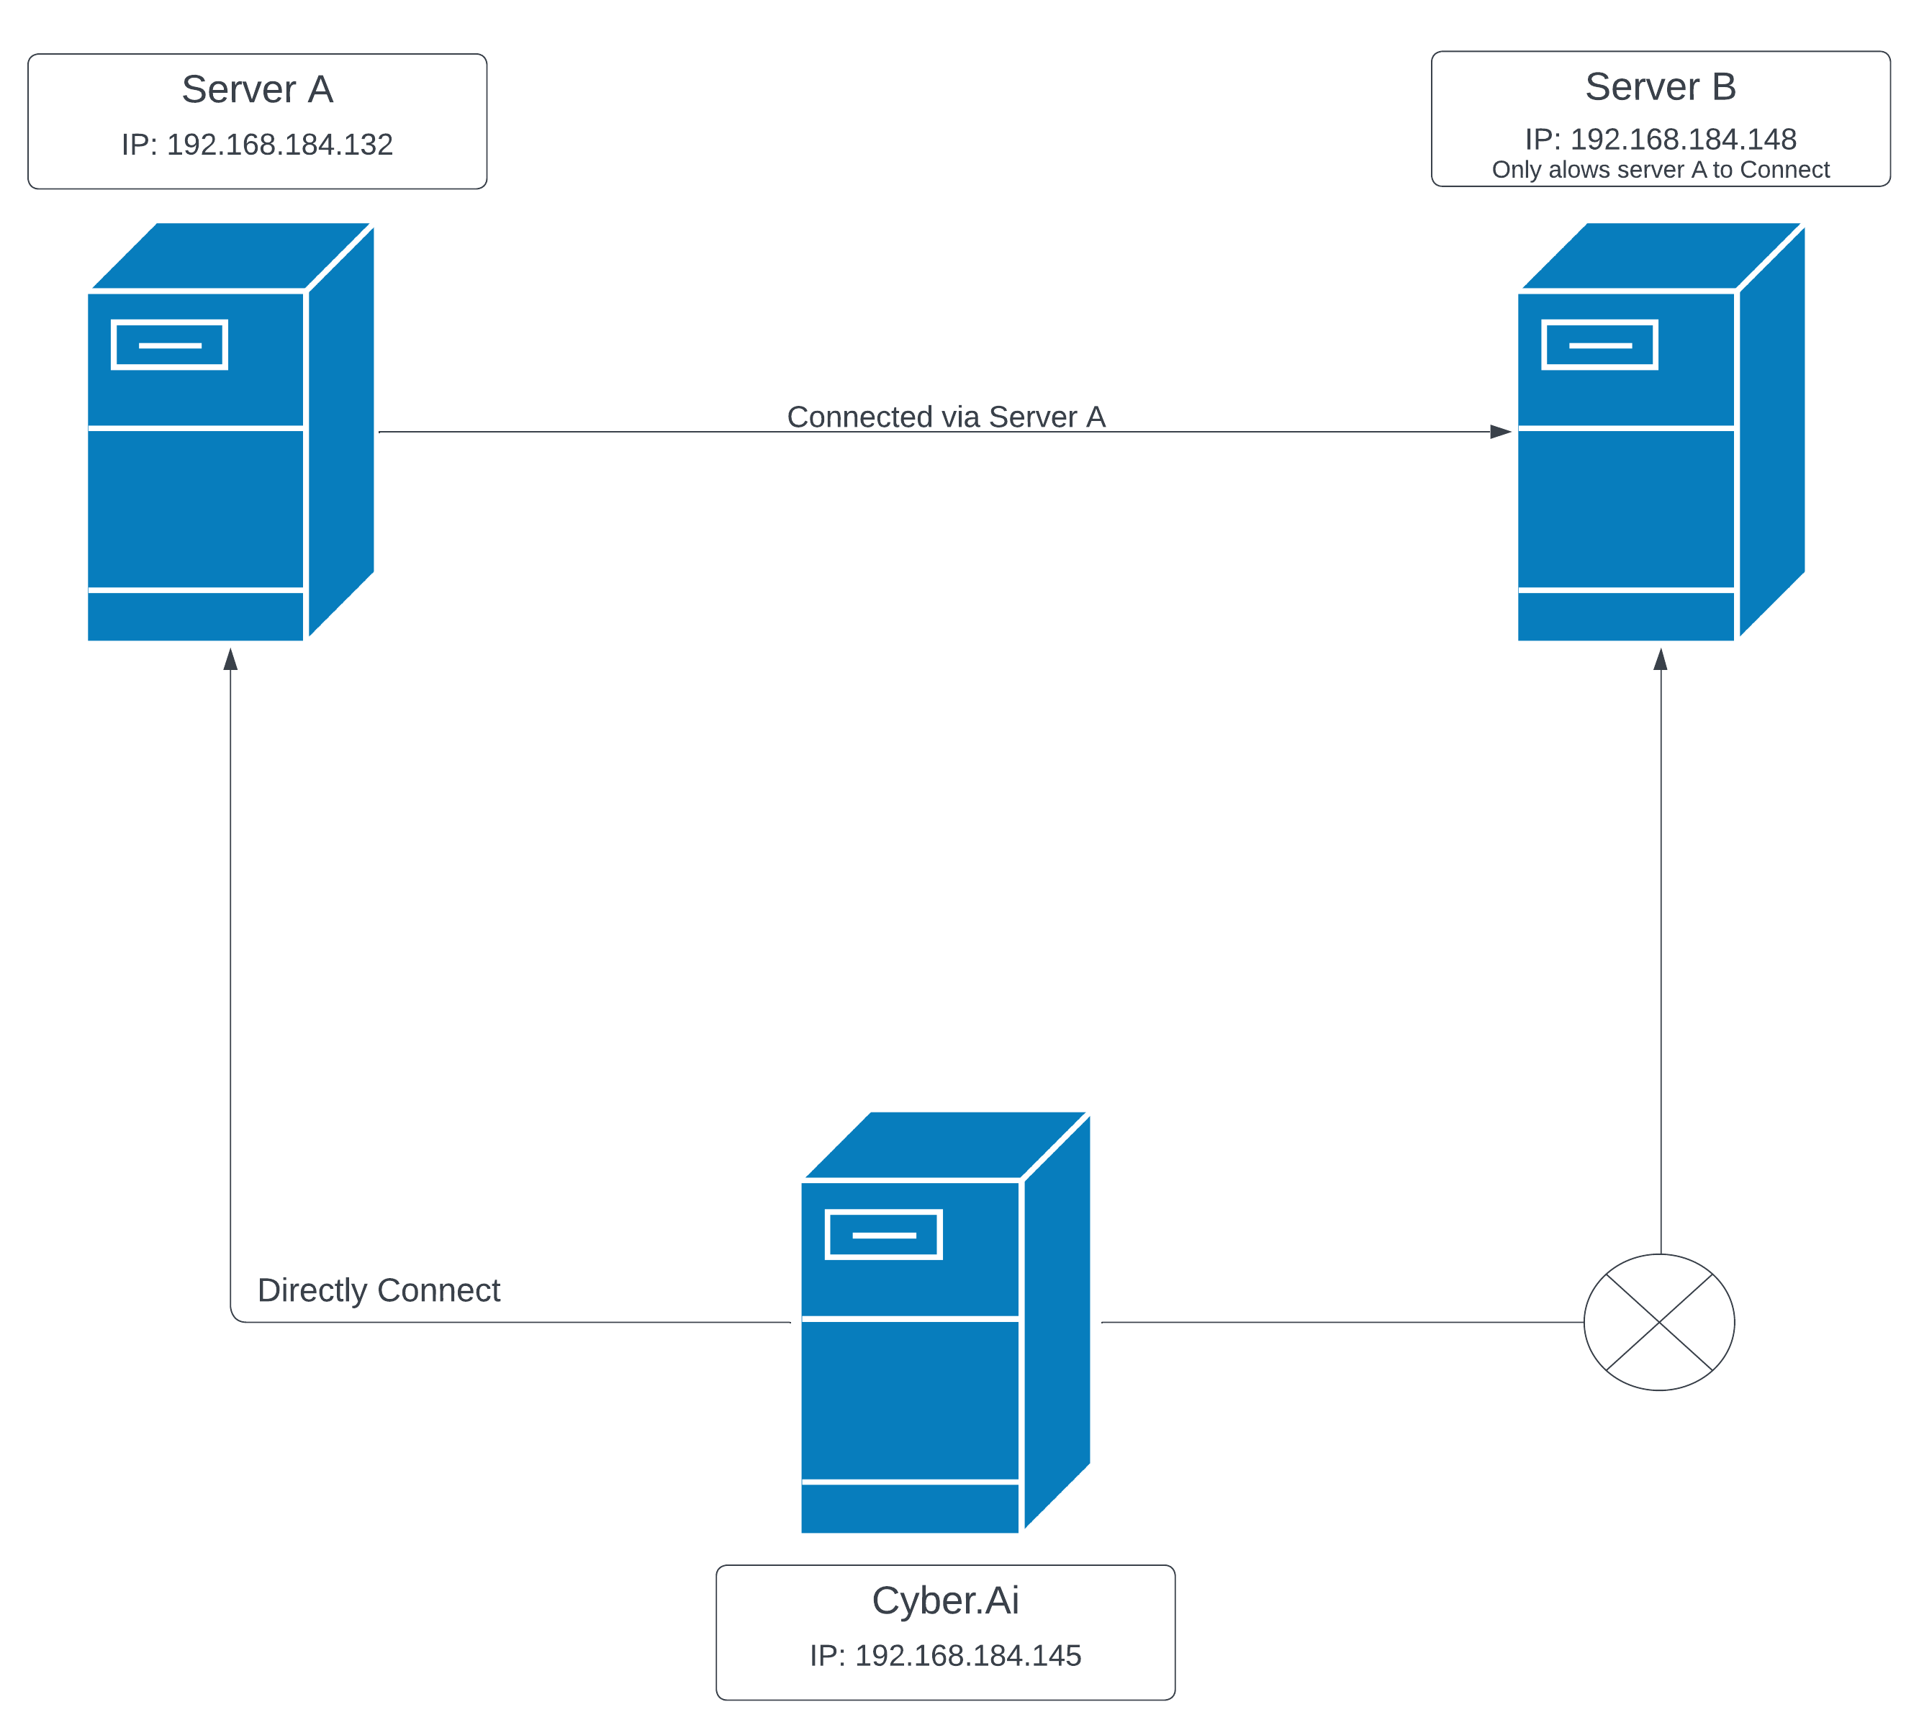
experiment 2: Exploitation via compromised server
The CyberAi can directly connect to the Server-A, but cannot directly connect to the Server-B. So, the CyberAi must execute the exploit to the Server-B via the Server-A.

Slide 10
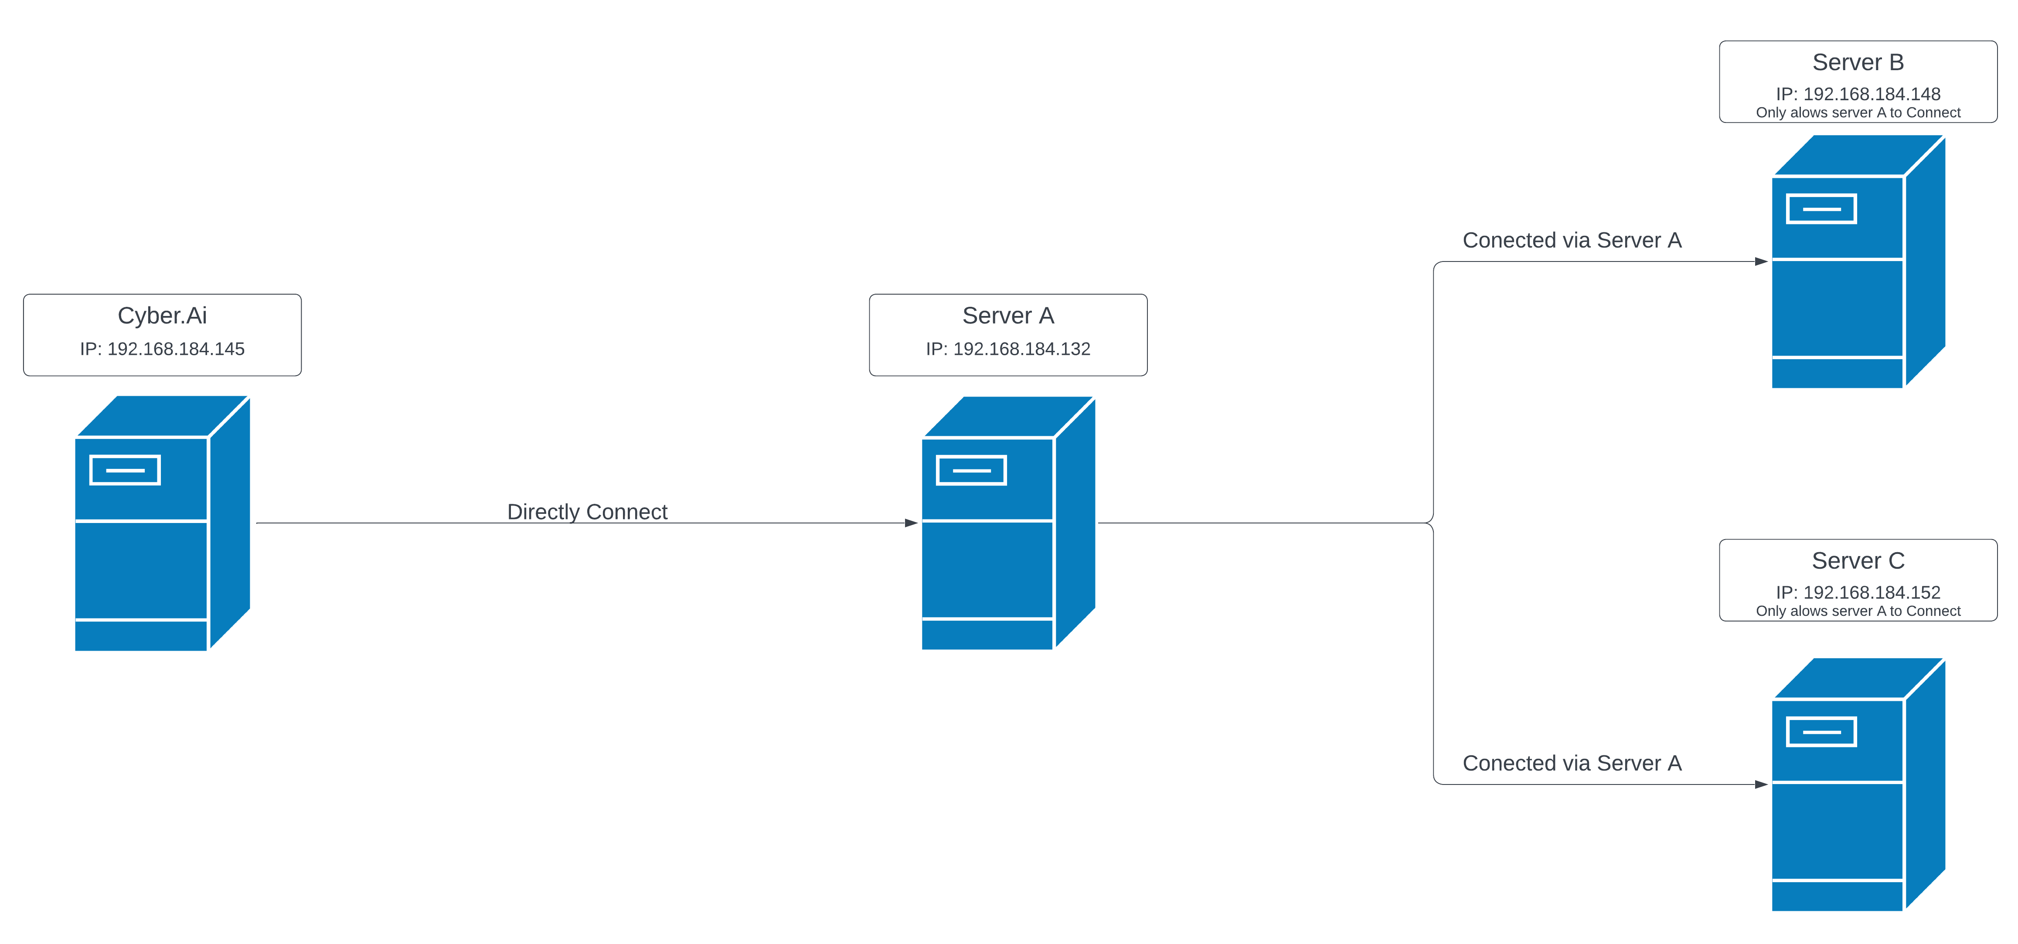
Experiment 3: Deep Penetration
The CyberAi can directly connect to the Server-A, but cannot directly connect to the Server-B and C. So, the CyberAi must execute the exploit to the Server-B and C via Server-A.

Slide 11
Processing flow
Step 1: Intelligence Gathering
Step 2: Exploitation
Step 3: Post – Exploitation
Step 4: Generate Report

Slide 12
Step 1: Intelligence gathering
Nmap: Identify open ports, products
Contents Discovery: Identify Web products using found product contents on the web port.
Web crawling: Collection HTTP responses on the Web port.
By analyzing HTTP responses using String-matching and Naïve Bayes, identify Web products.

Slide 13
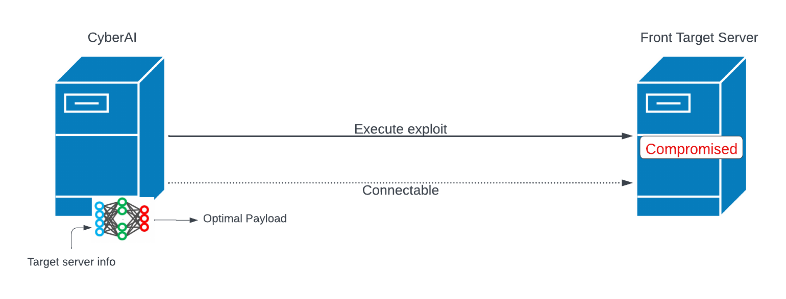
Step 2: Exploitation
Open session between “CyberAi” and front server (=compromised server).

Slide 14
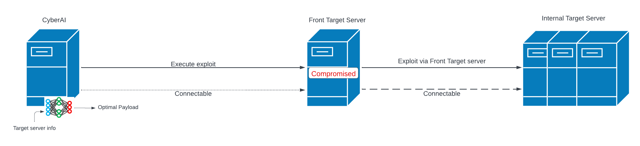
Step 3: Post-Exploitation
Pivoting and execute the exploit to internal server via compromised server.

Slide 15
Step 3: Post-Exploitation
If detect new server, repeat Step1-3 in new server.

Slide 16
Step 4: Generate report
Create the report of penetration test.

Slide 17
Conclusion
In conclusion, CyberAi showcases the future of penetration testing – a blend of human expertise and machine intelligence. While it is not a panacea for all cybersecurity challenges, it is undeniably a leap forward, offering a more adaptive, efficient, and comprehensive approach to vulnerability assessment. As cybersecurity threats grow and evolve, tools like CyberAi will undoubtedly play a pivotal role in fortifying digital defences and ensuring a safer cyber landscape

Slide 18
Thank you

